Slide 1
Hypertension
Editing File

Slide 2
At the end of the lecture, the student should
Know the etiology, risk factors and complications of hypertension, so as to be able to identify patient risk factors amenable to treatment by lifestyle modification, and to investigate patients appropriately for causes of secondary hypertension
Key principles to be discussed:
Raised systemic blood pressure is a major cause of morbidity and mortality.
Hypertension can cause or contribute to: atherosclerosis, left ventricular hypertrophy, chronic renal failure, cerebrovascular disease and retinopathy.
Normal values for blood pressure.
Causes of secondary hypertension.
Genetic and environmental factors contributing to the aetiology of essential hypertension.
Pathology of blood vessels (blood vessels changes) in both primary and secondary hypertension.

Slide 3
Hypertension
Definition
a sustained (at least 3 readings) systolic pressure in excess of 140 mmHg or a sustained diastolic pressure more than 90 mmHg (>140/90)
It’s a common problem.
( 25 % of the population )
Asymptotic until late
- Silent Killer
- painless.
Complications alert to diagnosis but late.
In the early stages of HTN there are few or no symptoms.
At some point shows symptoms when it has advanced
Hypertension is an important factor which contributes in development of:
Coronary heart disease.
Cerebrovascular accidents (stroke)
Cardiac hypertrophy
Congestive heart failure.
Aortic dissection.

Slide 4
Risk factors for Hypertension*
Sedentary or inactive lifestyle
Hereditary, Genetics-family history
( most important)
Use of oral contraceptives
(used for long period, 10 yrs)
Race: African-America
Risk factors
Diabetes
Gender: Men & postmenopausal women
Heavy alcohol consumption
Age
Diet, particularly sodium intake
Lifestyle-stressful
Obesity
Classification of Hypertension
Based on etiology or cause
Based on clinical features
Primary/Essential Hypertension (95%)
Secondary Hypertension (5-10%)
Benign
Malignant(5%)

Slide 5
Classification of Hypertension based on etiology/cause
Primary/ Essential Hypertension (95%) | Mechanisms largely unknown. It is idiopathic.
Secondary Hypertension (5-10%) it can be due to pathology in | Renal | Acute glomerulonephritis, Renal artery stenosis, Renal vasculitis Adult polycystic disease Chronic renal disease, Renin producing tumors
 | Endocrine | Adrenocortical hyperfunction (Cushing syndrome, primary aldosteronism, congenital adrenal hyperplasia - gene defect affecting aldosterone metabolism) Hyperthyroidism/Thyrotoxicosis Hypothyroidism/Myxdema, Pheochromocytoma Acromegaly ( growth hormone ) Exogenous hormones (glucocorticoids, estrogen e.g. oral contraceptives & sympathomimetics ) Pregnancy-induced
 | Vascular | Coarctation of aorta Vasculitis e.g.Polyarteritis nodosa Increased intravascular volume Increased cardiac output Rigidity of the aorta
 | Neurogenic | Psychogenic Increased intracranial pressure Sleep apnea Acute stress, including surgery
Topic
Renal failure leads to hypertension
&
Hypertension leads to renal failure

Slide 6
Classification of Hypertension based on clinical features
Benign | The BP is at modest level (not very high). It can be idiopathic HTN or secondary HTN Fairly stable over years to decades. (Gradually rising) Compatible with long life.
Malignant (5%) | there is rapidly rising BP which often leads to end organ damage It can be a complication of any type of HTN (i.e. essential or secondary) It is seen in 5% of HTNsive patients. The diastolic pressure is usually over 120mmHg It is associated with: Widespread arterial necrosis and thrombosis Rapid development of renal failure Retinal hemorrhage and exudate, with/without papilledema Hypertensive encephalopathy Left ventricular failure Leads to death in 1 or 2 years if untreated.

Slide 7
Pathogenesis of essential hypertension
Female’s slides only
1- Genetic factors
There is a strong genetic component (family history) e.g. a genetic effect is involved in making people more susceptible or less susceptible to high salt diet etc.
Defect in renal sodium homeostasis:
reduced renal sodium excretion is a key initiating event in most forms of essential hypertension.
Decreased sodium excretion -> leads to increase in fluid volume (feel thirst -> drink water) and therefore -> increase in cardiac output and therefore -> elevated BP.
This is usually due to defect in cell membrane function affecting the Na/Ca transport.
Kidney
Functional vasoconstriction:
abnormality in vascular tone such as increased sympathetic stimulation will cause vasoconstriction leading to increased peripheral resistance.
CNS
Structural abnormality in vascular smooth muscle also leads to increased peripheral resistance.
(Born with abnormal blood vessels with low capacity)
Blood vessels muscles
Also rare gene disorders can cause HTN by increasing renal sodium reabsorption e.g. Liddle syndrome.
Liddle syndrome is an inherited autosomal dominant type of HTN, that begins in childhood. It is caused by mutations of the epithelial sodium channel protein (ENaC) which leads to increased sodium reabsorption in the renal tubules (followed by water), which leads to hypertension.
Reabsorption of sodium is also correlates with potassium loss (hypokalemia).
Genetic mutation
The difference between
Defect in renal sodium homeostasis -> manifested at late age, >40s
Liddell syndrome -> early during childhood

Slide 8
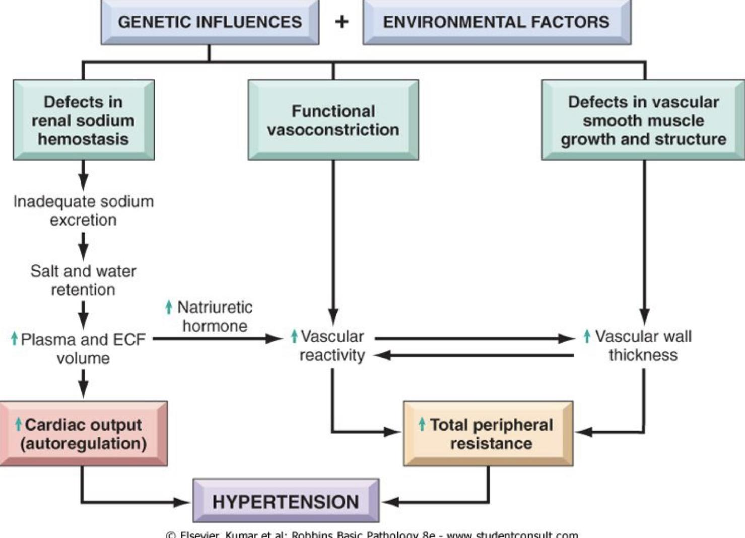
Pathogenesis of essential hypertension*
NOTE: In hypertension, both increased blood volume and increased peripheral resistance contribute to the increased pressure.
However reduced renal sodium excretion in the presence of normal arterial pressure (initially) is probably a key initiating event.
Essential HTN occurs when the relationship between cardiac output and peripheral resistance is altered.
Multiple genetic and environmental factors ultimately increase the cardiac output and/or peripheral resistance
(BP = Cardiac Output x Peripheral Resistance)
Essential HTN

Slide 9
Female’s slides only
Environmental factors
Smoking
Stress
Heavy Salt Consumption
Environmental factors
Physical activity
Obesity
Note
In hypertension, both increased blood volume and increased peripheral resistance contribute to the increased pressure. However reduced renal sodium excretion in the presence of normal arterial
pressure (initially) is probably a key initiating event.

Slide 10
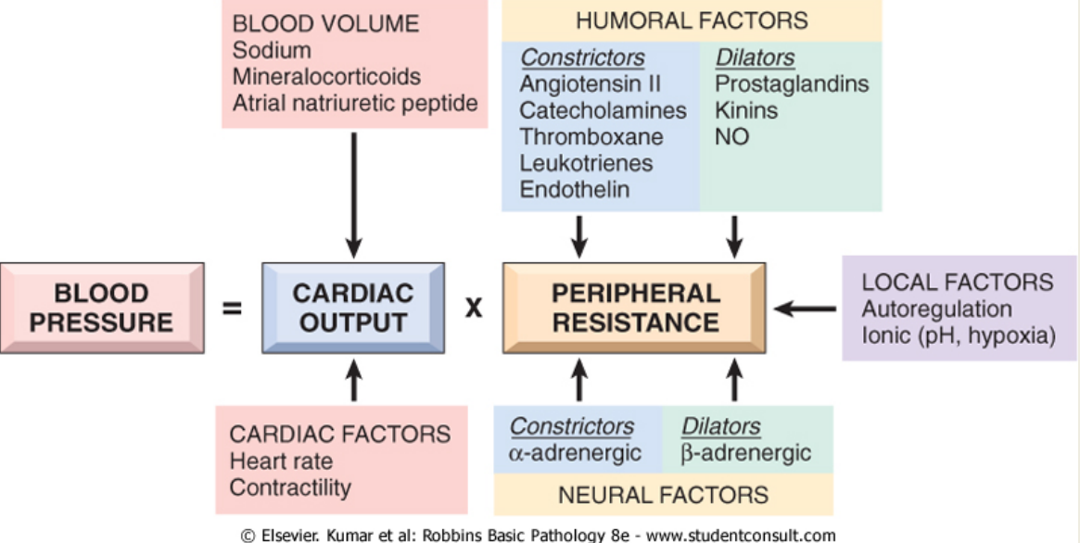
Explanation:
Regulation of blood pressure
There are 2 hemodynamic variables that are involved in the regulation of BP. They are cardiac output and peripheral vascular resistance. BP = Cardiac Output x Peripheral Resistance
Cardiac Output | Affected by blood volume and dependent on sodium concentrations.
Peripheral resistance | it is the resistance of the arteries to blood flow. When the arteries constrict the resistance increases and when they dilate the resistance decreases. Peripheral resistance is regulated at the level of the arterioles. Arterioles are also known as resistance vessels. Peripheral resistance is determined by three factors: ● Autonomic activity: sympathetic activity constricts peripheral arteries. (Sympathetic stimulation: arteries constrict. Parasympathetic stimulation: arteries dilate. ● Pharmacologic agents: vasoconstrictor drugs increase resistance while vasodilator drugs, e.g. nitroglycerin decrease it. ● Blood viscosity: increased viscosity increases resistance. Note: An increased blood flow in the arterioles induces vasoconstriction to protect tissues against hyperperfusion. Normal BP is maintained by a balance between factors that induce vasoconstriction (e.g. angiotensin II and catecholamines) and factors that induce vasodilation (e.g. kinins, prostaglandins and nitric oxide).
Regulation of blood pressure:

Slide 11
Regulation of blood pressure
There are 2 hemodynamic variables that are involved in the regulation of BP. They are cardiac output and peripheral vascular resistance. BP = Cardiac Output x Peripheral Resistance
Cardiac Output | Affected by blood volume and dependent on sodium concentrations.
Peripheral resistance | It is the resistance of the arteries to blood flow. When the arteries constrict the resistance increases and when they dilate the resistance decreases. Peripheral resistance is predominantly regulated at the level of the arterioles. Arterioles are also known as resistance vessels. Peripheral resistance is determined by three factors: ● Autonomic activity: sympathetic activity constricts peripheral arteries. (Sympathetic stimulation: arteries constrict. Parasympathetic stimulation: arteries dilate.) ● Pharmacologic agents: vasoconstrictor drugs increase resistance, while vasodilator drugs e.g. nitroglycerin decrease It. ● Blood viscosity: increased viscosity increases resistance. Reduced renal sodium excretion in the presence of normal arterial pressure is probably a key initiating event; it is a final common pathway for the pathogenesis of most forms of hypertension Note: An increased blood flow in the arterioles induces vasoconstriction to protect tissues against hyperperfusion. Normal BP is maintained by a balance between factors that induce vasoconstriction (e.g. angiotensin II and catecholamines) and factors that induce vasodilation (e.g. kinins, prostaglandins and nitric oxide).
Female’s slides only
• Reduced renal sodium excretion in the presence of normal arterial pressure is
probably a key initiating event; it is a final common pathway for the pathogenesis of most forms of hypertension

Slide 12
Endocrine factors : Renin, Angiotensin, Aldosterone,
ADH.
Endocrine factors: role of angiotensin aldosterone in regulating BP
Endocrine factors: role of angiotensin aldosterone in regulating BP
When BP falls kidneys are triggered to produce renin , renin converts
angiotensinogen to angiotensin I which will be converted to angiotensin II by
ACE in the lungs , angiotensin II will cause :
1. Renal cortex to secrete aldosterone (causing Na & water retention)
2. Vasoconstriction
3. Stimulate ( hypothalamus ) causing thirst.
When BP falls:
Kidney
Produces
Renin
Converts
Angiotensinogen
Angiotensin I
Using ACE
Angiotensin II
Renal cortex secretes aldosterone
Stimulate hypothalamus causing thirst
Vasoconstriction

Slide 13
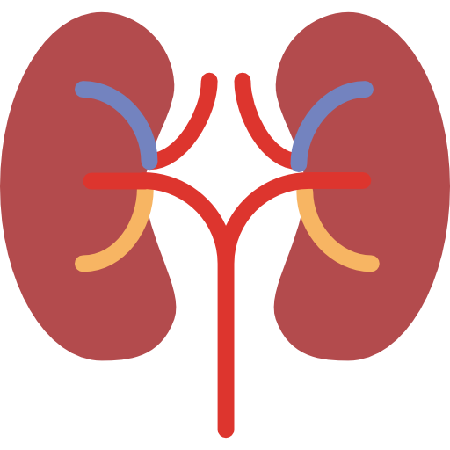
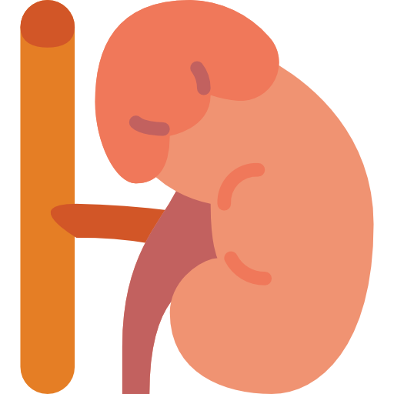
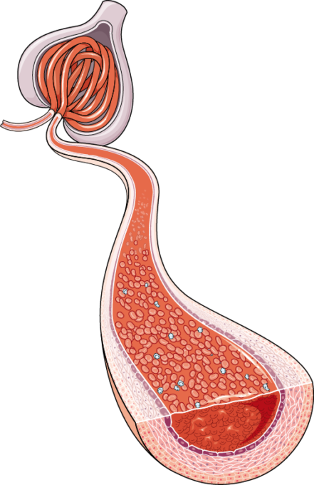
Atrial Natriuretic peptide/factor/hormone
(cardiomatrine/cardiodilatine/atriopeptin)
It is a protein/ polypeptide/ hormone secreted by the heart muscle cells in the atria of heart (atrial myocytes).
It is a powerful vasodilator and is involved in the homeostatic balance of body water, sodium, potassium and fat.
It is released in response to high blood volume. It acts to reduce the water, sodium and adipose loads on the circulatory system, thereby reducing blood pressure.
It has exactly the opposite function of the aldosterone secreted by the zona glomerulosa.
Effects of ANP
In the kidney | •Decreases sodium reabsorption and increases water loss. • Inhibits renin secretion, thereby inhibiting the renin–angiotensin–aldosterone system.
 | • Reduces aldosterone secretion by the zona glomerulosa of the adrenal cortex.
In the arterioles | • Promotes vasodilation.
 | • Increases the release of free fatty acids from adipose tissue.
Female’s slides only
In
the adrenal glands
In
the adipose tissue

Slide 14
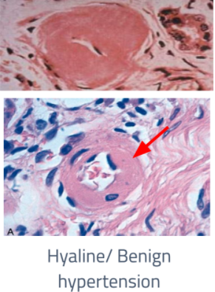
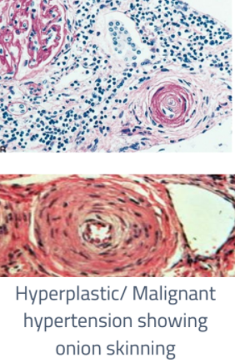
Morphology of blood vessels in HTN
In large Blood Vessels
(Macroangiopathy)
In small Blood Vessels
(Microangiopathy)Arteriolosclerosis
-Atherosclerosis. HTN is a
major risk factor in AS.
Hyaline
arteriolosclerosis:
Hyperplastic
arteriolosclerosis:
-Seen in benign hypertension
Can also be seen in elderly.
- In elderly & diabetic patients
even without hypertension.
- Can cause diffuse renal
ischemia which ultimately
leads to benign
nephrosclerosis
- A Hyaline arteriolosclerosis:
hyalinosis of arteriolar wall
with narrowing of lumen.
(particularly in the kidney).
-Characteristic of malignant
hypertension.
-Can show onion-skinning on
histology causing luminal
obliteration of vascular lumen
-May be associated with
necrotizing arteriolitis and
fibrinoid necrosis of the blood
vessel.
-Hyperplastic
arteriolosclerosis
(onion skinning) causing
luminal obliteration of
vascular lumen

Slide 15
Left ventricular cardiac hypertrophy
(Left sided hypertensive cardiomyopathy/ hypertensive heart disease)
Longstanding poorly treated HTN leads to left sided hypertensive heart disease. Treatment of HTN helps in recovery.
Hypertrophy of the heart is an adaptive response to pressure overload due to HTN. HTN induced left ventricular pressure overload which leads to hypertrophy of the left ventricle with increase in the weight of the heart and the thickness of the LV wall.
The left ventricle is considered hypertrophied if its wall >2Cm, and its weight >500g.
History of hypertension or extracardiac anatomical evidence of HTN helps in diagnosis. Like: kidney shrinkage.
Long Term: Dilation and wall thinning
LVH: concentric with absence of other cause of LVH.
For example when someone carries weight, his biceps will get bigger so is the ventricles the will undergo hypertrophy because ventricles will have to contract harder when there is resistance.

Slide 16
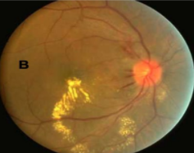
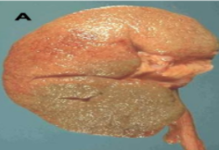
Complication of HTN*:
Hemorrhage, infarction
leading to Cerebrovascular
accidents
❖ Left ventricular cardiac hypertrophy (left sided hypertensive cardiomyopathy/
hypertensive heart disease)
❖ Coronary heart disease
❖ Aortic dissection
Brain
Hypertensive retinopathy
(photo B) is especially
seen in malignant
hypertension.
Cardiovascular
EYe
Kidney
Benign nephrosclerosis
(photo A)
Renal failure in untreated or in malignant hypertension

Slide 17
Summary
Definition | sustained both systolic and diastolic pressure more than 140/90 mmHg
Risk Factors | Hereditary Genetics-family history Race: African-Americans Gender: Men & postmenopausal women Age Obesity | Diet, particularly sodium intake Lifestyle-stressful Heavy alcohol consumption Diabetes Use of oral contraceptives Sedentary or inactive lifestyle
Classifications of HTN | Based on etiology or cause Primary/Essential Hypertension (95%) : Mechanisms largely unknown. It is idiopathic. | Based on clinical features (both can be primary or secondary HTN) Benign The BP is at modest level (not very high). Fairly stable over years to decades. Compatible with long life.
 | Secondary Hypertension (5-10%): it can be due to pathology in the renal endocrine vascular neurogenic | Malignant(5%): rapidly rising BP which often leads to end organ damage The diastolic pressure is usually over 120mmHg Leads to death in 1 or 2 years if untreated. It is associated with: Widespread arterial necrosis and thrombosis Rapid development of renal failure Retinal hemorrhage and exudate, with/without papilledema Hypertensive encephalopathy Left ventricular failure
Pathogenesis Of Essential HTN | 2 Factors increase CO (cardiac output) and/or PR (peripheral resistance) which eventually lead to HTN
 | Genetic factors Defect in renal sodium homeostasis: reduced renal sodium excretion -> increase in CO Functional vasoconstriction: abnormality in vascular tone such as increased sympathetic stimulation -> increased PR Structural abnormality in vascular smooth muscle -> increase in PR Rare gene disorders can cause HTN by increasing renal sodium reabsorption e.g. Liddle syndrome. dle syndrome is an inherited autosomal dominant type of HTN, that begins in childhood. It is caused by mutations of the epithelial sodium channel protein (ENaC) | Environmental factors: stress obesity smoking physical inactivity heavy consumption of salt

Slide 18
Summary cont’d
Regulation of BP | 2 hemodynamic variables that are involved in the regulation of BP
 | Cardiac output is affected by blood volume and is dependent on sodium concentrations | Peripheral resistance (regulated at the level of the arterioles): is determined by three factors: ▪Autonomic activity: sympathetic activity constricts peripheral arteries. ▪Pharmacologic agents: vasoconstrictor drugs increase resistance while vasodilator drugs decrease it. ▪Blood viscosity: increased viscosity increases resistance.
 | - An increased blood flow in the arterioles induces vasoconstriction to protect tissues against hyperperfusion. -BP is maintained by a balance between factors that induce vasoconstriction (e.g. angiotensin II and catecholamines) and factors that induce vasodilation (e.g. kinins, prostaglandins and nitric oxide).
Factors play role in regulation of BP | ENDOCRINE FACTORS: Renin angiotensin aldosterone How Angiotensin 2 causes elevated BP: Simulate Hypothalamus -> Thirst & drink -> increase overload Induce vasoconstriction of blood vessels Adrenal cortex produce aldosterone -> sodium & water retention
 | a protein/ polypeptide/ hormone secreted by atrial myocytes Atrial natriuretic peptide / factor / hormone (Cardionatrine / Cardiodilatine / atriopeptin) powerful vasodilator -balance of body water, sodium, potassium and fat- reduce the water, sodium and adipose loads on the circulatory system, opposite function of the aldosterone In the kidney: It decreases sodium reabsorption and increases water loss. It inhibits renin secretion, thereby inhibiting the renin–angiotensin–aldosterone system In adrenal gland: It reduces aldosterone secretion by the zona glomerulosa of the adrenal cortex. In arterioles: It promotes vasodilatation In adipose tissue It increases the release of free fatty acids from adipose tissue.

Slide 19
Vascular morphology in HTN | In large Blood Vessels (Macroangiopathy) | In small Blood Vessels (Microangiopathy)
 | Atherosclerosis. HTN is a major risk factor in AS. | Hyaline arteriolosclerosis: Seen in benign HTN ►Can also be seen in elderly and diabetic patients even without hypertension. ►Can cause diffuse renal ischemia which ultimately leads to benign nephrosclerosis | Hyperplastic arteriolosclerosis: Characteristic of malignant HTN ►Can show onion-skinning on histology causing luminal obliteration of vascular lumen ►May be associated with necrotizing arteriolitis and fibrinoid necrosis of the blood vessel.
Heart in HTN | Left ventricular cardiac hypertrophy (also known as left sided hypertensive cardiomyopathy/ hypertensive heart disease)
 | Due to.. Longstanding poorly treated HTN | is an adaptive response to pressure overload due to HTN. | HTN = left ventricular pressure overload = hypertrophy of the left ventricle increase in the weight of the heart Increase the thickness of the LV wall
Complications of HTN The organs damaged in HTN are: | Cardiovascular Left ventricular cardiac hypertrophy (left sided hypertensive cardiomyopathy/ hypertensive heart disease) Coronary heart disease Aortic dissection
 | Kidney Benign nephrosclerosis (photo A) Renal failure in untreated or in malignant hypertension
 | Eyes Hypertensive retinopathy (photo B) is especially seen in malignant hypertension.
 | Brain Hemorrhage, infarction leading to Cerebrovascular accidents

Slide 20
MCQ
For more question
1- A sustained blood pressure in excess of how much is considered hypertension?
A- 130/75 | B- 120/80 | C- 140/90 | D- 180/100
2- The etiology of primary hypertension is usually:
A- Neurogenic | B- Idiopathic | C- Renal | D- Cardiogenic
3- Liddle syndrome is caused by a mutation of which gene?
A- ENaC | B- ABL1 | C- TGFBI | D- MTHFR
4- Which of these can be seen in elderly and diabetic patients even without hypertension?
A- Hyperplastic arteriolosclerosis | B- Hyaline arteriolosclerosis | C- Left-Sided cardiomyopathy | D- Atherosclerosis
5- Which of these is NOT a complication of HTN
A- Nephrosclerosis | B- Cardiac hypertrophy | C- Retinopathy | D- Intestinal distention
1:C, 2:B, 3:A, 4:B, 5:D

Slide 21
Team leaders:
Dema
Alkhattabi
Raneem Alwatban
Ibrahim
Alhezam
Sub-leader:
Hassan Alabdullatif
Team members:
Norah
Alrashoud
Maram
Beyari
Omar
Alkadhi
Farah
Alenezi
Manar
Alzahrani
Othman Alabdullah
Hoor
Aloraini
Nawaf
Alrefaei
Rakan
Alromayan
Mayssar Alshobaki
Saad
Alahmari
Osama
alburaih
Nouf
Aldhalaan
Emad
Almutairi
Abdulaziz
Alymni

