Slide 1
Atherosclerosis
Editing File

Slide 2
Understand the pathogenesis and clinical consequences of atherosclerosis.
Key principles to be discussed
Risk factors of atherosclerosis.
Pathogenesis of the fibro lipid atherosclerotic plaque.
Clinical complications of atherosclerosis.
Commonest sites for the clinically significant coronary atherosclerosis.
Macroscopic and microscopic changes in myocardial infarction.
Biochemical markers of myocardial infarction.
Complications of myocardial infarction: immediate and late.

Slide 3
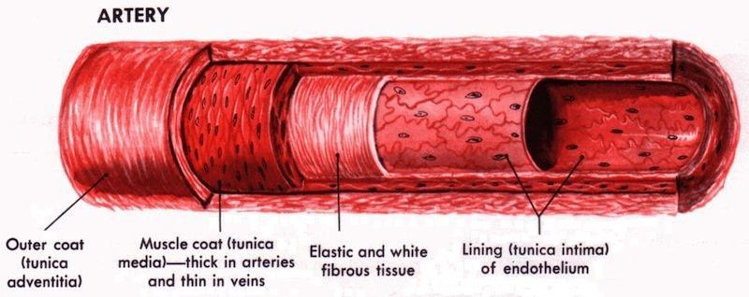
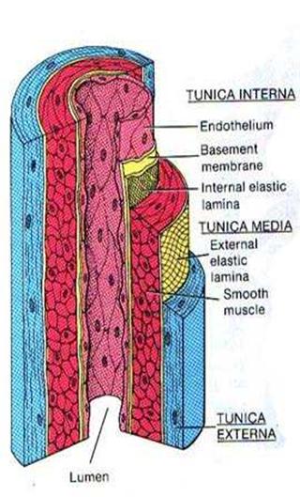
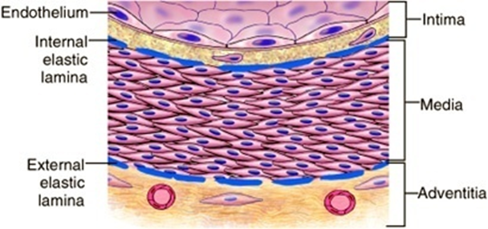
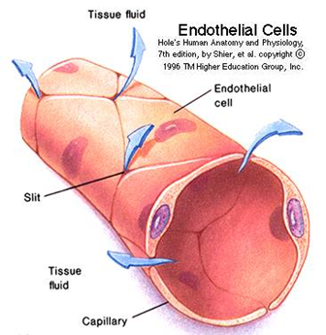
Normal Blood Vessels
Female Slides Only
Arteries
Capillaries
Large (elastic) arteries
aorta, common carotid, iliac
lots of elastic fibers
Medium (muscular) arteries
coronary, renal arteries
mostly smooth muscle cells
diameter of RBC
thin walls, slow flow
great for exchanging oxygen, nutrients
Small arteries/arterioles
all smooth muscle cells
blood pressure controlled here
Venules/veins
Lymphatics
large diameter, thin walls
compressible, penetrable by tumor
Have valves
drain excess interstitial fluid
from the interstitial tissue.
pass through nodes
End in the superior vena cava.
It Separate the content of the blood from the media
( muscle layer) Regulate the amount of blood that flow through it
Endothelial Cell:
If the endothelial cell gets injured, the basement membrane gets exposed. This exposure is a source of trouble and diseases.
- Intact endothelial cells are very important for normal physiology.
The endothelium is a single cell thick lining of endothelial cells and it is the inner lining of the entire cardiovascular system (arteries, veins and capillaries) and the lymphatic system.
(It covers the basement membrane completely.)
A normal structure and function of endothelium is essential for the maintenance of vessel wall homeostasis and normal circulatory function.
1
2
It is in direct contact with the blood/lymph and the cells circulating in it.
3

Slide 4
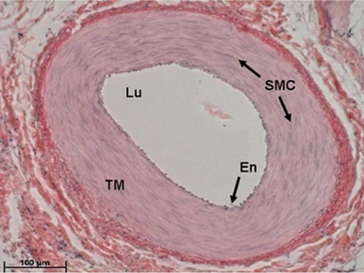
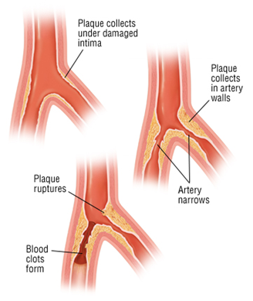
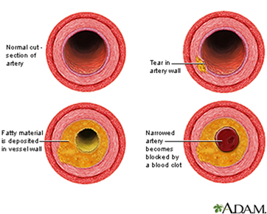
Normal Blood Vessels
Atherosclerosis (AS)
Female slides Only
Smooth muscle cells (SMC):
SMCs are present in the media of blood vessels, responsible for vasodilation and vasoconstriction of blood vessel. (to regulate the amount of the blood🩸in the vessel)
Any vascular injury or dysfunction stimulates SMCs. On stimulation, the SMCs:
1- Migrate from the media to the intima
2- In the intima the SMCs lose
the capacity to contract and gain the capacity to divide. So they proliferate as intimal SMCs.
(SMCs changed completely)
3- They synthesize collagen, elastin etc and deposit extracellular matrix (ECM).
Atherosclerosis (a type of arteriosclerosis, a build-up of fat (cholesterol) within the artery wall, slowly progressive) is characterized by intimal lesions called atheromas (also known as atheromatous plaque or fibrofatty plaque), which protrude into and obstruct vascular lumens and weaken the underlying media. as the Atheroma grows the vessel became narrower and the blood flow decrease leading to atherosclerosis.
The most commonly involved vessels are: in order
Abdominal aorta
Coronary arteries
Internal carotid arteries
1
2
Popliteal arteries
3
4
Vessels of the circle of Willis (3 brain arteries come together and meet to form a circle)
5
AS plaque grow leading to serious complications like In Coronary artery disease (angina & MI) and Carotid atherosclerotic disease (stroke)
#439
What is atheroma? An atheroma, or atheromatous plaque ("plaque"), is an abnormal accumulation of material in the inner layer of the wall of an artery. The material consists of mostly macrophage cells, or debris, containing lipids, calcium and a variable amount of fibrous connective tissue. Atheroma is shown in the below gross pathological picture

Slide 5
Atherosclerosis Risk Factors
Non-modifiable
Major
Potentially modifiable
(Can not be changed)
(By changing the lifestyle or medications)
Increasing age
Male gender
Family history
Genetic defects i.e:
hypercholesterolemia
Hyperlipidemia
Hypertension
Smoking
Diabetes
inflammation
^Factors cause endothelial injury
Estrogen protects against AS
High carbohydrate intake
Alcohol
Hardened (trans) unsaturated
fat intake
Physical inactivity
Obesity
Stress (type A personality)
Post-menopausal estrogen
deficiency
LipoproteinA (high levels)
Chlamydia pneumoniae
Minor/Lesser
/Uncertain /Nonquantitated
Associated with lifestyle
other
Importance of Lipoprotein
types in hyperlipidemia
(High levels)
Text
*High cholesterol markers in blood tests*
“Bad”
(promote AS)
“Good”
(protect against heart attack)
*Low-density (LDLs) “bad cholesterol”, LDL cholesterol deliver cholesterol to peripheral tissues
*Very-low-density (VLDPs)
Chylomicrons
High-density (HDLs) “good cholesterol”
Mobilizes cholesterol
from developing and existing atheromas and
transports it to the liver for excretion in the bile
High levels of HDL protect against heart attacks, low levels increase risk of heart disease. HDLs help reverse the effects of high cholesterol.

Slide 6
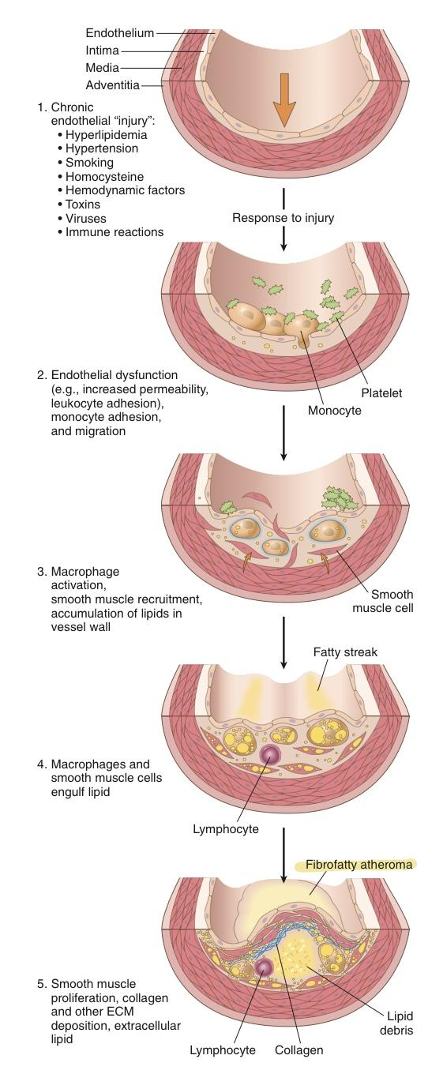
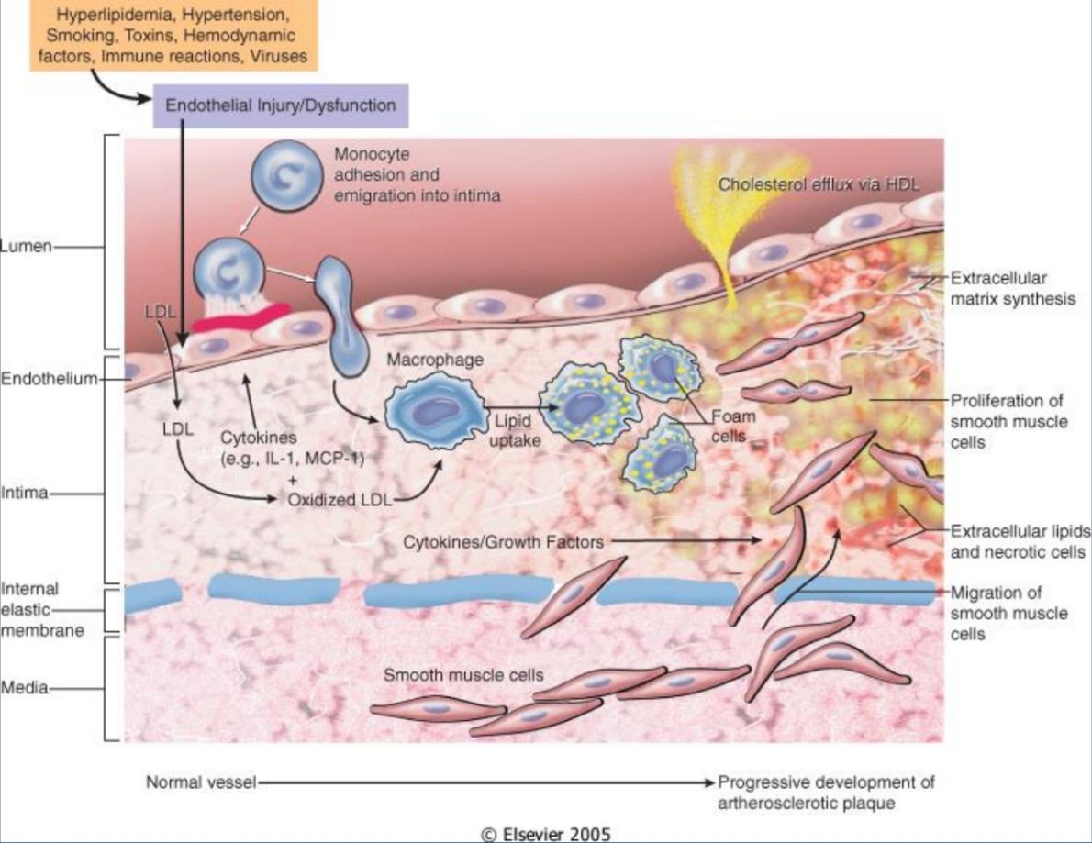
Pathogenesis of AS
The hypothesis is that AS is a response to injury
1
LP Accumulation
Mainly LDL with its high cholesterol content in the vessel wall and subtle chronic endothelial injury
2
Increased permeability and leukocyte (monocyte) adhesion
3
Adhesion of blood leukocytes to the endothelium
Then leukocytes migrate into intima & transform into macrophages & foam cells
4
Adhesion of Platelets
5
Release of Factors
From activated platelets,
macrophages, or vascular cells to cause migration of SMCs from media into the intima.
6
Proliferation of smooth
muscle cells in intima, and production of EC matrix (collagen & proteoglycans).
Produces proper atheroma
7
Enhanced accumulation of intracellular (macrophages and SMCs) and extracellularly lipids.
The main components of a fibrofatty plaques:
Lipids
Extracellular matrix
Cell, Proliferating smooth muscle cells
Endothelial injury
– Not completely understood
– Two most important causes of endothelial dysfunction are:
Hemodynamic disturbances
Hypercholesterolemia
– Inflammation is also an important contributor.
• Smooth muscle cell proliferation

Slide 7
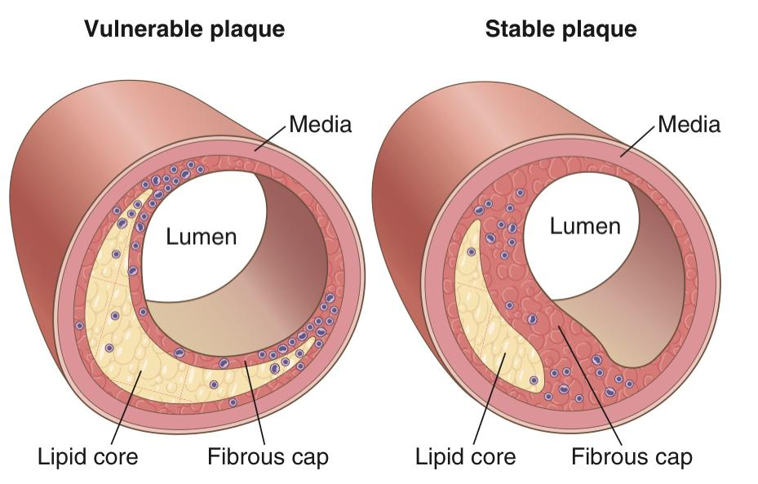
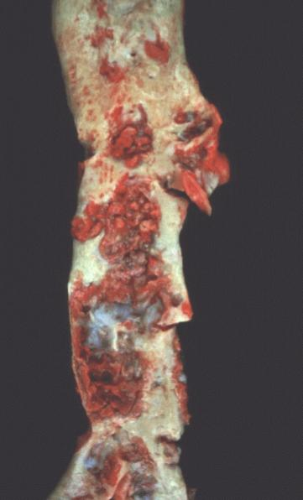
Plaque Types
Morphological Changes in AS
Gross Morphology of Atheroma
#441 EXTRA
Vulnerable plaque | Stable plaque
More Lymphocytes | Less lymphocytes
Bigger lipid core | Smaller lipid core
Thinner fibrous cap | Thicker fibrous cap
Calcification
Hemorrhage
Fissure
Ulcer
Thrombosis
Neovascul-
arization
Medial thinning
Cholesterol microemboli
Aneurysmal dilatation
Female Slides Only
SA plaques impinge (تتطفل) on the lumen of the artery
AS plaques vary in size
The key process in AS is intimal thickening and lipid accumulation
AS plaques usually involve only a
partial circumference of the arterial
wall ("eccentric" lesions) and are
patchy and variable along the vessel
length.

Slide 8
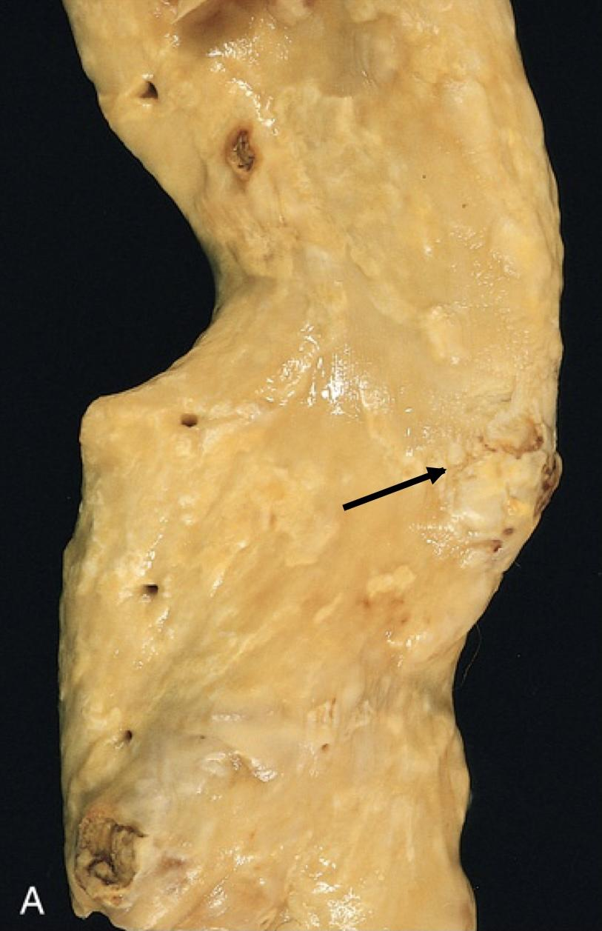
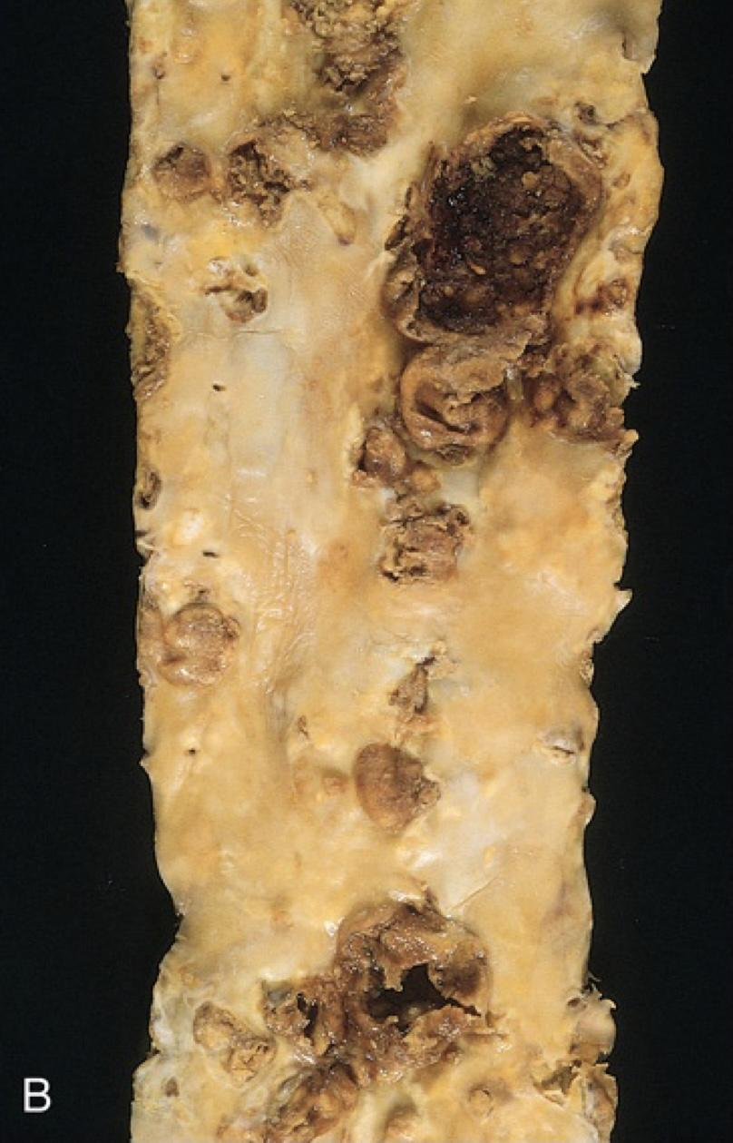
Cont.
Female slides Only
A
Mild atherosclerosis
composed of fibrous plaques, one of which is denoted by the arrow
B
Severe disease with diffuse and
complicated lesions
Microscopic morphology of AS
A well established atheroma/AS plaque consists of a raised focal lesion in the intima, with a soft, yellow, grumous/granular core of lipid (mainly cholesterol and cholesterol esters), covered by a firm, white fibrous cap. Atherosclerotic plaques have three principal components:
Cells: SMCs, Macrophages, Lymphocytes and foam cells
Lipid: typical atheromas contain relatively abundant lipid both extracellular and intracellular lipid
Extracellular matrix: collagen, elastic fibers and proteoglycans
NOTE: foam cells are large, lipid laden macrophages derived from blood monocytes, but SMCs can also imbibe lipid to become foam cells
Typically, the superficial fibrous cap is composed of SMCs and extracellular matrix. With some macrophages and T lymphocytes.
Below the fibrous cap is a necrotic core, containing a lipid deposits (primarily cholesterol and cholesterol esters), cholesterol clefts, debris from dead cells, foam cells, fibrin.

Slide 9
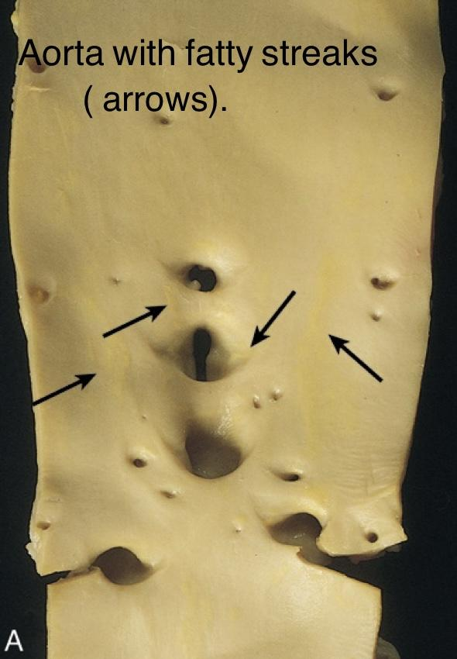
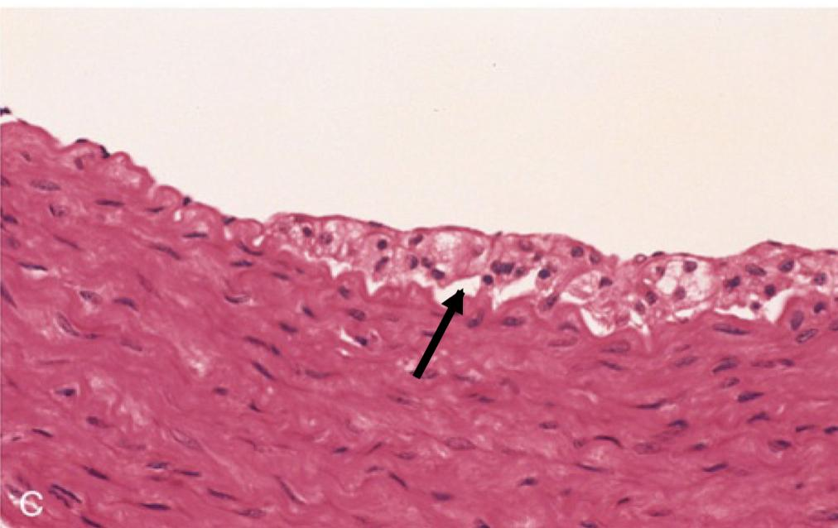
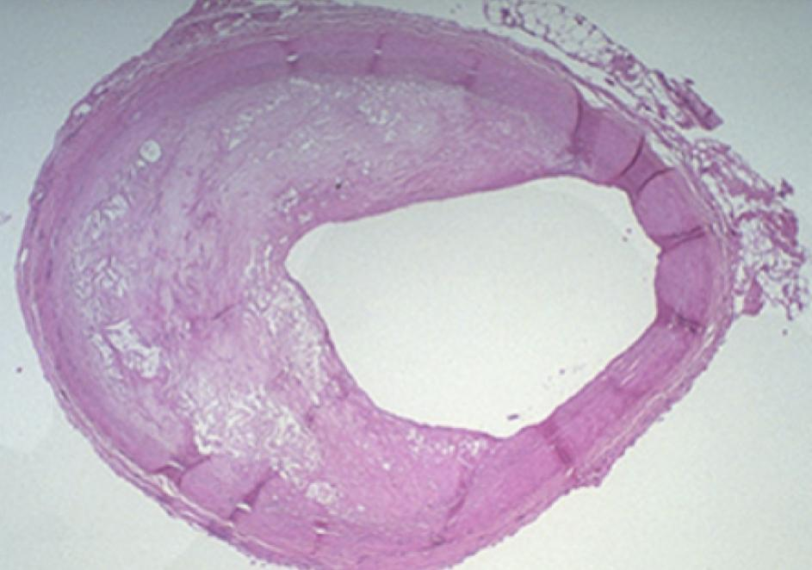
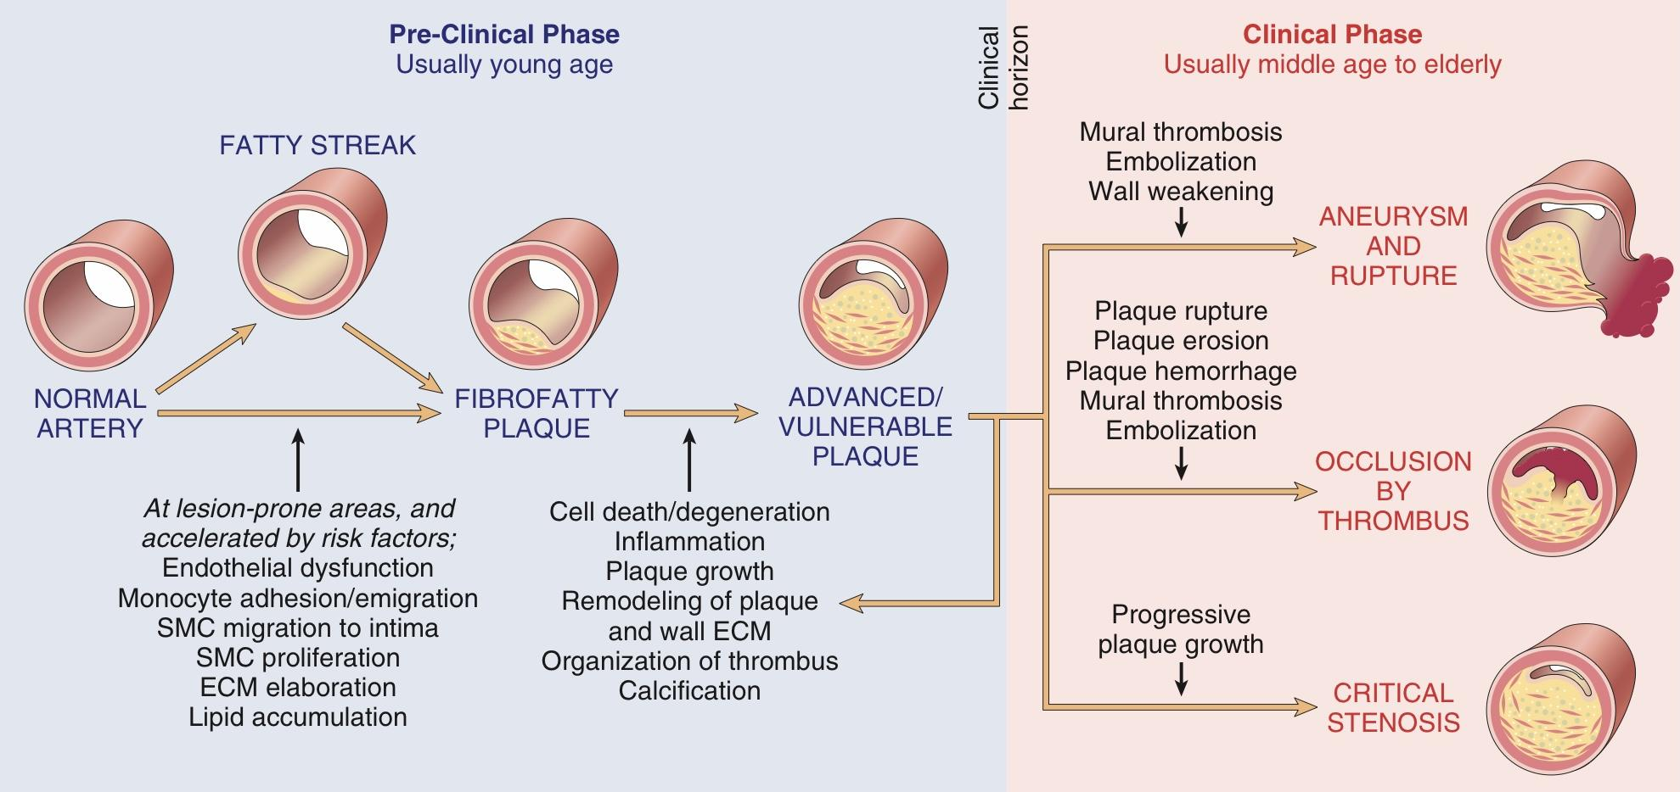
Fatty Streaks
Atherosclerosis and CVD
Female Slides Only
First
earliest lesion of atherosclerosis they are a collection of lipid and lipid laden foam cells in the intima.
Second
They do not cause any
disturbance in blood flow.
Third
begin as multiple yellow, flat spots less than 1 mm in diameter that coalesce into elongated streaks,1cm long or longer. They contain T lymphocytes, extracellular lipid in smaller amounts and rare lipid laden foam cells than in plaques.
Photomicrograph of fatty streak in an experimental hypercholesterolemic rabbit, demonstrating intimal macrophage-derived foam cells ( arrow).
Overall architecture demonstrating an eccentric lesion with a fibrous cap and a central lipid core with typical cholesterol clefts. The lumen is moderately narrowed.
Highlighted: symptomatic

Slide 10
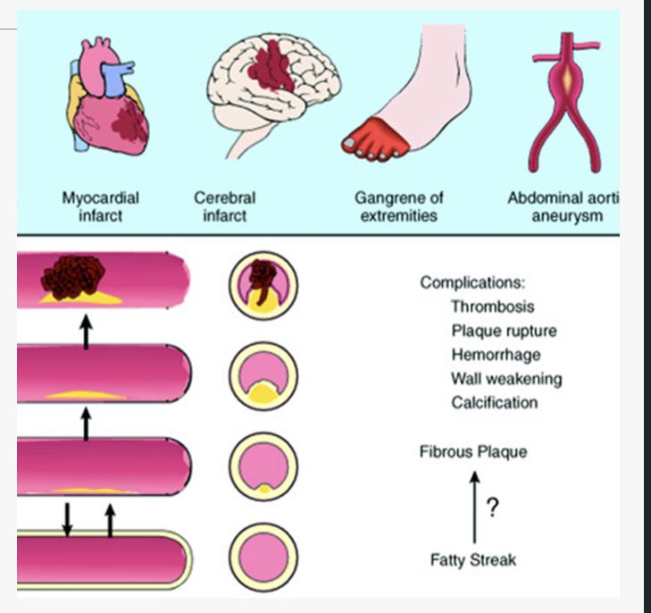
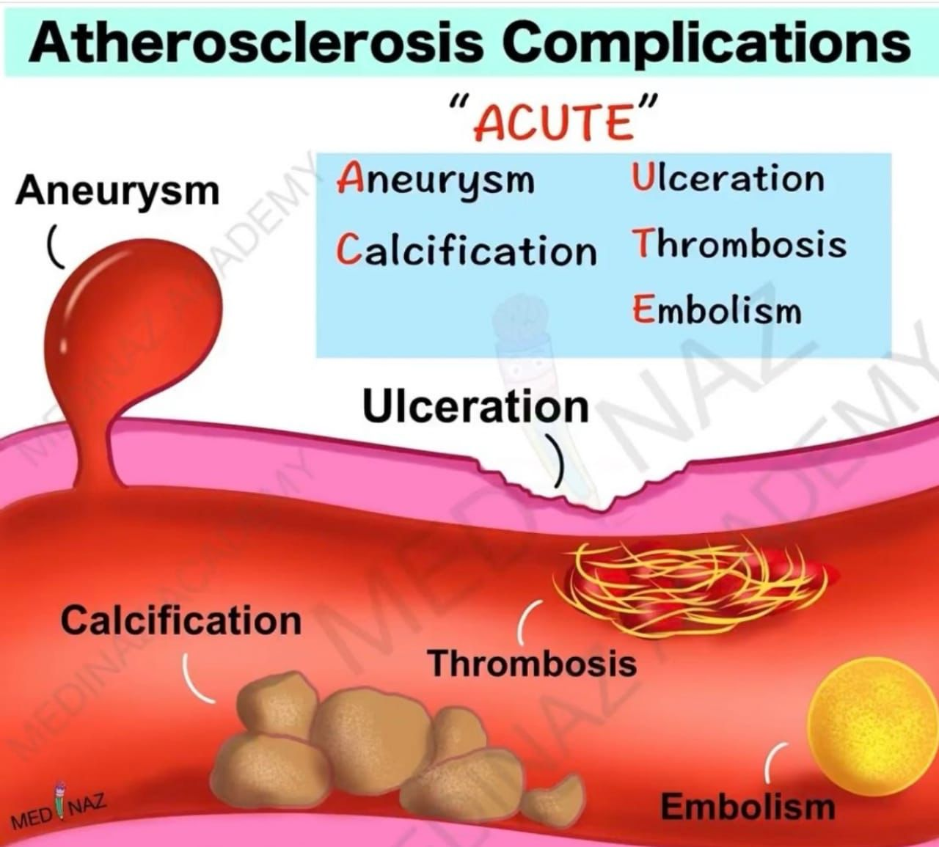
Pathological complications of AS
Female slides Only
Calcifications: Atheromas often undergo calcification
Hemorrhage into the plaque due to rupture of the overlying fibrous cap or the capillaries in the plaque. The hematoma may expand the plaque or induce plaque rupture
Plaque rupture/ulceration/ erosion (same meaning) of the AS plaques may induce thrombus formation OR the AS plaque may discharge debris into the bloodstream, producing microemboli composed of plaque lipid (cholesterol emboli or atheroemboli).
Advanced lesion of AS is at risk of the following
Weakening of the blood vessel wall with aneurysmal dilation. Atheroma can induce atrophy of the underlying media, causing weakness, aneurysm and potential rupture.
(Rupture > Bleeding > Hypovolemic Shock > Death)
Superimposed thrombosis (and thromboembolism), which usually occurs on top of ruptured or ulcerated plaques. It is the most feared complication. The thrombus can lead to partial or complete occlusion of the lumen. The thrombus can also embolize and lead to myocardial infarction, cerebral infarct, or gangrene.
If an atherosclerotic lesion progressively occludes a coronary artery at a sufficiently slow rate over years, other coronary vessels may undergo remodeling and provide compensatory blood flow to the area at risk; such collateral perfusion can subsequently protect
against MI, even if the
original vessel becomes
completely occluded.
Unfortunately with
acute coronary
blockage there is no
time for collateral flow
to develop and
infarction results
AS Clinical Complications:
Male’s slides only
1
Myocardial infarction (heart attack)
2
Cerebral infarction (stroke)
3
Aortic aneurysms
4
Mesenteric occlusion
5
Peripheral vascular disease (gangrene of the legs)
EXTRA pic

Slide 11
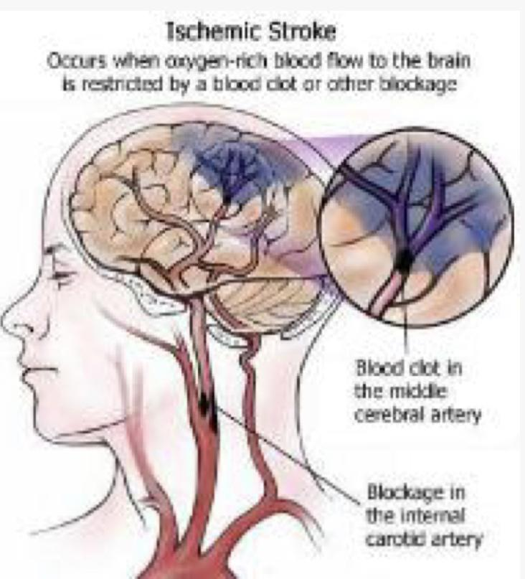
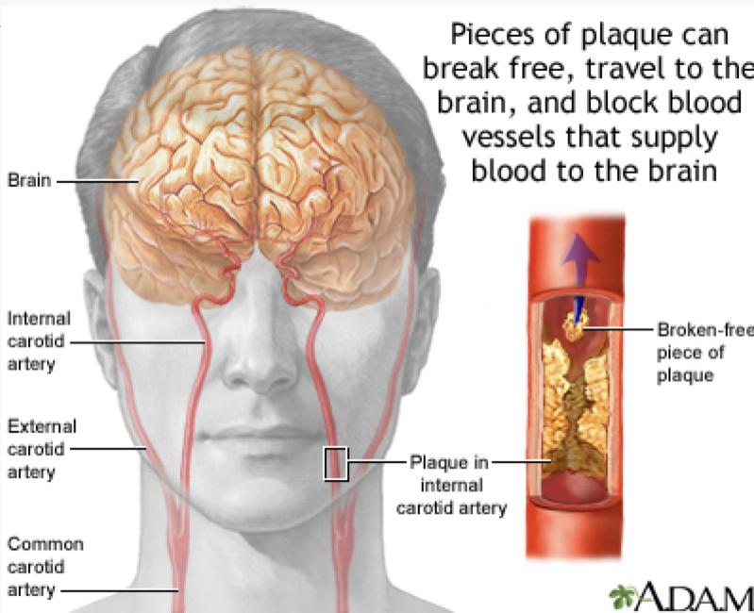
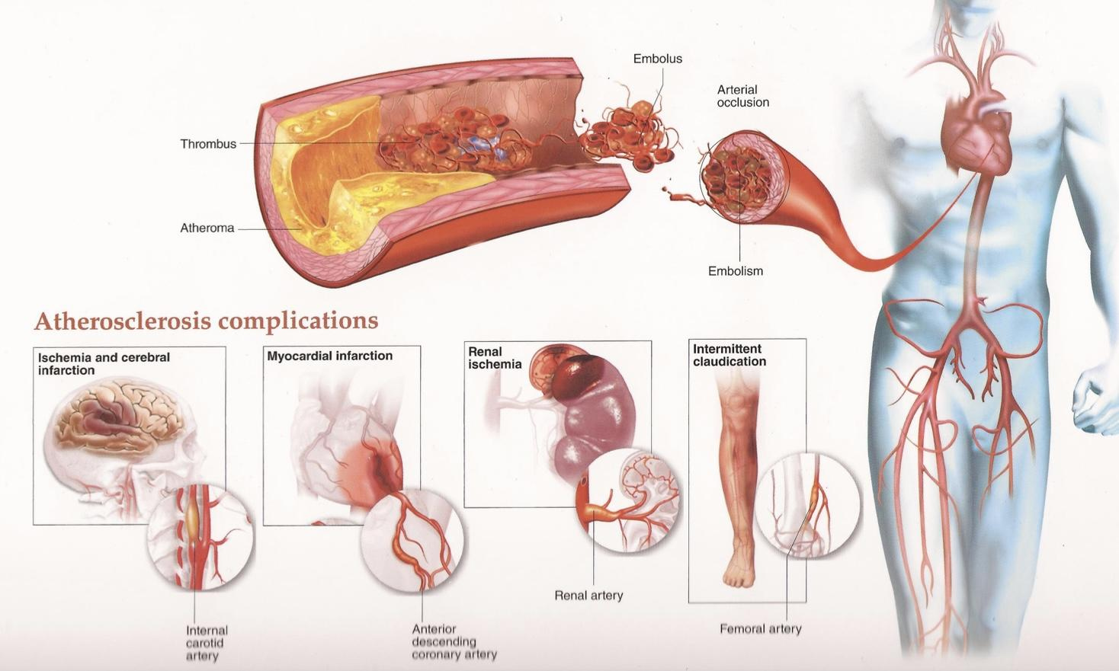
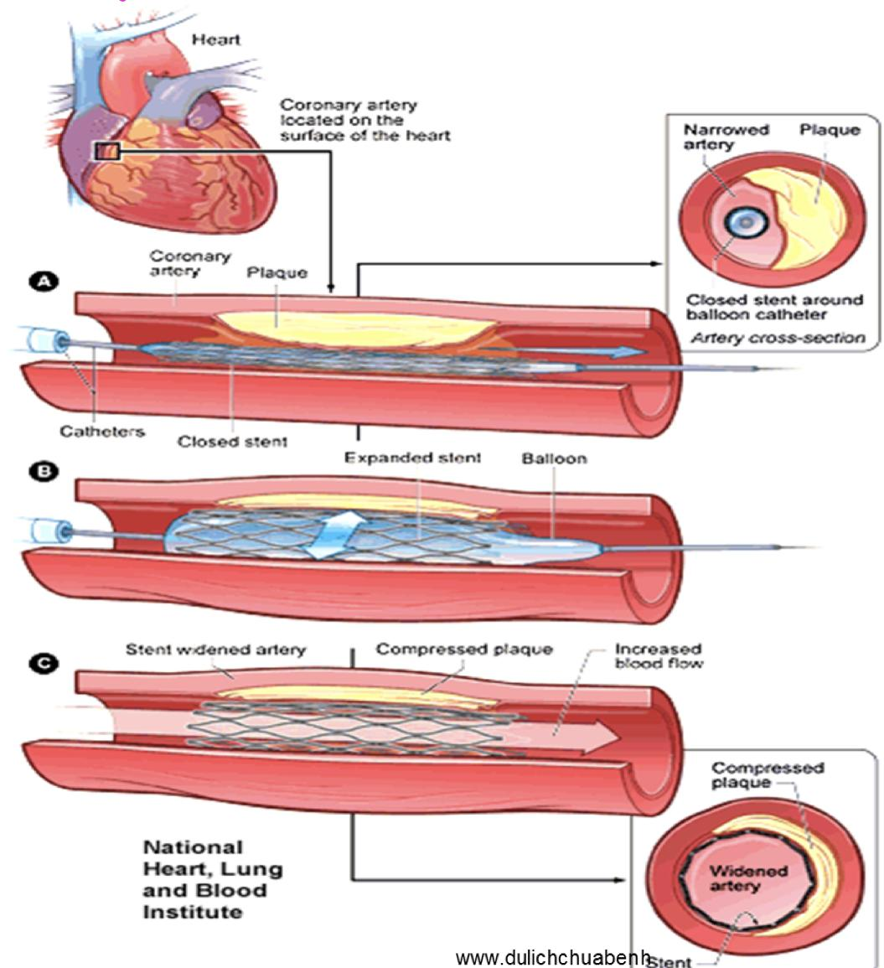
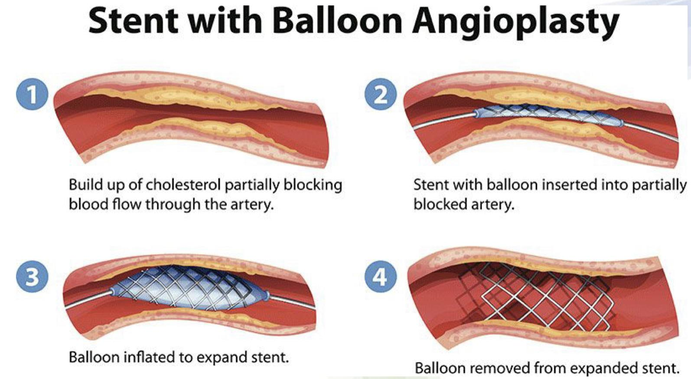
Stroke/Cerebrovascular Accident
Atherosclerosis and Cardiovascular Disease
Angioplasty
Dr: i wont ask you about it
Female slides Only
Ischemic stroke occurs when oxygen-rich blood flow to the brain is restricted, the type of the stroke depends on the site involved. #439
Angioplasty video starts at 1:57

Slide 12
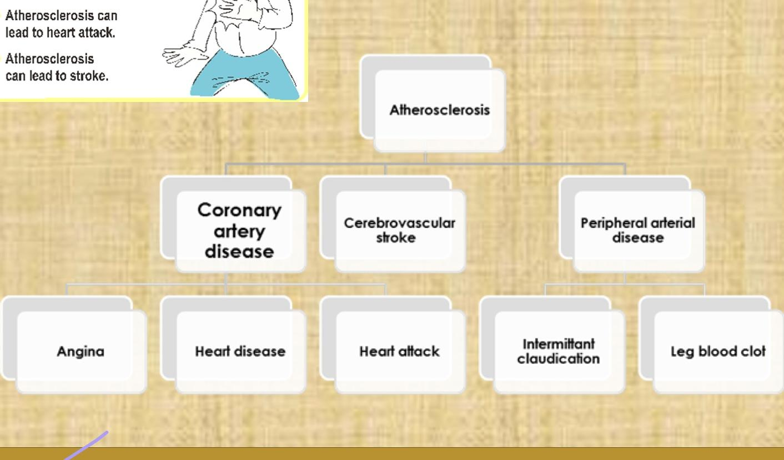
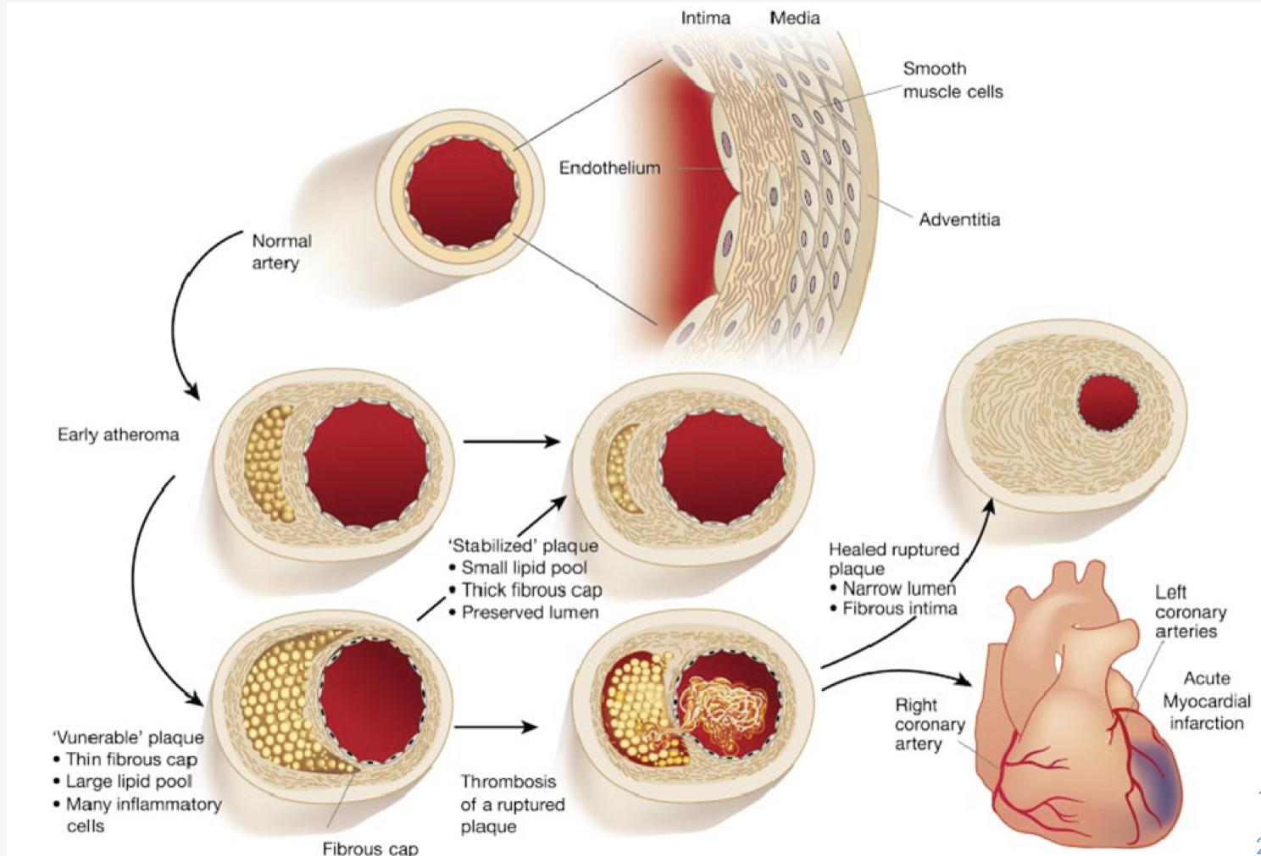
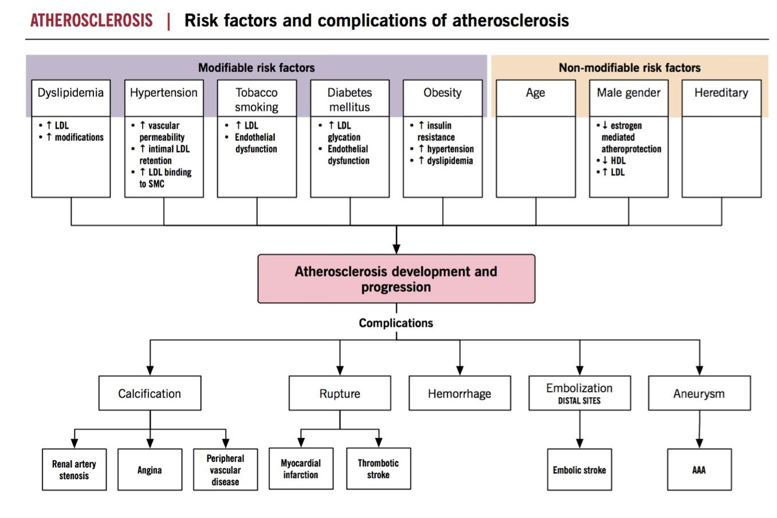
Summary
Female slides Only
Abdominal Aorta Artery

Slide 13
Summary
Atherosclerosis
Definition | Is a type of arteriosclerosis, a build-up of fat (cholesterol) within the artery wall, Slowly progressive. is characterized by intimal lesions called atheromas (also known as atheromatous plaque or fibrofatty plaque), which protrude into and obstruct vascular lumens and weaken the underlying media.
Sites | Abdominal Aorta > Coronary Arteries > Popliteal Artery > Internal Carotid > Vessels of the circle of Willis
Risk Factors
Pathogenesis | Hemodynamic disturbances or Hypercholesterolemia > Endothelial injury > LP accumulation > Increased permeability > Adhesion of blood leukocyte > Transform into macrophages and foam cells > Adhesion of platelets > release factors > migration of SMCs into intima > proliferation and production of EC matrix > Enhanced accumulation of IC and EC lipids
Morphology
Major | Minor
Non-Modifiable: Age + Male gender + Family history + Genetic abnormalities Potentially Modifiable: Hyperlipidemia + Hypertension + Smoking + Diabetes + Inflammation | Obesity + Physical inactivity + stress + postmenopausal + high carbohydrate intake + Alcohol + Lipoprotein Lp (a) + Trans unsaturated fat intake + Chlamydia pneumonia
Gross | Microscopic
intimal thickening and lipid accumulation SA plaques impinge (تتطفل) on the lumen of the artery AS plaques usually involve only a partial circumference of the arterial wall ("eccentric" lesions”) and are patchy and variable along the vessel length.( vary in shape) AS plaques vary in size | Cells: SMCs, Macrophages, Lymphocytes and foam cells Extracellular matrix: collagen, elastic fibers and proteoglycans Lipid: typical atheromas contain relatively abundant lipid both extracellular and intracellular lipid

Slide 14
Summary
Atherosclerosis
Complication | Calcification + Hemorrhage + Plaque rupture + Superimposed thrombosis (thromboembolism) + weakening of BV with aneurysmal dilation + Myocardial infarction + Cerebral infarction + Mesenteric occlusion + peripheral vascular disease
MCQ
For more question
1-which of the following is a major risk factor of Atherosclerosis?
a-Diabetes | b-Hyperlipidemia | c-Hypertension | d-All of them
2-two of the most important causes of endothelial dysfunction are.
a-Hemodynamic disturbances | b-Hypercholesterolemia | C-both A and B | D-non of them
3- The earliest lesion of Atherosclerosis:
a- Foam Cells | b- Calcification | c- Atheromatous plaque | d- Fatty Streak
4- Intermittent Claudication is a complication of Atherosclerosis in which artery:
a- Coronary Artery | b- Femoral Artery | c- Abdominal Artery | d- Circle of Willis
5- Which of the following is not one of necrotic center components:
a- Cholesterol Crystals | b- Calcium | c- Lymphocyte | d- Cell debris
1-d 2-c 3-d 4-b 5-c

Slide 15
Team leaders:
Dema
Alkhattabi
Raneem Alwatban
Ibrahim
Alhezam
Sub-leader:
Hassan Alabdullatif
Team members:
Norah
Alrashoud
Maram
Beyari
Omar
Alkadhi
Farah
Alenezi
Manar
Alzahrani
Othman Alabdullah
Hoor
Aloraini
Nawaf
Alrefaei
Rakan
Alromayan
Mayssar Alshobaki
Saad
Alahmari
Osama
alburaih
Nouf
Aldhalaan
Emad
Almutairi
Abdulaziz
Alymni

