Slide 1
Ischemic Heart Disease (IHD)
Helpful video for Ischemic heart disease by Ninja nerd.
Editing File

Slide 2
Understand the pathogenesis and clinical consequences of atherosclerosis.
Be able to discuss pathology and complications of ischemic heart diseases with special emphasis on myocardial infarction.
Know how lifestyle modifications can reduce the risk of ischemic heart diseases.
Key principles
Risk factors of atherosclerosis.
Pathogenesis of the fibro lipid atherosclerotic plaque.
Clinical complications of atherosclerosis.
Commonest sites for the clinically significant coronary atherosclerosis.
Macroscopic and microscopic changes in myocardial infarction.
Biochemical markers of myocardial infarction.
Complications of myocardial infarction: immediate and late.

Slide 3
Ischemic Heart Disease
Ischemic Heart Disease
IHD = a group of closely related conditions/syndromes caused by an imbalance between the myocardial oxygen demand and blood supply (resulting from myocardial ischemia). Usually caused by decreased coronary artery blood ﬂow (“coronary artery disease”)
(Robibins) Cardiac ischemia may be result of: -increase demand (e.g. with increase HR or hypertension), - Diminished blood volume ( e.g. hypotension shock), - diminished oxygenation (e.g. due to pneumonia or CHF), - diminished oxygen-carrying capacity (e.g. due to anemia or carbon monoxide poisoning)
The major cause is atherosclerosis, Less commonly it is due to vasospasm and vasculitis.
Is it exactly the same as coronary artery disease (CAD)? – Frequently yes
Four closely related conditions/syndromes that come under IHD are:
Chronic ischemic heart disease
Angina pectoris (chest pain)
(no necrosis)
Sudden cardiac death
Acute myocardial infarction
(with necrosis)
Epidemiology of IHD
Peak incidence: 60y for males and 70y for females.
● Men are more affected than women.(estrogen protects women)
● Contributing factors are same as that of atherosclerosis (Because it’s The most common cause thus its Contributing factors will Contribute in IHD) e.g.:
◦ Hypertension.
◦ Diabetes mellitus.
◦ Smoking.
◦ High levels of LDL.
◦ Genetic factors (direct or indirect)
◦ Lack of exercise.

Slide 4
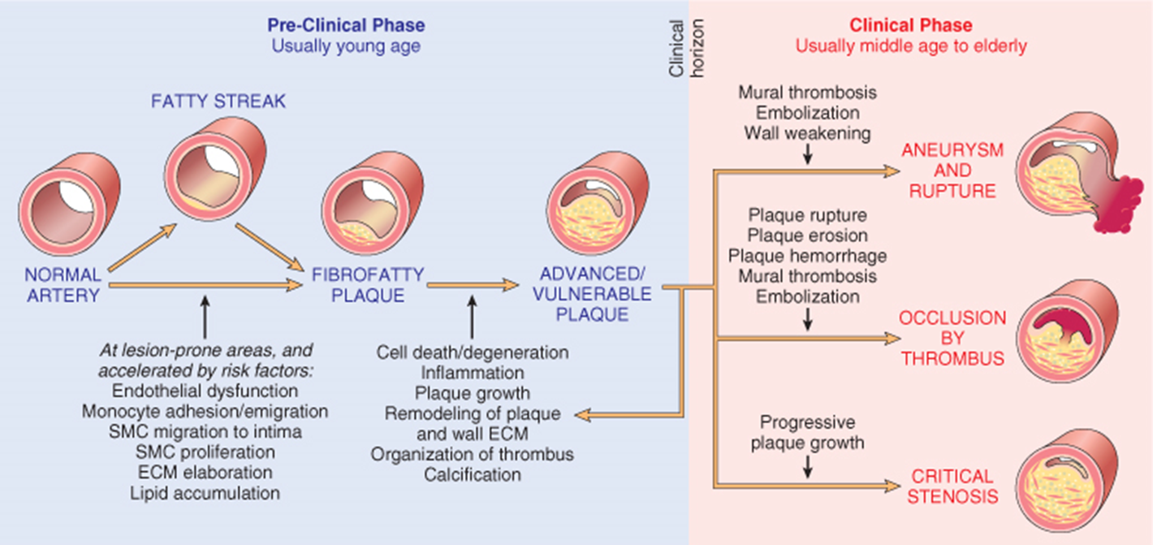
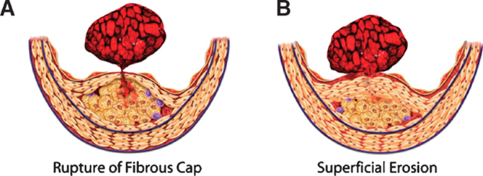
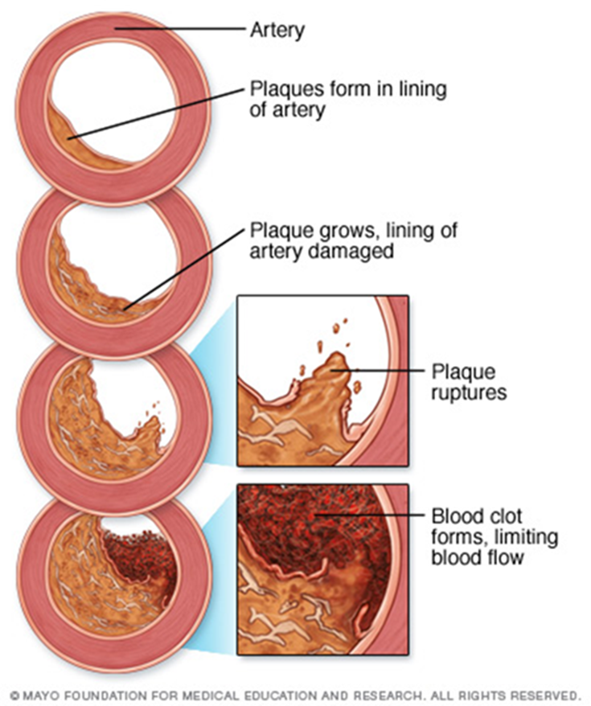
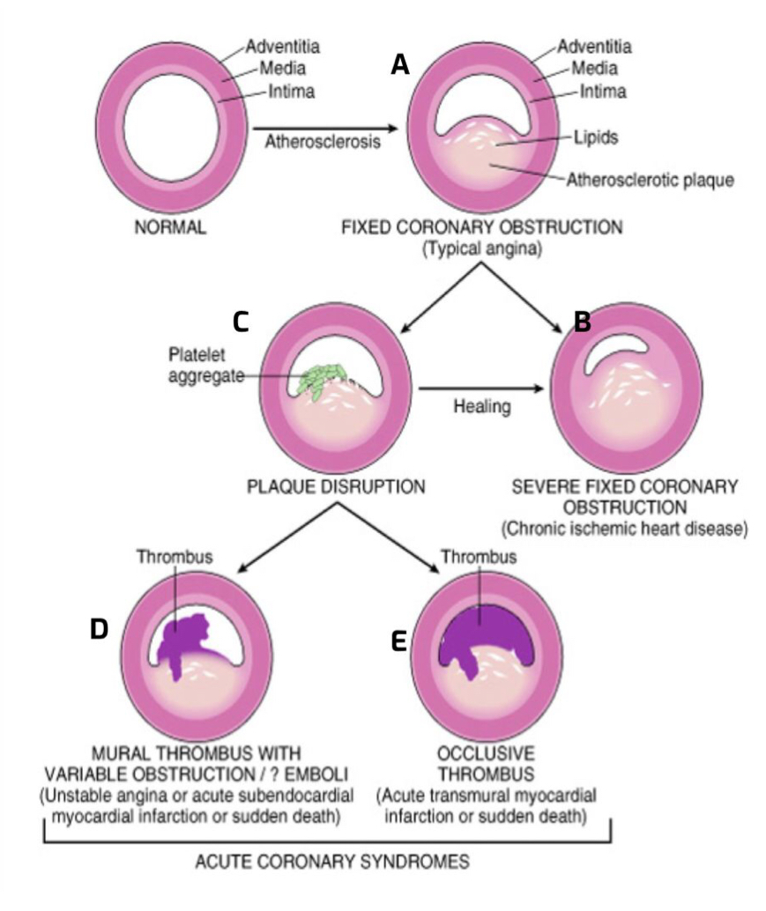
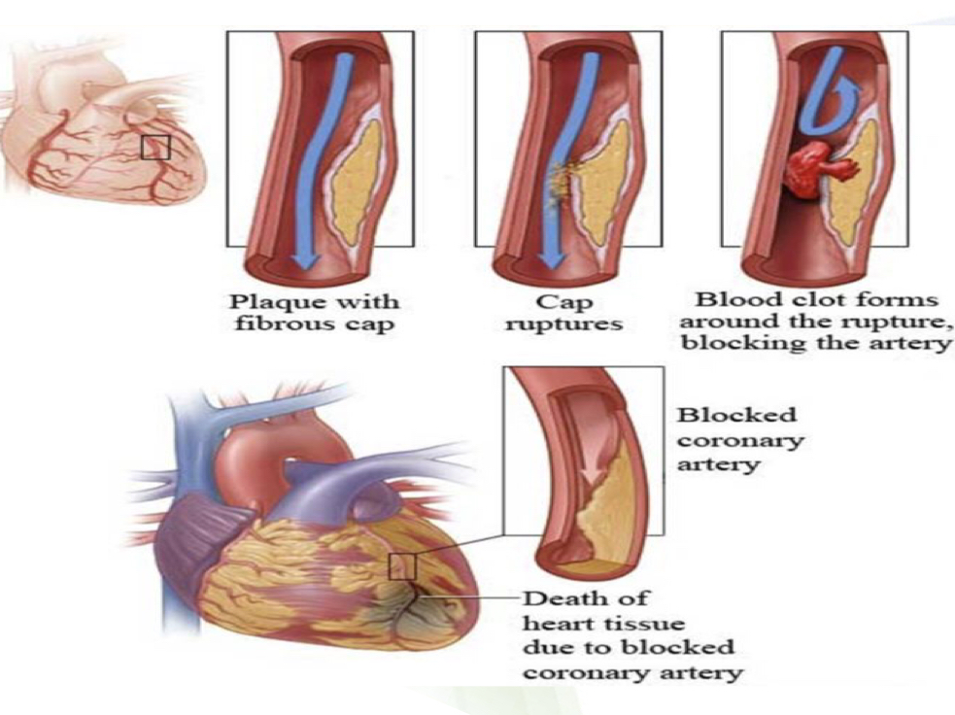
Pathogenesis of IHD
1-role of critical
Stenosis or obstruction
Disruption of a mildly stenosing plaque leading to rupture/ ulceration which can lead to:
i. hemorrhage into the atheroma which will expand in volume
ii. exposure of the pro-thrombogenic basement membrane just below the endothelial cells → thrombosis → the formed thrombus will further block the lumen of the blood vessel
So:
Acute plaque change can cause myocardial ischemia in the form of
unstable angina
acute myocardial infarction
and sudden cardiac death
2- Role of Acute Plaque Change
thrombus superimposed on a disrupted partially occluding plaque can convert
the plaque to either:
1-total occlusion leading to acute transmural MI or sudden death.
2-a partial/incomplete/subtotal occlusion leading to unstable angina, acute subendocardial infarction, or sudden death.
Thrombus in coronary artery can also embolize.
3- Role of Coronary Thrombus
A: We have ﬁxed coronary obstruction (Typical Angina), Atherosclerotic Plaque in the intima blocks 70% of the vessel.
B: Severe Fixed coronary artery, more than 70% is blocked (not important) C: When the Plaque is disrupted it can lead to D AND E . D: Mural thrombus with a Non complete obstruction (causes Unstable angina or acute subendocardial myocardial infarction or sudden death.)
E: When a complete obstruction happen it causes Acute transmural myocardial infarction or sudden death.
Vasoconstriction reduces lumen size and can therefore potentiate plaque disruption.
4- Role of Vaso-
constriction
Inflammatory processes play important roles at all stages of atherosclerosis.
5- Role of
Inflammation

Slide 5
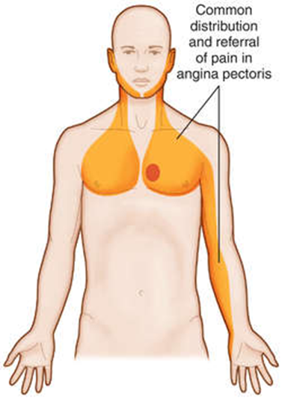
Angina Pectoris
Definition | Angina pectoris is a type of IHD characterized by paroxysmal and usually recurrent attacks of substernal or precordial chest discomfort, described as constricting, crushing, squeezing, choking, or knifelike pain. pain can radiate down the left shoulder, left arm, neck or left jaw (referred pain). Another Def. : Intermittent chest pain caused by transient, reversible ischemia.
Caused by | Angina pectoris is due to inadequate perfusion and is caused by transient (15 seconds to 15 minutes) myocardial ischemia that falls short of inducing necrosis i.e. duration and severity is not sufficient to cause infarction.
types | 1- Typical (stable) angina: • pain on exertion (movement,physical activities) • ﬁxed narrowing of coronary artery 2- Unstable (pre-infarction) angina: • increasing pain with less exertion • plaque disruption and thrombosis 3-Prinzmetal (variant) angina: • pain at rest •coronary artery spasm of unknown etiology (This type is the only type that is not related to atherosclerosis)
Stable angina / typical angina | ● Is the most common form of angina ● it is due to a fixed stenosis ● The chest pain is episodic ● Occurring reliably after certain levels of exertion ● Is caused by atherosclerotic disease with usually ≥70-75% narrowing of lumen ( ﬁxed stable critical stenosis). This reduction (due to ≥ 70% stenosis) of blood ﬂow in coronary vessels makes the heart vulnerable, so whenever there is increased demand (Ex:physical activity, emotional excitement,or any other cause of increased cardiac workload) there is angina pain. ● Management : Relieved by rest (ex:decreasing demand) or with vasodilators like sublingual nitroglycerin (sublingual drugs have the fastest absorption, we use it here in order to give immediate response )
Unstable / crescendo angina | ● It is an unstable and progressive angina condition. ● Pain occurs with progressively increasing frequency, and is precipitated with progressively less exertion, (even at rest), and tends to be of more prolonged duration. ● It is induced by Small fissure, or disruption or rupture of an atheroma plaque (acute plaque change), ( triggering: • Platelet aggregation • Vasoconstriction • Formation of a mural thrombus that may not be occlusive • Usually proceed MI) (with superimposed thrombosis and partial occlusion of a coronary vessels). ● Unstable angina is often the precursor of subsequent acute MI. Thus also called pre-infarction angina→ immediate investigation → correct the block within hours
Prinzmetal / Variant / Vessel spasm angina | ● is an uncommon pattern of episodic angina that occurs at rest and is due to coronary artery spasm. ● Prinzmetal angina generally responds promptly to vasodilators, such as nitroglycerin and calcium channel blockers. ● Not related to atherosclerotic disease (most important feature ) ● The etiology is not clear. (This type is the only type that is not related to atherosclerosis)

Slide 6
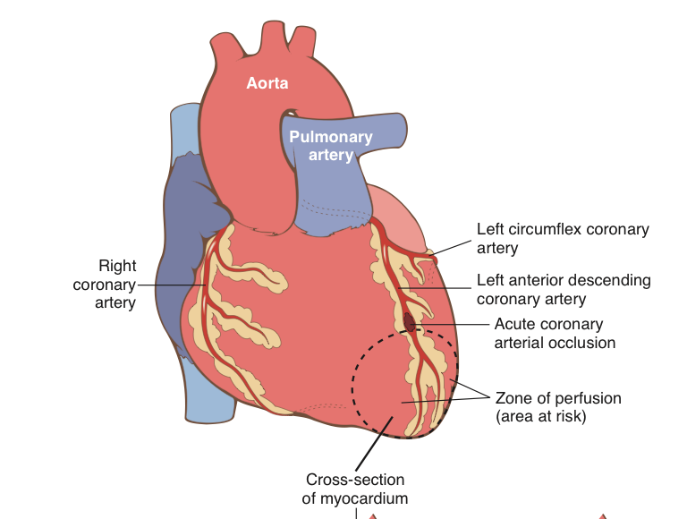
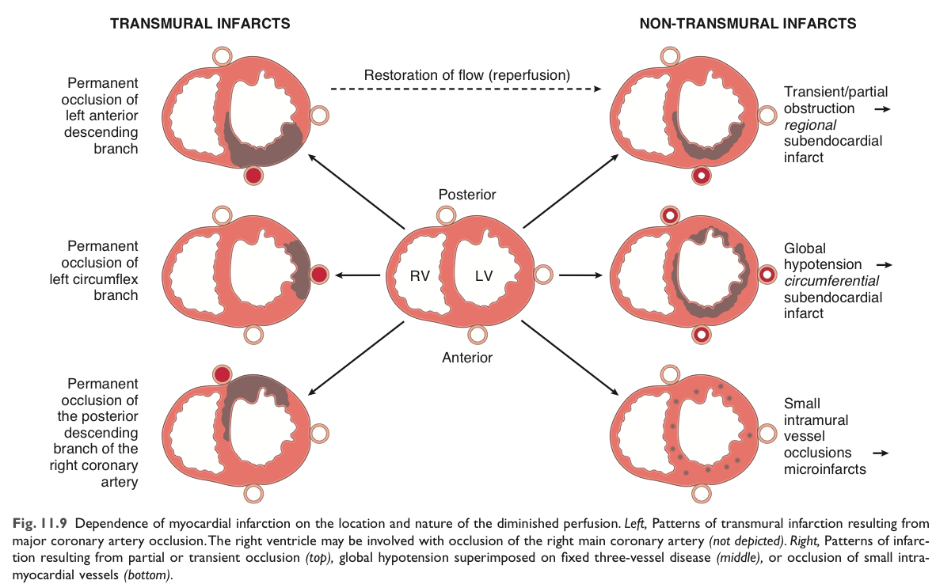
Myocardial infarction(MI) (Heart attack)
Helpful video
Definition | The death of cardiac muscle (coagulative necrosis) resulting from ischemia. The severity or duration of ischemia is enough to cause cardiac muscle death The commonly affected coronary vessel in MI: In persons with right dominant coronary artery heart (90% of population) the commonly affected blood vessels are: 2 cm proximal Left anterior descending artery.(40-50%).“Most commonly affected artery”, ● anterior left ventricle ● anterior septum ● apex circumferentially 1st and last thirds of Right coronary artery (30-40%), ● posterior left ventricle ● posterior septum ● right ventricular free wall, sometime Left circumﬂex artery (about 20%), infarct involves lateral left ventricle except the apex
Risk factors | Are the same as those of coronary atherosclerosis. Atherosclerosis + age + male gender. Females are more affected after menopause due to decreased estrogen production.
Sequence of events
Types | Transmural : Full thickness (>50% of the wall). Subendocardial : Inner 1/3 of myocardium. The infarction as usual will start distal to the vessel but will stop due to Two mechanisms: •Fixed atherosclerosis but with increased demand,vasospasm or hypotension •Evolving transmural with relieve of the obstruction (often multifocal)
“Necrosis of the heart muscle resulting from ischemia.” Robbins book
احتمالية إصابة النساء تتساوى مع الرجال فقط بعد انقطاع الطمث، قبل انقطاع الطمث تكون احتمالية الإصابة أقل من الرجال
1
Acute plaque change
3
Thrombus formation
5
Hypoxia
7
Cardiac muscle necrosis
Long standing atherosclerotic plaque
2
Disruption of the plaque
4
Ischemia
6
Irreversible cell injury
8
(Unlike angina)
The sequence above will lead to MI.
The type of necrosis is coagulative necrosis
Note: the thrombus usually evolves to completely occlude the lumen of the coronary vessel within minutes

Slide 7
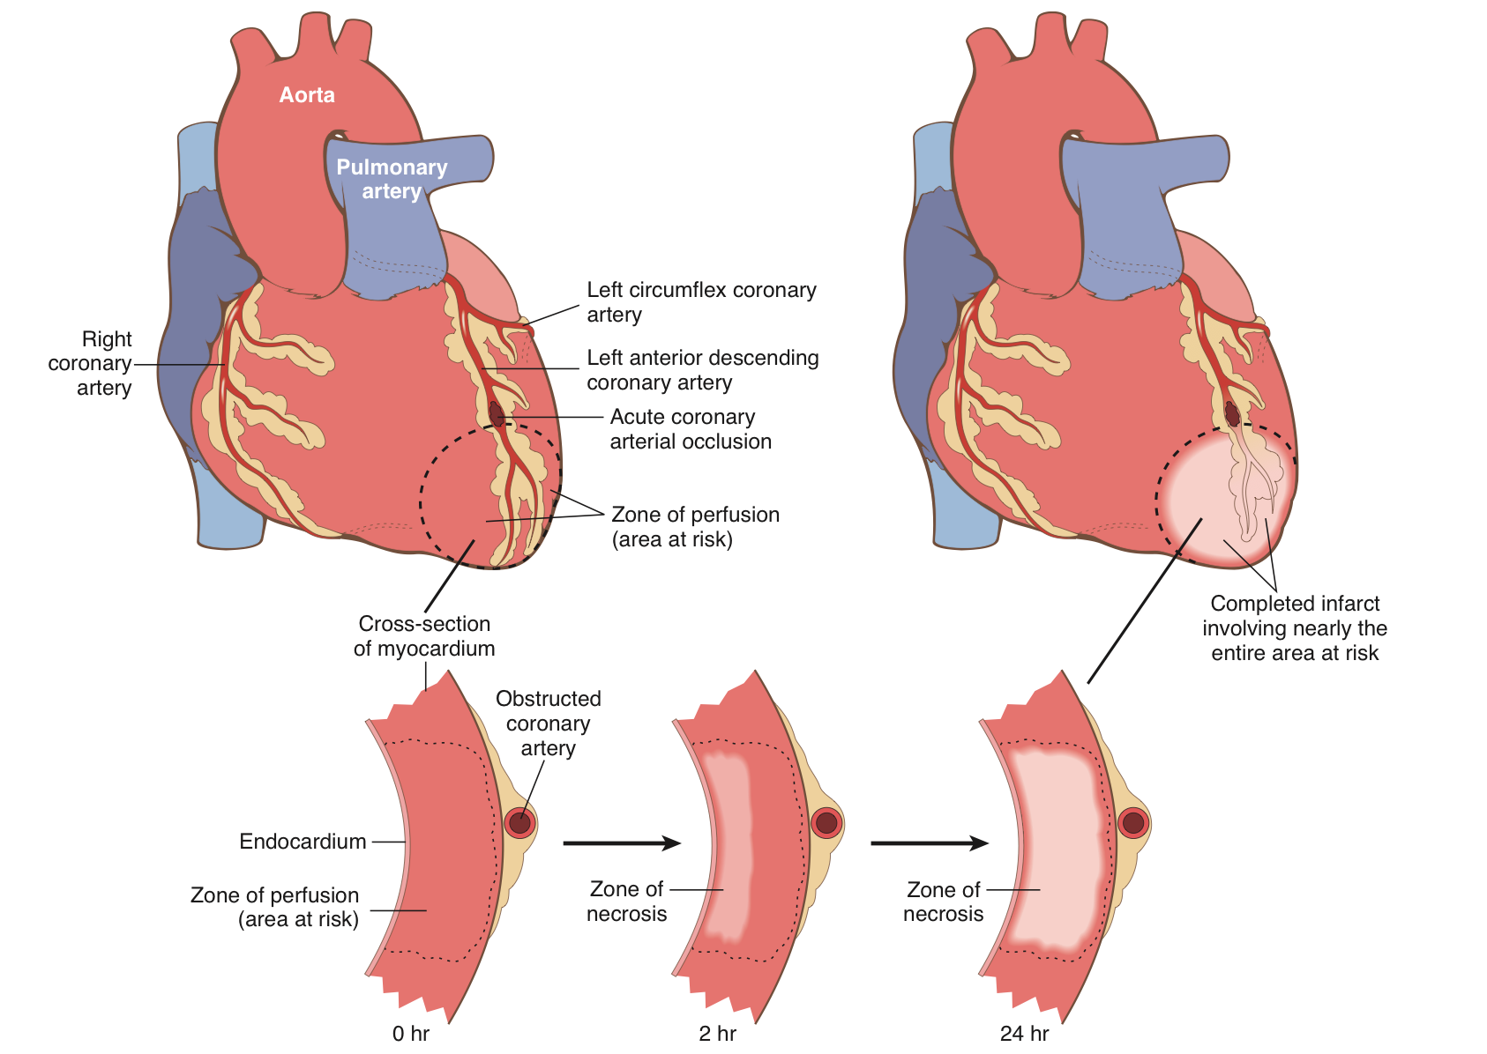
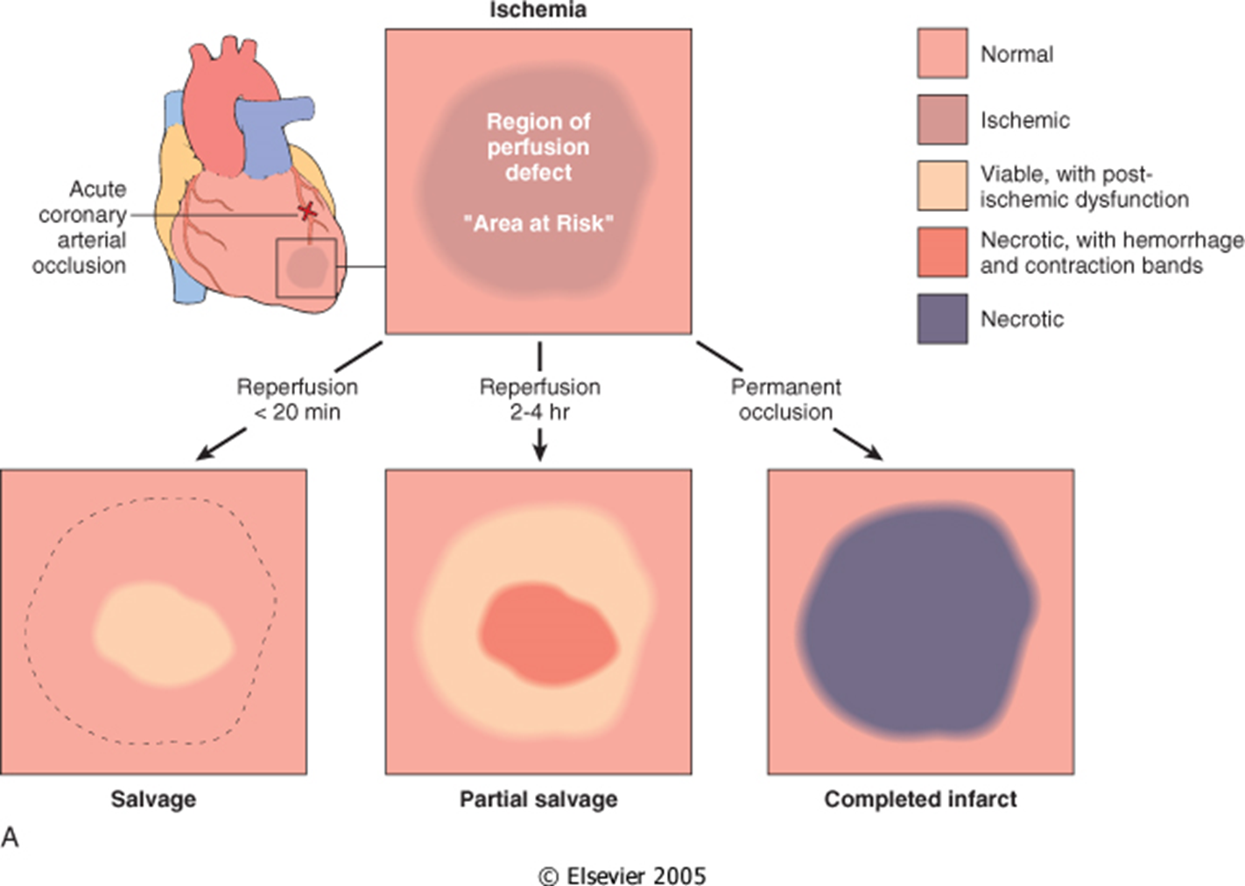
Pathogenesis of MI(Female slides)
Severity of ischemia
Most common cause is acute thrombosis (in coronary arteries) on a preexisting disrupted atherosclerotic plaque. In the typical case of MI, the following sequence of events usually occur:
1
2
3
Acute plaque change
Thrombus formation
Occlusion of the lumen
(Sudden change in the structure of an atheromatous plaque e.g. disruption, ulceration, rupture or intraplaque hemorrhage).
Exposure of the thrombogenic subendothelial basement membrane resulting in thrombus formation
Frequently within minutes, the thrombus evolves to completely occlude the lumen of the coronary vessel.
Severe ischemia lasting at least 20 to 40 minutes causes irreversible injury and myocardial necrosis on the ultrastructural level (on electron microscopy).
Myocardial necrosis mostly starts in the sub-endocardial region (because it is less perfused and has high intramural pressure).Note that a very narrow zone of myocardium immediately beneath the endocardium is spared from necrosis because it can be oxygenated by diffusion from the ventricle. Robbins book
The full size of the infarct is usually determined within 3-6 hours of the onset of severe myocardial ischemia. During this period, lysis of the thrombus by treatment with streptokinase or tissue plasminogen activator, may limit the size of the infarct. So any intervention in this time frame can potentially limit the final extent of necrosis.
reperfusion injury can incite greater local damage than the damage might have occurred without rapid restoration of blood flow. reperfusion injury is mediated in part by oxygen free radicals generated by the increased number of infiltrating leukocytes facilitated by reperfusion. Reperfusion-induced microvascular injury causes not only hemorrhage but also endothelial swelling that occludes capillaries and may prevent local blood flow (called no-reflow).
A reperfused infarct usually has hemorrhage because the vasculature injured during the period of ischemia is leaky after flow is restored

Slide 8
Pathogenesis Cont. (Female slides)
Morphologic changes in MI
The precise location, size, and specific morphologic features of an
acute myocardial infarct depend on:
The location, severity, and rate of development of coronary atherosclerotic obstructions
1
The size of the area supplied by the obstructed vessels.
2
The duration of the occlusion
3
4
The oxygen needs of the myocardium at risk
The extent of collateral blood vessels
5
Other factors, such as blood vessel spasm, alterations in blood pressure, heart rate, and cardiac rhythm.
6
7
In addition reperfusion may limit the size of the infarct.
Time | Gross changes | Microscopic changes
0-4h | None | None
4-12h | Mottling | Coagulation necrosis
12-24h | Mottling | Coagulation necrosis, neutrophils come in
1-7 days | Yellow infarct center | Neutrophils die, macrophages come to eat dead cells
1-2 w | Yellow center, red border | Granulation tissue*
2-8 w | Scar | Collagen
*the granulation tissue, it’s not stable ( it’s not fibrotic ) thus it will be prone to complication ( rupture of the infarcted area )

Slide 9
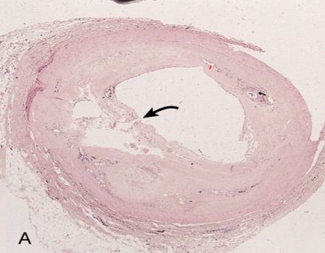
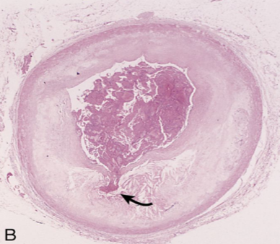
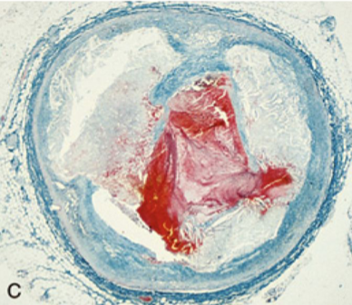
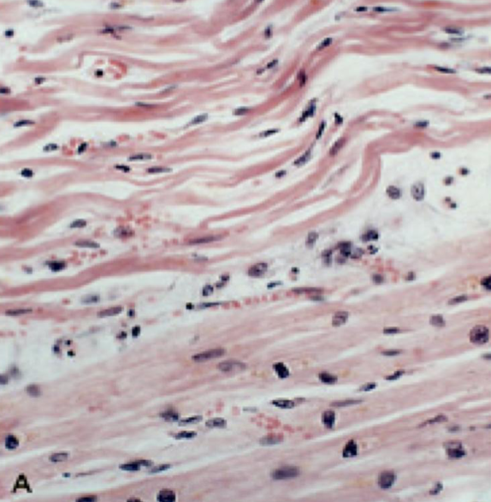
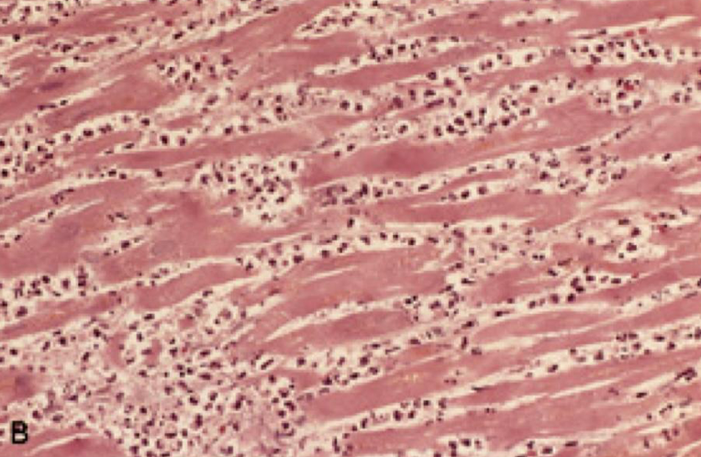
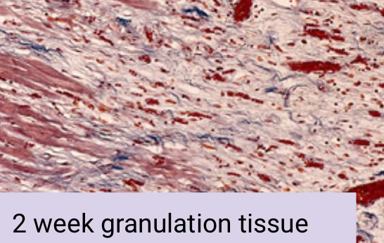
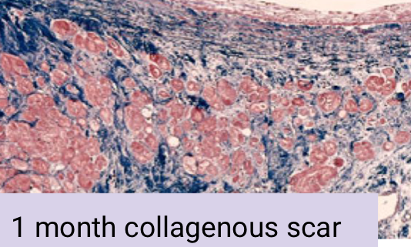
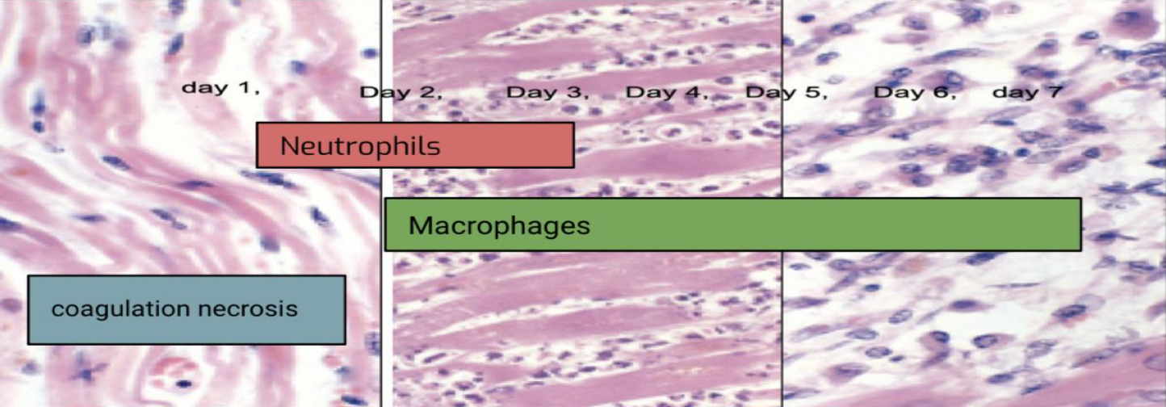
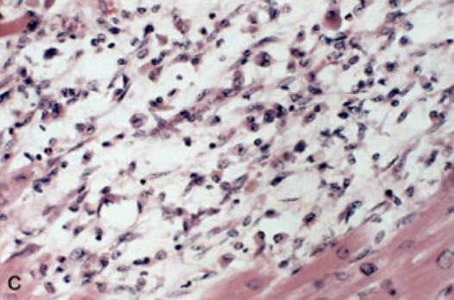
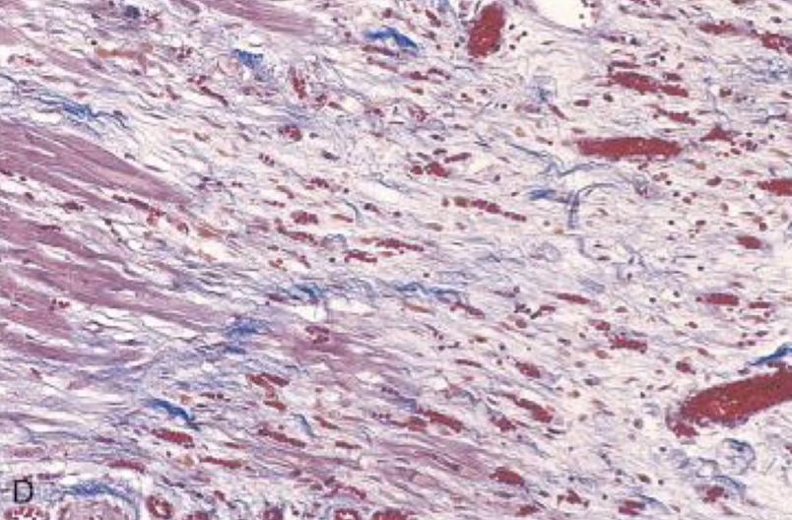
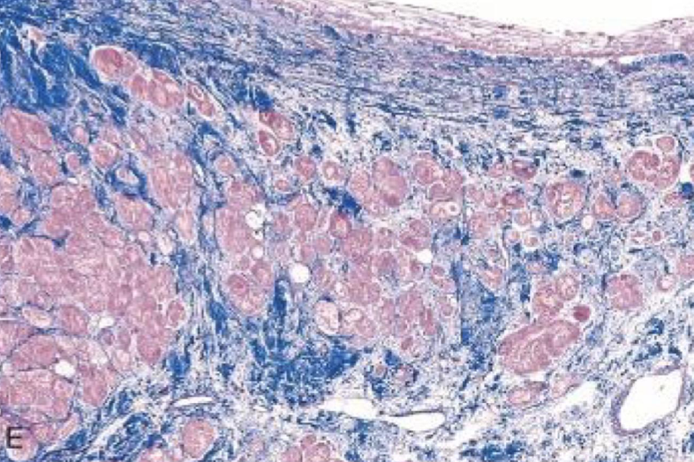
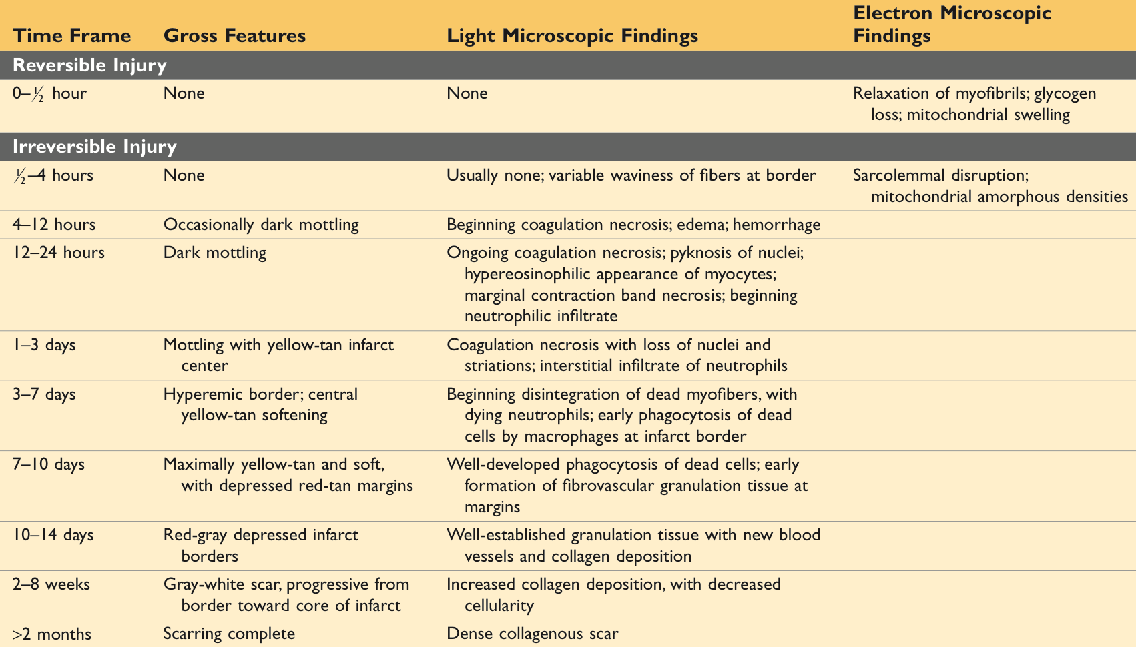
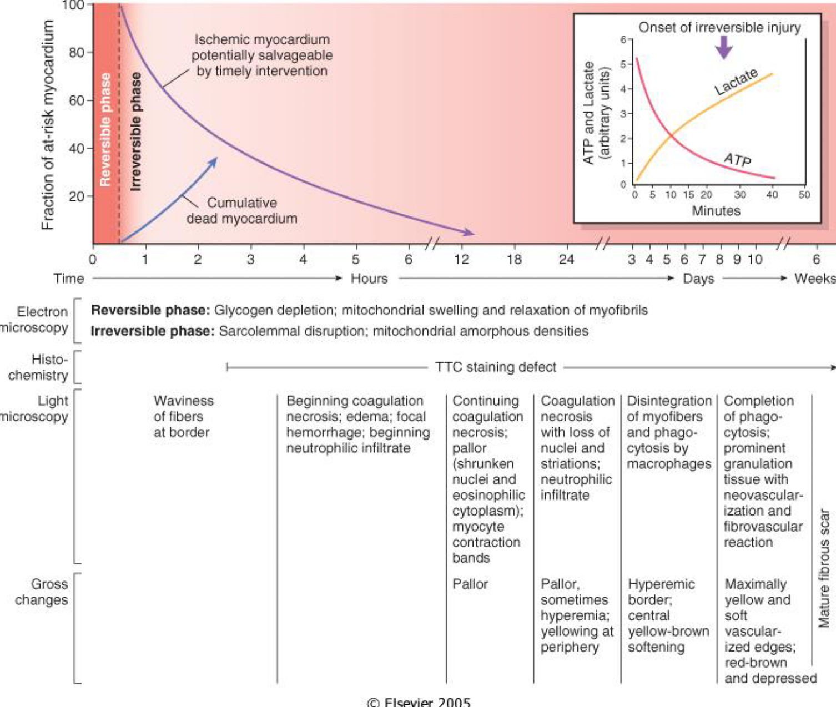
Microscopic changes
A. plaque rupture without superimposed thrombus in patient who died suddenly
B. Acute coronary thrombosis superimposed
on an atherosclerotic plaque with focal
disruption of the fibrous cap,
triggering fatal myocardial infarction
C. Massive plaque rupture with superimposed thrombus, also triggering a fatal myocardial infarction (special stain highlighting fibrin in red) in both.
A.one-day-old infarct showing coagulative necrosis with few neutrophils, wavy fibers with elongation, and narrowing, compared with adjacent normal fibers (lower right).
B. Dense neutrophilic infiltrate in an area of acute myocardial infarction of 3 to 4 days' duration.
Coagulation necrosis: Can be seen after the ﬁrst 4 hours till the end. Neutrophils: Can be seen after the ﬁrst 12 hour till the 3rd day Macrophages: can be seen after the second day till the 7th day.
MED439
C. Nearly complete removal of necrotic myocytes by phagocytosis (approximately 7 to 10 days).
D. Granulation tissue approximately 3 weeks post MI
E. Healed MI with replacement of the necrotic fibers by dense collagenous scar. Residual cardiac muscle cells are present

Slide 10
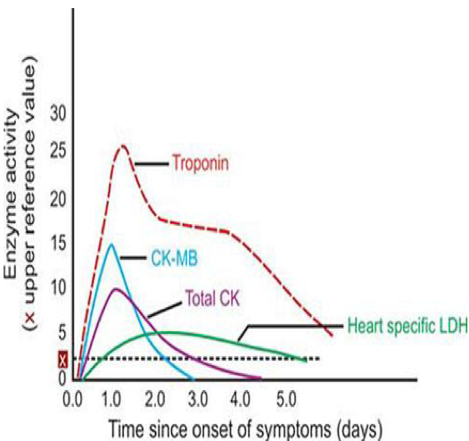
Clinical features of MI
Laboratory evaluation
Myocardial infarction can be silent (DM, Old age)
Diaphoresis (Sweating)
Rapid and weak pulse
1
2
Symptoms
Dyspnea , Nausea
6
3
Cardiogenic shock
Can be seen in massive MI (>40% of lt. ventricle)
ECG shows typical findings of ischemia
5
4
changes :
- Q waves ( indicating transmural infarct )
- ST-segment abnormalities
- T-wave inversion
Pain
Pain: (the ischemia → release of adenosine, bradykinin pain)
- Severe crushing substernal chest pain, which may radiate to the neck, jaw, epigastrium, shoulder or left arm
- Pain lasts for hours to days and is not relieved by nitroglycerin (nitroglycerin works on angina, so, you can differentiate between the two by the patient's response to the drug).
-No pain 20% of patients (diabetics(due to sensory neuropathy), hypertensive, elderly) (So, they can have myocardial infarction without knowing)
Extra:
Non-ST-segment elevation MI (NSTEMI)→ST depression →subendocardial infarct
ST-segment elevation MI (STEMI)→ST elevation →transmural infarct
1
Troponins: best marker, TnT, Tnl (more specific).
- Tnl and TnT are not normally detectable in the circulation
- After acute MI both troponins become detectable after 2 to 4 hours, peaks at
48 hours. Their levels remain elevated for 7 to 10 days
2
CK-MB is the second best marker: (for detecting reinfarction) It begins to rise within 2 to 4 hours of MI, peaks at 24 hours and returns to normal within approximately 72 hours
3
Lactate dehydrogenase (LD): Rise 24 hrs, peaks 72 hrs, gradually disappears in 5 to 14 days.
Myoglobins
4

Slide 11
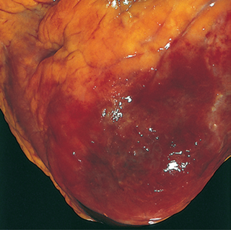
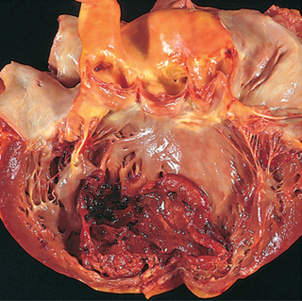
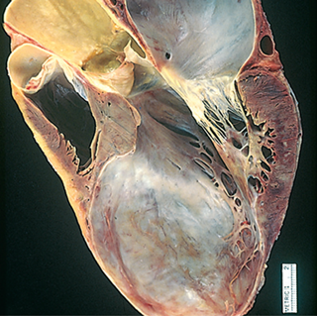
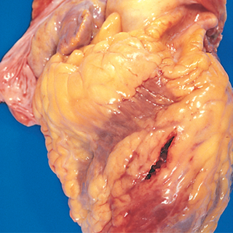
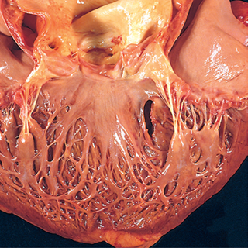
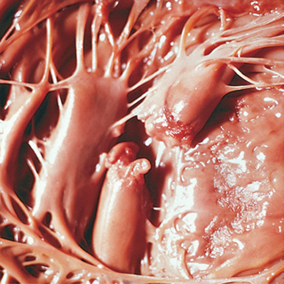
Outcomes\complications of myocardial infarction
No complications in 10-20%.
25% die, presumably due to arrhythmia.
10% of the rest will die within a month.
Overall 30% die in the 1st year and then 10% per year.
MI lead to sudden death in some cases, even before reaching the hospital
80-90% experience one or more of the following complications:
1- Cardiac arrhythmia (75-90%) | patients have conduction disturbances which can cause sudden death especially in ventricular arrhythmia. (The most common cause of death in patients with acute MI)
2- Left ventricular failure with pulmonary edema (60%) Congestive heart failure (CHF) | Associated with mild to severe pulmonary edema
3- Cardiogenic shock (10%) (>40% infarct of LV) | condition in which your heart suddenly can't pump enough blood
4- Myocardial rupture | Rupture of free wall Septum Papillary muscle (which will lead to blood regurgitation) or Mitral valve incompetence
5- Thromboembolism Occurs in 15-49% of patients (Mural thrombus) potentially source of emboli | Combination of contractility abnormality in contractility (causing stasis), and endocardial damage (due to exposure of underlying thrombogenic basement membrane) can lead to cardiac thrombosis and embolism (thrombosis attaches to the heart chamber wall)
6-Pericarditis | Inflammation of the pericardium
7- Ventricular aneurysm formation (ventricle is dilated and the wall is thinned out) | In which the ventricle is dilated and the wall is thinned out
8- External rupture of the infarct | Associated with bleeding into the pericardial space (hemopericardium).
9- Progressive late heart failure in the form of chronic IHD. | --------
10- Infarct extension and expansion | --------
Fibrinous pericarditis
Mural thrombus
Aneurysm
Ventricular wall rupture
Septal rupture
Papillary Muscle rupture

Slide 12
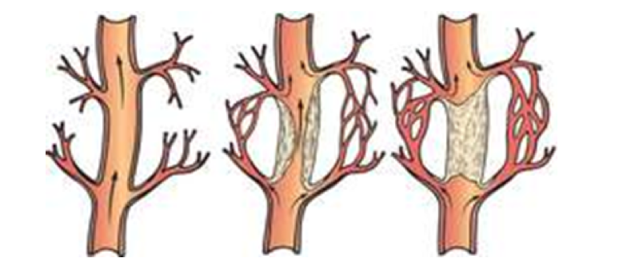
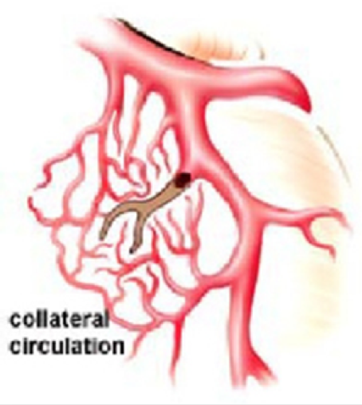
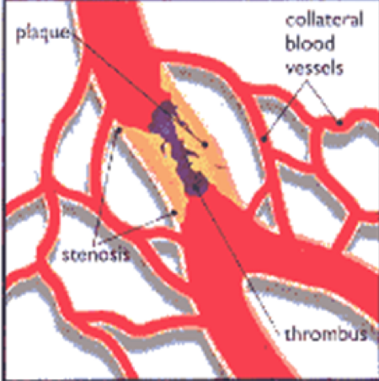
Chronic ischemic heart disease
Progressive heart failure due to ischemic injury, either from:
Prior infarction(s) (most common)
Or chronic low-grade ischemia
sudden cardiac death(SDC)
Unexpected death from cardiac causes either without symptoms or within 1 to 24 hours of symptom onset (different authors use different time points)
Results from a fatal arrhythmia, most commonly in patients with severe coronary artery disease
Acute coronary syndrome
is applied to three catastrophic manifestations of IHD:
- Unstable angina
- Acute MI
- Sudden cardiac death
Collateral circulation
Collateral circulation is the alternate circulation around a blocked artery or vein via another path, such as nearby minor vessels, it can help to supply blood flow to ischemic region caused by stenosis or occlusion of the arteries.

Slide 13
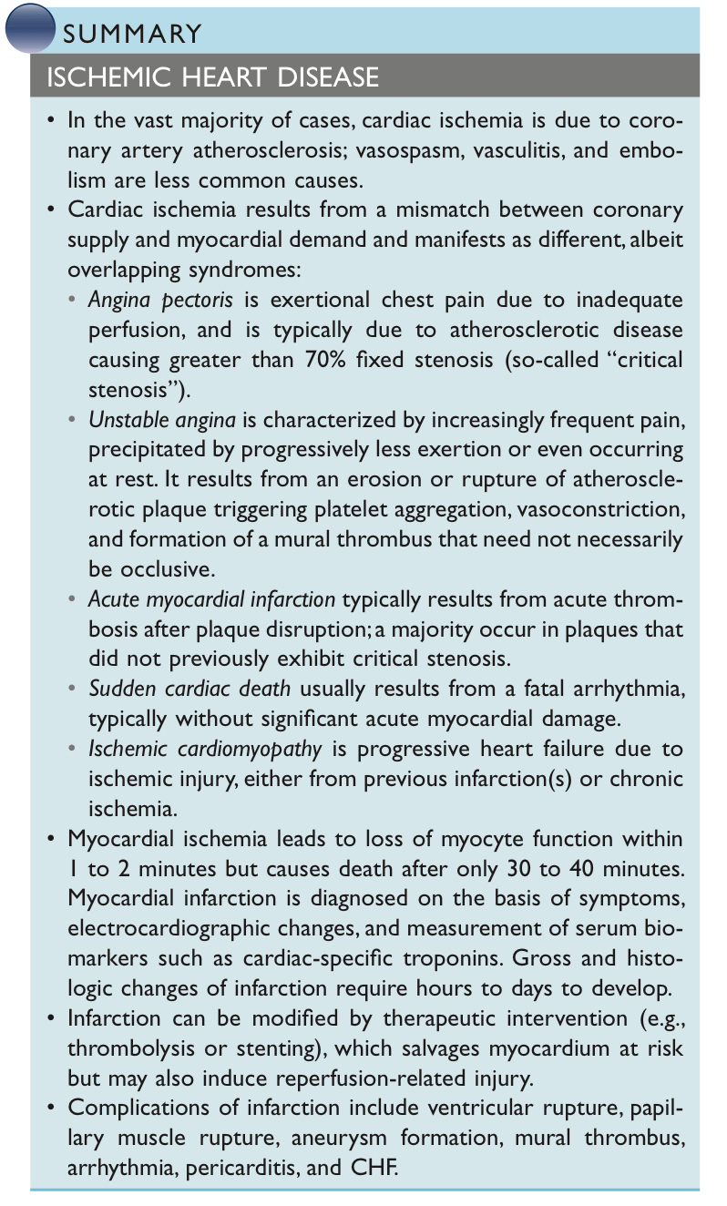
Summary (Female slides)
Necrosis of heart acute coronary artery muscle is caused by thrombosis
ischemia
Usually caused by acute coronary artery thrombosis
Myocardial infarction
irreversible injury/cell death in 20-40 minutes
Prompt reperfusion death occurs within can salvage 20-40 minutes
myocardium In other words, rapid reoxygenation of the myocardium can save it
01
Clinical features:
Severe, crushing chest pain ± radiation
Not relieved by nitroglycerin, rest
Sweating, nausea, dyspnea
Sometimes no symptoms
Laboratory evaluation:
Troponins detected within 2-4 hours, remain elevated for a week.
CK-MB increases within 2-4 hours, returns to normal within 72 hours
02
03
Complications:
contractile dysfunction
arrhythmias
Rupture
chronic progressive heart failure
Prognosis:
Depends on remaining function and perfusion
Prompt reperfusion can salvage myocardium
Overall 30% die in the 1st year and then 10% per year
04

Slide 14
MCQs
Check out 442 Quizlet bank
1-what is the main cause of stable angina?
A-diabetes mellitus | B-hypertension | C-atherosclerosis | D-hyperthyroidism
2-Which of the following types of angina is not related to atherosclerosis?
A-variant angina | B-crescendo angina | C-stable angina | D-unstable angina
3-Which of the following microscopic findings can be seen in MI day 7-14?
A-Granuloma | B-Fibrosis | C-Granulation tissue | D-Neutrophils
4-After recovering from a myocardial infarction attack, a patient presents to the clinic 5 days later with a chest pain. The patient was diagnosed with another MI attack. Which of the following is the best marker to help you in diagnosis ?
A- ESR | B-Troponins | C-CK-MB | D-Myoglobins
5-The fate of a thrombus may include all of the following except:
A-Propagation | B-Embolization | C-Lysis | D-Neoplastic transformation
1-C 2-A 3-C 4-C 5-D

Slide 15
Team leaders:
Dema
Alkhattabi
Raneem Alwatban
Ibrahim
Alhezam
Sub-leader:
Hassan Alabdullatif
Team members:
Norah
Alrashoud
Maram
Beyari
Omar
Alkadhi
Farah
Alenezi
Manar
Alzahrani
Othman Alabdullah
Hoor
Aloraini
Nawaf
Alrefaei
Rakan
Alromayan
Mayssar Alshobaki
Saad
Alahmari
Osama
alburaih
Nouf
Aldhalaan
Emad
Almutairi
Abdulaziz
Alymni

