Slide 1
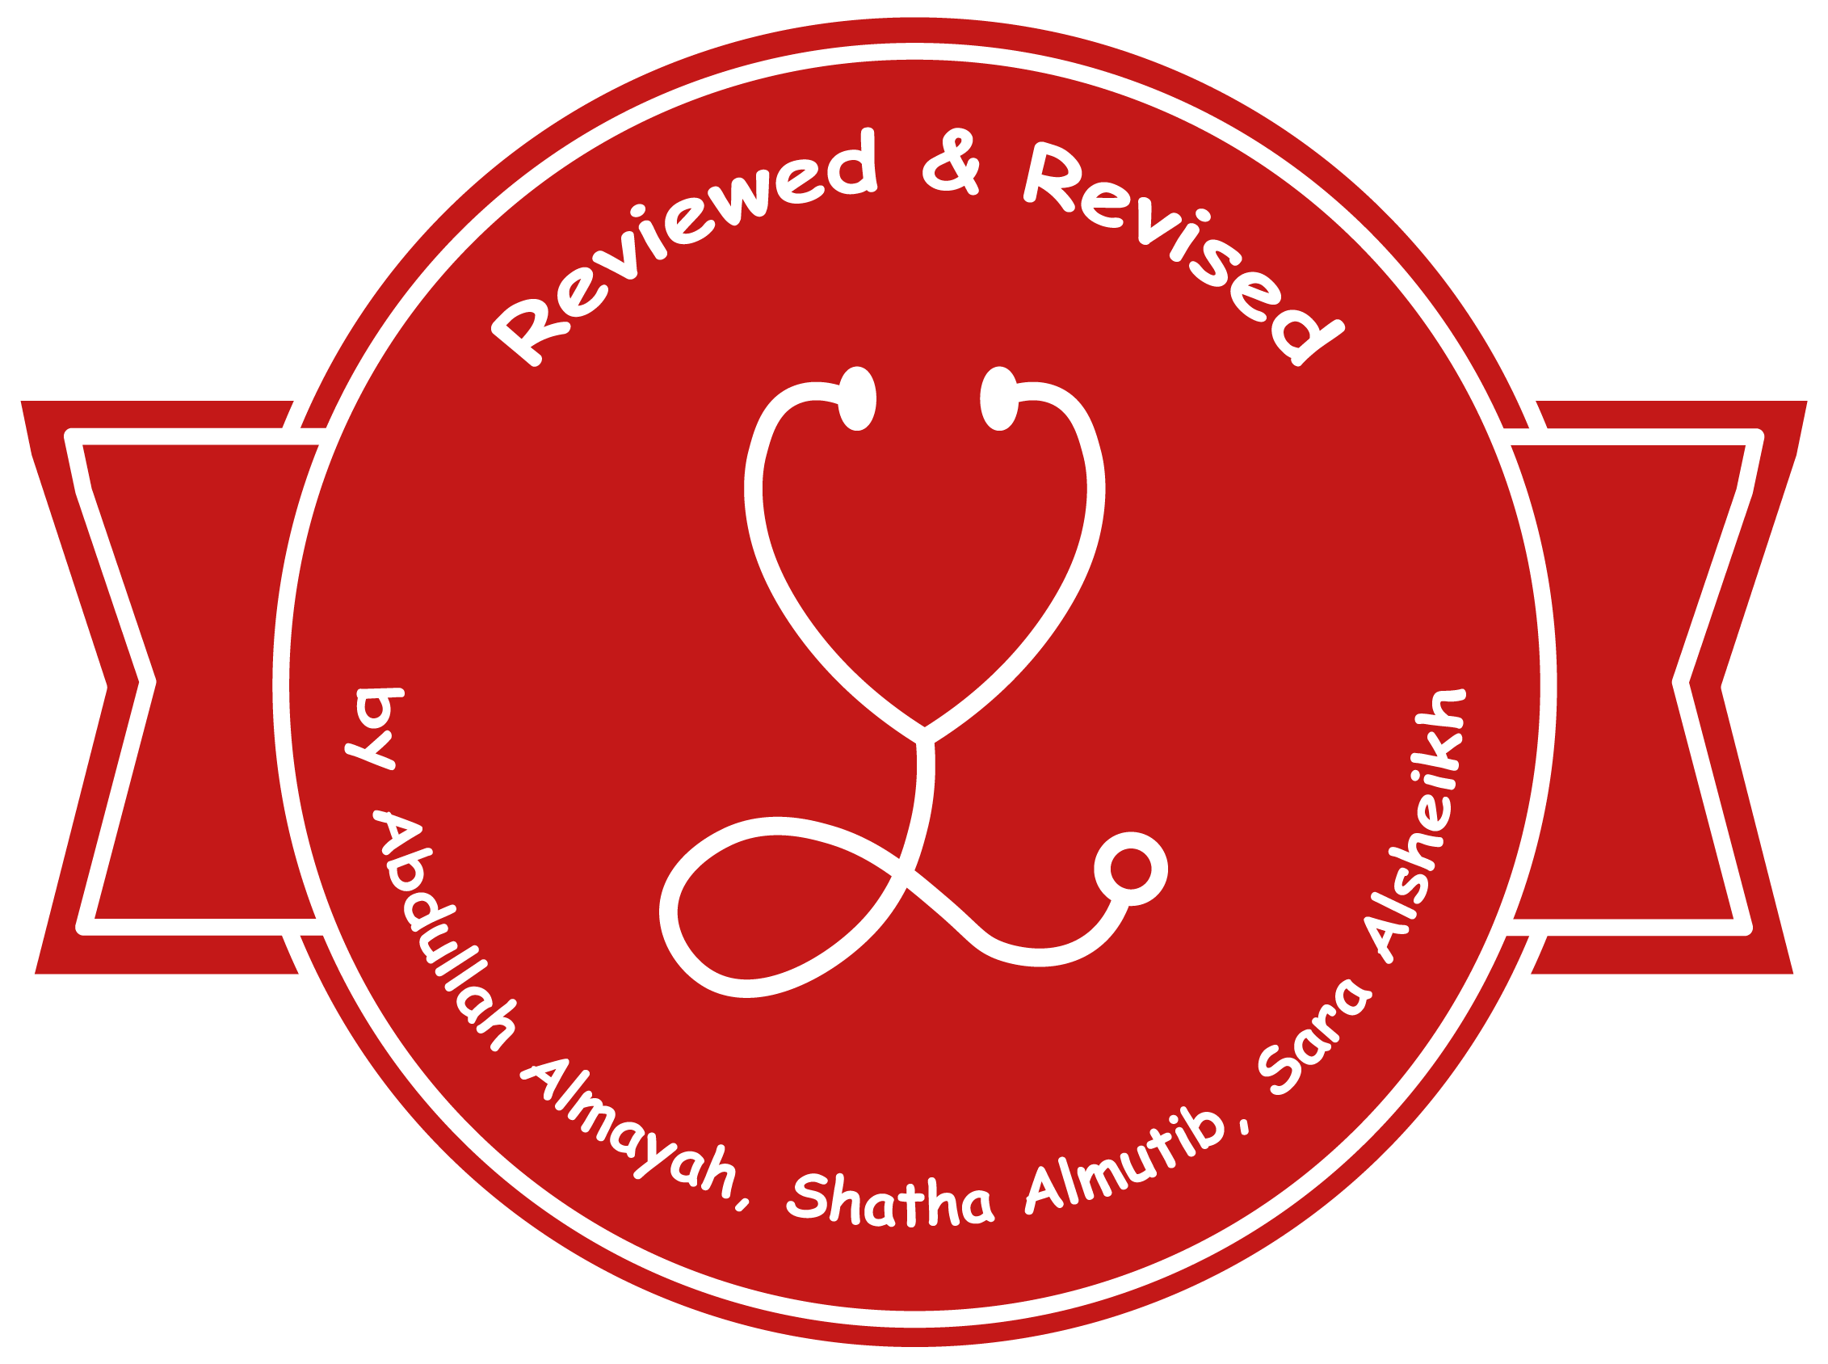
Thromboembolism
Editing File

Slide 2
Understand the basic pathology of thrombogenesis and the risk factors for development of deep vein thrombosis. Know the types of embolus than can occur and the pathology of pulmonary embolism.
Pathological aspects of thrombogenesis: vessel wall abnormality, vascular stasis or turbulent flow and increased blood coagulability. Causes of thrombus and embolism formation.
Predisposing factors for deep vein thrombosis.
Pathology of pulmonary thromboembolism.
Brief description of other forms of emboli like: fat embolism, air embolism, atherosclerotic plaque embolism, amniotic fluid embolism, nitrogen embolism and infective endocarditis

Slide 3
Hemostasis:
Male slides.
Normal Haemostasis: A consequence of tightly regulated process: Maintain blood in a fluid, clot-ree state in normal vessels. Inducing the rapid formation of a localized hemostatic plug at the site of vascular injury. Hemostasis and Thrombosis: Both hemostasis and thrombosis involve three structural and molecular components: The vascular wall. Platelets. The coagulation cascade.
The Vascular Wall: Intact endothelial cells maintain liquid blood flow by actively: Inhibiting platelet adherence. Preventing coagulation factor activation. Lysing blood clots that may form. Endothelial cell stimulation results in expression of procoagulant proteins (e.g., tissue factor vWF) that contribute to local thrombus formation. Loss of endothelial integrity expose underlying vWF and basement membrane collagen, both substrate for platelet aggregation and thrombus formation. Dysfunctional endothelial cells can produce more procoagulant factors (e.g., platelet adhesion molecules, tissue factor) or may synthesize less anticoagulant effectors (e.g., thrombomodulin, PGI2, t-PA).
Coagulation Factors: Coagulation occurs via the sequential enzymatic conversion of cascade of circulating and locally synthesized proteins. Tissue factor elaborated at sites of injury is the most important initiator of coagulation cascade. At the final stage of coagulation, thrombin converts fibrinogen into insoluble fibrin, which helps to form the definitive hemostatic plug. Coagulation is normally constrained to sites of vascular injury by: Limiting enzymatic activation to phospholipid complexes provided by activated platelets. Natural anticoagulants elaborated at the sites of endothelial injury or during activation of the coagulation cascade. Inducing of fibrinolytic pathways involving plasmin through the activities various PAs.
Hemostasis and Thrombosis

Slide 4
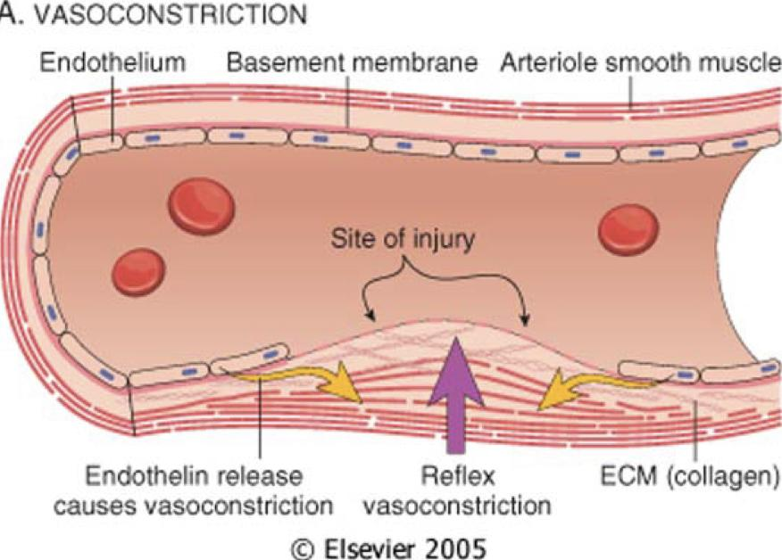
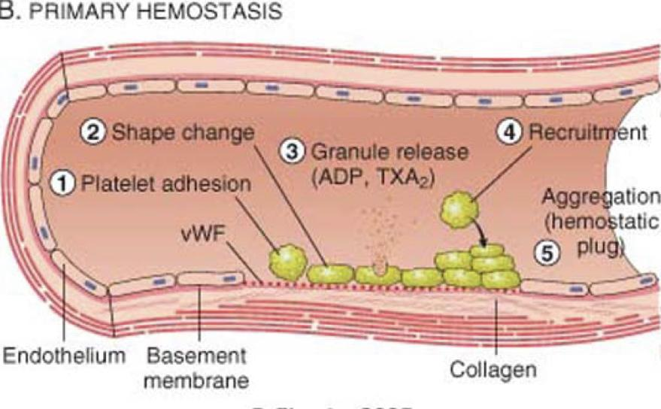
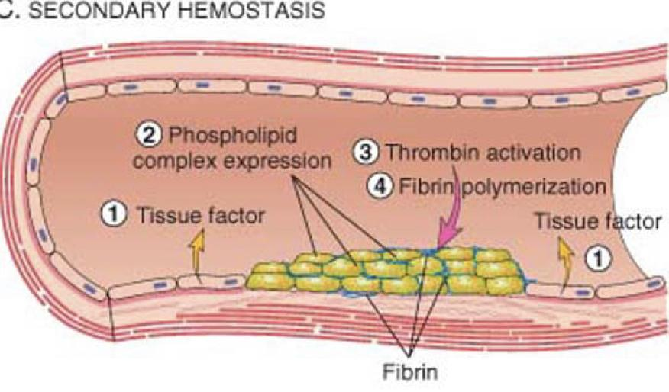
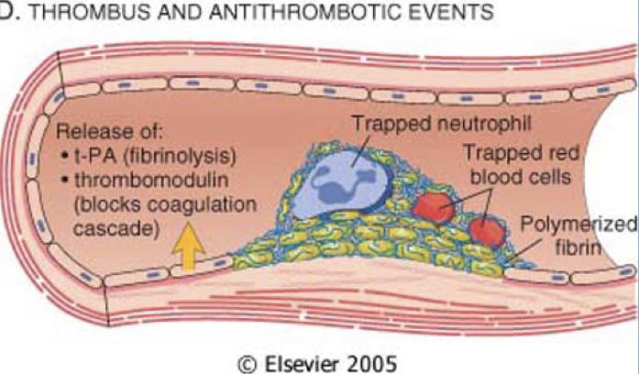
Hemostasis:
Male slides.
1-Vasoconstriction
After vascular injury, local neurohumoral factors induce a transient vasoconstriction.
2-Primary Hemostasis
Platelet adhere (via GpIB receptors) to exposed extracellular matrix (ECM) by binding to von Willebrand factor (vWF) and are activated, undergoing a shape change and granule release. Released adenosine diphosphate (ADP) and thromboxane A2 (TXA2) lead to further platelet aggregation (via binding of fibrinogen to platelet GpIlb-IIIa receptors), to form the primary hemostatic plug.
3-Secondary Hemostasis
Local activation of the coagulation cascade (involving tissue factor and platelet phospholipids) results in fibrin polymerization, “cementing” the platelets into a definitive secondary hemostatic plug.
4-Thrombus and Antithrombotic Events
Counter-regulatory mechanisms, such as release of t-PA )tissue plasminogen activator, a fibrinolytic product), and thrombomodulin (interfering with coagulation cascade), limit the hemostatic process to the site of injury.

Slide 5
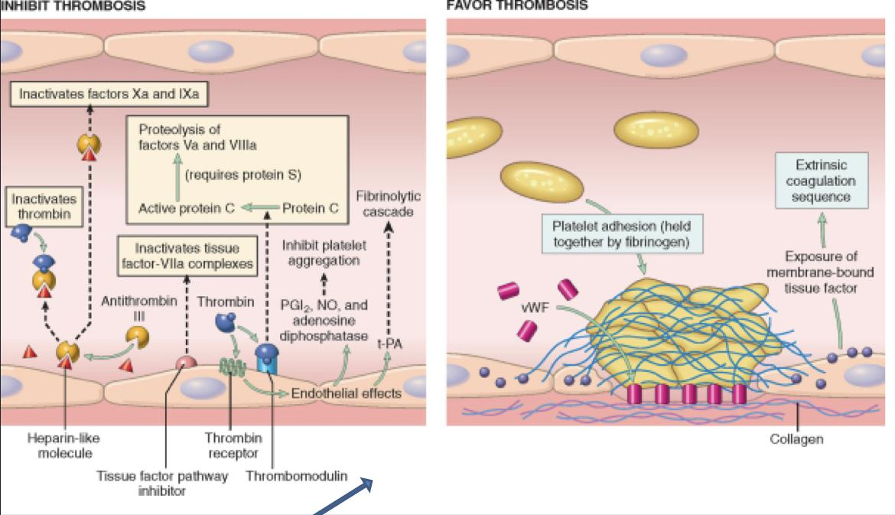
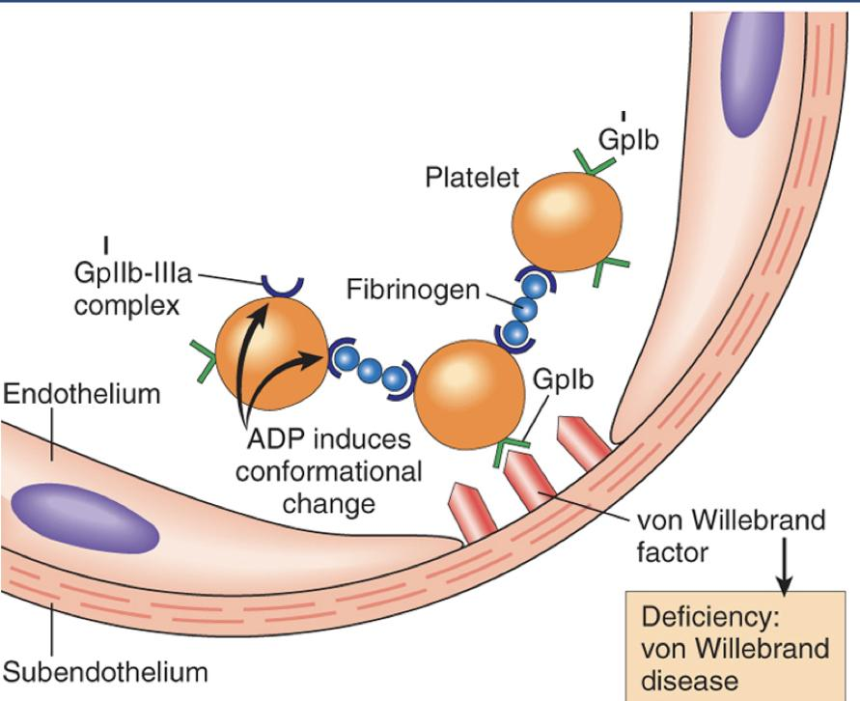
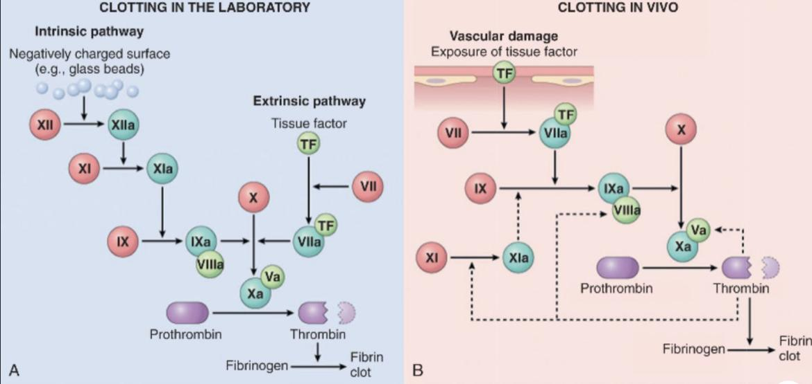
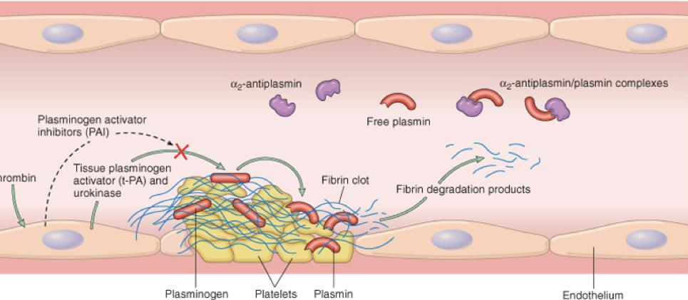
Hemostasis:
Male slides.
Additional reading: Anti- and procoagulant activities of endothelium. NO, nitric oxide; PGI2, prostacyclin; t-PA, tissue plasminogen activator; vWF, von Willebrand factor. The thrombin receptor is also called a protease-activated receptor (PAR)
Platelet adhesion and aggregation. Von Willebrand factor function as an adhesion bridge between subendothelial collagen and the glycoprotein Ib (GpIb) platelet receptor. Aggregation is accomplished by binding of fibrinogen to platelet GpIIb- IIIa receptors and bridging many platelets together. ADP, adenosine diphosphate.
The details of the diagram are additional reading: The classical coagulation cascade. Note the common link between the intrinsic and extrinsic pathways at the level of factor IX activation. Factors in red boxes represents inactive molecules; activated factors are indicated with a lower-case a and a green box. HMWK, high-molecular-weight kininogen. This reaction requires vitamin K as a cofactor.
The fibrinolytic system, illustrating various plasminogen activators and inhibitors, major players include t-PA.

Slide 6
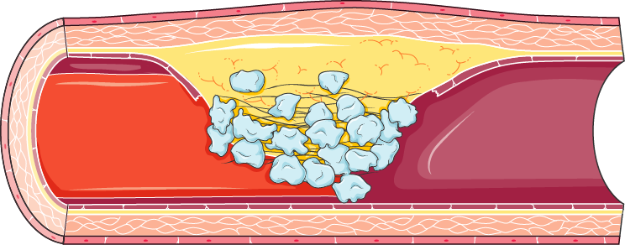
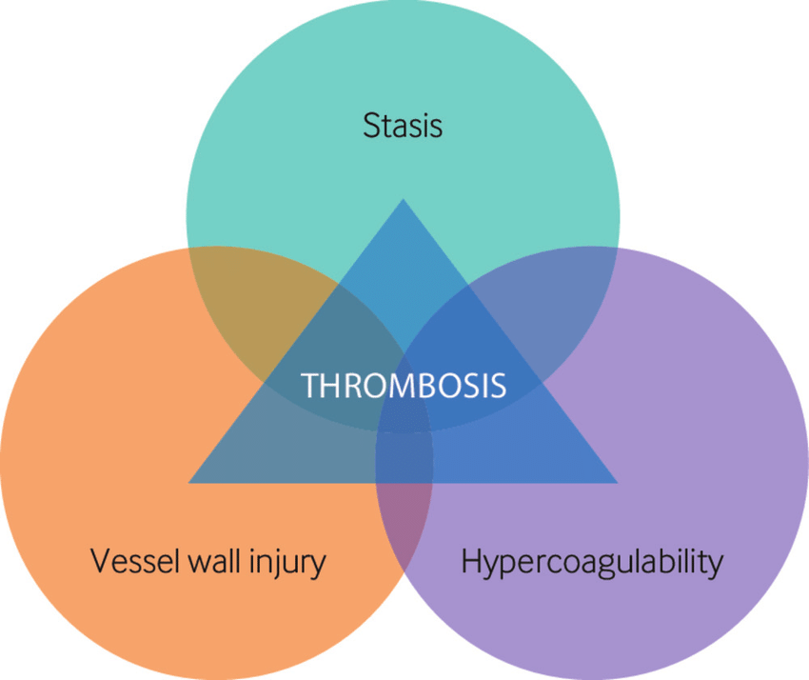
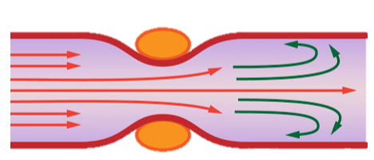
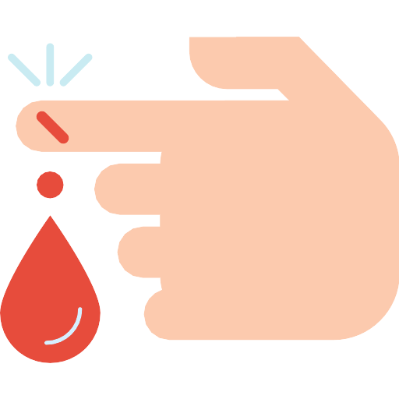
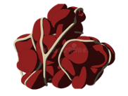
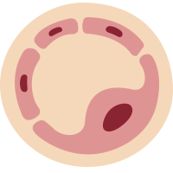
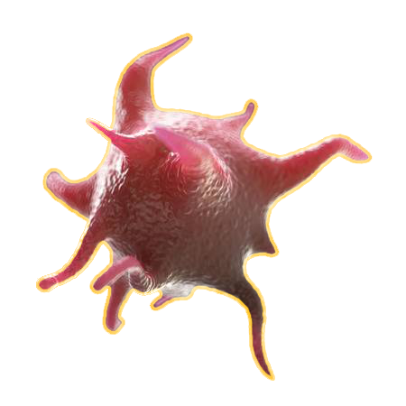
Definitiones:
Pathogenesis:
Thrombosis
It is a process by which a thrombus is formed. It represents hemostasis in the intact vascular system ( It is the pathological form of haemostasis.)
It is intravascular coagulation of blood and it often causes significant interruption to blood flow.
Thrombus
Is a solid mass (blood clot) made up of blood constituents which develops in artery or vein
Can only occur during life but clotting can occur after death or in test tube
*Many doctors don’t know the difference between clot and thrombus
Clot : Physiological
Thrombus : Pathological
Virchow triad
3 primary influences predisposes to thrombus formation
1- Endothelial injury.
2- Stasis or turbulence of blood flow.
3- Blood hypercoagulability
It results from interaction of platelets, damaged endothelial cells and the coagulation cascade. All 3 are components of the hemostatic process.
Component of the hemostatic process
Endothelial cell
Coagulation cascade
Integrity of endothelium is the most important factor.
Endothelial cells are resistant to the thrombogenic influence of platelets and coagulation proteins. Intact endothelial cells are thromboresistant.
Platelets
Is a major contributor to thrombosis. It is a series of enzymatic conversions, that end in the formation of thrombin. Thrombin then converts the soluble plasma protein fibrinogen into the insoluble protein fibrin. And fibrin is a constituent of the thrombus.
Maintain the integrity of the vascular endothelium and participate in endothelial repair through *PDGT. They form platelet plugs and promote the coagulation cascade through the platelet phospholipid complex (that provide an important surface for coagulation-protein activation)
The factors may act independently or may combine to promote thrombus formation
e.g. Injury to endothelial cells can also alter local blood flow and affect coagulability.
or abnormal blood flow (stasis or turbulence), in turn, can cause endothelial injury.
PDGF : Platelet-Derived Growth Factor

Slide 7
Virchow Triad:
Endothelial cell
Definition
Location
Importance
The endothelium is a single thick cell lining of endothelial cells and, it’s the inner lining of the entire cardiovascular system (arteries, veins, and capillaries) and the lymphatic system.
It’s in direct contact with the blood/lymph and the cells circulating in it.
Endothelial structural and functional integrity is fundamental to the maintenance of vessel wall homeostasis and normal circulatory function.
Endothelial Injury
Endothelial injury is a major cause of thrombosis in the heart or arteries.
Conditions lead to chronic subtle endothelial dysfunction/injury:
Note
Hypertension.
Scarred Valves.
Bacterial endotoxins.
Radiation
Hypercholesterolemia.
Cigarette smoking.
Turbulent blood flow
Homocysteinemia
Endothelial injury can contribute to thrombosis in several clinical setting, e.g.:
Endothelial injury due to myocardial infarction
Ulcerated plaquues in atherosclersotic arteries
Traumatic or inflammatory vascular injury
Exposure of subendothelial ECM i.e: the basement membrane.
Endothelial injury leads to:
Adhesion of platelets.
Release of tissue factor and ultimately thrombosis.

Slide 8
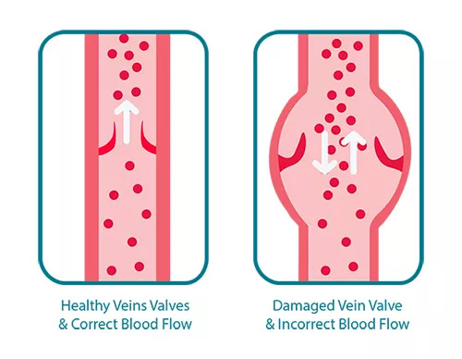
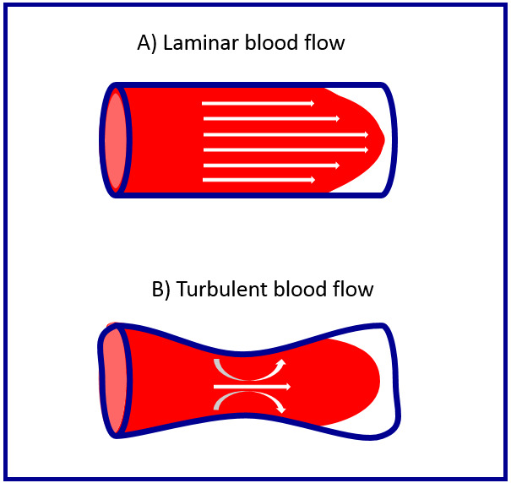
Virchow Triad:
Stasis or turbulence of blood flow
Definition
Abnormal blood flow: disruption of laminar blood flow can bring platelets into contacts with endothelium and promote endothelial cell activation.
1. Stasis: plays a major role in the development of venous thrombi.
Note
2. Turbulence: contributes to arterial and cardiac thrombosis by causing endothelial injury or dysfunction
Abnormal blood flow contributes to thrombosis in several clinical settings:
Ulcerated atherosclerotic plaques.
Abnormal aortic and arterial dilations.
Acute myocardial infarction.
Hyperviscosity syndromes.
Sickle cell anemia.
Blood Hypercoagulability
Definition
Any change of the coagulation pathways that predisposes to thrombosis.
Primary/Genetic:
Secondary/acquired states
High risk for thrombosis:
(e.g. mutation in factor V gene - factor V Leiden ) or prothrombin gene, anti-thrombin III deficiency, protein C or S deficiencies, or fibrinolysis defects.
Prolonged bed rest or immobilization.
Myocardial infarction, Atrial fibrillation.
Tissue damage (surgery, fracture, burns)
Cancer.
Prosthetic cardiac valves.
Disseminated intravascular coagulation.
Heparin-induced thrombocytopenia.
Antiphospholipid antibody syndrome (lupus anticoagulant syndrome).
Secondary/acquired states
Low risk for thrombosis:
Cardiomyopathy, Nephrotic syndrome, Hyperestrogenic states (pregnancy), Oral contraceptive use, Sickle cell anemia, Smoking.
Heparin is a blood thinner but on the complications it may ends making blood clot

Slide 9
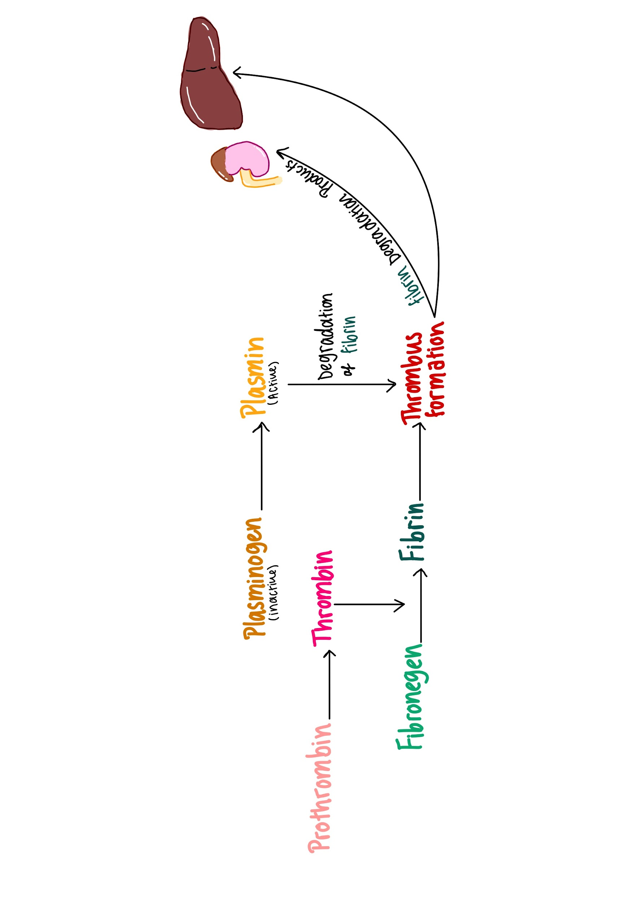
Fibrinolysis (thrombus dissolution):
Mechanism:
Definition
Activation of the clotting cascade induces coagulation. It also triggers the fibrinolytic cascade that limits the size of the final clot. It concurrently with thrombogenesis
Function
Fibrinolytic cascade helps dissolve the thrombus and therefore restores blood flow in vessels occluded by thrombus.
01
02
03
Conversion
Inactive proenzyme plasminogen
Active plasmin
Plasmin then splits the fibrin in the thrombus.
The thrombus is dissolved by plasmin

Slide 10
Thrombotic disorders:
1- Anti-thrombotic (hemorrhagic):
Disseminated Intravascular Coagulation
2- Prothrombotic:
Leading to pathological bleeding states, such as hemophilia, Christmas disease and Von Willebrand disease.
Leading to hypercoagulability with pathologic thrombosis, e.g. hereditary thrombophilia and antiphospholipid antibody syndrome.
Both prothrombotic and antithrombotic disorder characterized by widespread thrombosis and hemorrhage resulting from the consumption of platelets and coagulation factors.
 | Hereditary Thrombophilia | Antiphospholipid antibody syndrome
Definition | Is a prothrombotic familial syndrome. | Is a prothrombotic hypercoagulable autoimmune multisystem disorder caused by the presence of antiphospholipid antibodies.
Characteristic | Characterized by recurrent venous thrombosis and thromboembolism | Is characterized by recurrent thrombosis and embolism and fetal loss in pregnancy.
Others | Factor V leiden thrombophilia is genetically inherited prothrombotic disorder of blood. Factor V leiden is mutated from human factor V that causes an increase in blood clotting (hypercoagulability). Can be caused by deficiency of antithrombotic proteins, e.g. antithrombin 3, protein C, & protein S. | Patients have prolonged partial thromboplastin time (PTT). It is sometimes associated Systemic Lupus Erythematosus and so this antibody is also known as lupus anticoagulant.

Slide 11
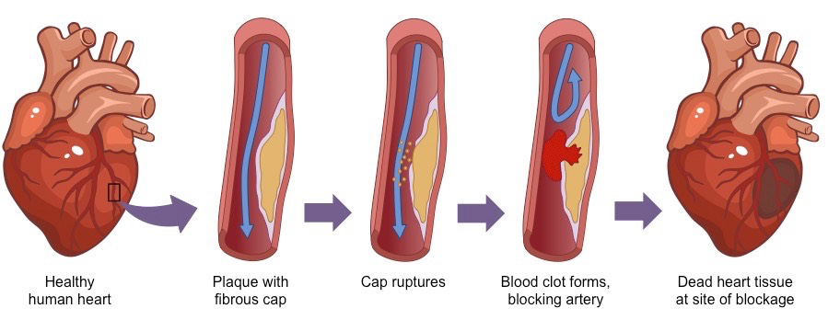
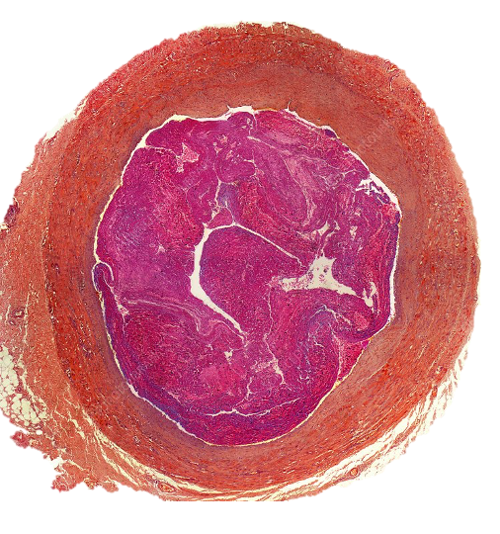
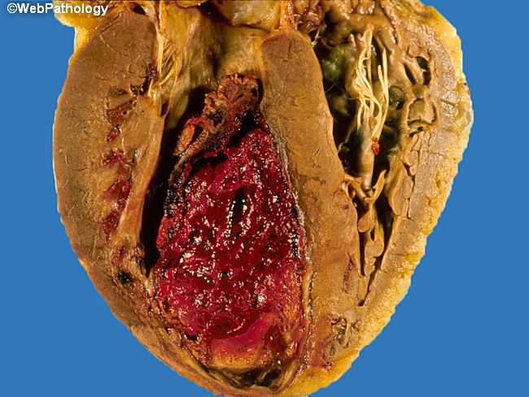
Morphology of thrombus:
1
Thrombi are focally attached to underlying vascular surface and may develop anywhere in the cardiovascular system, the cardiac chambers, valve cusps ( vegetations), arteries, or capillaries. They vary in size and shape, depending on the site of origin.
2
Arterial or cardiac thrombi usually begin at a site of endothelial injury (e.g., atherosclerotic plaque) or turbulence (vessel bifurcation). Venous thrombi characteristically occur in sites of stasis.
3
The propagating tail of either thrombi may not be well attached (particularly in veins) is prone to fragmentation, creating an embolus
4
Arterial thrombi grow in a retrograde direction from the point of attachment (i.e. toward the heart). Venous thrombi extend in the direction of blood flow (i.e. toward the heart).
Fibrin
Platelets
Red blood cell
Few inflammatory cells
5
A thrombus is made up of:
Mural Thrombus
Definition:
Cause:
Lines of Zahn:
When arterial thrombi arise in heart chambers or in large blood vessels such as the aortic lumen
Abnormal myocardial contraction or endomyocardial injury promotes cardiac mural thrombi.
Thrombi formed in the heart or aorta may have apparent laminations, called lines of Zahn seen grossly (and microscopically). Lines of Zahn are produced by alternating pale layers of platelets admixed with some fibrin and darker layers containing more red cells. Show antemortem thrombsosis
Looks like the wave rock in Arizona

Slide 12
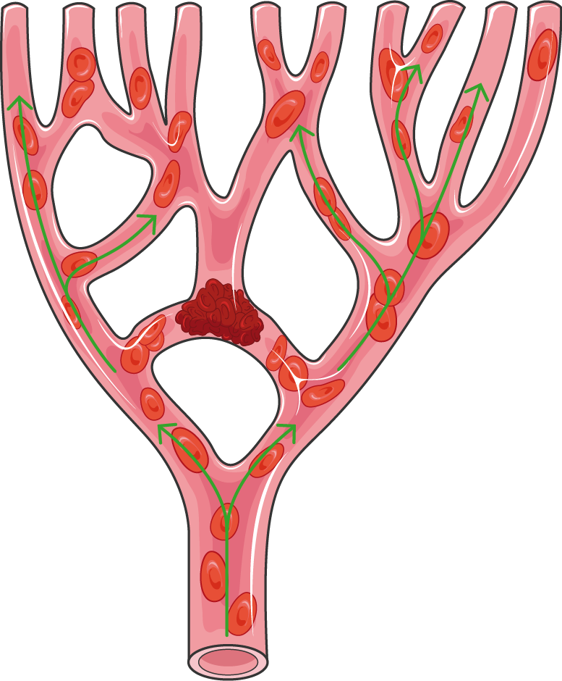
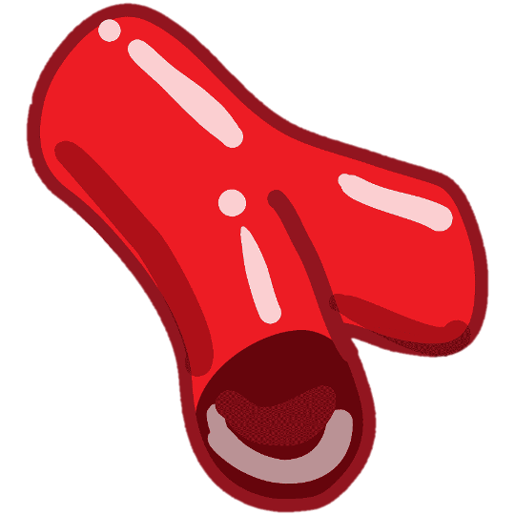
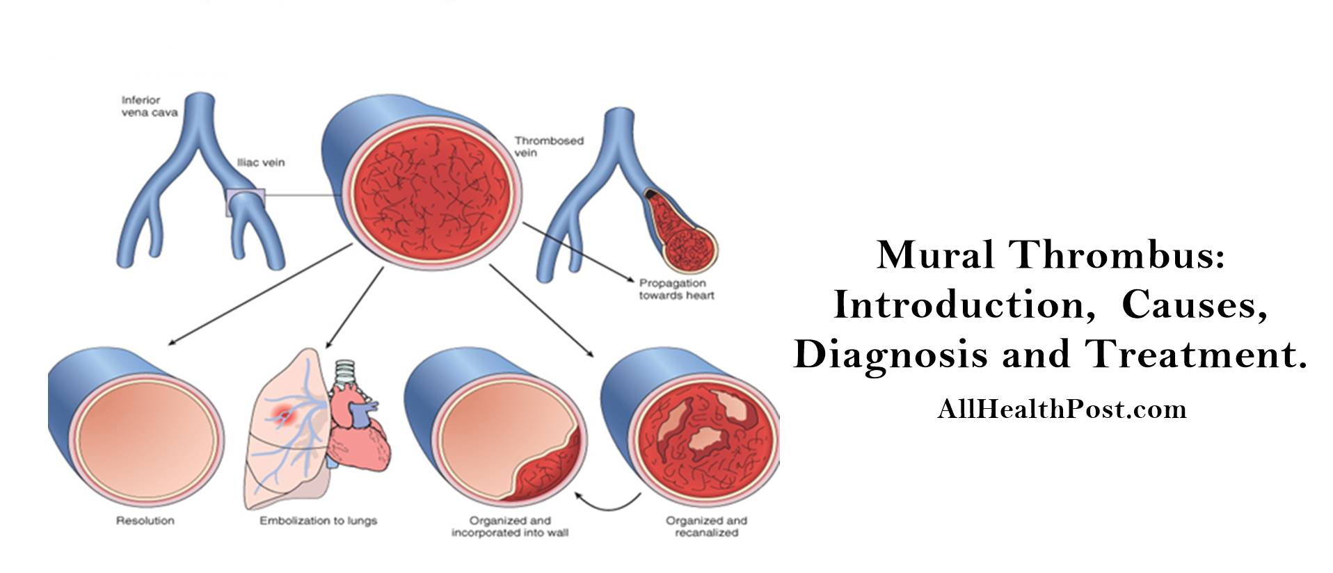
Clinical effects of thrombosis:
Fate of thrombus:
Thrombi are significant because
They cause obstruction of arteries and veins
1
2
they are potential sources of emboli.
Clinical effects depend on the site of thrombosis
Venous thrombi have capacity to embolize to the lungs and can cause death.
Arterial thrombi can cause vascular obstruction at critical sites and cause serious consequence, e.g. ischemia and necrosis.
Propagation
Organization and recanalization
111
Resolution
Embolism
Organization and
Incorporation into the wall
Resolution : removed
Propagation : clot grow in layers
Embolism : the clot carried with the blood
Organization : like fibrosis or granulation
Recanalization : fibrinolysis but not complete so the blood can go through the clot

Slide 13
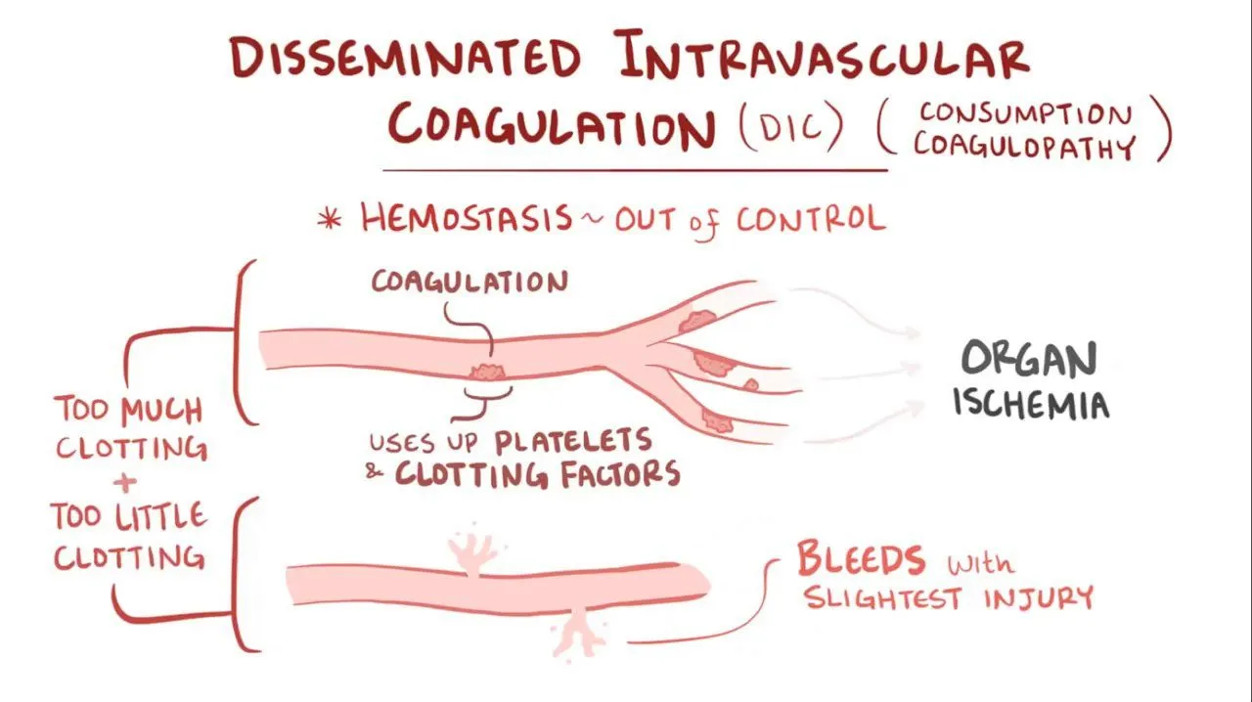
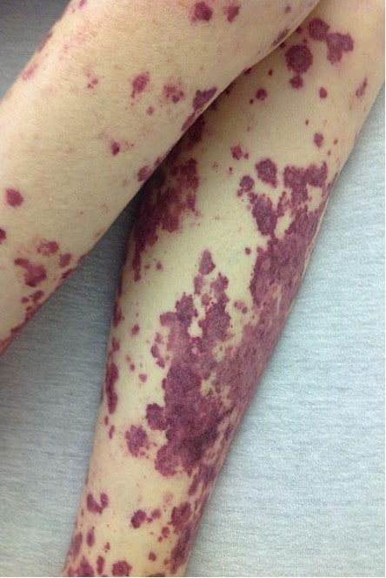
Important slide
Male slides
Disseminated Intravascular Coagulation (DIC)
Definition
Sudden or insidious onset of widespread fibrin thrombi and hemorrhage in the microcirculation.
Is both prothrombotic and antithrombotic disorder
Morphology
Although these thrombi are not grossly visible, they are readily apparent microscopically
Complications
- Can cause diffuse circulatory insufficiency,
particularly in the brain, lungs, heart, and kidneys.
- It can evolve into a bleeding catastrophe:
- platelet and coagulation protein consumption
(hence the synonym consumption coagulopathy)
- At the same time, fibrinolytic mechanisms are
activated
Classification
DIC is not a primary disease but rather a potential complication of any condition associated with widespread activation of thrombin.

Slide 14
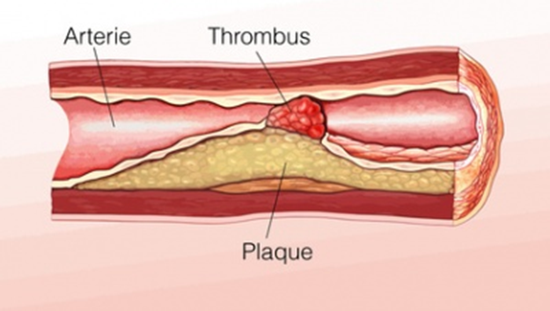
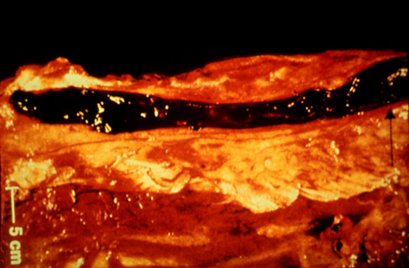
Types of Thrombi
Types And Characteristics | Arterial Thrombi | Venous Thrombi ‘phlebothrombosis’
Nature | Usually occlusive | Almost invariably occlusive, and often occurs at sites of stasis taking the shape of the vein
Setting | Usually superimposed on a ruptured atherosclerotic plaque, but other vascular injuries (vasculitis, trauma) may be the underlying cause. | These thrombi form in the relatively static venous circulation so they tend to contain more enmeshed RBCs (and relatively few platelets) therefore they are known as red, or stasis thrombi.
Most affected sites | Most common sites in descending order, are coronary, cerebral, and femoral arteries. | Veins of the lower extremities (90% of cases) - Upper extremities, periprostatic plexus, or the ovarian and periuterine veins can also be affected. - Under special circumstances, they can also occur in the dural sinuses, portal vein, or hepatic vein.
Gross appearance | Gray-white and friable | Red
Thrombi on heart valves ‘Vegetations’
Infective | Sterile
Infective endocarditis: bacterial or fungal blood-borne infections may result in the development of large thrombotic masses on heart valves. | Non-bacterial thrombotic endocarditis: Is non-infective vegetations on valves in Patients with: hypercoagulable states Subtle endothelial abnormalities Malignancy and other debilitating diseases Patients with systemic lupus erythematosus can have noninfective, verrucous (Libman-sacks) endocarditis.

Slide 15
Deep vein thrombosis (DVT) & Thrombophlebitis
Deep vein thrombosis
Definition | Venous thrombosis that arises in the deep veins of the legs. They occur with stasis or in hypercoagulable states. Often associated with inflammation and then it is termed thrombophlebitis.
Site | Common in deep the larger leg veins at or above the knee, (e.g. Popliteal, femoral, and iliac veins).
Clinical Features | DVTs can cause local pain and edema, venous obstructions from DVTs can be rapidly offset by collateral channels. But it can be asymptomatic in approximately 50% of affected individuals,and it will be recognized only in retrospect after embolization.
Complications
DVT
occurs
Embolize
Travels to the right side of the heart
Travels to the lungs
Pulmonary embolism

Slide 16
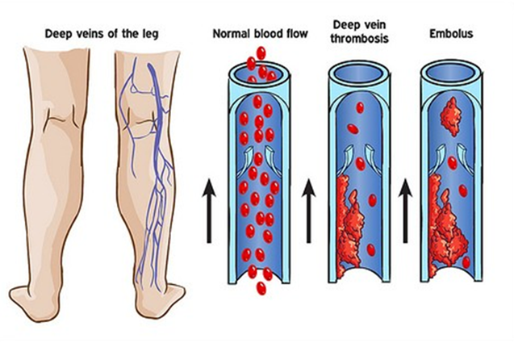
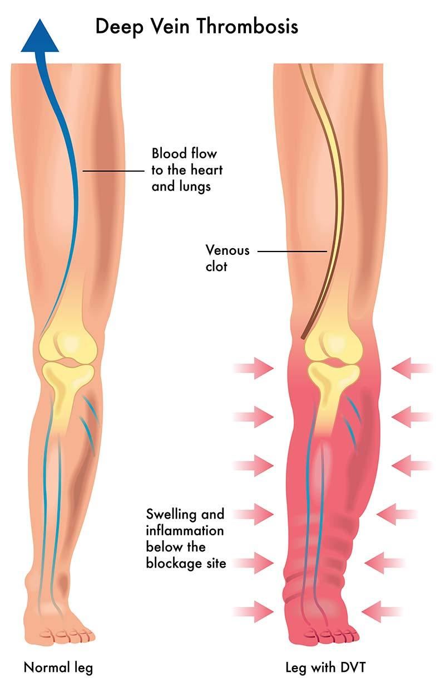
Predisposing factors for DVT
Bed rest and immobilization
Tumors
- associated inflammation and coagulation factors (tissue
factor, factor VIII)
- procoagulants (e.g., mucin) release
Trauma, surgery, and burns
(immobilize and are also associated with vascular insults, procoagulant release from injured tissues, increased hepatic synthesis of coagulation factors, and altered t-PA production)
Advanced age (Regardless of the specific clinical setting)
Congestive heart failure
Causes impaired venous return.
Pregnancy
The potential for amniotic fluid infusion into the circulation at the time of delivery can cause thrombogenesis.
late pregnancy and the postpartum period are also associated with systemic hypercoagulability.

Slide 17
Postmortem clots may be confused with venous thrombi
Differences | Postmortem clot | Venous Thrombus
Feel | Gelatinous | Firm
Morphology | Has dark red dependent portion where red cells have settled by gravity and a top layer of yellow “chicken fat”. | Sectioning typically reveals gross and/or microscopic lines of Zahn.
Attachment | Not attached to the underlying wall | Almost always has a point of attachment.
Embolism
Definition
An embolus (pleural: emboli) is a detached intravascular solid, liquid, or gaseous mass that is carried by the blood to a site distant from its point of origin
Majority of the emboli represent some part of a dislodged thrombus,
hence the commonly used term thromboembolism
If the emboli is lodged in vessels too small to permit further passage, it results in partial or complete vascular occlusion leading to ischemic
necrosis of distal tissue (infarction)
Depending on the site of origin, emboli may lodge in the pulmonary
or systemic circulations

Slide 18
Types of Embolism
Pulmonary Embolism | Site of lodging & Occlusion | In the pulmonary vasculature - Depending on the size: occlude main pulmonary artery, or impact across the bifurcation (saddle embolus) or pass out into smaller, branching arterioles of the pulmonary circulation. - Paradoxical embolism: embolus may pass through interatrial or interventricular defect to gain access to the systemic circulation.
 | Complications | - Frequently multiple emboli (perhaps sequentially, or as a shower of smaller emboli from a single large thrombus). - In general, the patient who has had one pulmonary embolus is at high risk of having more. - Most (60-80%) are clinically silent because they are small. - When more than 60% of the pulmonary circulation is obstructed by emboli. Sudden death, infarction, right heart failure (cor pulmonale) occurs and cardiovascular collapse. - Embolic obstruction of medium-sized arteries can cause pulmonary hemorrhage but usually not pulmonary infarction: - the lung has a dual blood supply and the intact bronchial arterial circulation continues to supply blood to the area. - Embolic obstruction of small end-arteriolar pulmonary branches usually does result in associated infarction
 | Origin & Pathway | - In more than 95% of cases, venous emboli originate from deep leg vein thrombi above the level of the knee through progressively larger channels and pass through the right side of the heart entering the pulmonary vasculature.
Systemic Thrombo- embolism | Site of lodging & Occlusion | - In the arterial circulation - Major sites are the lower extremities (75%) and the brain (10%). - Most arise from an intracardiac mural thrombi (80%). - 2/3 of which are associated with Lt ventricular wall infarcts. - 1/4 with dilated left atria (e.g. secondary to mitral valve disease). - The remainder originates from: - Aortic aneurysms - Thrombi on ulcerated atherosclerotic plaques - Fragmentation of valvular vegetations
 | Complications | - Consequences depend on the extent of collateral vascular supply in the affected tissue, the tissue’s vulnerability to ischemia, and the caliber of the vessel occluded. - Causes infarction of tissues supplied by the artery.

Slide 19
Fat Embolism | Site of lodging & Occlusion | - Microscopic fat globules may be found in the circulation after fractures of long bones (which have fatty marrow) or, rarely in soft tissue trauma and burns. - Fat is released by marrow or adipose tissue injury and enters the circulation through rupture of the blood vessels and act as embolus..
 | Complications | - Although fat and marrow embolism occurs in some 90% of individuals with severe skeletal injuries, fewer than 10% of such patients show any clinical findings. - Fat embolism syndrome is characterized by pulmonary insufficiency, neurologic symptoms, anemia, and thrombocytopenia.
Amniotic Embolism | Site of lodging, Occlusion & Characteristics | - Uncommon and grave complication of labor and the immediate postpartum period. - Caused by infusion of amniotic fluid or fetal tissue into the maternal circulation via a tear in the placental membranes or rupture of uterine veins. - Microscopy: presence in the pulmonary microcirculation of squamous cells shed from fetal skin, fetal hair, fetal fat,etc. - Characterized by sudden severe dyspnea, cyanosis, and hypotensive shock, followed by seizures and coma. - Marked pulmonary edema and diffuse alveolar damage are also present. Systemic fibrin thrombi indicative of DIC can also be seen.
 | Complications | - If the patient survives the initial crisis, pulmonary edema develops, along with disseminated intravascular coagulation, owing to release thrombogenic substances from amniotic fluid.
Air Embolism | Site of lodging & Occlusion | - Gas bubbles within the circulation can obstruct vascular flow (and cause distal ischemic injury) acting as thrombotic masses. - Bubbles may coalesce to form frothy masses sufficiently large to occlude major vessels. - Air may enter the circulation during obstetric procedures or as a consequence of chest wall injury.
 | Complications | - An excess of 100 cc (ml) is required to have a clinical effect. E.g. : Decompression sickness.
Rare forms of emboli include:
- Fat droplets - Bubbles of air or nitrogen - Foreign bodies (e.g. bullets)
- Atherosclerotic debris (cholesterol emboli) - Tumor fragments - Bits of bone marrow

Slide 20
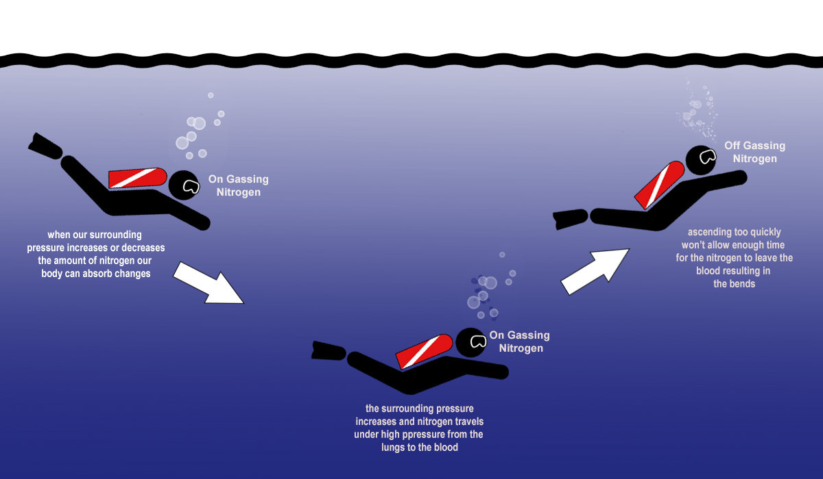
Decompression sickness
Causes
When air is breathed at high pressure (e.g., during a deep-sea dive) increased
amounts of gas (particularly nitrogen) become dissolved in the blood and tissues.
If the diver then ascends (depressurizes) too rapidly the nitrogen expands in the
tissues and bubbles out of solution in the blood which leads to gas emboli.
Complications & Symptoms
- can induce focal ischemia in a number of tissues:
- brain and heart
- skeletal muscles, causing pain (the bends)
- In the lungs, respiratory distress, (the chokes)
Treatment
Placing the individuals in a compression chamber where the
barometric pressure may be raised, thus forcing the gas bubbles
back into solution followed by subsequent slow decompression
A more chronic form of decompression sickness is called caisson disease in which, persistence of gas emboli in the skeletal system leads to multiple foci of ischemic necrosis; the more common sites are the heads of the femurs, tibia, and humeri.

Slide 21
MCQ:
Check out 442 Quizlet bank
1- In thrombus, the dark lines of zahn are due to:
A- Coagulated fibrin. | B- Aggregated proteins. | C- Aggregated platelets. | D- Aggregated RBCs
2- The major factors predisposing to thrombogenesis include all of the following except:
A- Arterial blood flow. | B- Pattern of blood flow. | C- Hypercoagulability. | D- Endothelial injury.
3- Thrombosis due to Hypercoagulability is seen in:
A- Severe trauma or burns. | B- Cardiac failure. | C- Women taking oral contraceptive. | D- All of the above.
4- An autopsy of a 30 year-old female Had a firm, red blood clot that showed lines of Zahn. What type of clot was it?
A- Arterial thrombus | B- Venous thrombus | C- Postmortem clot | D- Vegetation
5- A 75 year-old man had a catheterization performed on an artery in his left leg because of a an embolism that had risen from a mural thrombus, what type of embolus is it?
A- Pulmonary embolus | B- Systemic thromboembolus | C- Fat embolus | D- Air embolus
6- A 25 year-old man was diagnosed with decompression sickness, what chronic complication will you be looking out for?
A- Fat embolus | B- Arterial thrombus | C- Crohn’s disease | D- Caisson disease
1.D, 2.A, 3.D, 4.B, 5.B, 6. D

Slide 22
Team leaders:
Dema
Alkhattabi
Raneem Alwatban
Ibrahim
Alhezam
Sub-leader:
Hassan Alabdullatif
Team members:
Norah
Alrashoud
Maram
Beyari
Omar
Alkadhi
Farah
Alenezi
Manar
Alzahrani
Othman Alabdullah
Hoor
Aloraini
Nawaf
Alrefaei
Rakan
Alromayan
Mayssar Alshobaki
Saad
Alahmari
Osama
alburaih
Nouf
Aldhalaan
Emad
Almutairi
Abdulaziz
Alymni

