Slide 1
Vasculitis
Editing File

Slide 2
At the end of this lecture, the student should know the common causes of vasculitis with special emphasis on the clinic-pathological features and mechanism of:
Vasculitis
Giant cell arteritis
Polyarteritis nodosa
Wegener’s granulomatosis
Cutaneous hypersensitivity vasculitis
Thromboangiitis obliterans (Burger’s disease)

Slide 3
Introduction: Vasculitis
Definition
Definition
Definition
Vasculitis
It is a general term for inﬂammation of vessel walls/vascular inflammatory injury of arteries (more common) and veins, has many possible symptoms (depending on the vessel it’s affecting) and often with necrosis.
Causes of vasculitis
Immune-mediated
(Most common)
Invasion of vascular walls by:
Main immunological mechanisms:
● Immune complex deposition
● Antineutrophil cytoplasmic antibodies (ANCAs) (antibodies against cytoplasmic neutrophils)
● Anti-endothelial cell antibodies
● Autoreactive T cells
Infectious pathogens
Physical or chemical injury

Slide 4
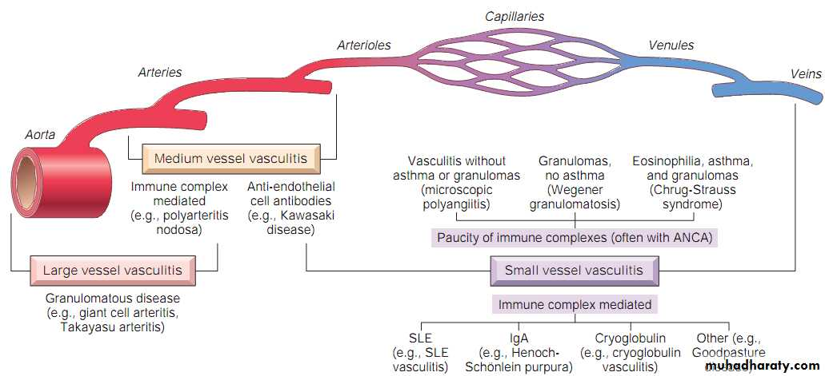
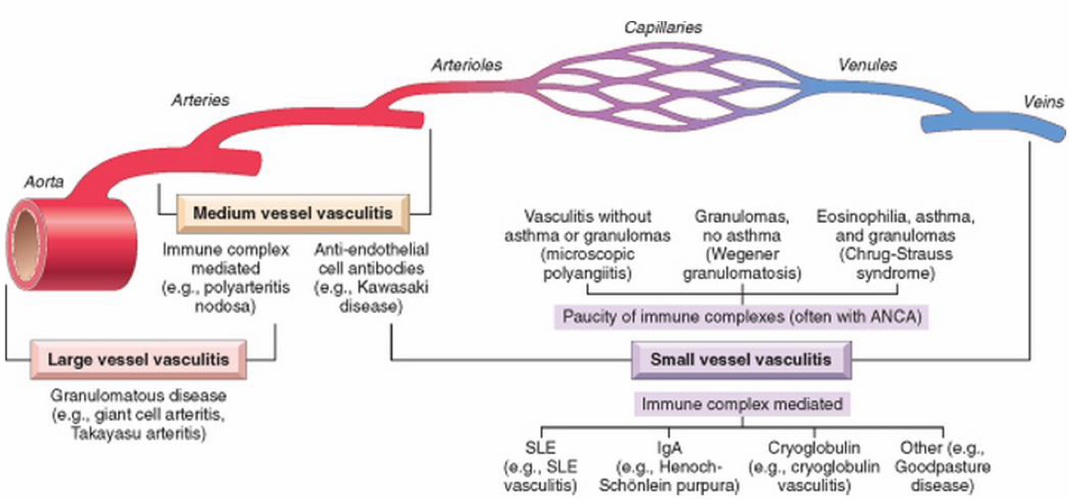
Overview: Types of vasculitis
They are classified according to the size of the affected vessel.
Vessel | Disease |  | Notes
Large | Giant-cell arteritis |  | >50. Arteries of head.
 | Takayasu arteritis |  | F <40. “Pulseless disease”
Medium | Polyarteritis nodosa |  | Young adults. Widespread.
 | Kawasaki disease |  | <4. Coronary disease. Lymph nodes.
Small | Wagener’s granulomatosis |  | Lung, kidney. c-ANCA.
 | Churg-Strauss syndrome |  | Lung. Eosinophils. Asthma. p-ANCA.
 | Microscopic polyangiitis |  | Lung, kidney. p-ANCA.
 | Cutaneous leukocytoclastic vasculitis |  | Idiopathic, infectious, drugs, chemicals, cancer and systemic disease like HNP.

Slide 5
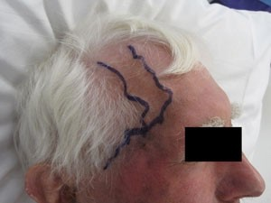
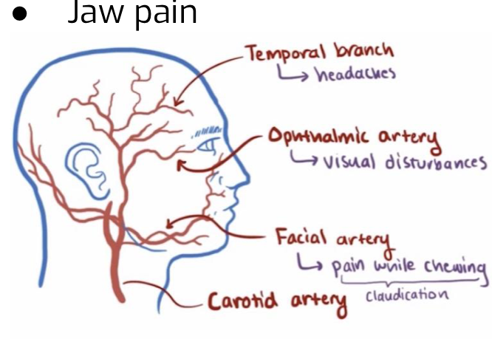
Giant-cell (temporal) arteritis
Definition
Chronic, granulomatous inflammation with giant cell of large to medium/small-sized arteries, especially the branches of the carotid artery in the head (branches of the ophthalmic artery & principally affects temporal artery), rarely the aorta (giant-cell aortitis). The involvement is segmental, acute, & chronic..
Epidemiology
Most common type of vasculitis
Unknown cause, But it is probably an autoimmune condition. T cell-mediated
Above 50 years old
More common in females (F:M, 2:1)
Symptoms
(Clinical features)
Fever.
● Facial pain or headache, often most intense along the course of the superﬁcial temporal artery. which is painful to palpation. Temporal artery is the most effected
● Visual problems and acute vision loss (blindness ) (due to ophthalmic artery involving )
● Thickened and painful temporal artery.
Jaw pain.
Vague symptoms:
– Fever, fatigue and weight loss

Slide 6
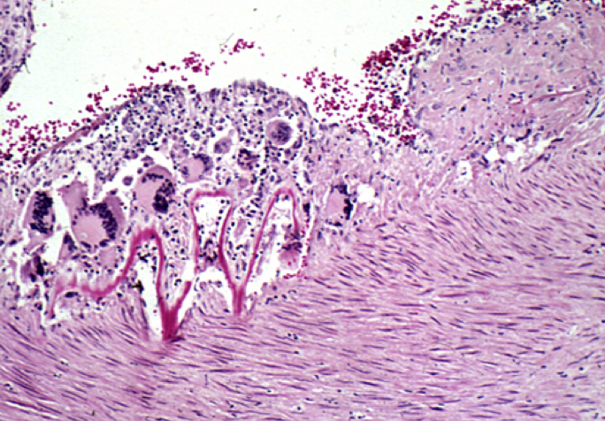
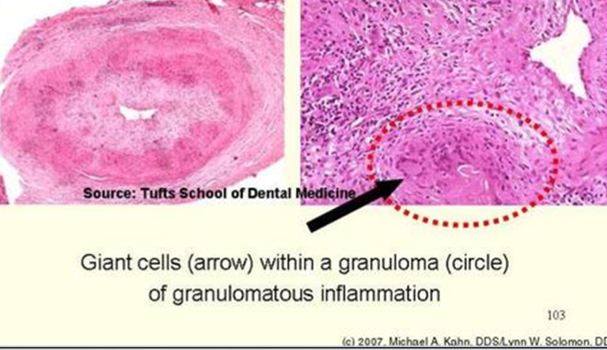
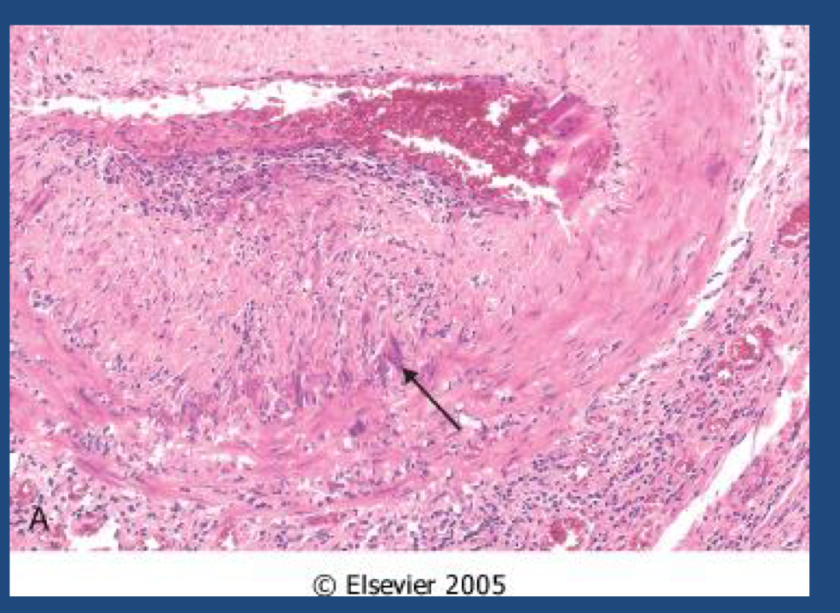
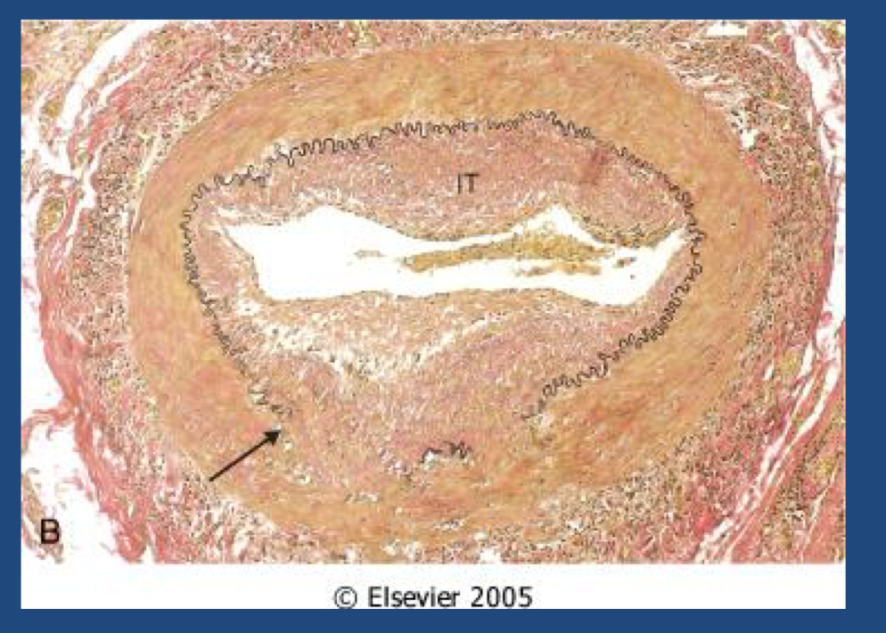
Giant-cell (temporal) arteritis
Diagnosis & Treatment
439 note: Clinical index of suspicion that leads to obtaining a biopsy from affected area. As its segmental sometimes biopsies are negative since not the whole vessel is diseased.
● The diagnosis depends on biopsy of an adequate segment (from the temporal artery) and histologic conﬁrmation.
● Treatment - corticosteroids (weakens immune response).
Morphology
● Granulomatous inﬂammation of the blood vessel wall.
● Giant cells. Necrotizing granuloma
● Disruption and fragmentation of internal elastic lamina.
● Proliferation of the intima with associated occlusion
of the lumen.
● The healed stage reveals collagenous thickening of the vessel wall and the artery is transformed into a ﬁbrous cord.
Remember! Everything heal with fibrosis

Slide 7
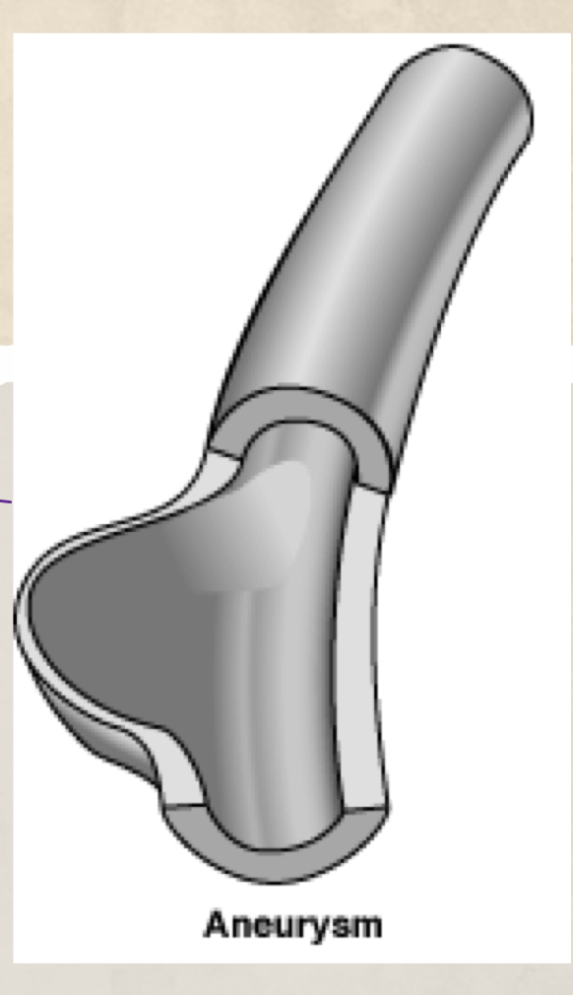
Polyarteritis nodosa (PAN)
Definition
Segmental (nodosa= nodes) necrotizing (fibrinoid necrosis)inﬂammation of arteries of medium to small size, but not arterioles, capillaries, or venules could involve any organ (renal and visceral vessels) except the lungs (pulmonary circulation).(We don’t know why)
Epidemiology
It’s a disease of young adults.
Characteristics
Most frequently kidneys (most common, so renal manifestations are seen), heart, liver, and gastrointestinal tract.
Renal arterial involvement is often prominent and is a major cause of death.
PAN been associated with hepatitis B or hepatitis C virus infection. Some 30% of patients with PAN have hepatitis B antigenemia. The immune cells attack the endothelium rather than hepatitis B and causing transmural inﬂammation (all 3 layers of vessel are affected ). 439 note
Weakening of the arterial wall due to the inﬂammatory process may cause aneurysmal(انبعاج) dilation or localized rupture.
● Particularly characteristic of PAN is that all
the different stages of activity ( i.e. active (acute). and chronic stages) may coexist in same artery or in different artery at the same time.
No association with ANCA (antineutrophil cytoplasmic antibodies)
Typically episodic, with long symptom-free intervals
Because the vascular involvement is widely scattered, the clinical findings
may be varied and puzzling.

Slide 8
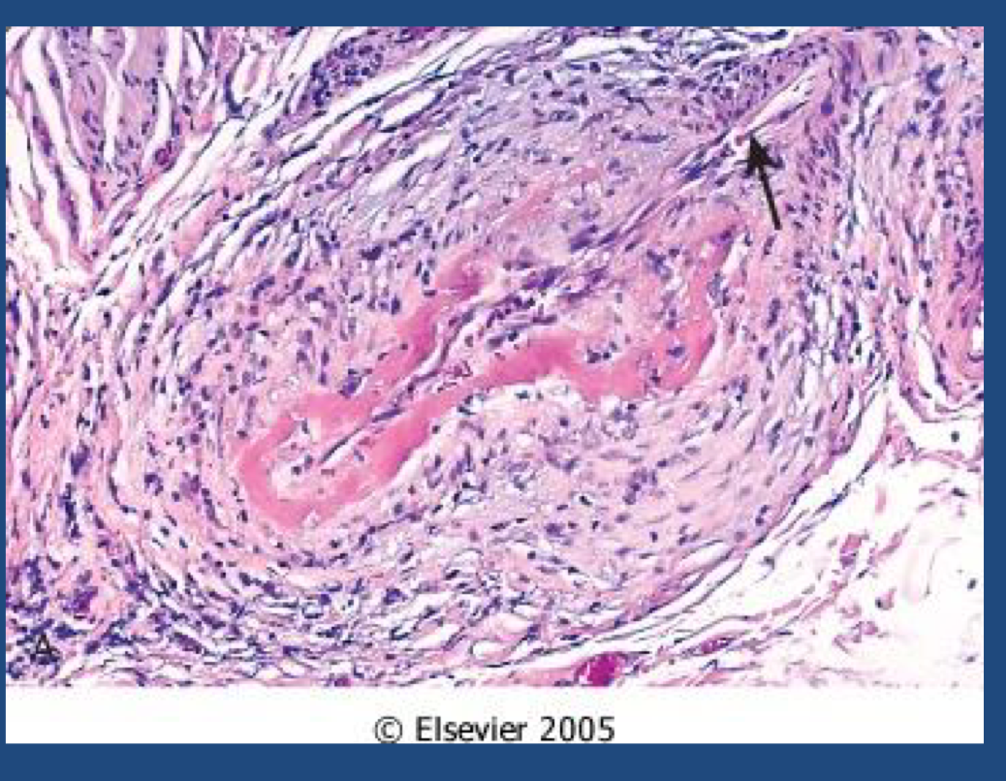
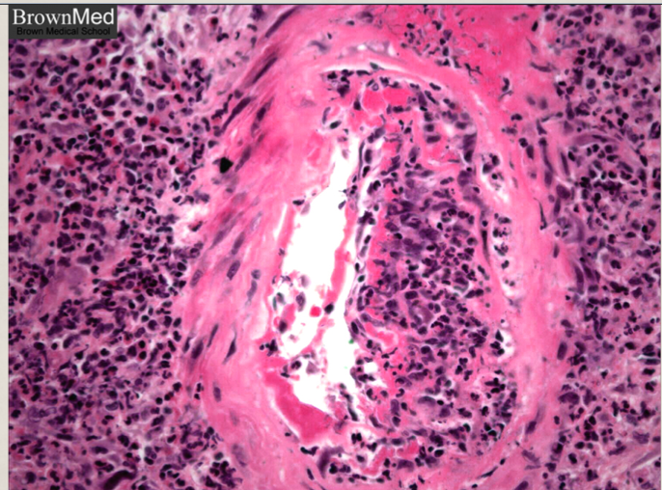
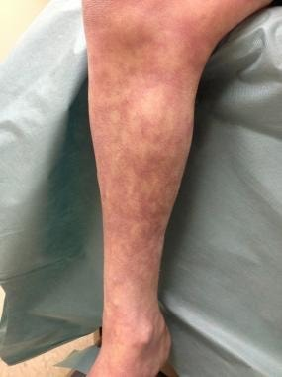
Polyarteritis nodosa (PAN)
Diagnossis & Treatment
Biopsy is often necessary to confirm the diagnosis
Fatal if untreated, but steroids, cyclophosphamide and other immunosuppressive therapy results in remissions or cures in 90%.
Complications
Vessel rupture
Impaired perfusion:
Ulcerations
Infarcts
Ischemic atrophy (not infarction)(If it is chronic).
Haemorrhages in the distribution of affected vessels may be the first sign of disease.
Morphology
Polyarteritis nodosa with segmental inﬂammation and ﬁbrinoid necrosis and occlusion of the lumen of this artery. Note that part of the vessel wall at the left side is uninvolved.
Symptoms
(Clinical features)
Manifestations are due to ischemia and infarction of the affected tissue/organ:
● Fever
● Weight loss
● Abdominal pain
● Melena (bloody stool)
● Diffuse muscular pain
● Peripheral neuritis
Hypertension, usually developing rapidly.

Slide 9
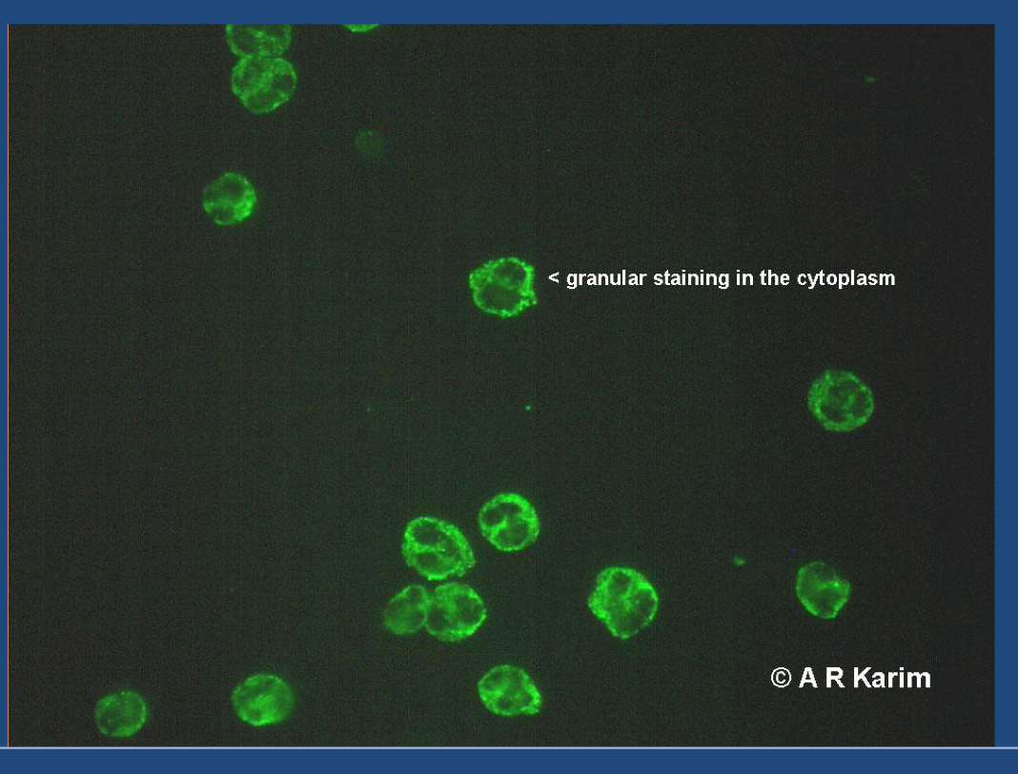
Antineutrophil cytoplasmic antibodies (ANCA)
(Male slide)
Girls don’t skip!
Typical of Wagener granulomatosis
The most common target antigen is proteinase-3 (PR3)
Cytoplasmic localization (C-ANCA)
Microscopic polyangiitis and churg-Strauss syndrome
Perinuclear localization (P-ANCA)
Most of the autoantibodies are specific for myeloperoxidase (MPO)
ANCAs serve as useful diagnostic markers for the ANCA-associated vasculitides.
Their levels can reflect the degree of inflammatory activity.
C-ANCA
P-ANCA

Slide 10
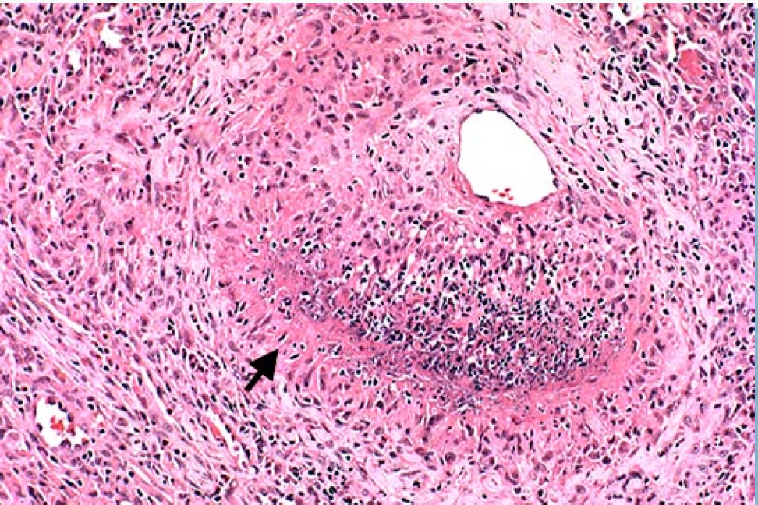
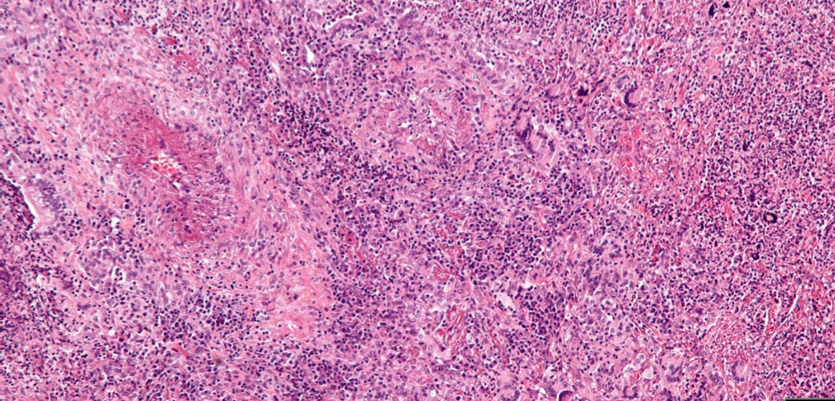
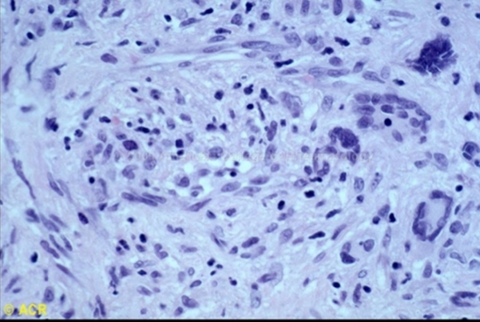
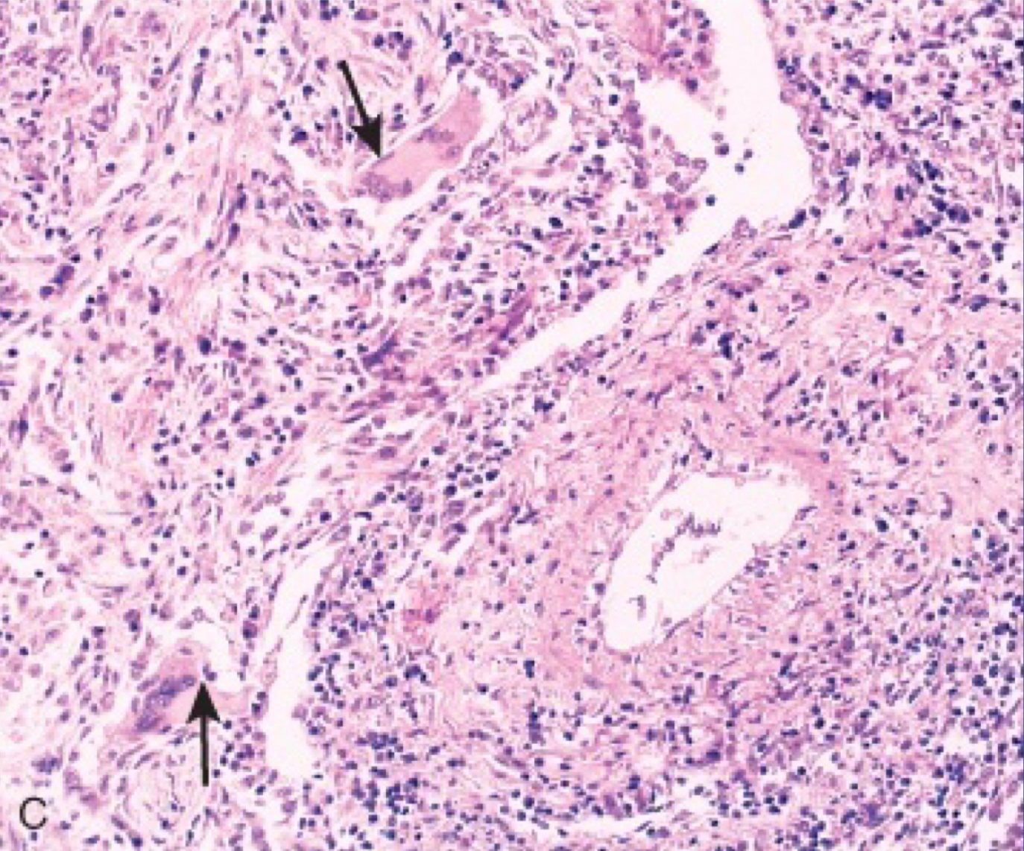
Granulomatosis with. Polyangiitis
(Wegener granulomatosis)
Definition | is a type of necrotizing vasculitis
Characteristics | characterized by the triad of 1) Acute necrotizing granulomas of the upper and lower respiratory tract (lung), or both 2) necrotizing or granulomatous vasculitis of small to medium- sized vessels (most prominent in the lungs and upper airways) 3) renal disease in the form of focal necrotizing, often crescentic, glomerulonephritis/glomerulitis
Epidemiology | Males are affected more often than females, at an average age of about 40-50 years
Symptoms | Persistent pneumonitis , chronic sinusitis , mucosal ulcerations of the nasopharynx ,and evidence of renal disease.
Diagnosis | C-ANCAs (antineutrophilic cytoplasmic antibodies) is positive in serum of more than 95% of patients.
Prognosis | Without Rx -> 80% die With Rx -> 90% live (not cured) The Rx -> immunosuppression Untreated: fatal - may lead to death within 2 years if not treated.
Morphology

Slide 11
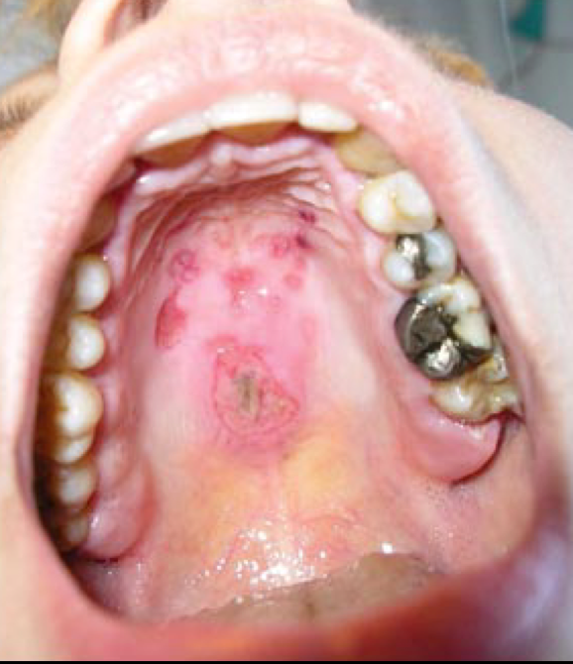
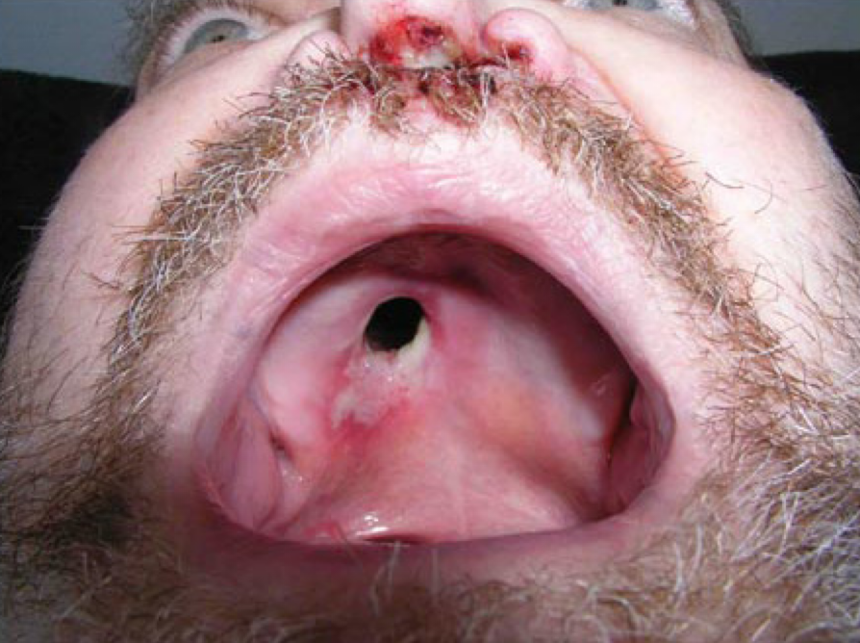
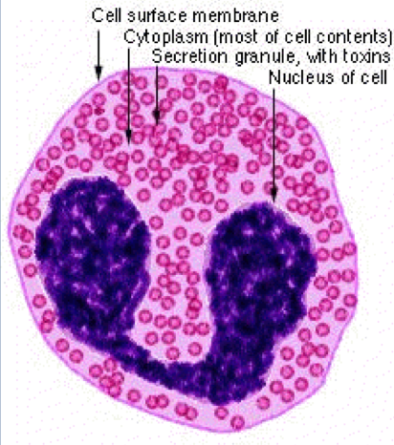
Churg-Strauss syndrome (additional reading)
Females’ doctor said: I will never ask you about this
Pathology team advises you to study it
Granulomatosis with. Polyangiitis
(Wegener granulomatosis)
Wegener granulomatosis: palatal destruction(Because of ischemia that will lead to tissue death)
Definition
Eosinophil-rich and granulomatous inflammation involving the respiratory tract and necrotizing vasculitis affecting small vessels
Associated with
p-ANCAs.
Associated with asthma and blood eosinophilia
Clinical features

Slide 12
Cutaneous leukocytoclastic (hypersensitivity vasculitis/ angiitis)
Females’ slides only
Skin
WBC’s
Breaking down
Definition | Necrotizing vasculitis of arterioles, capillaries, venules. It is inflammation of small blood vessels Leukocytoclasis refers to the nuclear debris of infiltrating neutrophils in and around the vessels.
Characteristics | It is the most common vasculitis seen in clinical practice. commonly seen in the dermis of skin characterized by palpable purpura. .All lesions tend to be of the same age. (All are acute or all are chronic) It affects many organs e.g. skin (most common), mucous membranes, lungs , brain, heart, GI , kidneys and muscle.
Etiology | Idiopathic Immunologic reaction to an antigen that may present as: Drugs e.g. penicillin Infectious microrganisms e.g. strept. and other infections, heterologous proteins, food products and toxic chemicals tumor antigens in various cancers. It may be a part of a systemic diseases e.g: Collagen vascular diseases (lupus erythematosus, rheumatoid arthritis) Henoch-Schonlein purpura

Slide 13
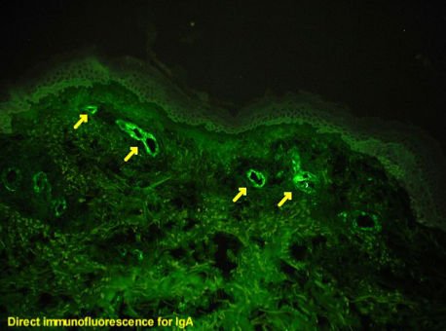
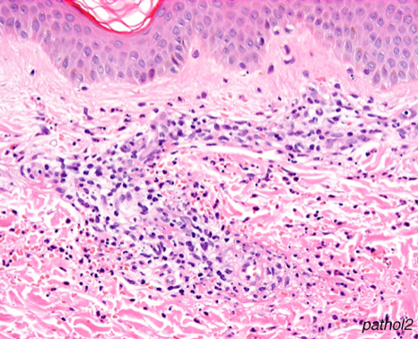
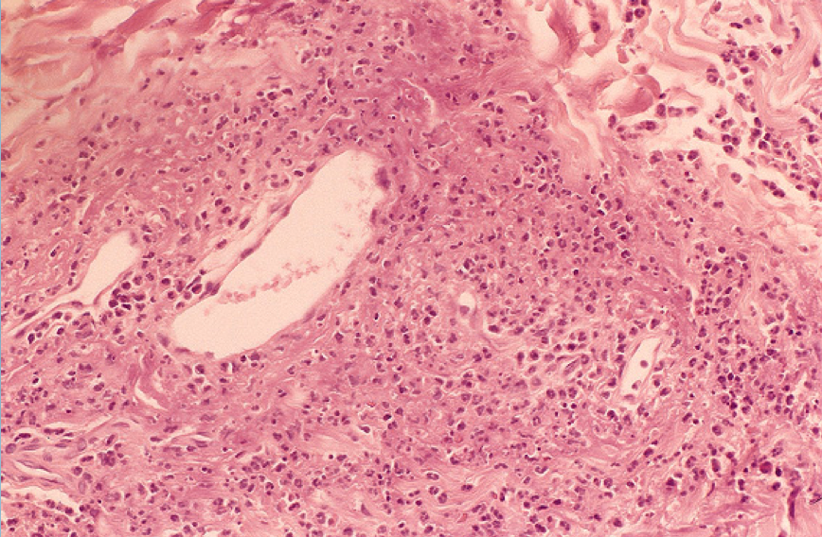
Henoch-Schonlein purpura (HSP)
( females’ doctor said everything in this slide is imp.)
Females’ slides only
Definition | HSP is an IgA-mediated, autoimmune systemic disease in which the small vessels show leukocytoclastic vasculitis.
Etiology | The etiology remains unknown.
Characteristics | Serum levels of IgA are high in HSP Skin biopsy will show necrotizing leukocytoclastic vasculitis of capillaries in the dermis. The immunofluorescence shows IgA immunoglobulin deposition in the wall the affected capillaries.
will show deposits of IGA immunoglobulin in the wall the capillaries in Henoch-Schonlein purpura (HSP) .
Microscopically
Investigations
(Skin biopsy is often diagnostic.)
Direct immunofluoroscence
Histologically there is infiltration of vessel wall with neutrophils, which become fragmented called as leukocytoclasia or nuclear dust.
Leukocytoclastic vasculitis in a skin biopsy showing fragmentation of neutrophil nuclei in and around vessel walls.

Slide 14
Thromboangiitis obliterans (Buerger disease)
Definition | Buerger disease is a condition that occurs almost exclusively in heavy smokers of cigarettes.
Characteristics | It is characterized by segmental, thrombosing, Focal sharply segmental acute and chronic inflammation of medium-sized and small arteries, principally of the leg and hands (tibial and radial arteries, associated with thrombosis) with secondary extension into adjacent veins and nerves.
Etiology and epidemiology | Unknown eitology Patients are usually under 35 years of age. Tobacco either leads to direct toxicity to endothelium, or induces an immune response Almost exclusively in heavy tobacco smokers.
Clinical features | pain in the affected hand or foot induced by exercise (called instep claudication) Patients can have pain even at rest, due to the neural involvement. Chronic ulcerations of the toes, or fingers (extremities) may appear, followed in time by frank gangrene. Abstinence from cigarette smoking in the early stages of the disease brings relief (ameliorate) from further attacks however, once established, the vascular lesions do not respond to smoking abstinence. Results in severe vascular insufficiency and gangrene of the extremities cold-induced Raynaud phenomenon a superficial nodular phlebitis (venous inflammation)
Morphology | Microscopically: there is acute and chronic inflammation, mixed inflammatory infiltrate are accompanied by luminal thrombosis; small microabscesses, occasionally rimmed by granulomatous inflammation. The inflammatory process extends into adjacent veins and nerves (rare with other forms of vasculitis), and in time all three structures become encased in fibrous tissue.

Slide 15
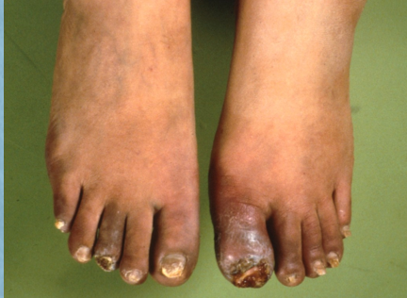
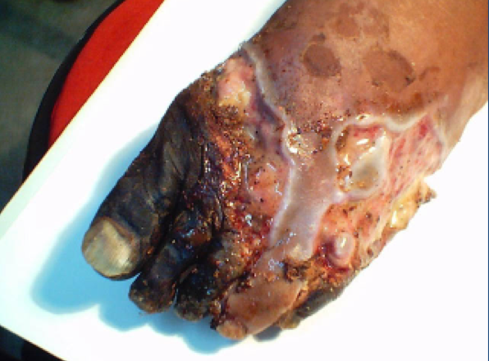
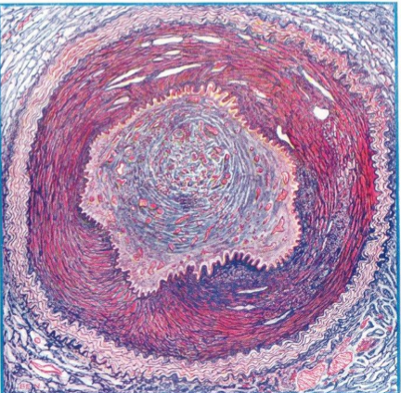
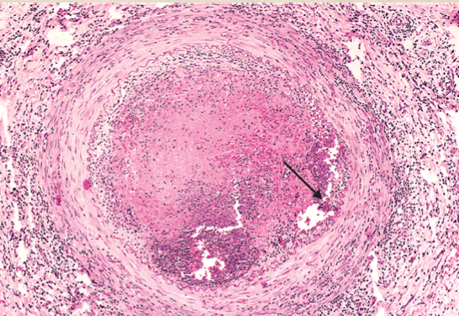
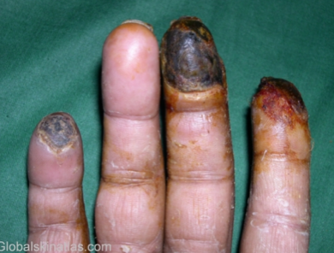
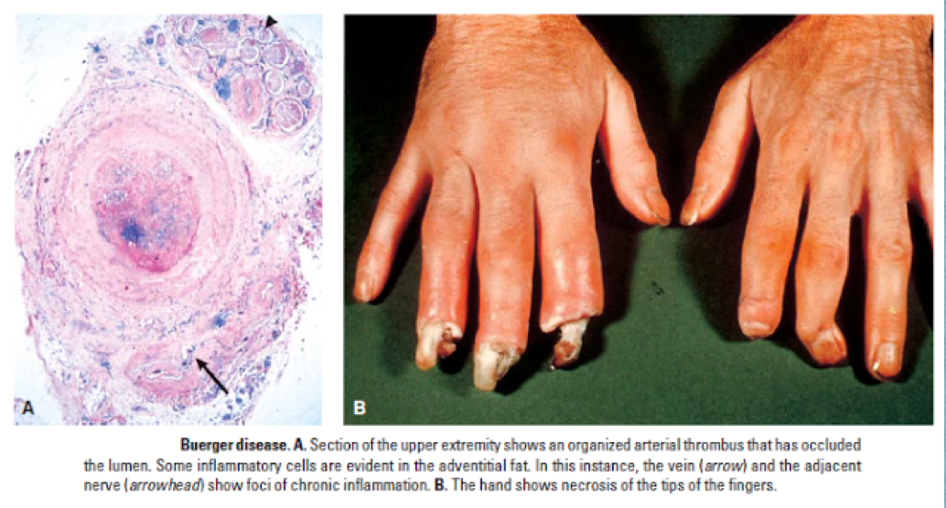
Thromboangiitis obliterans (Buerger disease)

Slide 16
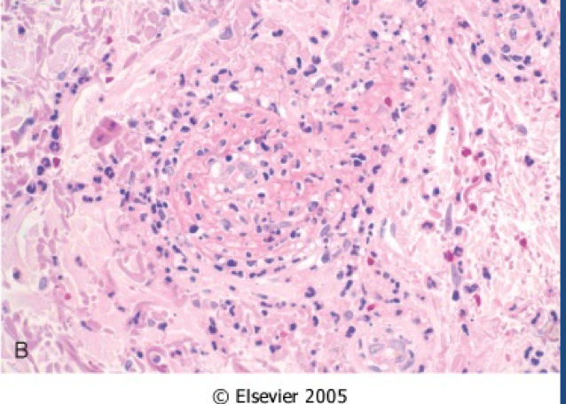
Microscopic polyangitis/ polyarteritis
Definition | It is a systemic small vessel vasculitis associated with glomerulonephritis (renal disease). Necrotizing vasculitis that generally affects capillaries as well as arterioles and venules of a size smaller than those involved in PAN
Clinical features | P-ANCA is characteristically present in more than 70% of patients. In the past it has been confused with leukocytoclastic vasculitis. Rarely, larger arteries may be involved All lesions of microscopic polyangiitis tend to be of the same age in any given patient Necrotizing glomerulonephritis (90% of patients) and pulmonary capillaritis are particularly common.
Pathogenesis | In many cases, an antibody response to antigens such as drugs (e.g., penicillin), microorganisms (e.g., streptococci), heterologous proteins, or tumor proteins is the presumed cause This can result in immune complex deposition, or it may trigger secondary immune responses
Microscopically | Depending on the organ involved, major clinical features include: – Hemoptysis – Hematuria and proteinuria – Bowel pain or bleeding – Muscle pain or weakness – Palpable cutaneous purpura

Slide 17
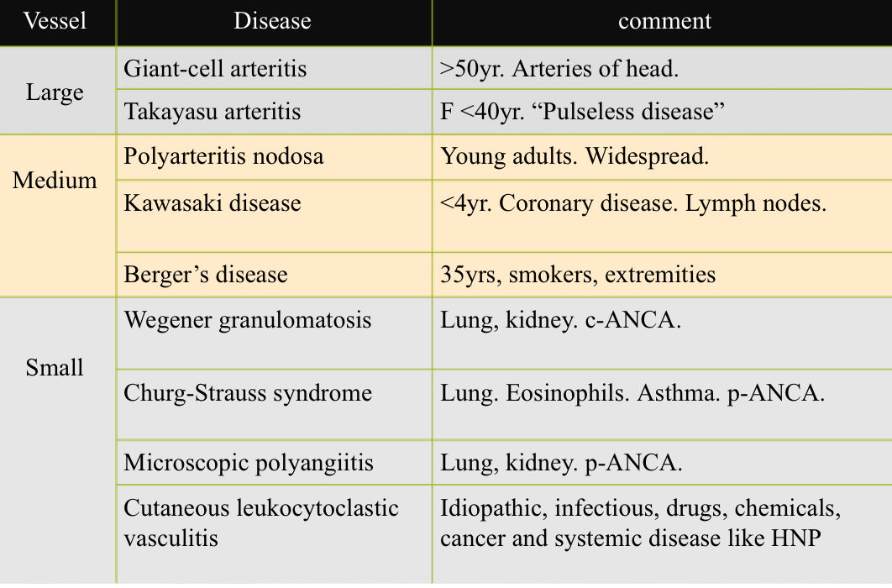
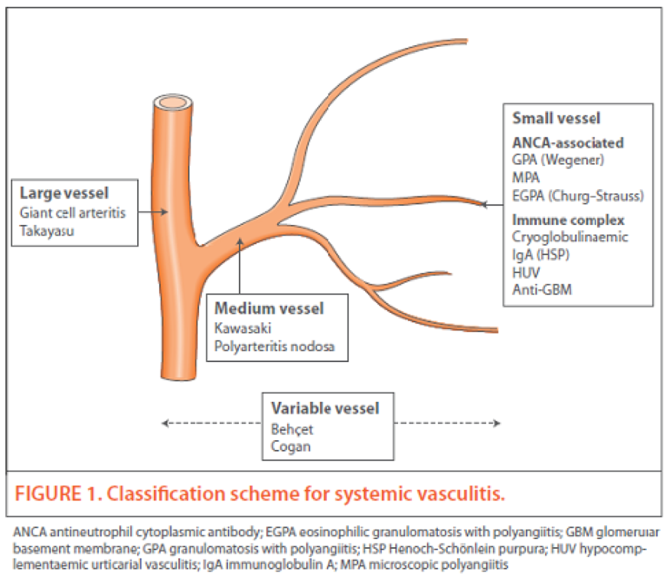
Summary of Vasculitides

Slide 18
Summary
 | Important characteristics
Giant-cell arteritis | Chronic, granulomatous inflammation (giant cell) of large to small size arteries especially the branches of the carotid, the involvement is segmental. The most common type. Symptoms include: 1-Fever 2-Facial pain 3-Visual problems
Polyarteritis nodosa | Segmental necrotizing inflammation of medium to small size arteritis, Not the arterioles, capillaries, venules. Can affect any organ except the Lungs. Highly associated with Hepatitis B,C. Not associated with ANCA. Active and chronic stages may coexist. Manifestation are due to ischemia and infarction of the affected organ.
Granulomatss with Polyangiitis ( wegener granulomatosis) | necrotizing granulomas of the upper and lower respiratory tract necrotizing or granulomatous vasculitis of small to medium- sized vessels renal disease in the form of necrotizing, crescentic, glomerulonephritis. C-ANCAs is positive in serum Persistent pneumonitis , chronic sinusitis , mucosal ulcerations of the nasopharynx , and evidence of renal disease.

Slide 19
Summary
 | Important characteristics
Microscopic polyangitis/ polyarteritis | Small vessels vasculitis associated with glomerulonephritis (renal disease) P-ANCA is characteristically present
Cutaneous leukocytoclastic (hypersensitivity vasculitis/ angiitis) | inflammation of small blood vessels seen in the dermis of skin characterized by palpable purpura. All lesions tend to be of the same age. It affects many organs e.g. skin (most common), mucous membranes, lungs , brain, heart, GI , kidneys and muscle. Immunologic reaction to an antigen that may present as Drugs e.g. penicillin, Infectious microrganisms e.g. strept. and other infections, food products and toxic chemicals tumor antigens in various cancers. may be a part of a systemic diseases e.g: Collagen vascular diseases (lupus erythematosus, rheumatoid arthritis) Henoch-Schonlein purpura Histologically there is infiltration of vessel wall with neutrophils, which become fragmented called as leukocytoclasia or nuclear dust. The direct immunofluorescence will show deposits of IGA immunoglobulin in the wall the capillaries in Henoch-Schonlein purpura (HSP) .

Slide 20
Summary
 | Important characteristics
Henoch-Schonlein purpura (HSP) | HSP is an IgA-mediated, autoimmune systemic disease in which the small vessels show leukocytoclastic vasculitis. Skin biopsy will show necrotizing leukocytoclastic vasculitis of capillaries in the dermis. The immunofluorescence shows IgA immunoglobulin deposition in the wall the affected capillaries.
Thromboangiitis obliterans (Buerger disease) | It is characterized by segmental, thrombosing, acute and chronic inflammation of medium-sized and small arteries, principally of the leg and hands (tibial and radial arteries) with secondary extension into adjacent veins and nerves. Buerger disease is a condition that occurs almost exclusively in heavy smokers of cigarettes Patients are usually under 35 years of age pain in the affected hand or foot induced by exercise (called instep claudication). Patients can have pain even at rest, due to the neural involvement. Chronic ulcerations of the toes, or fingers may appear, followed in time by gangrene. .

Slide 21
MCQ
1-c 2-c 3-c 4-d 5-a
1-a 56 year old female came to the hospital with: Face pain , 38c Temperature After examination the doctor told her that there is a damage in her ophthalmic artery and that she will be blind within 48 hours. Which one of the following is true about this disease?
a-Affect both arteries and veins | b-Affect only large arteries | c-It could affect the aorta | d-Affect male more than female
2-which one of the following is not true about Polyarteritis nodosa (PAN)?
a-Associated with Hepatitis C | b-Associated with Hepatitis B | c-Associated with ANCA | d-Active and chronic stages may coexist.
3- A patient came with visual problem, biopsy was done and showed granulomatous inflammation what’s the diagnosis? ( the question is from the females’ doctor)
a-polyarteritis nodosa | b-cutaneous leukocytoclastic | c-giant cell arteritis | d- buerger disease
4- which of the following vasculitis affects all the organs except the lung, and which organ does it affect the most? ( the question is from the females’ doctor)
a-polyarteritis nodosa, heart | b-wegener granulomatous, kidneys | c-wegener granulomatous, liver | d- polyarteritis nodosa, kidneys
5- A patient came to the hospital with palpable purpura, skin biopsy showed necrotizing leukocytoclastic vasculitis of capillaries in the dermis and immunofluorescence showed elevated IgA what’s the diagnosis
a- Cutaneous leukocytoclastic with Henoch-Schonlein purpura | b-Thromboangiitis obliterans | c-Polyarteritis Nodosa | d- Giant-Cell (Temporal) Arteritis

Slide 22
6-b 7-b 8-c
MCQ
For more question
6- a patient came to the hospital with necrotizing granuloma of the upper and lower respiratory tract, necrotizing or granulomatous vasculitis of small to medium-sized vessels and renal disease, tests showed positive C-ANCA in serum what’s the diagnosis
a-polyarteritis nodosa | b- Wegener granulomatous | c-buerger disease | d- Cutaneous leukocytoclastic
7- A patient was diagnosed with microscopic polyangitis, what will be characteristically present in the patient’s serum?
a-C-ANCA | b-P-ANCA | c-CK- MB | d- troponin
8- 30 Y.O smoker patient came to the hospital suffering from pain in his toes associated with chronic ulceration what’s the diagnosis?
a- Cutaneous leukocytoclastic | b- polyarteritis nodosa | c- Thromboangiitis obliterans | d- Giant-Cell (Temporal) Arteritis

Slide 23
Team leaders:
Dema
Alkhattabi
Raneem Alwatban
Ibrahim
Alhezam
Sub-leader:
Hassan Alabdullatif
Team members:
Norah
Alrashoud
Maram
Beyari
Omar
Alkadhi
Farah
Alenezi
Manar
Alzahrani
Othman Alabdullah
Hoor
Aloraini
Nawaf
Alrefaei
Rakan
Alromayan
Mayssar Alshobaki
Saad
Alahmari
Osama
alburaih
Nouf
Aldhalaan
Emad
Almutairi
Abdulaziz
Alymni

