Slide 1
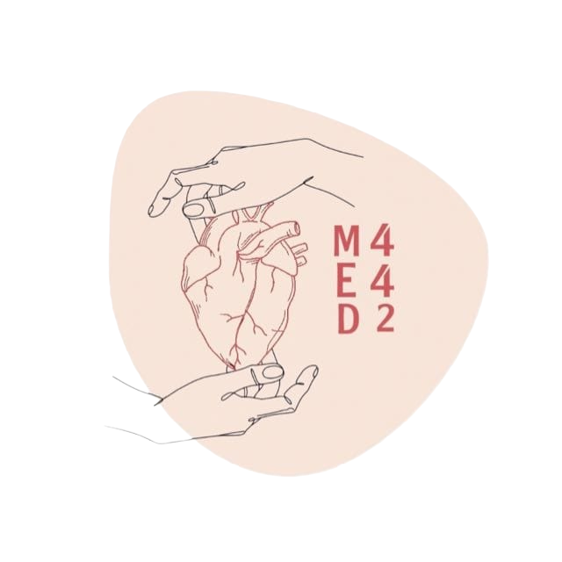
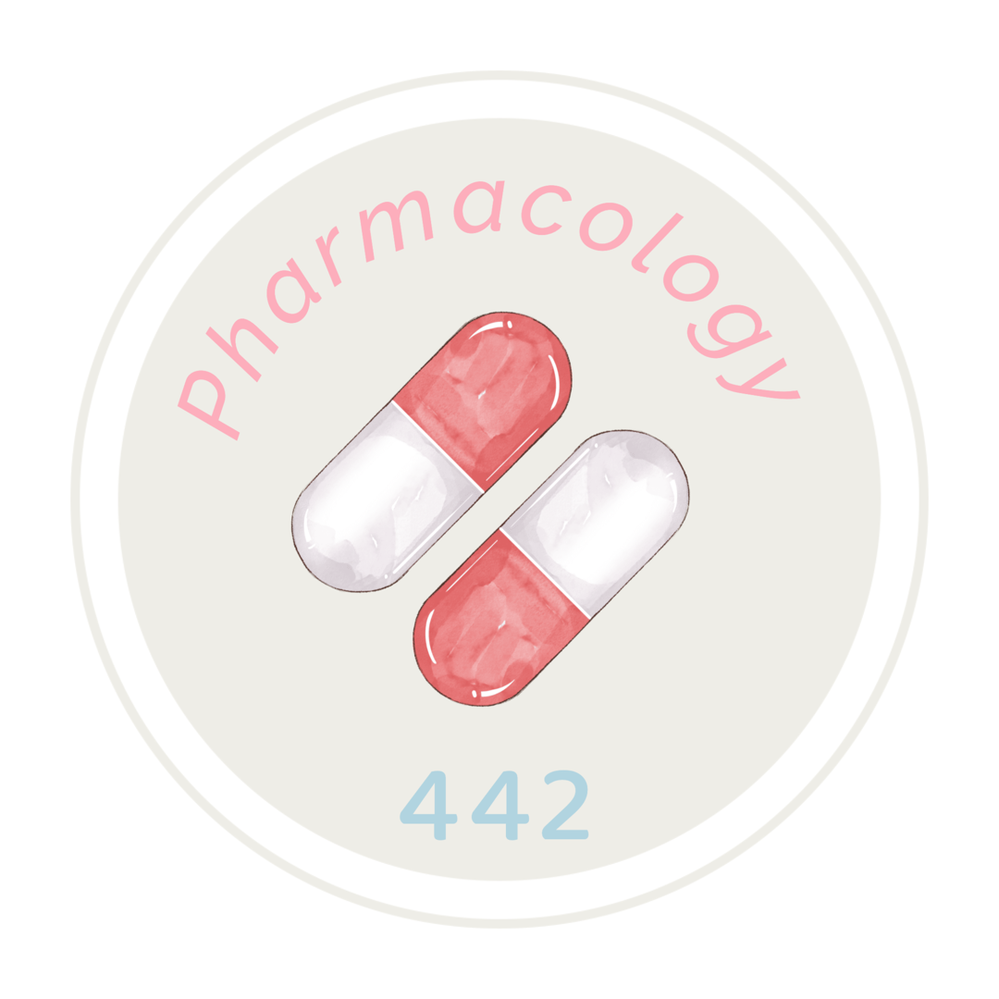
#8
Beta Adrenergic Blockers
Objectives:
Outline the mechanisms of action of B-blockers.
Classify B-receptor blockers into selective & non-selective.
Know the pharmacokinetic aspects & pharmacodynamic effects of B- adrenergic blockers.
Identify the specific uses of non selective and selective B -adrenergic blockers.
Editing File
Main Text
Female Slides
Male Slides
Important
Doctors Notes
Extra
Foda’s videos:
Click here for video timestamps
First
Second

Slide 2
ß-Adrenoceptor Blockers
Mnemonics (only for drugs mentioned in this lecture):
• All β-blockers end in “olol” except mixed blockers → end in “lol” only.
• All cardioselective β-blockers begin with the letters A→ M “Exclusive Beta Blockers Are Acting Mainly Cardioselectively” → thanks to Abdullah Alomran!
• All non-selective β-blockers begin with the letters O→ Z (β2= second half of the alphabet).
Pharmacodynamic Classification
According to selectivity
Non-selective β-antagonists blocks β1&β2 receptors “stop”
“O→Z”
(Sotalol, Timolol (eye),Oxprenolol, Propranolol, Pindolol)
Selective β1 antagonists (Cardiogenic)“A→M” “ABCEM”
Acebutolol,Atenolol,Bisoprolol,Betaxolol,Celiprolol,Esmolol,Metoprolol
Mixed α, β Receptors Blockers
Carvedilol,Labetalol
According to presence of agonistic/antagonistic action
“Intrinsic Sympathomimetic Activity”(ISA)
Without ISA(Pure antagonists)
Atenolol,Bisoprolol,Metoprolol,Propranolol,Sotalol,Timolol,Carvedilol
With ISA (may activate beta receptor)
Acebutolol,Pindolol,Oxprenolol,Celiprolol
According to presence of membrane stabilizing effects
Effect:-‏Block Na Channels (makes muscle cells unresponsive to pacemaker stimulation → ↓ excitability ‏→ no action potential → ↓ contraction of muscles)
‏- Quinidine-like action (Quinidine is a class of antiarrhythmic drugs)
- Antiarrhythmic action.
Drugs: Propranolol,Labetalol
-Mnemonic: “COntain Partial Agonistic Activity”: Celiprolol + Oxprenolol + Pindolol + Acebutolol
-Extra note: Beta-blockers with ISA may not be as effective as the pure antagonists in the secondary prevention of MI. They cause less bradycardia & less peripheral vasoconstriction. However, this may be useful in patients who develop symptomatic bradycardia or bronchoconstriction in response to beta-blockers, which makes ISA favorable in particular cases.
-Never use ISA drugs with angina, arrhythmia, & myocardial infarction (we do not want any simple stimulation).
With ISA = may partially activate B receptors

Slide 3
Pharmacokinetic Classification
According to lipid solubility
Drug | Oral absorption | Liver metabolism (most are excreted in urine) | t1/2 | CNS side effects CNS depressant effects i.e. Sedative effect ↓Anxiety | Drugs
Lipophilic | Complete “given orally” | Yes ”undergo hepatic clearance “ | Short | High | Metoprolol,Labetalol ,Propranolol,Carvedilol, Timolol
Hydrophilic | Irregular “given IV” | No ”undergo renal clearance” | Long Except Esmolol(10min.given IV | Low | Bisoprolol,Atenolol, Sotalol, Esmolol
Most ß blockers are lipid soluble
To sum up… thanks to team411
Drugs: (14) | Selectivity | Sympathomimetic Activity (ISA) | Membrane stabilizing effects | Lipid solubility
Sotalol | Non selective β- Antagonists | without ISA | — | Hydrophilic
Timolol |  | without ISA |  | Lipophilic
 |  | — |  | —
Oxprenolol |  | with ISA |  | —
Propranolol |  | without ISA | Present | Lipophilic
Pindolol |  | with ISA | — | —
Acebutolol | Selective β-1 | with ISA | — | —
Atenolol |  | without ISA |  | Hydrophilic
Bisoprolol |  | without ISA |  | Hydrophilic
Betaxolol |  | — |  | —
Celiprolol |  | with ISA |  | —
Esmolol |  | — |  | Hydrophilic
Metoprolol |  | without ISA |  | Lipophilic
Carvedilol | Mixed nonselective β-α | without ISA | — | Lipophilic
Labetalol |  | with ISA | Present | Lipophilic

Slide 4
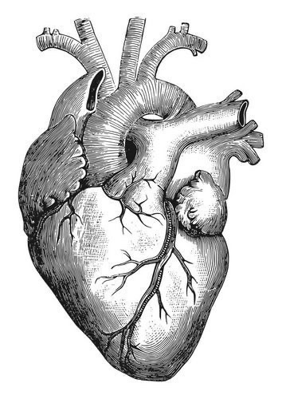
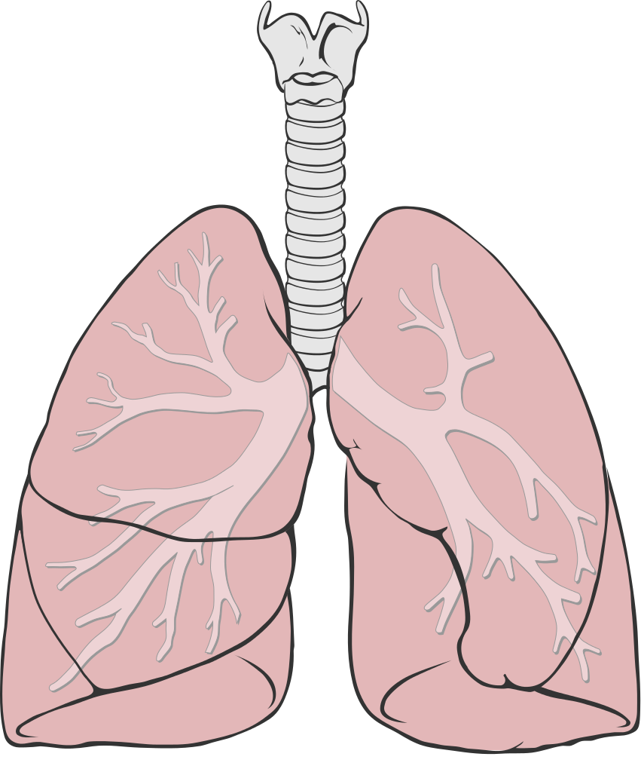
Pharmacological actions
CVS have negative inotropic (force of contraction), chronotropic (HR), dromotropic (conduction velocity) → ↓ COP (cardiac output)
ß1 receptors are found in the heart & JG cells in the kidney
ß2 receptors are found in the bronchi, blood vessels, liver, skeletal muscles
ß3 receptors are found in adipose tissue
CVS
1
-Antianginal effects (ischemic heart disease):
• ↓ Heart rate (bradycardia) → ↓ Oxygen consumption due to bradycardia
• ↓ Force of contraction → ↓ Cardiac work
-Anti-arrhythmic effects:
↓ excitability, ↓ automaticity & ↓ conductivity
(due to its sympathetic blocking).
-Blood pressure:
Antihypertensive
↓ BP in hypertensive patients due to effects on:
• Inhibiting heart properties → ↓ cardiac output (β1)
• β Blockade →↓ renin secretion →↓ Ang II & aldosterone
secretion (β1)
• Presynaptic inhibition of NE release from adrenergic nerves→ ↓ sympathetic
-Blood vessels (β2):
Block vasodilatory effect of β2 → ↑ peripheral resistance (PR) → ↓blood flow to organs → cold extremities → contraindicated in peripheral diseases like Raynaud's disease
2
Eye
↓ Aqueous humor production from ciliary body thus reduces intraocular pressure(↓IOP)
ِ• e.g. Timolol as eye drops (mnemonic: time for eye drop)
(The only drug from β blockers used for glaucoma)
3
Respiratory tract β2
Bronchoconstriction → contraindicated in asthmatic patients
(unless if selective β1 blockers were given not β2)
4
Metabolic effects & intestine
•Hypoglycemia due to ↓ Glycogenolysis in liver & ↓ Glucagon secretion in pancreas
• ↓ Lipolysis in adipocytes
• All mask hypoglycemic manifestations in diabetic patients → COMA
• Na+ retention 2ndry to ↓BP → ↓ renal perfusion.
β blockers ↓ cardiac output, which lowers the BP & ↓ renal perfusion.This will cause renin to be ↑ as a reflex (to restore BP). Renin will ↑ aldosterone, which in turn causes Na & water retention.
• ↑ Intestinal motility

Slide 5
Cardiovascular disorders
Clinical Uses
Cardiac Arrhythmias | • In supraventricular (above ventricles) & ventricular (in ventricles) arrhythmias . • Bisoprolol and Carvedilol are preferred • B-blockers are class II antiarrhythmic agents & are used for tachyarrhythmias only. (Give ones with a quinidine like effect)
Hypertension | • Propranolol, Atenolol, Bisoprolol • Labetalol: α, β blocker in hypertensive pregnant (doesn’t harm the baby although it crosses BBB, if methyldopa doesn’t work) & hypertensive crisis (because it’s given parenterally). [very important]
Angina pectoris | • ↓ heart rate, ↓ cardiac work & oxygen demand. • ↓ the frequency of angina episodes. • Atenolol, Bisoprolol, Metaprolol (ß1 selective) Angina: a condition marked by severe pain in the chest, often also spreading to the shoulders, arms, and neck, owing to an inadequate blood supply to the heart.
Congestive heart failure (Heart failure with edema) | • Bisoprolol & Metoprolol (ß1 selective) Carvedilol (drug of choice), :Non selective α,β blocker & antioxidant (an extra effect) • ↓ myocardial remodeling & ↓risk of sudden death
Myocardial infarction | • ↓ infarct size, ↓ morbidity & mortality,  ↓ myocardial O2 demand. (Cardioprotective effect) • Antiarrhythmic action. • ↓ incidence of sudden death.
Other disorders
Chronic Glaucoma | • e.g. Timolol as eye drops • ↓ secretion of aqueous humor by ciliary body. • ↓ Intraocular pressure (IOP)
Anxiety (Social & performance type) | • eg. Propranolol • Controls symptoms due to sympathetic system stimulation as tachycardia, tremors, sweating (somatic symptoms)(للقلق علاج نفسي ايضًا؛هذا للأعراض الجسمانية فقط)
Hyperthyroidism (Thyrotoxicosis) | • Protect the heart against sympathetic overstimulation cause by overproduction of thyroid hormone (thyrotoxicosis) • Controls symptoms; Tachycardia - Tremors - Sweating • Propranolol is the drug of choice.
Migraine | •Prophylactic •↓ episodes of chronic migraine •↓catecholamine-induced vasodilatation in the brain vasculature , e.g. propranolol. A migraine is due to vasodilation
Pheochromocytoma “A small vascular tumor of the adrenal medulla, causing irregular secretion of epinephrine and norepinephrine, leading to attacks of raised blood pressure, palpitations, and headache “ | • Used with α-blockers (never alone) , because alone it causes vasoconstriction => increases BP which is the opposite effect of what we want •α-blockers lower the elevated blood pressure •β-blockers protect the heart from NE.

Slide 6
Thanks to Team 439!
Note: if no receptors are written then both receptors are involved
ADRs of ß-blockers
Mnemonic: C THE BALD FISH
c | ● Cold extremities (β2) → due to vasoconstriction (↓ blood flow). ● Coronary spasm (β2)→ in variant angina patients Variant angina is a type of angina where common atherosclerotic risk factors do not usually apply.
T | ● ↑ Triglycerides (TG) → Hypertriglyceridemia (β2)
H | ● Hypotension (β1) ● Heart failure (β1) ● Hypoglycemia (β2) ● Hallucinations if the drug was lipophilic
E | ● Erectile dysfunction & impotence (β2) due to ↓ blood flow (vasoconstriction).
B | ● Bradycardia or heart block (β1) ● Bronchoconstriction (β2) → contraindicated in asthma & emphysema (Both are less pronounced with β-blockers with ISA)
A | ● Arrhythmia
L | ● Lack of energy
D | ● Depression if the drug was lipophilic ● Disturbance of GIT
F | ● Fatigue
I | ● Intermittent claudication (limping) (β2)→ due to vasoconstriction
s | ● Sodium Retention
H | -
● β2 adverse effects are only with non-selective β blockers.
○ However, the cardioselectivity of β1 blockers decreases at high doses.
● All β-blockers mask hypoglycemic manifestations i.e. tachycardia, sweating → COMA.
○ Thus, regular monitoring of blood glucose (especially in diabetic pts) is recommended.
Precautions
● Sudden stoppage will give rise to a withdrawal syndrome: rebound angina, arrhythmia,
myocardial infarction & hypertension.
○ Why? due to up-regulation of β-receptors (عددها يزيد)
■ Prolonged β blockade can cause a compensatory rise in β receptors. Abrupt termination
then leads to increased sympathetic activity (rebound reaction).
● To prevent withdrawal manifestations the drug is withdrawn gradually.
○ Applies to 2 classes of drugs: β-blockers + corticosteroids.

Slide 7
.
Drug | Propranolol (prototype) |  | Labetalol | Carvedilol
MAO | ● Non-selective competitive blocker of β1 & β2 ● Membrane stabilizing action / quinidine-like / local anesthetic effect ● Sedative actions (because it’s lipophilic) / No ISA |  | ● Non-selective α1 & β blocker Ends in “lol” only → mixed ● With ISA ● Has local anesthetic effect ● Rapid acting | ● Non-selective α1 & β blocker Ends in “lol” only → mixed ● No ISA & no local anesthetic effect ● Antioxidant action Patients who have heart failure have ↓ COP. Normally, when there is a decrease in COP, the sympathetic system gets activated which stimulate β1 (tachycardia). But because the patient has HF, the heart is exerting more effort than normal which will cause hypertrophy to the heart which will lead to irreversible remodeling or changes in the myocytes. These changes are harmful & ↑ the risk of sudden death. A drug with antioxidant activity ↓ the chance of these changes to occur which ↓ the risk of sudden death.
P.K | Lipophilic: ● Completely absorbed ● 70% destroyed during 1st pass hepatic metabolism ● 90-95% protein bound ● Cross BBB ● Excreted in urine ● Given p.o or parenteral |  | Given p.o & IV | -
Action | General | ● Membrane Stabilization: Block Na channels→ direct depressant to myocardium → has local anesthetic + antiarrhythmic effects. Blocking the Na channels will ↓ the generation of impulses from the pacemaker, so it ↓ arrhythmia & give a local anesthetic action. ● β-blocking Effect (antiarrhythmic effects) ● CNS Effect: has sedative action, ↓ tremors & anxiety→ used to protect against social performance type anxiety. | ● Does NOT alter serum lipids or blood glucose ● Peripheral vasodilation→ ↓ BP | -
 | β1 | CVS ● Inhibit heart properties → ↓ cardiac output ● Anti-ischemic action → ↓ cardiac work + O2 consumption ● Antiarrhythmic effects → ↓ excitability, automaticity & conductivity + by membrane stabilizing activity ● Propranolol has now been replaced by cardioselective β-blockers

Slide 8
.
Drug | Propranolol (prototype) |  | Labetalol | Carvedilol
Action | β2 | Blood Vessels: Vasoconstriction→ ↓ blood flow specially to muscles, other organs except brain → cold extremities Bronchi: Bronchospasm specially in susceptible patients Intestine: ↑ Intestinal motility Metabolism: ● Liver: ↓ Glycogenolysis→ Hypoglycemia ● Pancreas: ↓ Glucagon secretion ● Adipocytes: ↓ Lipolysis ● Skeletal muscles: ↓glycolysis Peripheral & central nervous systems: local anesthetic effect,↓ tremors, & ↓ anxiety | ● Does NOT alter serum lipids or blood glucose ● Peripheral vasodilation→ ↓ BP | -
 | β1&β2 | Antihypertensive action (blood pressure) by: ● Inhibiting heart properties→ ↓ cardiac output ● β blockade: ↓ renin & RAAS system (renin angiotensin aldosterone system) ● Presynaptic inhibition of NE release from adrenergic nerves ● Inhibiting sympathetic outflow in CNS
Uses | ● Hypertension ● Chronic glaucoma ● Arrhythmias ● Migraine [Prophylaxis; to prevent attacks] ● Myocardial infarction ● Hyperthyroidism → tachycardia ● Angina ● Anxiety: (specially social & performance type) ● Pheochromocytoma; used with α-blockers (never alone) ● Tremors → can be managed by non-selective β-blockers only as they’re caused by β2 |  | ● Severe hypertension in pheochromocytoma (instead of giving 2 medications to block α & β, labetalol is given because it’s non selective) ● Hypertensive crisis (e.g. during abrupt withdrawal of clonidine). ● Pregnancy-induced hypertension | Congestive heart failure to reverse its pathophysiological changes
ADRs | - |  | ● Orthostatic hypotension (α1) ● Sedation & dizziness | ● Orthostatic hypotension (α1) ● Edema (α1)
Heart Block β-blockers can precipitate heart block as they cause bradycardia
Diabetic patients→ Masking of hypoglycemia→ GIVEN
CAUTIOUSLY
Peripheral vascular disease (e.g.Raynaud's) (safer with cardio-selective β1 blocker)
Contraindications of β-blockers
Hypotension
Alone in pheochromocytoma (must be given with α blockers) β blockers alone cancel out the vasodilatory effects of β2 → unopposed α1vasoconstriction → hypertension [except β blockers with α1 antagonism]
Bronchial Asthma
(safer with cardio-selective
β-blockers).

Slide 9
Extra
Intermittent claudication: Peripheral artery disease most commonly affects the legs, but other arteries may also be involved. The classic symptom is leg pain when walking which resolves with rest.
Risk factors: Diabetes, hypercholesterolemia, hypertension
Summary
Thanks team 439
Classification | Drug | Notes | Uses | Adverse effect Contraindication |  | Contraindication
Non selective ß Blockers | Propranolol | - Membrane stabilizing effect - ß blocking effect - CNS effect | Migraine prophylaxis, Hyperthyroidism, (thyrotoxicosis) Relieve anxiety (social performance), hypertension, arrythmia, myocardial infarction | Cold extremities Erectile dysfunction Bronchoconstriction | All mask hypoglycemic manifestation Should be withdrawn slowly to prevent upregulation of ß | - Diabetes - Asthma - Using alone in pheochromocytoma - Hypotension -Raynauds disease
 | Timolol |  | Glaucoma
Non selective åß | Labetolol |  | Hypertension in pregnant women and hypertensive emergency | Orthostatic/postural hypotension
 | Cadvedilol | Antioxidant action | Congestive heart failure
ß1 blockers | Atenolol |  | Myocardial infarction Hypertension | Hypotention Heart failure Bradycardia
 | Bisoprolol
 | Metoprolol
 | Esmolol | Short duration of action | Arrythmia

Slide 10
MCQ’S
What’s the drug of choice in Congestive heart failure?
a- Propranolol | b- Carvedilol | c- Timolol | d-Sotalol
2- Which drug that have short half-life of 10 min?
a-Metoprolol | b-Atenolol | c- Esmolol | d- Propranolol
3- what is the main use of Bisoprolol?
a- Hypertension | b-Angina pectoris | c- MI | d- CHF
4- Which one is true about Proranolol?
a-don’t have sedation action | b-membrane stabilization | c- selecive b1 blocker | d- increase the cardiac output
5-What’s the drug of choice in Cardiac Arrhythmias?
a-Timolol | b-Labetalol | c-Bisoprolol | d-Propranolol
6-Which drug is blocking the Na channels?
a-Sotalol | b-Propranolol | c-Carvedilol | d-Acebutolol
1- b
2- c
3- a
4- b
5- c
6- b
SAQ’S
1- give 3 examples of contraindications of b-blockers?
Diabetic patient, bronchial asthma , hypotension
2-What’s the mechanism of action of Propranolol?
• Non-selective competitive blocker of ß1 & ß2 • Membrane stabilizing action / quinidine-like/ local anesthetic effect • Sedative actions (because it's lipophilic)/No ISA
3-How can the Timolol treat the Glaucoma?
by decreasing the Aqueous humor production from ciliary body thus reduces intraocular pressure(IOP)
4- list 5 ADRs of b-blockers ?
Fatigue, sodium retention, disturbance of GIT , Erectile dysfunction& impotence, heart failure

Slide 11
Pharmacology Team
442
Leaders
Arob Alasheikh
Othman Alabdullah
Dena Alsuhaibani
Hassan Alabdullatif
Members
Noura bin hammad
Rahaf Almutairi
Jana Alhazmi
Lina ALyahya
Aljazi AlBabtain
Atheer Alkanhal
Reema Alquraini
Nouf Aldhalaan
Noura Alshafi
Layan Aldoukhi
Farah Alfayez
Razan Almohanna
Alanoud Almarzoqi
Shahed Bukhari
Tharaa Alhowaish
Rakan Alromayan
Meshari alshathri
Nasser Alghaith
Alwaleed Faqihi
Malik halees
Nawaf Alrefaei
Saad Alahmari
Emad Almutairi
Khaled bin arbeed
Salem alrasheed
Mohammed Almajhadi
Mohammed aloraini
Faisal adel
Khalid alrasheed
Faris Alseraye
Fahad Alhelelah
Luay Almutair
Omar Alkadhi
Special thanks to: Shatha Alshabani & Abdulaziz Al manea
any suggestions or Complaints :
Pharmacology442@gmail.com

