Slide 1
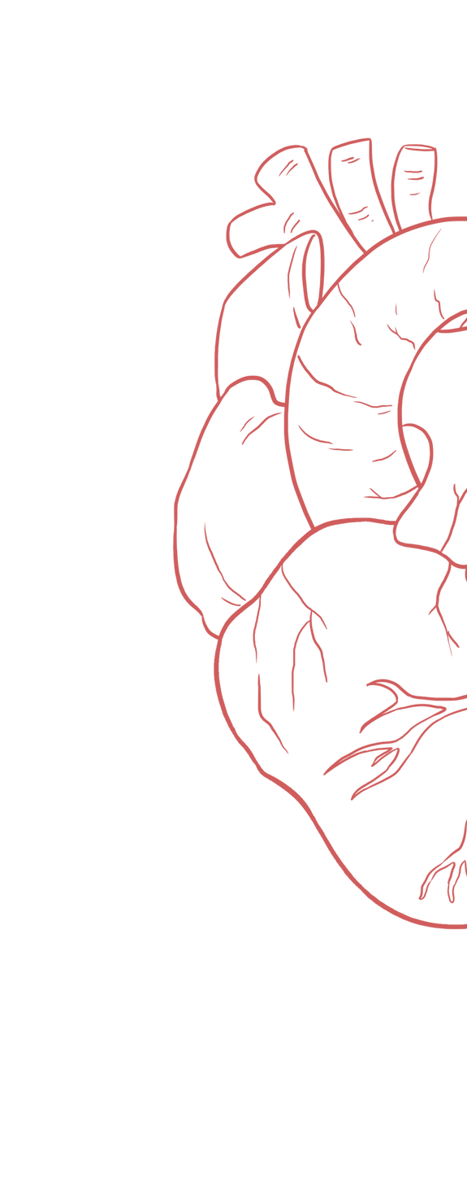
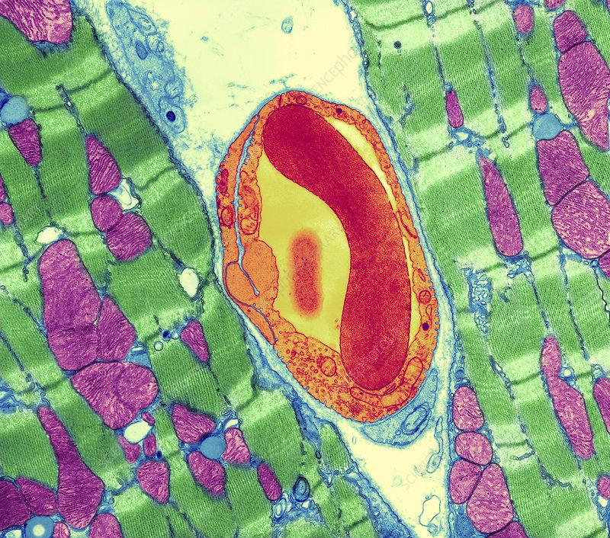
Contractile Mechanism in Cardiac Muscles
____________
Color Index:
Main Text
Important
Girl’s Slides
Boy’s Slides
Dr’s Notes
Extra Info
Cardiac muscle in green & capillary in red using TEM!!
“ For further explanation, you should check Female’s powerpoint slides speaker’s notes”

Slide 2
Objectives
Girl’s Slides
Define cardiac muscle contractility & types of its contraction
Understand the physiology of cardiac muscle
Understand the phases of cardiac action potential and the ionic bases
Identify the refractory period of cardiac muscle
Discuss the role of ca++ in the regulation of cardiac muscle function
Describe the mechanism of excitation contraction coupling
Discuss factors affecting cardiac contractility

Slide 3
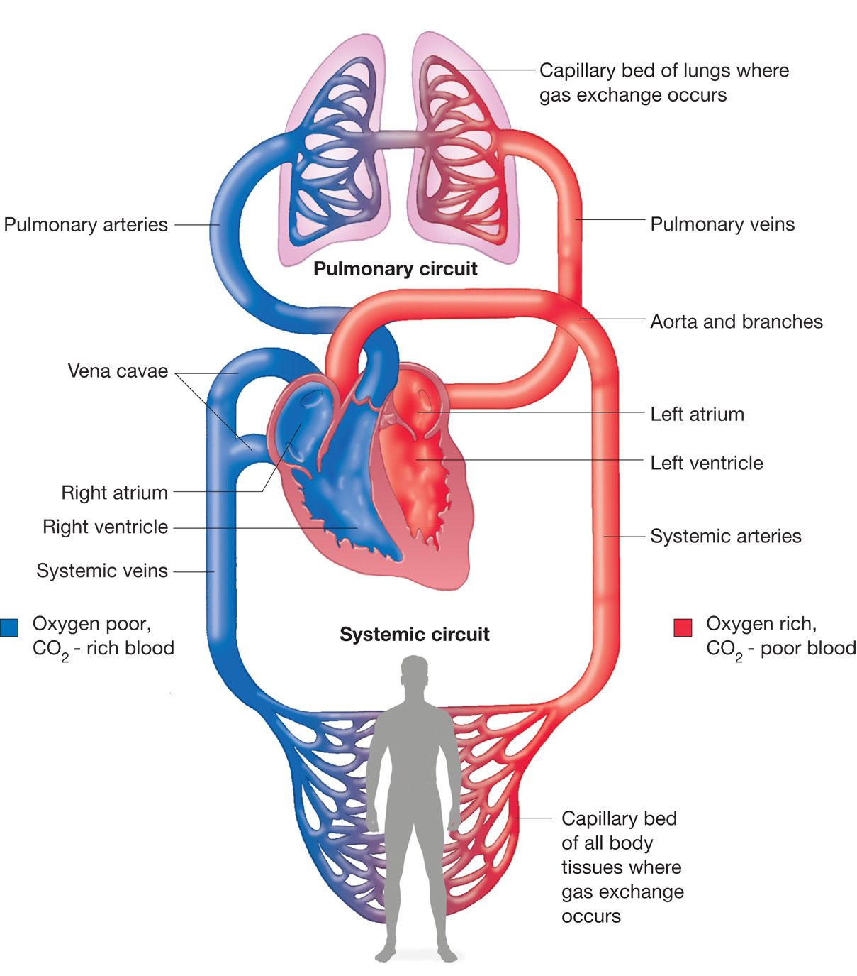
Primary function of cardiovascular system
Girl’s Slides
Deliver blood to tissues
Providing essential nutrients to cells for metabolism
Removing waste products.
The heart muscle is remarkable. At an average heart
rate of 70 beats/min , the heart needs to contract
and relax more than 100 000 times a day without
stopping or tiring.

Slide 4
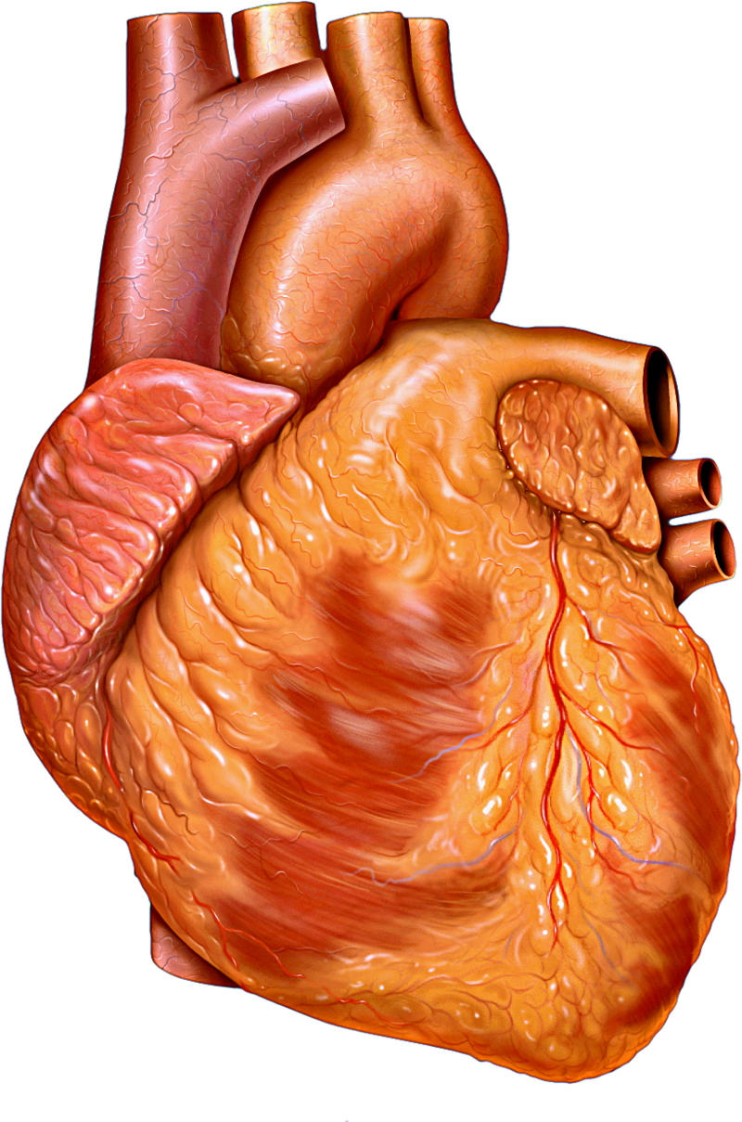
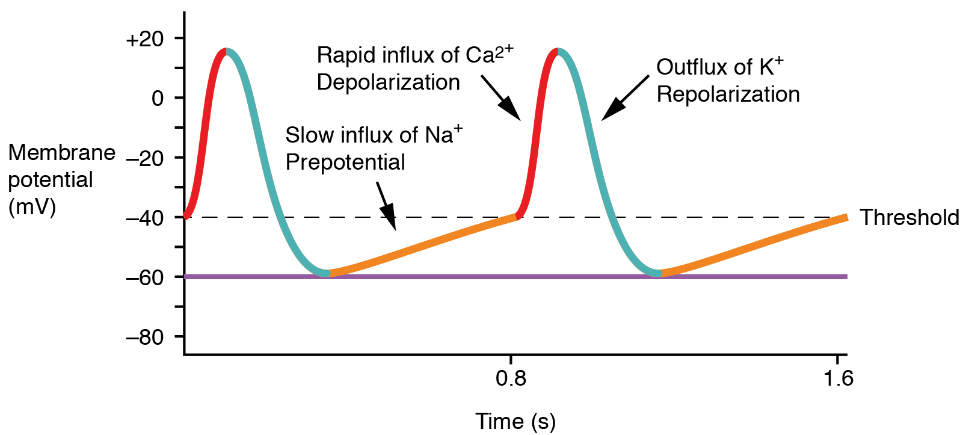
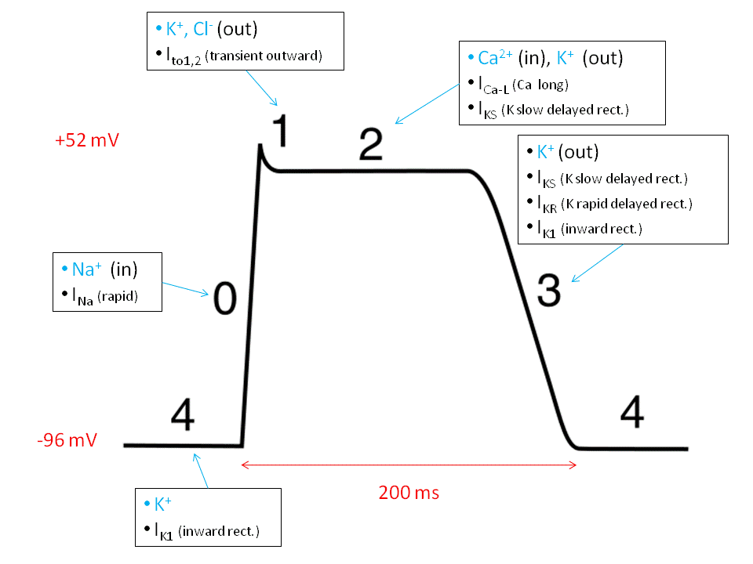
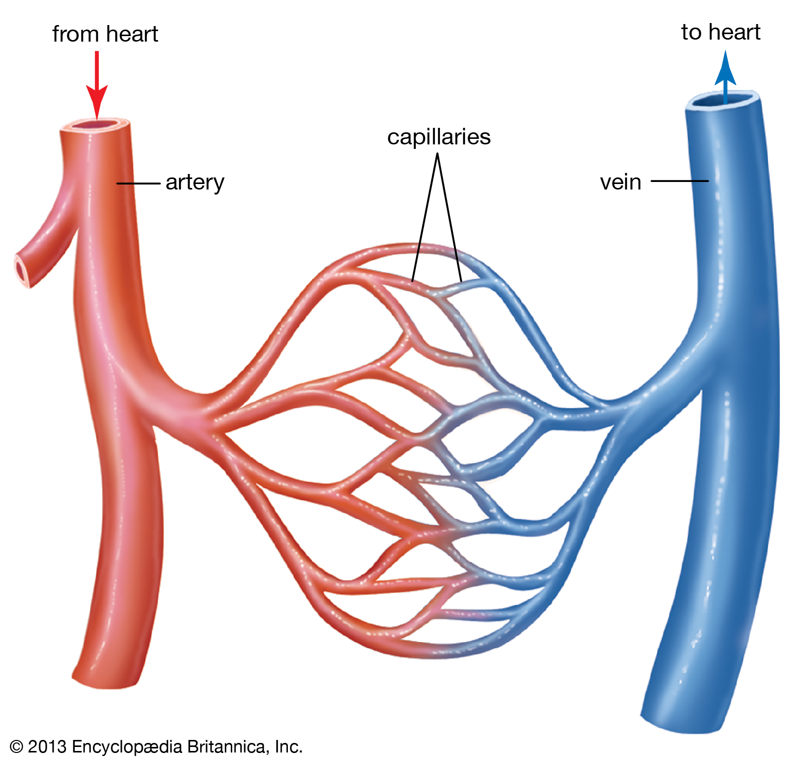
cardiovascular system
Girl’s Slides
Pacemaker action potential
Electrical Activity
(Action Potential)
Heart
(Cardiac Muscle)
Non-pacemaker action potential
Mechanical Activity
Cardiovascular system (CSV)
Vascular System
(Blood Vessels)
Peripheral Circulation and
Blood Flow

Slide 5
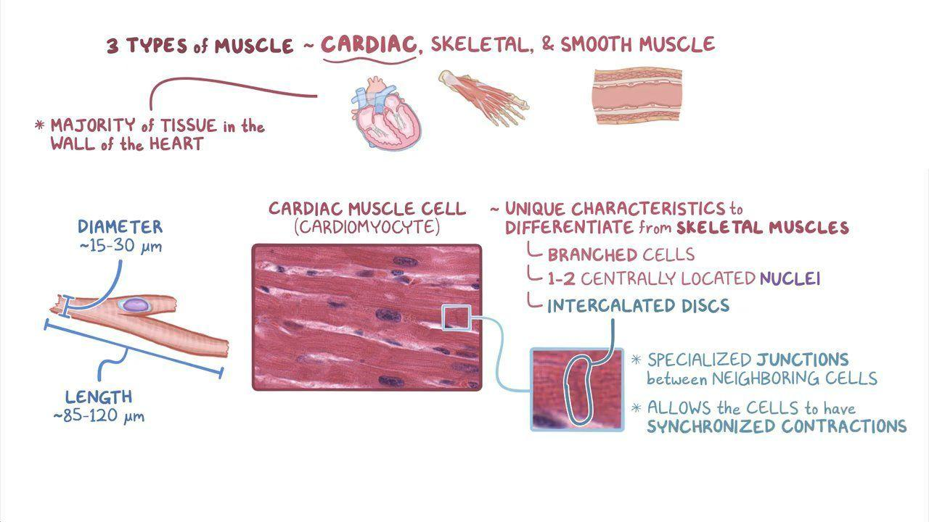
Physiologic anatomy of cardiac muscle
Girl’s Slides
Cardiac muscle cells are found only in the heart, are specialized to pump blood powerfully & efficiently throughout our entire lifetime.
Contractility describes the relative ability of the heart to eject a stroke volume (pump blood).
(ال stroke volume هو كمية أو حجم الدم اللي يطلع من القلب عبر ال aorta للجسم خلال النبضة الواحدة)
Characteristics of cardiac muscle tissue cells :
1
2
involuntary
Intrinsically controlled
3
4
striated
Branched and single nucleated.

Slide 6
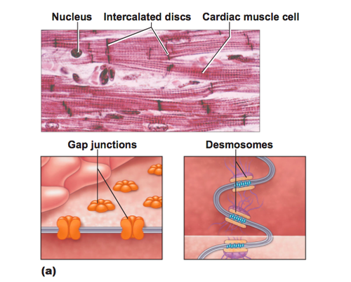
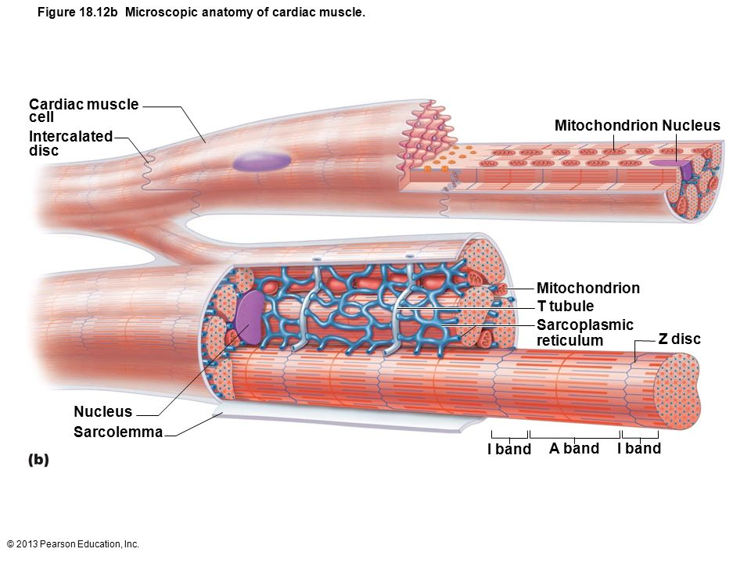
Physiologic anatomy of cardiac muscle
Girl’s Slides
Cardiac muscle fibers are striated & each muscle fiber is made up of:
1
Sarcolemma
5
Muscle fiber plasma (cell) membrane
Myofibril
2
Sarcoplasm
6
The muscle fiber cytoplasm
Myofilaments
3
Sarcoplasmic Reticulum
7
Smooth endoplasmic reticulum (SER)
Sarcomere
4
The smallest contractile unit
of a muscle fiber, a compartment of myofibrils
Transverse Tubules
Tubules formed by invaginations
of the sarcolemma and flanked by the sarcoplasmic reticulum

Slide 7
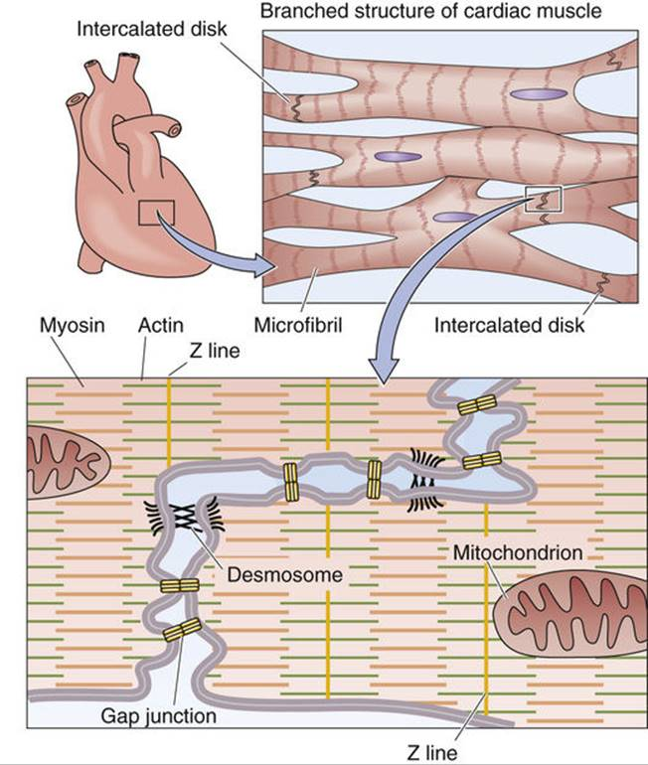
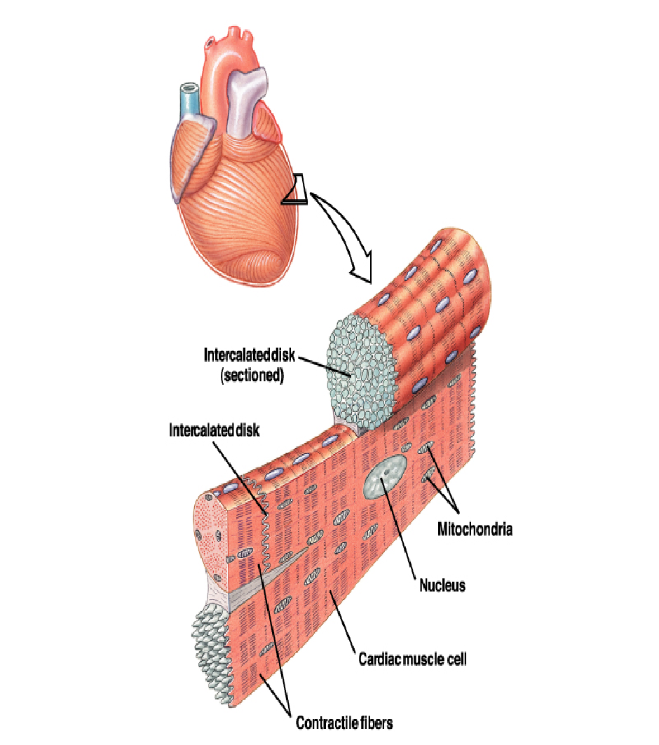
Primary function of cardiovascular system
Cardiac muscle fibers are striated in appearance
Functional unit is called Sarcomere
1-Fibers are branched; connect to one another at intercalated discs.
2-The discs contain several Gap Junctions
3-Nuclei are centrally located
4-Abundant Mitochondria
6-Sarcoplasmic Reticulum is less abundant than
in skeletal muscle, but greater in density than smooth muscle
7-Sarcolemma: Has specialized ion channels that
skeletal muscle does not ( - voltage-gated Ca2+ channels)
8-Fibers are not anchored at ends; allows
for greater sarcomere shortening and lengthening

Slide 8
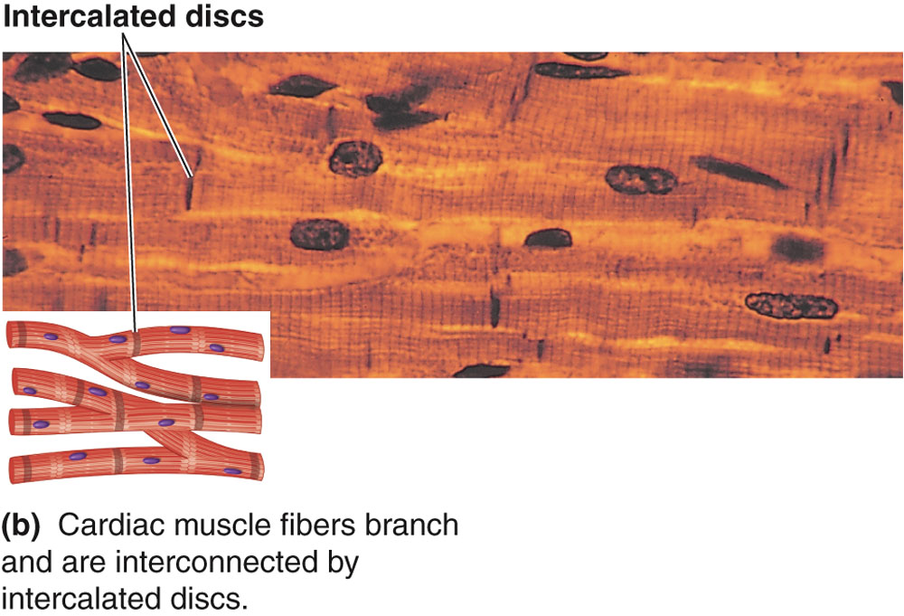
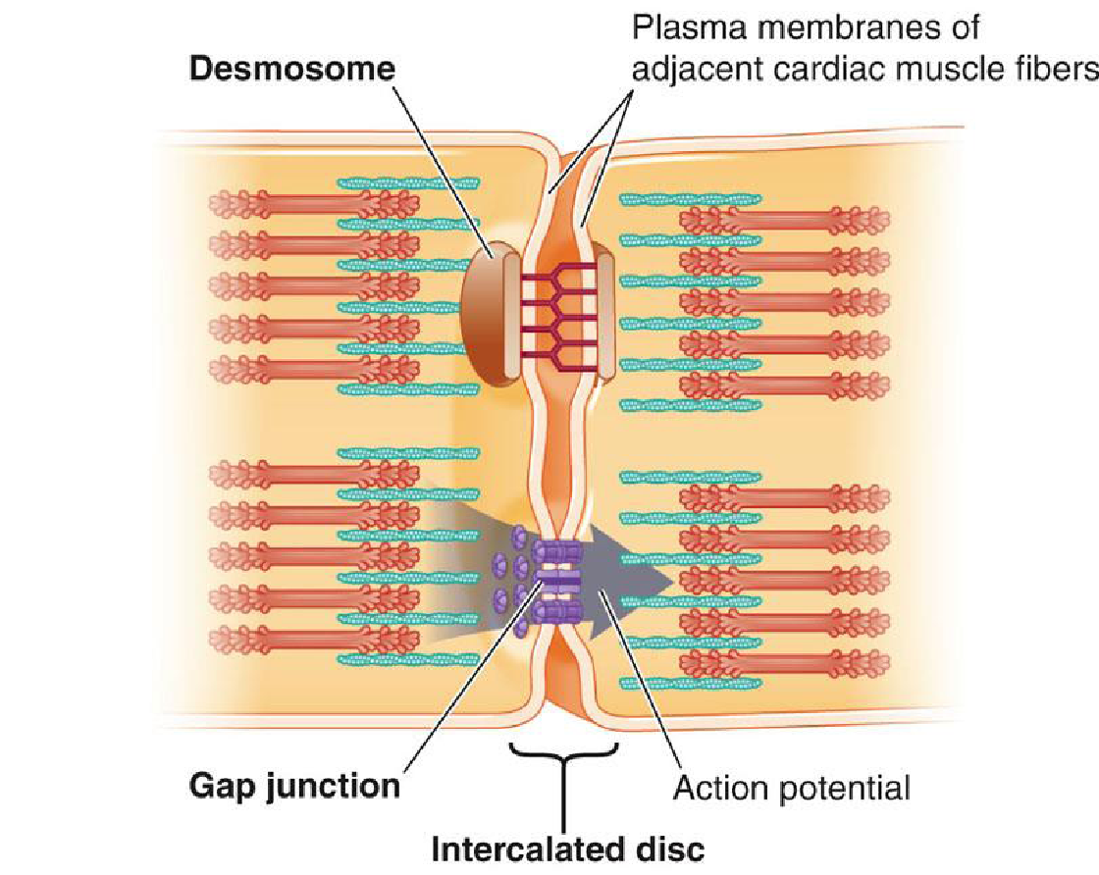
Cardiac Muscle
The dark areas crossing the cardiac muscle fibers are called intercalated discs; they are actually cell membranes that separate individual cardiac muscle cells from one another.
Interconnected by intercalated discs and form functional syncytia
Within intercalated discs –two kinds of membrane junctions:
Desmosomes (Anchoring)
Gap junctions
1
2
Girl’s Slides
AP pass easily
Membranes fuse and form permeable gap junctions which allow
Formation of syncytium

Slide 9
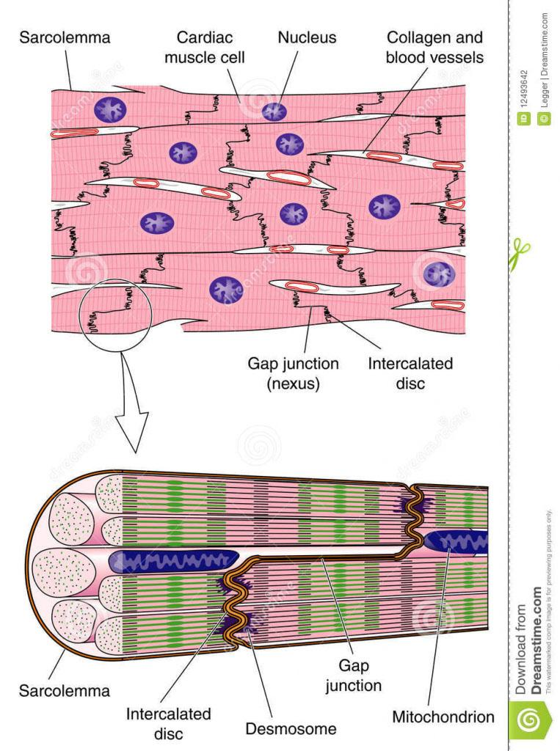
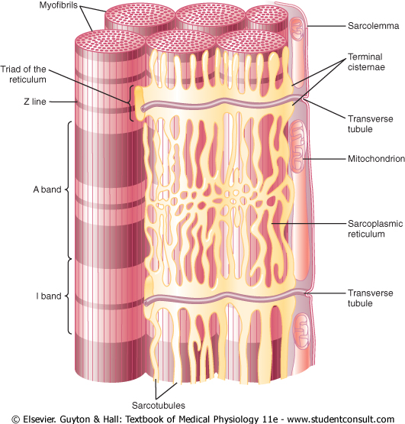
Cardiac Muscle

Slide 10
Physiology of Cardiac Muscle
Atrial
Girl’s Slides
Automatic
rhythmical electrical discharge in form of APs (SA node)
Types of heart muscle
Excitatory and
conductive
Conduction
of APs through heart (conductive fibers)
contract weakly because they contain
few contractile fibrils
What's the difference between cardiac and skeletal muscle contraction?
Atrial and ventricular muscle contract in the same way as skeletal muscle,
except that duration of contraction is much longer in cardiac muscle.
Ventricular

Slide 11
Cardiac Muscle
Boy’s Slides
At intercalated disc cell membranes fuse with one another, form permeable
“communicating” junctions (gap junctions) allow free diffusion of ions.
Ions move with ease in the intracellular fluid along the longitudinal axes of the cardiac muscle fibers, so that action potentials travel easily from one cardiac muscle cell to the next.
Thus, cardiac muscle is a syncytium of many heart muscle cells, action potential spreads to all of them.
Boy’s Slides
Isometric Contraction
Muscle contraction without significant shortening or change in distance.
Muscle contraction without significant change in force of contraction.
Isotonic Contraction
ISO = same

Slide 12
Cardiac Muscle properties
The cardiac muscle cells are responsible for electrical stimulation which leads to mechanical function. The electro-physiologic properties of cardiac muscles are:
1
Automaticity
Ability to spontaneously generate an electrical impulse.
2
Excitability
Ability to respond to an electrical impulse.
3
Conductivity
Allow transmission of electrical impulse to another cardiac cell.
4
Contractility
Ability to contract after electrical impulse response
5
Rhythmicity
Ability to send electrical impulses in a regularly manner.

Slide 13
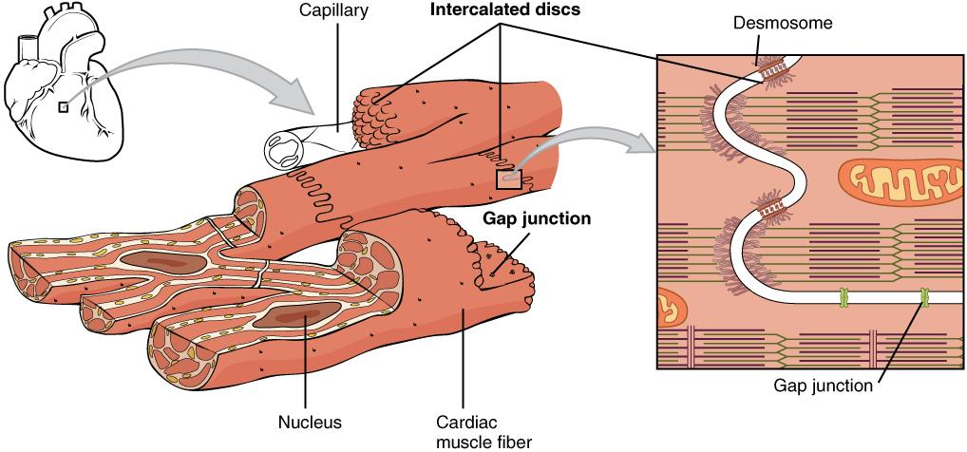
Types of cardiac muscle cell
Heart beats rhythmically as result of action potential, it generates by itself (Auto-rhythmicity)
1. Contractile cells
-99% of cardiac muscle cells
-Perform mechanical work of pumping
2. Autorhythmic cells
-Specialized for initiating and conducting action potentials responsible for contraction of myocytes
-Do not contract
How do gap junctions within intercalated disks aid contraction of the heart?
They allow impulses to spread from one cardiac muscle cell to another, allowing sodium, potassium, and calcium ions to flow between adjacent cells, propagating the action potential, and ensuring coordinated contractions.

Slide 14
Cardiac muscle as syncytium:
Girl’s Slides
Heart is composed of two syncytium:
Separated by fibrous tissue
What's the importance of this separation?
Allows atria to contract ahead of ventricles
How do action potentials reach ventricles?
Action Potentials are conducted by AV bundle.
1. Atrial
2. Ventricular
Girl’s Slides
-Cardiac muscle goes through the same series of isometric and isotonic events as skeletal muscle.
Therefore, the cardiac cycle (Heart beat) has two phases which are considered to be isometric (Isovolumic contraction, and Isovolumic relaxation) while all the other phases are considered to be isotonic in nature.

Slide 15
EXCITATION-CONTRACTION COUPLING
Excitation
(action potentials)
Increase Ca++
Contraction
(shortening)
Excitation of the heart heart is triggered by electrical impulse rather than neurotransmitters.
Contraction of the heart heart is triggered by elevation of intracellular calcium influx

Slide 16
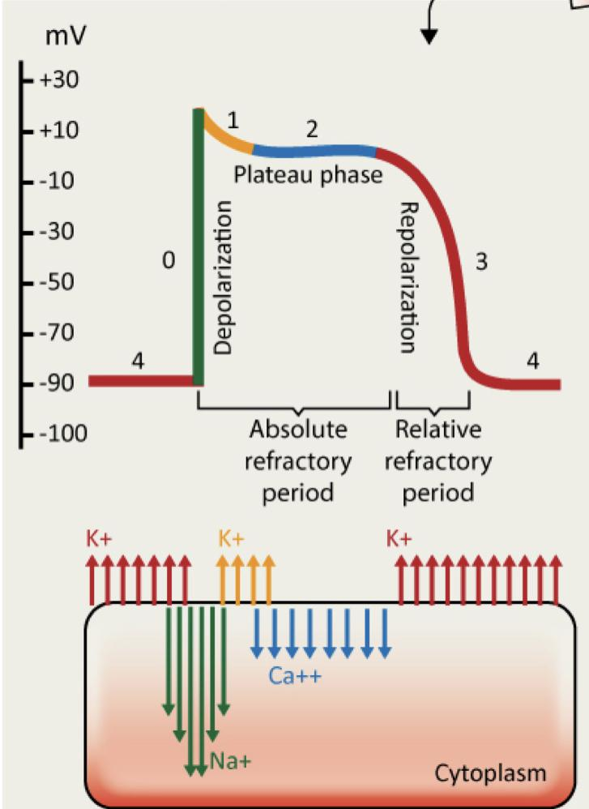
ACTION POTENTIALS IN CARDIAC MUSCLE
Girl’s Slides
The ionic basis for the Aps in the ventricles, atria, and Purkinje system is identical. The AP in these tissues shares the following characteristics:
1
2
3
Long duration
Stable resting membrane potential
Plateau
Action potential in cardiac muscle ( ventricle) :
Phase 0 :
Depolarization, fast Na⁺influx.
Phase 1:
Early repolarization, K⁺ efflux.
Plateau =0.2 sec, slow Ca⁺² channels open
causing Ca⁺² influx
Phase2 :
Phase3 :
Repolarization: K⁺ efflux.
Phase4 :
Resting, K⁺ efflux

Slide 17
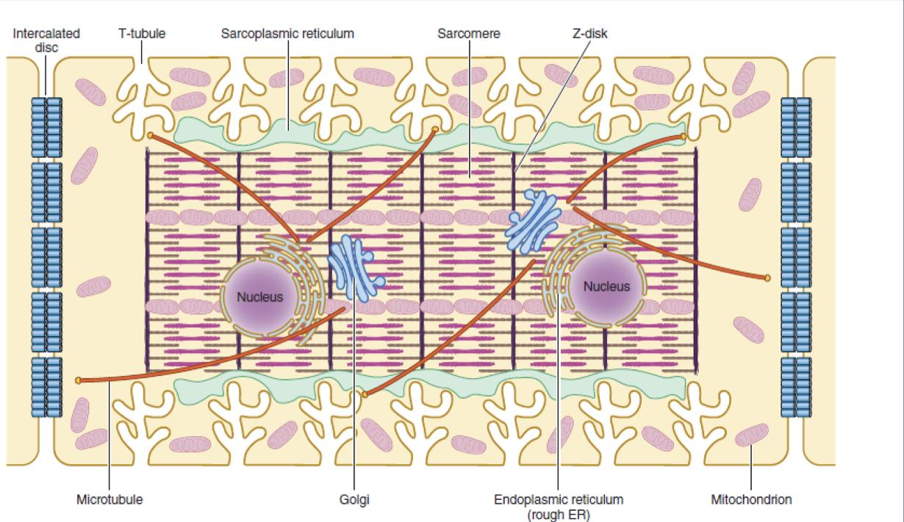
ILLUSTRATION OF THE INTERNAL STRUCTURES OF AN ADULT VENTRICULAR CARDIOMYOCYTE
Plateau
Girl’s Slides
Why is plateau phase is critical
To cardiac muscle function ?
1
It causes ventricular contraction to last as much as 15 times as long in cardiac muscle as in skeletal muscle.
It prevents additional impulses from spreading through the heart prematurely, thereby allowing the muscle sufficient time to contract and pump blood effectively.
What causes the plateau ?
2
• Prolonged opening of the slow calcium-channels allows calcium
to enter, cause plateau.
T-tubules, which are enriched with voltage-gated L-type calcium channels, are positioned closely near the sarcoplasmic reticulum, the primary internal calcium store.

Slide 18
DIFFERENCE BETWEEN ACTION POTENTIAL IN SKELETAL AND CARDIAC MUSCLE
Girl’s Slides
 | First | Second | Duration
Skeletal Muscle | AP is caused by sudden opening of large numbers of fast Na⁺ channel . | At end of closure, repolarization occurs due to K⁺ efflux, and AP is over within a thousandth of a second. | Duration of AP shorter than its mechanical response ->can undergo tetanus via repeated stimulation
Cardiac Muscle | AP is caused by opening of 2 channels: (1) fast Na⁺ channels (same as in skeletal muscle ) (2) slow Ca⁺² channels (also called Ca⁺² -Na⁺ channels or long lasting). | After onset of AP, membrane permeability for K⁺↓fivefold (does not occur in skeletal muscle). • Decreased K⁺ permeability ↓ out flux of K⁺ during plateau and prevents return of AP voltage to resting level. •When slow Ca⁺² channels close, K⁺ permeability ↑ rapidly returning membrane potential to resting level, ending AP. | Duration of AP same as duration of its mechanical response->cannot undergo tetanus via repeated stimulation

Slide 19
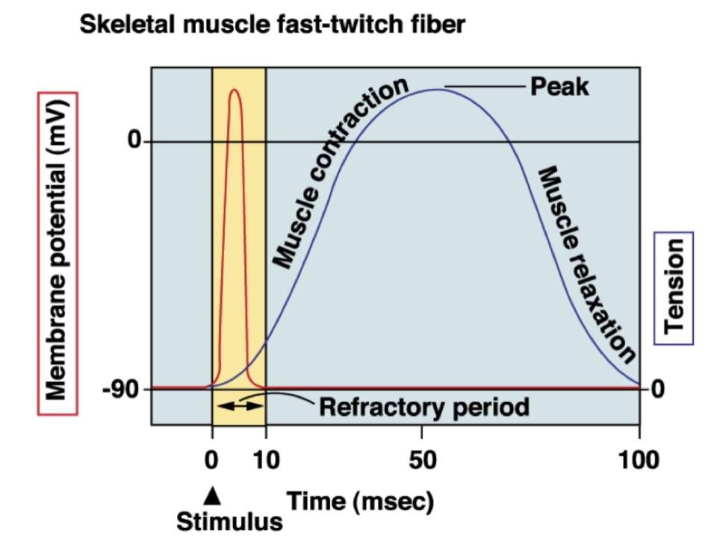
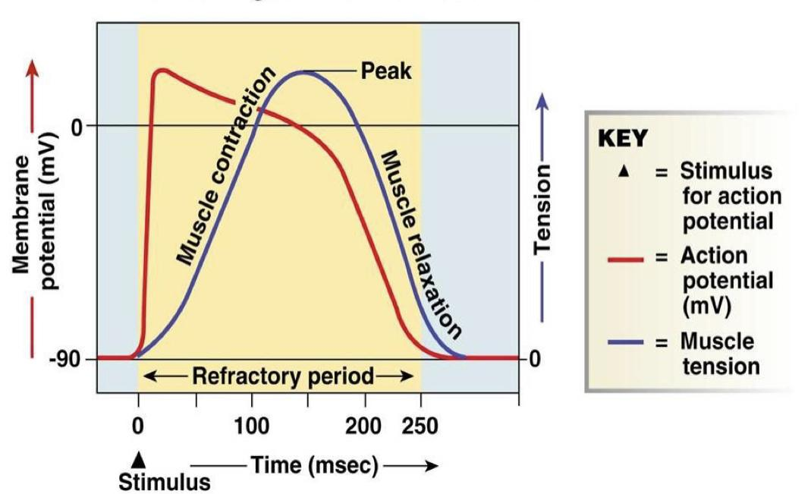
DIFFERENCE BETWEEN ACTION POTENTIAL IN SKELETAL AND CARDIAC MUSCLE
Girl’s Slides
Cardiac muscle fibre: the refractory
Period lasts almost as long as the
Entire muscle twitch
Skeletal muscle fast-twitch fiber

Slide 20
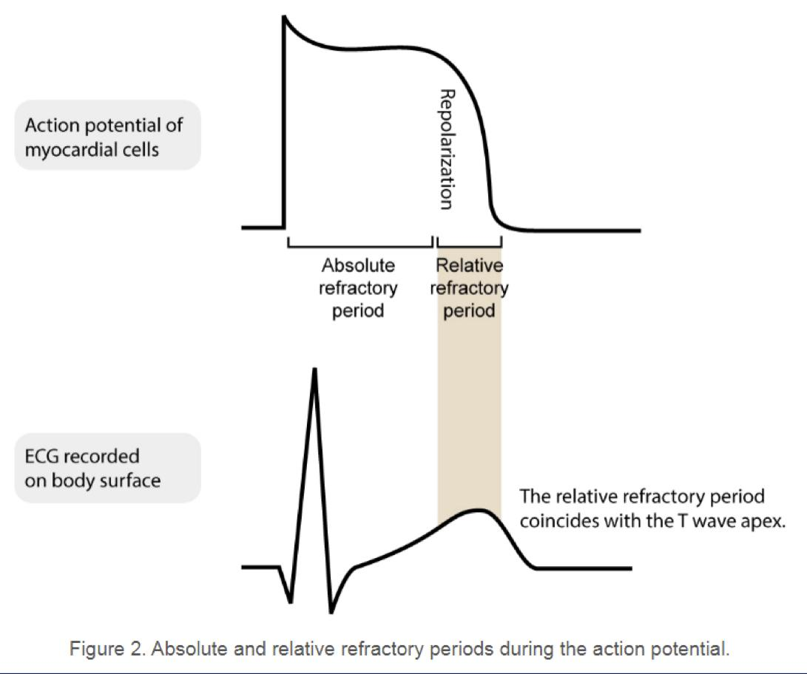
REFRACTORY (RESISTANT) PERIOD OF CARDIAC MUSCLE
Girl’s Slides
Absolute Refractory period (ARP) | Relative refractory period (RRP)
•Absolute Refractory period (ARP) of ventricle: 0.25 -0.30 sec ( signal cannot re- excite an already excited area of cardiac muscle) •acts as a protective mechanism in the heart | •Relative refractory period (RRP) of ventricle: 0.05 sec (muscle difficult to excite but can be excited by a strong signal “premature” contraction)

Slide 21
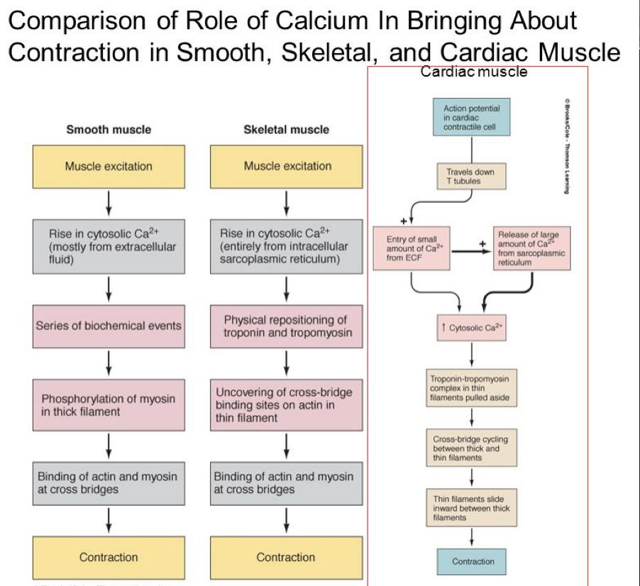

Slide 22
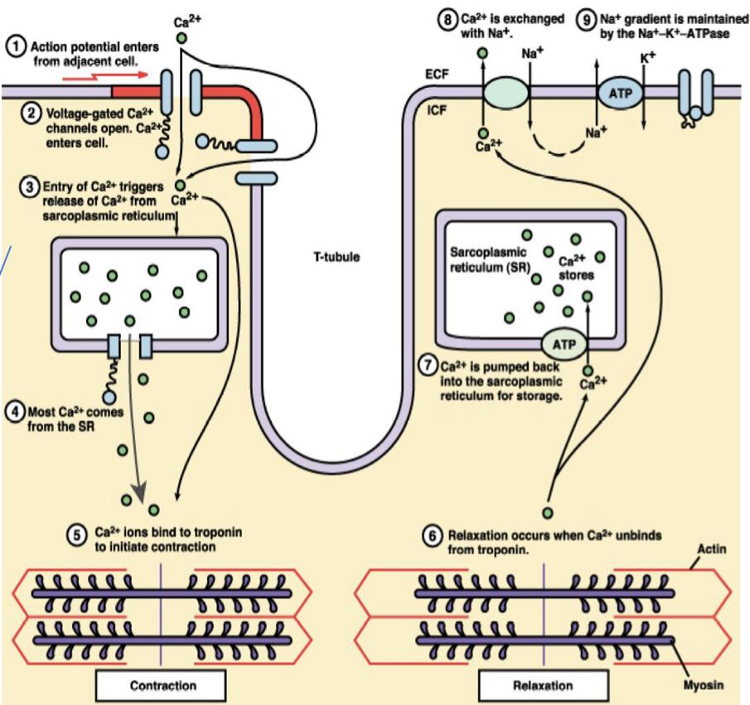
EXCITATION-CONTRACTION COUPLING IN CARDIAC MUSCLE
Girl’s Slides
Cardiac muscle fibers contract via excitation-contraction coupling, using a mechanism unique to cardiac muscle called calcium -induced calcium release (CICR) .
CICR involves conduction of Ca⁺² ions into the cardiomyocyte, triggering further release of ions into the cytoplasm.
Entry of extracellular Ca⁺² ions causes the release of Ca⁺² from the sarcoplasmic reticulum (calcium-induced calcium release), source of about 95% of calcium in cytosol.

Slide 23
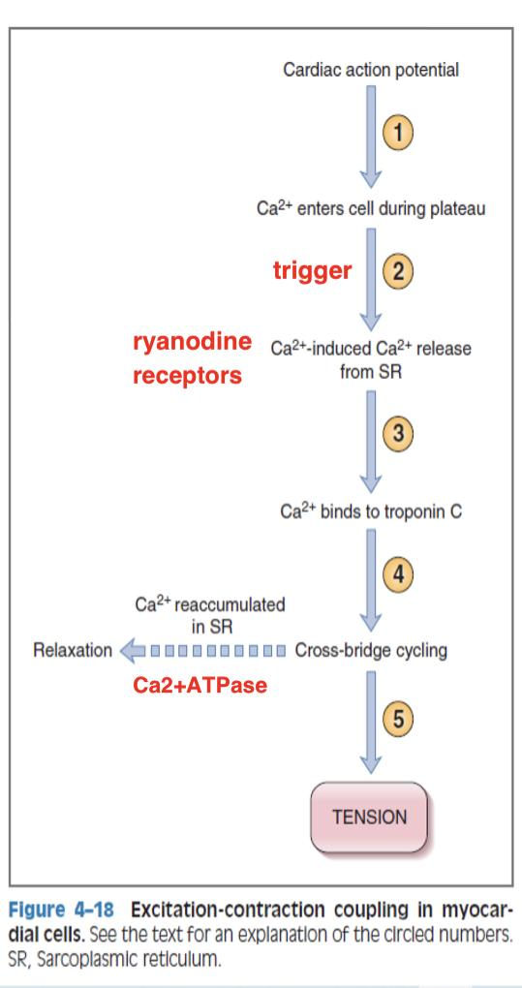
EXCITATION-CONTRACTION COUPLING…
1- AP is initiated in cell membrane, and depolarization spreads to interior of cell via T tubules.
2- Entry of Ca⁺² triggers release of more Ca⁺² from SR through ryanodine receptors.
3 & 4- Ca⁺² release from the SR Increases intracellular Ca⁺² which binds to troponin C, tropomyosin is moved out of the way, and interaction of actin and myosin occurs.
5-Relaxation occurs when Ca⁺² is re- accumulated in SR by Ca⁺² ATPase (SERCA, sarco-endoplasmic reticulum calcium-ATPase).
SR: sarcoplasmic reticulum

Slide 24
EXCITATION-CONTRACTION COUPLING…
Girl’s Slides
What's the importance of Ca+2 from T tubules?
Without Ca⁺² from T tubules, strength of cardiac muscle contraction would be reduced considerably because:
• SR is less well developed than that of skeletal muscle and does not store enough Ca⁺² to provide full contraction.
•Therefore, T tubules of cardiac muscle have a diameter 5x as great as skeletal muscle tubules
•Inside T tubules is a large quantity of mucopoly-saccharides (glycosaminoglycans ”GAGs” found remember?!) that are electro-negatively charged and bind an abundant store of Ca⁺² keeping Ca⁺² available for diffusion to interior of cardiac muscle fiber when a T tubule AP appears.

Slide 25
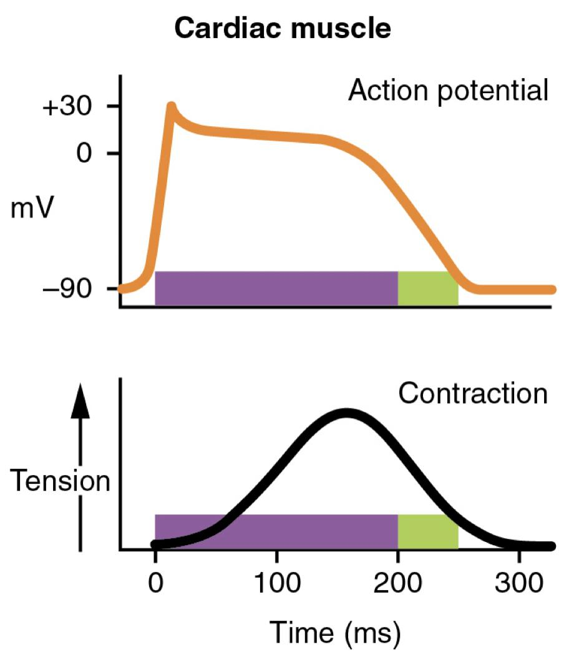
EXCITATION-CONTRACTION COUPLING…
DURATION OF CONTRACTION :
Summary from male’s slide:
Ca++ enters cell during depolarization and triggers release of Ca++ by terminal cisternea.
Ca++ bind to TN-C, including a conformational change in the troponin complex.
myosin head bind to actin, leading to cross-bridge movement (requires ATP hydrolysis)and reduction in sarcomere length.
Ca++ is resequestered by SR by the SERCA pump
Ca++ is removed from TN-C, and myosin unbinds from actin (requires ATP) this allow the sarcomere to resume its original, relaxed length
Cardiac muscle begins to contract a few millisec after AP begins and continues to contract until a few millisec after AP ends.
The duration of contraction of cardiac muscle is mainly a function of the duration of AP ( about 0.2 sec in atrial muscle and 0.3 sec in ventricular muscle).

Slide 26
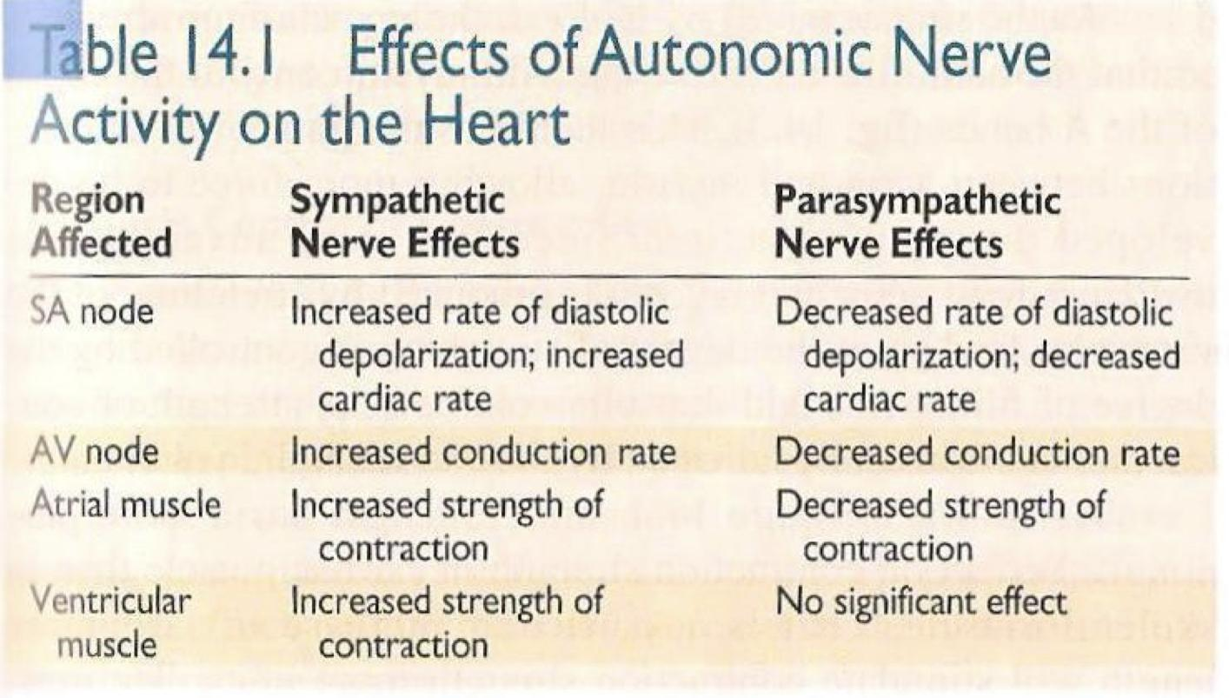
FACTORS REGULATING CONTRACTILITY :
female Dr said
Are important
Girl’s Slides
• Contractility correlates directly with the intracellular Ca⁺² concentration
• Therefore, the larger the inward Ca⁺² current and the larger the intracellular stores, the greater the increase in intracellular Ca⁺² concentration and the greater the contractility.

Slide 27
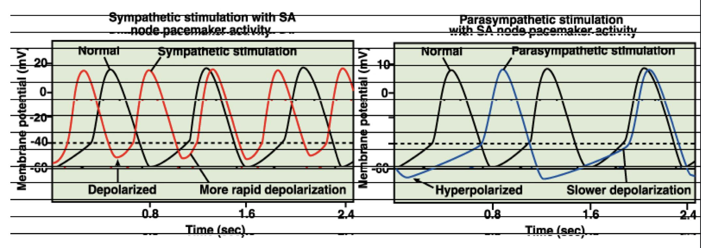
FACTORS REGULATING CONTRACTILITY …
Boy’s Slides
Autonomic nervous system modulates the frequency of depolarization of pacemaker
Sympathetic stimulation (neurotransmitter); binds to β1 receptors on the SA nodal membranes
Parasympathetic stimulation (neurotransmitter); binds to muscarinic receptors on nodal membranes; increases conductivity of K⁺ and decreases conductivity of Ca⁺²

Slide 28
MCQs
Q1: What are the two structures that fuse together to form the intercalated disc?
A- gap junctions | B- fascia adherens | C- cell membranes | D- cardiac cell
Q2: A spontaneous generation of electrical impulses, known as?
A- Conductivity | B- Automaticity | C- Contractility | D- Excitability
Q3: which one of AP in cardiac muscle have plateau phase ?
A- phase 0 | B- phase 1 | C- phase 2 | D- phase 3
Q4: cardiac muscle begin to contract a few millisec after :
A- AP begin | B- AP end | C- depolarization | D- Repolarization
Q5: Refractory period (RP) that signal can’t re-excite an already excited area ?
A- ARP | B- RRP | C- Zero RP | D- Blocked RP
Answers: 1.C 2.B 3.C 4.A 5.A

Slide 29
SAQs
Q1: What is the importance of gap junctions?
Q2: what causes plateau ?
Q3: what is the difference between the type of refractory period of cardiac muscle ?
1- it permits AP to pass easily through cardiac cells and form syncytium
2- Prolonged opening of the slow calcium-channels allows calcium
to enter.
3-answer in slide 23 .

Slide 30
Team Leaders
THANK YOU
Saleh aldeligan
Qusai Alsultan
Raghad Alkhudair
Raghad Alnadeef
Team Members
Othman Aldraihem
Abdulaziz Alqahtani
Abdullah Alshahri
Saad Al Hammad
MOHAMMED ALDAWSARI
Ahmad Almarshed
Rayan Alahmari
ABDULRAHMAN BINBAKHIT
Abdulaziz Alymni
Faisal Alkhunein
Abdullah Alqarni
Raid Almadi
Mohammad Alrashed
Abdulrahman bin Ateeq
Amer Alghamdi
Mishal Alsuwayegh
Nawaf alturki
Hussam Aleid
Raid almadi
Mohammed AlShehri
Nouf Aldhalaan
Amani Alotaibi
Shahed bukhari
Shahad Aljeri
Maha Alkoryshy
Alhnouf Hadi
Mayssam Aljaloud
Hissa Alshiqari
Mashael Albugami
Renad Alayidh
Ghada Binslmah
Razan Alsulami
Shaden albassam
Razan Almanjomi
Reem Alhazmi
Dhai hamdan
Shahad alaskar
Haifa Almuddahi
Reema alquraini
deema aljuribah
Kadi Khalid aldossari
Farah alhalafi
Theme was done by Mohammad Alrashed
Physio442@gmail.com
Editing File

