Slide 1
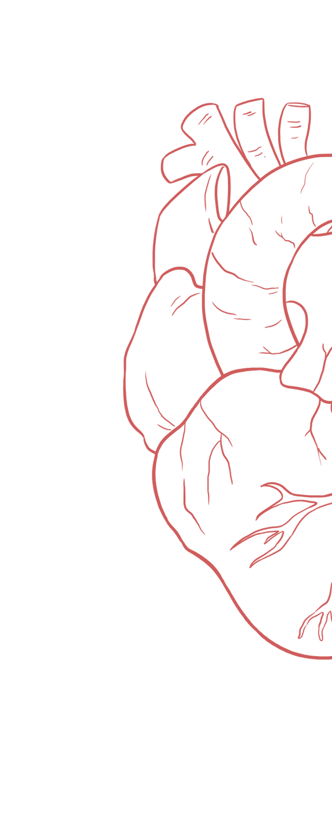
Arterial Blood Pressure
____________
Color Index:
Main Text
Important
Girl’s Slides
Boy’s Slides
Dr’s Notes
Extra Info

Slide 2
Objectives
Definition & concept of Arterial Blood Pressure.
Define normal values & variations of Arterial Blood Pressure.
Define pulse & Mean Arterial Pressures.
Understand the affecting & determining factors of arterial blood pressure & effect of gravity on arterial blood pressure.
Define systolic and Diastolic blood pressure & Describe how BP is measured
Hypotension and Hypertension & Clinical features and complications of Hypertension
Know the physiological significance

Slide 3
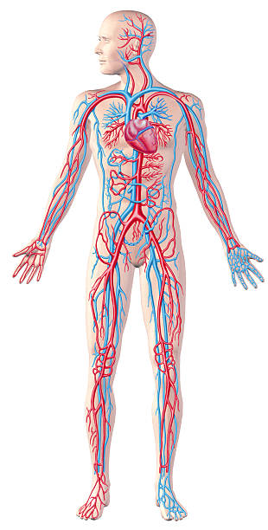
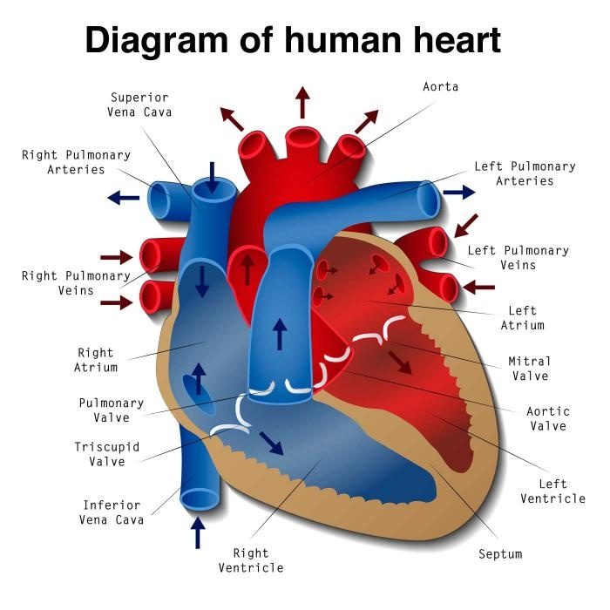
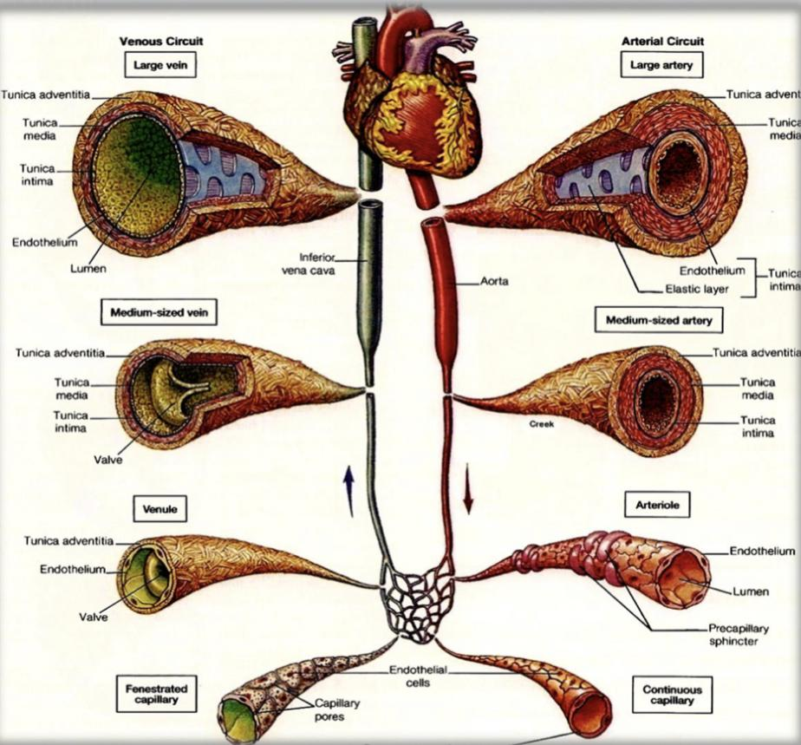
The Cardiovascular System
The cardiovascular system is part of the circulatory system, & consists of:
Only in female slide
The heart
The vascular system
Consists of arteries, arterioles,.capillaries, venules, & veins.
A hollow muscular organ, of approximately fist size.
Located in the chest - left to midline, behind the sternum, anterior to vertebral column, & superior to diaphragm.
Consists of (4) chambers.
Having (4) valves.
Right- sided pump: Carries deoxygenated blood to the pulmonary circulation.
Left- sided pump: Carries oxygenated blood to the systemic circulation.

Slide 4
The Vascular System
Only in female slide
Consists of tube of vessels that blood flows through.
These Vessels are arteries & veins.
Arteries carry blood away from the heart.
The largest artery is the aorta.
Arteries are thicker to be able to handle the higher pressure of blood moving through them.
Arteries branch out into many smaller arteries.
Veins push blood back to the heart.
The largest (2) veins are the superior & inferior vena cavae.
Veins have thin walls & accommodate more blood without increased pressure (= higher compliance
Veins are called the capacitance vessels.
Veins hold most of blood in body (≈70%).
A complex system connects veins & arteries throughout the body: arterioles, capillaries, & venules.
Both arteries & veins have 3 main layers.

Slide 5
Types of Blood Pressure
Depending on the nature of the blood vessels,
Arterial Blood Pressure
Venous Blood Pressure
Capillary Blood Pressure
Pressure Changes Throughout Systemic Circulation
Only in female slide
Blood flows down a pressure gradient.
Pressure is highest at the Heart (driving pressure), & decreases over distance.
Pressure decreases more than 90% from the Aorta to Vena cava.
Greatest drop in pressure occurs in Arterioles (resistance vessels) which regulate blood flow through tissues.
No large fluctuations of pressure in Capillaries & Veins. fluctuations = تغيرات
BP reaches 120 mmHg in the Aorta & drops to 2 mmHg in the Right Atrium
Veins have only 0 -10 mm Hg Pressure. So blood pressure is less in the veins when compared to arteries
Note : vaso = arterioles , veno = venules

Slide 6
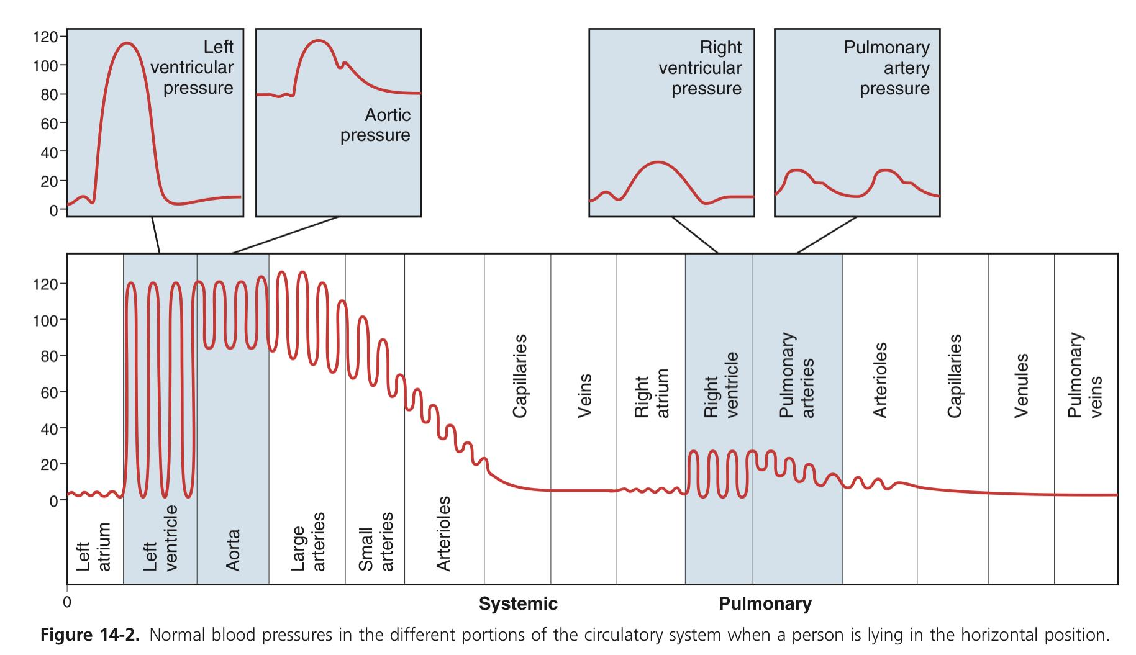
Blood pressure changes
From Guyton
Note at the far right side of the Figure the respective pressures in the different parts of the pulmonary circulation. In the pulmonary arteries, the pressure is pulsatile, just as in the aorta, but the pressure is far less: pulmonary artery systolic pressure averages about 25 mm Hg and diastolic pressure averages about 8 mm Hg, with a mean pulmonary arterial pressure of only 16 mm Hg. The mean pulmonary capillary pressure averages only 7 mm Hg. Yet, the total blood flow through the lungs each minute is the same as through the systemic circulation.the low pressures of the pulmonary system are in accord with the needs of the lungs because all that is required is to expose the blood in the pulmonary capillaries to oxygen and other gases in the pulmonary alveoli.
Blood pressure in different parts of the circulatory system.

Slide 7
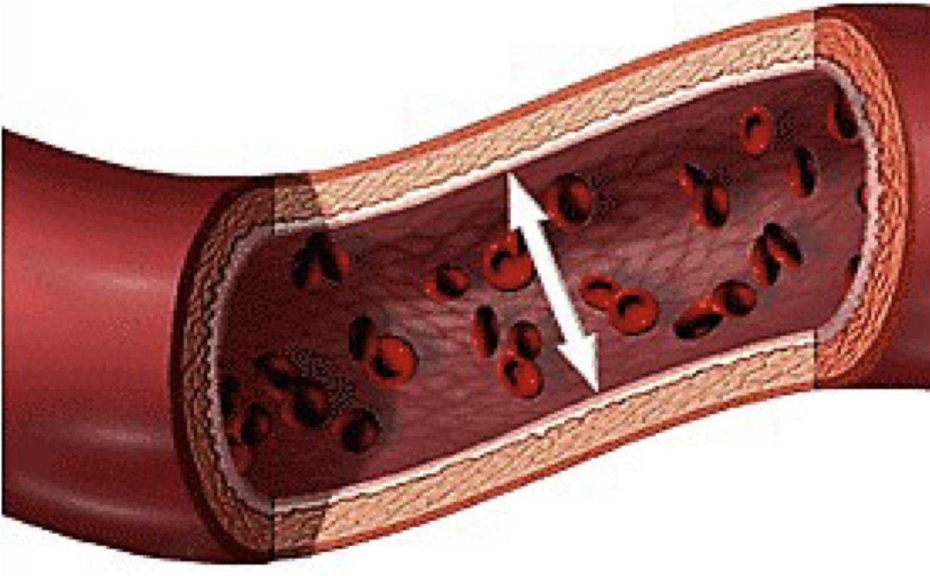
Arterial Blood Pressure
Arterial Blood Pressure (ABP) is : the lateral pressure force exerted by the blood flow on the arterial wall against any unit area of the vessel wall.
The pressure force of blood flow is created & determined by the pumping force of the heart.
Arterial blood pressure (ABP) is one of the most important vital signs. Why? Because steady ABP = stable perfusion for tissues أحد اهم العلامات الحيوية المهمة في الجسم لانه يوصل الدم للأنسجة
important to keep normal levels of blood pressure for proper blood flow to the body’s organs & tissues.
Standard units of BP: Measured in (mmHg), & sometimes in (cmH2O) (1mmHg = 1.36 cmH2O)
1 ml of mercury pressure= 1.36 centimeters of water pressure because the specific gravity of mercury is 13.6 times that of water, and 1 centimeter is 10 times as great as 1 millimeter.
Arteries are Pulsatile. so arterial pressure varies. (because their wall is made of thick smooth muscle, it’s not fixed)

Slide 8
Arterial Blood Pressure Measures
Systolic Blood Pressure
Maximum force exerted by the blood flow against any unit area of the vessel wall during
maximum contraction (systole) of the heart.
Diastolic Blood Pressure
Minimum force exerted by the blood flow against any unit area of the vessel wall during
maximum relaxation (diastole) of the heart.
Normal Levels of Arterial Blood Pressure:
Normal adult arterial blood pressure measures 120mmHg systolic/80mmHg diastolic.
Normal adult Arterial Blood Pressure varies physiologically, with an ideal range of,
80 /90 –120 mmHg systolic.
60 – 80 mmHg diastolic.
Both numbers are important to determine the health state of the heart.
Higher numbers indicate that the heart is working too hard to pump blood to the rest of the body.

Slide 9
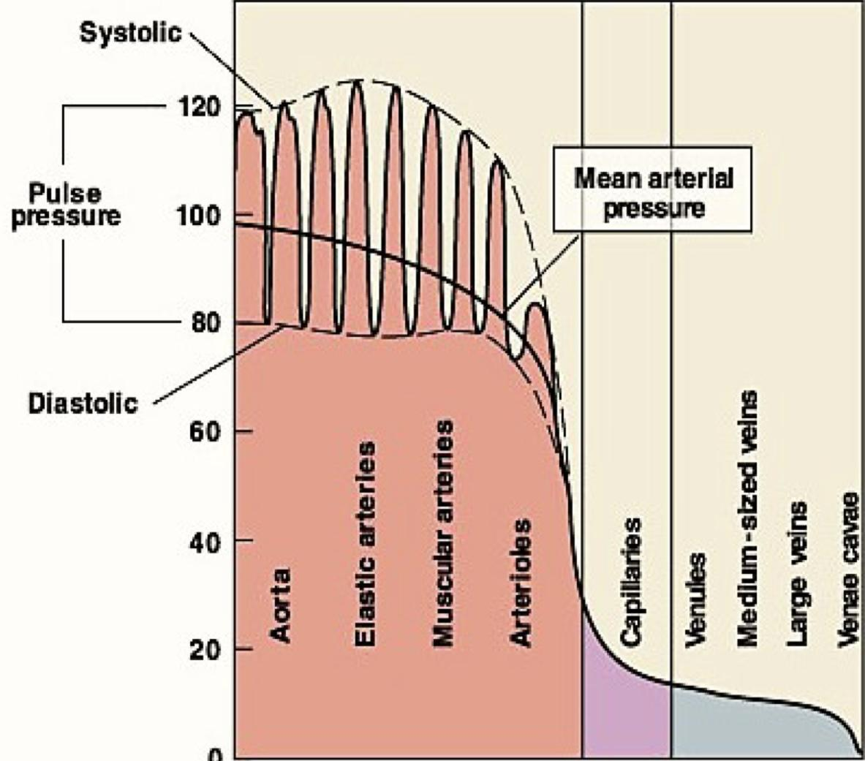
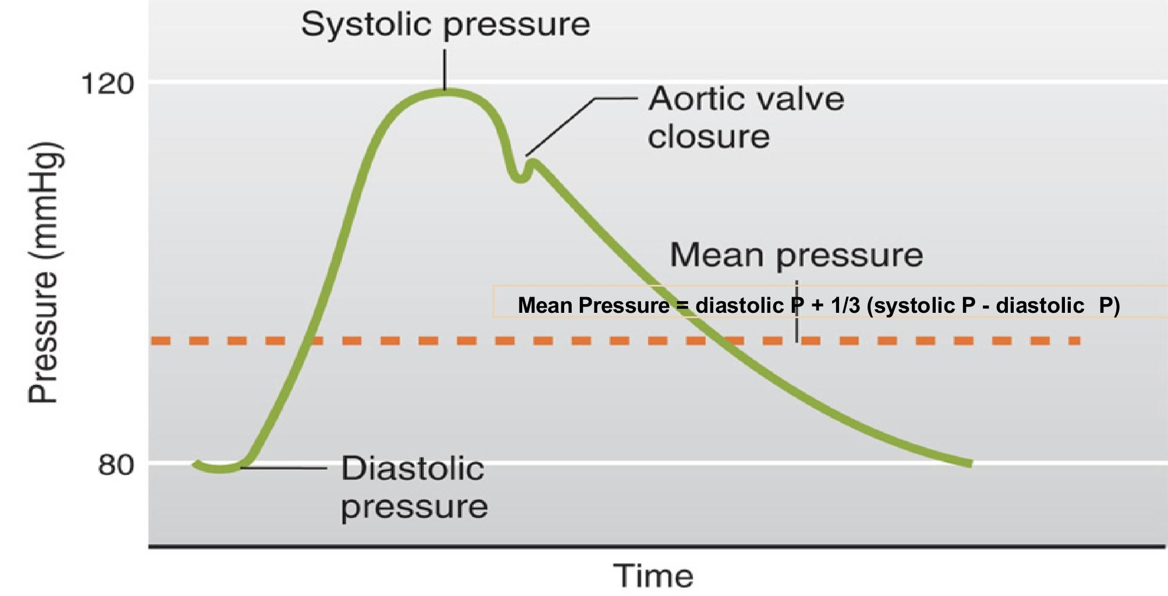
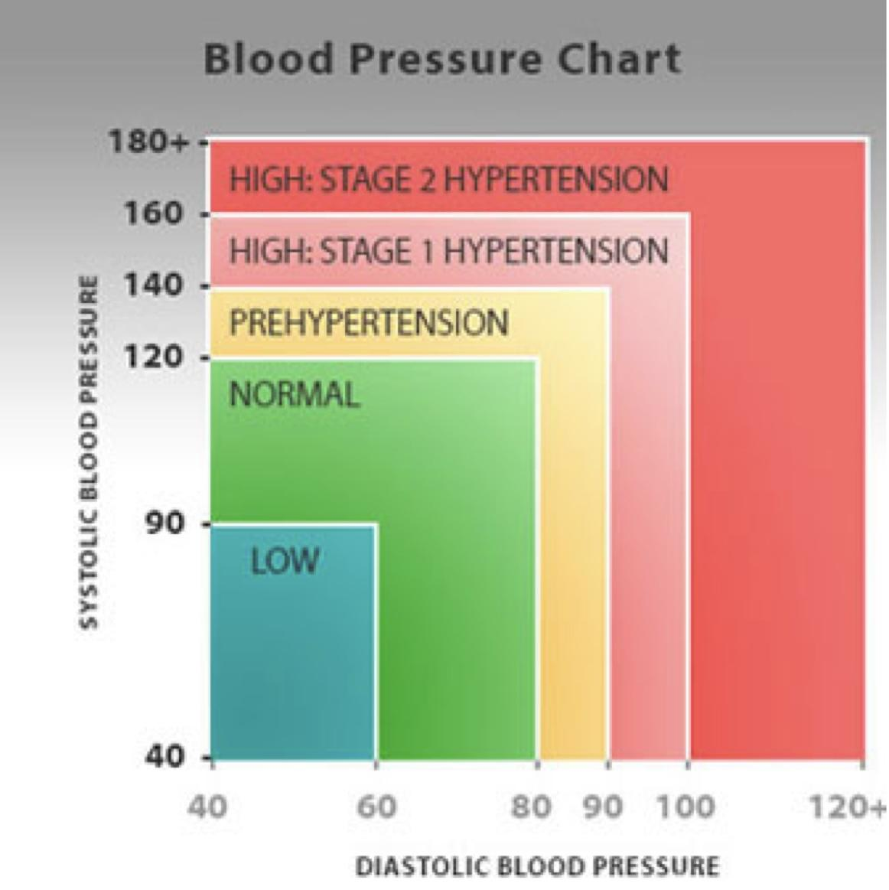
Arterial Blood Pressure Measures
only in male slide
Arterial BP in different parts of circulatory system
highest at the heart.
Over distance
90% from aorta to vana cava
Greatest pressure drop occurs in arterioles
No great fluctuation in capillaries & veins
Arterial blood pressure

Slide 10
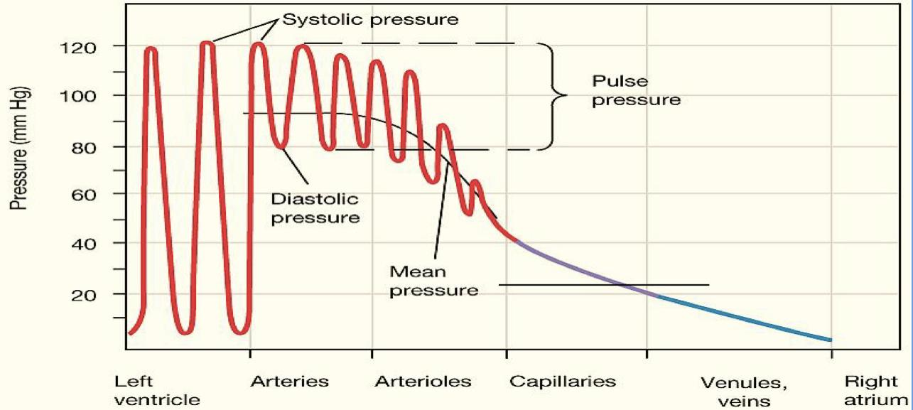
Pulse and Mean Arterial Pressures
Pulse rate is always same as the heart rate, which is the number of beats per minute (bpm).
Arteries are Pulsatile, so arterial pressure varies, & a single value is used to represent the overall driving pressure.
,This value is called the Mean Arterial Pressure (MAP). Pulsatile means it have muscle thickness makes it palpable; that’s why the ABP fluctuates.
Mean arterial pressure: is the average of the arterial pressures measured in millisecond over a period time
Mean arterial pressure is a better indicator of perfusion to the vital organs than systolic blood pressure.
It’s responsible for driving blood into the tissues throughout the cardiac cycle.
It is not equal to the average of systolic and diastolic pressure.
To calculate a mean arterial pressure, double the diastolic blood pressure and add the sum to the systolic blood pressure. Then divide by 3.
Pulse Pressure = Systolic Blood Pressure – Diastolic Blood Pressure
(MAP) = Diastolic Pressure + 1/3 (Systolic P - Diastolic P)
OR MAP = Systolic P + 2 (Diastolic P)
3
Example If a patient’s blood pressure is 83/50 mmHg, his MAP would be 61 mm Hg.
MAP = 1/3 (SBP - DBP) + DBP = 1/3 (83-50) + 50 = 1/3 (33) + 50 = 11 + 50 = 61 mm Hg
Another way:
MAP = SBP + 2 (DBP)/3 , MAP= 83 +2 (50) /3 , MAP = 83 +100/3 , MAP = 61
Pulse Pressure = Systolic P – Diastolic P
= 120 - 80 = 40 mmHg

Slide 11
Arterial Blood Pressure Guidelines
Blood Pressure Chart
American Heart Association
Blood Pressure Categories Guidelines
Nov
2017
Value | Old Guidelines | New Guidelines
<120 | normal | normal
120-129 | high normal | elevated blood pressure
130-139 | high normal | stage 1 hypertension
140 or Higher | hypertension | stage 2 hypertension
Blood Pressure Category | Systolic |  | Diastolic
normal | <120 | And | <80
Elevated (prehypertension) | 120-129 | And | <80
High Blood Pressure (Hypertension) Stage 1 | 130-139 | Or | 80 - 89
High Blood Pressure (Hypertension) Stage 2 | 140 or Higher | Or | 90 or Higher
Hypertensive Crisis ( consult your doctor immediately) | Higher than 180 | And/Or | Higher than 120

Slide 12
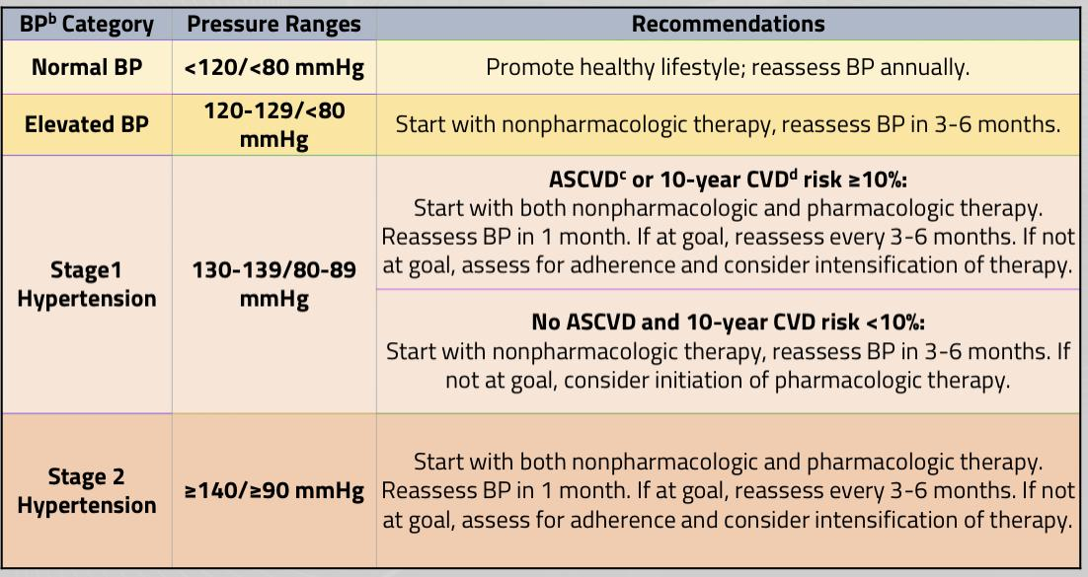
American Heart Association (AHA)
Only female slide
The AHA/ACC started synthesizing evidence and publishing guidelines specifically for hypertension (HTN) in 2014.
The last update was in 2017 & the major change at that time was:
Lowering the definition of HTN from ≥140/≥90 mmHg to ≥130/≥80 mmHg.
Re-classified "pre-HTN" as elevated blood pressure (120-129/<80 mmHg).
Table: AHA/ACCa Guideline Recommendations by Blood Pressure Category.
The AHA/ACC has released a scientific statement in 2021 offering new guidance for management of stage 1 hypertension among patients with low ASCVD risk.
Among low-risk adults (no ASCVD or 10-year CVD risk <10%) with stage 1 hypertension (blood pressure 130-139/80-89mmHg)
Management of stage 1 hypertension starts with nonpharmacologic therapy.
If blood pressure remains uncontrolled at 3-6 months, consider starting pharmacologic therapy.
a: AHA/ACC, American Heart Association, American College of Cardiology.
b: BP, blood pressure.
c: ASCVD, atherosclerotic cardiovascular disease.
d: CVD, cardiovascular disease.

Slide 13
Physiological Factors Affecting Arterial Blood Pressure
Temperature:
ABP (⬇️) with Heat due to vasodilatation, & ( ⬆️ ) with cold due to vasoconstriction.
Pregnancy:
ABP (⬆️) due to ⬆️ in hemodynamics/metabolism .
Sex:
Male > Female , equal at menopause.
Sleep:
ABP (⬇️) due to ⬇️ venous return.
Age:
ABP rises with age, elderly > children, due to atherosclerosis, diabetes, …
Race:
( dietary factors, or⬆️ stress)
Body mass index:
ABP rises with body size or obesity.
Gravity:
ABP is higher in lower limbs than upper limbs.
Emotions:
ABP ( ⬆️ )due to neural & hormonal factors.
Hormones:
Some hormones like adrenaline, noradrenaline & thyroid H (⬆️) BP.
Exercise:
(⬆️) ABP due to ⬆️ venous return.

Slide 14
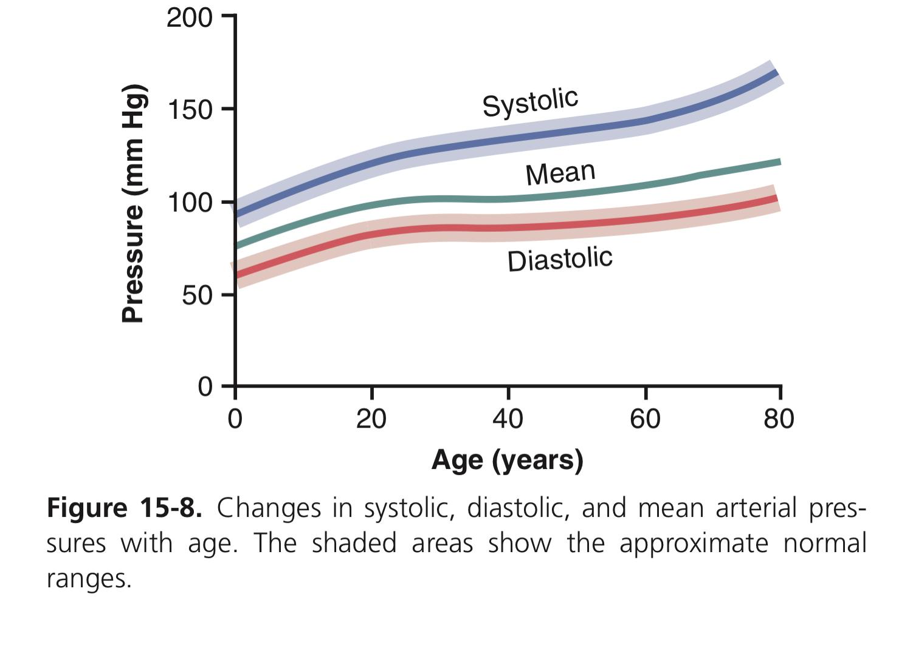
Physiological Factors Affecting Arterial Blood Pressure: Age
Only in male slide
From Guyton :
A slight extra increase in systolic pressure usually occurs beyond the age of 60 years. his increase results from decreasing distensibility, or “hardening,” of the arteries, which is often a result of atherosclerosis. The final effect is a higher systolic pressure with considerable increase in pulse pressure, as previously explained. Note that the mean pressure (solid green line) at all ages is nearer to the diastolic pressure than to the systolic pressure. However, at very high heart rates, diastole comprises a smaller fraction of the cardiac cycle and the mean arterial pressure is more closely approximated as the average of systolic and diastolic pressures.
كلما نكبر في السن كلما الضغط يزيد

Slide 15
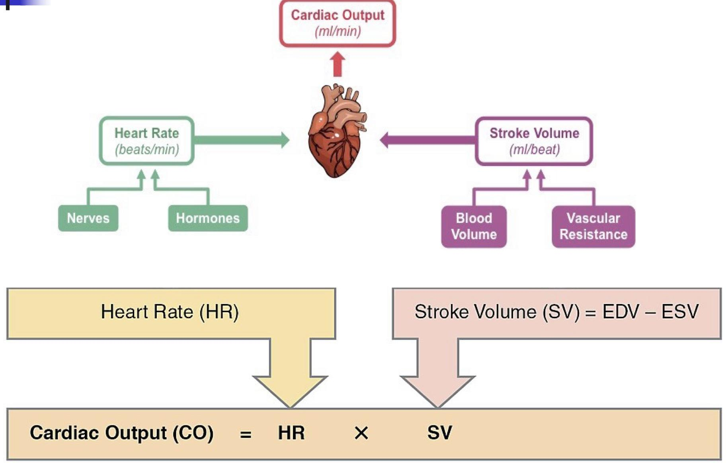
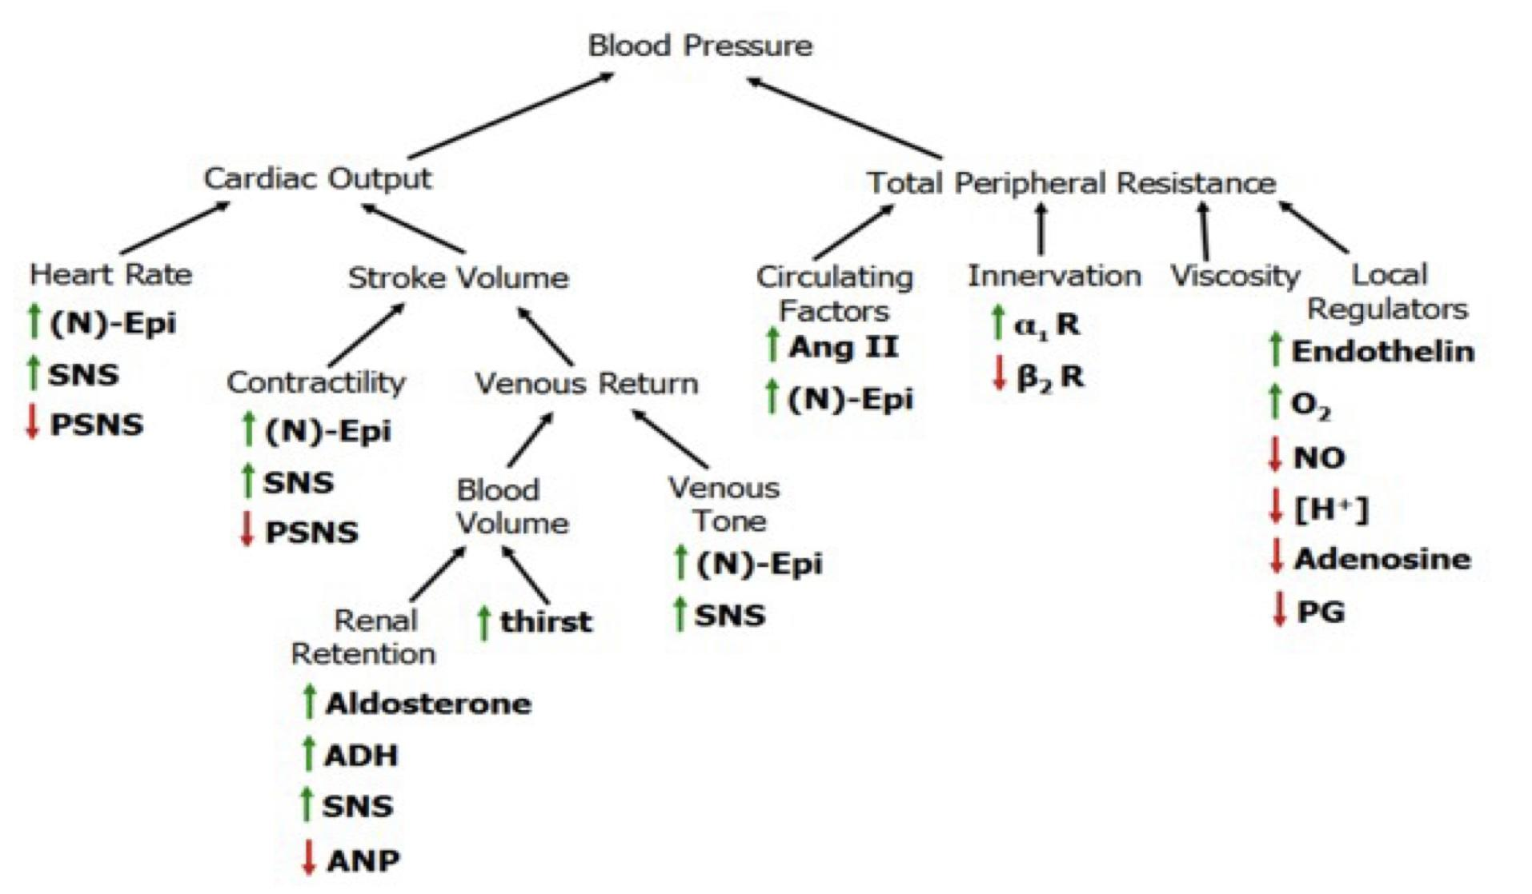
Male slides
Physiological Factors affecting Arterial Blood Pressure

Slide 16
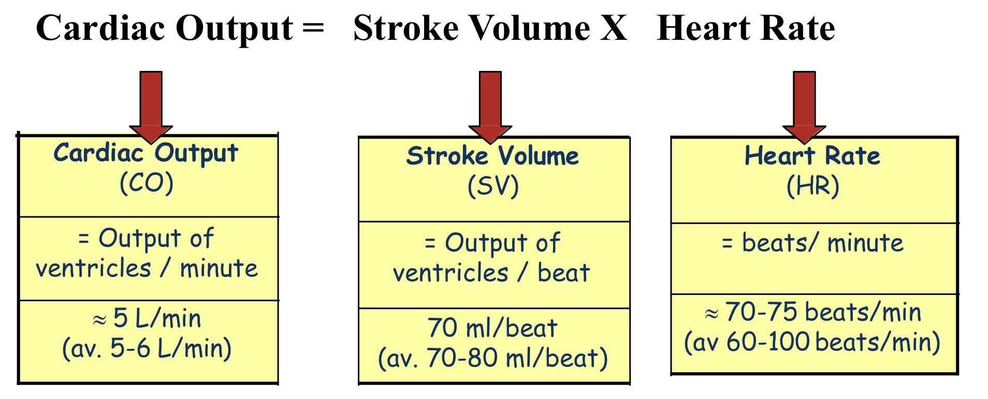
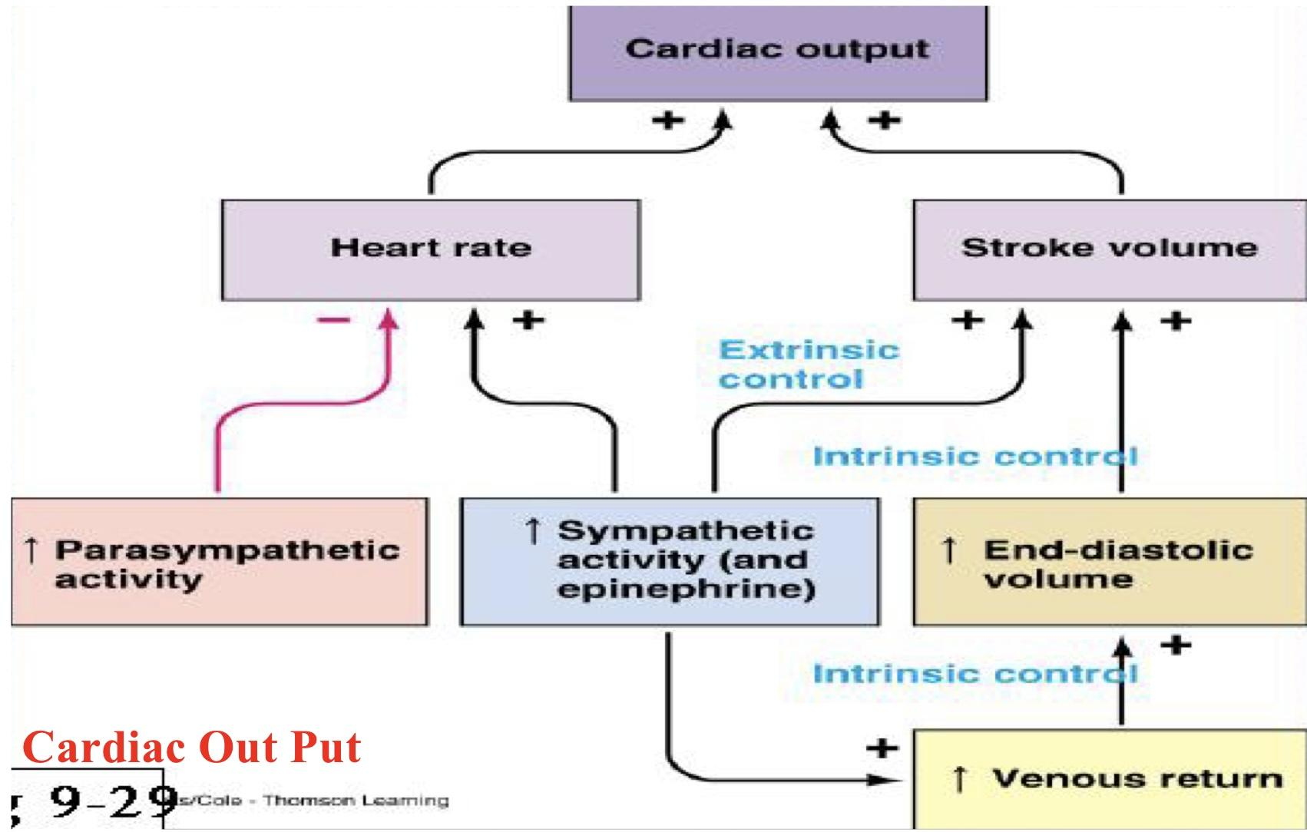
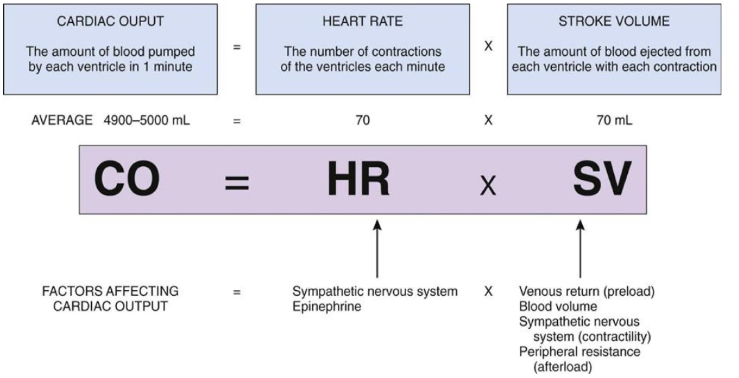
Physiological Factors affecting Arterial Blood Pressure
Only in male slide

Slide 17
Factors Determining Arterial Blood Pressure
Only in female slide Except the definition of CO
Blood Pressure = Cardiac Output X Peripheral Resistance
team 436: If one of these factors are missing then there will be 1. Cardiac Output (Flow) NO blood pressure.
MAP
Co
PR
Cardiac output (Flow) | 2. Peripheral Resistance = afterload | 3. Blood volume
CO =Stroke volume(SV) x Heart rate(HR) CO is a function of: 1-Stroke volume. 2-Heart rate. Determined by : 1- Stroke volume 2-Heart rate Note that Any increase in the (SV)or (HR)will increase the CO which will eventually increase the arterial blood pressure | Depends on: 1- Blood Vessels’ Size ( r) 2- Blood Viscosity / Thickness (η) 3- Blood vessels length (L) remains constant so we can ignore it Note that any increase in Peripheral Resistance will eventually increase the arterial blood pressure | Depends on: 1- Fluid intake 2- Fluid loss Note that any increase the Blood volume will eventually increase the arterial blood pressure
أي تغيير في أحد هذه العوامل سوف يؤدي إلى التأثير على ضغط الدم

Slide 18
The Cardiac Output (CO)
Variables affecting Stroke Volume & Heart rate
CO =Stroke volume(SV) x Heart rate(HR)
is the volume of blood pumped by the ventricle per minute..
CO is expressed in L/min.
At rest, CO is 4-6 L/min ( 5 L/min), in healthy adults, when the HR = 70 bpm
Since normal total adult resting blood volume 5 L, the blood volume circulates through the body once each minute.
Any factor that affects these parameters will affect the CO.
Contractility
(Myocardial function)
Ventricular End- Diastolic Volume (EDV), which is affected by the Autonomic Preload (Venous Return)
Ventricular Myocardium
(for SV)
Afterload (Peripheral Resistance)
SA node(for HR)
Autonomic Innervation
Hormones/ Drugs

Slide 19
I: Regulation of The Cardiac Output
Only female slide
Peripheral Resistance (Afterload) (Mean arterial blood pressure)
CO =Stroke volume(SV) x Heart rate(HR)
Starling’s law of the heart – the more stretch of cardiac muscle, the stronger the contraction
Intrinsic
Stretch
Frank – Starling’s Law
Strength of Contraction
Extrinsic
Hormones/Drugs
Sympathetic n
Parasympathetic n
End Diastolic volume (EDV)
Arrows for Inhibitor
Arrows for Stimulator

Slide 20
I: Regulation of The Cardiac Output- stroke volume
Only female slide
Regulation of Stroke Volume | End diastolic volume ≠ preload
Stroke volume (SV) : the amount of blood pumped by ventricle per beat. Stroke volume (SV)= 70-80 mL/beat. Stroke volume (SV) is determined by the: End-diastolic Volume : the volume of blood in ventricles at the end of diastole. 110-130 mL End-systolic Volume :Amount of blood left in ventricles at the end of systole. 40-60 mL Stroke volume (SV) is regulated by 3 variables: End Diastolic Volume: Affect the (EDV) Affected by the preload (venous return) Contractility (Strength of contraction):Affect the (ESV). Affected by Starling’s law & sympathetic innervation. Total Peripheral Resistance Affected by the (Afterload): Affect the(ESV) Affected by size & length of blood vessel. Thickness (viscosity) of blood. | Preload: (Venous Return) is the amount of blood returns to the heart from the veins, into the atria. End- diastolic volume (EDV) is amount of blood presented to the ventricles from the venous return prior to ventricular ejection. When venous return increases, EDV increases & stretches or lengthens the ventricular muscle fibers. علاقة طردية بين EDV and preload
Stroke Volume = (EDV) – (ESV)

Slide 21
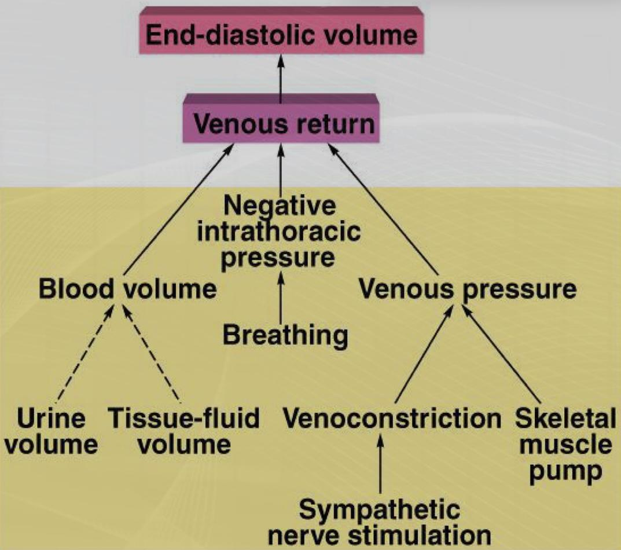
How does The EDV affect the SV & CO ?
Frank-Starling’s Mechanism
Only in female slide
An increase in the End- diastolic volume (EDV) amount will increase the myocardial fibers stretch, thus increasing the initial fiber length.
The increase in the initial fiber length will increase the strength of myocardial contractility.
Factors Affecting End-Diastolic Volume
End-diastolic pressure is affected by the preload (venous return) which is affected by: Blood volume. Pressure gradient Gravity. Veno-constriction: caused by sympathetic nervous system. Presence of valves in the large veins. Skeletal muscles pump. Respiratory activity (Deep inspiration increase venous return).

Slide 22
Factors Affecting Venous Return (Preload):
2- Pressure Gradient
Only in female slide
1- Blood volume
At constant venous capacity, as the blood volume ↑→ the Mean Circulatory Pressure ↑ → ↑ VR.
At constant venous capacity, as the blood volume ↓→ the Mean Circulatory Pressure ↓ → ↓ VR.
Venous capacity is the volume of blood that the veins can accommodate.
• ↑Pressure gradient →↑ venous return.
• Since the right atrium is the site of venous blood collection from all around the body → the pressure inside the right atrium i.e. Right Atrial Pressure (RAP) is called Central Venous Pressure (CVP)
• The pressure is highest in large arteries & continue to drop throughout the pathway, reaching zero-2 mmHg at right atrium.
• The high pressure in the arteries 120 mmHg forces the blood to continually move
into areas where the pressure is lower.

Slide 23
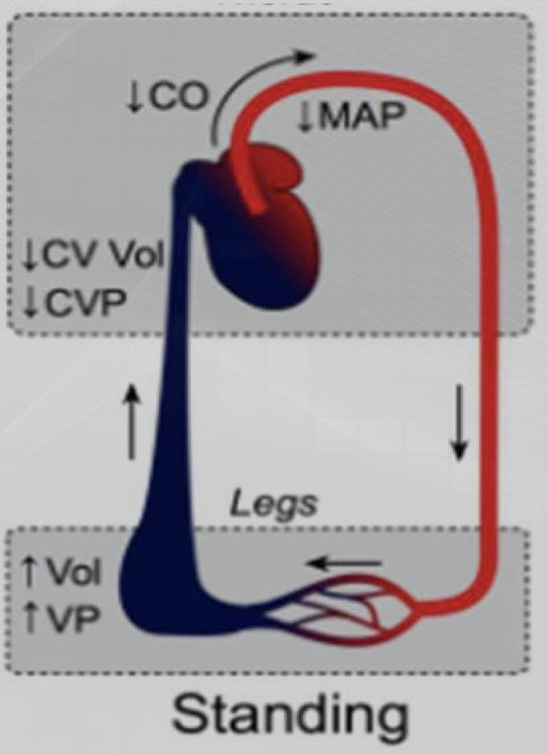
Factors Affecting Venous Return (Preload):
5- Presence of valves:
Only in female
slide
3- Gravity
Standing:
When a person initially stands, right atrial pressure & ventricular EDV falls, which decreases stroke volume by the Frank-Starling mechanism. So, CO & arterial pressure decrease.
Arterial Blood Pressure.
The flow through the entire systemic circulation falls because arterial pressure falls, therefore the pressure gradient driving flow throughout the entire circulatory system is decreased.
4- Venoconstriction:
By sympathetic stimulation ↑ venous return (VR).
Permit blood to move forward towards the heart & prevent it from moving back toward the tissues.

Slide 24
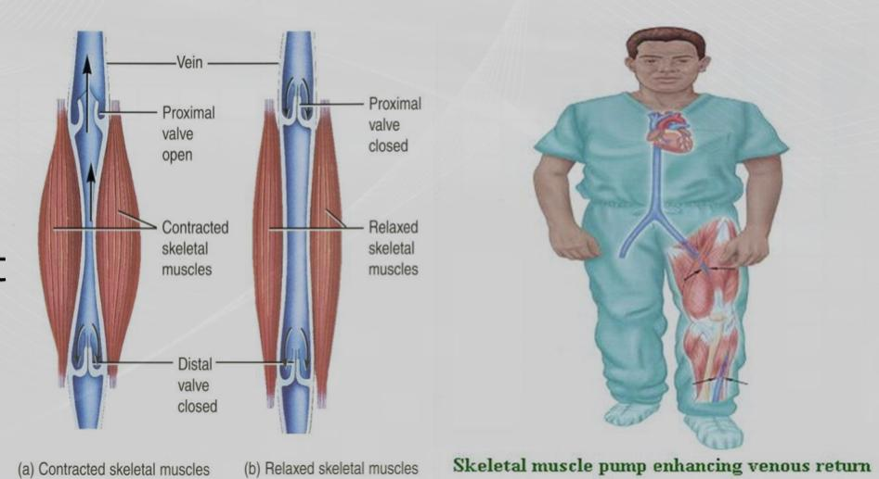
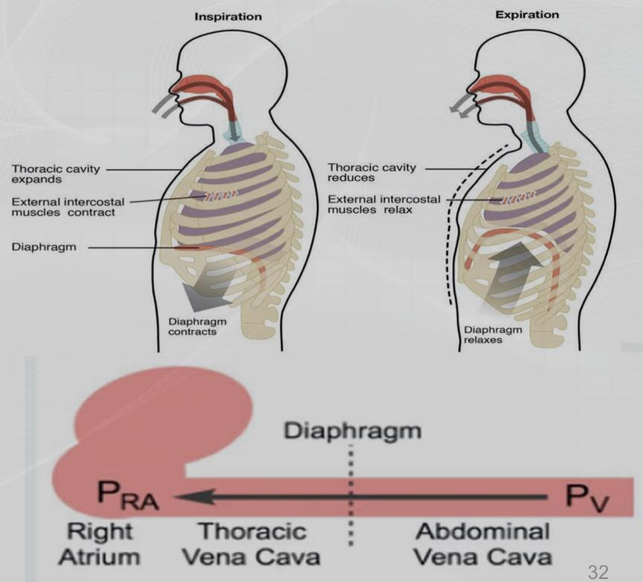
Factors Affecting Venous Return (Preload):
6. The skeletal muscle pump
7. Respiratory Activity: Respiratory/Thoracic Pump
Only in female slide
Rhythmical contraction of limb muscles (as occurs during walking, running or swimming)
→↑ VR by the muscle pump mechanism that squeeze the blood vessels between muscle fibers.
Inspiration→↑ venous return (VR)
because of a decrease in the right atrial pressure (RAP).
In Valsalva maneuver (forceful expiration against a closed glottis), intrapleural pressure become positive which is transmitted to the large veins in the chest→↓ VR

Slide 25
Factors Affecting Venous Return (Preload):
Factors Affecting End- Diastolic Volume:
Only in female slide
Venous return (VR) is decreased when:
1. The Right Atrial Pressure (RAP) is increased.
2. Pumping capability becomes diminished.
3. The Nervous circulatory reflexes are absent.
EDV is ↑ with:
• Increased total blood volume.
• Increased venous return.
• Increased venous tone.
• Increased skeletal muscle pump (exercise).
• Increased negative intrathoracic pressure.
• Stronger atrial contraction.
EDV is ↓ with:
• Standing.
• Decreased venous return.
• Increased intrapericardial pressure.
• Decreased ventricular compliance.

Slide 26
End- Systolic Volume (ESV)
Factors Affecting End- Systolic Volume
Only in female slide
■ End- Systolic volume (ESV) is the volume of blood remaining in the ventricle at the end of systole
↓ SV → ↑ ESV
↑ SV → ↓ ESV
■ End- Systolic volume (ESV) is determined by the:
I: Cardiac contractility.
II: Afterload.
1-Contractility (Strength of contraction):
■it is affected by starling law & sympathetic innervation
■Intrinsically affected by: Frank Starling’s law of the heart, which is affected by the End Diastolic Volume (EDV).
[Frank Starling’s law states that the force of contraction depends on the initial length of the muscle].
■ Extrinsically affected by sympathetic stimulation, hormones & drugs.
↑↑ contractility → ↑↑ SV → ↓↓ ESV
↓↓ contractility → ↓↓ SV → ↑↑ ESV
2-Total Peripheral Resistance (Afterload):
■ It is affected by the size & length of blood vessel, also thickness(viscosity) of blood
■ Afterload is the resistance to flow against (oppose) ventricular contraction.
■ Afterload increases by any factor that restricts arterial blood flow: Such as
an increase in arterial pressure (vasoconstriction).
■ As the afterload increases, the Stroke volume decreases.
■ In response to all regulatory mechanisms:
Vasoconstriction will ↑↑ Peripheral Resistance → ↓↓ peripheral Flow → ↓↓ SV → ↑↑ ESV.
Vasodilatation will ↓↓ Peripheral Resistance → ↑↑ peripheral Flow → ↑↑ SV → ↓↓ ESV.

Slide 27
Heart Rate
Heart rate: the number of heart beat each minute/The number of contractions of the ventricles each minute.
Normal heart rate (HR) = 60-100 beats/min
If > 100 beats/min → Tachycardia
If < 60 beats/min → Bradycardia
❑ As the HR increases, the CO increases.
• ↑ HR up to 180 bpm, ventricular filling is adequate and CO ↑ .
• At very high HR, filling may be compromised to a degree that CO falls.
❑ As the HR decreases, the CO decreases.
❑ The HR has an influence on cardiac contractility as well Frequency-Force Relation.
“Only in female slide Except the definition of HR”

Slide 28
Regulation of Heart Rate
It is regulated by two ways
“Only in female slide”
1. Autonomic Nervous System:
through cardiac control centers in medulla oblongata in the brain stem:
▪ Cardiac-accelerator Center (Vasomotor center) → Sympathetic nerve fibers.
▪ Cardiac-inhibitory Center → Parasympathetic nerve fibers.
•Sympathetic nervous stimulation, increases the HR & the contractility.
• Parasympathetic nervous stimulation (vagus nerve) slows the HR.
**note that they never function at the same time; one is stimulated and the other is
inhibited (not blocked).
2. Hormones/Drugs:
Epinephrine , norepinephrine & thyroxine →increase HR.
Decrease blood calcium→ decreases HR.
But increase blood calcium level → causes prolonged contraction
Sympathetic, drugs, and parasympathetic affect HR
Only sympathetic and drugs affect contractility (parasympathetic has no effect on contractility).

Slide 29
Regulation of Heart Rate
“Only in female slide”
3.Physical Factors:
• Age: Resting HR is faster in fetus and then gradually decreases throughout life.
• Gender: HR is faster in females (72-80 beats/min) than in males (64-72 beats/min).
• Temperature: Heat increases HR as occurs in high fever. Cold has the opposite effect.
• Exercise: Increases HR through sympathetic nervous system.
4.Blood Volume:
•Atrial reflex(Bainbridge reflex).
• This reflex adjusts HR In response to VR.
• Increase Blood Volume,stimulates stretch receptors in right atrium.
•This triggers increase in HR through Increased sympathetic activity.

Slide 30
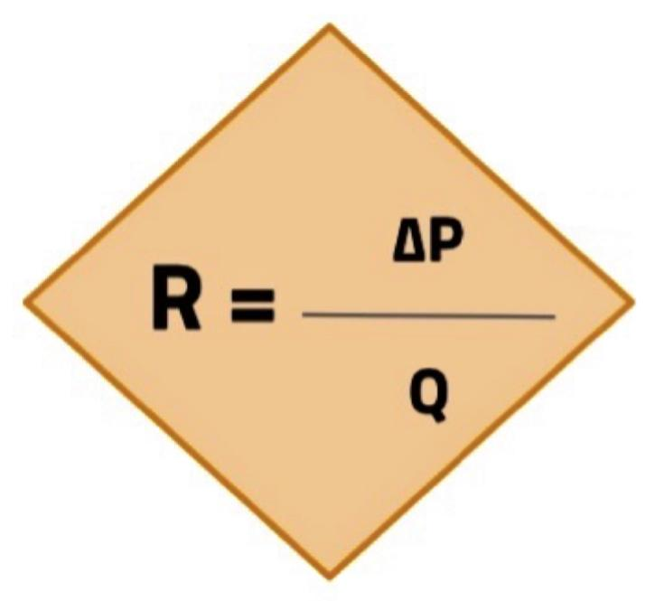
II: Peripheral Resistance (PR): Affecting Factors
“Only in female slide”
Vascular Resistance (R) is the tendency of the vascular system to oppose the flow (Q).
Vascular Resistance (R) is affected by :
- directly by the pressure difference (∆P)
- inversely by the blood flow (Q).
-
Flow (Q)= 1
R
Resistance to flow is influenced by:
Length of the tube (L), radius of the tube(r), & viscosity of the blood (h)
In a human, the length (L) of vascular system is fixed. Accordingly, the blood viscosity (h)& radius(r) of blood vessels have the largest effect on the resistance
Poiseuille’s Law R=8hL/πr^4

Slide 31
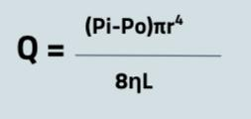
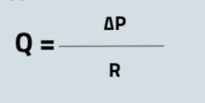
Blood Flow and poiseuille’s Law
“Only in female slide”
Blood flow (Q) is the amount of blood moving through a vessel in a given time period.
Generally, blood flow equals to the Cardiac Output (CO).
Blood flow has 2 equations:
From guytone : the blood flow to body according to tissue’s needs, tissue needs more blood flow when they are active. Most tissues “autoregulate” their own blood flow ’permits blood flow from one tissue to be regulated independently of flow to another tissue’ .
Important
1-Difference in pressure
2- viscosity
3- Length
4- radius
The blood flow (Q) is affected by the pressure difference (∆P) & the resistance (R).
Flow and Poiseuille’s Law
Fluid Flow (Q) through cylindrical tubes. Flow ↓ when resistance ↑.
Flow resistance ↓ when vessel diameter ↑.
Pi-Po)=∆P: difference in pressure (direct relationship) R: Resistance
r: radius (direct). ƞ: Viscosity (inverse). L: Length (inverse).

Slide 32
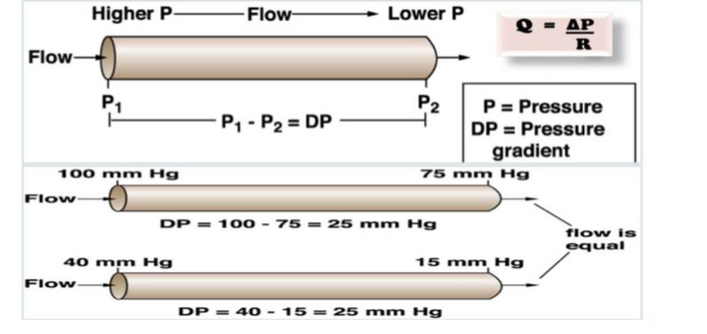
Blood flow and Pressure
Blood flows down a pressure gradient
Only in female slide
Pressure difference ΔP is directly proportional to the flow(Q)
-Absolute value of pressure is not important to flow ( Q ) , but the difference in pressure (ΔP or gradient) is important to determining flow ( Q )
-The resulting pressure is called the driving pressure in vascular system

Slide 33
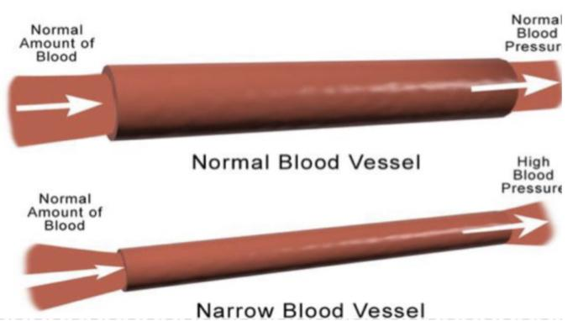
Effect of Radius (r) on Flow & pressure
Only in female slide
Radius(r) Directly proportional to flow(Q).
Vascular tone - effects
❖ Increased tone in a segment of blood vessel e.g increased arteriolar tone.will do:
-Decreased radius of arteriole.
-Greatly increased blood across the arteriole
-The effect on blood volume:
- Increased upstream (in artery).
- Decreased downstream (in capillaries).
Radius(r) is Inversely proportional to pressure(P).
THIS PICTURE IS IN BOTH MALE AND FEMALE SLIDES

Slide 34
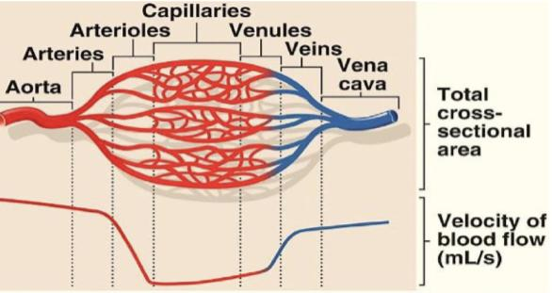
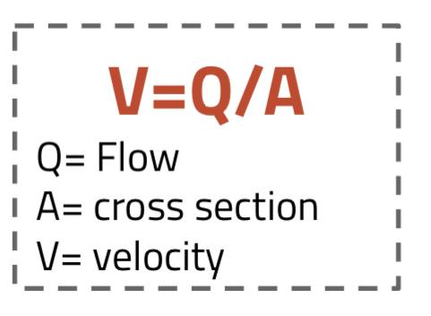
Flow (Q) and Cross-Sectional Area/Diameter
The velocity of blood flow within each segment of the circulatory system is inversely proportional to the total cross-sectional area of the segment. Because the aorta has the smallest total cross-sectional area of all circulatory segments, it has the highest velocity of blood flow.
The diameter of a single capillary is quite small, the number of capillaries supplied by a single arteriole is so great that the total cross-sectional area available for the flow of blood is increased. Hence, the pressure of the blood as it enters the capillaries decreases.
Explanation:
A single Aorta has a cross section of 2.5cm^2 How many aoera is there at the same level?
only one so 2.5^2 (1)= 2.5^1
a single capillary has a cross section of say 0.3^2 But How many capillaries are there at the same level? 10000
so 03^2 (10000)= 30000^2 and that’s why capillaries has higher cross sectional area than aorta because there are so many of them which is good we need it to be slower because that’s where exchange occurs
Note: numbers are not accurate I was only trying to make a point
As diameter of vessels decreases The total cross-sectional area increases
Velocity of blood flow decreases

Slide 35
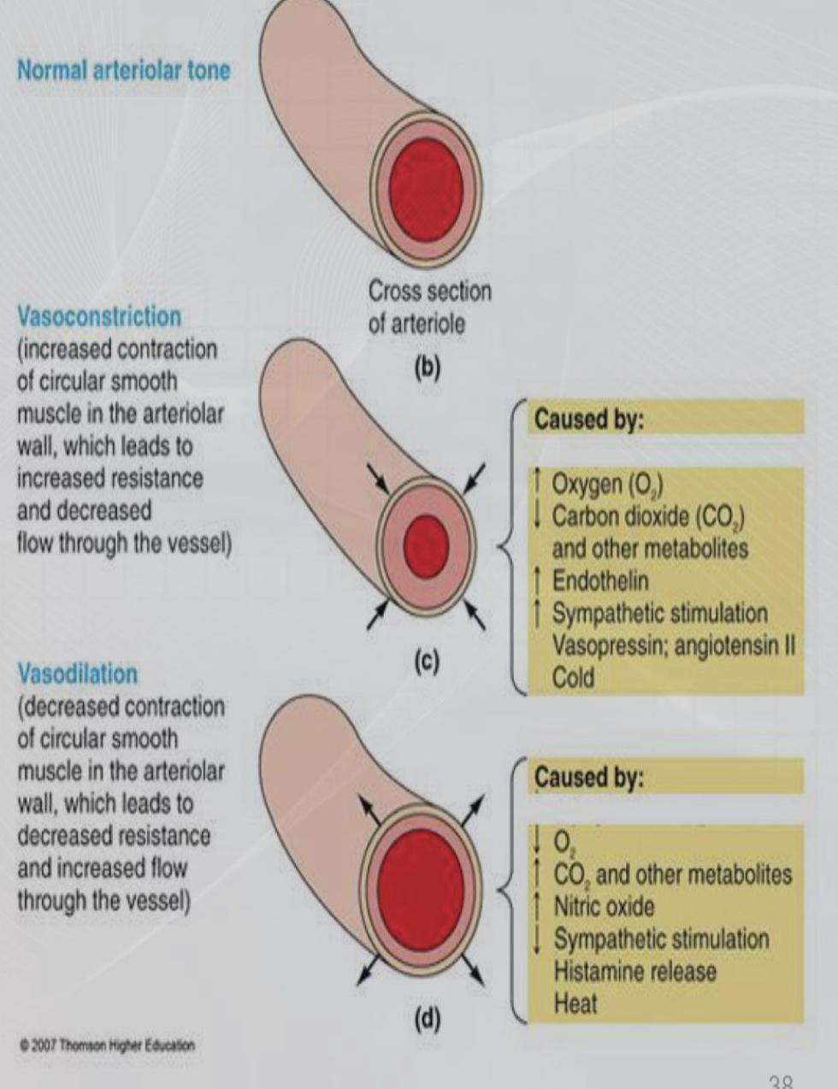
Factors Affecting Vessel Diameter: Radius (r)
Important
1- Nitric Oxide (NO)
2- Atrial Natriuretic Peptide (ANP)
3- Histamine
4- Prostacyclin (PGI2)
5-CO2 & other metabolites
6-β 2 R.
7-[H+]
8 -Adenosine
1- Vasopressin(also called ADH)
2- Angiotensin II
3- Thromboxane A2
4-Epinephrine & Norepinephrine
5- Oxygen (O2)
6- Cold
7- α 1 R.
8- Endothelin-1
Vasodilator Agents:
Vasoconstrictor Agents:
Radius of vessel ⬆ = blood flow ⬆ & the peripheral resistance and the pressure decreased

Slide 36
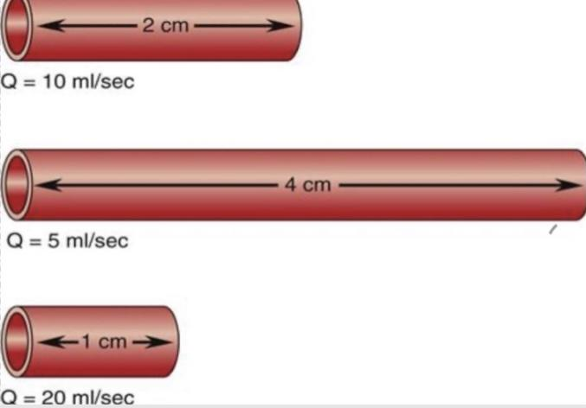
Effect of Viscosity & Length on Flow
“Only in female slide”
Effect of Viscosity (η) on flow
Effect of Length (L) on flow
❖ Length is inversely proportional to the flow.
N.B. In a normal human, length of the vascular system is fixed (cannot change).
❖ Blood viscosity ( h ) is the thickness & stickiness of the blood
❖ Human blood is five times more viscous than distilled water
❖ It is an important factor that determines the resistance of blood to flow.
❖ Viscosity of the whole blood is mainly due to cells, & that of plasma is due to plasma proteins.
❖ Viscosity ( h ) is inversely proportional to the flow ( Q ).
viscosity increases as plasma decreases as a result of sweating,diarrhea,vomiting.

Slide 37
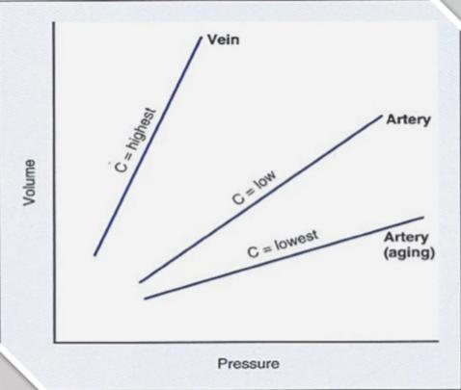
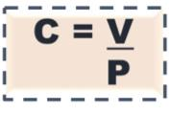
Compliance (C) of Blood Vessels:
“Only in female slide”
-Compliance = Distensibility.
صفةالمطاطیة؛ َقاِبلَِّیُة الَّتَمُّدِد
-Compliance is the volume (V) of blood that the vessel can hold at a given pressure (P).
-Venous system has a large compliance & acts as a blood reservoir (high volume & low pressure).

Slide 38
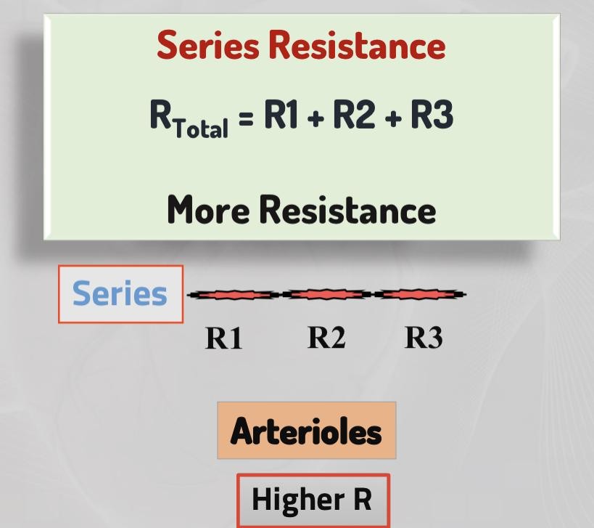
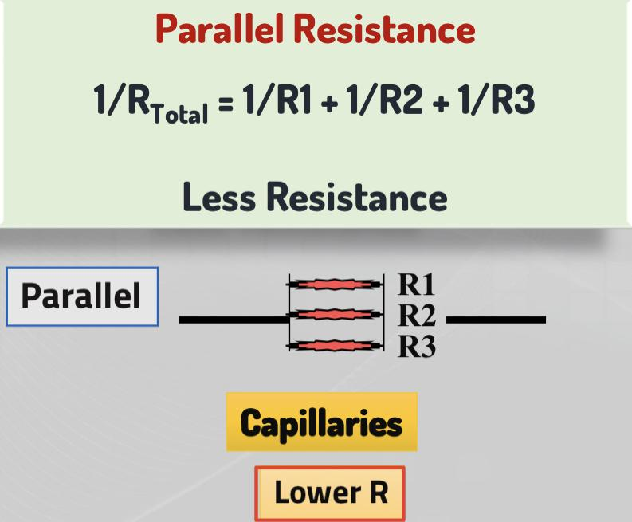
Resistance to Flow in the Cardiovascular System
R= resistance
R total= Total resistance

Slide 39
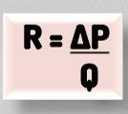
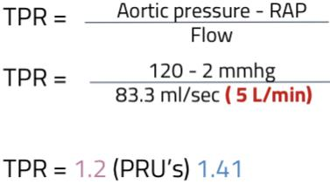
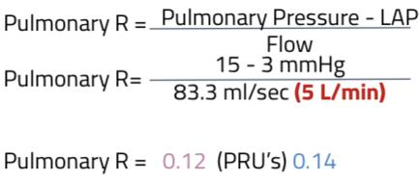
Total Peripheral Resistance (TPR):
Total Peripheral Resistance (TPR) is higher in the systemic circulation than
the pulmonary circulation.
Systemic Circulation
Pulmonary Circulation
*TPR= Total Peripheral Resistance; PulR= Pulmonary Resistance; RAP= Right Atrial Pressure; LAP= Left Atrial Pressure; PRU= Peripheral Resistance 31
Units.

Slide 40
Total Peripheral Resistance
Peripheral resistance depends on:
Size and Length of blood vessel.
Thickness (viscosity) of blood.
Blood Volume depends on :
Balance between fluid intake and fluid loss.

Slide 41
Blood pressure and blood volume
Only in male slide
Blood Volume:
An increase in blood volume → ↑CO → ↑ABP.
A decrease in blood volume as in hemorrhage, dehydration → ↓VR → ↓CO → ↓ABP.
Elasticity of blood vessels:
q Changes in the elasticity of large vessels affects ABP.
q In atherosclerosis, decrease in arterial compliance ("hardening of the arteries").
This makes arteries like a tube, during systole, blood is ejected into the arteries, they don’t distend as
normal and pressure increases significantly → ↑ PP.

Slide 42
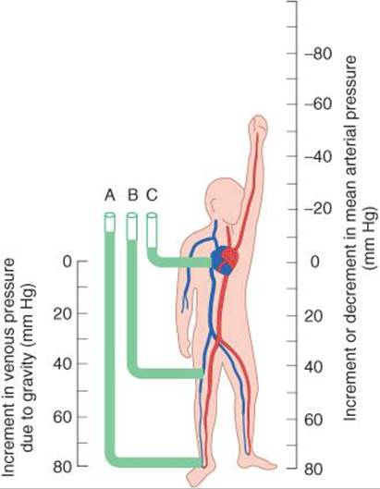
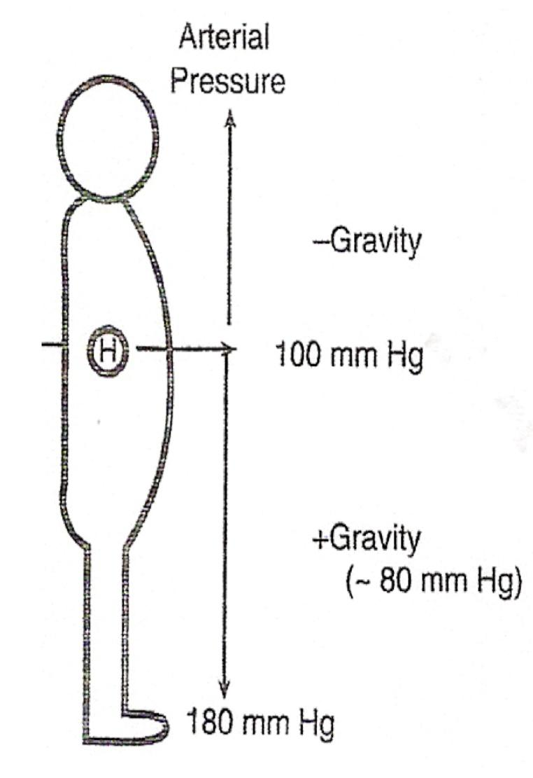
Effect of Gravity on blood pressure
Only in male slide
The pressure in any vessel below the level of the heart is increased
Decreased in any vessel above the level of the heart due to the effect
of Gravity.
Gravitational effect = 0.77 mmHg/cm at the density of normal blood.
In an adult human in the upright position, if mean MAP at heart level = 100 mmHg, the MAP in an artery at the head (50 cm above heart) = 100- [0.77X 50] = 62 mmHg.
Above heart level
50cm = 100 – [0.77 X 50] = 62 mm of Hg
1cm = 0.77 mm of Hg
Below heart level
105cm = 100 + [0.77 X 105] = 180 mm of Hg

Slide 43
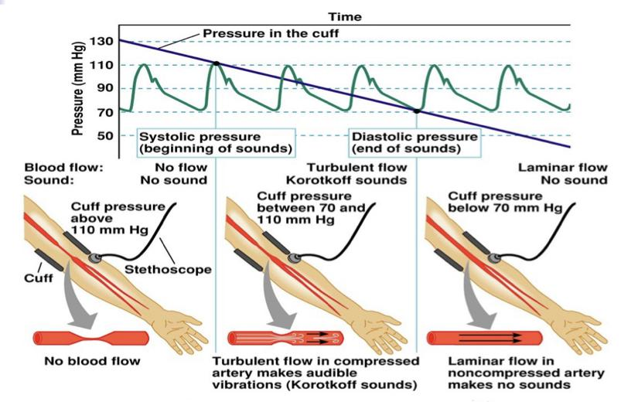
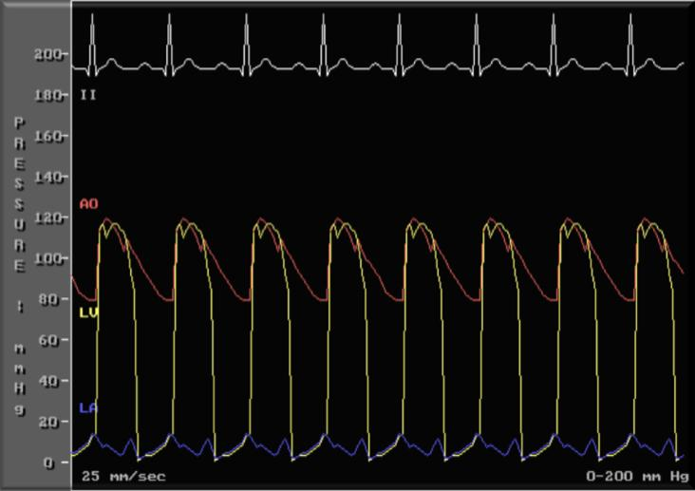
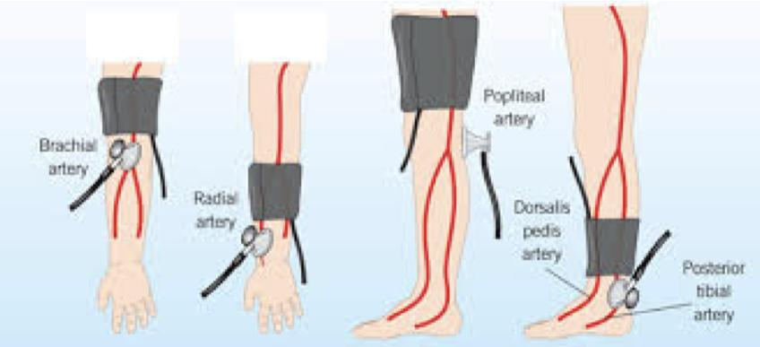
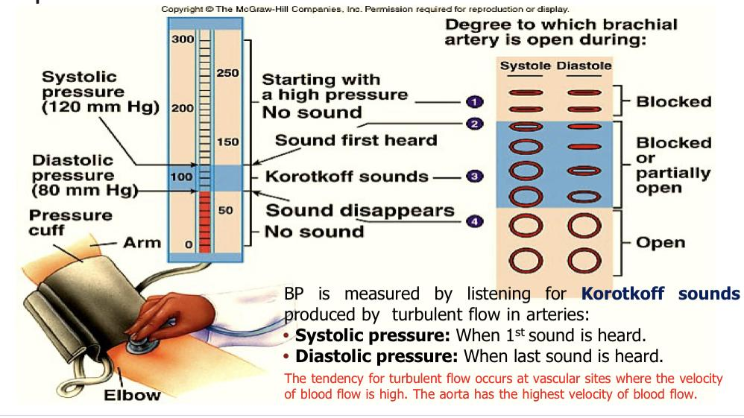
Measurement of Blood Pressure
Sphygmomanometer Types
Blood Pressure Cuff Size:
Only in male slide
Two methods:
Direct
Arterial catheter
Indirect
Stethoscope and blood pressure cuff
Mercury sphygmomanometer
Aneroid equipment
Automatic equipment
Small – children & small adults Average
Large – overweight & large adults

Slide 44
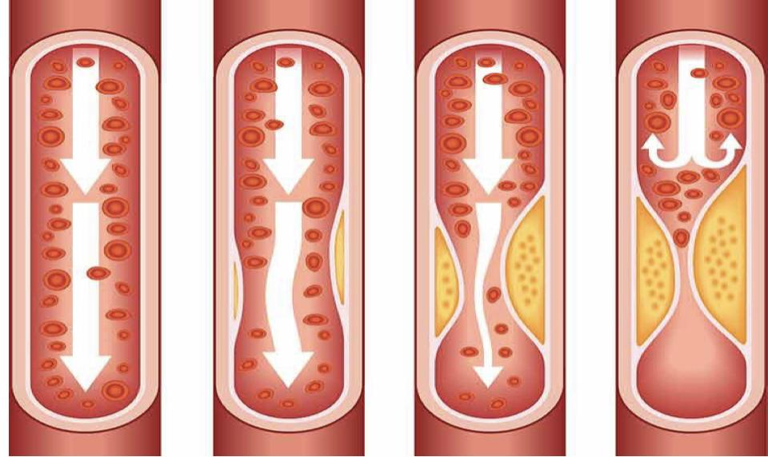
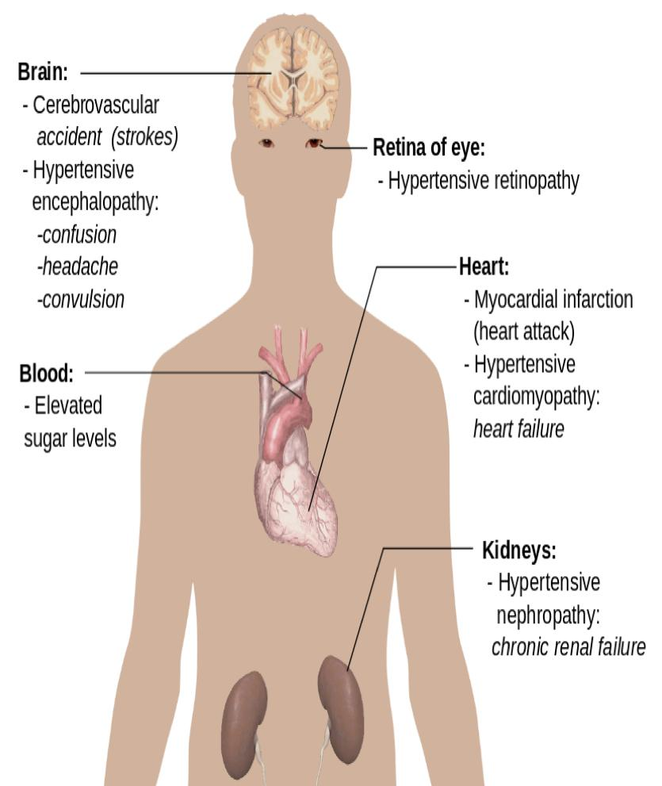
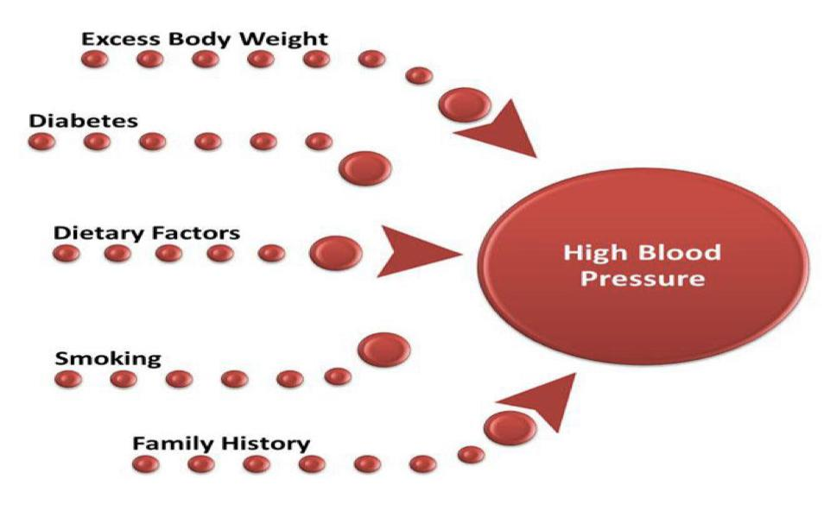
CLINICAL FEATURES­-COMPLICATIONS OF
HYPERTENSION
Only in male slide
Headache
Nausea
Vomiting
Dizziness
Confusion
Shortness of breath
Chest discomfort
Visual disturbance
Sleepiness
May be asymptomatic

Slide 45
MCQs
Q1: what is the effect of thyroxine Hormone on heart rate ?
A- Tachycardia | B-Bradycardia | C-Nothing | D-All
Q2: what is the effect of Hypocalcemia on heart rate ?
A- Tachycardia | B-Bradycardia | C-Nothing | D-All
Q3: what is the effect of Histamine on Vessel diameter?
A- Vasodilators | B-Vasoconstrictors | C-Nothing | D-All
Q4: what is the main factor responsible of Viscosity of blood?
A- RBC & plasma proteins ( fibrinogen ) | B- WBC | C-Hematocrit values | D- All
Q5: Blood velocity is higher in :
A- Aorta | B-Capillaries | C-Arteries | D-Arterioles
Answers: 1.A 2.B 3.A 4.A 5. A

Slide 46
SAQs
Q1: what are the factors affecting PR
Slid 27
Q2: Define Compliance of blood vessels
Slid 34
Q3: Enumerate the factors affecting vessels diameter
Slid 31

Slide 47
Thanks for Team441 !
Team Leaders
Saleh Aldeligan
Qusai Alsultan
Raghad Alkhudair
Raghad Alnadeef
THANK YOU
Team Members
Nouf Aldhalaan
Amani Alotaibi
Shahed Bukhari
Shahad Aljeri
Maha Alkoryshy
Alhnouf Hadi
Mayssam Aljaloud
Hissa Alshiqari
Mashael Albugami
Renad Alayidh
Ghada Binsalmah
Razan Alsulami
Shaden Albassam
Razan Almanjomi
Reem Alhazmi
Dhai Hamdan
Shahad Alaskar
Haifa Almuddahi
Reema Alquraini
Deema Aljuribah
Kadi Khalid Aldossari
Farah Alhalafi
Othman Aldraihem
Abdulaziz Alqahtani
Abdullah Alshahri
Saad Al Hammad
Mohammed Aldawsari
Ahmad Almarshed
Rayan Alahmari
Abdulrahman Binbakhit
Abdulaziz Alymni
Faisal Alkhunein
Abdullah Alqarni
Raid Almadi
Mohammad Alrashed
Abdulrahman bin Ateeq
Amer Alghamdi
Mishal Alsuwayegh
Nawaf alturki
Hussam Aleid
Raid Almadi
Mohammed AlShehri
Theme was done by Mohammad Alrashed
Physio442@gmail.com
Editing File

