Slide 1
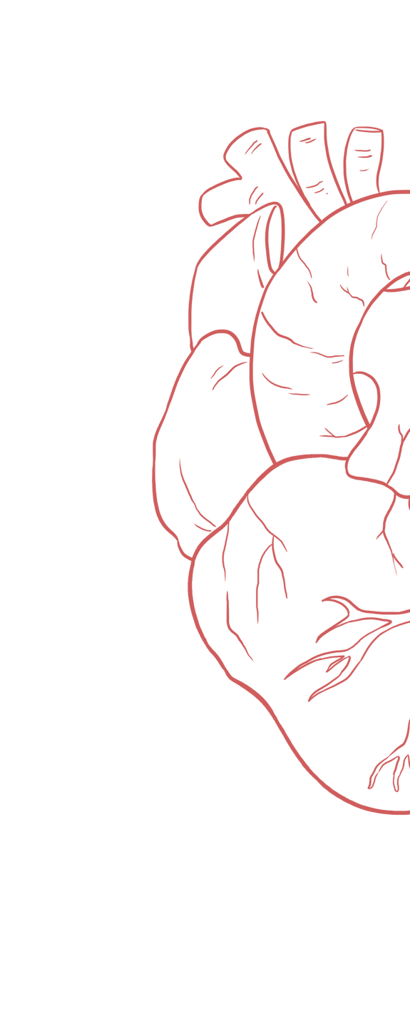
Shock
____________
Color Index:
Main Text
Important
Girl’s Slides
Boy’s Slides
Dr’s Notes
Extra Info

Slide 2
Objectives
-To define Shock.
-To describe different types and causes/etiology of shock .
-To understand the pathophysiology of shock.
-describe the pathways leading to shock
-To define different stages of shock especially hypovolemic shock.
-To understand different compensatory mechanisms in response to shock(especially hypovolemic/hemorrhagic shock).
-To understand complications & causes of irreversible shock.
-clinical features and management

Slide 3
Introduction
Cells:
The basic unit of life, and should get their needed of energy to stay alive.
No Oxygen
No Energy
No Life
Shock is a clinical expression of an acute circulatory failure occur as a result of diminished Cardiac Output or reduced effective circulating volume, leading to:
1- Inadequate tissue perfusion severe enough to induce derangements in normal cellular metabolic function
Consequences ?
*Cellular hypoxia. * due to failure to deliver oxygen to tissues leading end organ injury/dysfunction relative to their impaired metabolic requirements, and cellular damage
Defined as Circulatory shock.
Shock is progressive rather than a static condition
If not controlled & correct quickly, it may lead to irreversible shock & death
An acute emergency situation
What is meant by shock?
Note: medical & not electric shock

Slide 4
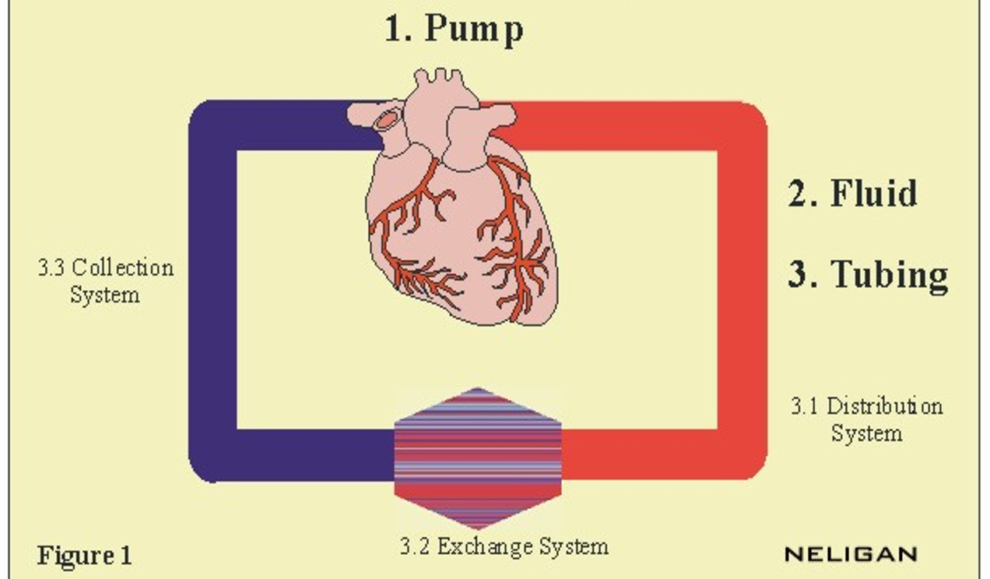
Effects of Tissue Hypoperfusion ?
What is Shock?
Boys Slide
The effects of tissue hypoperfusion anr initially reversible but can lead to hypoxia, which causes 4 things :
1-Cell membrane and ion pump dysfunction
2-Intra-
cellular edema
4-Inadequate regulation of intracellular pH (due to shifting to anaerobic cellular respiration.
3-Leakage of intracellular contents into extracellular space.

Slide 5
Types of Circulatory Shock
1-MAP=CO × PR Low Output Shock Inability to produce adequate cardiac output.
1- Obstructive: obstructive in pulmonary or systemic circulation.
2-Cardiogenic: pump failure “Heart Produced”.
3-Hypovolemic (most common): too little blood volume
2-MAP=CO × PR High/ Normal Output Shock (Distributive) Mal-distribution of blood as a result of “venous pooling, loss of venous tone, & generalized vasodilatation
Neurogenic (spinal) Behaves like hypovolemic shock, Low CO “Nerve produced” (Toxicity due to infection)
Vasogenic "Vessels produced” (No disorders caused this condition) | 1-Psychogenic (Vasogenic)
 | 2-Anaphylactic (Low CO) Extensive histamine release in allergy Sudden reaction to allergen when it reaches a specific amount of dose
 | 3-Septic/Toxic (Vasogenic) Massive infection releases vasodilators “cytokines”

Slide 6
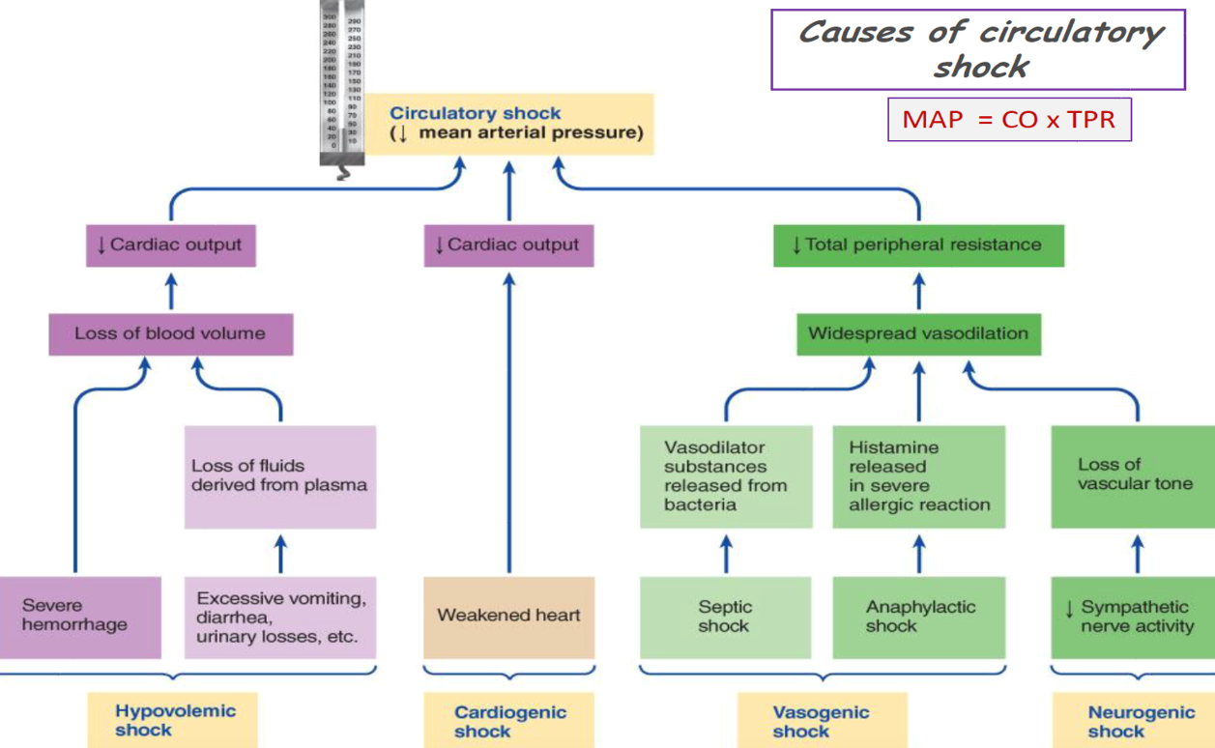
Causes of Shock:
Boys Slide

Slide 7
Physiological Causes of Shock:
Boys Slide
Cardiac abnormalities that decreases the heart to pump blood.
These includes MI, toxic, severe heart valve dysfunction, & heart arrhythmias
Circulatory shock results from diminished cardiac pumping ability is called cardiogenic shock, 85% people die due to cardiogenic shock
Circulatory Shock Caused by Decreased CO.
2 types of factors can severely reduce cardiac output
2. Factors decreasing venous return also decrease cardiac output because the heart cannot pump blood that does not flow into it. The common cause of decreased venous return is diminished blood volume, decreased vascular tone (The driving force of pressure toward the heart).

Slide 8
General Mechanism :
Boys Slide
MAP=CO × PR
Flow=Pressure
Inadequate preload.
Excessive afterload.
Poor contractility.
Inadequate heart rate.
Excessive dilatation.
Inadequate systemic vascular resistance.
Adequate flow= Adequate pressure
Inadequate flow= Inadequate pressure
Inadequate fluid container
Inadequate pump:
Inadequate fluid volume
Adequate perfusion= No Shock
Hypoperfusion= Shock
Hypovolemia (decreased body fluid).

Slide 9
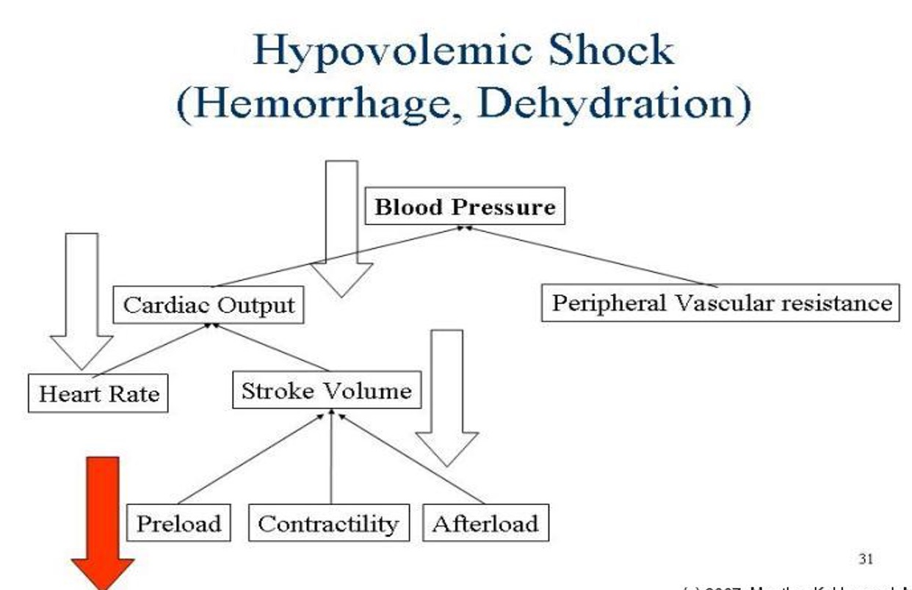
General Mechanism :
Boys Slide
MAP=CO × PR
Heart becomes incapable of contracting with sufficient force to pump enough blood into the peripheral arterial tree. Cardiac shock occurs when more than 40% of the left ventricle is infarcted and death occurs in about 85 % of patients once they develop cardiac shock.

Slide 10
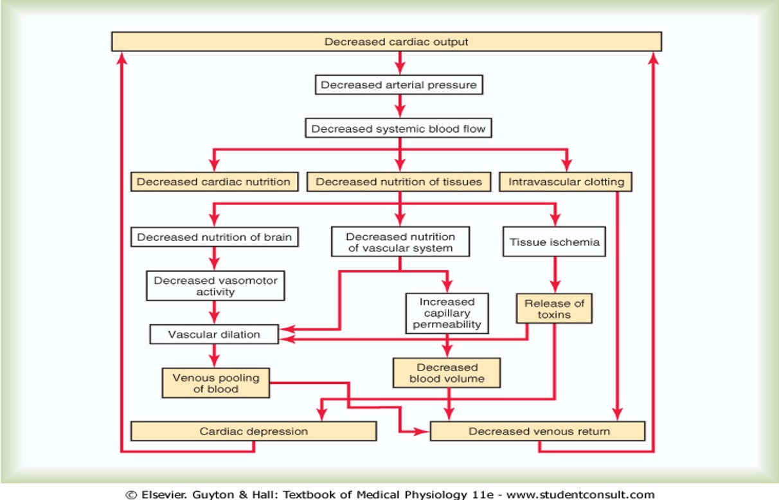
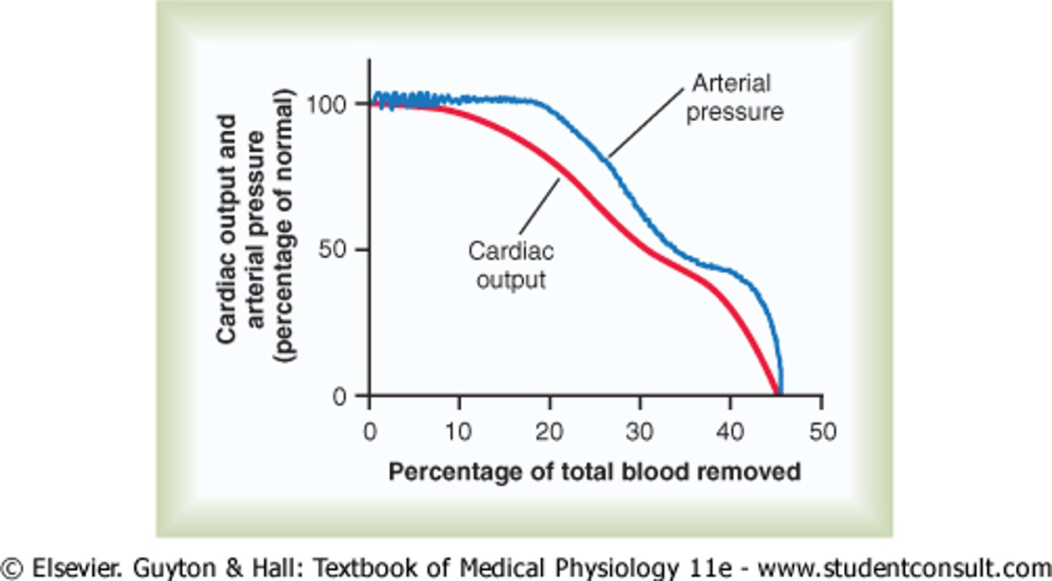
General Mechanism :
Boys Slide
MAP=CO × PR
Effect of hemorrhage on cardiac output and arterial pressure

Slide 11
Pathophysiology of Shock
Reduce capillary perfusion
Shift to anaerobic metabolism
Release of free radicals & oxidative stress
Apoptosis
Inadequate tissue oxygen
Metabolic acidosis
Tissue damage

Slide 12
Pathophysiology of Shock:
Boys Slide
Anaerobic metabolism
Inadequate perfusion
Cell hypoxia
Energy Defect
Lactic acid accumulation and fall in PH
Peripheral pooling of blood
Failure of pre-capillary sphincters
Destruction, dysfunction, and cell death
Vasoconstriction
Metabolic acidosis
Efflux of potassium
Intracellular lysosomes release digestive enzymes
Cell membrane dysfunction and failure of “sodium pump”
Capillary endothelium damage
Toxic substances enter circulation
Influx of sodium and water

Slide 13
Metabolic Changes & Cellular Response to Shock:
Female slides
1
Reduce capillary perfusion:
2
After 3 - 5 hours of shock:
Spasm of pre/post capillary sphincters.
Hypoxic tissue damage, (oxidative stress)
Anaerobic metabolism (anaerobic glycolysis)
Lactic acid production.
Metabolic acidosis (intracellular acidosis).
Failure of Na+/K+ pump (⬆ [Na+] & [Ca2+]).
Lysosomes, nuclear membranes & mitochondrial breakdown.
Precapillary sphincters dilate, venules are still constricted.
Blood stagnation in capillaries.
Hypoxia continue + fluid leaves to extra vascular compartment.
Further reduction in circulating blood volume.
3
Granulocytes accumulation at injured vessels:
Free radicals release.
Further tissue damage.

Slide 14
Metabolic Changes & Organ Response to Shock:
Female slides
1
Damage in GIT mucosa:
allows bacteria into circulation.
4
Respiratory distress syndrome
occurs, due to damage of capillary endothelial cells &
alveolar epithelial cells, with release of cytokines.
2
Cerebral ischemia:
depression of VMC → vasodilation + ↓ HR
further decrease in blood pressure.
5
Multiple organ failure & death.
3
Myocardial ischemia
depressed contractility + myocardial damage
more shock & acidosis.
VMC= vasomotor center (sympathetic)

Slide 15
Stages of shock
Circulatory shock changes with different degrees of severity, shock is divided into:
1-Reversible shock/ Non- progressive: (Compensated)
-reflex compensatory mechanisms are activated (neuro-hormonal activation)
- Defense mechanisms are successful in
maintaining perfusion.
-Full recovery can be caused/changes can be reversed by normal circulatory compensatory mechanisms (without help from outside therapy) or by treatment
2-Progressive:
- Defense mechanisms begin to fall/Body begins to loss its ability to compensate “needs urgent therapy”
-inadequate perfusion begins/tissue hypoperfusion with worsening of circulatory & metabolic imbalance including lactic acidosis
- Multi-organ failure.
3-Irreversible shock:(uncompensated)
- Complete failure of compensatory mechanisms.
Shock progressed to an extent that all forms of known therapy are inadequate to save the life, even though, for the moment, the person is still alive.
-Severe cell and tissue injury result in multi-system organ failure and may end with death.

Slide 16
Compensatory mechanism to shock
Possible Mechanisms That Lead to Developing Irreversible Shock
Female slides
1. ↑ HR, ↑ Myocardial contractility, ↑ CO,
↑ Preload & filling pressure, Vasoconstriction in order to ↑ BP.
By stimulation of Sympathetic Nervous System through:
● Baroreceptors reflex mechanism, which is stimulated by low BP
● chemoreceptors reflex
mechanism , which is stimulated by hypoxia & acidosis
2. ↑ Blood volume. through
-Activation of Renin-Angiotensin System:
● Angiotensin II & III: Powerful vasoconstrictors.
● Aldosterone: will lead to Na+ & water retention.
- Stimulation of ADH (vasopressin):
• Water retention, vasoconstriction, with thirst & drinking stimulation.
3. Synthesis of Plasma Proteins: (3-4 days)
4. Fluid- shift mechanism.
Shock Stimulus
Lysosomal Activation, Release Proteases
Splitting of Plasma Proteins
Vasoactive Peptides, Amines, etc.
Hypotension, Fluid Loss
Irreversible shock

Slide 17
Reflex Compensation to shock
Physiological reflex compensatory reaction in response to decrease BP will result in:
1
↑ HR & myocardial contractility → ↑ CO.
2
Vasoconstriction → ↑ Preload & filling pressure.
↑ Blood volume.
3
4
↑ Vascular compliance.
5
Restoration of tissue perfusion.
HR= heart rate CO=cardiac output BP=blood pressure

Slide 18
In summary: compensatory mechanism to shock
Initial physiological insult leading to shock state
Decrease in cardiac output and tissue perfusion
Increase BP, HR, & myocardial contractility
Sympathetic nervous system activation
Renin-angiotensin activation
Endocrine response
Renal system conserves sodium and water which will increase preload
Increase vasoconstriction +activation of ADH which will increase preload
Increase vascular compliance, blood volume, and cardiac output
Restoration of tissue perfusion
Big thanks for 441 team

Slide 19
Types of Circulatory Shock
Boys Slide
Type | Causes | Symptoms and Signs
Hypovolemic shock | Bleeding (internal/external), dehydration (severe vomiting, severe diarrhea), plasma loss (as in burns) → low blood volume → decreased cardiac output→ hypotension | hypotension; weak but rapid pulse; cool, clammy skin; rapid, shallow breathing; anxiety, altered mental state
Cardiogenic shock | Heart problems (e.g., myocardial infarction, heart failure; cardiac dysrhythmias)--> decreased contractility→ decrease in stroke volume→ decreased cardiac output→ hypotension | as for hypovolemic shock + distended jugular veins & may be absent pulse
Obstructive shock | Circulatory obstruction (e.g., constrictive pericarditis, cardiac tamponade, tension pneumothorax, pulmonary embolism → reduced blood flow to lungs→ decreased cardiac output→ hypotension | As for hypovolemic shock + distended jugular veins & pulsus paradoxus (in cardiac tamponade).
Distributive shock Vasogenic Low-resistance shock | Septic shock: infection→ release of bacterial toxins → activation of NOS in macrophages → production of NOS in macrophages→ vasodilation→ decreased vascular resistance→ hypotension | hypotension; fever; warm, sweaty skin
 | Anaphylactic shock: allergy (release of histamine→ vasodilation→ decreased vascular resistance→ hypotension | skin eruptions; breathlessness, coughing; localized edema; weak, rapid pulse
 | Neurogenic shock: spinal injury→ loss of autonomic and motor reflexes → reduction of peripheral vasomotor tone → vasodilation→ decrease in peripheral vascular resistance→ hypotension | as for hypovolemic except dry skin

Slide 20
Hypovolemic Shock (Low Cardiac Output)
MAP=CO × PR
Features: Most common type of shock. A life- threatening condition, due to inadequate blood or plasma volume. Insufficient perfusion can lead to organ failure. Requires immediate emergency medical attention. Requires immediate emergency medical attention. Treatment: fluid replacement or blood transfusion & treat the underlying cause.
Caused by (etiology): | Excessive/severe/massive loss of body fluid (blood/plasma) Loss of more than or equal to 15% (one-fifth) volume of body fluid (blood/plasma). Blood loss (hemorrhage Any source of bleeding (internal or external) → Trauma, GI bleed, Ruptured aneurysm or surgery): commonest. Fluid/plasma loss: Vomiting, diarrhea, burns, excess sweating, dehydration, trauma.
Physiology Hemodynamic changes: | Low cardiac output (CO):The heart is unable to pump sufficient amounts to the body parts Reduced venous return (preload), leading to reduction in EDV, & in stroke volume. End organ hypoperfusion, leading to organ failure due to insufficient perfusion.

Slide 21
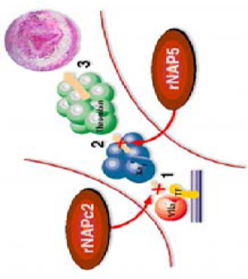
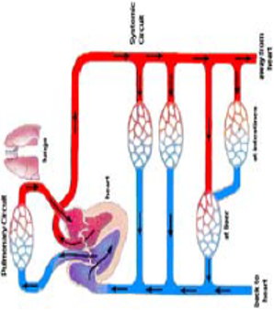
Hypovolemic Shock (Low Cardiac Output)
MAP=CO × PR
Boys Slide
i-Hematologic
system
Activating of coagulation cascade.
Constriction of the blood vessels (via local thromboxane A2 release)
Platelet plug (platelets aggregation and adherence) form an immature clot on the bleeding source.
Fibrin plug,(The damage vessel expose collagen, which subsequently causes fibrin deposition and stabilization of the clot)
The human body responds to acute hemorrhage by activating four major physiological systems:
i. Hematologic
ii. Cardiovascular
iii. Renal
iv. Neuroendocrine system
ii. Cardiovascular system
Increase: heart rate, myocardial contractility and constrict peripheral blood vessels (sympathetic activation).
This response occurs secondary to an increase secretion of NE and decrease vagal tone (regulated by baroreceptor in the carotid arch, aortic arch, left atrium, and pulmonary vessels)
The CVS also respond by redistributing of blood to brain, heart, kidneys, and away from skin, muscles, GIT.
Early, adequate hemodynamic support is critical to prevent worsening organ dysfunction and failure.
The VIP rule:
- Ventilate (oxygen administration)
- Infuse (fluid resuscitation)
- Pump (administration of vasoactive agents)

Slide 22
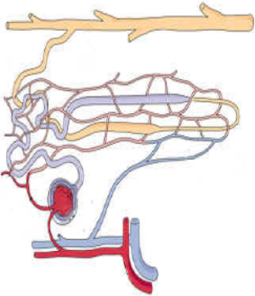
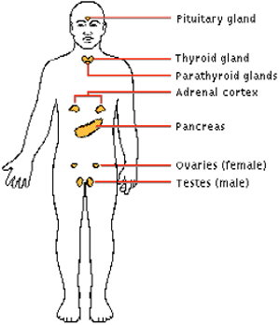
Hypovolemic Shock (Low Cardiac Output)
Boys Slide
MAP=CO × PR
Stimulating an increase in renin secretion(Angiotensinogen) from juxtaglomerular apparatus.
Renin give angiotensinogen
Lungs and liver give angiotensin i&ii
Ang II has two main effects:
vasoconstriction which increase blood pressure.
Stimulation aldosterone secretion which retain salt and water
Thus, increases thirst and the desire to salt.
iii-Renal
System
iv-
Neuroendocrina
System
Causes an increase in circulating ADH.(antidiuretic hormone)
ADH released in response to decrease in blood pressure (as detected by baroreceptor) and decrease in Na+ concentrations.
ADH increases the reabsorption of water and salt (NaCl) by the distal tubule and collecting ducts.

Slide 23
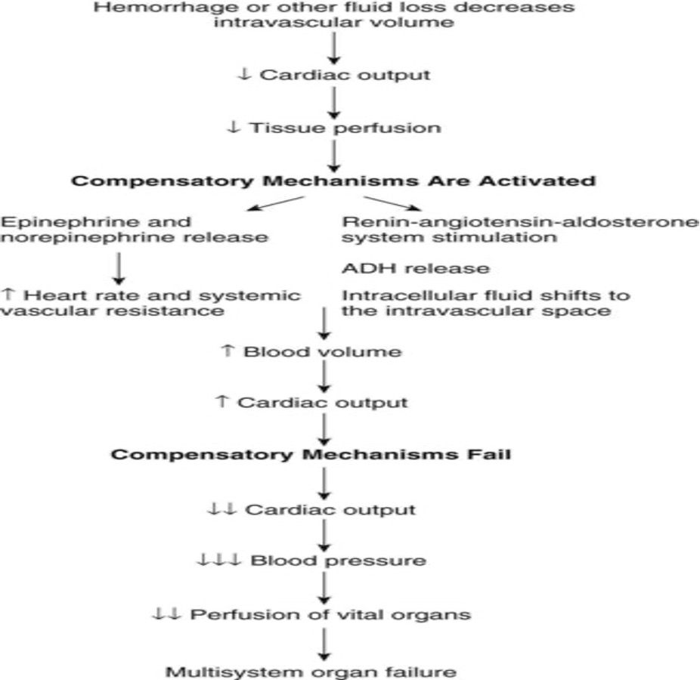
Hypovolemic Shock (Low Cardiac Output)
Boys Slide
MAP=CO × PR

Slide 24
Classes of Hypovolemic Shock
By the amount of blood loss (Hemorrhagic Shock)
Blood loss | % Blood volume | Pulse | Blood Pressure | Pulse Pressure | Resp.rate | UOP (urine output) | Mental Status /CNS symptoms | Fluid
Class 1 | <750 | < 15% | <100 | Normal | Normal | 14-20 | >30 | Normal/ SI.Anxious | Crystalloid (I.V Fluid)
Class 2 | 750-1500 | 15-30% | >100 | Normal | Decreased | 20-30 | 20-30 | Mildly Anxious | Crystalloid (I.V Fluid)
Class 3 | 1500-200 | 30-40% | >120 | Decreased | Decreased | 30-40 | 5-15 | Confused | Blood
Class 4 | >2000 | >40% | >140 | Decreased | Decreased | >35/40 | negligible | Lethargic | Blood

Slide 25
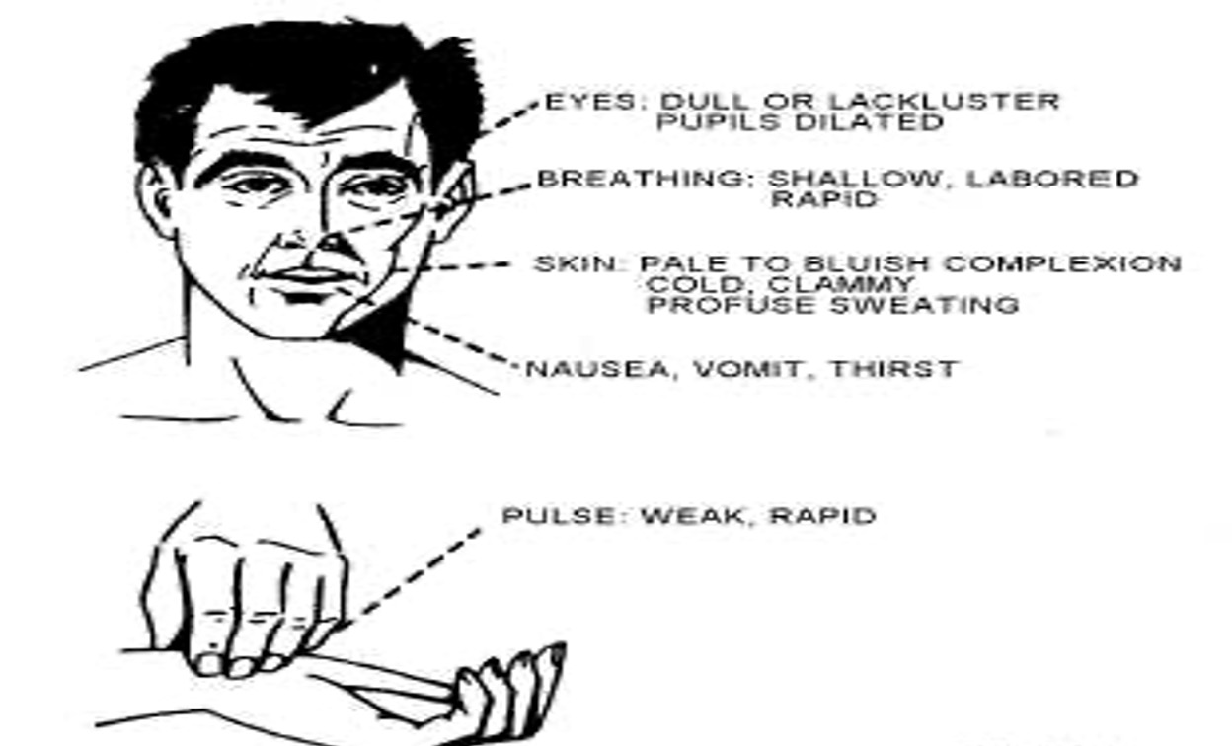
Signs & Symptoms of Hypovolemic Shock: (clinical features)
Symptoms relating to heart | Systemic symptoms
Sustained/generalized hypotension ( <80-85/40 mmHg for 30 min ) | Intense/increased thirst
Tachycardia (increased HR) (sensed by baroreceptors in compensation to decrease MAP) | Tachypnea (rapid respiration/increased resp.rate) (sensed by chemoreceptors in compensation to hypoxia)
Rapid, weak, & thready pulse (140/min) | Oliguria (low urine output)/ Anuria (no urine output)
-Cold ,pale,clammy skin Due to hypo-perfusion -decreased capillary refill -pupillary dilation (Vasoconstriction due to potent sympathetic stimulation) | Blood test: lactic acidosis , increase anion gap Metabolic acidosis symptoms (confusion, vomiting, loss of appetite
Bradycardia and death (end stage) | Loss of consciousness
Restlessness due to hypo-perfusion | Sweating

Slide 26
Cardiogenic shock
Low Cardiac output
Female slides
MAP=COxPR
Pump Failure: Cardiac muscle is unable to pump adequate blood flow to the vital organs & body parts in presence of a normal blood volume.
associated with loss of > 40% of LV myocardial function.
Mortality rate is high, 60-90%.
LV=Left ventricle; MI=Myocardial infarction
Causes
Hemodynamic changes
Deterioration or failure of cardiac function
Myocardial: Either, Acute intrinsic Myocardial damage: Myocardial Infarction (Most common.), Myocarditis, Cardiomyopathy. Or extrinsic compression.
Mechanical: Acute valvular dysfunction, e.g. rupture of papillary muscle post MI.
Arrhythmogenic: Sustained Arrhythmias, e.g. heart block, ventricular tachycardia.
Obstructive: Pulmonary embolism, Cardiac tamponade.
Low cardiac output (CO) with reduced stroke volume (SV).
Increased Left ventricular end diastolic filling pressure -LVEDP (right/left/both).
Decreased coronary perfusion, leading to ischemia & further myocardial dysfunction.
Persistent hypotension (Systolic pressure < 90 mmHg / -MAP 30 mmHg below baseline)
End organ hypoperfusion.

Slide 27
Signs and Symptoms:
Cardiogenic Shock
Female slides
Similar signs & symptoms to that of hypovolemic shock.
Laboratory findings: increase troponin I & T
Congestion of lungs & viscera: (Chest X-Ray -CXR)
Interstitial pulmonary edema.
Alveolar edema.
Cardiomegaly.
Prognosis: 70% mortality

Slide 28
Obstructive shock
Low Cardiac output
Female slides
MAP= COxPR
Physiology: hemodynamics changes:
Cardiac output (CO) is reduced despite normal intravascular volume & myocardial function.
Decrease stroke volume.
End organ hypoperfusion.
Causes
Examples
• Obstruction of venous return:
e.g. Vena Cava Syndrome (usually neoplasms).
• Compression of the heart:
e.g. hemorrhagic pericarditis → cardiac tamponade.
• Obstruction of the outflow of the heart:
- Aortic coarctation or dissection.
- Pulmonary or systemic hypertension.
- Massive pulmonary embolism.
- Tension pneumothorax.
- Congenital or acquired outflow obstructions.
Causative factors may be located within the pulmonary or systemic circulation or associated with the heart itself or caused by trauma surgery.
Extracardiac obstructive shock results from an obstruction to flow in the cardiovascular circuit.

Slide 29
Distributive Shock
High/Normal Cardiac Output
Female slides
MAP = COxPR
2 Types:
Neurogenic (Spinal)
Vasogenic: -Septic or non-septic (anaphylactic or psychogenic or adrenal insufficiency
Features
Causes
Hemodynamic changes
Distributive shock is also known as vasodilatory shock.
There will be an inappropriate distribution of blood flow which will lead to a decrease in blood flow to the vital organs resulting in their damage.
It occurs as a result of systemic vasodilatation which is caused by loss of vascular resistance (tone)(compliance).
It can be also caused by leakage of fluid from capillaries into the surrounding tissues (capillary leak syndrome).
It can be caused by sepsis, allergic reactions, adrenal insufficiency, trauma, drug overdose & toxicity.
Cardiac output (CO) is mostly normal or elevated.
Increased Venous capacitance due to vasodilatation.
Decreaesed Peripheral resistance(PR )& venous return(VR).

Slide 30
Distributive shock
i-Neurogenic Shock:
Female slides
MAP = COxPR
It is also called spinal shock (venous pooling)
Can be caused by trauma, injury involving the spinal cord, devastating cervical or head injury, or by anesthetic accident.
Loss of disruption of autonomic nervous system innervation below the level of injury.
Sympathetic nervous system is damaged resulting in a decreased adrenergic input to the blood vessels & heart, causing loss or drop in vasomotor (vascular) tone.
consequences ?
Generalized peripheral vasodilation
Orthostatic (postural) hypotension
Cardiac output (CO) is severely reduced as blood is pooled in the peripheral veins. (Capacity of blood ↑, & venous return ↓.)
Bradycardia, & low body temperature
Behaves like hypovolemic shock.
Blood volume remains normal.

Slide 31
Distributive shock (ii- Vasogenic Shock)
MAP = COxPR
Female slides
Septic/toxic /endotoxic Shock | Most common in emergency. Dysregulation of the immune response to infection that leads to activation of systemic cytokine cascades release & result in: peripheral vasodilatation, pooling of blood & fluid leak from capillaries. Bacterial endotoxin triggers peripheral vasodilatation & endothelial injury. Inflammatory cytokines may also cause some cardiac dysfunction. Leukocytes- induced damage. Disseminated intravascular coagulation (coagulopathy) Signs and Symptoms Septic Shock; Patient flushed & warm: due to hyper-dynamic state.
Non-Septic Shock | Anaphylactic shock | Most common in emergency. Caused by exposure to an antigen resulting in a massive & generalized allergic reaction. Systemic release of inflammatory mediators from mast cells & basophils. Histamine triggers systemic peripheral vasodilation & ↑ capillary permeability leakage. Can lead to low cardiac output (CO) distributive shock Clinical example: IgE-mediated hypersensitivity reactions
 | Psychogenic shock | Simple fainting (syncope) as a result of stress, pain, or fright. Dilatation of blood vessels. Result in: Blood pressure falls. - Brain becomes hypo-perfused. ↑ HR (pulse). - Loss of consciousness.

Slide 32
Fluid-Shift Mechanism in Shock
Female slides
-In most cases of shock, both the hydrostatic pressure (in capillary) decreases while oncotic pressure (osmotic pressure) are constant, as a result:
• The fluid exchange from the capillary to the extracellular space decreases.
• The fluid return from the extracellular space to the capillary increases.
-This will lead to an increase in the blood volume & the BP in order to help in compensating the shock situation.
Tissue hydrostatic pressure= 0 mmHg
Negative interstitial free fluid pressure= 3 mmHg
Decrease outflow
Interstitial fluid
Increase inflow
Arterial blood
Blood capillary
Venous Blood
Hydrostatic pressure= 20 mmHg
Hydrostatic pressure= 10 mmHg
Colloid osmotic pressure= 25-28 mmHg
Hydrostatic pressure is the force of the fluid volume against a membrane, while osmotic pressure is related to the protein concentration on either side of a membrane pulling water toward the region of greater concentration
BP=Blood pressure

Slide 33
Normal Forces at The Arterial & Venous Ends of The Capillary
Female slides
Tissue hydrostatic pressure= 0 mmHg
Negative interstitial free fluid pressure= 3 mmHg
NFP= (+10+3)
= +13 mmHg
NFP= (-10+3)
= -7mmHg
Interstitial fluid
Arterial blood
Blood capillary
Venous Blood
Hydrostatic pressure= 35 mmHg
Hydrostatic pressure= 15 mmHg
Colloid osmotic pressure= 25-28 mmHg
At arterial end: | At venous end:
-Hydrostatic pressure dominates at the arterial end, as a net sum of pressure forces (blood hydrostatic pressure + Interstitial fluid (IF) osmotic pressure) flow fluid out of the circulation. -Water moves out of the capillary with a net filtration pressure (NFP) of +13 mmHg. 13 mmHg NFP causes an average of 1/200 of plasma in flowing blood to filter out of arterial end of the capillary into the interstitial space. | -Oncotic pressure dominates at the venous end, as a net sum of pressure forces (blood osmotic pressure + Interstitial fluid (IF) hydrostatic pressure) flow fluid into the bloodstream . -Water moves into the capillary with a NFP of -7 mmHg.

Slide 34
Normal Forces at The Arterial & Venous Ends of
The Capillary
Female slides

Slide 35
MCQs
Answers: 1.C 2.B 3.D 4.D 5.C 6.B
Q1:Which stage of shock associated with complete failure of compensatory mechanism?
A- Progressive stage | B- Reversible stage | C- Irreversible stage | D-initial nonprogressive stage
Q2: During shock ,what happens to hydrostatic & oncotic pressure respectively ?
A- increases, increases | B-decrease,constant | C-constant,increase | D-decrease, increase
Q3: .Which of the following clinical signs is not typical for a classic presentation of shock?
A- Cool Extremities | B- Weak pulse | C- Tachypnea | D- Systemic Hypertension
Q4: Which of the following is not a major mechanism for lack of oxygen delivery to tissues?
A- Inadequate blood volume | B- Inadequate Cardiac delivery | C- Inadequate vascular tone | D- Inadequate coronary perfusion.
Q5: Which one of the following is not a sign of hypovolemic shock?
A- pale skin | B- intense thirst | C- Alveolar edema | D-Oliguria
Q6: Which of the following is caused by Capillary leak syndrome?
A- Obstructive shock | B- Distributive shock | C- Cardiogenic shock | D- Hypovolemic shock

Slide 36
SAQs
Q1: what is the consequences of shock?
▪ Cellular hypoxia due to failure to deliver oxygen to the tissues, leading to cellular damage.
▪ End organ injury/dysfunction (vital organs) relative to their impaired metabolic requirements.
Q2: List the pathophysiology of shock
Answer : slide 14
Q3: ‘Shock’ associated with trauma is characterized by:
Answer: Slide 22 → hemodynamic changes & Slide 27.

Slide 37
Team Leaders
THANK YOU
Saleh aldeligan
Qusai Alsultan
Raghad Alkhudair
Raghad Alnadeef
Team Members
Othman Aldraihem
Abdulaziz Alqahtani
Abdullah Alshahri
Saad Al Hammad
MOHAMMED ALDAWSARI
Ahmad Almarshed
Rayan Alahmari
ABDULRAHMAN BINBAKHIT
Abdulaziz Alymni
Faisal Alkhunein
Abdullah Alqarni
Raid Almadi
Mohammad Alrashed
Abdulrahman bin Ateeq
Amer Alghamdi
Mishal Alsuwayegh
Nawaf alturki
Hussam Aleid
Raid almadi
Mohammed AlShehri
Nouf Aldhalaan
Amani Alotaibi
Shahed bukhari
Shahad Aljeri
Maha Alkoryshy
Alhnouf Hadi
Mayssam Aljaloud
Hissa Alshiqari
Mashael Albugami
Renad Alayidh
Ghada Binslmah
Razan Alsulami
Shaden albassam
Razan Almanjomi
Reem Alhazmi
Dhai hamdan
Shahad alaskar
Haifa Almuddahi
Reema alquraini
deema aljuribah
Kadi Khalid aldossari
Farah alhalafi
Theme was done by Mohammad Alrashed
Physio442@gmail.com
Editing File

