Slide 1
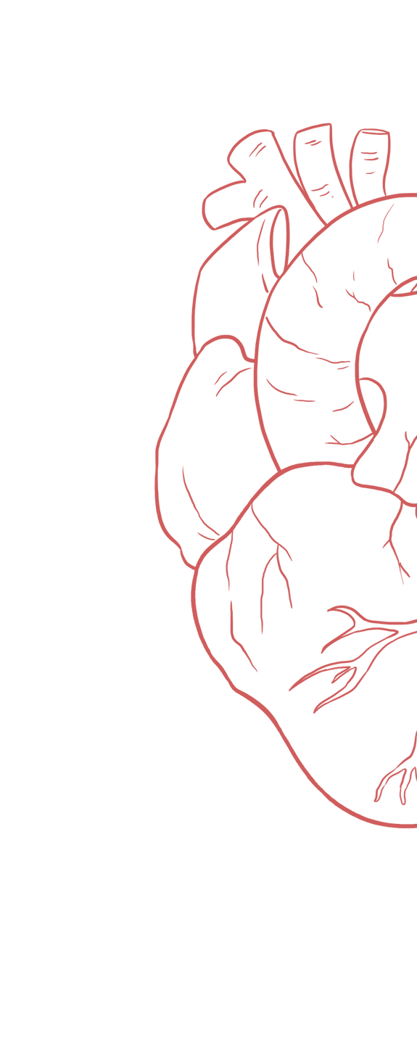
Coronary Circulation
____________
Color Index:
Main Text
Important
Girl’s Slides
Boy’s Slides
Dr’s Notes
Extra Info
Female slide similar to anatomy it will be good revision
But focus on psychological part of the lecture best luck to the best future doctors (:

Slide 2
Objectives
Ninja nerd 11min
Animation 4min
Osmosis 1min
To understand Normal Coronary blood flow & factors affecting it.
Facts about Coronary blood flow.
Coronary blood flow in systole and diastole.
Explain and differentiate between angina and myocardial infarction.
To identify the Coronary circulation & areas of their supply in the heart.
To understand Coronary collateral circulation & Coronary dominance.
To understand mechanisms Control Discuss the regulation of coronary blood flow.

Slide 3
Coronary circulation & its Importance
Definition :
It’s circulation of blood in blood vessels that supply the heart muscle (myocardium)
One third of all deaths in the world result from coronary artery disease
Consists of :
Arterial supply
Venous drainage
Lymphatic drainage
Almost all elderly people have at least some impairment of the coronary artery circulation
Heart uses primarily free fatty acids and to lesser extent glucose and lactate for metabolism
Coronary arteries supply oxygenated blood to myocardium
cardiac veins drain away the blood once it has been deoxygenated from to the cardiac muscle.
Two third of coronary blood flow occurs during diastole
Coronary circulation “major importance” not only to its own tissues but to the entire body & even to the level of consciousness of the brain from moment to moment.

Slide 4
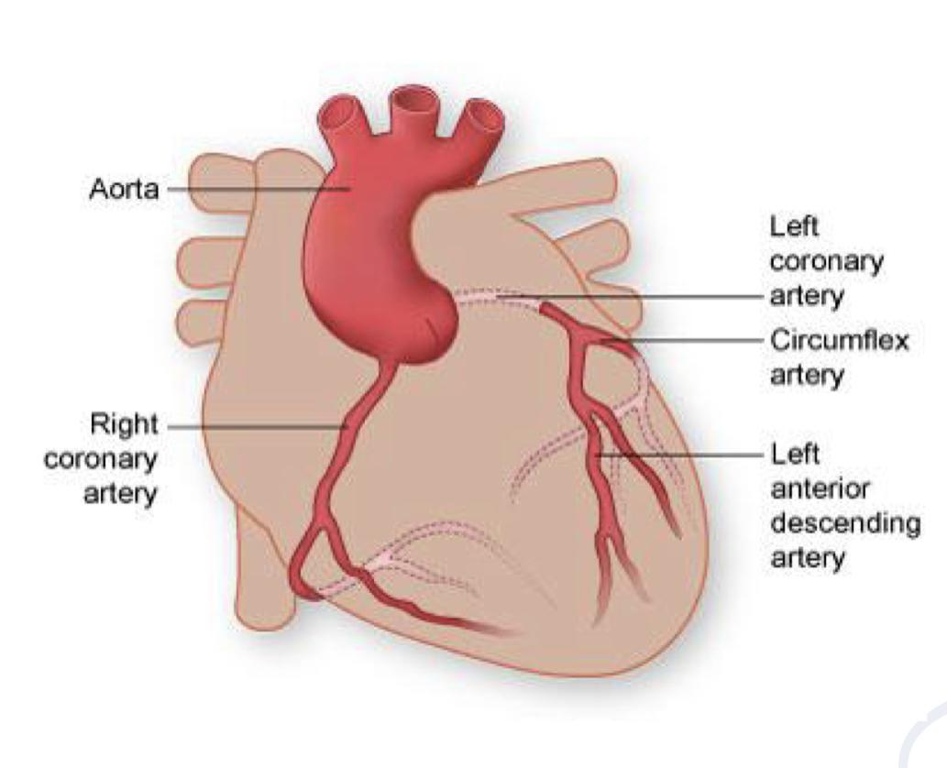
Coronary sinus & arteries
Girl’s slides
Left coronary artery (LCA)
Arterial supply:
Cardiac muscle is supplied by two coronary arteries
Right coronary artery (RCA)
Both arise from the coronary sinus at the aortic root, just superior to the aortic valve cusps.
Origin
Branch
They wrap with their branches around the outside of the heart to supply all cardiac muscle with blood.
Coronary arteries
deliver oxygenated
blood to the cardiac
muscle.

Slide 5
Coronary sinus & arteries
Girl’s slides
Coronary sinus:
Aortic valve has three cusps:
Left coronary cusp (LCC)
Right coronary cusp (RCC)
Posterior non-coronary cusp (NCC)
Coronary sinus is just above the corresponding cusps,
where the coronary ostia arise
There may be variations in the
number
shape
location
of coronary ostia or origins of the coronary arteries
-most of which are of NO clinical significance.

Slide 6
Right coronary artery
Left coronary artery
Girl’s slides
Smaller than the left coronary artery
Also known as the left main coronary artery
(LMCA)
Arises from the right coronary sinus.
Larger than the right coronary artery
Curves posteriorly & descends downward on the posterior surface of the heart
Arises from the left coronary sinus.
Runs for 10-25 mm before bifurcating (ينقسم).
Then Terminates by anastomosing with the right
coronary artery.
Terminates by anastomosing with the left coronary artery
Supplies blood to the right atrium, the SA (sinoatrial)
& AV (atrioventricular) nodes, right ventricle, bottom
portion of both ventricles, & back of the septum
Supplies blood to the left side of the heart
muscle (left ventricle & left atrium).
Right posterior descending artery (RPD): Also called posterior interventricular artery. Right acute marginal artery (AM).
Left anterior descending artery (LAD): Also called anterior interventricular artery
Circumflex artery (CX).
Main Branches
of right coronary artery
Main Branches
of left coronary artery

Slide 7
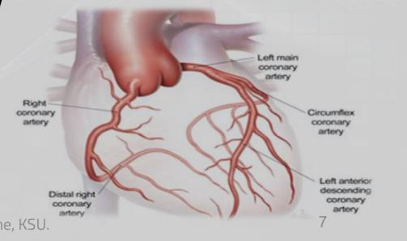
Left anterior descending artery (LAD)
Circumflex artery (CX)
Girl’s slides
Considered the most critical vessel in terms of myocardial blood supply.
It supplies 45-55% of the left ventricle
(the anterior & apical part of the heart) :
Further divides into:
1-Diagonal arteries.(D1, D2)
2-Left conus arteriosus artery.
3-Septal perforator (SP) artery.
1. The anterolateral of the left ventricle.
2. The apex of the heart.
3. The anterior 2/3 of the interventricular (IV) septum.
4. The front of the right ventricle.
5. The right & left bundle branches.
Further divides into:
Left obtuse marginal (OM) artery(om1,om2), which supplies the left ventricle
SA nodal artery, which supplies the SA- node in ~40% of hearts & the surrounding myocardium.
Left branch to the AV- Bundle.
Posterior ventricular branch
Anterior ventricular branch.
Encircles the heart muscle.
Supplies blood to the lateral & posterior surface of the heart: left atrium,& the posterolateral of the left ventricle.

Slide 8
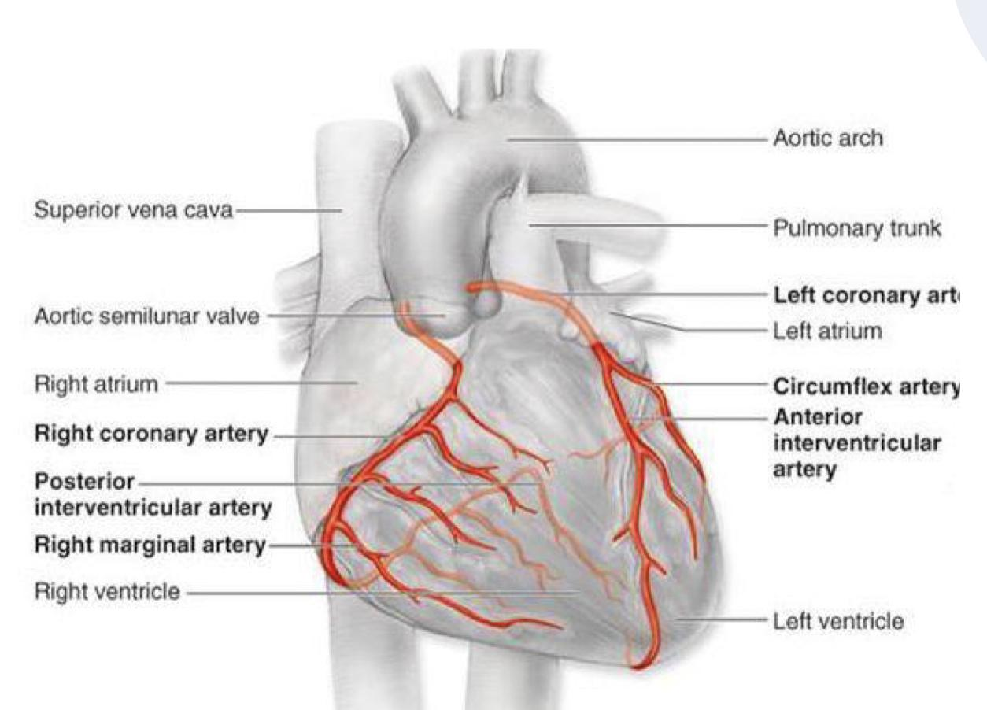
Right posterior descending artery (RPD)
Right acute marginal artery (AM)
Girl’s slides
Also called posterior interventricular artery.
Curves posteriorly & descends downward on the posterior surface of the heart.
Supplies blood to the right atrium, right ventricle, bottom portion of the left ventricle, & posterior 1/3 of the Interventricular (IV) septum.
Branches into AV nodal artery, which supplies the AV- node (in 60-90 % of hearts) & the surrounding myocardium.
Smaller branches from the right coronary artery:
1- Atrial branch: gives off SA nodal artery, which supplies the SA- node in 60%(~50-73%) of hearts & the surrounding myocardium.
2- Right conus arteriosus artery.
3- Right anterior ventricular artery.
4- Septal perforator (SP) artery.
Supplies blood to the right margin of the right ventricle with minimal supply to the apex.

Slide 9
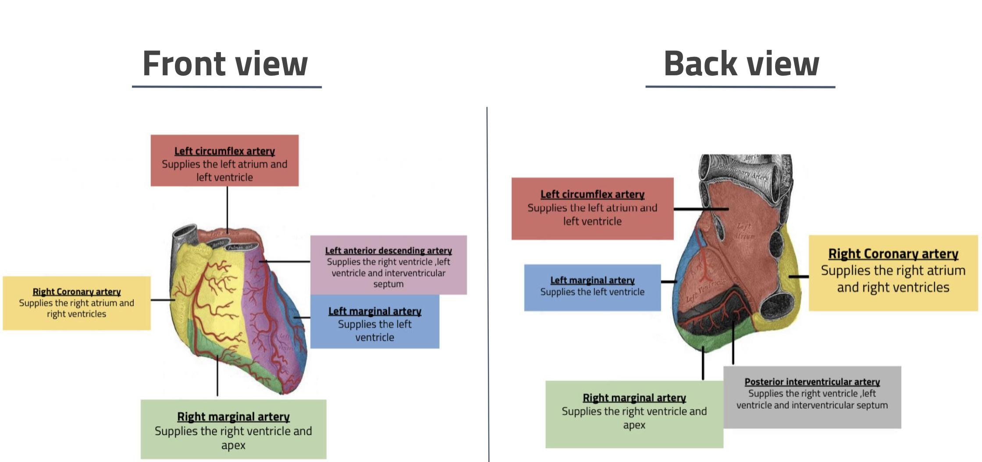
Coronary Circulation: Areas of Distribution
Revision
Girl’s slides

Slide 10
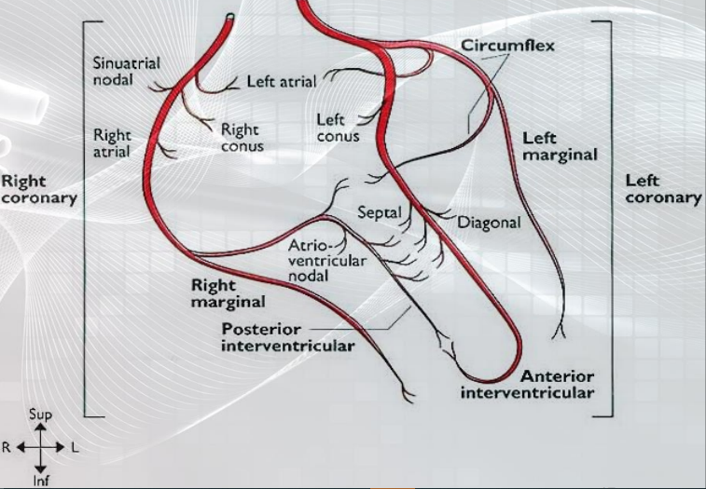
Summary: Coronary arteries: Branches & Areas of supply
SA nodal a. (60%)
Sinoatrial node, surrounding myocardium
Right marginal a.
right ventricle
Right coronary artery (right ventricle, right atrium, inferior third of interventricular septum)
Posterior interventricular a.
(RV,LV,IV septum)
AV nodal a.
Atrioventricular node, surrounding myocardium
Aorta
Left marginal a.
Circumflex a.
left ventricle
Posterior surface of LV
SA nodal a. (40%)
Left coronary artery (left ventricle, left atrium, anterosuperior two-third of interventricular septum)
Sinoatrial node, surrounding myocardium
Anterior interventricular a.
(RV,LV,IV septum)

Slide 11
1-Anastomosis
2- Collateral Circulations:
Girl’s slides
Definition:
Collateral circulation is a network of extra-cardiac channels formed of tiny blood vessels.(plan B)
Cardiac anastomosis: the two coronary arteries anastomose in the myocardium
Extracardiac anastomosis: the two coronary arteries anastomose with:
Under normal conditions it is not open, it opens only in emergencies when the coronary arteries are blocked.
Vasa vasorum(small vessels)of the aorta
Vasa vasorum of pulmonary
arteries.
Internal thoracic arteries.
The bronchial arteries.
Phrenic arteries.
When the coronary arteries narrow to the point that blood flow to the heart muscle is limited (coronary artery disease), collateral vessels may enlarge & become active.
This allows blood to flow around the blocked artery to another artery nearby or to the same artery past the blockage, and protecting the heart tissue from injury.

Slide 12
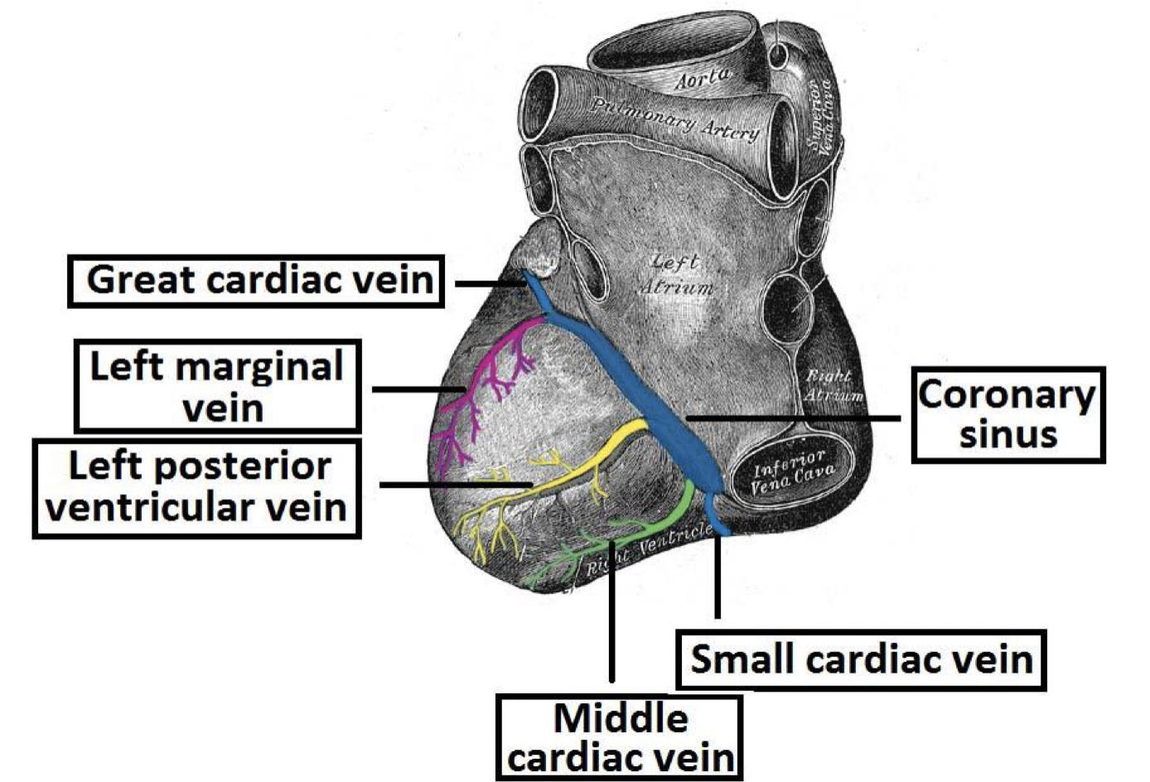
3- Venous Drainage Of The Heart:
4- Lymphatic Drainage Of The Heart:
Most of the venous blood returns to the heart into the right atrium through the coronary sinus via the cardiac veins.
5-10% drains directly into heart chambers, right atrium & right ventricle, by the anterior cardiac vein & by the small veins that open directly into the heart chambers.
Cardiac venous drainage occur through:
Coronary sinus, which lies in the posterior part of the atrioventricular groove & is a continuation of the great cardiac vein.
Anterior (great), middle, & small cardiac veins.
Smallest cardiac veins (Venae Cordis Minimae).
Girl’s slides
Lymphatics of the
heart accompany the two coronary arteries & form two trunks:
The right trunk, ends in the brachiocephalic node.
The left trunk, ends into the tracheo-bronchial lymph nodes at the bifurcation of the trachea.

Slide 13
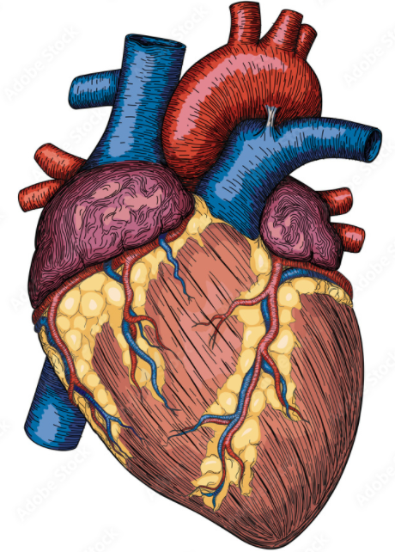
Coronary Circulation: Venous Drainage Of The Heart
Coronary Circulation
Right marginal artery
Small Cardiac Vein
Right coronary artery
Posterior interventricular artery
Aorta
Middle Cardiac Vein
Coronary Sinus
Right Atrium
Circumflex artery
Left coronary artery
Great Cardiac Vein
Anterior interventricular artery

Slide 14
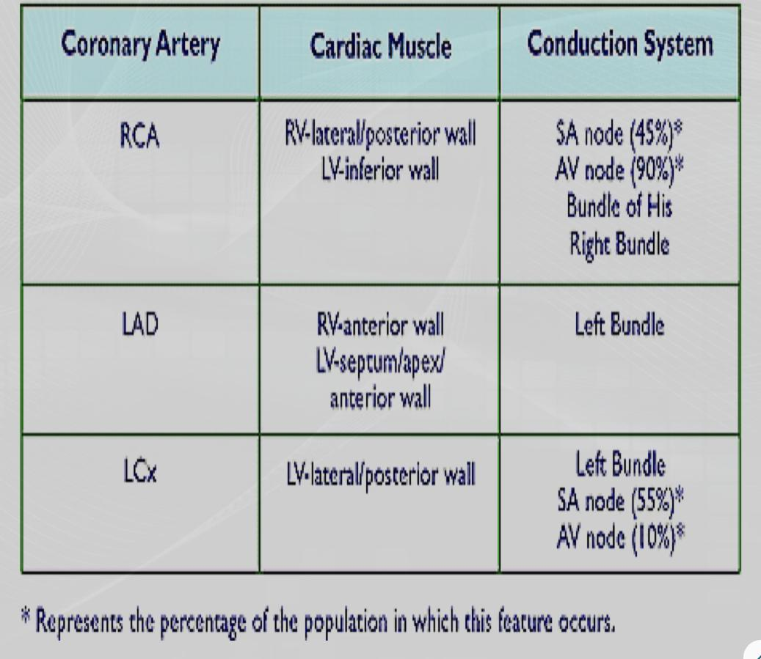
Coronary Dominance
Girl’s slides
Coronary dominance depends on which artery (or arteries) supplies the AV node.
Usually, the right coronary artery is the dominant artery in 85-90% of hearts, as it supplies the AV- node.
There are three types
Left dominant
(8-10)%
through the CX branch
Right dominan
(85-90)%
Co-dominant “balanced”
(7-10)%
Clinical importance:
In case of left dominance, a block in LCA will affect the entire left ventricle & Interventricular (IV) septum
In case of right or balanced dominance, a block in RCA will at least spares part of the septum (2/3) & the left ventricle.
where the posterior interventricular artery is formed by both right coronary & Left CX arteries.

Slide 15
Coronary blood flow
Two-thirds of coronary blood flow occurs during (beginning) diastole .
Coronary blood flow (CBF) at rest in human is about 225-250 ml/min ,about 5% of cardiac output.
At rest, the heart extract 60-70% of oxygen from each unit of blood delivered to the heart (other tissues extract only 25% of O2).
During times of extreme demand, the coronary arteries can dilate up to four times greater than normal
Why heart is extracting 60-70% of O2?
Because heart muscle has more mitochondria, up to 40% of cell is occupied by mitochondria, which generate energy for contraction by aerobic metabolism, therefore, heart needs O2.
CBF increases in proportion to exercise or work output. When more oxygen is needed, O2 can be increased to heart only by increasing blood flow.

Slide 16
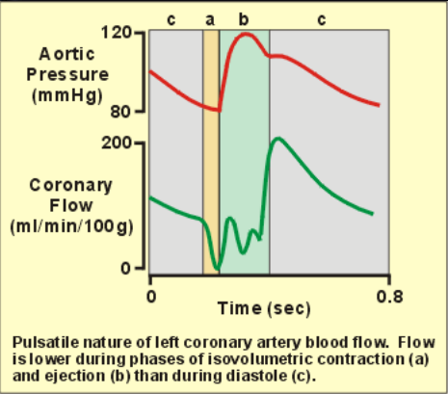
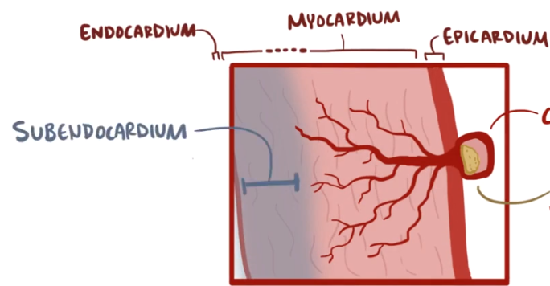
Changes in Coronary Blood Flow (CBF) During Systole & Diastole
During systole when heart muscle contracts it compresses the coronary arteries therefore blood flow is less to the left ventricle during systole and more during diastole.
Blood flows to the subendocardial portion of Left ventricle ,which occurs only during diastole.
Thus its more prone to ischemia
*Extra picture for subendocardial region

Slide 17
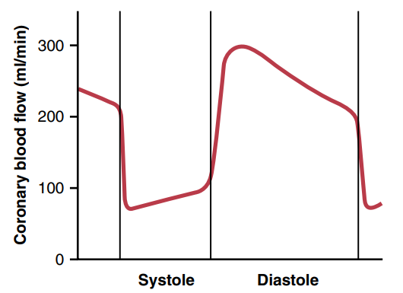
Changing in CBF during systole & diastole
In right ventricle:
In left ventricle:
CBF to the right side of the heart is not much affected during systole, & so more blood will flow to the right ventricle than the left one.
During systole when heart muscle contracts it compresses the coronary arteries therefore blood flow is less to the left ventricle during systole and more during diastole.
Blood flow to the Subendocardial portion of the left ventricle occurs only during diastole, & is not there during systole.
Explanation: Pressure difference between the aorta & the right ventricle is greater during systole (95 mmHg) than during diastole (80 mmHg), therefore more blood flow to right ventricle occurs during systole.
Therefore, Subendocardial region of the left ventricle is prone to ischemic damage & it is the most common site of myocardial infarction.

Slide 18
Girl’s slides
Pressure gradient between Aorta and heart chambers affect CBF
 | Pressure (mmHg) in |  |  | Pressure difference (mmHg) between Aorta
 | Aorta | Lt Ven | Rt Ven | Lt Ven | Rt Ven
Systole | 120 | 120 | 25 | 0 | 95
Diastole | 80 | 0-2 | 0-2 | 80 | 80
In general, maximal coronary blood flow occurs during the early part of diastole (Isometric Relaxation Phase); however, CBF for the right ventricle could be better during systole (difference of 95 mmHg).

Slide 19
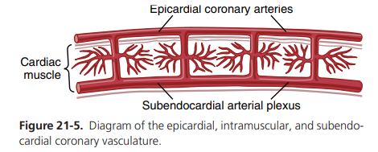
Extra explanation slide Thx to #team441
Coronary vascular resistance
During systole there is a decline in Coronary blood flow (increase in coronary vascular resistance), this is because of the compression on the intramyocardial arteries by cardiac muscles.
But the epicardial conductance vessels are not surrounded by muscles (no compression during systole).
Therefore the vessels which are responsible of Coronary vascular resistance are the intramyocardial vessels not the epicardial vessels.
Epicardial conductance vessels: Contribute only to a small percentage of coronary vascular resistance.
Intramyocardial vessels (arterioles): Contribute to most of the total coronary vascular resistance.
Blood flows to the subendocardial portion of left ventricle only during diastole, therefore this portion of left ventricle is prone to ischemic changes & is the most common site of myocardial infarction.
However, the extra vessels of the subendocardial plexus normally compensate for this reduction .

Slide 20
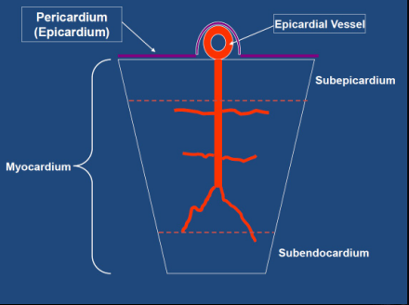
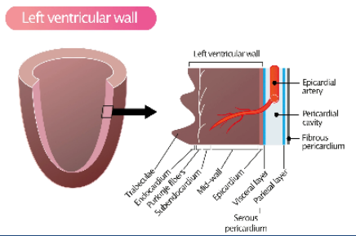
Coronary Vascular Resistance Boys slide
Epicardial conductance vessels: Contribute only to a small % of resistance.
Intramyocardial vessels (arterioles): Contribute most to total coronary vascular resistance.
*
* arterioles is resistant vessels (has ↑ resistant)
* arteries has lower resistance
*
Thus, Left Coronary vessels receive minimum amount of blood during systole because of :
1- ↑resistance in the coronary arterioles
2- the compression on the vessels due to muscle contraction

Slide 21
REGULATION OF CORONARY BLOOD FLOW
1- Metabolic control Chemical Factors Affecting Coronary Blood Flow
2- Autoregulation
3- Endothelial control of coronary vascular tone
4- Extravascular compressive forces
5- Neural control
6- Pressure in the aorta

Slide 22
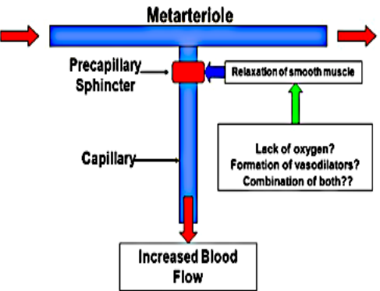
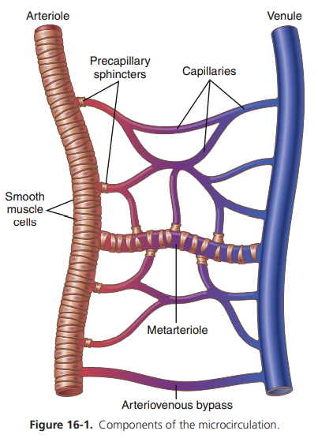
1- METABOLIC CONTROL Chemical Factors Affecting Coronary Blood Flow
Coronary circulation is very sensitive to myocardial tissue oxygen tension.
Increased oxygen demand results in a lower tissue oxygen tension.
This causes:
Vasodilation and increased blood flow by chemical factors like:
Lack (↓) of oxygen.
High (↑)conc. of CO2.
High (↑) conc. of NO.
High (↑) local conc. of H+ ion.
High (↑) local conc. of K + ion.
High (↑) local conc. of
Lactate, Prostaglandin,
Adenosine
Adenine nucleotides.
Adenosine, which is formed from ATP during cardiac metabolic activity, causes coronary vasodilatation.
Note: An increase in Ca+2 conc. does not increase the Coronary blood flow (CBF).
*Extra picture for metarterioles

Slide 23
2- AUTOREGULATION
Boys slide
From the vessels it self (Intrinsic)
Ability of a vascular network to maintain constant blood flow over a range of arterial pressures.
Auto regulation is an independent determinant of coronary blood flow.
The set point at which coronary blood flow is maintained depends on myocardial oxygen consumption (MVO2).
3- ENDOTHELIAL CONTROL OF CORONARY VASCULAR TONE
Damage to endothelial cells will lead to:
Decreased Nitric Oxide and Prostacyclin production.
Increased Endothelin production.
This will lead to:
Vasoconstriction (vasospasm)(ET1). Endothelin Type 1 receptor
Thrombosis. (pro-coagulant such as Willebrand factor)

Slide 24
4- Neural Control
Sympathetic Control:
Parasympathetic Control:
Coronary blood flow is controlled predominantly by local metabolic, auto regulatory, and endothelial factors.
Neural control of the coronary circulation complements the above local effects.
Effect of Sympathetic Stimulation: Catecholamines (EP NE)
Coronary arteries have:
Alpha Adrenergic receptors, which mediate vasoconstriction (more epicardial).
Beta Adrenergic receptors, which mediate vasodilation (more intramuscular).
Beta1 in conduit arteries.
Beta2 in resistance arterioles.
Indirect effect of sympathetic stimulation:
Direct effect of sympathetic stimulation:
Sympathetic stimulation in intact body will lead to release of adrenaline & nor-adrenaline, increasing heart rate (HR) & force of contraction.
Experimentally, injection of nor-adrenaline
after blocking the Beta adrenergic receptors
in un anesthetized animals elicits coronary vasoconstriction.
However,coronaries will vasodilate due to the release of vasodilator metabolites.
Example: Athletes.

Slide 25
Benefits of Indirect Effect of Nor-adrenergic Discharge
Girl’s slides
When the systemic blood pressure (BP) decreases (very low), it will cause a reflex increase of nor-adrenergic discharge.
This will lead to an increase in the Coronary blood flow (CBF) secondary to metabolic changes in the myocardium.
In this way, circulation of the heart is preserved, while the flow to other organs is compromised.
Effect of Parasympathetic Stimulation: Acetylcholine
Vagal stimulation causes coronary vasodilatation.m in healthy subjects (intact endothelium)
Vasoconstriction in patients with atherosclerosis( damaged endothelium).
However, parasympathetic distribution is not great.
There is more sympathetic innervation of coronary vessels.
Effect of Tachycardia on Coronary Blood Flow
Girl’s slides
Coronary blood flow (CBF) is reduced with tachycardia.
WHY? With tachycardia, the diastolic period will be shortened.

Slide 26
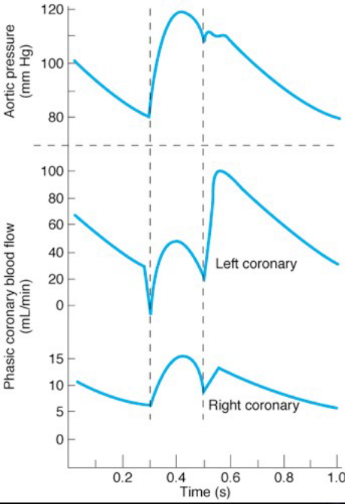
5- EXTRAVASCULAR COMPRESSIVE FORCES
Boys slide
In left ventricle:
In right ventricle:
Early Systole:
Initial Flow Reversal.
Remainder of Systole:
Flow follows aortic pressure curve, but at a much reduced pressure.
Early Diastole :
Abrupt pressure rise (80-90% of LV flow occurs in early diastole).
Remainder of Diastole:
> Pressure declines slowly as aortic pressure decreases.
Lower pressure generated by thin right ventricle in Systole. No reversal of blood flow during early systole.
Systolic blood flow constitutes a much greater proportion of total blood flow.
*
* The right coronary flow reach its peak during systole

Slide 27
Girl’s slides
Control of Coronary Blood Flow
Coronary blood flow (CBF) shows considerable auto regulation.
1
Local muscle metabolism is the primary controller:
Oxygen demand is a major regulatory factor of local coronary blood flow.
2
Nervous control of CBF:
Sympathetic greater effects than parasympathetic.
Direct effects of nervous stimuli on the coronary vasculature.

Slide 28
Boys slide
FACTORS INCREASING MYOCARDIAL O2 CONSUMPTION:
1- Increased Heart Rate.
2- Increased Inotropy (Contractility).
3- Increased Afterload.
4- Increased Preload.
Changes in preload affect myocardial oxygen consumption less than do changes in the other factors.
% of O2?
T: wall tension P: pressure
r: radius
h: wall thickness
Laplace law: T= P*r/h
Preload increases the diameter in the ventricles and then the wall tension helps the ventricles to recoil.
Thus, it has the least factor that affect the myocardial O2 consumption

Slide 29
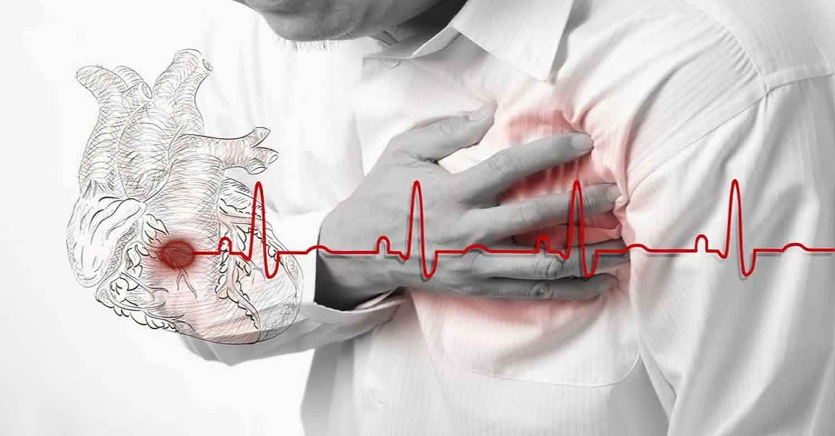
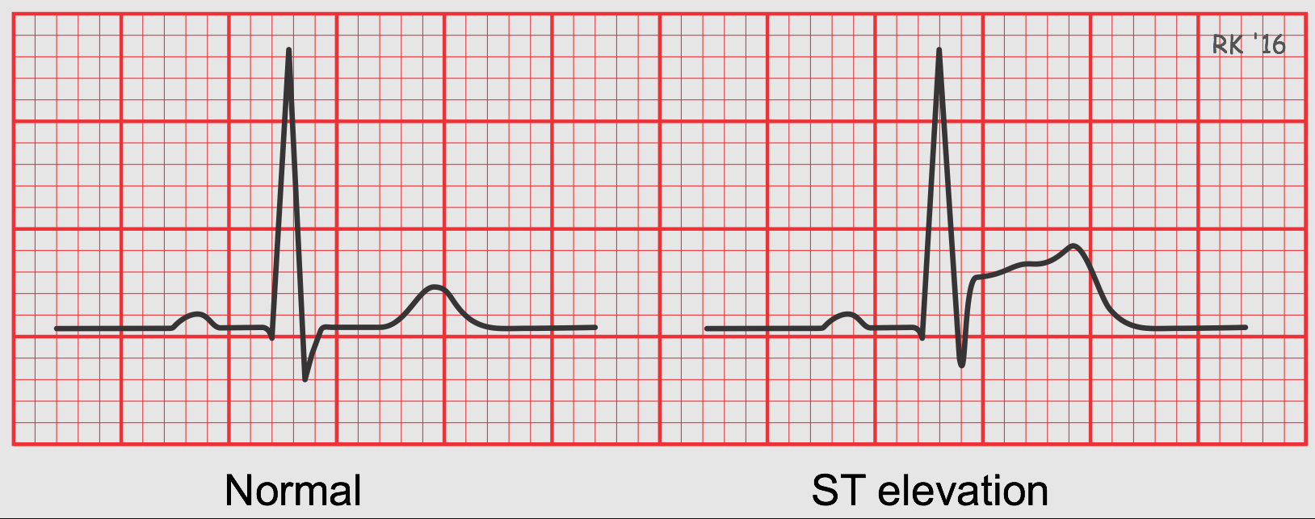
Boys slide
MYOCARDIAL INFARCTION:
ANGINA:
The irreversible death (necrosis) of heart muscle due to a lack of oxygen
Most common cause of death.
Clinical features: 1- Chest pain – even at rest & last for hours. Severe pain – sudden onset, but can develop gradually.
2- Associated with: sweating, vomiting.
3- Hypotension.
4- increased troponin & CK enzymes (Blood test)
5- Elevated ST segment (ECG)
Chest pain caused by reduced blood flow to the heart muscles. (like pressure, tightness, Squeezing in your chest)
Investigation:
ECG may be normal between attacks.
Exercise ECG – 75% positive,
Normal results does not exclude the condition.
Treatment for attack:
Stop exercise
Glyceryl trinitrate 0.5mg under the tongue.
(side effects → headache)

Slide 30
MCQs
Q1: Which of the following areas is more likely to be ischemic in the heart :
A- Epicardium | B- Myocardium | C- Subendocardium | D- Pericardium
Q2: The Right & Left coronary arteries anastomose in the :
A- Epicardium | B- Myocardium | C- Endocardium | D- Subendocardium
Q3: During systole, The blood supply to the ventricles:
A- More in the Right Ventricle | B- More in the left ventricle | C- Same blood flow in both Ventricles | D- There is no blood flow to the ventricles during systole
Q4: Which one of the following factors will Causes coronary vasodilation:
A- ↓ in K + ion conc. | B- ↑ in Adenosine conc. | C-↑ in Oxygen conc. | D- Both A&B
Q5:Which stimulation will lead to vasodilation of the coronary artery?
A- alpha receptor | B- beta receptors | C- Vagal stimulation | D- Both B&C
Answers: 1.C 2.B 3.A 4.B 5.D

Slide 31
SAQs
Q1:list the Importance of coronary circulation?
Slide 4
Q2: what is the clinical importance of Coronary Dominance?
In case of left dominance, a block in LCA will affect the entire left ventricle & Interventricular (IV) septum
In case of right or balanced dominance, a block in RCA will at least spares part of the septum (2/3) & the left ventricle.
Q3: What are the Regulation of coronary blood flow?
Metabolic control
Auto regulation
Endothelial vascular tone
Extravascular compressive force
Neural control

Slide 32
SAQs from female Dr
Why is the Blood flow in right ventricle during systole not affected ?
Because of Pressure difference between the
aorta & the right ventricle is greater during
systole (95 mmHg) than during diastole (80
mmHg), therefore more blood flow to right
ventricle occurs during systole.
Why right coronary artery is the dominant artery in 85-90% of hearts?
Because it supplies the AV- node.
Why does the Collateral Circulations occur?
During emergency in case coronary arteries are blocked

Slide 33
Team Leaders
THANK YOU
Saleh aldeligan
Qusai Alsultan
Raghad Alkhudair
Raghad Alnadeef
Team Members
Othman Aldraihem
Abdulaziz Alqahtani
Abdullah Alshahri
Saad Al Hammad
MOHAMMED ALDAWSARI
Ahmad Almarshed
Rayan Alahmari
ABDULRAHMAN BINBAKHIT
Abdulaziz Alymni
Faisal Alkhunein
Abdullah Alqarni
Raid Almadi
Mohammad Alrashed
Abdulrahman bin Ateeq
Amer Alghamdi
Mishal Alsuwayegh
Nawaf alturki
Hussam Aleid
Raid almadi
Mohammed AlShehri
Nouf Aldhalaan
Amani Alotaibi
Shahed bukhari
Shahad Aljeri
Maha Alkoryshy
Alhnouf Hadi
Mayssam Aljaloud
Hissa Alshiqari
Mashael Albugami
Renad Alayidh
Ghada Binslmah
Razan Alsulami
Shaden albassam
Razan Almanjomi
Reem Alhazmi
Dhai hamdan
Shahad alaskar
Haifa Almuddahi
Reema alquraini
deema aljuribah
Kadi Khalid aldossari
Farah alhalafi
Theme was done by Mohammad Alrashed
Physio442@gmail.com
Editing File

