Slide 1
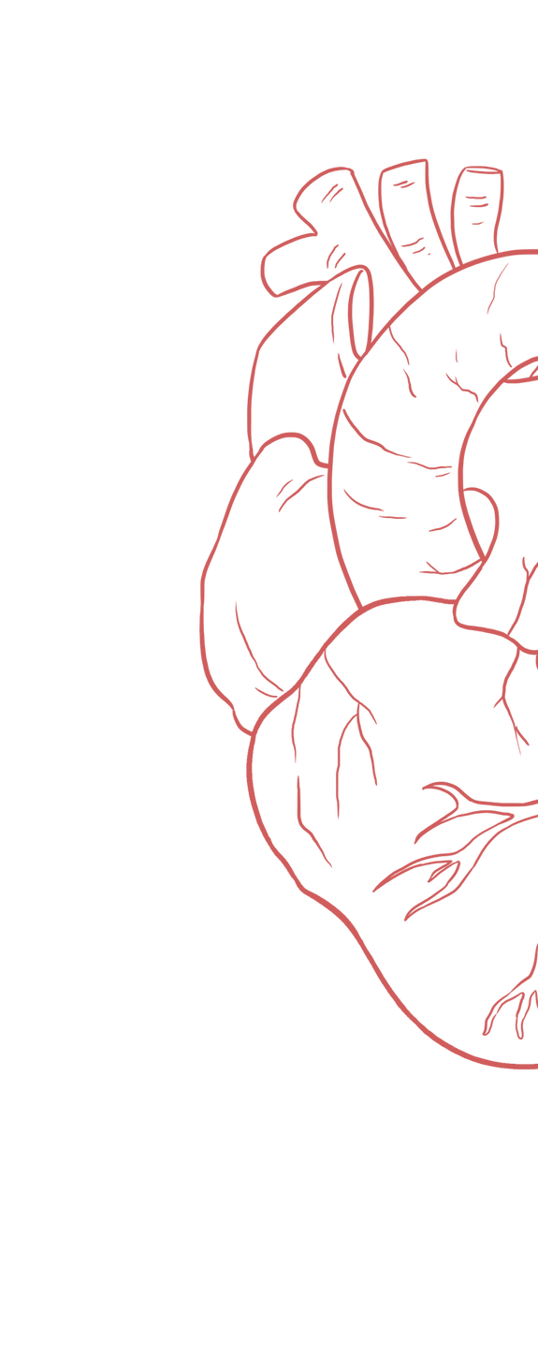
Pathophysiological Changes in Pulmonary Embolism
____________
Color Index:
Main Text
Important
Girl’s Slides
Boy’s Slides
Dr’s Notes
Extra Info

Slide 2
Objectives
Pulmonary circulation
Definition of pulmonary embolism
Clinical significance of pulmonary embolism
Sources, etiology & risk of pulmonary embolism
Clinical presentation of pulmonary embolism
Differential diagnosis
Pathophysiological & hemodynamic changes of pulmonary embolism

Slide 3
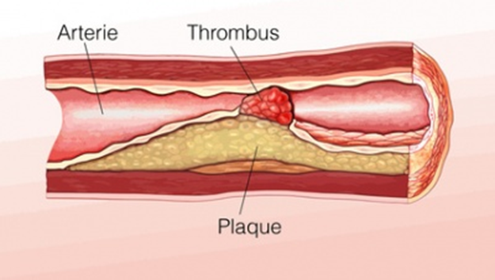
Pulmonary Circulation
Deoxygenated blood
Is pumped through the semilunar pulmonary valve into the left & right main pulmonary arteries ( one for each lung ), which branch into smaller pulmonary arteries that spread throughout the lungs. Exchange occurs here
Pulmonary Circulation
part of the circulatory system that is
pumped from the right ventricle to the
lungs carrying deoxygenated blood, &
returns oxygenated blood to the left
atrium of the heart.
Oxygenated blood
Leaves the lungs through pulmonary veins
to the left atrium completing the pulmonary
cycle.
Pulmonary Embolism
Pulmonary embolism (PE) is a thrombotic disorder where an occlusion occurs in pulmonary artery by a blood clot preventing blood flow to the lungs

Slide 4
Clinical Significance
The incidence of diagnosed pulmonary embolism (PE) increases with age.
The annual rate is about 1 in 10 000 in individuals below 40 years of age & can reach 1 in 100 in patients over 80 years.
According to autopsy (تشريح بعد الوفاة ) studies, the disease is clinically suspected in less than half of fatal cases.
PE is one of the 3 leading causes of death related to the CVS (along with MI & stroke).
Can lead to immediate death, or serious complications among survivors.
Most episodes of pulmonary embolism carry a low mortality risk (about 1%) when properly diagnosed & treated
The most common preventable cause of death among hospitalized patients in the USA.
High mortality rate (200,000 – 300.000) death annually in the USA.
There is a lack of national data for incidence, prognosis, & rate of death of pulmonary embolism.
Pathogenesis & Source of Pulmonary Embolism
1 - Pulmonary embolism can arise from any clot anywhere in the body.
2 - Minor sources:
- Fat embolism (droplet)
- Air embolism (bubble)
- Amniotic fluid embolism
- Septic embolism
- Tumor embolism
3- Clot move mostly from a dislodge of deep vein thrombosis (DVTs) in calf veins.
4- To reach the lungs, thromboemboli travel through the right side of the heart.

Slide 5
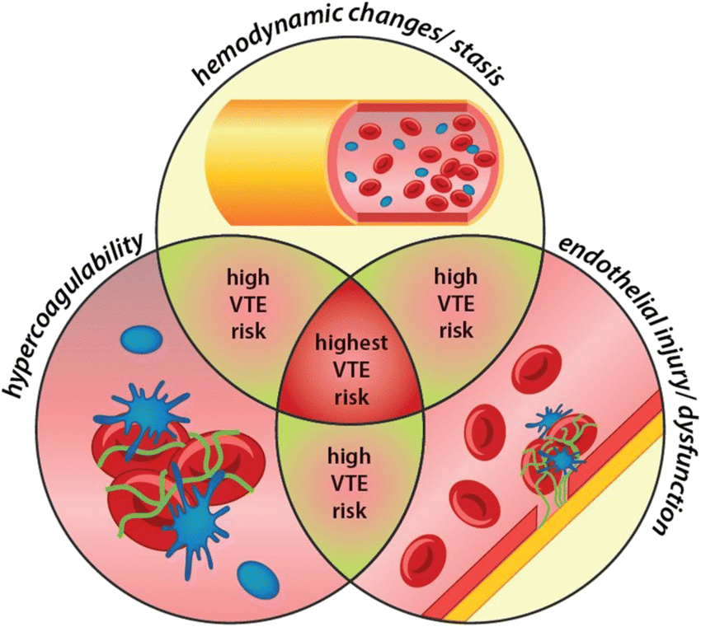
Etiology & Risk Factors of Clot Formation (Virchow's Triad)
Hypercoagulability (Blood) | ● Major surgery/ trauma ● Malignancy ● Pregnancy ( postpartum ) ● Inherited thrombophilia ● Infection and sepsis ● Inflammation ● Dehydration ● Inflammatory bowel disease ● Autoimmune condition ● Estrogen therapy
Vascular Damage (Vessel) | ● Thrombophlebitis ● Cellulitis ● Atherosclerosis ● Indwelling catheter/ heart valve ● Physical trauma, stain or injury ● Microtrauma to vessel wall ● Venipuncture
Circulatory Stasis (Flow) | ● Immobility ● Venous obstruction (obesity, tumor, pregnancy) ● Varicose veins ● Atrial fibrillation or left ventricular dysfunction ● Congenital abnormalities affecting venous anatomy (May-Thurner & Paget-Schroetter syndrome) ● Low heart rate(bradycardia) & low blood pressure

Slide 6
Clinical Presentation
The reduced blood flow to the lungs can cause debilitating symptoms including shortness of breath & can be life-threatening.
Small PE
Moderate PE
Massive PE
● Asymptomatic
● Shortness of breath
● Chest discomfort
Shortness of breath
Tachycardia
Tachypnea
Pleural rub
Haemoptysis
Pleuritic chest pain
● Severe chest pain
● Pallor ● Sweating
● Central cyanosis
● Elevated JPV (jugular
venous pulse)
● loud P2, S2 split,
gallop rhythm
● Circulatory shock
● Syncope ● Death
DIFFERENTIAL DIAGNOSIS
MI Rib fracture PNEUMONIA BRONCHITIS PLEURISY PNEUMOTHORAX COSTOCHONDRITIS

Slide 7
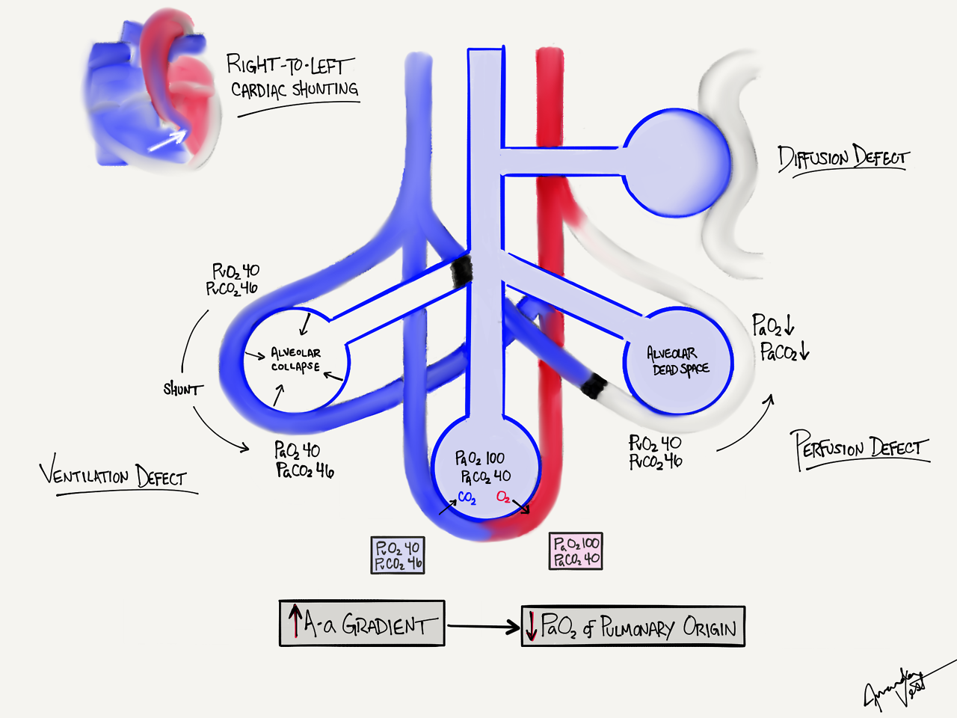
Hallmarks of Pathophysiological & Hemodynamic Events In PE
1. Ventilation perfusion defects
The optimal V/Q ratio is (0.8)
Pulmonary embolism leads to a perfusion
defect (due to wasted ventilation).
Resulting in a segmental Dead space effect.
Leading to pathological abnormalities of the alveolar arterial (O2) gradient.
Eventually leading to the development of hypoxemia
Alveolar-Arterial O2 Gradient:
-(alveolar) – a (arterial gradient) less than 10 mmHg is optimal. (up to 20 mmHg is considered normal).
-In PE, there is an abnormally increased value.
-This will lead to the development of hypoxemia.
-The severity of hypoxemia is related directly to the severity of mechanical obstruction (The clot burden).

Slide 8
Hallmarks of Pathophysiological & Hemodynamic Events In PE cont..
2. Increased Pulmonary Vascular Resistance
Due to:
❑ Vascular obstruction.
❑ Release of vasoactive mediators from the platelets (neurohumoral reflex).
Pulmonary Vascular Adaptation
❑ The normal pulmonary circulation adapts to the diverted blood flow through the recruitment & dilation of compliant pulmonary arterial vessels.
❑ These adaptive mechanisms fail when a greater proportion of the pulmonary circulation is compromised by larger emboli &/or by the elaboration of vasoconstricting mediators, at which point pulmonary vascular resistance & pulmonary arterial pressure increase.
3. Decreased Pulmonary Compliance
Due to:
❑ Local hypo-perfusion interfering with surfactant production by alveolar type II cells.
❑ Surfactant is subsequently depleted, resulting in :
▪Alveolar edema ▪ Alveolar collapse ▪Areas of atelectasis.

Slide 9
Hallmarks of Pathophysiological & Hemodynamic Events In PE
4. Development of Hypoxemia
Due to:
1. Defective V/Q ratio.
2. Decreased pulmonary compliance.
3. Loss of surfactant with the subsequent development of pulmonary edema & areas of atelectasis.
4. Increased pulmonary vascular resistance leading to increased blood diversion through the physiological shunts.
5. Decreased pulmonary capillary surface area resulting in decreased lung diffusion capacity.
6. Reflex bronchoconstriction causes due to stimulation of irritant receptors, increasing the work of breathing in some patients.
5. Right Ventricular Failure (most fatal)
1. Large emboli, particularly in patients with compromised
cardiac function, may cause an acute increase in pulmonary vascular resistance. (large emboli→immediate failure of R ventricle, scattered big emboli occluding smaller arteries→pulmonary hypertension→back pressure on R ventricle→R ventricle failure)
2. This leads to an acute right ventricular strain & can lead to a fatal decrease in cardiac output.
3. This is the most devastating & feared complication of acute pulmonary Thromboembolism.
4. In complete obstruction (saddle embolus), cardiac output may be reduced to zero, causing immediate cardiovascular collapse & death.
5. Such dramatic presentations occur in less than 5% of cases & are virtually untreatable, this highlights the importance of primary prevention of deep vein thrombosis

Slide 10
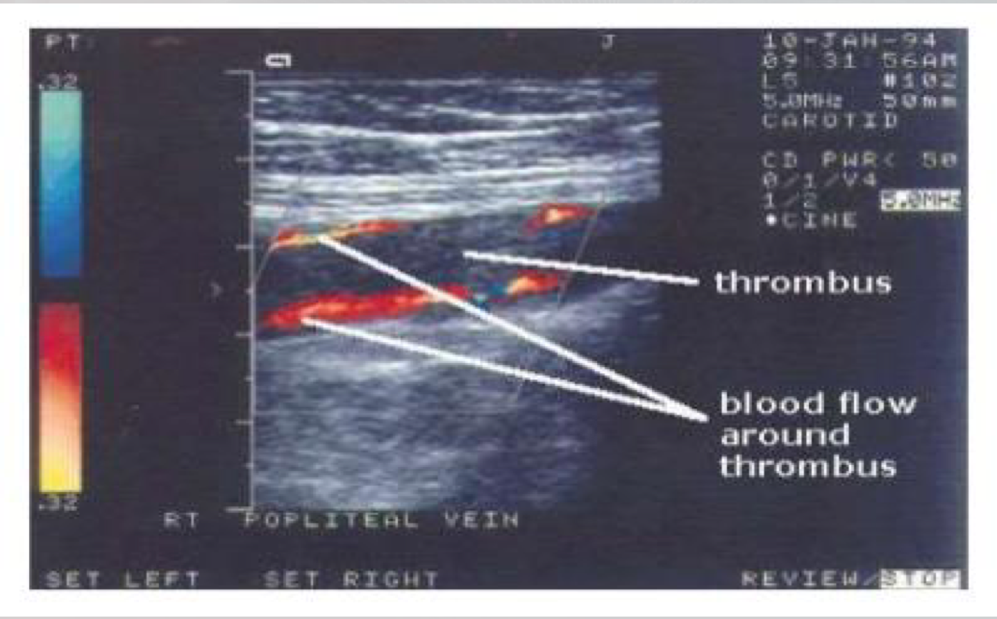
Diagnosis of Pulmonary Embolism
Diagnosis of Pulmonary Embolism (PE) is based on:
Investigations
Signs & symptoms
Blood tests.
Electrocardiogram (ECG).
Chest x-ray.
Computerized tomography pulmonary angiography (CTPA)
& CT scan.
Ventilation-perfusion scan.
Echocardiography
Lower limb venous system ultrasonography & Doppler.
(detect for venous thrombosis)

Slide 11
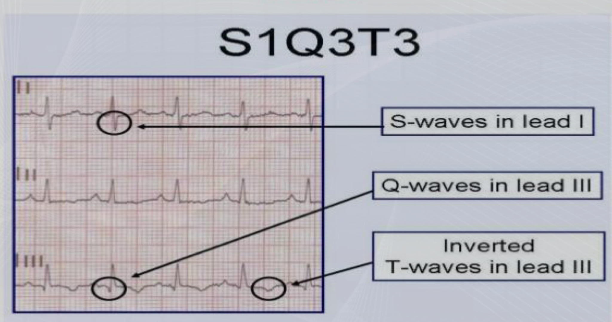
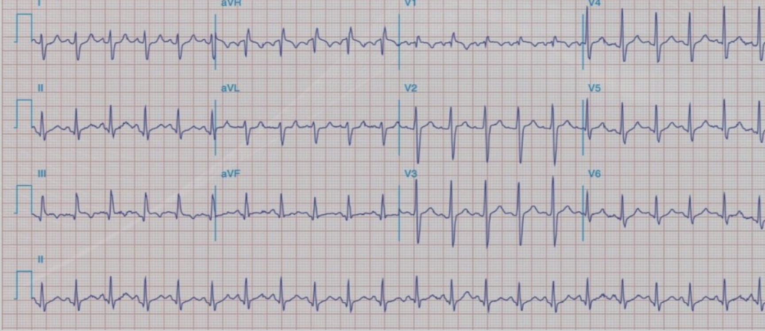
Investigations
Blood Tests
❑ Quantitative plasma D- dimer ELIZA assay:
• D-Dimer is marker of coagulation.
• D-Dimer is a small fibrin protein degradation fragment.
• D-Dimer is a very sensitive marker for clot formation but not specific = A rule out test.
• D- dimer level increased in the blood of all deep vein thrombosis (DVT) sufferers.
• D- dimer level increased in various other conditions as myocardial infarction, pneumonia,
sepsis, & some types of cancer.
❑ Complete blood count (CBC), Coagulation profile, Erythrocytes sedimentation rate
(ESR), LDH, Arterial blood gases (ABG).
❑ Elevated cardiac biomarkers.
• Cardiac troponin.
• May indicate a concomitant myocardial infarction (MI). or injury.
ECG
ECG is usually done to exclude other conditions
that may have similar symptoms.
❑ ECG findings:
• Sinus tachycardia.
• Nonspecific ST segment & T wave changes (S1Q3T3).
• Right ventricular strain pattern.
• ECG changes are specific but not Sensitive.
• Present in around 60% of cases only

Slide 12
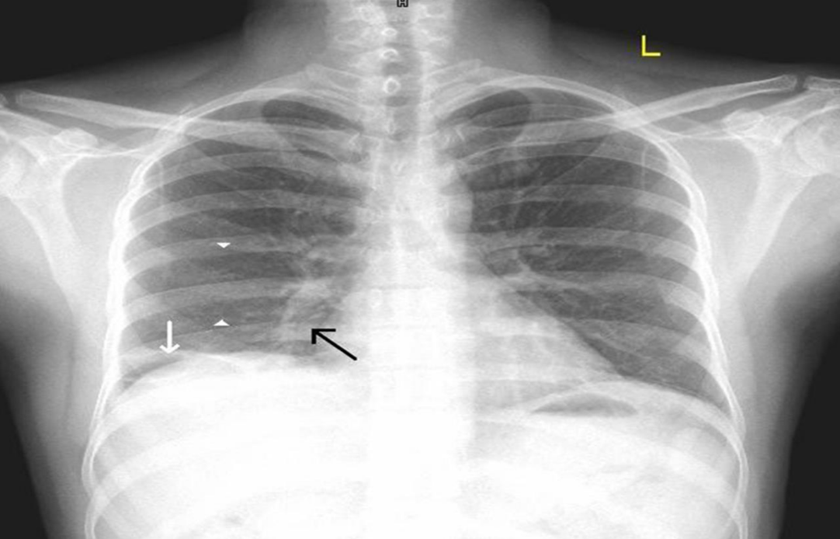
Investigations cont…
Chest X-Ray
CXR is usually done to exclude other conditions
that may have similar symptoms.
❑ Chest X-Ray findings:
• Atelectasis.
• Parenchymal infiltration.
• Elevated diaphragm.
• Enlarged mediastinum.
• Enlarged hilum.
• Cardiomegaly.
• Pulmonary edema.
• Pleural effusion.
• Oligemia (Westermark’s sign).
• Prominent central pulmonary artery (Fleischner sign).
• Wedge-shaped pleural-based area of increased opacity (Hampton’s hump).
Chest radiograph (posterior–anterior view) showing, a lateral wedge-shaped opacity (white arrow) in the right lower zone (Hampton’s hump), a focal area of oligemia (space between white arrow heads) in the right lower zone (Westermark’s sign) & a prominent right descending pulmonary artery (black arrow) (Palla’s sign).

Slide 13
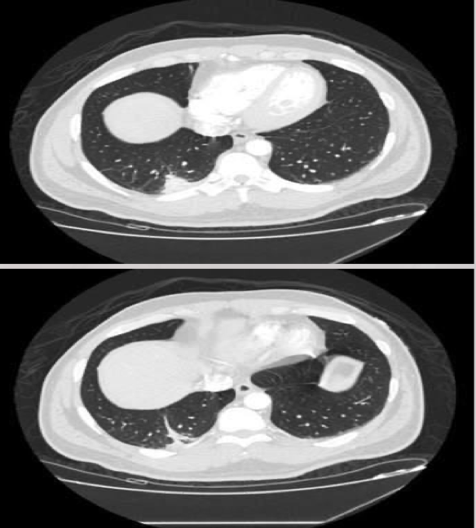
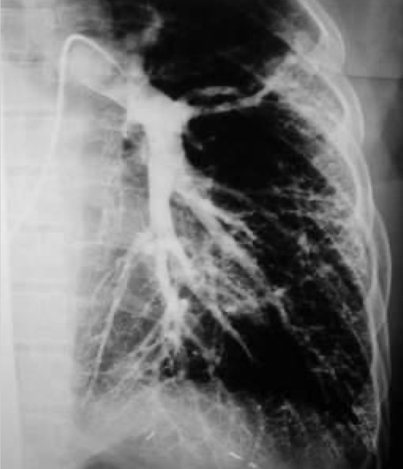
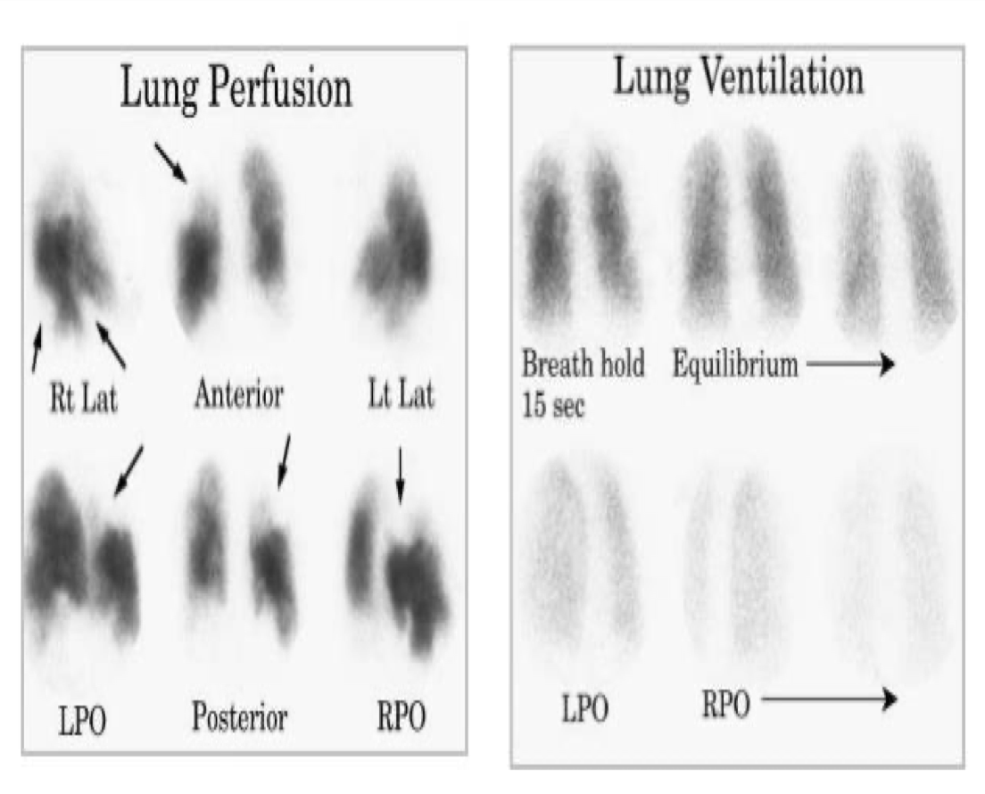
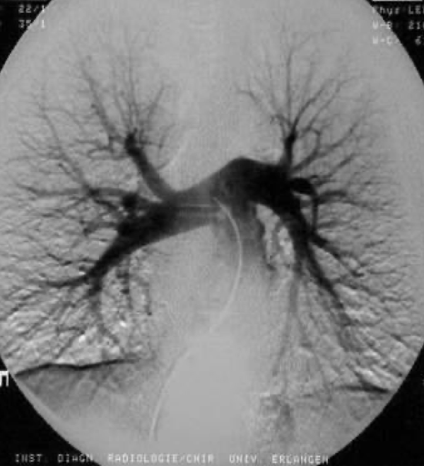
Investigations cont…
Chest Imaging Studies
(The Gold Standard)
CT Scans
Pulmonary V/Q Scanning Studies
Done to visualize the pulmonary vessels & to scan the pulmonary emboli.
Computerized tomography pulmonary angiography (CTPInvasive CT angiography,
contrast enhanced or spiral chest CT scan).
Inhaling a slightly radioactive gas that is visible during this scan can show the parts of the lungs with no blood supply. This may be caused by a pulmonary embolism.
May be used in patients who
cannot tolerate intravenous
contrasts (segmental perfusion
defect with normal ventilation).

Slide 14
Management of Pulmonary Embolism
Emergency management
Further management
(next slide)
Oxygen therapy to keep
saturation > 90%
Analgesia
(for chest pain)
Perform ECG
Insert Iv access & send baseline blood for testing
Management of cardiogenic
shock (fluids & inotropes -
Dobutamine )

Slide 15
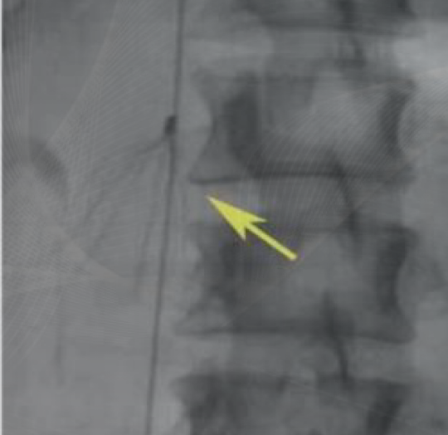
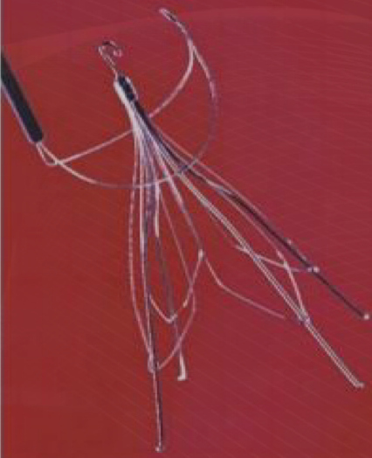
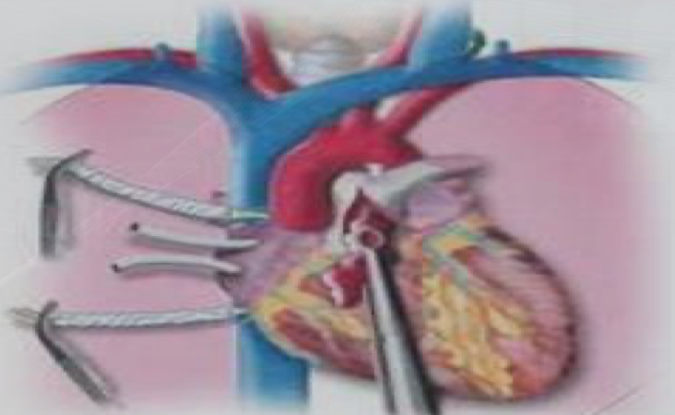
Further Management of Pulmonary Embolism
❑ Immediate anti-coagulation therapy is the foundation of treatment:
▪ Low molecular weight heparin (LMWH), Unfractionated heparin (UFH), or Fondaparinux, intravenously (IV).
▪ Followed by, long term oral anticoagulation (Warfarin).
▪ Fibrinolysis: Recombinant tissue plasminogen activator (tPA).
❑ Thrombolytic therapy: to relieve pulmonary vascular obstruction,improve right ventricular efficacy, & correct hemodynamic instability.
❑ Inferior vena cava filters may be used in selected cases,
especially if the anticoagulation is contraindicated.
❑ Maintaining adequate circulatory support.
❑ Surgical treatment: Pulmonary embolectomy,
or pulmonary thrombo- endarterectomy (Catheter embolectomy).
▪ Is applied in massive life-threatening pulmonary embolism.

Slide 16
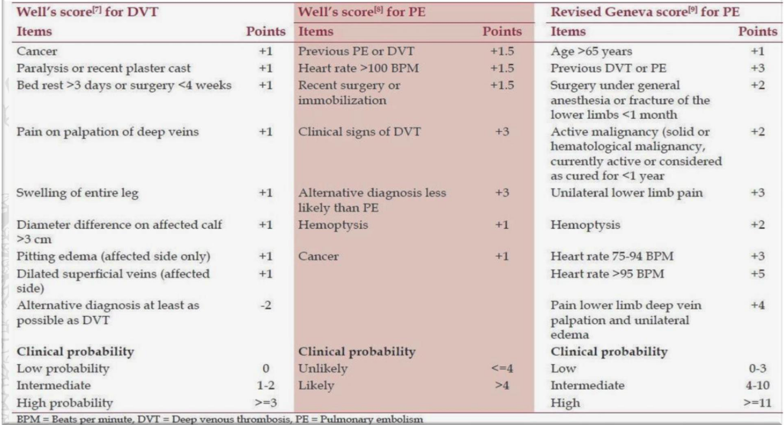
Assessment of Clinical Probability
❑ “Well’s Score”
or “Geneva rule”
❑ Improvements of signs, symptoms & risk factors.
❑ Improvements in diagnostic non-invasive &
D-dimer tests.
Prognosis of Pulmonary Embolism
❑ The prognosis of pulmonary embolism is greatly influenced by the
premorbid vascular condition.
❑ Patients without pre-existing cardiopulmonary disease can accommodate occlusion of up to roughly one-third of the pulmonary circulation with a negligible increase in pulmonary vascular resistance & pulmonary arterial pressure.
❑ normal adaptive mechanisms are ineffective in patients with pre-existing cardiovascular abnormalities (e.g., Atherosclerosis & pulmonary hypertension), making them susceptible to significant instability with any subsequent impairment of the pulmonary vasculature.
Prevention
Compression stockings
Aspirin
Follow up
& assessment of clinical probability
Anticoagulation
Management of risk factors.

Slide 17
MCQs
Q1: Deoxygenated blood move through
A-pulmonary artery | B-pulmonary vein | C-carotid artery | D-jugular vein
Q2: Component of virchow triad
A- hypercoagulability | B- circulatory stasis | C-vascular damage | D-all of them
Q3: The gold standard Investigation is…
A- Blood test | B- Chest x-ray | C- (CTPA)& CT scan. | D- ECG
Q4: which one can show the parts of the lungs with no blood supply?
A- chest X-ray | B- CT scam | C- Pulmonary V/Q Scan | D- all of them
Q5: Small PE may lead to
A- death | B-pallor | C-shortness of breath | D-syncope
Answers: 1A. 2.D 3C. 4C. 5.C

Slide 18
SAQs
Q1: Mention 3 of vascular damage risk factors
1- cellulitis 2-infection 3-venepuncture
Q2: Mention 3 investigations to diagnose PE
1-blood test 2- EKG 3- CT scan
Q3: How to assess PE
By well’s score

Slide 19
Team Leaders
THANK YOU
Saleh aldeligan
Qusai Alsultan
Raghad Alkhudair
Raghad Alnadeef
Team Members
Othman Aldraihem
Abdulaziz Alqahtani
Abdullah Alshahri
Saad Al Hammad
MOHAMMED ALDAWSARI
Ahmad Almarshed
Rayan Alahmari
ABDULRAHMAN BINBAKHIT
Abdulaziz Alymni
Faisal Alkhunein
Abdullah Alqarni
Raid Almadi
Mohammad Alrashed
Abdulrahman bin Ateeq
Amer Alghamdi
Mishal Alsuwayegh
Nawaf alturki
Hussam Aleid
Raid almadi
Mohammed AlShehri
Nouf Aldhalaan
Amani Alotaibi
Shahed bukhari
Shahad Aljeri
Maha Alkoryshy
Alhnouf Hadi
Mayssam Aljaloud
Hissa Alshiqari
Mashael Albugami
Renad Alayidh
Ghada Binslmah
Razan Alsulami
Shaden albassam
Razan Almanjomi
Reem Alhazmi
Dhai hamdan
Shahad alaskar
Haifa Almuddahi
Reema alquraini
deema aljuribah
Kadi Khalid aldossari
Farah alhalafi
Theme was done by Mohammad Alrashed
Physio442@gmail.com
Editing File

