Slide 1
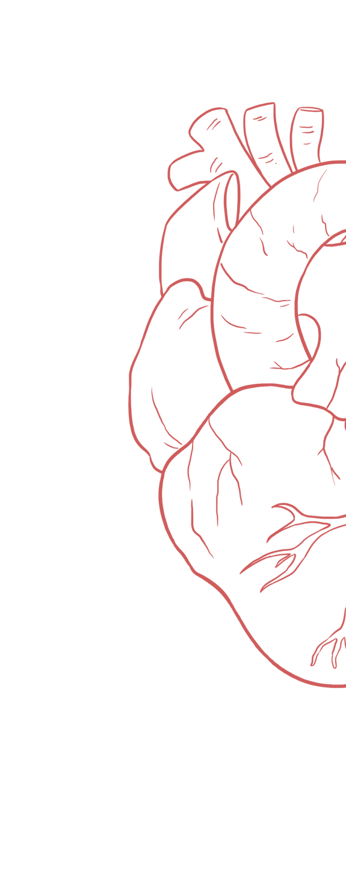
Capillary Circulation
____________
Color Index:
Main Text
Important
Girl’s Slides
Boy’s Slides
Dr’s Notes
Extra Info

Slide 2
Objectives
To describe components of microcirculation
To recognize different types of blood capillaries.
To understand regulation of flow in capillary beds.
To understand formation of the interstitial fluid.
Define edema, state its causes, and understand its mechanism of formation.
To understand the role of lymphatics.
Diffusion and filtration.

Slide 3
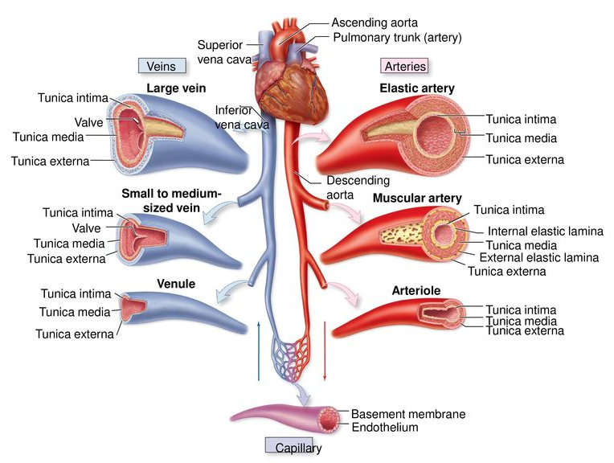
The Vascular System & Components of Microcirculation
Aorta : Elastic recoil.
Arteries: muscular, low resistance vessels
Arterioles : High resistance vessels
Capillaries: Exchange vessels
Venules :weaker muscular coat
Veins : capacitance vessels

Slide 4
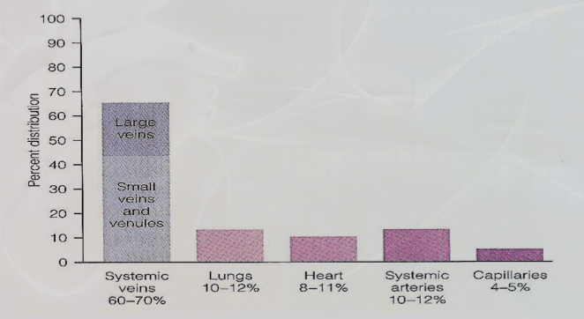
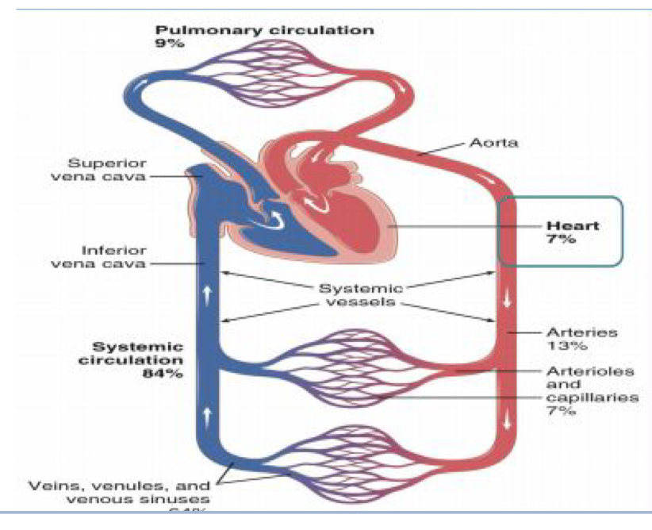
Distribution of Blood Within Aorta : Elastic recoil. The Circulatory System At Rest

Slide 5
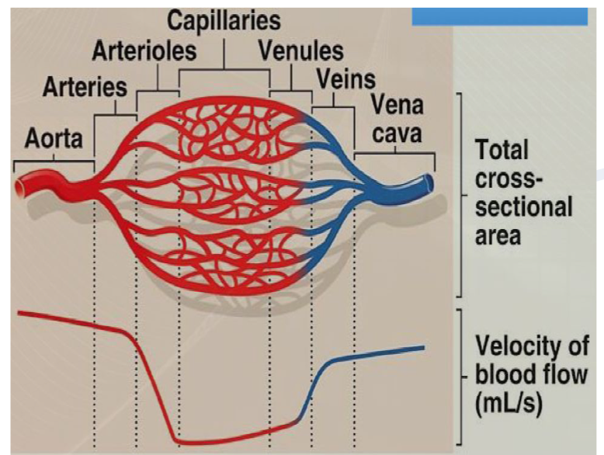
Capillaries (Microcirculatory Vessels)
Capillaries Cross-Sectional Area
Capillaries are the smallest blood vessels in the vascular system.
There are large in number (over 10 billion) in the body.
It consists ONLY of the Tunica Interna with a SINGLE Layer of endothelial cells
Provide direct access to the cells.
Most permeable.
Site of exchange with tissue: Permits exchange of nutrients & waste products.
At rest, 4-5% of circulating blood is present in
capillaries.
Capillary is of 0.5-1mm in length.
Capillary is very small in diameter (4-9 microns).
As the diameter of blood vessel decreases, the total cross- sectional area increases & the velocity of blood flow decreases.
The total capillary surface area ranges from 700-1000 m2 of surface area (>3 tennis courts).
The velocity of blood flow within each segment of the circulatory system is inversely proportional to the total cross-sectional area of the segment. Because the aorta has the smallest total cross-sectional area of all circulatory segments, it has the highest velocity of blood flow.
V=Q/A
V=velocity, Q=Flow, A=cross sectional area

Slide 6
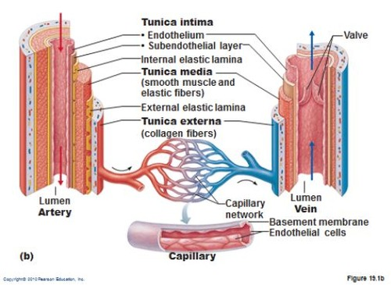
Capillary Wall
Organ Variability of Capillary Filtration
Girls’ Slides
Capillary wall is composed of a single layer of simple squamous epithelia.
Capillary wall is of 0.5 micrometers in thickness.
It regulates transfer of fluid from blood to the interstitial fluid space & vice versa.
Girls’ Slides
Brain & Muscle | small
subcutaneous | moderate
Intestines | large
Liver & Kidneys | extremely large
Why is there a difference?
Because of their permeability.
How does the permeability change?
By alteration of clefts size/Pores between cells.

Slide 7
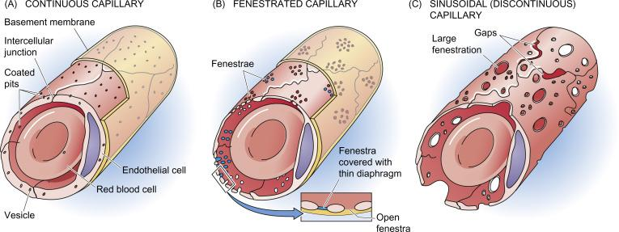
Types of Capillaries :
Capillaries are classified into (3) types according to their wall permeability and/or diameter.
Wall permeability is affected by the size & diameter of the pores.
Continuous
Fenestrated
Sinusoidal
Do not have fenestrae.
Allow only very small molecules to pass Found in brain, muscles, lung & adipose tissue.
Have wider pores.
Allow large substances to pass but not plasma proteins. Found in kidney glomeruli, small intestine & endocrine glands.
Large diameter with large fenestrae (wider gaps between the cells). Endothelium is discontinuous. Found in liver, spleen, bone marrow lymphoid tissue, & some endocrine glands.

Slide 8
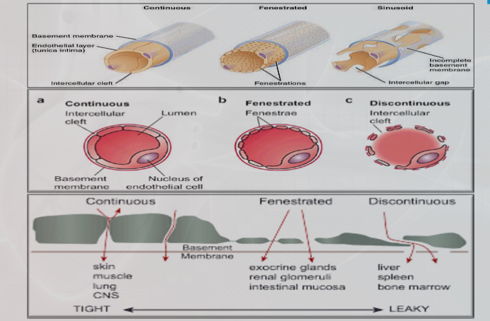
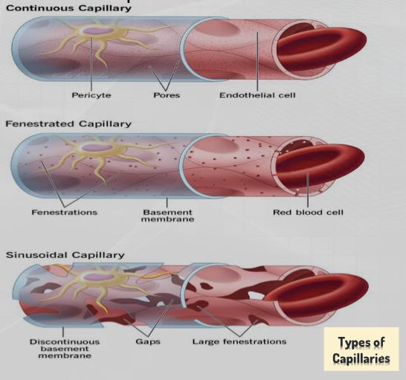
Types of Capillaries .. CONT

Slide 9
How does the permeability change?
Girls’ Slides
Factors that mediate pore size change:
Histamine | If little = will increase the flow (distends vessel). If a lot = will decrease the arterial blood pressure (anaphylaxis).
Cytokines | Alters flow/pressure & permeability.
Drugs | Any drug influencing contraction or dilation of smooth muscle & endothelial permeability.
Nerves | Sympathetic
Inflammation | Stretches the cells apart & increases the cleft size. If too much, can compress the vessels as well.

Slide 10
Functions of Capillaries
Girls’ Slides
Exchange vessels between blood & tissues | Capillary tone | Play a metabolic role | Play a role in temperature regulation
Provide direct access to the cells. Most permeable. Transport nutrients & oxygen from blood to the tissues. Remove CO2 & cellular waste products from the tissues to the blood. | - | Produce PGI2; Growth factors for blood cells: fibroblast GF, platelet GF; & in the lungs, angiotensin converting enzyme. Inactivation of intercellular messengers. Antithrombotic function. | Blood vessel dilatation (vasodilatation), Increase heat loss across epidermis. Blood vessel constriction (vasoconstriction), heat conservation across epidermis.

Slide 11
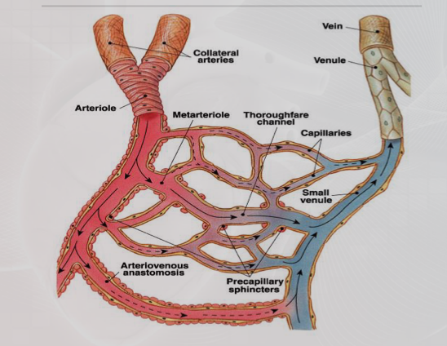
Capillary Beds (Network) / Component of Microcirculation
Capillaries are arranged in capillary beds
Arterioles divides into a number of metarterioles, which do not have a continuous smooth muscle coat.
Blood flow through the metarteriole to enter capillary bed via precapillary sphincters.
Venules drain capillary network.
Arteriolar smooth muscle, meta-arterioles, & precapillary sphincters regulate the blood flow in the capillary network.
Capillary beds consist of two types of vessels
1- Vascular shunt
Directly connects an Arteriole to a Venule.
2- True capillaries
Exchange vessels
-O2 & nutrients cross to cells
-CO2 & metabolic waste products cross into blood

Slide 12
Blood Flow Through Capillary Beds (Network)
Mechanisms of Trans-Capillary Exchange
Girls’ Slides
Blood flows from arterioles through metarterioles, then to capillary network
Simple diffusion
For lipids soluble gases (O2 and CO2) according to concentration gradient
(passive diffusion) by cell membrane bilayer
Filtration (bulk flow)
for fluid transfer by starlings force according to pressure gradient (hydrostatic pressure and osmotic pressure)
Venules drain network.
Vesicular transport
Transcytosis
Arteriolar smooth muscle, metarterioles, and precapillary sphincters regulate the blood flow in capillary network.
Mediated (membrane transport)
occurs only in capillaries of the brain and involves secondary active transport,e.g.transport of glucose moves by co-transports in cell membrane”

Slide 13
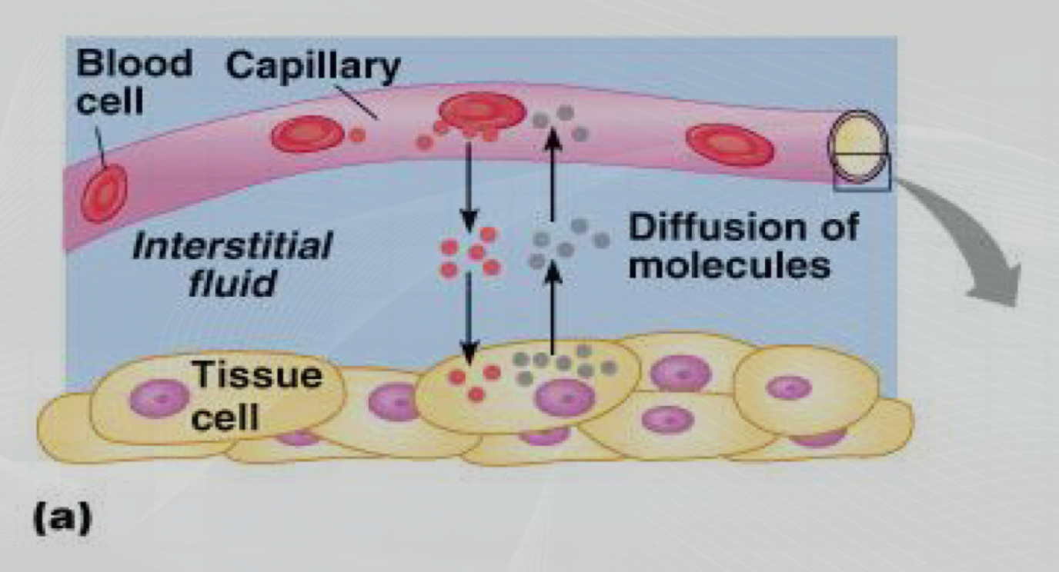
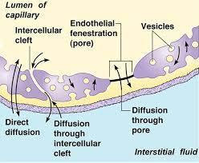
Trans-Capillary Fluid Transfer
Formation of Interstitial Fluid (IF)
Girls’ Slides
The Interstitial Fluid (IF) formation is regulated by the net filtration pressure force at the two vascular ends (arteriolar & venular) of the capillary bed.
Net filtration pressure is affected by the net balance between the two forces (hydrostatic & oncotic pressures) found in the capillaries & in the interstitial fluid.
Movement of fluid from Capillaries is affected by the:
Trans- capillary transfer Occurs by Diffusion or by vesicular transport.
Diffusion occurs through,
cells: for lipid soluble molecules.
intercellular clefts between cells:for non-lipid soluble molecules.
Filtration (Bulk Flow): Fluid movement is affected & influenced by the concentration gradients, cleft size (permeability) & hydrostatic pressure influence the fluid movement (varies by organ & situation)
Blood pressure
Osmosis
Capillary permeability
Excessive fluid gained by tissues is removed by the Lymphatic system.

Slide 14
Hydrostatic & Oncotic Pressures
Interstitial hydrostatic pressure (P IF) (Outward Force) : |  |  | Capillary Hydrostatic Pressure (Outward Force):
Interstitial hydrostatic pressure (PIF) is almost 0 mmHg. The interstitial fluid pressure which is caused by pumping of lymphatic system is negative 3 mmHg in most tissues. Encapsulated organs have positive interstitial pressures (+5 to +10 mmHg). PIF varies from one organ to another: Subcutaneous tissues: -2 mmHg. Liver, Kidney: +1mmHg. Brain: As high as +6mmHg. |  |  | Normal Capillary hydrostatic pressure ranges from 30-35 mmHg at the arterial end, & from 10-15 mmHg at the venous end.
Interstitial Oncotic (osmotic) Pressure (Inward Force): |  |  | Capillary Oncotic (osmotic) Pressure (Inward Force):
Colloid osmotic pressure is caused by presence of large proteins. There is almost no colloid osmotic pressure in the interstitial space. |  |  | Colloid osmotic pressure is caused by presence of large proteins. High content of proteins in plasma accounts for + 10 mmHg its higher osmotic pressure compared to that of the Interstitial fluid (IF). Plasma osmotic pressure: Is high (25-28 mmHg) & will attract fluid & dissolved substances from tissue spaces into the circulation.

Slide 15
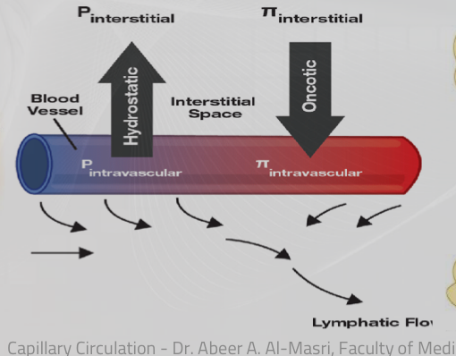
How Does Fluid Filtrate at The Capillary Bed?
Girls’ Slides
Fluid transfer depends on the relative balance & equilibrium between the hydrostatic & osmotic pressures found in capillary plasma & interstitial space
Any loss of plasma colloids will result in an increase loss of fluid from the vasculature to the interstitial space.

Slide 16
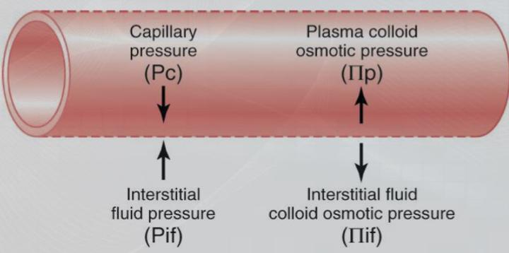
How Do We Calculate Net Movement at Capillary Beds?
Starling’s Equation for Capillary Filtration
Girls’ Slides
Filtration rate of fluid at Capillary beds =
Flux = Kf [(Pc – Pif) – σ (πp – πif)]
Net Filtration Pressure (NFP) multiplied by Filtration Coefficient (Kf).
Kf = Capillary filtration coefficient (surface area & permeability)
Pc = Capillary hydrostatic pressure
Pif = Interstitial hydrostatic pressure
σ = Capillary reflection coefficient (0 to 1) 1 = impermeable to proteins
πc = Capillary colloid osmotic pressure
πif = Interstitial colloid osmotic pressure
Filtration Rate = Kf X NFP
Filtration Coefficient (Kf) is a product of surface area times the hydraulic conductivity of membrane (membrane permeability).
If NFP = positive, then fluid is lost from capillary.
If NFP = negative, then fluid is gained by capillary.
What Does this All Mean?
Fluid transfer depends on the relative balance between hydrostatic pressure & osmotic pressure.

Slide 17
Diffusion at Capillary Beds (Fluid Balance – Starling's Forces)
Girls’ Slides
Outward force ↓ out of the capillaries |  |  |  | Inward force ↑ into the capillaries
Capillary blood pressure | Interstitial fluid pressure | Interstitial fluid colloidal osmotic press | Total | Plasma colloidal osmotic pressure | Interstitial hydrostatic pressure
Pc= 30 / 35 to 15 mmHg | PIF= 0 mmHg | μIF= 3 mmHg | 38 - 18 mmHg | μc=25 or 28 mmHg | PIF=0 mmHg
Pc is determined by both arterial & venous pressure | - | πi is determined by interstitial fluid protein concentration. Normally, because there is little loss of protein from capillaries, there is little protein in interstitial fluid, making μIF quite low. | - | it’s determined by protein concentration of capillary blood. Thus, ↑ in protein concentration causes ↑ in μc | -

Slide 18
Starling’s Forces & Filtration at Capillary Beds
Girls’ Slides
Fluid Balance: Net Filtration & Absorption of Fluid Across The Capillary Membrane
At arterial end of capillary
Outward forces | Value
Capillary blood pressure | Pc= 30-35 mmHg
Negative interstitial free fluid pressure | PIF= -3 mmHg
Total outward force | 38 mmHg
Inwards forces | Value
Plasma colloidal osmotic pressure | μC= 25-28 mmHg
Total inward force | 25 mmHg
Net outward force | 38-25=+13 mmHg
At venous end of capillary
Outward forces | Value
Capillary blood pressure | Pc= 10-15mmHg
Negative interstitial free fluid pressure | PIF= -3 mmHg
Total outward force | 18 mmHg
Inwards forces | Value
Plasma colloidal osmotic pressure | μC= 25-28 mmHg
Total inward force | 25 mmHg
Net outward force | 18-25=-7 mmHg

Slide 19
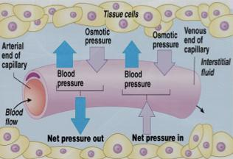
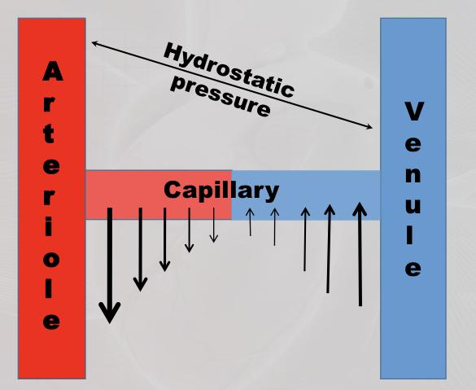
Diffusion at Capillary Beds Net Filtration & Absorption of Fluid Across The Capillary Membrane
Girls’ Slides
Net Filtration & absorption of fluid across the capillary membrane

Slide 20
Normal Forces a Arterial & Venous Ends of Capillaries
Tissue hydrostatic pressure = 0 mmHg
Negative interstitial free fluid pressure = 3 mmHg
Interstitial Fluid
Atrial blood
Blood Capillary
Venous Blood
Hydrostatic pressure = 35mmHg
Colloid Osmotic pressure = 25-28mmHg
Hydrostatic pressure = 15mmHg
NFP = (+10+3) = +13 mmHg
NFP = (-10+3) = -7mmHg
At arterial end:
Hydrostatic pressure dominates at the arterial end, as a net sum of pressure forces (blood hydrostatic pressure + Interstitial fluid (IF) osmotic pressure) flow fluid out of the circulation through capillary pores.
Water moves out of the capillary with a net filtration pressure (NFP) of +13 mmHg.
13 mmHg NFP causes an average of 1/200 of plasma in flowing blood to filter out of arterial end of the capillary into the interstitial space.
At venous end:
Oncotic pressure dominates at the venous end, as a net sum of pressure forces (blood osmotic pressure + Interstitial fluid (IF) hydrostatic pressure) flow fluid into the bloodstream.
Water moves into the capillary with a NFP of -7 mmHg.

Slide 21
Clinical significance of capillary filtration
Blood loss: Vasoconstriction of arterioles lead to decrease in capillary
hydrostatic pressure. Osmotic pressure of plasma proteins favours absorption of interstitial fluid lead to increase Blood volume.
Congestive heart failure: Venous pressure rises lead to build-up of blood in
capillaries lead to increase capillary hydrostatic pressure lead to increase filtration lead to edema.
Hypo-proteinemia: (Starvation, liver disease) lead to decrease plasma protein colloid
osmotic pressure lead to loss of fluid from capillaries edema.
Inflammation: The gaps between the endothelial cells increase because of the inflammatory mediators increase movement of proteins into the interstitial space leading to edema.

Slide 22
Lymphatic Capillary System
Begin as blind ended tubes.
Parallel to the venous system.
Collect the excess interstitial fluid & return it to blood vessels in the subclavian vein.
Approximately 120 ml/day is returned to
the blood vessels.
Muscle activity pumps fluid in lymph vessels.
Lymphatic capillaries are small, thin-walled , micro-vessels located in the spaces between cells except CNS. Serve to drain and process ECF.
Lymphatic capillary carries lymph into lymphatic vessels, connects to a lymph node to the venous circulation .
Lymphatic capillaries are slightly larger in diameter than blood capillaries, allow interstitial fluid to flow into them but not out.
Interstitial fluid enter the lymphatic capillaries through loose junctions between endothelial cells.
Lymph flow back to the thoracic duct with the help of contraction of both the lymphatic vessel walls smooth muscle & the surrounding skeletal muscle.
Failure of lymphatic drainage can lead to edema.
Lymphatic vessels present between capillaries.
3 basic functions
Drain excess interstitial (tissue) fluid back to the blood, in order to maintain original blood volume.
Transports absorbed fat from small
intestine to the blood.
Helps provide immunological
defenses against pathogens.

Slide 23
Edema
Girls’ Slides
Is the term used to describe unusual accumulation of interstitial fluid. Loss of fluid from the vascular space into the extravascular or interstitial space will result in :
• Low blood volume which will result in low blood pressure.
• Loss of fluid from capillaries into the tissue which will result in edema.
Causes
Occurs when an alteration in Starlings forces balance due to:
Any decrease in Plasma protein(Albumin) concentration, will lead to a decrease in plasma osmolarity, allowing fluid to escape from circulation to the interstitial
Any increase in Capillary hydrostatic pressure.
Failure of Lymphatic drainage
Increase in capillary permeability or pore size secondary to:
Histamine
Bradykinin or administration of certain drugs
Inflammation & release of cytokines
Involvement of some types of hormones.
Activation of Renin-Angiotensin-Aldosterone System which will results in secondary Hyperaldosteronism, leading to sodium (Na+) & water retention.
Activation of Anti-diuretic hormone (ADH)/Vasopressin, leading to water retention.

Slide 24
Remember!
Hydrostatic Pressure (Outward Force)
Oncotic (osmotic) Pressure (Inward Force)
Average normal Capillary hydrostatic pressure: Is ≊17.3 mmHg. Pressure normally ranges from 30-35 mmHg on the arterial end to 10-15 mmHg on the venous end.
Interstitial fluid pressure: In most tissues is negative 3.
Encapsulated organs have positive interstitial pressures (+5 to +10 mmHg).
Negative Interstitial fluid pressure: Is caused by pumping of lymphatic system.
Capillary hydrostatic pressure: Is opposing the Capillary osmotic pressure & tends to force fluids out of the circulation into the tissue spaces.
High content of proteins in plasma : accounts for its higher osmotic pressure compared to that of the interstitial fluid (IF). Note that the
Osmotic pressure is determined by the protein concentration.
Plasma osmotic pressure: Is high (25-28 mmHg) & will attract fluid & dissolved substances from tissue spaces into the circulation.
Colloid osmotic pressure: Is caused by presence of large proteins.
Equilibrium between osmotic and hydrostatic pressures is always maintained.

Slide 25
Summary
Summary of Factors Affecting Capillary Filtration
1.Blood pressure | 2. Permeability
3. Organ structure (encapsulated or not?) | 4. Osmotic pressure
Under normal circumstances, which of the following has the greatest influence on capillary fluid exchange ? (the order is important)
1.Blood pressure (greatest effect) | 2. Permeability
3. Osmotic pressure | 4. Lymphatic pressure
Which of the following is altered by the body to increase capillary filtration?
1.Blood pressure | 2. Permeability
3. Osmotic pressure | 4. Lymphatic pressure

Slide 26
MCQs
Answers: 1.A 2.D 3.C 4.B 5. A
Q1: A type of capillary don’t have fenestrae
A- continuous | B-fenestrated | C-sinusoidal | D-discontinuous
Q2: Capillary plays a role in lung by produce:
A- growth factor | B-fibroblast GF | C- platelets GF | D- ACE
Q3: The regulator of blood flow in capillary:
A- valves | B-no. of contractions | C- precapillary sphincter | D-left ventricular
Q4: If the NFP negative this is means?
A-lost fluid from capillary | B-gain fluid from capillary | C- nothing happen | D-none of these
Q5: Arterioles divides into a number of metarterioles,
A- Do not have a continuous SMC | B- Have a continuous SMC | C- Both | D- none

Slide 27
SAQs
Q1: The Classification of Vascular System & Comparison of Blood Vessels?
Answer slide 3
Q2: Define EDEMA?
Answer: Is the term used to describe unusual accumulation of interstitial fluid.
Q3: What are the types of capillary? And they’re classified based on?
Answer : 1- continues 2-Fenestrated 3- Sinusoidal
And their classified according to their wall permeability

Slide 28
Team Leaders
THANK YOU
Saleh aldeligan
Qusai Alsultan
Raghad Alkhudair
Raghad Alnadeef
Team Members
Othman Aldraihem
Abdulaziz Alqahtani
Abdullah Alshahri
Saad Al Hammad
MOHAMMED ALDAWSARI
Ahmad Almarshed
Rayan Alahmari
ABDULRAHMAN BINBAKHIT
Abdulaziz Alymni
Faisal Alkhunein
Abdullah Alqarni
Raid Almadi
Mohammad Alrashed
Abdulrahman bin Ateeq
Amer Alghamdi
Mishal Alsuwayegh
Nawaf alturki
Hussam Aleid
Raid almadi
Mohammed AlShehri
Nouf Aldhalaan
Amani Alotaibi
Shahed bukhari
Shahad Aljeri
Maha Alkoryshy
Alhnouf Hadi
Mayssam Aljaloud
Hissa Alshiqari
Mashael Albugami
Renad Alayidh
Ghada Binslmah
Razan Alsulami
Shaden albassam
Razan Almanjomi
Reem Alhazmi
Dhai hamdan
Shahad alaskar
Haifa Almuddahi
Reema alquraini
deema aljuribah
Kadi Khalid aldossari
Farah alhalafi
Theme was done by Mohammad Alrashed
Physio442@gmail.com
Editing File

