Slide 1
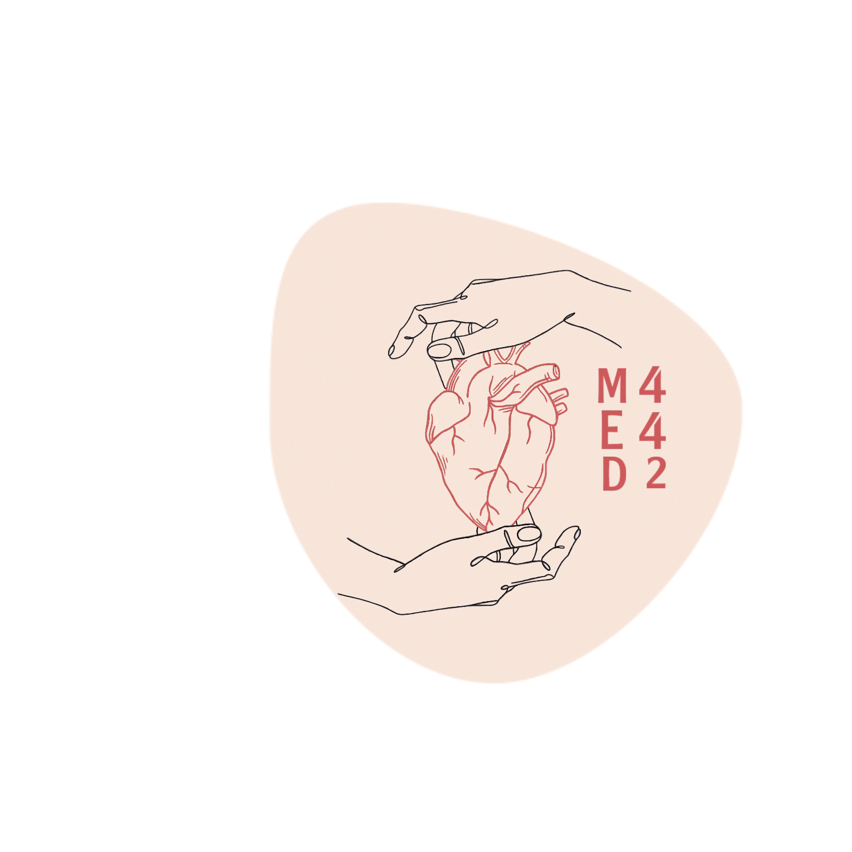
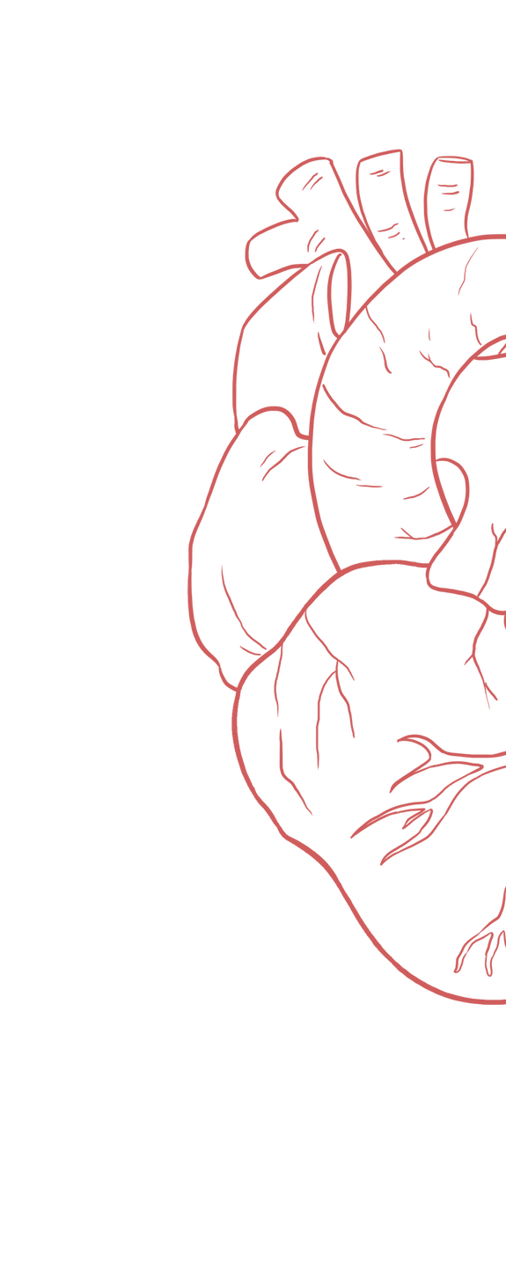
Cardiac Electrical Activity
____________
Color Index:
Main Text
Important
Girl’s Slides
Boy’s Slides
Dr’s Notes
Extra Info

Slide 2
Objectives
Good Video Form: Female Doctor
Know the components of the conducting system of the heart, conduction velocities & spread of cardiac impulse throughout the heart.
Understand control of excitation and conduction in the heart.
Identify the action potential of the pacemaker , the differences between pacemaker potential & action potential of myocardial cells.
Describe the control of heart rhythmicity and impulse conduction by the cardiac nerves, what is latent and abnormal pacemakers.

Slide 3
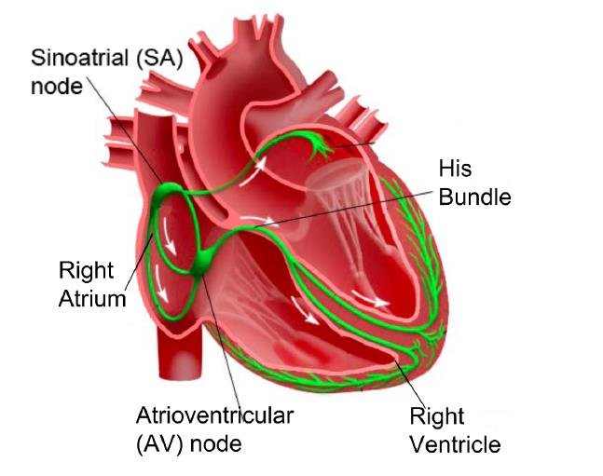
Abbreviations
Right atrium : RA
Heart rate : HR
Action potential : AP
Sinoatrial : SA
Atrioventricular : AV
Sodium Ion : Na⁺
Potassium Ion : K⁺
Calcium Ion : Ca⁺²
Extracellular Fluid : ECF
Resting membrane potential : RMP

Slide 4
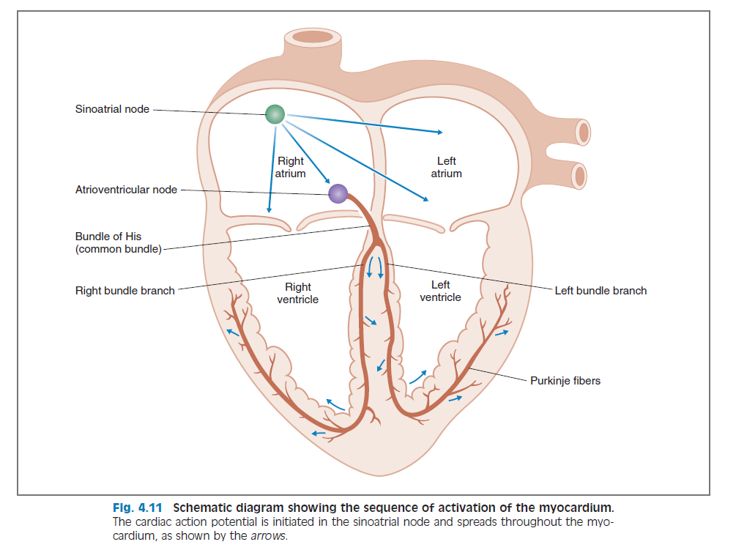
Rhythmical Excitation of the Heart
The heart is endowed with a special system for:
Generating rhythmical electrical impulses to cause rhythmical contraction of heart muscle
Conducting impulses rapidly through heart.
When this system functions normally:
Atria contract ⅙ of a sec (0.1–0.2 sec) ahead of ventricular contraction (allows filling of ventricles).
All portions of ventricles contract at same time (essential for effective pressure generation in the ventricular chambers).
The atria contract before the ventricles, So it can be filled with blood

Slide 5
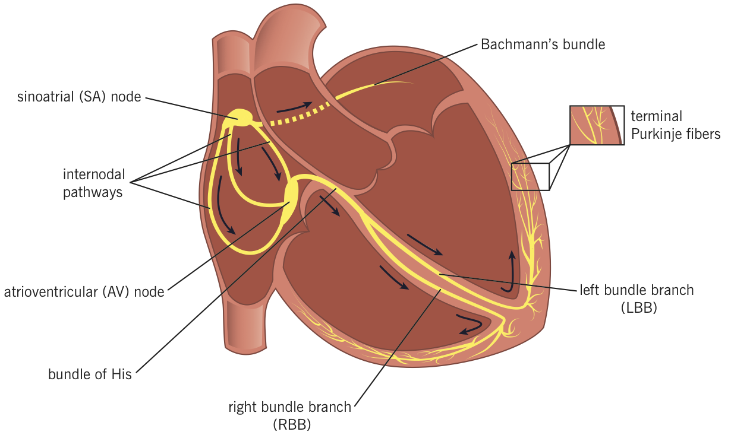
Components & Sequence of excitation of Conducting System
Components
SA Node
Internodal Pathway
AV Node
Sequence
AV bundle (bundle of His)
Right & left bundle branch
Purkinje fibers

Slide 6
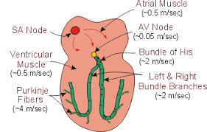
Conduction Velocity
Conduction velocity differ in myocardial tissue: It is slowest in AV node and fastest in the Purkinje fibers
Tissue | Conduction Velocity(m/sec) | Importance
SA node | 0.05
AV node | 0.05 (0.01-0.05) | Allow filling of ventricles
AV bundle ( His ) | 1 (1-2)
Purkinje | 4 (2-4) | To allow efficient ejection of blood (pump)
Ventricular muscle | 1
Atrial pathways (atria) | 1 (0.3-1)

Slide 7
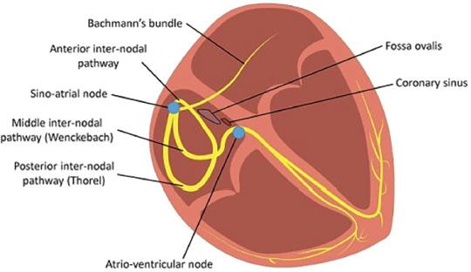
Sinoatrial (SA) node
It’s a small, flat strip of specialized cardiac muscle.
Known as : Pacemaker (controls HR) of the heart (Responsible for generating the electrical impulses, that bring about the mechanical activity i.e contraction of the heart ).
SA node has the fastest rate of autorhythmicity.
Located in : superior posterolateral wall of RA.
It has few contractile fibers.
It’s fibers connect directly with atrial muscle.(SA node APs spreads immediately into atrial muscle wall)
The cardiac impulse after it’s origin in the SA node spreads throughout atrial muscle through two routes:
Ordinary Atrial muscle fibers. (impulses العضلات نفسها تنقل الـ )
Internodal pathway
Internodal Pathway
-They conduct the impulses faster than atrial muscle fibers, because of specialized conduction fibers.
Anterior internodal bundle of Bachman
Middle internodal bundle of Wenkebach
Posterior internodal bundle of Thoral

Slide 8
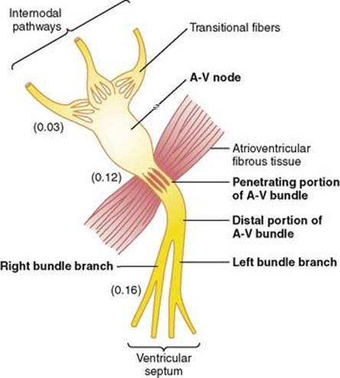
Atrioventricular (AV) node
AV node is located: in the posterior wall of the right atrium immediately behind the tricuspid valve.
Slow Conduction in AV Node: cause of diminished number of gap junctions. (between the successive cells in the conducting pathways).
The impulse after leaving SA node takes 0.03 sec to reach the AV node. (Delay)
Female Doctor:
Numbers are important.
Delay & its significance
Impulse originates
In SA node
Delay of 0.09 sec
in AV node
Delay of 0.04 sec occurs in AV bundle
Total delay = 0.16 sec
Reaches AV node 0.03 sec after its sent
Enters A-V bundle, passes into ventricles.
This delay allows time for the atria to empty their blood into the ventricles before ventricular contraction begins & thus ↑ efficiency of the pumping action of the heart.

Slide 9
Purkinje Fibers
Transmission of Cardiac Impulse in Ventricular Muscle
AV Bundles (Bundle of His)
One-Way Conduction is a characteristic feature of the A-V bundle, allows only forward conduction
from atria to ventricles.(inability of AP to travel backward from the ventricles to the atria)
Atrial muscle is separated from ventricular muscle by a continuous fibrous barrier which acts as an insulator to prevent the passage of cardiac impulse between atria & ventricle. (Except through AV bundle)
Bundle Branches (Right & Left)
Bundle of His splits into two branches which are called right and left bundle branches present on the sides
of the ventricular septum.
Total time of Cardiac impulse transmission: From entering Bundle branches to the termination of Purkinje fibers = 0.03sec
Very large fibers, transmit AP at a velocity of 1.5-4.0 m/sec (6 times than ventricular muscle)
Why the transmission of AP through purkinje fibers is rapid?
caused by a very high level of permeability of gap junctions.
The rapid conduction through the purkinje fibers ensures that different parts of ventricles are excited almost simultaneously; this greatly increases the efficiency of heart as a pump.
Girls slides
Once impulse reaches ends of Purkinje fibers, it is transmitted through ventricular muscle mass by ventricular muscle fibers themselves.

Slide 10
Action Potential in Cardiac Muscle (non-pacemaker AP )
Boys slides
The cardiac action potential is made of 3 phases(Generally):
Depolarization: caused by the opening of Fast Na⁺ channels & slow Ca channels.
Plateau: remaining of slow Ca⁺² channels open for several ms(milli seconds), drawing large amount of Ca⁺² inside which prolong depolarization.
The presence of Plateau in the action potential causes ventricular contraction to last as much as 15 times as long in cardiac muscle as in skeletal muscle (more time to contract ).
Repolarization: Opening of K⁺ channels.

Slide 11
Action Potential in Cardiac Muscle (non-pacemaker AP )
Boys slides
It has 5 Phases:
Phase 0 (depolarization) :
Voltage gated Na⁺channels (fast Na⁺ channels, slow Ca channels ) open and cell depolarize.
Membrane potential reaches about +20 millivolts before Na⁺channels close.
Phase 1 (initial repolarization) :
Fast Na⁺channels close.
Cell begins to repolarize & K⁺ ions leaves the cell through open fast K⁺ channels (K⁺ efflux).
Phase 2 (Plateau) :
Fast K⁺ channels close & Ca⁺² channels open.
K⁺efflux & ↑ Ca⁺² influx causes AP to plateau.
-Why Plateau occurs?
Voltage gated Na⁺channels, called fast channels.
Voltage-gated Ca⁺²- Na⁺ channels (L-type Ca⁺²)Prolonged, slow to open, called slow channels.
Voltage-gated K⁺ channels are slower to open.
This delays the return to RMP of −80 to −90 mV. (Resting State)
The presence of plateau in AP causes ventricular contraction to last as much as 15 times as long in cardis muscle in skeletal muscle
(بينما ال K يطلع ويحاول يرجع السالبية فيه قنوات Ca مفتوحة توازن )

Slide 12
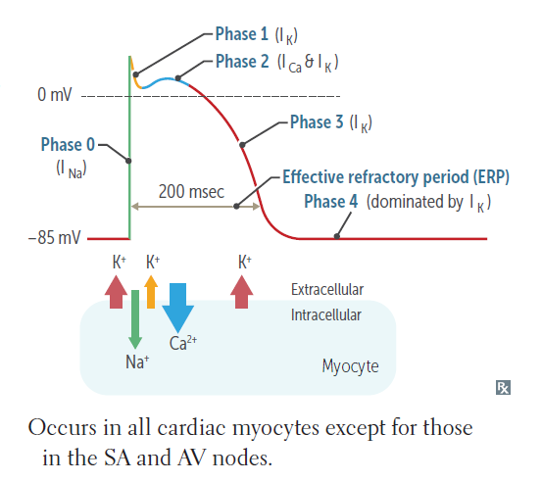
Action Potential in Cardiac Muscle (non-pacemaker AP )
Boys slides
Phase 3 (rapid repolarization) :
Ca⁺² channels close and slow K⁺ channels open.
The closure of Ca⁺² channels and increased K⁺ permeability, permitting K⁺ to rapidly exit the cell (Rapid K⁺ efflux).
Phase 4 (resting membrane potential) :
Averages about (−90 mV).

Slide 13
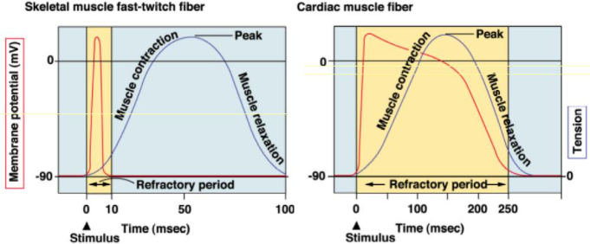
Refractory Periods
Boys slides
Heart contracts as syncytium thus contraction lasts almost 300 msec.
Refractory periods last almost as long as contraction, So:
1: Myocardial muscle cannot be stimulated to contract again until it has relaxed.
2: Summation and tetanus of cardiac muscle is impossible
Which ensures alternate periods of contraction and relaxation which are essential for pumping blood.
Long refractory period prevent ventricles from contracting at too high rates so that enough time is allowed for refill of the ventricles.
The refractory period is short in skeletal muscle, but very long in cardiac muscle.
This means that skeletal muscle can undergo summation and tetanus, via repeated stimulation
Cardiac muscle can not undergo sum action potentials or contractions and can’t be tetanised

Slide 14
SA nodal Action Potential ( pacemaker AP )
Girls slides
Divided into 3 phases:
Phase 0 (depolarization):
It’s caused by ↑ influx of Ca⁺² by L-type channels (slow channels) that began to open toward the end of Phase 4. (Resting -60mv)
Phase 3 (repolarization):
Repolarization occurs as K⁺ channels open thereby increasing outward directed,(Efflux)
hyperpolarizing K⁺currents.
Unlike ventricular AP the opening of Ca²⁺ channels is not sustained & there is no ‘plateau’ stage. Therefore, the action potential is triangular in shape.
Once the cell complete repolarized at about -60 mV the cycle spontaneously repeated
Phase 4 (pacemaker potential):
• At -60 mV, (Resting) slow Na⁺ "funny" channels initiate phase 4. (Na+ influx)
• At -50 mV, (Transient) T-type Ca⁺² channel opens. Ca⁺² influx depolarizing cell.
• At -40 mV, (Long lasting) L-type Ca⁺² channels open. More Ca⁺² influx & depolarize cell until an AP threshold is reached (between -40 and -30 mV).

Slide 15
Mechanism of SA node rhythmicity
Hyperpolarization
Girls slides
Cardiac muscle has 3 types of membrane ion channels that play important roles in causing
voltage changes of AP:
1- Fast Na⁺ channels 2- Slow Ca⁺² channels. 3- K⁺ channels.
RMP of SA node is (−55 → −60 mV) which is less negative than ventricular, Why? Because It’s leaky to Na⁺ & Ca⁺²
(الصوديوم والكالسيوم يتسربون إلى داخل الخلية فتصبح أقل سالبية)
Return of AP to its negative state occurs slowly, rather than the abrupt (rapid) return that occurs for ventricular fiber.
Pacemaker channels (Ca⁺²,Na⁺,K⁺ channels) become activated in hyperpolarized state, So:
Without the membrane voltage becoming very negative at the end of phase 3, pacemaker channels remain inactivated, which suppresses pacemaker currents and decreases the slope of phase 4.
K⁺ channels remain open continuing movement of positive charges out of cell (efflux), with resultant excess negativity inside the fiber.

Slide 16
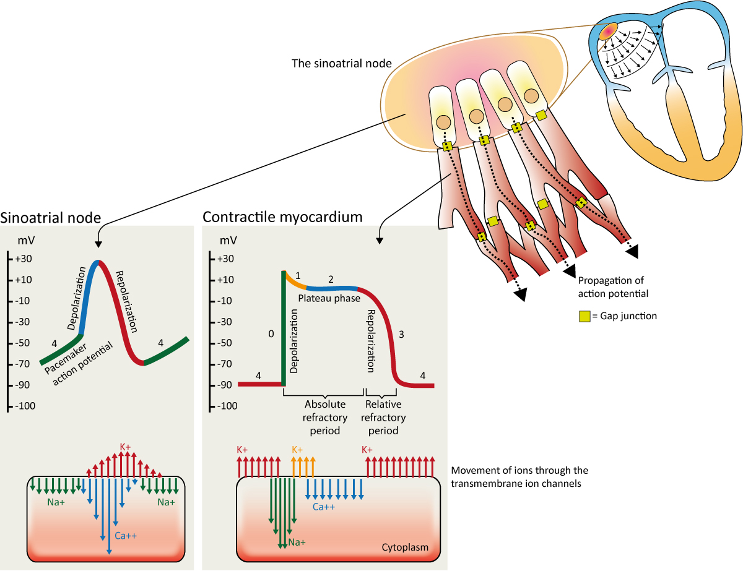
SA nodal Action Potential ( pacemaker AP )
Girls slides

Slide 17
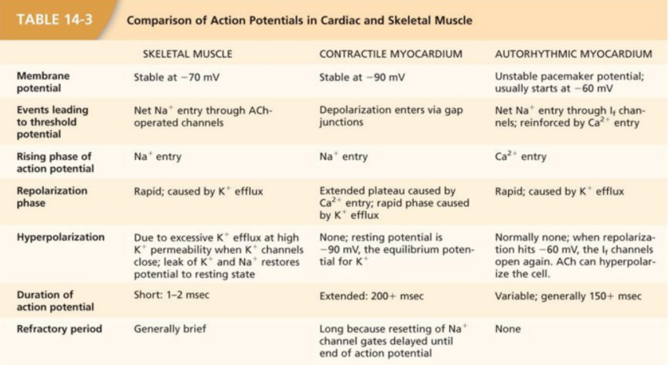
Comparison of AP in: Cardiac, Skeletal muscle and SA node

Slide 18
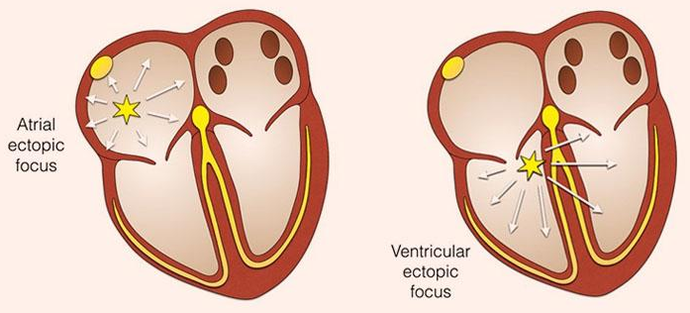
Latent “ectopic” pacemaker
Girls slides
Why does SA node rather than A-V node or Purkinje
fibers control heart’s rhythmicity?
- Because its rate of rhythmical discharge is faster than any other part of heart.
A pacemaker elsewhere than SA node is called an “ectopic” pacemaker.
An ectopic pacemaker causes an abnormal sequence of contraction of the different parts of the heart and can cause significant debility of heart pumping.
Cause of shift of the pacemaker is blockage of transmission of the cardiac impulse from the SA node to the other parts of the heart.
عشان كذا إذا صار فيه مشكلة في توصيل ال SA node إلى ال AV node or Purkinje تبدا تسوي self-excitation وتصير ectopic pacemaker
Explanation from Guyton :
Each time the sinus node discharges, its impulse is conducted into both the AV node and the Purkinje fibers, also discharging their excitable membranes. But the sinus node discharges again before either the A-V node or the Purkinje fibers can reach their own thresholds for self-excitation.

Slide 19
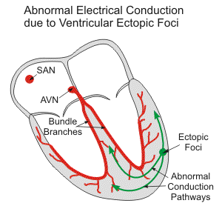
Latent Pacemakers
Girls slides
Location | Intrinsic Firing Rate (impulses/min)
SA node | 70-80
AV node | 40-60
Bundle of His | 40
Purkinje fiber | 15-20
The lower you go in the heart the lower the rate.

Slide 20
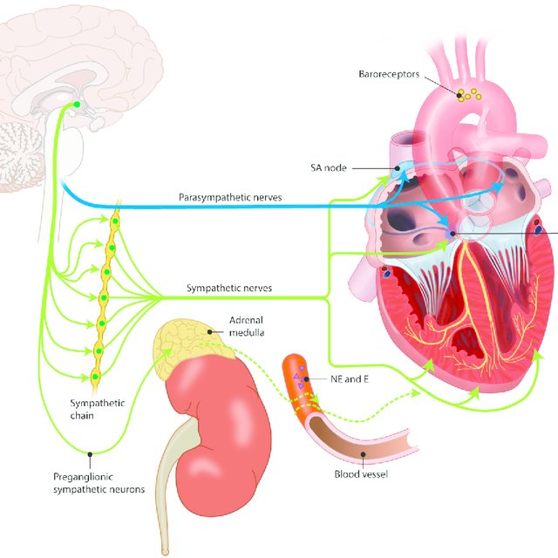
ANS control of heart
Girls slides
The effects of the autonomic nervous system on HR are called: chronotropic effects.
Sympathetic fibers go directly to heart: Stimulation increases activity of heart Increasing HR and enhancing strength and volume of pumping.
Parasympathetic stimulation causes a marked decrease in HR & a slight or no decrease in heart muscle contractility .
- | Sympathetic | Parasympathetic
Heart Rate | ↑ | ↓
Conduction Velocity | ↑ | ↓
Contractility | ↑ | ↓ (atria only)
parasympathetic nerves (vagal) are distributed mainly to the S-A and A-V nodes, to a lesser extent to the muscle of the two atria, and very little directly to the ventricular muscle.

Slide 21
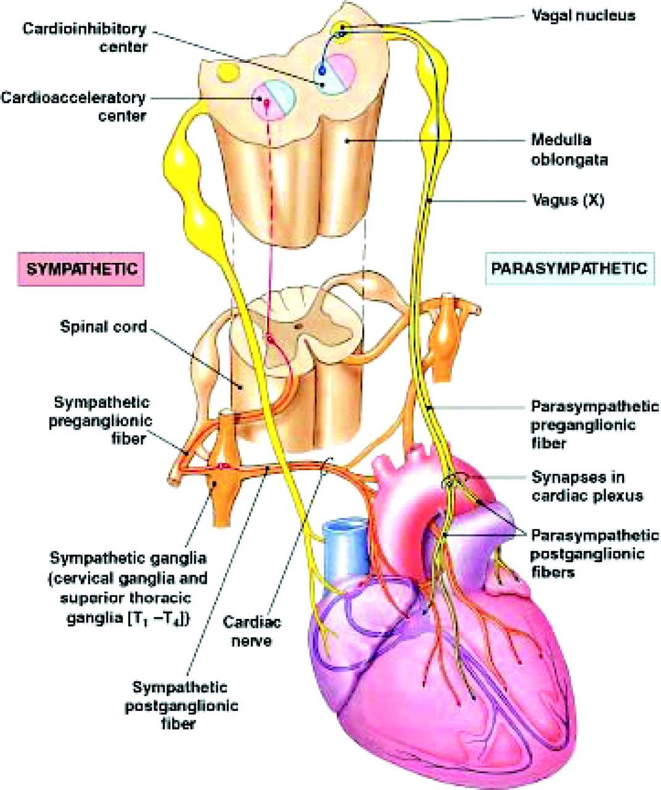
Mechanism of Sympathetic Effect
Girls slides
Stimulation of sympathetic nerves releases norepinephrine
Norepinephrine stimulates β1 adrenergic receptors
Increases permeability to Na⁺ & Ca⁺² causing more + resting potential and increased excitability
Increases rate of SA node discharge (increase heart rate & contraction)

Slide 22
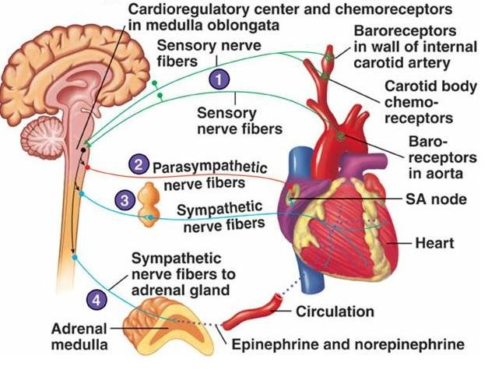
Mechanism of Parasympathetic (vagal ) Effect
Girls slides
Parasympathetic stimulation releases acetylcholine (Ach)
Acetylcholine increases permeability to K⁺ allowing rapid leakage of K⁺ out of conductive fibers.
Causes increased negativity inside fibers (hyperpolarization) making tissue less excitable.
Decreases rate of rhythm of the SA node and AV junctional fibers. (decrease heart rate)
Strong stimulation of vagi stops rhythmical excitation by SA node or blocks transmission of
cardiac impulse from atria into ventricles.(then some small area in the Purkinje fibers, usually in the ventricular septal portion of the A-V bundle, develops a rhythm of its own and causes ventricular contraction)

Slide 23
MCQs
Q1: What is the normal physiological pacemaker of the heart ?
A- AV node | B-SA node | C-Purkinje fibers | D- buckman bundle
Q2: What is the conduction velocity of Purkinje fibers ?
A- 0.05 | B-0.03 | C-1 | D-4
Q3: Refractory periods last for :
A- 300ms | B-250ms | C-doesn’t exist | D-as long as contraction
Q4: The total delay from originated impulse to AV node is:
A- 0.16 | B-0.04 | C-0.5 | D-0.03
Q5: Why the electrical impulse reaches the ventricles delayed?
A- Cause of SA node | B-To fill the atria | C-Cause of AV node | D-Cause of purkinje fibers
Answers: 1B. 2D. 3D. 4A. 5C

Slide 24
SAQs
Q1: what is the Significance of AV nodal Delay?
This delay allows time for the atria to empty their blood into the ventricles before ventricular contraction begins.
Q2: Why the transmission of action potentials through the Purkinje fibers is rapid?
caused by a very high level of permeability of gap junctions.
Q3: Why Plateau occurs?
Voltage activated sodium channels, called fast channels.
Voltage-activated calcium-sodium channels (L-type calcium), slow to open, called slow channels.
Moreover, voltage-gated potassium channels are slower to open.

Slide 25
Team Leaders
THANK YOU
Saleh aldeligan
Qusai Alsultan
Raghad Alkhudair
Raghad Alnadeef
Team Members
Othman Aldraihem
Abdulaziz Alqahtani
Abdullah Alshahri
Saad Al Hammad
MOHAMMED ALDAWSARI
Ahmad Almarshed
Rayan Alahmari
ABDULRAHMAN BINBAKHIT
Abdulaziz Alymni
Faisal Alkhunein
Abdullah Alqarni
Raid Almadi
Mohammad Alrashed
Abdulrahman bin Ateeq
Amer Alghamdi
Mishal Alsuwayegh
Nawaf alturki
Hussam Aleid
Raid almadi
Mohammed AlShehri
Nouf Aldhalaan
Amani Alotaibi
Shahed bukhari
Shahad Aljeri
Maha Alkoryshy
Alhnouf Hadi
Mayssam Aljaloud
Hissa Alshiqari
Mashael Albugami
Renad Alayidh
Ghada Binslmah
Razan Alsulami
Shaden albassam
Razan Almanjomi
Reem Alhazmi
Dhai hamdan
Shahad alaskar
Haifa Almuddahi
Reema alquraini
deema aljuribah
Kadi Khalid aldossari
Farah alhalafi
Theme was done by Mohammad Alrashed
Physio442@gmail.com
Editing File

