Slide 1
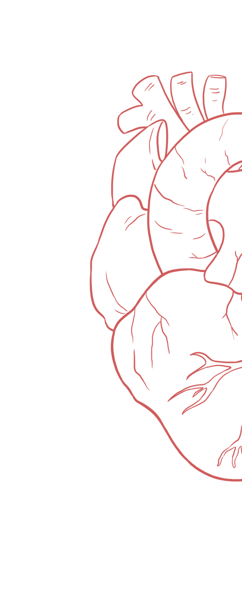
Cardiac Cycle 1&2
____________
Color Index:
Main Text
Important
Girl’s Slides
Boy’s Slides
Dr’s Notes
Extra Info

Slide 2
Objectives
General principle of the cardiac cycle
Identify events occurring during cardiac cycle: mechanical, electrical, volume & pressure changes, heart sounds.
Understand and enumerate the various phases of the cardiac cycle
Explain the effect of heart rate on duration of systole and diastole
Recognize the pressure, electrical, sound and volume changes during cardiac cycle
Correlate different phases of cardiac cycle with various changes in events.
Compare and contrast left and right ventricular pressures and volumes during the normal cardiac cycle.
Describe atrial pressure waves & their relationship to cardiac cycle
Describe the use of the pressure-volume loop in describing the phases of the cardiac cycle

Slide 3
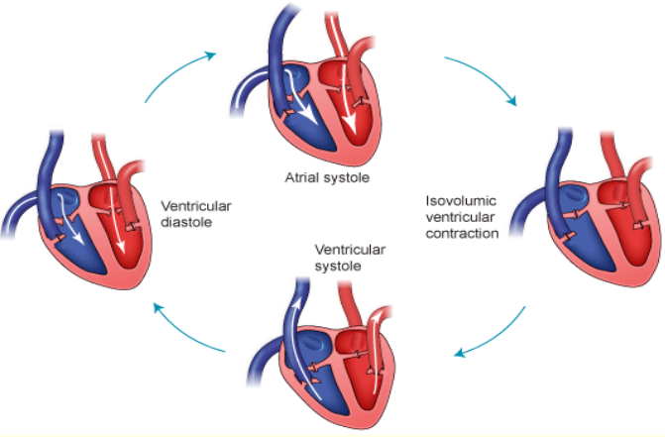
Cardiac Cycle
Diastole and systole
The cardiac (mechanical and electrical) events that occur from the beginning of one heartbeat to the beginning of the next beat is called the cardiac cycle. “Cardiac cycle is a complete beat of the heart”
Mechanical Events :
Pressure changes
Volume changes
Heart sounds
Electrical Events : Electrocardiogram (ECG)
How does the cardiac cycle start ?
-Each cycle is initiated by spontaneous generation of an action potential in the sinus node (SA node).
The cardiac cycle consists of a period of relaxation called diastole during which the heart fills with blood. This period is followed by a period of contraction called systole.
The cardiac cycle consists:
Atrial and ventricular systole
Atrial and ventricular diastole

Slide 4
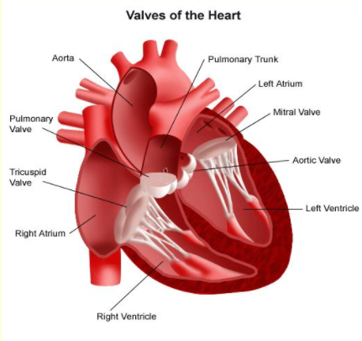
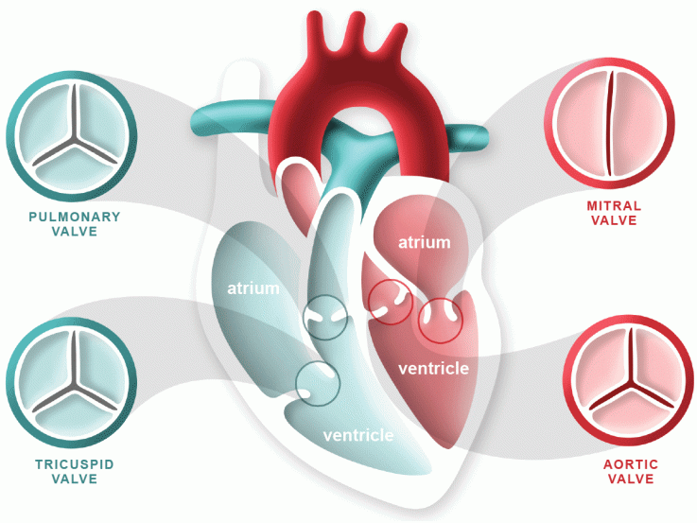
Cardiac valves
1. Open tricuspid and mitral valves —> A.Atrial Systole (atrial contraction)
2. Closed tricuspid and mitral valves → B. Isovolumetric Ventricular Contraction
3. Open pulmonic and aortic valve → C. Rapid Ventricular Ejection
4. Closed pulmonic and aortic valves → E. Isovolumetric Ventricular Relaxation

Slide 5
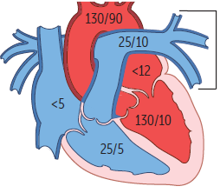
Pressure changes in the heart chambers
Chambers | Normal range (mmHg)
Right atrium | 2-8
Left atrium | 2-10
Right ventricle | Systolic: 25-30 Diastolic: 3-12
Left ventricle | Systolic: 100-120 Diastolic: 3-12
Pulmonary artery | Systolic: 25-30 Diastolic: 4-12
Aorta | Systolic: 120 Diastolic: 80 Pulse pressure (difference between systolic and diastolic): 120-80 = 40 mm Hg.
Remember
Events are the same in the right & left sides of the heart, but with lower pressures in the right side. Why? Because in the right side we have less muscle size and less distance to move the blood.
Fluids, flow according to pressure gradients—that is, they move from regions that are higher in pressure to regions that are lower in pressure.
Atrium pressures are not very important
Ventricular pressures are very important
Around the same pressure to allow movement of blood

Slide 6
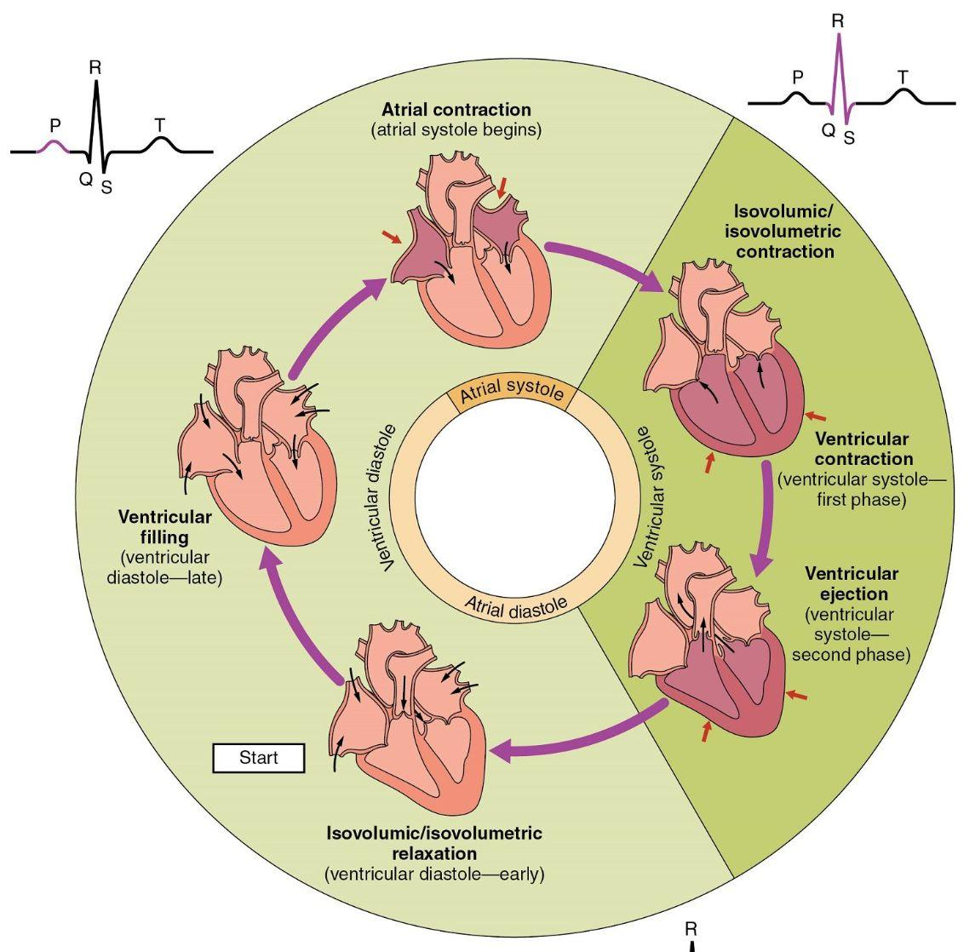
Phases of the cardiac cycle
Atrial events
Ventricular events
Atrial systole
Atrial diastole
Ventricular systole
Ventricular diastole
Isovolumetric contraction of ventricles(0.05 s)
Maximum ejection phase (0.112 s)
Reduced ejection phase. (0.141 s)
Total of 0.303 Sec
Protodiastole (0. 033 s)
Isovolumetric relaxation (0. 071 s)
Rapid inflow (0.110 s)
Reduced inflow (0.161 s)
Atrial systole (0.12 s)
Total of 0.495 sec.
Total duration of Cardiac cycle =Ventricular systole duration +ventricular diastole duration =0.303 + 0.495 = 0.8 seconds at 75 bpm

Slide 7
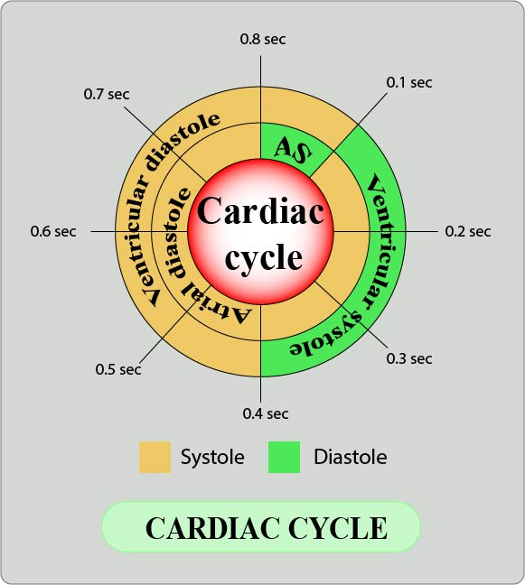
Duration of cardiac cycle
Duration of cardiac cycle = reciprocal of heart rate =1/HR
Average duration = 0.8 seconds
Example: heart rate is 75 beats/min,
Duration of cardiac cycle is = 1/75 = 0.0133 min x 60 (1 minute=60 sec)=0.8 sec
(Numbers are important)
Atrial total: 0.8 sec
Atrial systole (AS)= 0.1 sec
Atrial diastole= 0.7 sec (Long duration because the ventricle is filling with the blood from all over the body)
Ventricular total duration: 0.8 sec
Ventricular systole duration= 0.3 sec
Ventricular diastole duration= 0.5 sec
Diastole is usually longer than systole
 | Heart Rate 75/min | Heart rate 200/min
Duration of cardiac cycle | 0.8s | 0.3s
Duration of systole | 0.27s | 0.16s
Duration of diastole | 0.53s | 0.14s
Increase in heart rate
Decrease in duration
*no need to memorise numbers of 200/min, understand the relationship

Slide 8
Events of the cardiac cycle
Ninja nerd: Cardiac cycle
Atrial Systole
Isovolumetric Ventricular Contraction
Rapid Ventricular Ejection
Reduced Ventricular Ejection
Isovolumetric Ventricular Relaxation
Rapid Ventricular Filling
Reduced Ventricular Filling (Diastasis)
Realise the pattern
Know the Mechanical event, Electrical event, Valves (opened/closed), and Pressure in each phase
Focus on the events in the left side of the heart

Slide 9
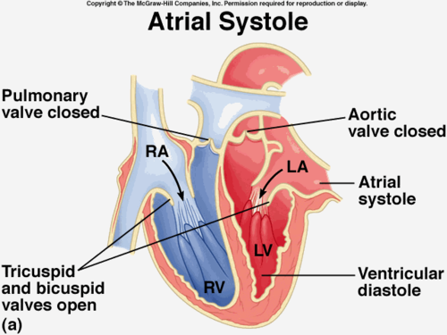
A- Atrial Systole (atrial contraction)
SA node fires AP -> P wave
(electrical activity)
Left Ventricle filling (20%)
Atrial
contraction
↑↑↑ Atrial
pressure
Tricuspid & bicuspid (mitral) valves open
Heart sound: S4 is not audible in normal adults →If heard it is caused by stiffness in ventricles, atria needs to contract strongly to fill the ventricles, producing the sound S4

Slide 10
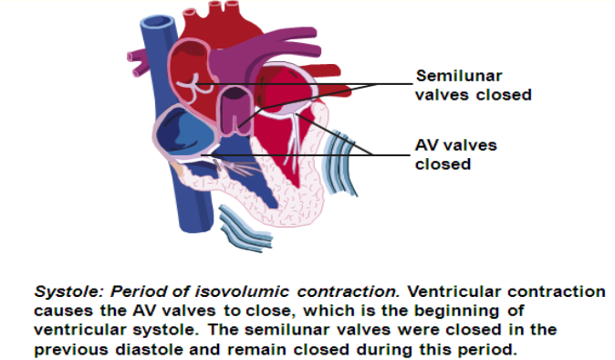
B- Isovolumetric Ventricular Contraction
QRS (electrical event) Depolarization of the ventricles
LV contracts with no significant shortening of fibers (increase tension)
LVP ↑↑ (slightly above 0-2 mmHg)
LVP > LAP
IVP pushes the cusps of the AV valve up & AV orifices are closed
All valves are closed. The semilunar (SML) valves (aortic+pulmonary) remain closed.
IVP < pressure of large arteries → sudden closure of AV (Mitral +Tricuspid) valves → S1
Isovolumetric means “No change in volume” !!
(No movement of blood)

Slide 11
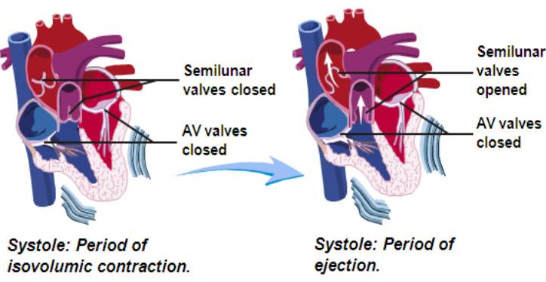
C- Rapid Ventricular Ejection (MAXIMUM EJECTION PHASE)
LV contracts with shortening of the fibers
↑ LVP, rises up to 120 mmHg → LVP > Aortic pressure
Aortic valve opens → 70% of stroke volume is ejected from the LV to aorta
Lt
End of the ST segment
Rt
What part of the cardiac cycle most of the blood is ejected?
-Rapid ventricular ejection
RVP > 25 mmHg
Pulmonary valve opens
Valves open: Semilunar valves (aortic and pulmonary valves)
At the end of this phase: intraventricular pressure reaches its peak level.

Slide 12
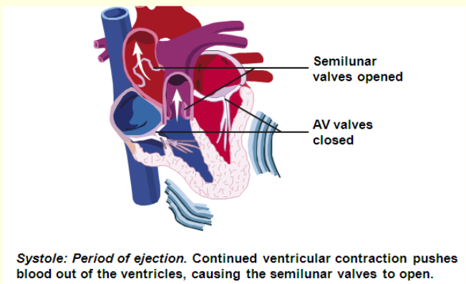
D- Reduced Ventricular Ejection (REDUCED EJECTION PHASE)
Ventricles begin to repolarize
(T wave)
(LV contraction is weaker)
(Electrical event)
Blood continues to be ejected into aorta.
Less volume of blood (30% of stroke volume) flows into aorta & pulmonary artery
LVP falls but is still higher than aorta so ventricular emptying continues
Aortic valve is still open
Marked by the beginning of the T wave on the ECG

Slide 13
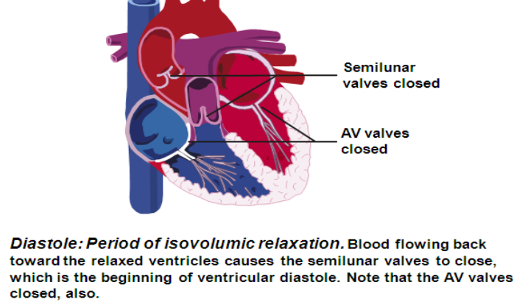
E- Isovolumetric Ventricular Relaxation (diastole)
Full repolarization of ventricles
End of T wave
LV relaxes
→Intraventricular pressure drops
LVP < aortic pressure
Sudden closure of SML valves → S2
Isovolumetric (either contraction or relaxation) --> all valves are closed
Semilunar valves remain closed (Intraventricular pressure <arteries pressure).
Ventricular pressure > atrial pressure → AV valves remain closed
The blood does not enter or leave the ventricles.

Slide 14
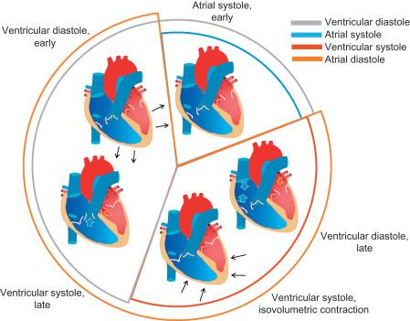
F- Rapid Ventricular Filling
No contraction, blood moves because of gravity
LVP falls (2-4 mmHg) < LAP (6-9 mmHg)
When ventricular volume increases, the ventricular pressure decreases lower than intra atrial pressure
Mitral / bicuspid valve opens & ventricle begins to fill with blood
LV volume ↑↑ rapidly (70-80% of ventricular volume)
Blood: left atrium → the left ventricle.
Left ventricle
RVP falls (0-2 mmHg) < RAP (6-8 mmHg)
Tricuspid valve opens & ventricle begins to fill with blood
RV volume ↑↑ rapidly (70-80% of ventricular volume)
Blood: right atrium → the right ventricle.
Right ventricle
Rapid flow of blood from atria to ventricles ► S3, which is normal in children but is not heard in normal adults. S3, is known as the “ventricular gallop,”

Slide 15
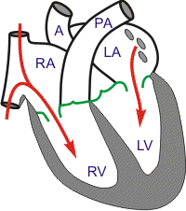
G- Reduced Ventricular Filling (Diastasis)
It is the final portion ,of ventricular filling which occurs at a slower rate than in the previous phase (longest)
In this phase blood has already (70-80% filled) & remaining <(5%) is filling then the atrial systole again with (20%)
Heart rate alters the time available for
diastasis
It’s the longest phase in the cardiac cycle
Then the atrial will contract and will begin a new cycle (atrial systole)
Contraction in ventricular filling moves only 20% of the blood
Note that in Rapid Ventricular Ejection 70% of blood movement is due to contraction while in this phase (Reduced Ventricular Filling) contraction contributes to movement of only 20% of the blood
In other words;
Ejection →most of the blood moves with contraction
Filling → most of the blood moves with no contraction (gravity)
AV valves are open (mitral and tricuspid valves)

Slide 16
Summary of cardiac cycle
These events are very important
 | Electrical event | Mechanical event | Valves + Heart Sound | Pressure
A.Atrial Systole (atrial contraction) | P wave | Atrial contraction | AV valves open (mitral + tricuspid) | Atrial pressure increases
B. Isovolumetric Ventricular Contraction | QRS | LV contracts with no significant shortening of fibers. | MV closes (S1) All are closed | LVP increases LVP > LAP
C. Rapid Ventricular Ejection | End of the ST segment | LV contracts blood is ejected from LV into aorta | Semilunar valves: Aortic and pulmonary valve opens | increasing LVP LVP > aortic pressure
D. Reduced Ventricular Ejection | ventricles begin to repolarize (T wave) | LV contraction is weaker blood continues to be ejected into aorta | aortic valve is still open | LVP falls but is still higher than aorta
E. Isovolumetric Ventricular Relaxation | Full repolarization of ventricles: End of T wave | LV relaxes | aortic valve closes (S2) All are closed | LVP < aortic pressure
F. Rapid Ventricular Filling |  | ventricle begins to fill with blood LV volume increases rapidly. | MV opens (S3) | LVP falls< LA pressure
G. Reduced Ventricular Filling (Diastasis) |  | It is the final portion of ventricular filling, which occurs at a slower rate than in the previous phase.

Slide 17
SUMMARY CARDIAC CYCLE EVENTS : OPENING & CLOSING OF VALVE
Male slide
Stage | AV valves | Semilunar valves | Status of ventricles & atria
Early diastole | Open | Closed | Whole heart is relaxed , Ventricles are expanding & filling
Atrial systole | Open | Closed | Atria contract & pump blood , Additional 10-40% filling of ventricles
Isovolumic ventricular contraction | Closed | Closed | Ventricular myocytes begin to contract , Ventricle volume unchanged
Ventricular ejection | Closed | Open | Ventricles fully contract , Pump blood to rest of blood
Isovolumic ventricular relaxation | Closed | Closed | Ventricles relax , Ventricle volume unchanged , Atria expand & are filling

Slide 18
End-Diastolic Volume, End-Systolic Volume, and Stroke
Volume Output
Girls slides
Understand and memorise all of the definitions (important)
•During diastole, filling of ventricles increases volume of ventricle to 110 -120 ml.
this is called the end-diastolic volume, EDV.
•During systole, the volume ejected is about 70 ml, this is called the stroke volume (SV) output.
• The remaining volume in each ventricle (after ejection), about 40 to 50 ml, is called the end-systolic volume (ESV). Ventricle is never completely empty
Stroke Volume: The volume of blood ejected on one ventricular contraction
Stroke volume = end-diastolic volume – end-systolic volume
•By increasing the EDV and decreasing the ESV, the SV output can be
increased.

Slide 19
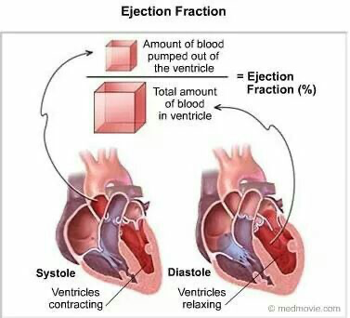
Ejection Fraction, and Cardiac Output
Girls slides
Know the definitions
Cardiac output = Volume ejected per minute (mL/min) average of 5-7L but can pump up to 20L (from tissues and veins) physiologically
Cardiac output = Stroke volume × Heart rate
Ejection fraction: the fraction (%) of the end-diastolic; volume that is ejected in one stroke volume. (shows ventricular function)
Ejection fraction=
Stroke volume / End-diastolic volume X100
Video about cardiac output (Ninja nerd)
Stroke volume is the amount of blood ejected in one CYCLE
Cardiac output is the amount of blood ejected in one MINUTE

Slide 20
Stroke Volume, Ejection Fraction, and Cardiac Output
Girls slides
Exercise to memorise
A man has an EDV of 110 mL, an ESV volume of 40 mL, and a
heart rate of 75 beats/min. What is his stroke volume, his cardiac output, and his ejection fraction?
Stroke volume = EDV − ESV = 110 - 40 = 70ml
Cardiac output= SV × HR = 70 X 75 = 5250 mL/min
Ejection fraction= SV / EDV X 100 = 70 /110 X 100 = 0.64 X 100 = 64%
Normal ejection fraction is about 60 – 65 %. (might be 50-65%)
Ejection fraction is good index of ventricular function.

Slide 21
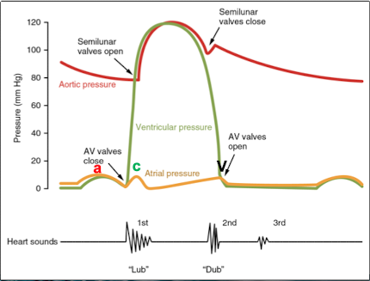
Pressure Changes in the Atria—a, c, and v Waves
(ALL yellow line)
Girls slides
Curve a: atrial contraction (increases pressure)
Curve c : bulging of the A-V valves backwards (due to increase in pressure in ventricles), at beginning of ventricular contraction
Curve V: Results from flow of blood into atria at end of ventricular contraction.
V

Slide 22
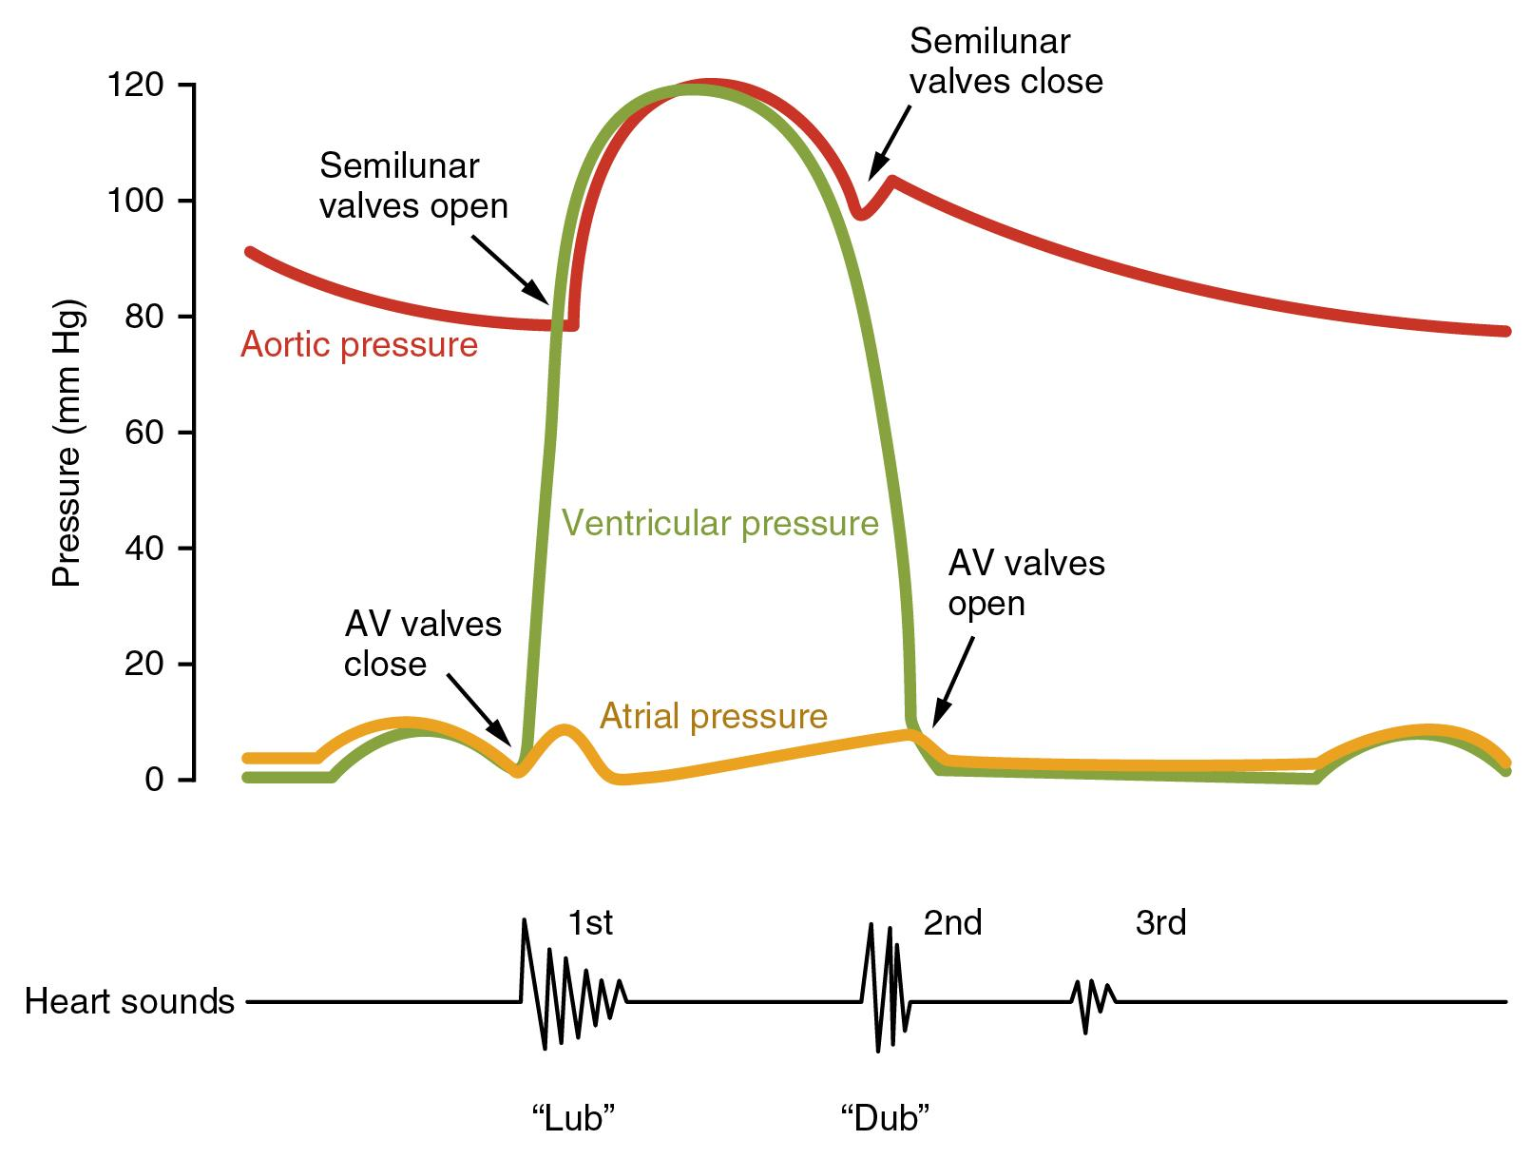
Aortic Pressure Curve (RED line)
Girls slides
The entry of blood into the arteries causes the walls of these arteries to stretch and the pressure to increase to about 120 mm Hg
Incisura (dicrotic notch)
caused by backward flow of blood immediately before closure of valve.
After Aortic valve has closed, pressure in the aorta decreases slowly throughout diastole to 80 mm Hg (diastolic pressure).

Slide 23
Volume-Pressure Diagram” During the Cardiac Cycle; Cardiac Work Output
Girls slides
Dr said : very important diagram
Phase III
It is divided into four phases.
Phase I: Period of filling. Volume is increasing.
Phase II: Period of isovolumic contraction. All valves are closed. Volume is constant but pressure is increased.
Phase III: Period of ejection. Volume is decreased.
Phase IV: Period of isovolumic relaxation. All valves are closed. Volume is constant but pressure is decreasing.
Phase IV
All valves closed
Phase II
All valves closed
Questions from Dr.:
What is point A? End-systolic pressure +Mitral valve open
What is point B?End- diastolic volume + Mitral valve close
What is point C? Aortic-valve opens
What is point D? Aortic-valve close
Calculate stroke volume? End-diastolic v- end-systolic v=70ml
Phase I

Slide 24
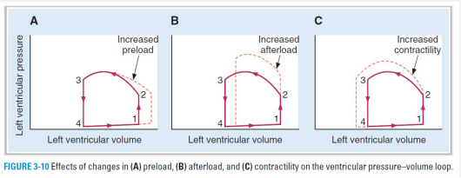
Concepts of Preload and Afterload of ventricle
Girls slides
Preload: the end-diastolic pressure when the ventricle has become filled. (If you increase the volume, you increase the preload). It is when the volume coming to the heart is MORE than it can take. Increase in volume = increase in pressure. More common in children.
Afterload: the pressure in the aorta leading from the ventricle. Hypertension → resistance (increased pressure) in the blood going from the heart to the aorta → may lead to heart failure. More common in adults.
In many abnormal functional states of the heart or circulation, the preload and afterload, or both are severely altered from normal.
A. Increased preload: venous return → increase in SV based on the Frank–Starling relationship....reflected in increased width of the PV loop.
B. Increased afterload: due to an increase in aortic pressure →
decrease in stroke volume....is reflected in decreased width of the PV loop.
C. Increased contractility: → increased width & height of the PV loop. (Athletes)

Slide 25
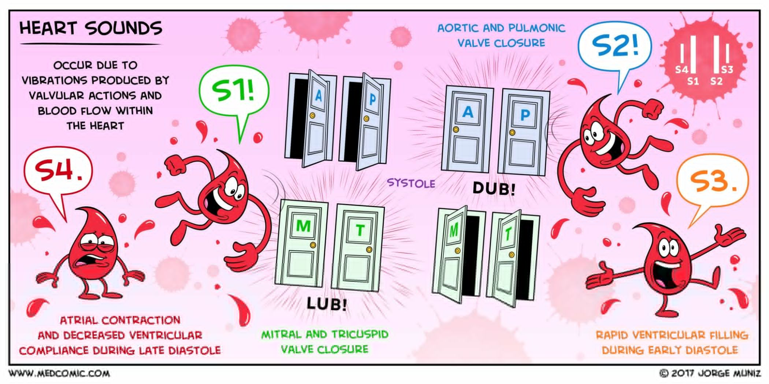
Heart sounds
Murmurs
Girls slides
Function of the Valves
• Atrioventricular (A-V) valves (tricuspid and mitral) prevent backflow of blood from ventricles to atria during systole
• Semilunar valves (aortic and pulmonary artery) prevent backflow from aorta and pulmonary arteries into ventricles during diastole.
• These valves, close and open passively (pressure gradients)
• Closing of valves causes audible sounds.
• No sounds occur when valves are open.
• Listening with a stethoscope to a normal heart, one hears “lub, dub, lub, dub”.
• First heart sound (S1): ” The “lub” is associated with closure of A-V valves at beginning of systole (of ventricle).
• Second heart sound (S2) “dub” is associated with closure of the semilunar (aortic and pulmonary) valves at end of systole (of ventricle).
Are abnormal sounds
Occurs in:
• Valvular disease.
• Congenital heart disease.
• Hyperdynamic circulations.

Slide 26
Causes of heart sounds
Girls slides
Video about heart sounds
Heart sound | Occurs during | Associated with
S1 | Isovolumetric contraction | Closure of mitral and tricuspid valves
S2 | Isovolumetric relaxation | Closure of aortic and pulmonary valves
S3 | Early ventricular filling | It is normal in children, But in adults is associated with ventricular dilation (e.g. ventricular systolic failure), anemia
S4 | Atrial contraction | Associated with stiff, low compliant ventricle (e.g. ventricular hypertrophy, ischemic ventricle)
S1, S2, are the normal “lub” “dub”
S3, S4 are associated with abnormality in adults

Slide 27
MCQs
Q1: In a resting adult, the typical ventricular ejection fraction has what value?
A- 20% | B- 40% | C- 60% | D- 80%
Q2: What happens at the end of ventricular isovolumic relaxation?
A- AV valves open | B- AV valves close | C- Semilunar valves open | D- Semilunar valves close
Q3: Which event is associated with the first heart sound (S1) ?
A- AV valves open | B- AV valves close | C- Semilunar valves open | D- Semilunar valves close
Q4: Which phase of cardiac cycle follows immediately after beginning of QRS wave?
A- Isovolumic relaxation | B- Isovolumic contraction | C- Atrial systole | D- ventricular ejection
Q5: What is the total duration of one cardiac cycle (at 75bpm) ?
A- 0.8 sec | B- 0.5 sec | C- 0.3 sec | D- 1 sec
Answers: 1.C 2.D 3.B 4.B 5.A

Slide 28
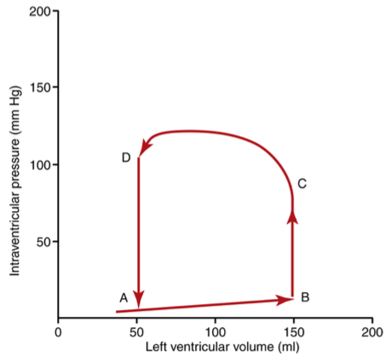
SAQs
Q1: A patient has a resting heart rate of 82 beats/min, normal blood pressure, and normal body temperature. Use the pressure-volume diagram of the left ventricle below to answer Question.
What is the stroke volume in milliliters?
Stroke volume = End Diastolic Volume − End Systolic Volume
150-50 = 100 ml
What is the cardiac output of this patient?
Cardiac output= Stroke Volume × Heart Rate
100x82 = 8200 ml/min

Slide 29
SAQs
Q2: List sounds of the heart. When do they occur? Associated with?
Answer
Q3: A man has an EDV of 90 mL, an ESV volume of 35 mL, and a
heart rate of 90 beats/min. What is his stroke volume, his cardiac output, and his ejection fraction?
Stroke volume = EDV − ESV = 90 - 35 = 55ml
Cardiac output= SV × HR = 55 X 90 = 4950 mL/min
Ejection fraction= SV / EDV X 100 = 55 /90 X 100 = 0.61 X 100 = 61%

Slide 30
Team Leaders
THANK YOU
Saleh aldeligan
Qusai Alsultan
Raghad Alkhudair
Raghad Alnadeef
Team Members
Othman Aldraihem
Abdulaziz Alqahtani
Abdullah Alshahri
Saad Al Hammad
MOHAMMED ALDAWSARI
Ahmad Almarshed
Rayan Alahmari
ABDULRAHMAN BINBAKHIT
Abdulaziz Alymni
Faisal Alkhunein
Abdullah Alqarni
Raid Almadi
Mohammad Alrashed
Abdulrahman bin Ateeq
Amer Alghamdi
Mishal Alsuwayegh
Nawaf alturki
Hussam Aleid
Raid almadi
Mohammed AlShehri
Nouf Aldhalaan
Amani Alotaibi
Shahed bukhari
Shahad Aljeri
Maha Alkoryshy
Alhnouf Hadi
Mayssam Aljaloud
Hissa Alshiqari
Mashael Albugami
Renad Alayidh
Ghada Binslmah
Razan Alsulami
Shaden albassam
Razan Almanjomi
Reem Alhazmi
Dhai hamdan
Shahad alaskar
Haifa Almuddahi
Reema alquraini
deema aljuribah
Kadi Khalid aldossari
Farah alhalafi
Theme was done by Mohammad Alrashed
Physio442@gmail.com
Editing File

