Slide 1
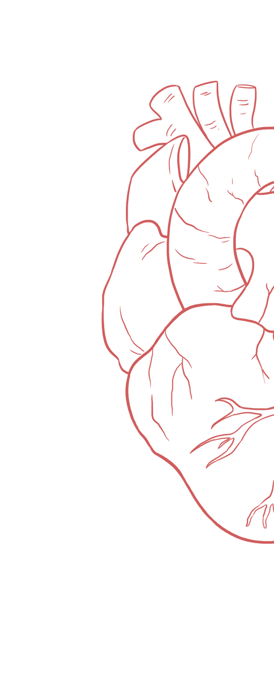
Electrocardiogram (ECG)
____________
Color Index:
Main Text
Important
Girl’s Slides
Boy’s Slides
Dr’s Notes
Extra Info

Slide 2
Objectives
Define ECG & list uses of ECG
Understand basic ECG principles
Define ECG & list uses of ECG
Recognize ECG waves, Intervals and, segments
Determine rate and normal heart rhythm
Have some idea about ECG abnormalities in common clinical conditions
Identify waves of ECG and the physiological causes
Define the normal intervals and segments
Discuss the bipolar and unipolar leads and their locations
Discuss the bipolar limb lead and the cardiac axis
Calculate the Heart Rate
ECG changes and body Electrolytes

Slide 3
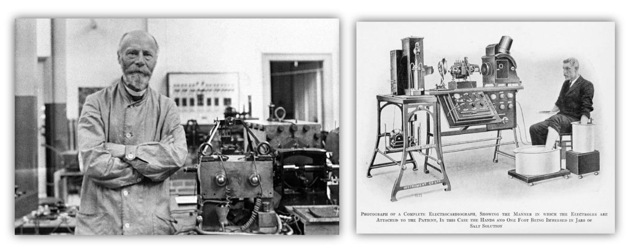
INTRODUCTION
The ECG’s origin dates back to the discovery of the heart muscle’s electrical activity. In 1901, Willem Einthoven (Dutch doctor and physiologist) made a breakthrough that facilitated the first steps towards electrocardiography, for which he subsequently won a Nobel Prize in 1924
Boys slides not very important slide
Body fluids are good conductors (body is a volume conductor). Fluctuations in electrical potential that represent the algebraic sum of action potentials of myocardial fibers can be recorded extracellularly. The record of these potential fluctuations during cardiac cycle is the electrocardiogram (ECG). ECG machine records these fluctuations on a moving strip of paper.
A record of waves (impulses) of electrical excitation in heart is called ECG and the recording is known as an electrocardiogram.
ECG is used as a technique to diagnose cardiac disease and to detect abnormal heart rhythm. They may also be used as a general health assessment in certain occupations, including aviation, diving and the military.

Slide 4
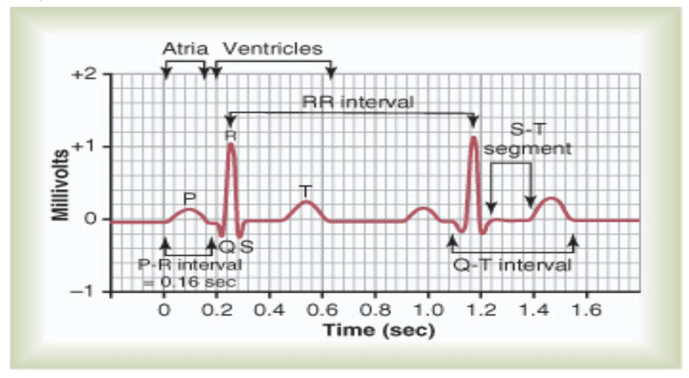
What is the ECG?
Terminology
“ECG” stands for electrocardiogram , or electrocardiograph .In some countries the abbreviation used is EKG
ECG: Electrocardiogram refers to the recording of electrical changes that occurs in heart during a cardiac cycle. It measures cardiac electricity activity.
It is the sum of electrical activity of the heart transmitted to surface of body.
It is a simple and important tool for providing evidence to support a diagnosis, and is sometimes crucial for patient management.
It records the electrical activity of the heart by surface electrodes.
The tracing shows waves of different shapes connected to each other by intervening intervals.
Electrocardiograph: It is an instrument that picks up the electric currents produced by the heart muscle during a cardiac cycle of contraction and relaxation.
Boys slide:
EKG is based on the German spelling of electrocardiogram, which is Elektrokardiogram.

Slide 5
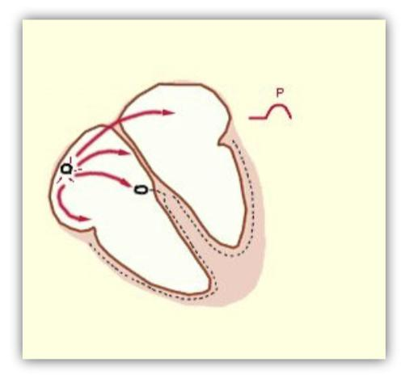
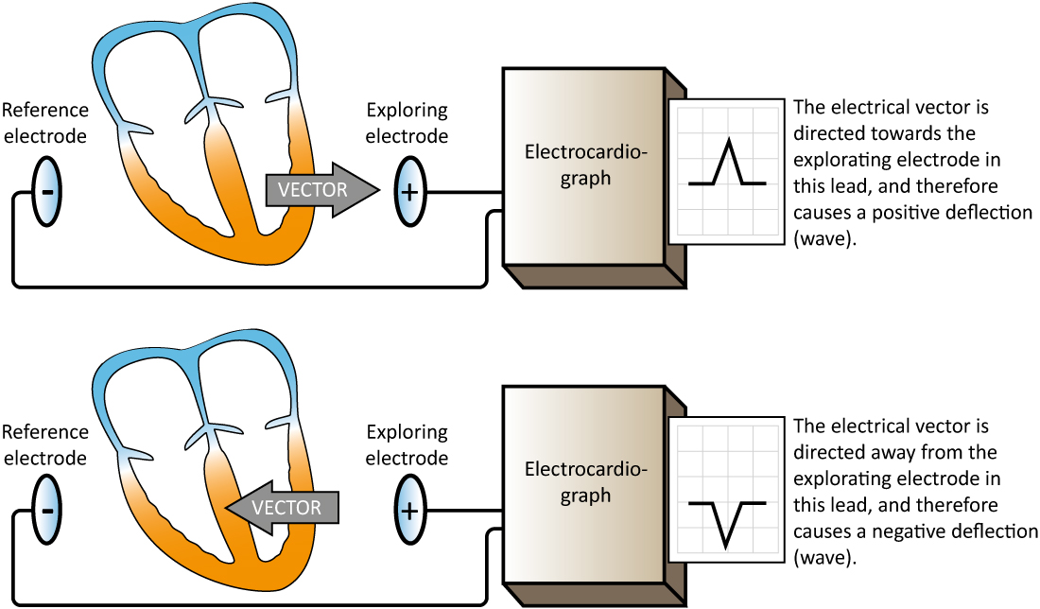
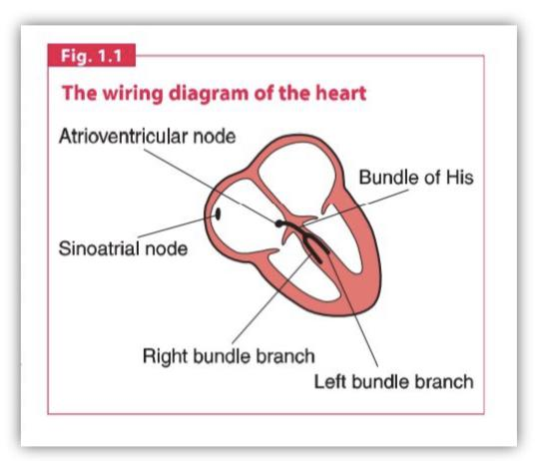
Heart wiring
Working principle of ECG
When the depolarization wave spreads through the heart, electrical currents pass into surrounding tissue and can be recorded from surface electrodes. Depolarization wave towards + electrode creates + deviation , & depolarization wave away from the + electrode creates - deviation.

Slide 6
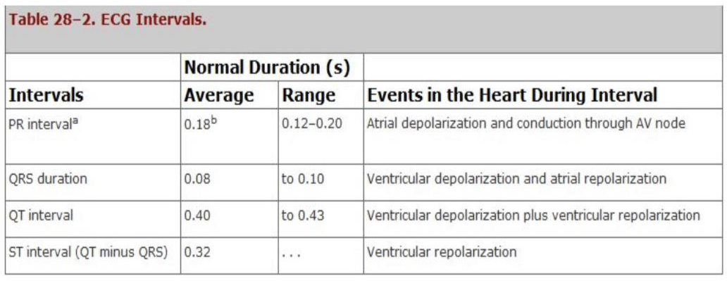
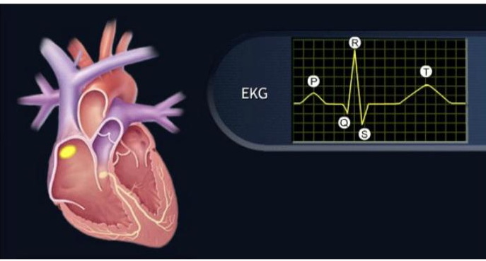
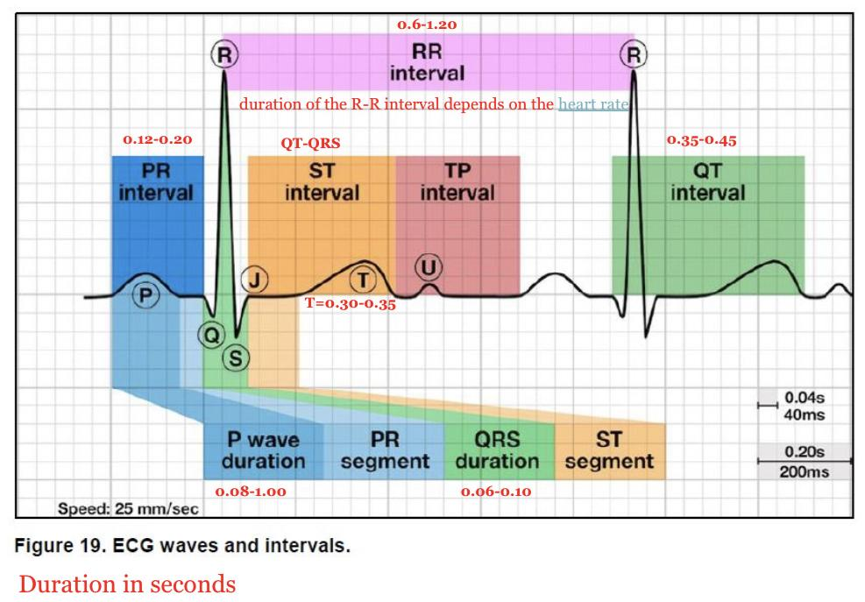
NORMAL ECG
Boys slides only
Normal ECG is composed of waver , intervals & segments :
❑ P wave
❑ QRS complex
❑ T wave Depolarization waves:
1- P wave : Atria depolarize before atrial contraction begins.
2- QRS complex : Ventricles depolarize before contraction.
Repolarization wave:
1- T wave : Ventricles recover from the depolarization state.
This process normally occurs in ventricular muscle 0.25 to 0.35 second after depolarization.
How does a 12-lead ECG work?
ECG is a graphical representation of the heart’s electrical activity, plotting its voltage on a vertical axis against time on a horizontal axis. 12 leads means we have 12 different views of the heart & its sides.
❑ST segment ❑PR segment ❑ST interval ❑QT interval ❑PR interval ❑RR interval

Slide 7
NORMAL ECG: PR INTERVAL
NORMAL ECG: QRS COMPLEX
NORMAL ECG: P Wave

Slide 8
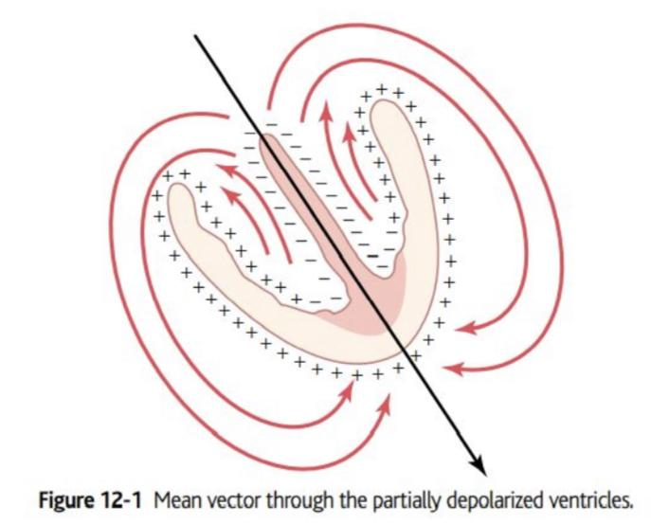
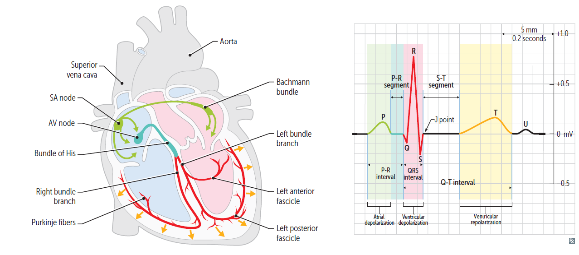
Principles of Vectorial Analysis of ECG
Girls slides
•Heart current flows in a particular direction in the heart at a given instant during cardiac cycle.
•A vector is an arrow that points in the direction of the electrical potential generated by current flow, with the arrowhead in the positive direction.
• Direction of a Vector Is Denoted in Terms of Degrees & length of the arrow is proportional to the voltage of the potential.
In normal heart, the average direction of the vector during spread of depolarization QRS wave through the ventricles is called the mean QRS vector, & is about +59 degrees

Slide 9
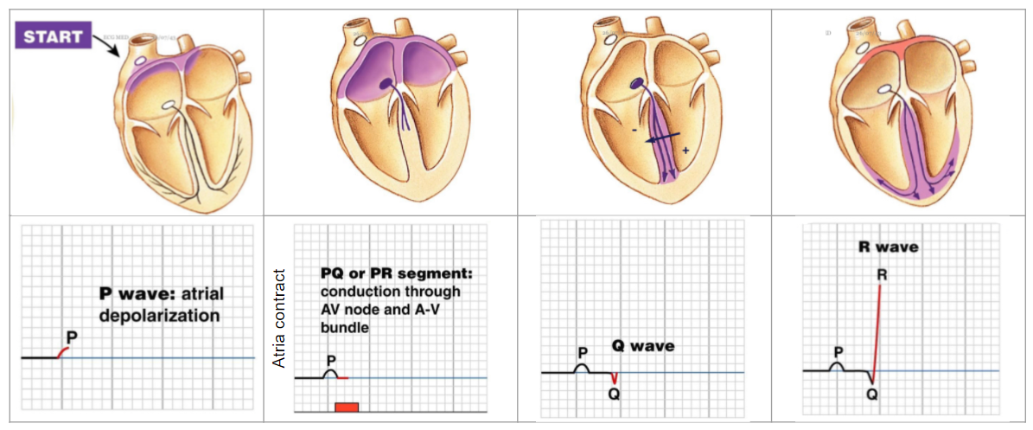
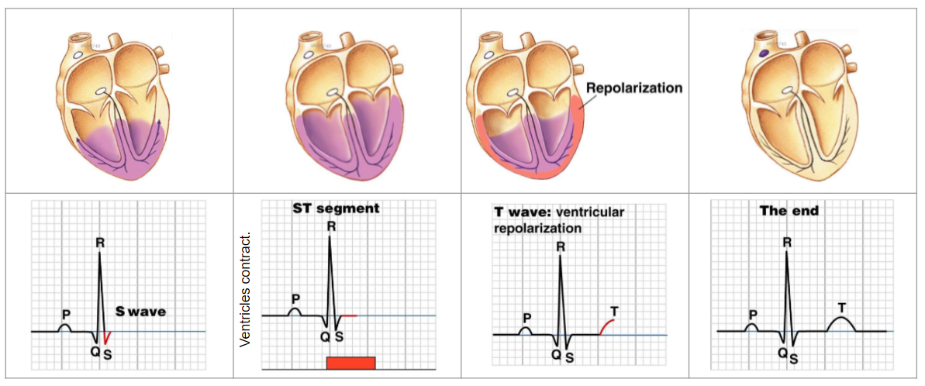
Electrical Events of the Cardiac Cycle

Slide 10
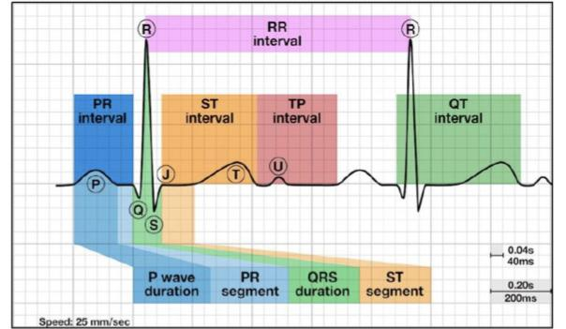
ECG waves, segments and intervals (detailed)
Girls slides
P wave = atrial depolarization.
PR segment = depolarization of AV node. It’s a flat line because the wave is not strong enough to be recorded on the voltmeter.
PR interval = wave goes over the atrium and through AV node and ends just before it activates the ventricles to depolarize.
Q wave = ventricular Septal Depolarization
R wave = major ventricular muscle depolarization.
S Wave = basal Ventricular depolarization.
The beginning of QRS complex is the start of ventricular systole & that goes until end of T wave. Ventricular diastole starts when T wave ends.
ST segment = during which, all ventricular myocardium is depolarized. All have positive charges. So there is no potential difference to be recorded by the voltmeter (ECG machine). So there is a flat line.
ST interval = initial, slow phase of ventricular repolarization
TP interval = represents the time when heart muscle cells are electrically silent
T wave = ventricular repolarization.
QT interval = Important because it captures the beginning of ventricular depolarization through the plateau phase to ventricular repolarization. It covers the entire ventricular activity.
RR interval = duration between each cardiac cycle
U wave = electrical activity of ventricular papillary muscle is out of phase with rest of the ventricles and will record as a “U” wave that shows after the T wave.
Segment is the region between two waves (elevation or depression or progression)
Interval is a duration of
time that includes one segment and
one or more waves.

Slide 11
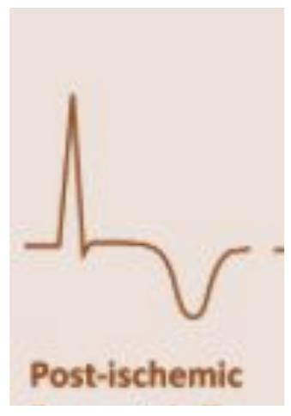
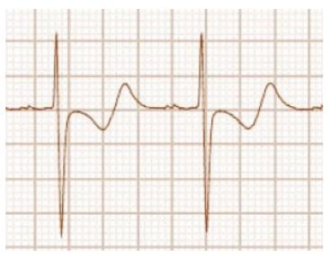
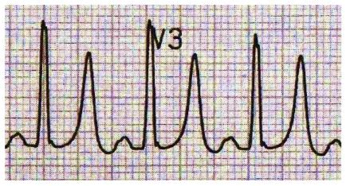
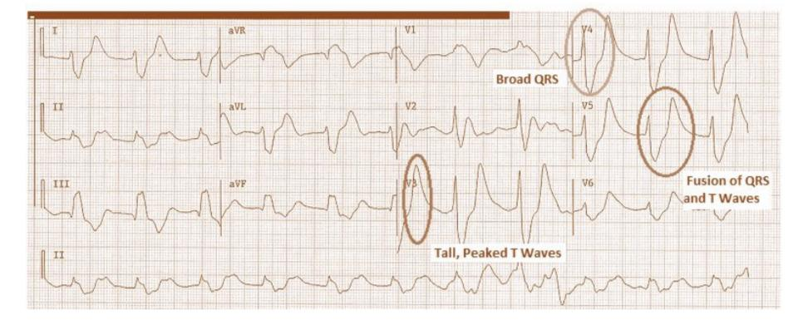
Abnormal T wave
Abnormal QRS complexes
Abnormal P wave
Girls slides
Anything that causes the right atrium to become hypertrophied (such as tricuspid valve stenosis or pulmonary hypertension) causes the P wave to become peaked.
Left atrial hypertrophy (usually due to mitral stenosis) causes a broad & bifid P wave.
Peaked T waves : hyperkalemia
Inverted T waves : ischemia
Biphasic T waves :Hypokalemia
Broad QRS complex (>100ms) (↑↑ width indicates that depolarization has spread through ventricles by an abnormal and therefore slow pathway): Ex. BBB, hyperkalemia (↑K⁺)
↑↑ height (↑↑ in muscle mass in either ventricle will lead to ↑↑ electrical activity): Ex. ventricular hypertrophy
Hyperkalemia

Slide 12
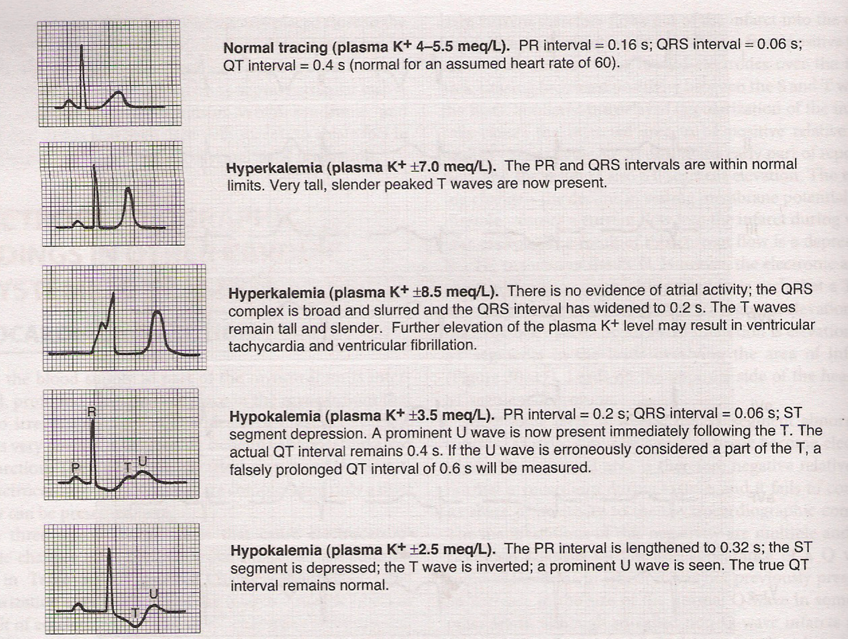
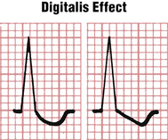
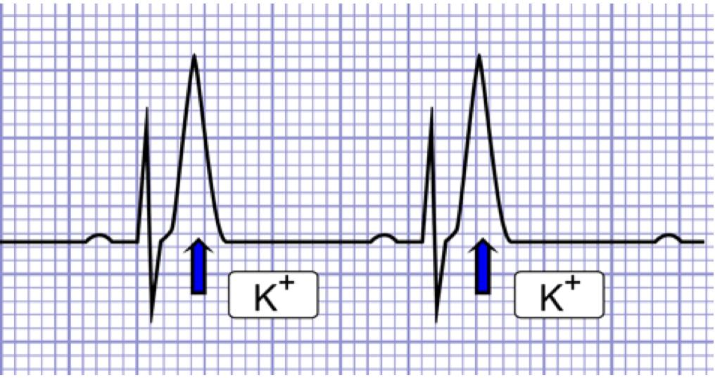
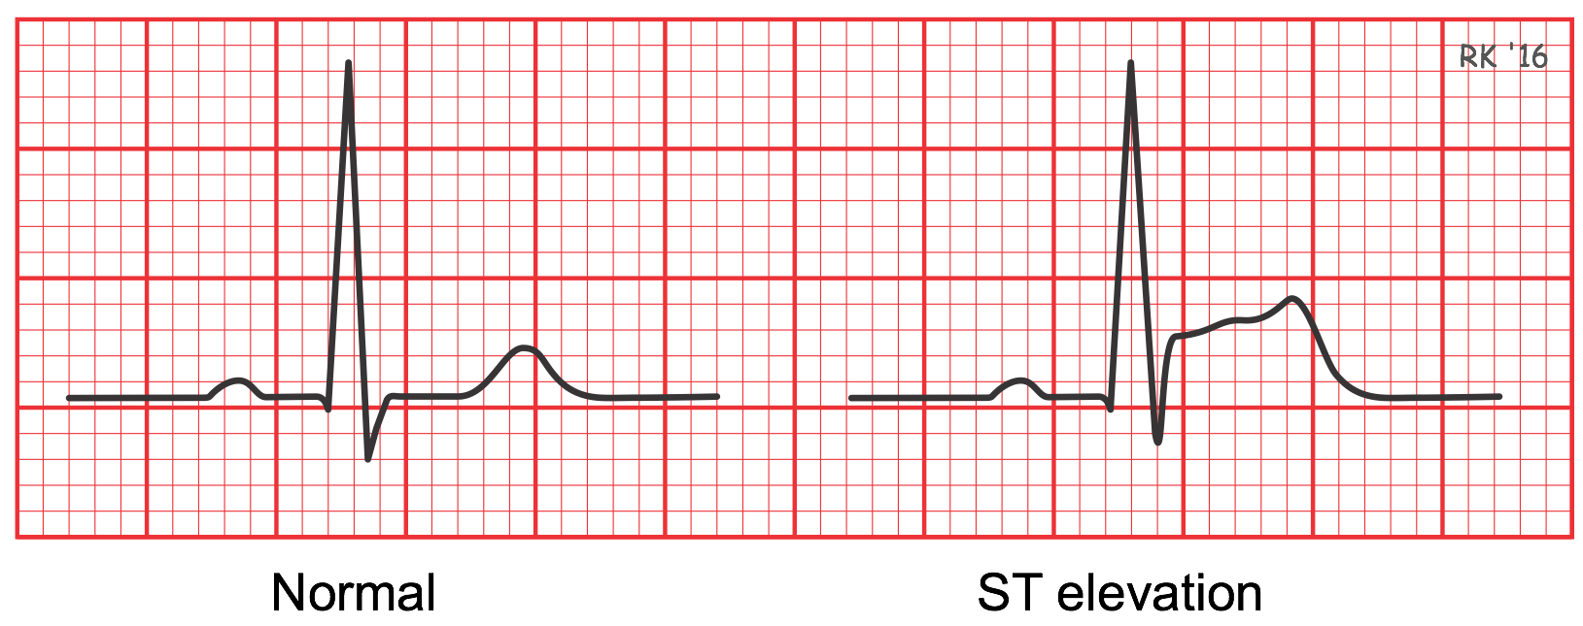
Special ECGs abnormalities
ECG -Drug effects (scooping of the ST-T complex produced by digitalis)
K⁺ changes
Peak T wave
ECG in Electrolyte imbalance (hyperkalemia)
ECG in Presence of ischemia

Slide 13
What information can be obtained?
Girls slides
Presence of ischemia or infarction in the heart along with its location and extent
Rate & Rhythm
of heart
Size of its chambers
Heart’s orientation
Electrolyte imbalance
Drug effects

Slide 14
Clinical Significance of different waves & segments of ECG
Boy’s Slides
ST Elevation - Acute MI or Angina
Shortened QT interval - Hypercalcemia
ST depression >1 mm - Ischemia/Angina (flat), digoxin (sloping)
Prolonged QT interval – Hypocalcemia
Q waves in 2 or more leads - Previous MI (Transmural)
T wave inversions and non-specific ST changes - Can be seen both in normal cases and in many diseases, therefore not useful for diagnosis.
U waves - Hypokalemia ('Hump' at the end of T wave)
Diffuse ST elevation with PR depression – Pericarditis
Peaked T waves or loss of P wave – Hyperkalemia
Tall P waves - Right atrial hypertrophy
Broad (and often bifid) P waves - Left atrial hypertrophy

Slide 15
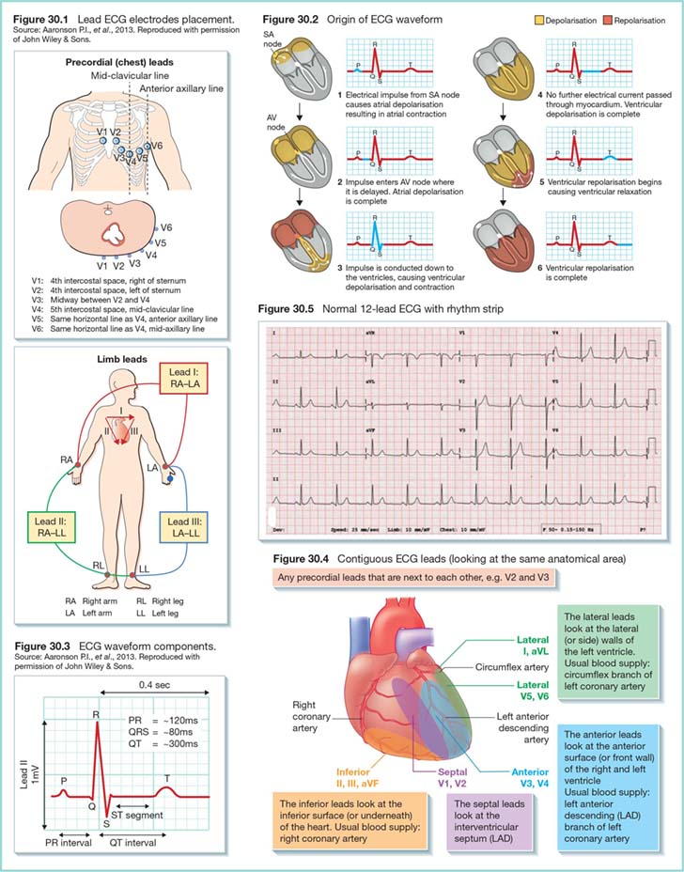
12-Lead ECG
Girls slides
Leads are electrodes which measure the difference in electrical potential between either:
Two different points on the body (bipolar leads) One point on the body and a virtual reference point with zero electrical potential, located in the center of the heart (unipolar leads)
A lead means a viewpoint of the heart
12-lead ECG is an ECG recording that looks at the heart from 12 different viewpoints providing a complete picture of the heart’s electrical activity
12-lead ECG is composed of six limb leads and six chest leads
Limb leads look at the heart in the coronal (frontal) plane while chest leads look at the heart in a horizontal plane
Bipolar lead records the potential difference between two electrodes, e.g. limb leads I, II & III
Unipolar lead records the potential of one electrode, e.g. limb leads aVR, aVL and aVF as well as chest leads are unipolar
The ECG has 12 leads and 10 electrodes
(6 chest + 3 limb and augmented + 1 earth)

Slide 16
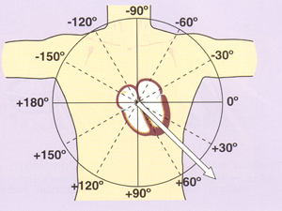
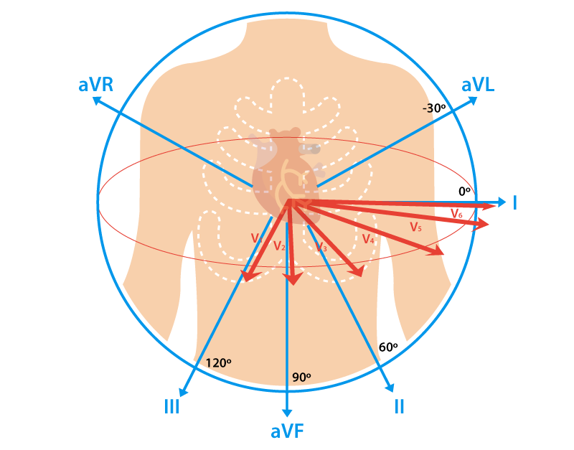
Limb leads
Axis for Each Standard Bipolar Lead & Each Unipolar Limb Lead
Girls slides
4 electrodes placed on :
Left arm (LA)
Right arm (RA)
left leg (LL)
Right leg (RL)-earth
3 electrodes will record six leads (views) of the heart in the coronal plane, namely; Lead I, lead II, lead III, aVR, aVL and aVF.
Each lead is a pair of electrodes connected to the body on opposite sides of the heart, & the direction from negative electrode to positive electrode is called the “axis” of the lead.
The hexagonal reference system

Slide 17
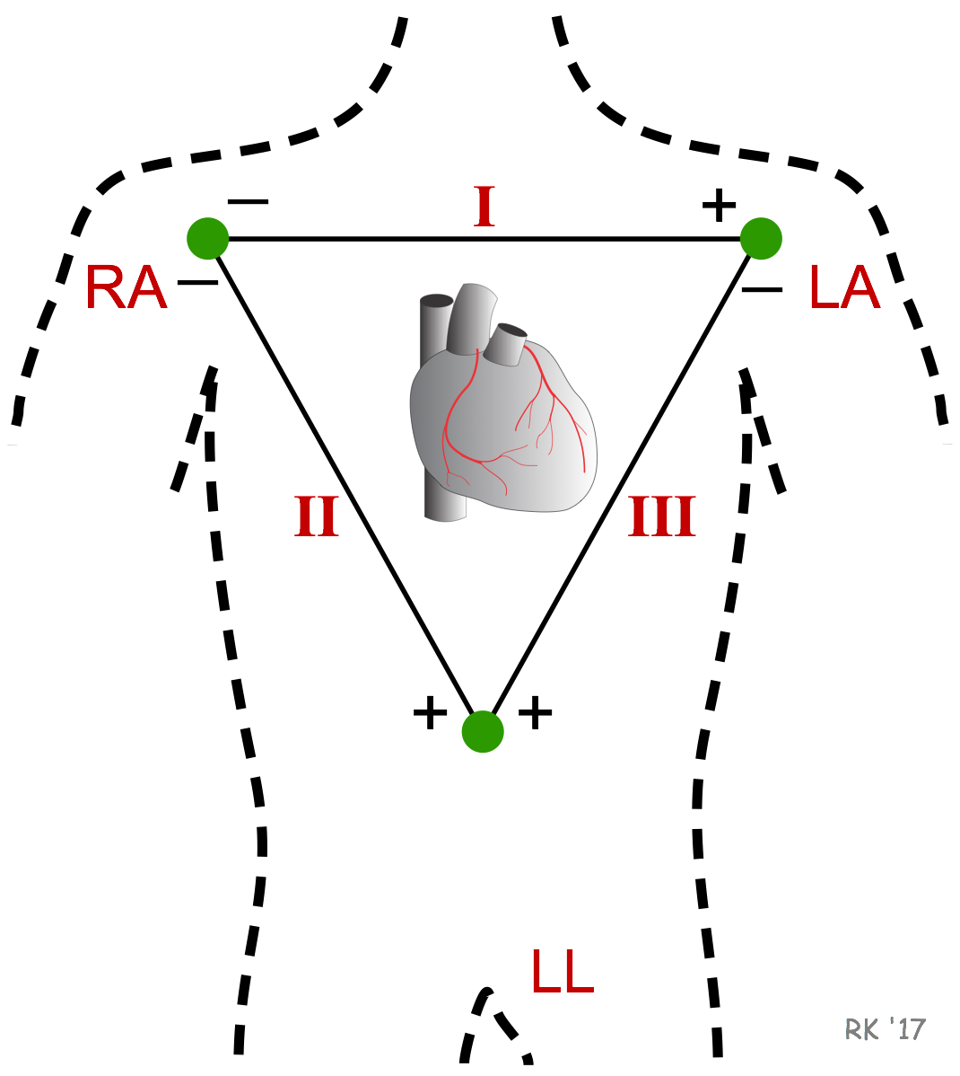
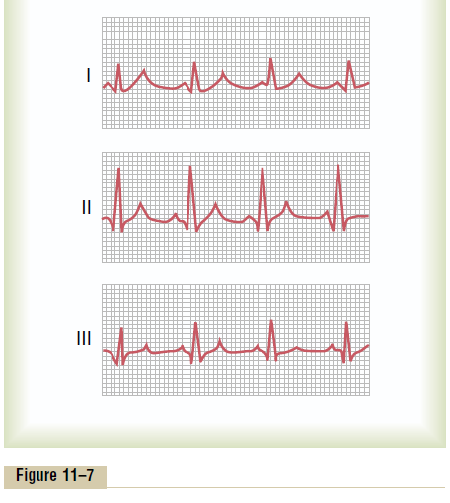
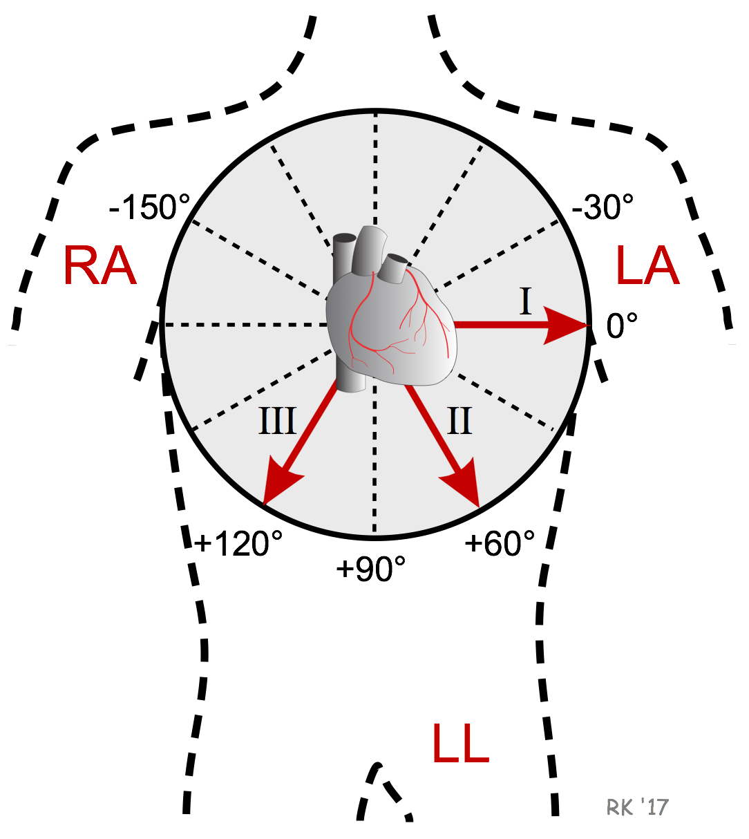
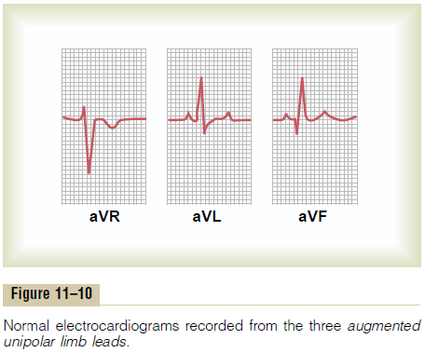
Limb leads
Girls slides
Bipolar lead : have a - & + pole. Electrical potential differences are measured between the poles
Normal ECG recorded from the three standard ECG leads
Unipolar lead : No - lead, heart is the - pole. Electrical potential difference is measured between the lead & the heart.
normal electrocardiograms recorded from the three augmented unipolar limb leads

Slide 18
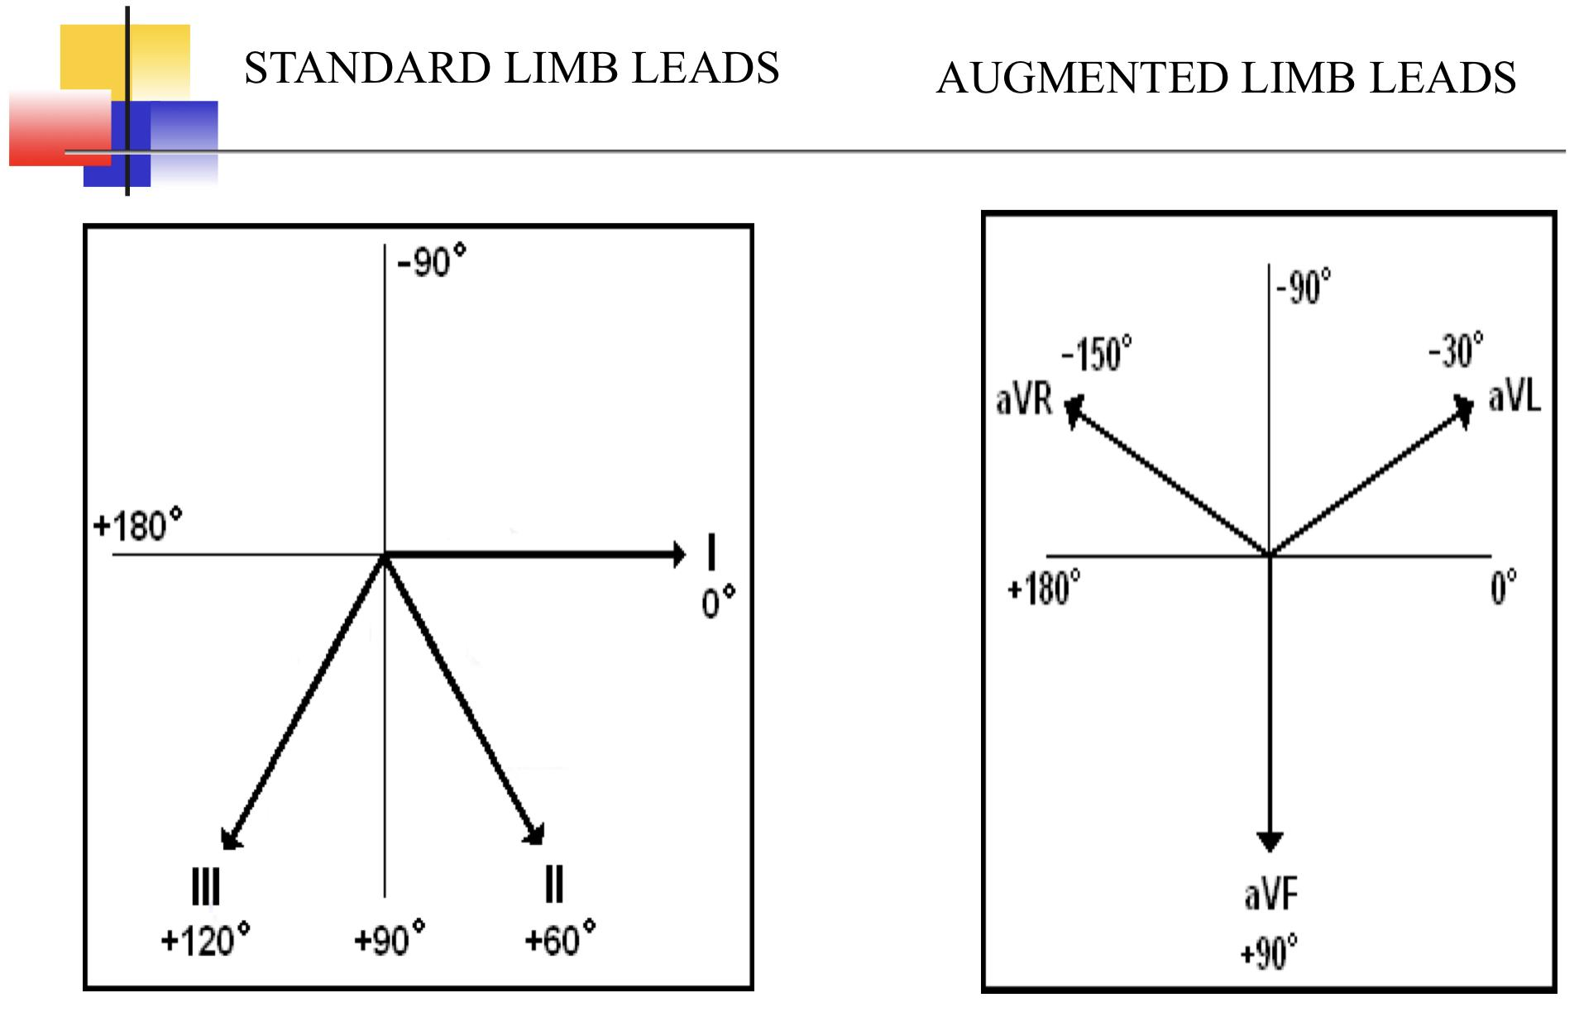
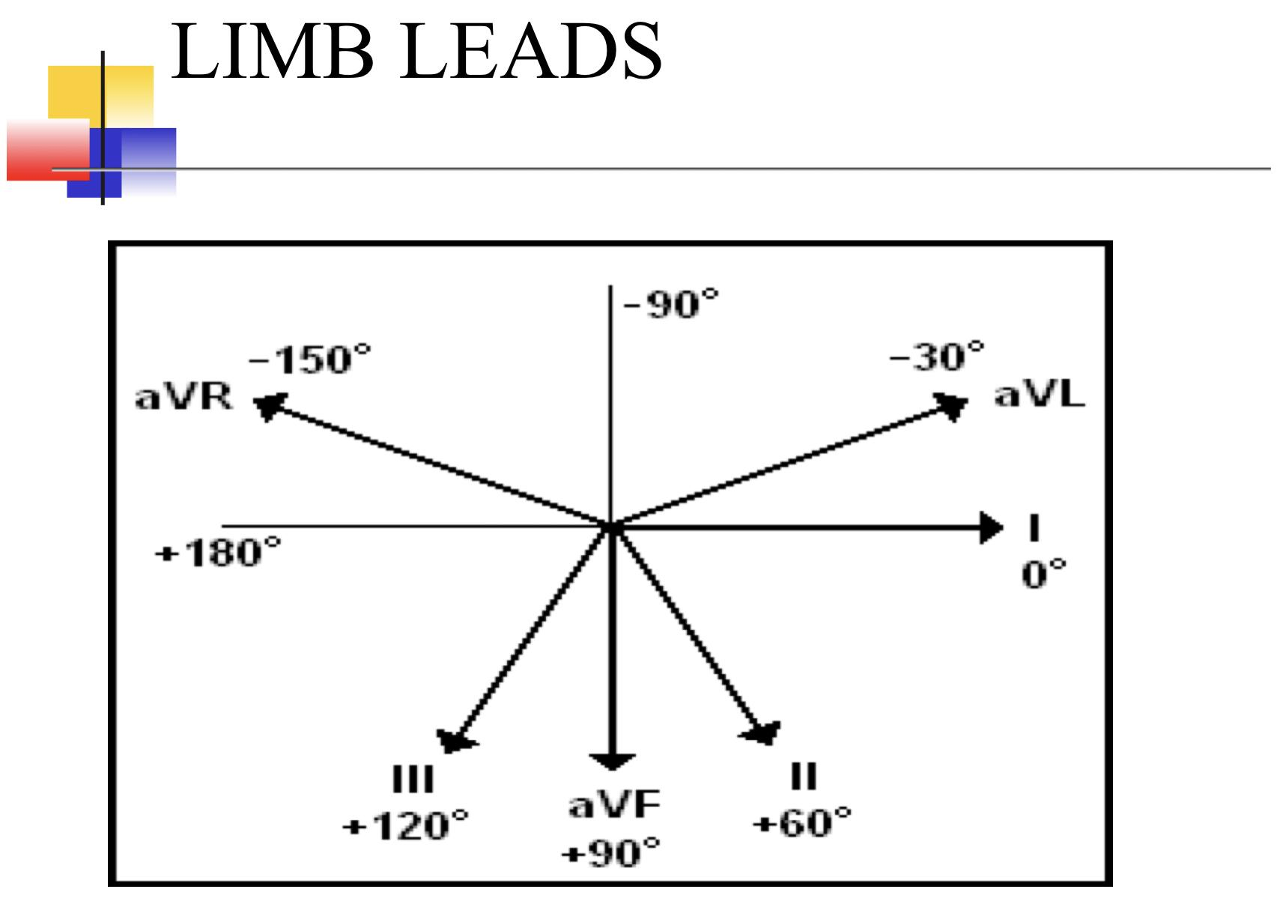
Limb leads
Boy’s Slides

Slide 19
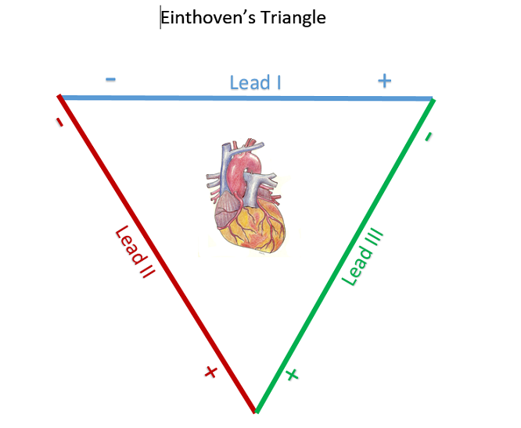
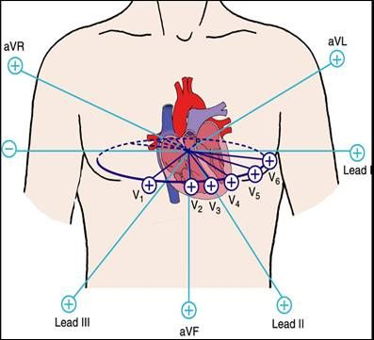
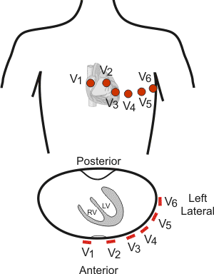
Einthoven’s Law
Precordial (chest Wilsons) leads
Girls slides
V1: 4th intercostal space (ICS), right sternal border
V2: 4th ICS, left sternal border
V3: midway between V2 and V4
V4: 5th ICS, mid -clavicular line
V5: 5th ICS (horizontal to V4), anterior axillary line.
V6: 5th ICS (horizontal to V4), mid-axillary line.
sum of the potentials recorded in leads I and III will = the potential in lead II.
Lead I + Lead III= Lead II

Slide 20
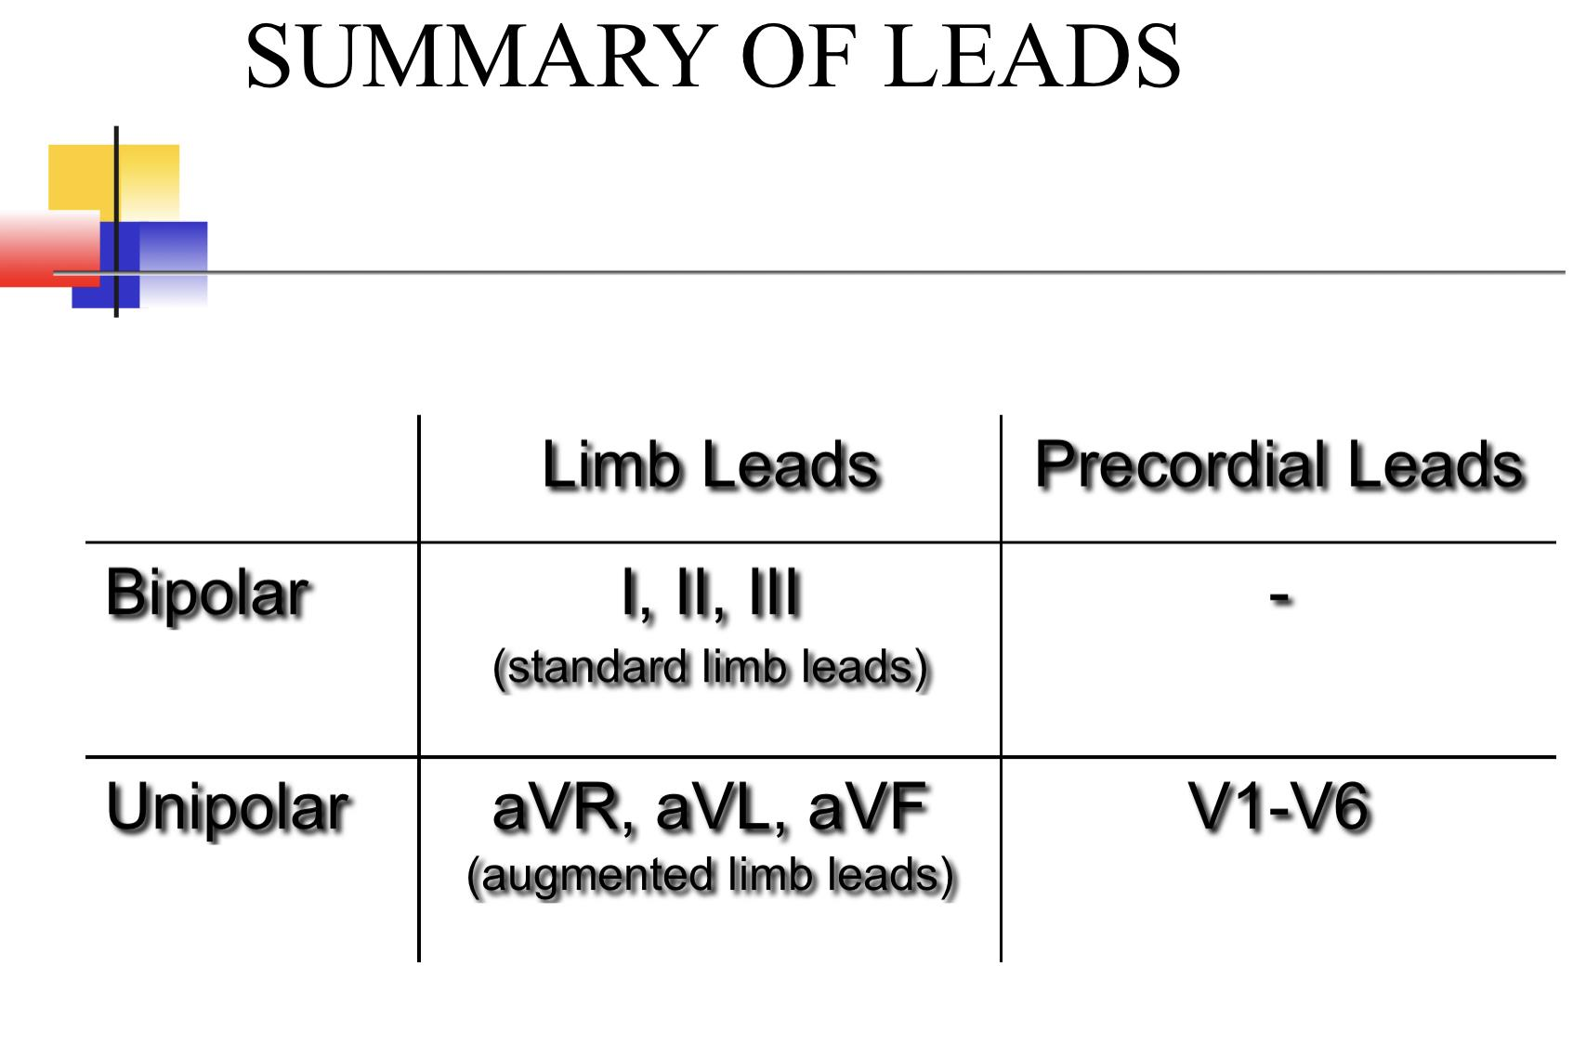
Precordial leads
Summary of leads
Boy’s Slides

Slide 21
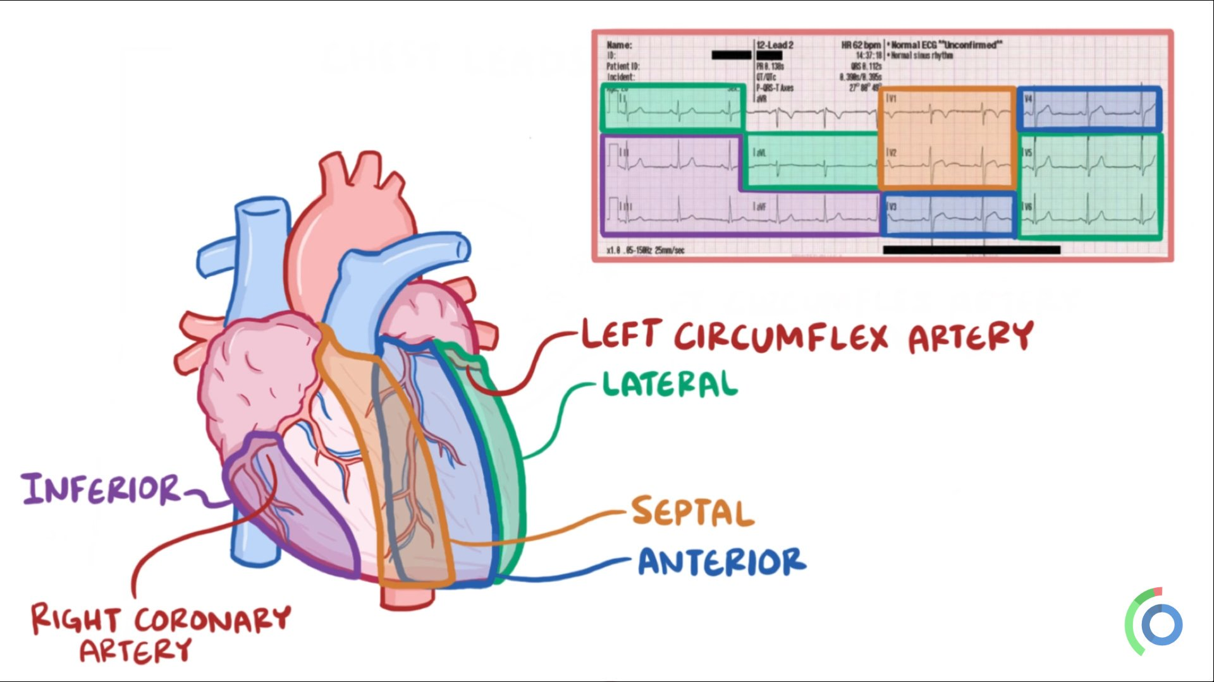
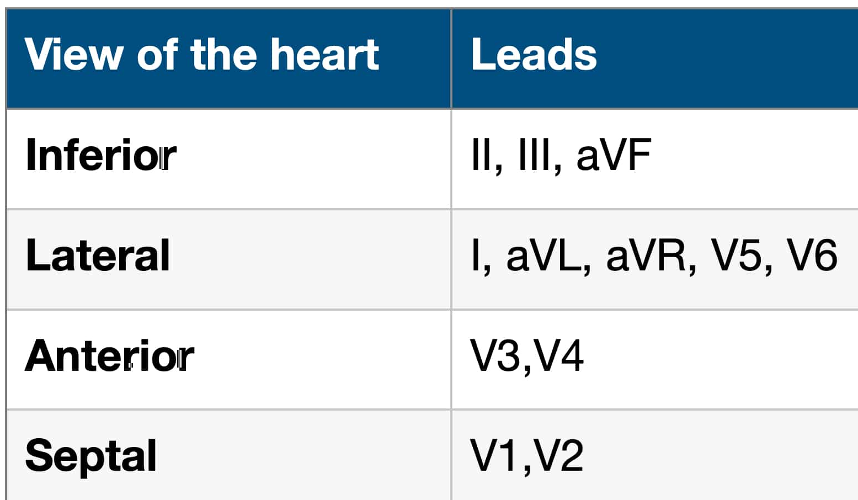
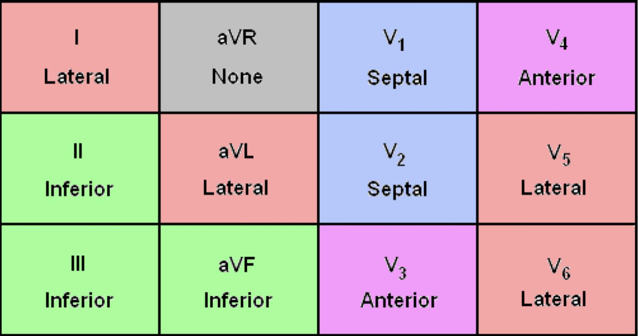
ANATOMICAL PRESENTATION OF LEADS
ECG Interpretation
Girls slides
The ECG paper
ECG waves and intervals
Heart rhythm determination
Heart rate calculation
Calculation of the cardiac axis

Slide 22
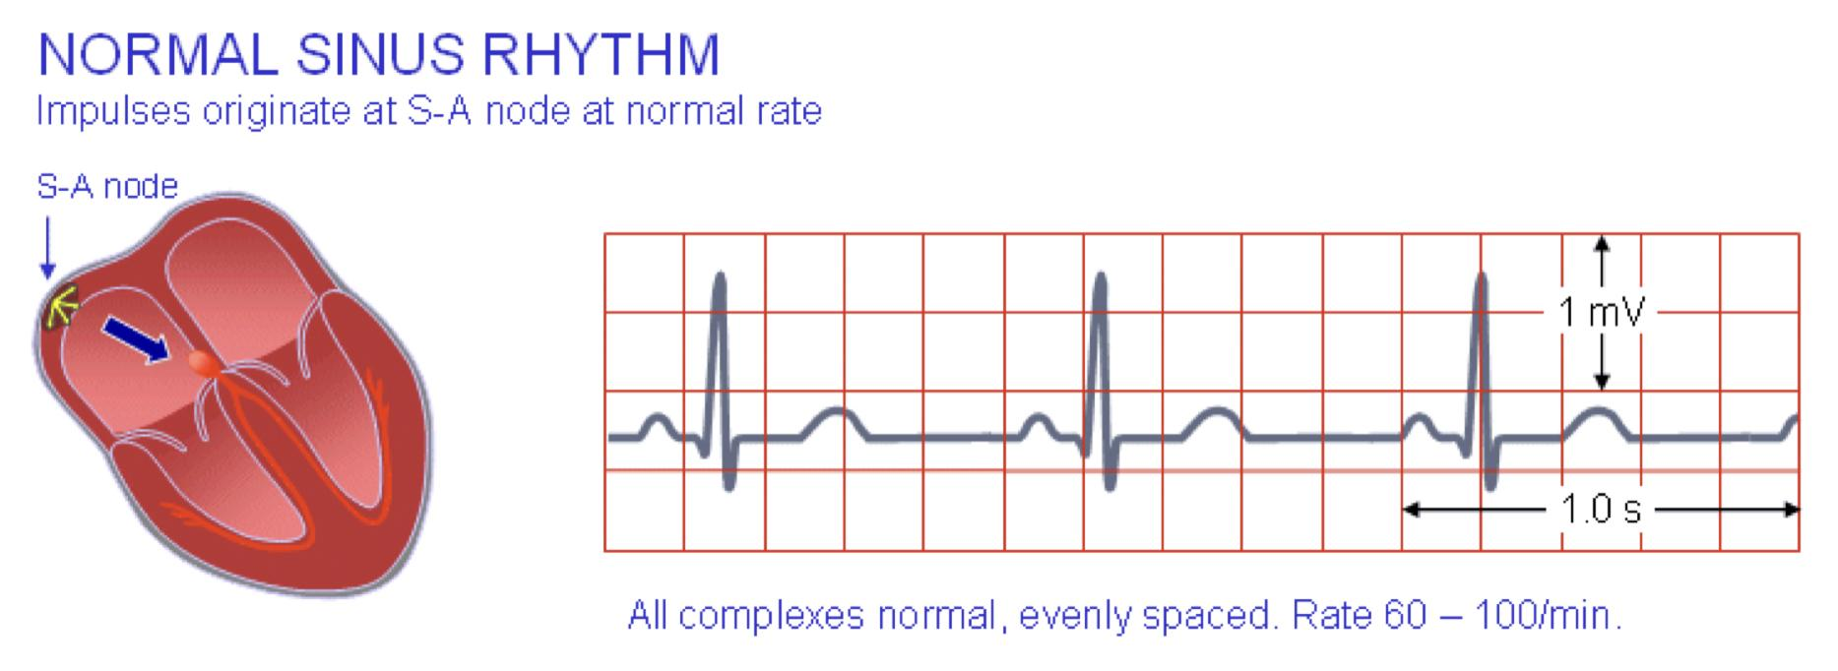
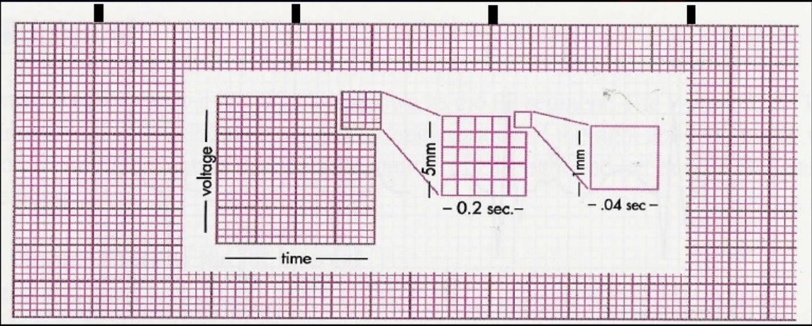
ECG paper
Heart rhythm determination
Girls slides
The ECG is recorded on graph paper.
The paper runs at a standard speed of 25mm/sec.
The horizontal axis denotes time while the vertical axis denotes voltage.
The graph paper is divided into large and small squares.
Each large square contains 5 small squares of 1 mm length.
Given that the paper runs at a rate of 25 mm/sec, horizontally, one small square of 1 mm length represents 0.04 sec.
The heart rhythm refers to the regularity of heart beat.
Heart rhythm can be determined by observing R-R intervals on ECG.
If R-R intervals are the same duration, the rhythm is said to be regular (sinus rhythm), whereas if R-R intervals are variable in length the rhythm is said to be irregular (arrhythmia).
Large square
Small square

Slide 23
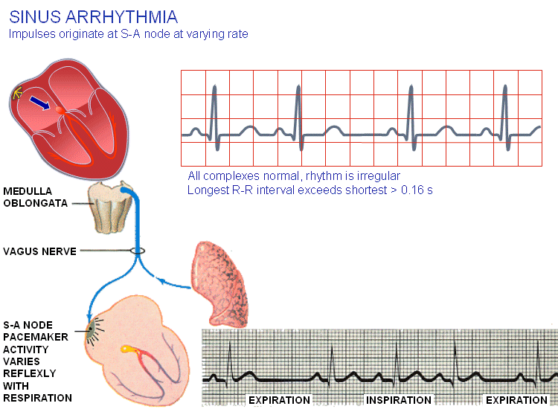
Sinus Arrhythmia
Girls slides
This pattern of arrhythmia is physiologic and is due to the different firing rate of SA node during inspiration & expiration.
The heart usually beats faster during inspiration and slower during expiration, showing unequal R-R intervals on ECG strip.
Impulses originate at SA node at varying rate
The RR intervals are shorter during inspiration & wider during expiration.
Inspiration ↑ heart rate by ↓ vagal tone.
10 second rule
most ECGs record 10 seconds of rhythm per page, one can simply count the number of beats present on the ECG and multiply by 6 to get the number of beats per 60 seconds.
More explanation in next slides(26)

Slide 24
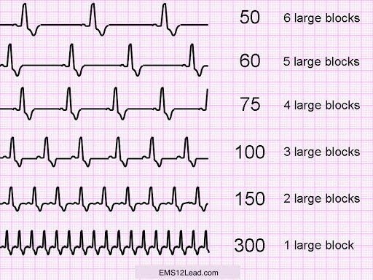
Heart rate calculation
Girls slides
Don’t skip
Regular heart rhythm
The heart rate can be calculated from the ECG using one of the following formulas:
(when the rhythm is normal)
Ex:300/6=50 beats per minute=bradycardia
R R
HR
(300 / 6) = 50 bpm
(300 / 4) = 75 bpm
(300 / 1.5) = 200 bpm

Slide 25
Heart Rate
Girls slides
Normal range of heart rate is between 60-100 beats/minute
Tachycardia
Bradycardia
higher than 100 beats/minute
Impulses originate at SA node at rapid rate
less than 60 beats/minute
Impulses originate at SA node at slow rate
All complexes normal, evenly spaced. Rate > 100/min All complexes normal, evenly spaced. Rate < 60/min

Slide 26
Heart rate calculation
Girls slides
2. Irregular heart rhythm
Count the number of QRS complexes in 30 large squares (which equals the number of QRS complexes in 6 seconds).
Ex: 33 x 6 = 198 bpm
10 seconds rule works well for irregular rhythm (go back to slide 23)
Then multiply the number of QRS complexes counted in 6 seconds by 10 to get the number of QRS complexes in one minute i.e. the heart rate.

Slide 27
Calculation of the Cardiac Axis
Girls slides
The cardiac axis is expressed as an angle and is measured in degrees.
The electrical axis is the average direction of the current flow in the heart during a cardiac cycle.
The depolarization wave normally spreads through the ventricles in a direction from base of the heart to its apex.
The cardiac axis refers to the general direction in which the heart depolarizes.

Slide 28
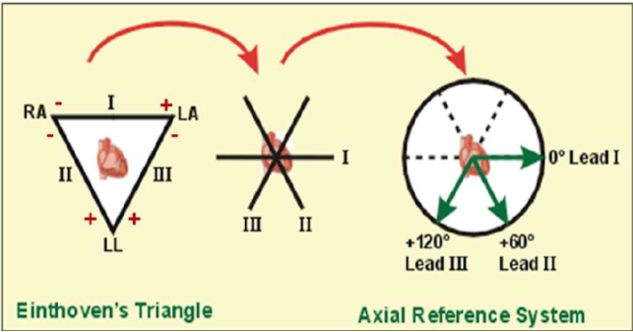
Calculation of the Cardiac Axis
Girls slides
Lead I will be looking at the heart from the left at an angle of 0 degrees.
Lead II is considered to be looking at the heart at an angle of +60⁰
Any deviation below that line is expressed as a positive number whereas deviations above the line are expressed as negative numbers.
Lead III looks at the heart at +120⁰
The axial reference system

Slide 29
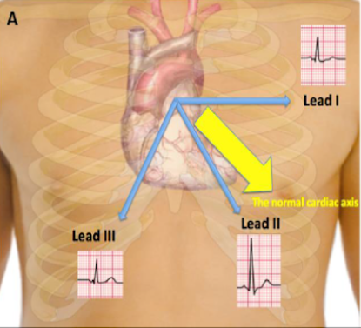
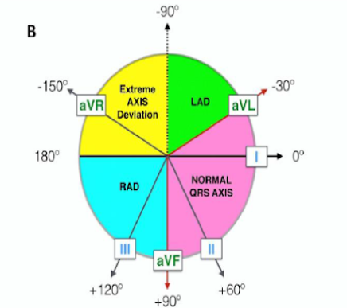
Normal Cardiac Axis (The QRS Axis)
The QRS axis represents the net overall direction of the heart’s electrical activity.
Abnormalities of axis can hint at:
Ventricular enlargement
Conduction blocks (i.e. hemiblocks)
Normal cardiac/QRS axis lies between -30 to +90 degrees.
right axis deviation (RAD) +90 to +180
Left axis deviation (LAD) between -30 to -90
Beyond these values, it will be extreme axis deviation
(A) In the normal heart, the average current flow occurs primarily in the direction from base to apex with negativity at the base and positivity towards the apex of the heart at an angle between (-30 to 90).
(B) shows the range in which the cardiac axis is considered normal (-30 th 90), LAD (-30 to -90), RAD (90 to 180) and extreme axis deviation (180 to -90)

Slide 30
The Accurate Way to Determine the Cardiac Axis
Girls slides
Use two limb leads, namely leads I and III.
1
Helpful video
Looking at the QRS complexes in these leads, calculate the size and
polarity of the QRS complex in each by subtracting the depth of S wave
from the height of the R wave.
2
Construct a vector diagram and draw arrows that represent the sum of
size and polarity for each lead on the diagram.
3
Drop a perpendicular line from the tip of each arrow. The point at which
the two perpendicular lines meet, constitute the tip of the cardiac axis.
4
Draw a line from that point to zero point and this will be the cardiac axis,
5

Slide 31
The quick and easy way to determine
the cardiac axis
Girls slides
Is by applying the “rule of thumb” on the direction of QRS complex in leads I and III/aVF of the ECG.
If the QRS complex is predominantly positive in both leads I and III, then the cardiac axis is normal.
If the QRS complex is predominantly positive in lead I and predominantly negative in lead III, this means left axis deviation.
If the QRS complex is predominantly negative in lead I and predominantly positive in lead III, this means right axis deviation.
If the QRS complex is predominantly negative in both leads I and III, this is extreme axis deviation.

Slide 32
Determination of the cardiac axis
Girls slides

Slide 33
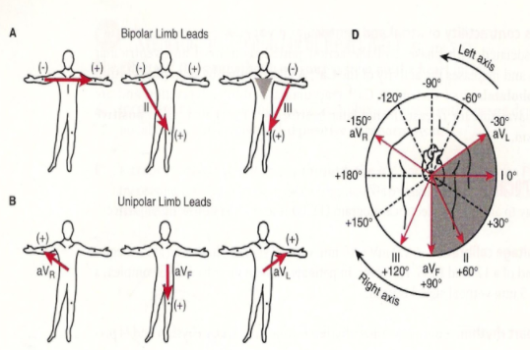
Extra slide for better understanding

Slide 34
The ECG trace analysis
Girls slides
The ECG ‘Rule of Fours’
Patients details.
Calculate the heart rate.
Comment on the rhythm of the heart.
Name the waves and intervals and calculate their duration.
Determine the cardiac axis.
Four initial features (history, rate, rhythm, axis).
Four waves (P, QRS, T, U).
Four intervals (PR, QRS, ST, QT).
What is the diagnosis

Slide 35
MCQs
Q1: How many seconds does a big square have in ECG?
A- 0.2 sec | B- 0.4 sec | C- 1 sec | D- 2 sec
Q2: Which of the following is unipolar limb lead ?
A- Lead I | B- Lead aVR | C- Lead V2 | D- All are correct
Q3: Calculate the heart rate in ECG from a patient with normal rhythm if 5 big boxes are between the R-R intervals
A- 75 beats/min | B- 100 beats/min | C- 60 beats/min | D- 135 beats/min
Q4: Which of the following indicates left axis deviation?
A- (-30 to -90) | B- (-30 to 90) | C- (90 to 180) | D- (180 to -90)
Q5: What do peak T waves indicate ?
A- ischemia | B-hypokalemia | C- atrium hypertrophy | D-hyperkalemia
Answers: 1.A 2.B 3.C 4.A 5.D

Slide 36
SAQs
Q1: Give 3 examples of information that can be obtained from ECG ?
Rate of the heart, size of it’s chambers, drug effects
Q2: What leads are represented by the lateral view of the heart?
I , aVL , V5 , V6
Q3: List QRS complex abnormalities.
Broad QRS complex (>100ms) Ex. BBB, hyperkalemia (↑K+)
↑↑ height : Ex. ventricular hypertrophy

Slide 37
Team Leaders
THANK YOU
Saleh aldeligan
Qusai Alsultan
Raghad Alkhudair
Raghad Alnadeef
Team Members
Othman Aldraihem
Abdulaziz Alqahtani
Abdullah Alshahri
Saad Al Hammad
MOHAMMED ALDAWSARI
Ahmad Almarshed
Rayan Alahmari
ABDULRAHMAN BINBAKHIT
Abdulaziz Alymni
Faisal Alkhunein
Abdullah Alqarni
Raid Almadi
Mohammad Alrashed
Abdulrahman bin Ateeq
Amer Alghamdi
Mishal Alsuwayegh
Nawaf alturki
Hussam Aleid
Raid almadi
Mohammed AlShehri
Nouf Aldhalaan
Amani Alotaibi
Shahed bukhari
Shahad Aljeri
Maha Alkoryshy
Alhnouf Hadi
Mayssam Aljaloud
Hissa Alshiqari
Mashael Albugami
Renad Alayidh
Ghada Binslmah
Razan Alsulami
Shaden albassam
Razan Almanjomi
Reem Alhazmi
Dhai hamdan
Shahad alaskar
Haifa Almuddahi
Reema alquraini
deema aljuribah
Kadi Khalid aldossari
Farah alhalafi
Theme was done by Mohammad Alrashed
Physio442@gmail.com
Editing File

