Slide 1
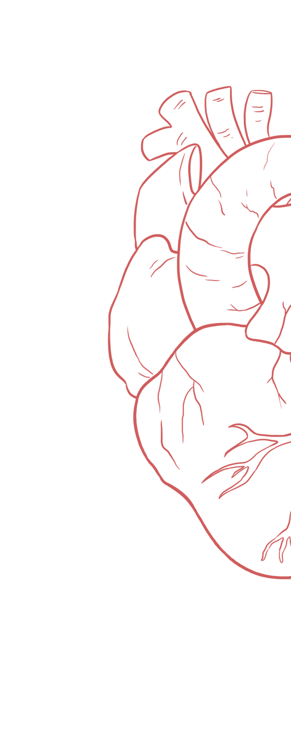
Jugular Venous Pulse & Heart Failure
____________
Color Index:
Main Text
Important
Girl’s Slides
Boy’s Slides
Dr’s Notes
Extra Info

Slide 2
Objectives: JVP
Identify the jugular venous pressure.
Know the method of examination of the internal venous pressure.
Describe Normal pattern of the jugular venous pulse.
What are the abnormalities of jugular venous pulse.

Slide 3
Objectives: Heart Failure
Define heart failure.
Identify types of heart failure.
Describe the causes and pathophysiological consequences of acute and chronic heart failure.
Indicators for diagnosis of heart failure.
Explain how left-sided failure leads to right-sided failure & congestive heart failure.
Discuss the compensatory mechanisms in heart failure.
Summarize clinical picture of left-sided and right-sided failure.
Interpret and draw Starling curves for healthy heart, acute heart failure, and heart failure treated with digoxin

Slide 4
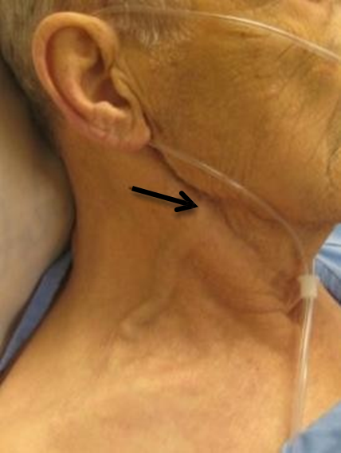
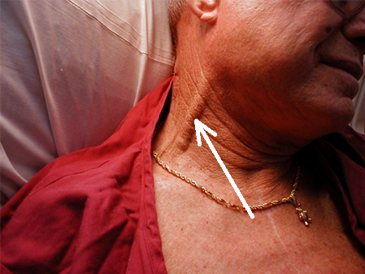
Jugular Venous Pulse and pressure definitions
Girls’ Slides
Jugular Venous Pulse: JVP is the oscillating top of vertical column of blood in right internal jugular vein. It reflects pressure changes in right atrium during the cardiac cycle.
Jugular Venous Pressure: Vertical height of oscillating column of blood in right internal jugular vein.

Slide 5
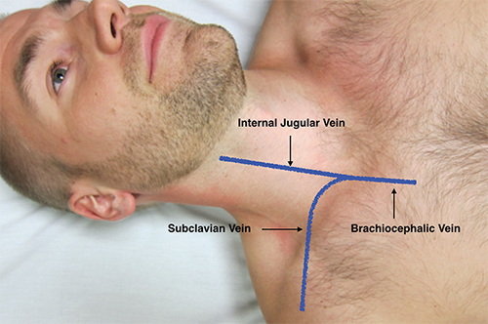
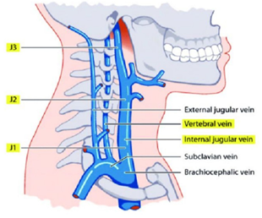
Why Right Internal Jugular Vein (IJV)?
Pressure changes in RA can be recorded from IJV
Right internal jugular veins (IJV) extend in an almost straight line to superior vena cava and has a direct course to RA, thus favoring transmission of the hemodynamic changes from the right atrium.
IJV is anatomically closer to RA.
IJV has no valves (valves in EJV prevent transmission of RA pressure that’s why it can’t be relied + obstructed by facial & muscular layers through which it passes)
The left innominate vein is not in a straight line and may be kinked or compressed between aortic arch and sternum, by a dilated aorta, or by an aneurysm.
left innominate vein = left brachiocephalic vein

Slide 6
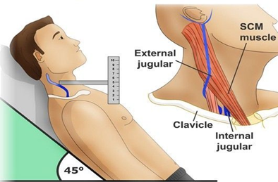
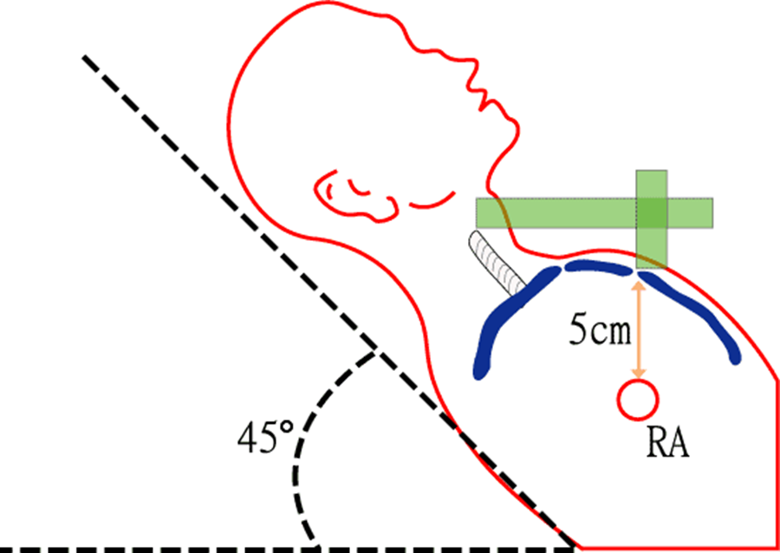
Method Of Examination
Girls’ Slides
The patient should lie comfortable during the examination.
Clothing should be removed from the neck and upper thorax.
Neck should not be sharply flexed.
Examined effectively by shining a light across the neck
There should not be any tight bands around abdomen.
Patient reclining with head elevated 45 °
Then observations are made by
1- The level of venous pressure
2-The type of venous wave pattern.

Slide 7
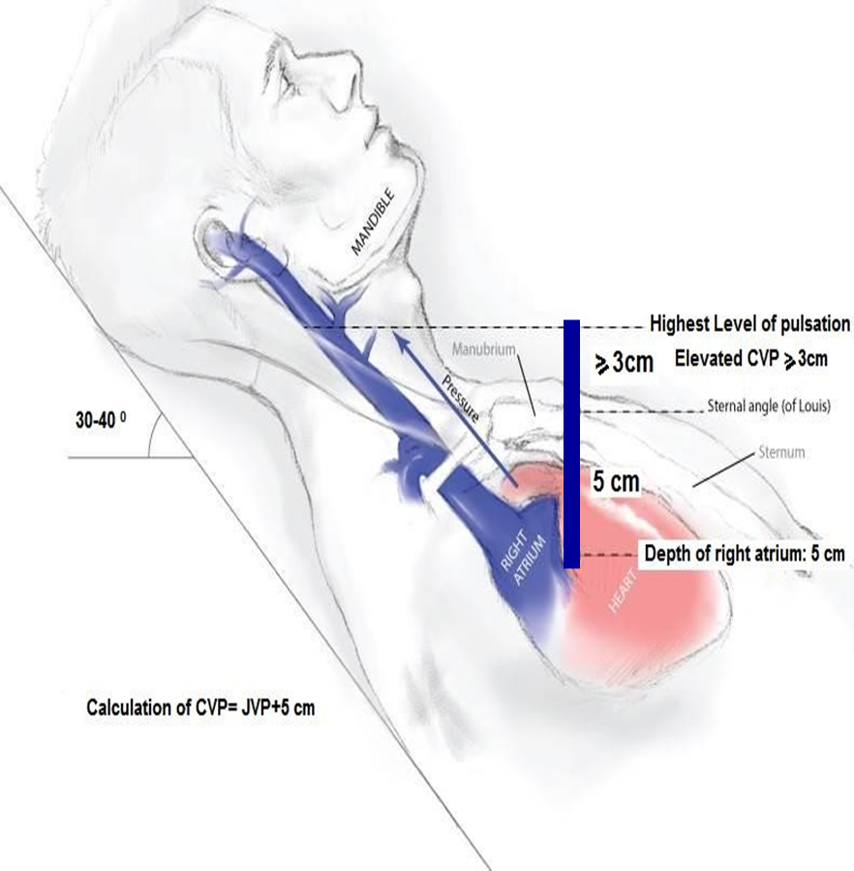
The level of venous pressure
Girls’ Slides
Using a centimeter ruler, measure the vertical distance between the angle of Louis (sternal angle) and the highest level of jugular vein pulsation.
JVP
The upper limit of normal is 3 cm above the sternal angle.
CVP= JVP + 5cm
Add 5 cm to level of venous pressure measure central venous pressure (CVP) since right atrium is 5 cm below the sternal angle.
CVP
Normal CVP is < 8 cm H2O
JVP= jugular venous pressure
CVP= Central venous pressure

Slide 8
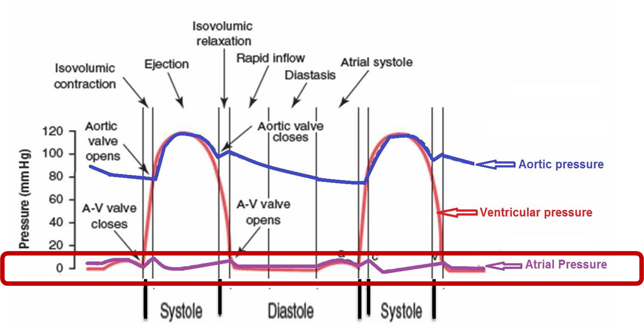
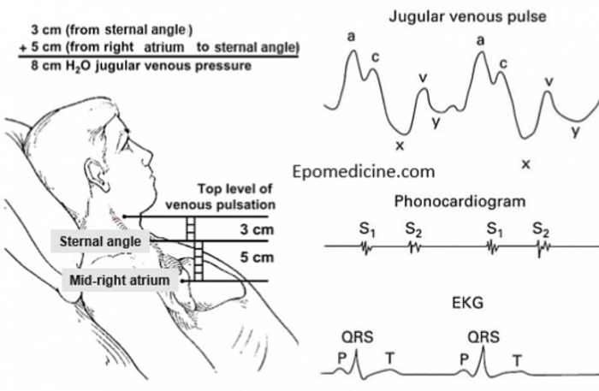
Atrial Pressure Changes During Cardiac Cycle
THE JUGULAR VENOUS PULSE (JVP)
JVP is the ‘’Atrial pressure’’
JVP ↑ in:
1. Rt. Sided heart failure
2. Fluid overload.

Slide 9
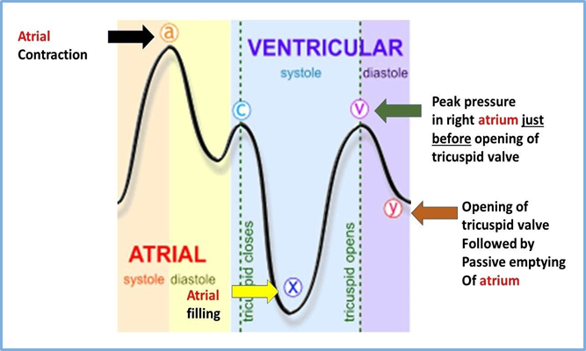
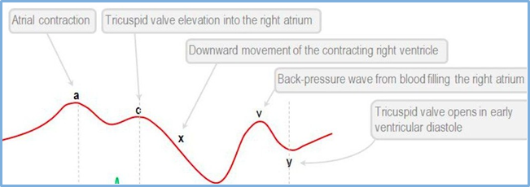
Normal pattern of the jugular venous pulse
(Atrial pressure changes during the cardiac cycle)
The normal JVP reflects phasic pressure changes in right atrial pressure (RAP) and consists of:
- Three positive waves (a, c, & v waves)
=( ↑atria pressure)
- Two negative descents (x&y waves)
= ( ↓atrial pressure).
These 3 waves are equal to:
ONE cardiac cycle = 0.8 sec
A: Atrial contraction
X: relaX
V: Volume
C: Closure
Y: the blood goes awaY

Slide 10
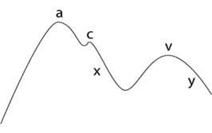
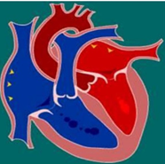
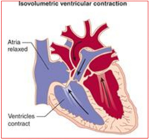
The waves
A wave | during Atrial systole | It represents the increase in right atrial pressure secondary to right atrial contraction occurring at the end of ventricular diastole.
C wave | during Ventricular systole | It represents the increase in right atrial pressure (+ve) as a result of bulging of AV valve into the atria (right atrium) during ‘isovolumetric contraction phase’. Or due to transmitted carotid pulsations. (bulging → ↓ atrial capacity → ↑ atrial pressure → ↑ JVP) team 39 -ve as a result of pulling of the atrial muscle & AV cusps down during ‘rapid ejection phase’, resulting in ↓ atrial pressure

Slide 11
X descent | during Ventricular systole | It represents the decrease in right atrial pressure due to atrial relaxation and downward displacement of tricuspid valve secondary to contraction of papillary muscles during ventricular systole (reduced ejection phase).
V wave | During atrial diastole | +ve: atrial pressure ↑ gradually due to continuous VR It represents the increase in right atrial pressure as it fills with blood returning from the great veins against a closed tricuspid valve during atrial diastole. -ve as a result of ↓ atrial pressure during ‘rapid filling phase’ “semilunar valves are closed during this wave”
Y descent | during Ventricular diastole | It represents the fall in right atrial pressure as blood flows out of the right atrium into the right ventricle upon opening of the tricuspid valve during the reduced filling phase.

Slide 12
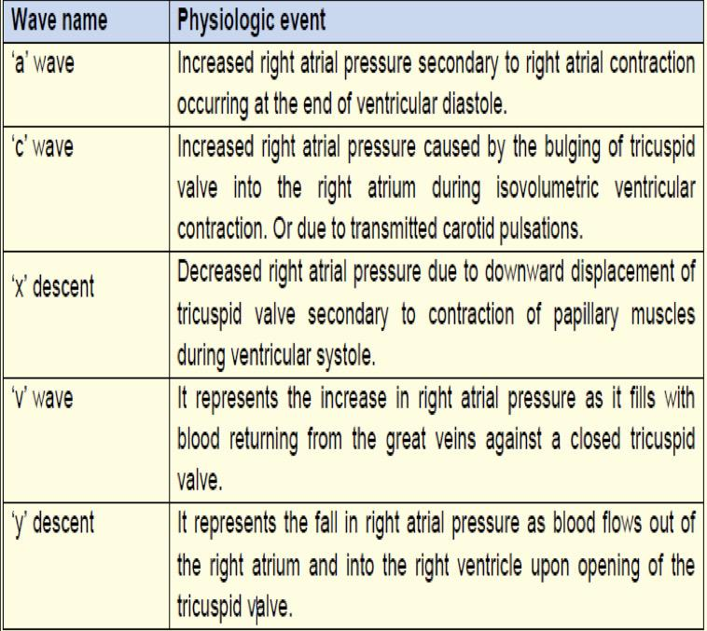
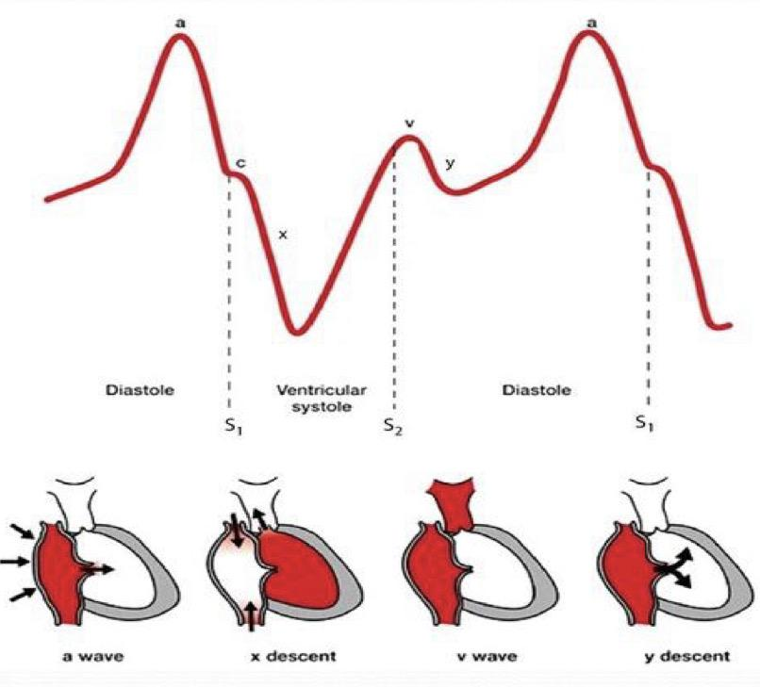
Summary: Causes of the Normal Waves of JVP
Girls’ Slides

Slide 13
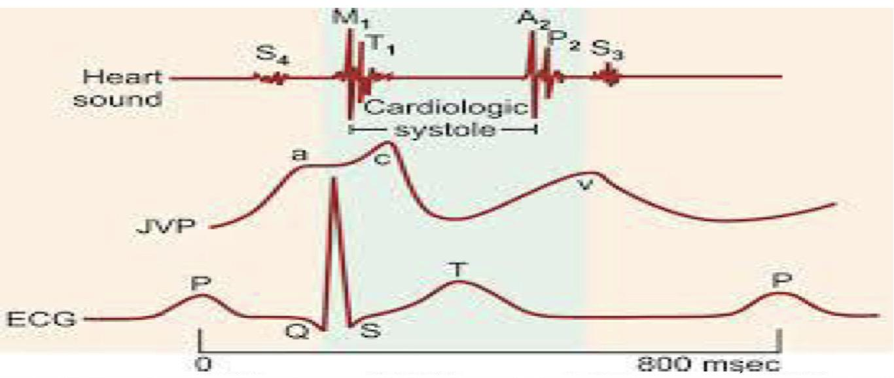
Correlation of JVP with ECG & Heart Sounds
Girls’ Slides
A simultaneous recording of the JVP and ECG shows the P wave in the ECG occurs just before the ‘a’ wave of JVP, thus showing atrial depolarization precedes the atrial contraction.
S1 occurs at the beginning of the ‘c’ wave
S2 occurs at the beginning of the ‘v’ wave

Slide 14
Abnormalities in Jugular Venous Pulse
Increased right ventricular filling pressure (↑ afterload on atria) e.g in heart failure, fluid overload (hypervolemia).
Obstruction of blood flow from the right atrium to the right ventricle e.g tricuspid stenosis, → cannon wave.
Superior vena caval obstruction e.g retrosternal thyroid goiter (enlargement of thyroid gland).
Positive intrathoracic pressure e.g pleural effusion, pneumothorax.
N.B: The JVP usually drops on inspiration along with intrathoracic pressure
(↓ intrathoracic pressure → ↓ JVP). normal condition.
Raised
JVP
Lowered JVP
● Hypovolemia (anything causing ↓ VR).

Slide 15
Abnormal “a” wave
very important
Elevated,Giant ‘a’ wave | Signifies increased right atrial pressure uniform, every beat | Right atrial (Ventricle) hypertrophy (↑ resist of filling) Tricuspid stenosis Decreased ventricular compliance (ventricular failure, pulmonary valve stenosis, or pulmonary hypertension)
Cannon ‘a’ wave | It occurs when the right atrial pressure becomes very high usually secondary to right atrial contraction against a closed tricuspid valve intermittent, various height | Atrial-ventricular asynchrony (atria contract against a closed tricuspid valve) Complete (AV) heart block (irregular) Following premature ventricular contraction( ventricular extrasystole) Ventricular tachycardia(regular) Ventricular pacemaker atrial flutter
Absent ‘a’ wave | The right atrial pressure does not increase due to failure of proper contraction | Atrial fibrillation or atrial flutter or TR

Slide 16
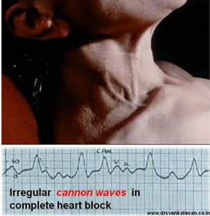
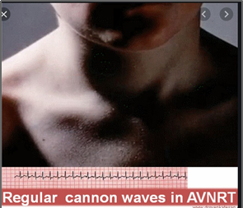
Cannon wave
Girls’ Slides
Regular
Irregular
occurs when atria and ventricular contractions occur nearly simultaneously (as in atrioventricular nodal reentrant tachycardia).
occur in complete heart block.

Slide 17
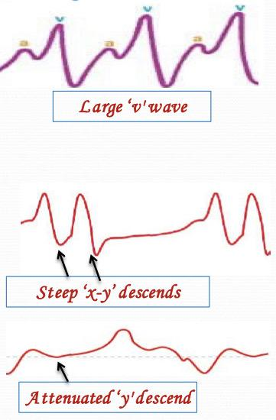
Abnormalities of Other Waves
Large ‘v' wave | Atrial septal defect Tricuspid regurgitation Constrictive pericarditis
‘c’ wave | Prominent in TR; absent in const.peric.
Diminished ‘v' wave | Hypovolaemia
Steep ‘x-y’ descends (Friedrich’s sign) | Constrictive pericarditis as it reduces elasticity of pericardial sac, raises AP and limiting ventricular filling in early diastole
Attenuated ‘y' descend, | Cardiac tamponade as it impedes ventricular filling
Girls’ Slides

Slide 18
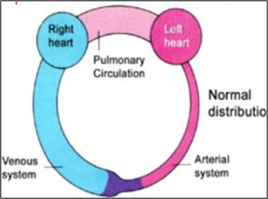
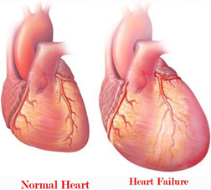
Heart Failure (HF)
Definition
It is the pathophysiological process in which the heart as a pump is unable to meet the metabolic requirements of the tissue for oxygen and substances despite the venous return to heart is either normal or increased.
So the heart might be receiving blood properly, but it can’t pump properly.team 39
How Fast Does Heart Failure Develop?
Usually a chronic disease so usually happens over time (chronic) but may happen all of a sudden (acute).
The heart tries to compensate for the loss in pumping function by:
Developing more muscle mass
Enlarging
Pumping faster
Heart failure can involve left or right side of the heart or both. (Congestive heart failure) CHF
Though each side of the heart can undergo failure separately, dysfunction of one side may lead to a sequence of events that make the opposite side also to fail.
Heart assumes a more spherical shape, enlargement of all 4 chambers.

Slide 19
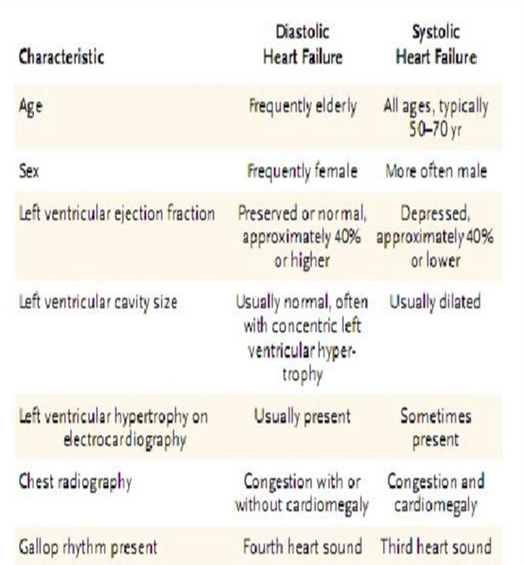
Heart Failure Causes
Boy’s Slides
HF is Manifested mainly by:
Inadequate cardiac output.
Build-up of blood in veins behind left heart or right heart (increased venous pressure).
1- Impaired cardiac function
Coronary heart disease
Cardiomyopathies (muscle disease)
Rheumatic fever
Endocarditis
Cardiac arrhythmias: e.g., complete heart block
2- Increased cardiac workload
Hypertension
Valvular disorders
Anemias
Congenital heart defects
3- Acute non-cardiac conditions
Volume overload
Hyperthyroidism, Fever, Infection

Slide 20
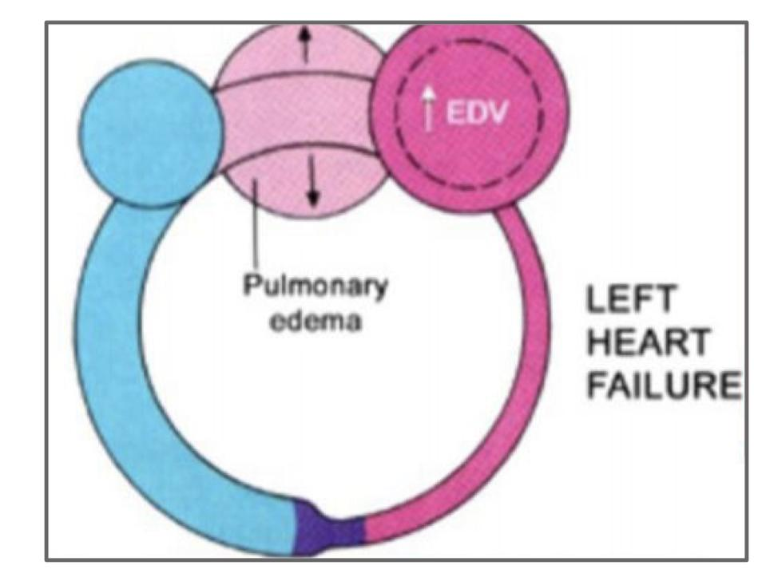
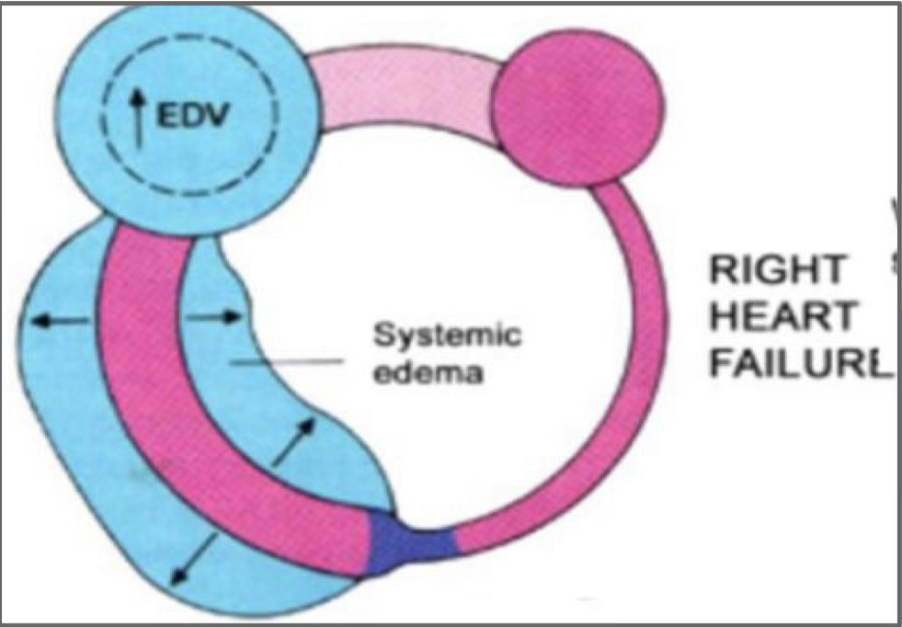
Left sided heart failure
Inadequate output of LV causing decreased CO to body and back pressure to the lungs (pulmonary edema).
The left side of the heart is usually where heart failure begins.
venous return (VR) from pulmonary circulation is not pumped out by the failing LV → blood accumulates in pulmonary circulation → ↑ the pulmonary capillary pressure→ the blood will leak→ pulmonary edema
Types of HF
Right sided heart failure
Inadequate output of RV causing decreased CO to lungs and back pressure to venous system (systemic edema).
It may occur alone but is usually a result of left-sided failure.
venous return (VR) from systemic circulation is not pumped out by the failing RV → blood accumulates in systemic circulation → ↑ the systemic capillary pressure → systemic edema

Slide 21
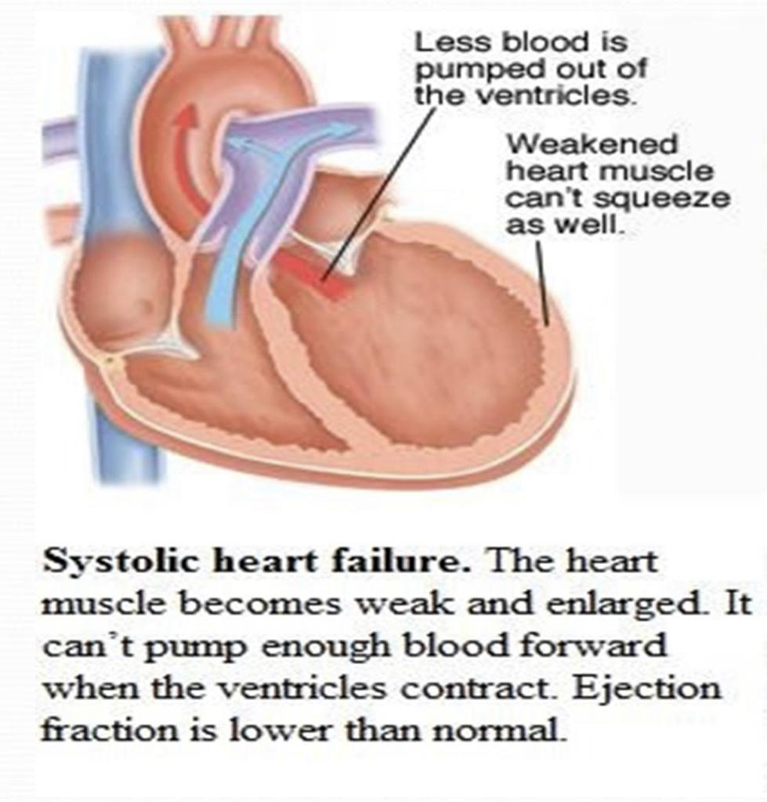
Congestive heart
Types of Heart Dysfunction that Leads To Hf
Systolic (or squeezing) heart failure
This is the most common cause of HF
The muscle of ventricle is weak and enlarged and loses some of its ability to contract or pump the amount of oxygenated and nutrient-filled blood the body needs into the circulation. N.B ejection fraction is lower than normal).
failure
Chronic left HF results in:
Secondary pulmonary hypertension
Pulmonary edema
right HF➔↑the systemic capillary → systemic edema . So having right & left HF in the same time .
Diastolic (or relaxation) heart failure
The heart loses its ability to relax because it becomes stiff. The walls of the heart thicken, and the size of the chamber may be normal or reduced.
As a result, the affected chamber cannot fill properly with blood during the rest period that occurs between each heartbeat. N.B Ejection fraction is often in normal range.

Slide 22
Causes of left Sided HF
Systolic Dysfunction
Diastolic Dysfunction
Impaired Contractility :
➔ Myocardial infarction
➔ Transient ischemia
(→fibrous tissue →can’t relax or contract)
➔ Chronic volume overload (hypervolemia).
➔ MR/AR (mitral/aortic regurgitation)
Increased Afterload :
➔ Uncontrolled HTN (prolonged hypertension).
➔ AS (Aortic Stenosis)
Obstruction of LV filling:
➔ MS mitral stenosis
➔ Pericardial constriction or tamponade
(blood or fluid in pericardial cavity → heart can’t relax & expand).
Impaired ventricular relaxation:
➔ Hypertrophic or restrictive cardiomyopathy (stiff).
➔ Transient ischemia
In both types, blood may “back up” in the lungs causing fluid to leak into the lungs (pulmonary edema).
Fluid may also build up in tissues throughout the body (edema).

Slide 23
Causes of right Sided HF
Cardiac Causes
Usually occurs as a result of left HF
Pulmonary stenosis
Right ventricular infarction
Pulmonary Vascular Disease
Pulmonary embolism
Pulmonary HTN
Right ventricular infarction
Pulmonary Parenchymal Disease
COPD
Interstitial lung disease
Chronic infections
Adult respiratory distress syndrome
COR PULMONALE: Right HF due to chronic lung disease

Slide 24
Acute vs Chronic Heart Failure
Sudden serious abnormalities of the heart (e.g., massive infarction, severe arrhythmias, valve rupture; sepsis) → acute heart failure (hour/days).
can be life threatening because the heart does not have time to undergo compensatory adaptations. [usually left-sided]
Cardiogenic shock develops following acute failure if the heart became unable to pump enough to even keep tissues alive.
Acute Heart Failure:
Chronic heart failure is a long-term condition (months/years).
It is associated with adaptive responses in the heart, ( Dilation hypertrophy).
which can be deleterious.
Chronic Heart Failure:

Slide 25
Compensatory Mechanism in CHF
1- ↓ firing of carotid sinus baroreceptor
→ ↑sympathetic stimulation
→ vasoconstriction of arterioles (increased afterload)
→ vasoconstriction of veins.
(increased preload).
→ ↑HR & force of contractility.
→ ↑CO &↑BP.
ANP and BNP (Atrial natriuretic peptide & Brain natriuretic peptide) are major antagonizing agents of the renin– angiotensin- aldosterone system. (will be discussed in Endocrine Block).
2- ↓renal perfusion → Activation of renin– angiotensin-aldosterone system → retention of extra salt & water by kidney .
(angiotensin→ vasoconstriction) (aldosterone→ NA & water retention).
3- ↓effective circulating blood volume → posterior pituitary releases ADH (vasopressin) → ↑H2O reabsorption.

Slide 26
Compensatory measures in heart failure
↓ blood flow\bp→ ↓ O2→ ↓Firing of carotid baroreceptors ↑Sympathetic
firing
↓CO → ↓ blood flow to the kidney → Retention of extra salt & water by kidney
↑Blood Volume
↑Heart contractility
↑Stroke volume
↑EDV

Slide 27
Complications of progressive heart failure:
Factors contributing to decompensation
Prolonged sympathetic activation to the heart: down regulation of the myocardial adrenergic receptors → ↓ the myocardial adrenergic receptors density and sensitivity to catecholamines. Consequently, the inotropic and chronotropic responses of the heart cannot be elevated in parallel to increased body requirements.
Vasoconstriction of the arterioles (under enhanced sympathetic activity): This increases resistance , thus the cardiac afterload. peripheral resistance is determined by arterioles
Hypertrophied heart : → imbalance between the O2 supply and need → deterioration of the ability to generate force (Hypertrophied heart needs more O2 & because of heart failure CO to the heart is less than normal)
Excessive salt and water retention.
Over-distended ventricle (↑diameter): Has to consume more energy and generate more wall tension to develop the required ejection pressure (Laplace low ).

Slide 28
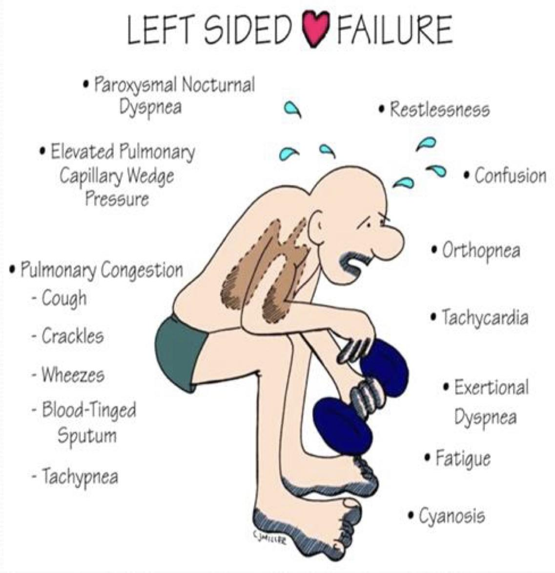
Clinical Picture of HF
Increased filling Poor Cardiac pressures
Congestion
Poor Cardiac Output Poor perfusion
1- Fatigue (↓ blood flow to muscles). 2-Ascites (accumulation of fluid in the abdomen as a result of systemic congestion).
3- Enlarged liver & spleen. 4-Distended (elevated) jugular veins. 5-Anorexia & complaints of GI distress(↓ blood flow to GIT). 6-Swelling of hands & Feet. 7-Dependent edema.(pitting edema).
Clinical picture of right sided heart failure
Pitting edema
1- Tachypnea (↑ rate of respiration), shortness of breath (dyspnea).
2-Orthopnea: dyspnea that occurs when lying flat, causing the person to have to sleep propped up in bed or sitting in a chair. (due to pulmonary edema)
3-Paroxysmal nocturnal dyspnea: attacks of severe shortness of breath and coughing at night. It usually awakens the person from sleep, and may be quite frightening.
4-Cough, rales (crackles), wheezing, blood tinged sputum, due to pulmonary edema(Congestion)
5-Restlessness, confusion and fatigue.
6-Pallor, cyanosis. 7-Tachycardia (compensatory mechanism).
8-exertional pain
Clinical picture of Left sided heart failure

Slide 29
Comparison between clinical picture of right & left sided HF
Clinical Picture
Left sided Failure
Right sided Failure
Pitting edema (hands & legs)
Mild to moderate
Moderate to severe
Fluid retention
Pulmonary edema (fluid in lungs). And pleural effusion (fluid in the pleural cavity)
Abdomen (ascites)
Organ enlargement
Heart
Liver, mild jaundice may be present
Neck Veins
Mild to moderate elevation of JVP
Severe elevation in JVP, Why? because it’s directly connected. Neck veins are visibly distended
Shortness of Breath
Prominent dyspnea. Paroxysmal nocturnal dyspnea and orthopnea.
Dyspnea is present but not as prominent
GIT symptoms: loss of appetite, bloating, constipation.
Present but not as prominent as in right-sided failure
Significantly more prominent than in left-sided failure

Slide 30
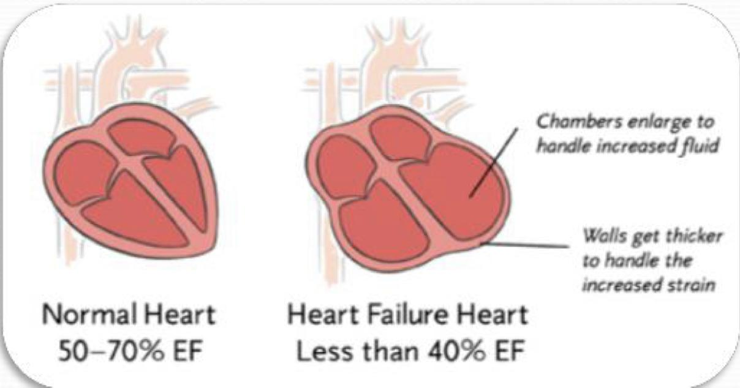
How heart failure is diagnosed?
A Key Indicator for Diagnosing Heart Failure Ejection Fraction (EF)
Medical history is taken to reveal symptoms
Tests
Chest X-ray.
Electrical tracing of heart (ECG).
Ultrasound of heart (Echocardiogram or ”Echo”).
X-ray of the inside of blood vessels (Angiogram).
Blood tests
Physical Examination
Ejection Fraction (EF):is the percentage of blood that is pumped out of the ventricle during each beat. If it is less than 50% then it’s heart failure. What mechanism is used to measure EF? Fractional Shortening
Fractional Shortening: one of the most basic measures in adult functional echocardiography. It simply looks at the degree of shortening of the left ventricular diameter between end-diastole and end-systole. It’s simply the difference between the most dilated state and most contracted state of the heart, the higher it is the better it is.

Slide 31
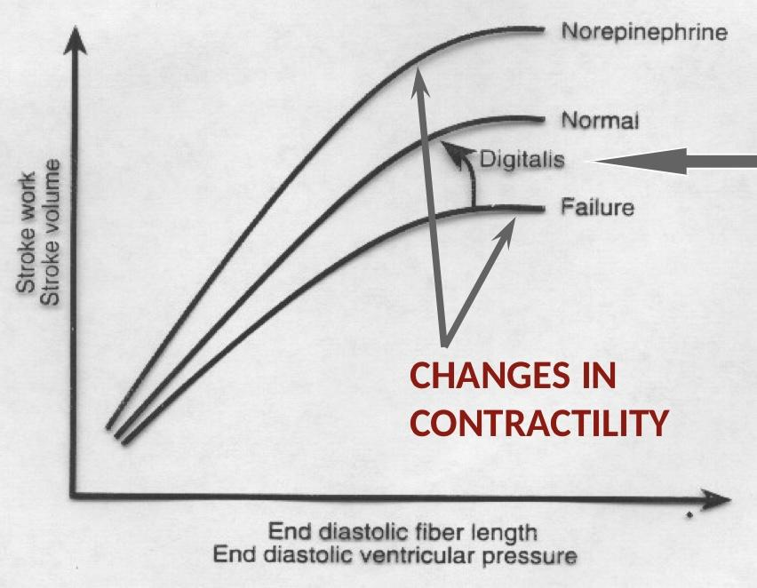
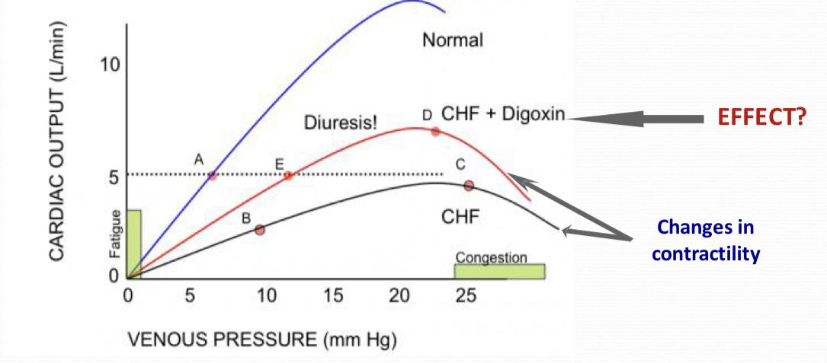
Treatment of Cardiac Failure
Reduction of salt & water retention.(which will decrease preload).
Aims at
↑In the pumping activity of failing heart
Diuretics
★ Digitalis improves pumping activity of heart by increasing cytosolic Ca++
Digitalis
Effects of congestive heart failure & digoxin on Frank-starling curve
Effect?

Slide 32
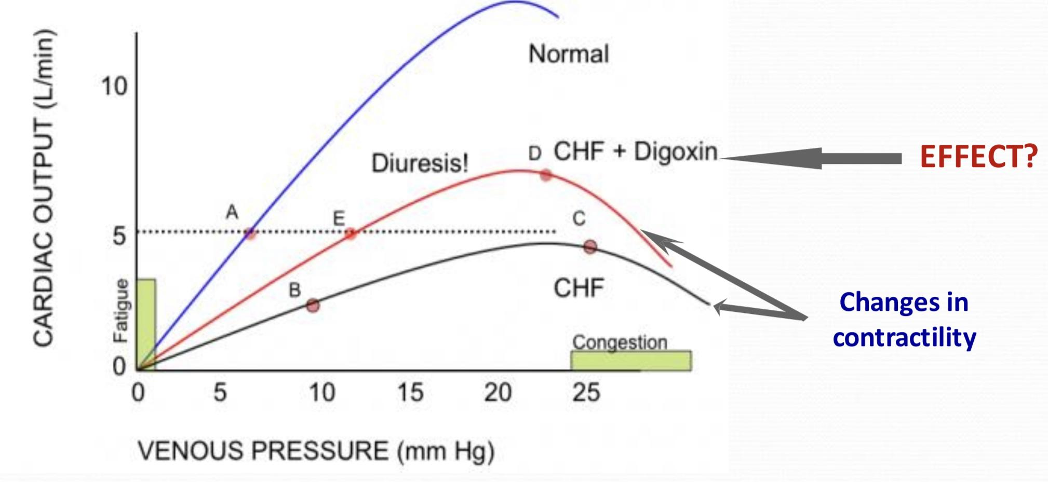
Special Thanks to med439
Digitalis (Digoxin): will shift the curve to the left and up.
Explanation: Effect of heart failure and digoxin on the Frank-Starling relationship. The normal set point required to maintain adequate tissue perfusion is a cardiac output of 5 L/min. During heart failure, the relationship between cardiac output and venous pressure becomes shifted down and to the right (patient moves from point A to B). Sympathetic activation and increased fluid retention result in an increased venous pressure (preload) which acts to increase cardiac output by increasing the stretch of cardiac fibers (patient moves from B to C). If cardiac output remains below 5 L/min, the kidney continues to retain fluid, and venous pressure continues to rise, until either a 5 L/min cardiac output is achieved, or the patient “drowns in their own fluids” (e.g. due to pulmonary congestion).Digoxin can shift the curve upwards and to the left by a mechanism different from sympathetic stimulation (so that the patient ideally moves from point C to D). The resulting increase in blood flow to the kidney results in a diuresis (patient moves from D to E) with an associated reduction in venous pressure due to reduced venous volume.
Mechanism of action: Digoxin exerts its positive inotropic action primarily by binding to and inhibiting the Na/K ATPase in cardiac cell membranes. The Na/K ATPase enzyme acts as a pump for the outward transport of Na+ in exchange for the inward transport of K+. The Na/K ATPase contains a receptor for digitalis glycosides, as well as for intracellular Na+ and extracellular K+. Digoxin's inhibition of the Na/K pump results in an increase in intracellular [Na]. Due to the presence of a Na/Ca antiporter, a rise in intracellular [Na+] also results in a rise in a consequent rise in intracellular [Ca2+] (see Figure X). Most of this rise in [Ca2+] is taken up into the sarcoplasmic reticulum (SR), and then released into the cytoplasm upon stimulation by an action potential. This larger Ca release.

Slide 33
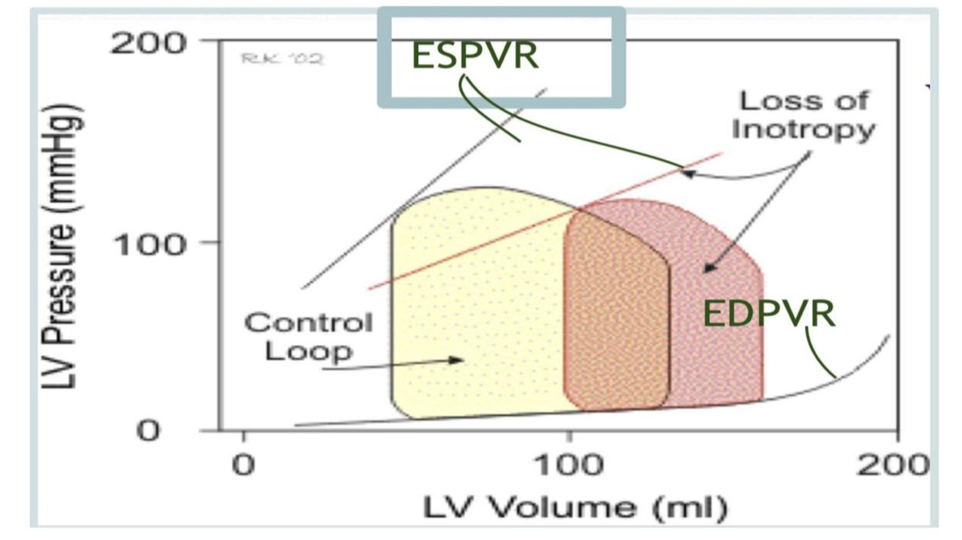
Effects of left ventricular systolic failure on left ventricular pressure volume loop :
Girls’ Slides
↓Slope of End-systolic pressure- volume relationship (ESPVR) I.e.↑ESV compensatory rise in preload sense the ventricle is not pumping well there will be more blood left ↑EDV
↓SV, because the ventricle is not pumping properly
↓EF
↓external Work (work done by the heart) (not CO)
↑EDP, because the EDV has increased.
Heart rate is unchanged.
remember PV loop from cardiac cycle? work → shaded area

Slide 34
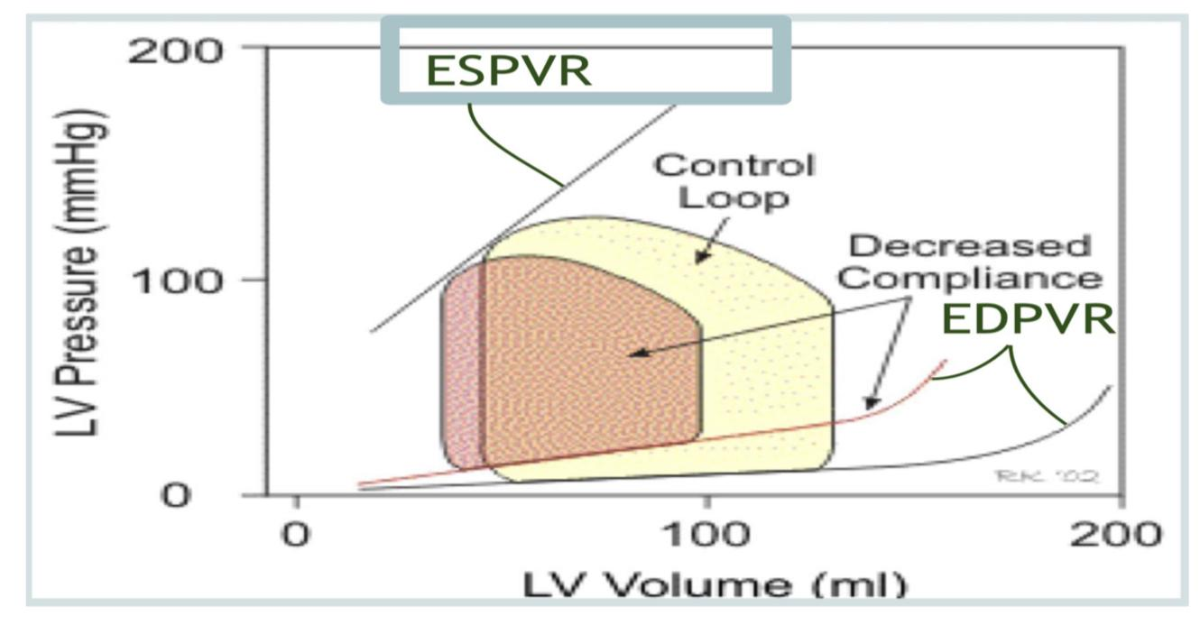
Effects of left ventricular diastolic failure on left ventricular pressure volume loop:
Girls’ Slides
↓Ventricular compliance/ relaxation (lusitropy). ↓EDV ↓SV ↓or no change in EF ↓ external Work ↑EDP ↑ slope End-systolic pressure- volume relationship (ESPVR) Heart rate, inotropy and systemic vascular resistance are unchanged.

Slide 35
MCQs
Q1: IJV is anatomically closer to ?
A- LA | B- RA | C- RV | D- LV
Q2: in right sided HF which organ is enlarged ?
A- kidney | B- heart | C- spleen | D- lung
Q3: Heart failure can involve:
A- Left side only | B-Right side only | C-Both L&R | D- /
Q4: Effect of left ventricular diastolic failure on left ventricular pressure volume loop ?
A- ↑EDP | B- ↑EDV | C- ↑EF | D- ↑SV
Q5: Absent ‘a’ wave is an indication of:
A- RH failure | B-Tricuspid stenosis | C- Atrial fibrillation | D- valves stenosis
Answers: 1.B 2.C 3.C 4.A 5.C

Slide 36
SAQs
Q1: mention the Types of Heart Dysfunction that Leads To Hf and the difference between them ?
Slide 19
Q2: mention 5 ways to diagnose heart failure ?
Medical history , Physical Examination , ECG , Angiogram , Chest X-ray.
Q3: define heart failure?
It is the pathophysiological process in which the heart as a pump is unable to meet the metabolic requirements of the tissue for oxygen and substances despite the venous return to heart is either normal or increased.

Slide 37
Team Leaders
THANK YOU
● Saleh aldeligan
● Qusai Alsultan
● Raghad Alkhudair
● Raghad Alnadeef
Team Members
Othman Aldraihem
Abdulaziz Alqahtani
Abdullah Alshahri
Saad Al Hammad
MOHAMMED ALDAWSARI
Ahmad Almarshed
Rayan Alahmari
ABDULRAHMAN BINBAKHIT
Abdulaziz Alymni
Faisal Alkhunein
Abdullah Alqarni
Raid Almadi
Mohammad Alrashed
Abdulrahman bin Ateeq
Amer Alghamdi
Mishal Alsuwayegh
Nawaf alturki
Hussam Aleid
Raid almadi
Mohammed AlShehri
● Nouf Aldhalaan
● Amani Alotaibi
● Shahed bukhari
● Shahad Aljeri
● Maha Alkoryshy
● Alhnouf Hadi
● Mayssam Aljaloud
● Hissa Alshiqari
● Mashael Albugami
● Renad Alayidh
● Ghada Binslmah
● Razan Alsulami
● Shaden albassam
● Razan Almanjomi
● Reem Alhazmi
● Dhai hamdan
● Shahad alaskar
● Haifa Almuddahi
● Reema alquraini
● deema aljuribah
● Kadi Khalid aldossari
● Farah alhalafi
Theme was done by Mohammad Alrashed
Physio442@gmail.com
Editing File

