Slide 1
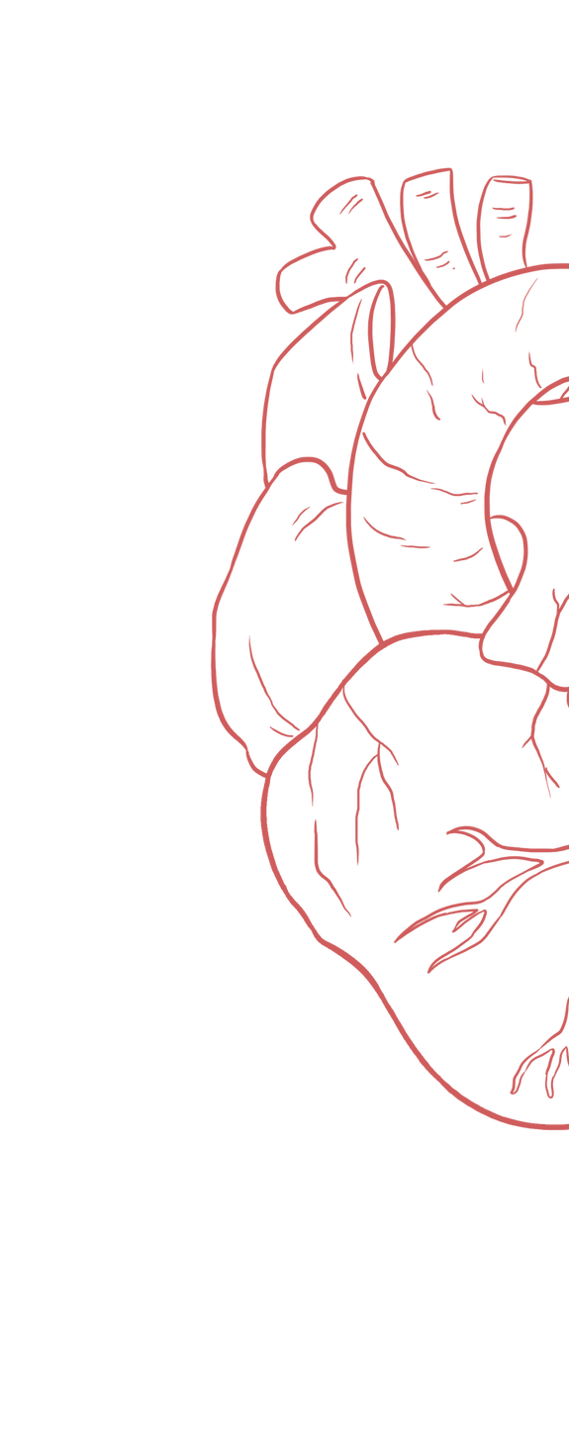
Venous Return & Factors Affecting It
____________
Color Index:
Main Text
Important
Girl’s Slides
Boy’s Slides
Dr’s Notes
Extra Info

Slide 2
Objectives
Discuss functions of the veins as blood reservoirs.
Know the pressure variations in systemic blood vessels
Define venous return, mean circulatory filling pressure and right atrial pressure
Describe measurement of central venous pressure (CVP) and state its
physiological and clinical significance.
Describe vascular and cardiac function curves under physiological and pathophysiological conditions.
State determinants of venous return and explain how they influence it:-
1- Pressure gradient 2- Blood volume 3- Vascular capacity 4- Sympathetic activity
5-Total peripheral resistance 6- Venous valves 7- Skeletal muscle pumps.
8- Respiratory activity 9- Gravity and explain the pathophysiology of varicose veins

Slide 3
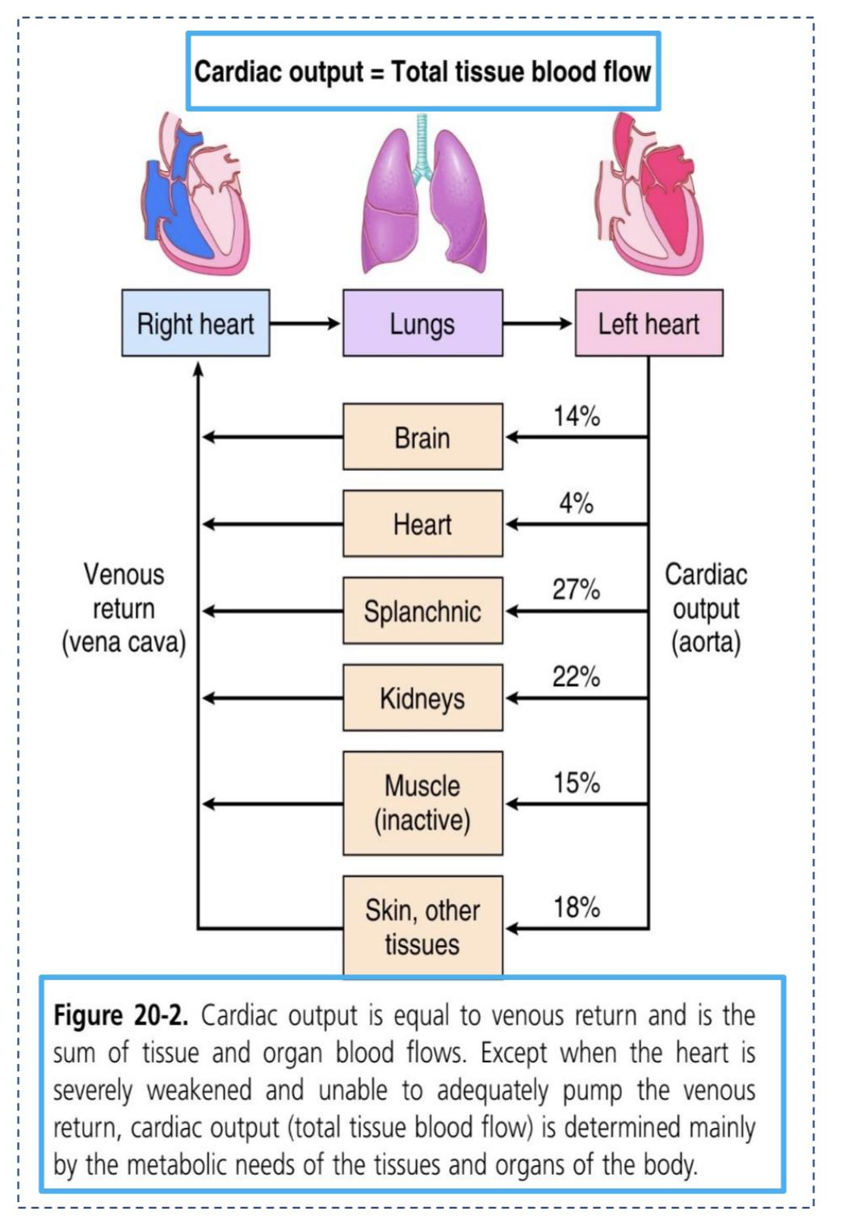
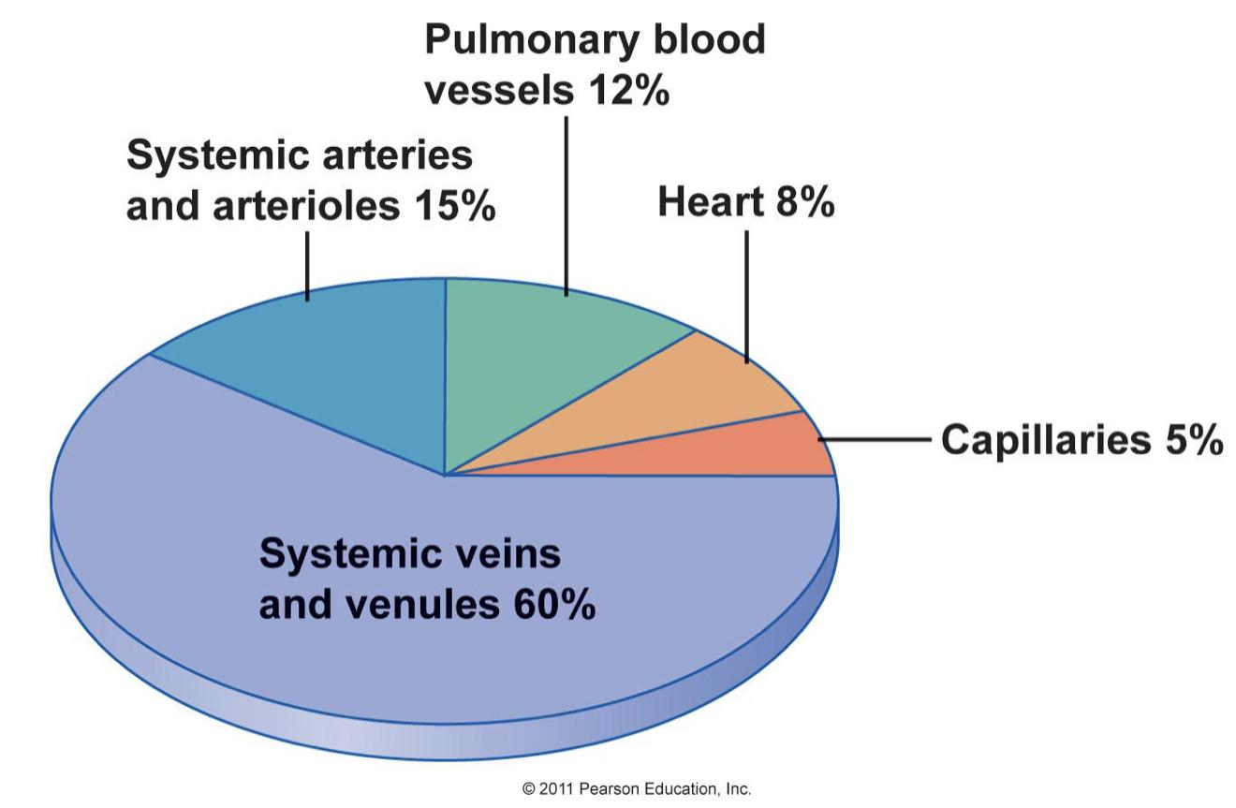
Cardiac Output = Total Tissue Blood Flow
What about veins?
Veins hold most of blood in body (70%).
They are called capacitance vessels.
They have thin walls & stretch easily to accommodate more blood without increased pressure (= higher compliance).
They have only 0 -10 mm Hg pressure.

Slide 4
Veins Are Blood Reservoirs
When the body is at rest and many of the capillaries are closed, the capacity of
the venous reservoir is increased as extra blood bypasses the capillaries and
enters the veins.
When this extra volume of blood stretches the veins (without significant change in
pressure due to venodilation), the blood moves forward through the veins more
slowly because the total cross sectional area of the veins has increased as a
result of the stretching. Therefore, blood spends more time in the veins.
When the stored blood is needed, (such as during exercise), extrinsic factors
reduce the capacity of the venous reservoir and drive the extra blood from the
veins to the heart so that it can be pumped to the tissues.

Slide 5
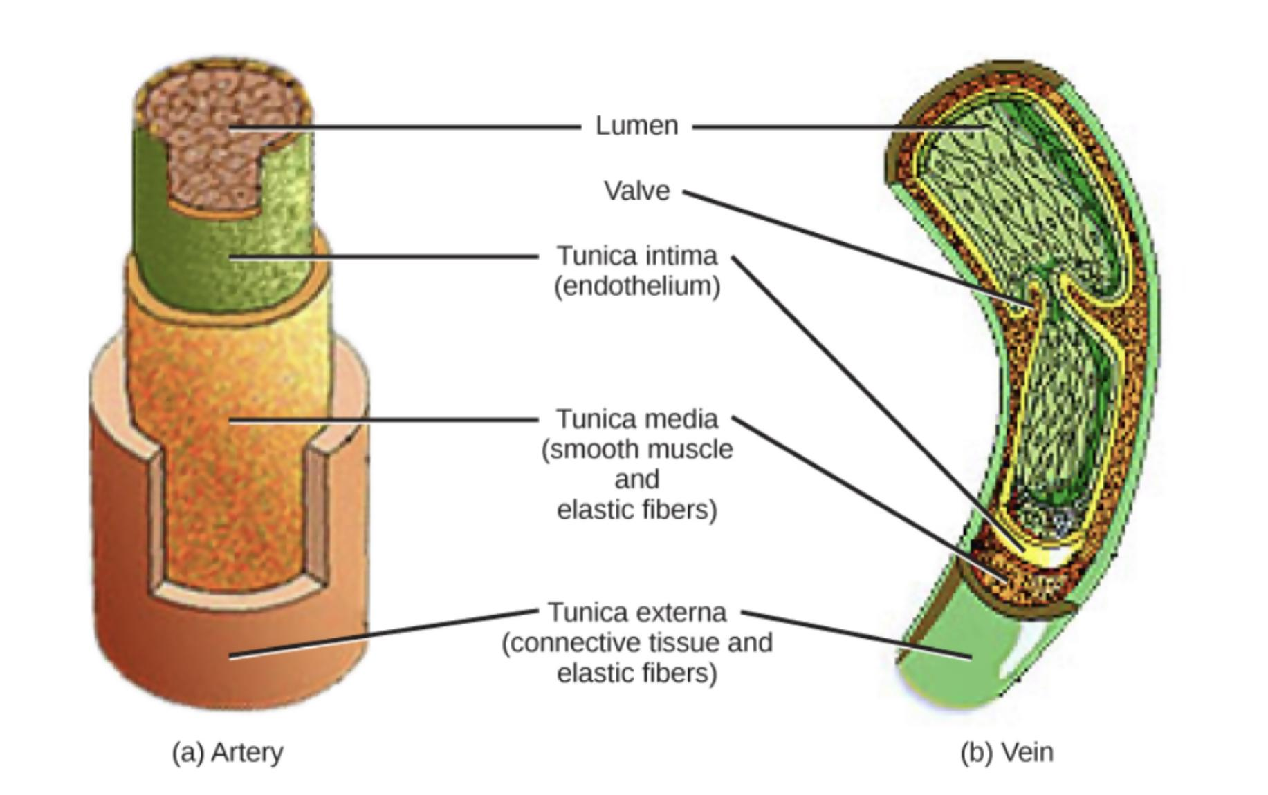
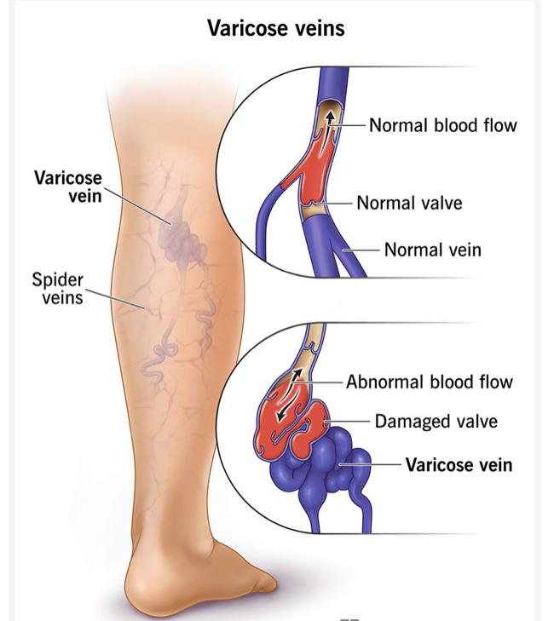
Structures of Veins
All 3 layers of veins are present:
tunica adventitia
tunica media
tunica intima
layers in veins are thinner than in arteries of corresponding size (external diameter)
Veins have paired semilunar, bicuspid valves to restrict backflow in lower extremities.
Varicose veins; Chronically raised pressure in the veins leads to pathological distention of the veins.
Or failure of the valves causing venous wall to expand
Venous ulcer; Increased capillary filtration leads to swelling (edema) with trophic skin changes and ulceration.

Slide 6
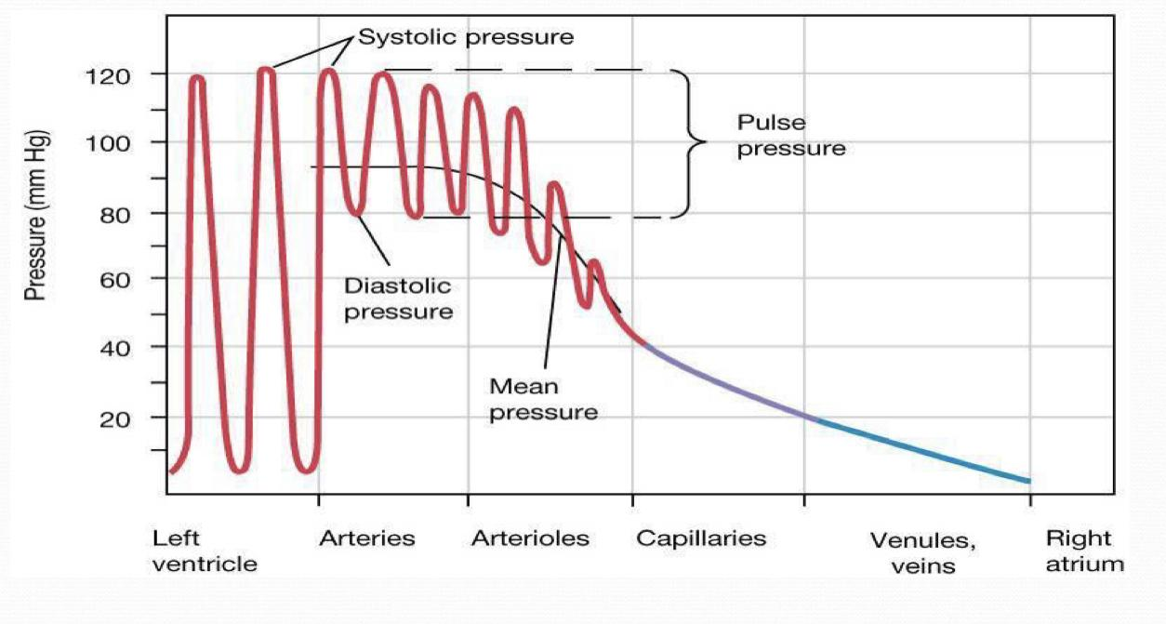
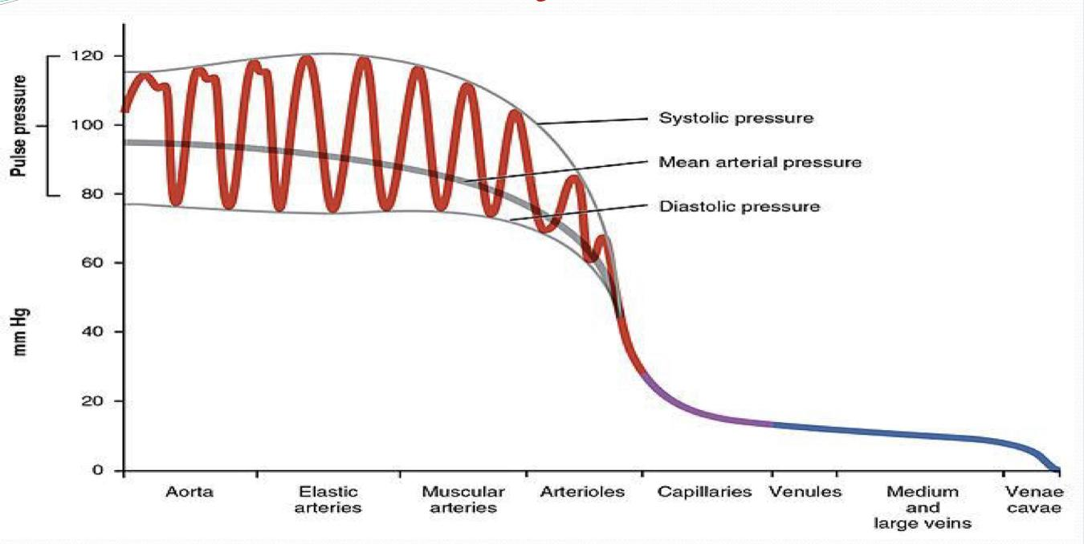
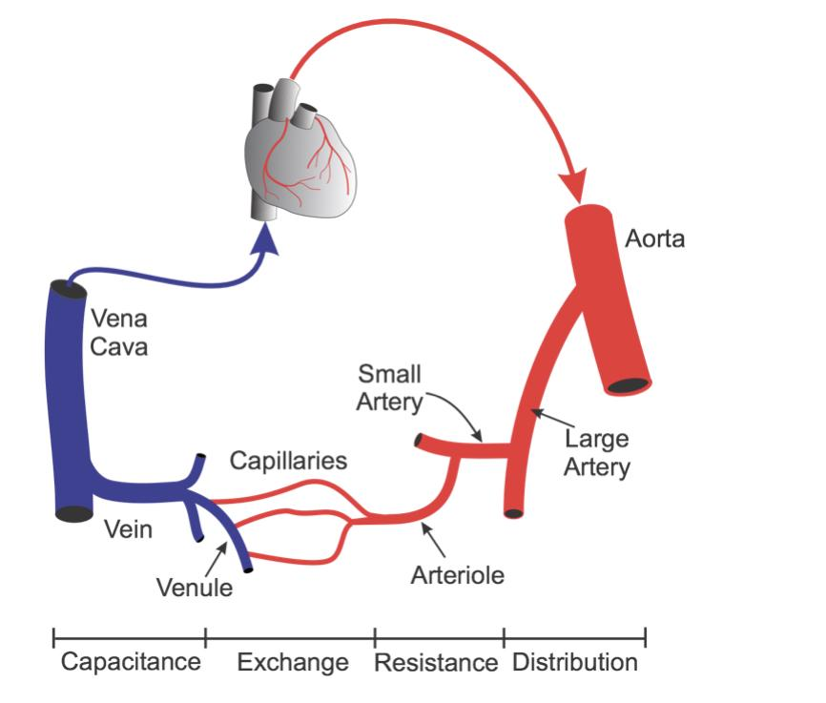
Systemic circulation
Pressure Variations in Systemic Blood Vessels
Arterioles
Arterioles
(resistance vessels) offer maximum
resistance.
Capillaries
(exchange vessels) are responsible
for gas exchange between blood and tissues but offer minimum resistance.
Veins
(capacitance vessels) are responsible for accommodating blood when needed during blood loss.

Slide 7
VENOUS RETURN -VR-
Lungs
Venous return (VR) is the flow of blood from the periphery to the heart (Rt atrium)
Pulmonary circulation
Normally VR must equal CO when averaged over time because the CVS is essentially a closed loop. Otherwise, blood would accumulate in either the systemic or pulmonary circulations.
Rt.A
Lt.A
Rt.V
Lt.V
VR is determined by the difference between the
venous pressure nearest to the tissues (mean
circulatory pressure; MCP) and the venous
pressure nearest to the heart (CVP).
Systemic circulation
Body
VR = MCP ─ CVP

Slide 8
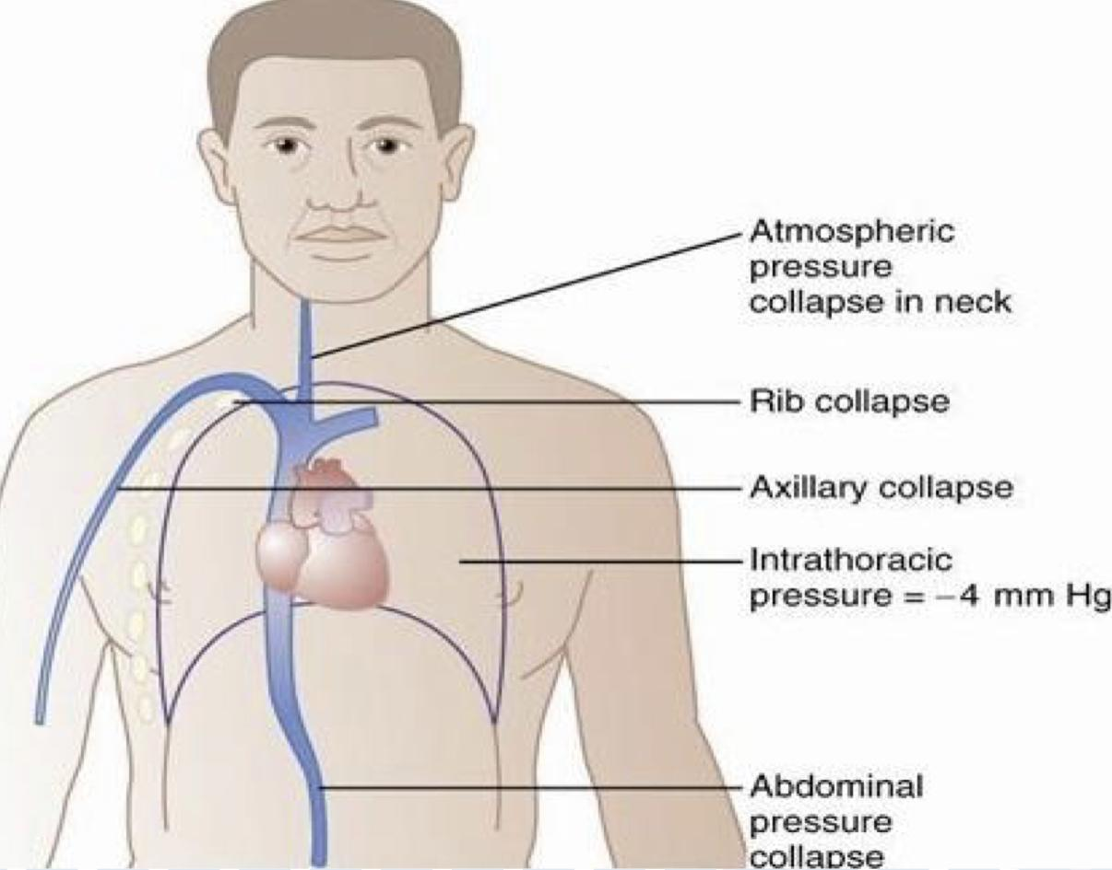
Central Venous Pressure -CVP-
CVP: is the pressure in the right atrium and the big veins of thorax (right atrial pressure (RAP) = jugular venous pressure)
CVP is measured with a catheter inserted in SVC. (superior vena cava)
The normal range of the CVP = 0 - 4 mm Hg.
It is the force responsible for cardiac filling.
CVP is used clinically to assess hypovolemia and during IV transfusion to avoid volume overloading.
CVP is raised in right-sided heart failure.
CVP is increased with hypervolemia and decreased with hypovolemia

Slide 9
Mean Circulatory Pressure (MCP)
Mean Systemic Filling Pressure (PSF)
↓Blood volume ↓MCP
↑Blood volume ↑MCP
Venoconstriction ↑MCP
Venodilation ↓MCP
What’s Mean Circulatory Pressure (MCP)?
03
It is the pressure nearest to the tissues and is about 7 mm Hg.
The value for right atrial pressure at which venous return is zero is called the mean systemic filling pressure.
01
02
It is affected by:
Blood volume: it is directly proportional to blood volume.
Venous capacity: it is inversely proportional to the venous capacity.

Slide 10
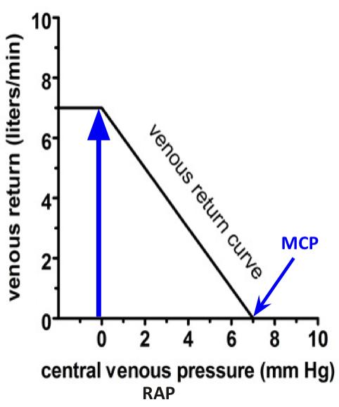
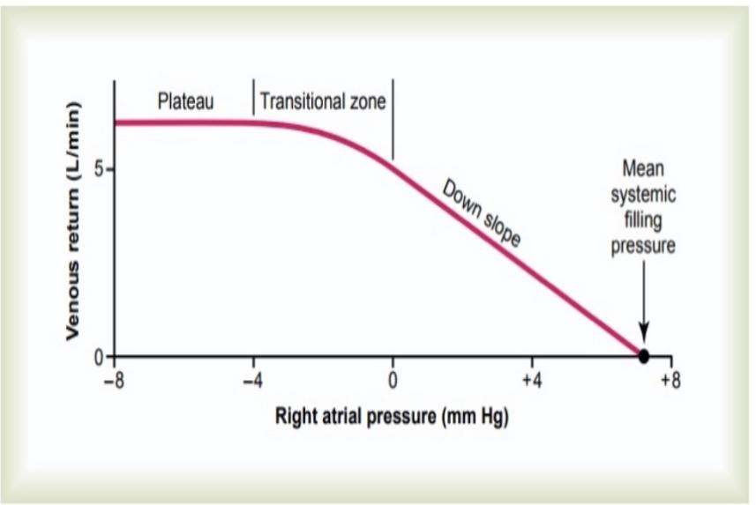
The Venous Return Curve
-The Vascular Function Curve -
There is an inverse relationship between venous return and right atrial pressure (RAP).
Venous return back to the heart, like all blood flow, is driven by a pressure gradient. The lower the pressure in the right atrium, the higher the pressure gradient the greater the venous return.
Thus as RAP increases, this pressure gradient decreases and venous return also decreases.
The knee (flat portion) of the vascular function curve occurs at negative values of RAP. At such negative values, the veins collapse & impedes VR inspite of high pressure gradient.
The curve relates VR To Right Atrial Pressure (RAP).
For example if VR is zero and RAP is at it shighest value, Psf =7 mm Hg).
Mean systemic filling pressure (Psf) is the point at which the vascular function curve intersects the X-axis

Slide 11
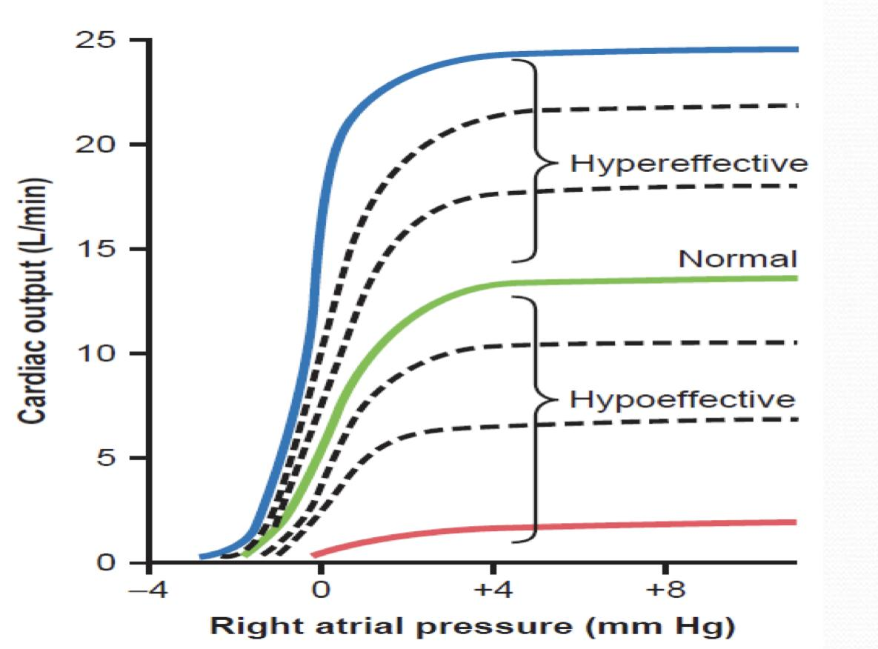
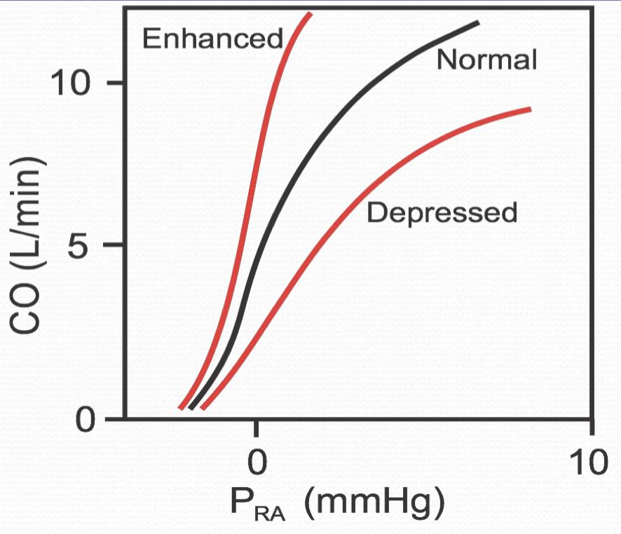
Effect of RAP Changes on Cardiac Function Curve
Cardiac Function Curve
Relates CO to RAP
Girls’ Slides
When the mean RAP is about 0 mmHg, the CO in an adult is about 5 L/min.
Normally, Rt atrial pressure (RAP) fluctuates with atrial contraction and respiration.
Because of the steepness of the cardiac function curve, very small changes in RAP (just a few mmHg), can lead to large changes in cardiac output.
It relates pumping of blood by the heart to RAP

Slide 12
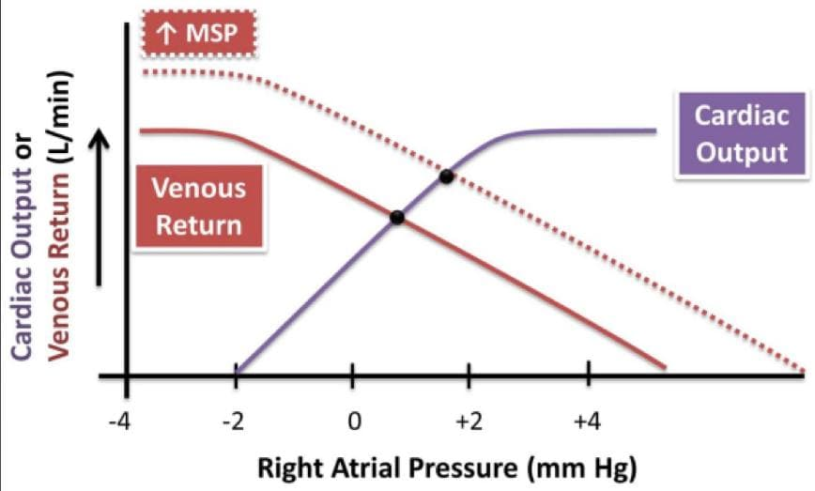
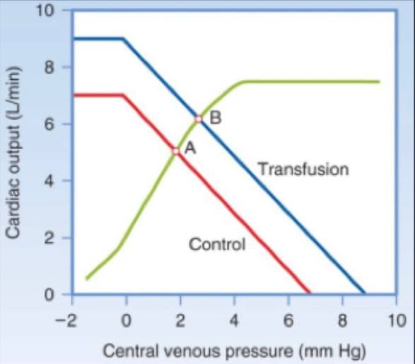
Combining cardiac and vascular function curves
Effects of changes in blood volume
Boys’ slides
Increases in blood volume as a result of transfusion of a large fluid volume into the circulation increase the amount of blood in the stressed volume and, therefore, increase the mean systemic pressure.
This results in shifting of the vascular function curve to the right.
هنا يكون التأثير على زيادة كمية الدم في الجسم
The cardiac function is not altered with changes in blood volume.
In the new steady state, the cardiac and vascular function curves intersect at a new point at which venous return and the cardiac output are increased. The RAP is increased.

Slide 13
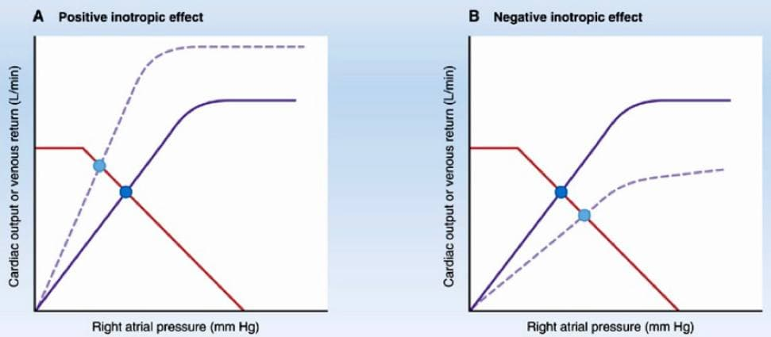
Combining cardiac and vascular function curves
Inotropic effects
Boys’ slides
Positive inotropic agents produce an increase in contractility, an increase in stroke volume, and an increase in cardiac output for any level of RAP. Thus, the cardiac function curve shifts upward (counter-clockwise), but the vascular function curve is unaffected.
Thus, there will be substantial increases in the cardiac output and venous return , while the RAP is decreased.
The opposite is true with negative inotropic agents.
هنا يكون التأثير على عملية الضخ الدم في القلب

Slide 14
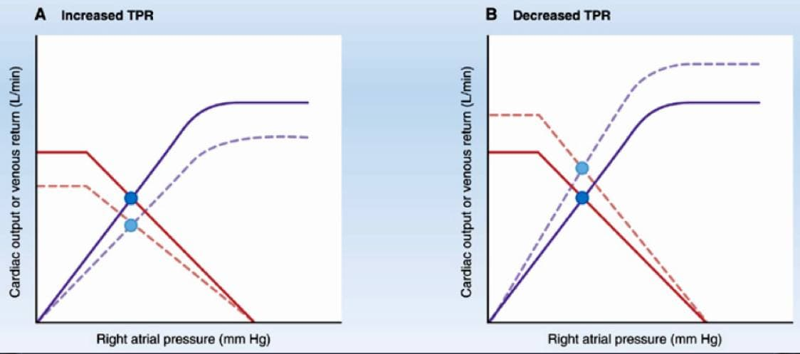
Combining cardiac and vascular function curves
Effects of changes in TPR total peripheral resistance
Boys’ slides
هنا يكون التأثير على ضخ الدم في القلب مع زيادة الدم الراجع للقلب
Changes in TPR alter both curves. The cardiac function curve changes because of a change in afterload
(arterial blood pressure), and the vascular function curve changes because of a change in venous return.
With increased TPR, there is a substantial decrease in the cardiac output and venous return with almost no
change in the RAP. The opposite is true when the TPR is decreased.

Slide 15
Basic Principles
Girls’ Slides
Flow of any fluid (blood) through a tube (vessel) depends on.
The pressure difference between the two ends (Pressure gradient).
The resistance to blood flow through the vessel
Controlled by the diameter of the vessel
Blood flows from high pressure to low pressure.

Slide 16
Determinants of venous return
Gravity
Venous Valves
Pressure gradient
venous return
Blood volume
Skeletal muscle Activity
Venous Capacity
Total Peripheral Resistance
Sympathetic activity
Thoracic Pump

Slide 17
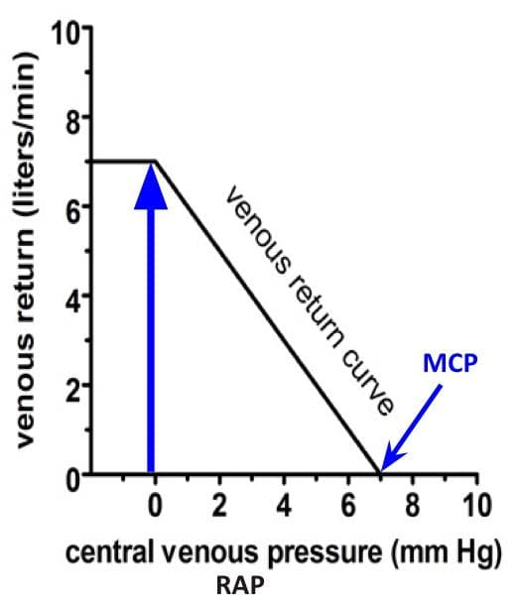
Determinants of venous return
1-Pressure gradient
VR back to the heart is driven by a pressure gradient. VR= MCP - RAP (CVP)
There is an inverse relationship between venous return and right atrial pressure (RAP).
Venous return-Vascular function curve:
Venous return back to the heart, like all blood flow, is driven by a pressure gradient. The lower the pressure in the right atrium, the higher the pressure gradient the greater the venous return.
Thus as RAP ↑, pressure gradient ↓ and VR also ↓.
The knee (flat portion) of the vascular function curve occurs at negative values of RAP. At such negative values, the veins collapse & impedes VR in spite of high pressure gradient.

Slide 18
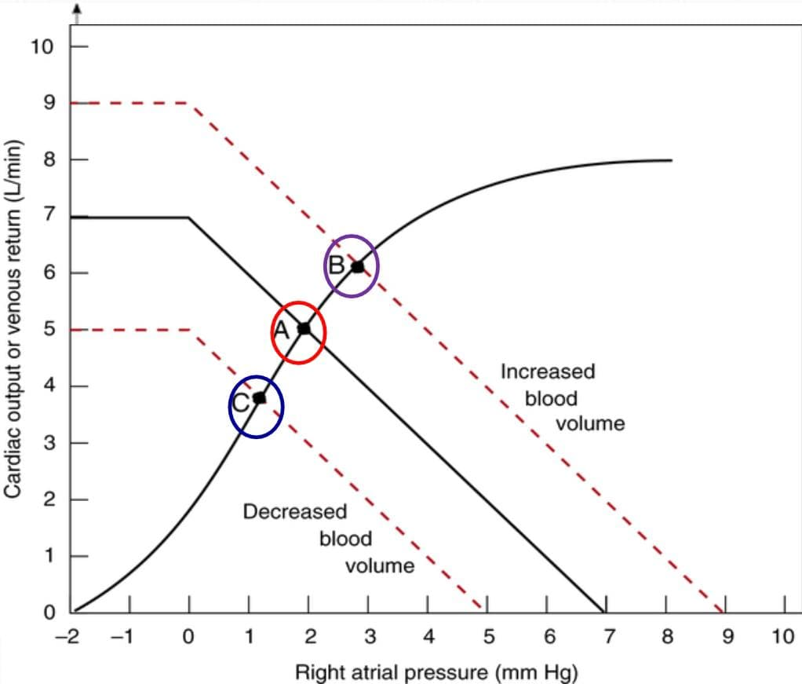
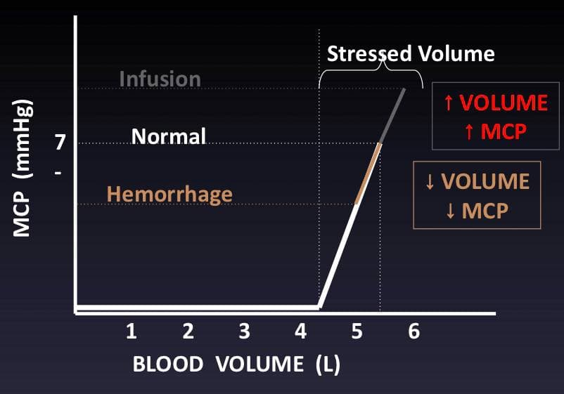
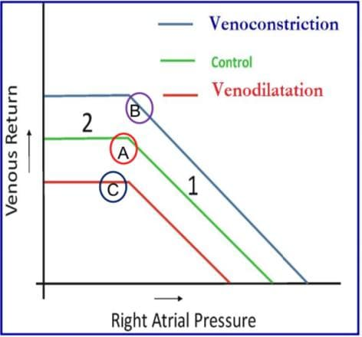
Determinants of venous return
MCP(Mean Systemic filling pressure)
VR(Venous Return)
2-Blood volume:
At a constant venous capacity:
As the blood volume increase the MCP and VR increase and point shift upward and to the right (point B).
As it decrease the MCP and VR decrease and point shift downward and to the left (point C)
3-Venous capacity: is the volume of the blood that the veins can accommodate.
At a constant blood volume:
as the venous capacity increase the → MCP and VR decrease and point shift downward to the left (point C).
As the venous capacity decrease → MCP and VR increase and point shift upward to the right (point B)

Slide 19
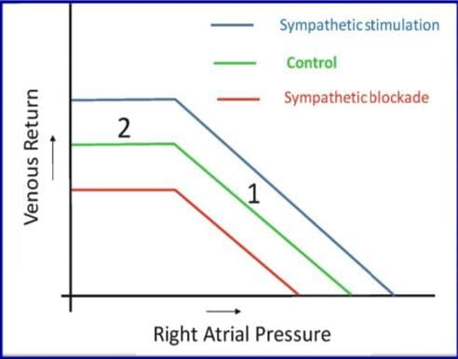
Determinants of venous return
4-Sympathetic activity
Venous smooth muscle is profusely supplied with sympathetic nerve fibers.
Sympathetic stimulation → venoconstriction → decreased venous capacity→ modest increase in mean systemic filling pressure (MCP) → increase in the VR
The veins normally have such a large diameter that the moderate vasoconstriction accompanying sympathetic stimulation has little effect on resistance to flow.

Slide 20
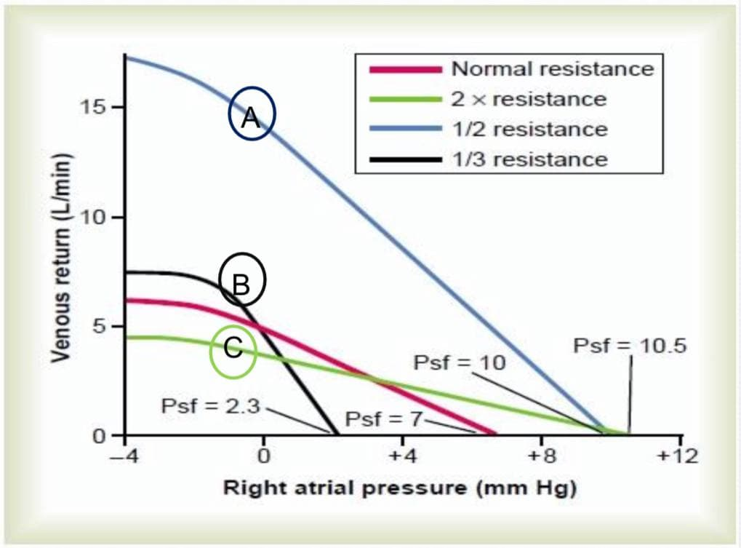
Determinants of venous return
For a given RAP
Girls’ Slides
5-Total peripheral resistance (TPR)
As the TPR decrease → the VR increase ( point A,B)
decreased resistance of the arterioles makes it easier for blood to flow from the arterial to the venous side of the circulation and back to the heart.
As the TPR increase → the VR decrease(point C) increased resistance of the arterioles makes it more difficult for blood to flow from the arterial to the venous side of the circulation and back to the heart.
Vasoconstriction
Increase TPR
Decrease VR

Slide 21
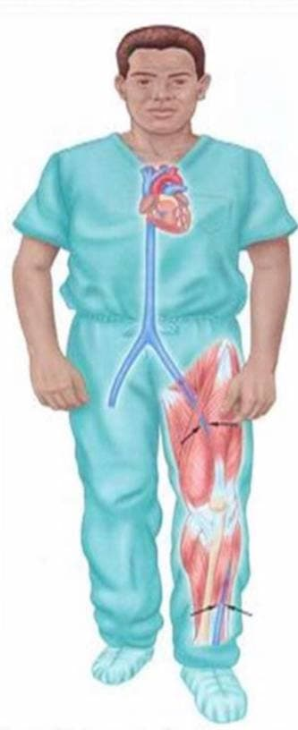
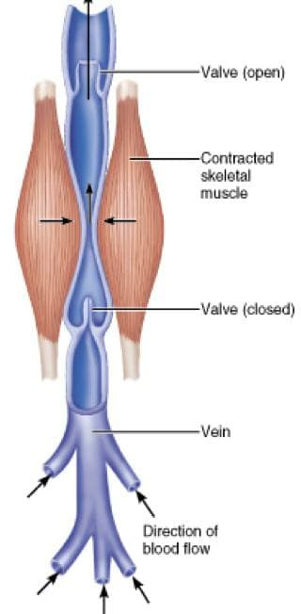
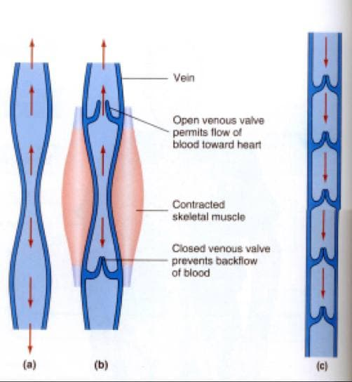
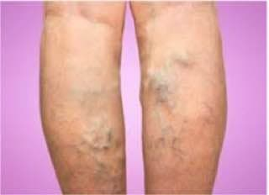
Determinants of venous return
6- Skeletal muscle activity
This is known as skeletal muscle pump
Skeletal muscle contraction → external venous compression → decrease in venous capacity and an increase in VR
Skeletal muscle activity also counter the effects of gravity on the venous system.
7- Venous valves
These valves permit blood to move forward towards the heart but prevent it from moving back toward the tissues.
These valves also play a role in counteracting the gravitational effects of the upright posture.
Skeletal muscle pump is ineffective when the venous valves are incompetent.

Slide 22
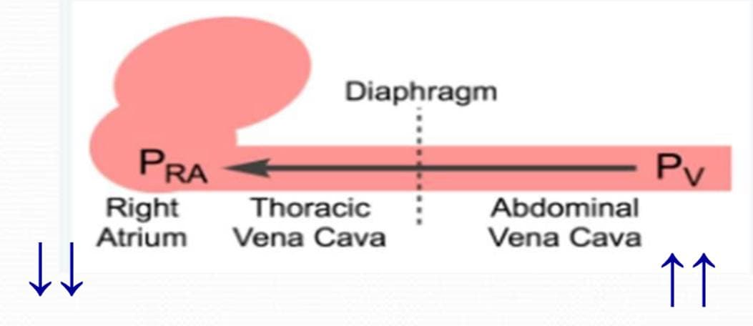
Determinants of venous return
8- Respiratory activity (Respiratory pump , Thoracic pump)
As the venous system returns blood to the heart from the lower regions of the body, it travels through the chest cavity.
The pressure in the chest cavity is 5 mmHg less than atmospheric pressure.
The venous system in the limbs and abdomen is subjected to normal atmospheric pressure.
Thus, an externally applied pressure gradient exists between the lower veins and the chest veins, promoting VR (respiratory pump).

Slide 23
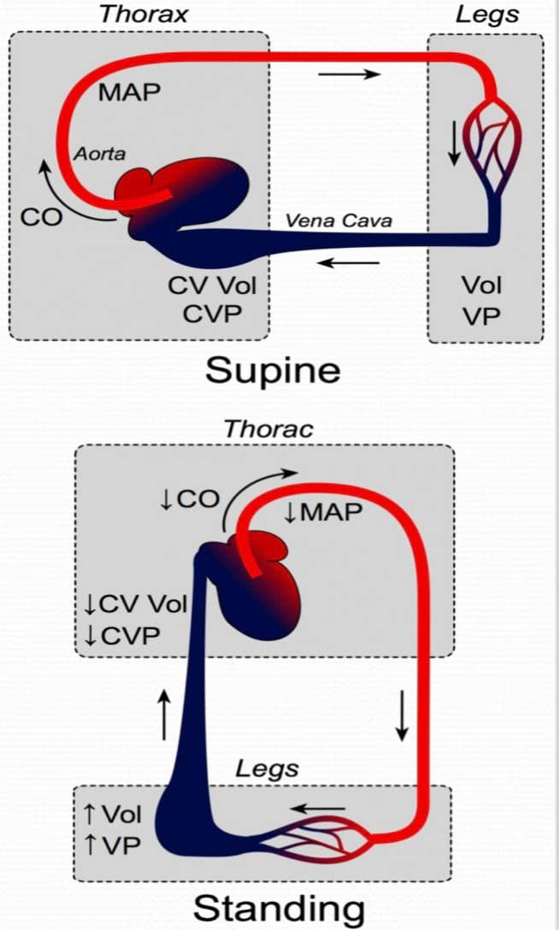
Determinants of venous return
9- Effect of gravity on VR
In standing, venous volume and pressure become very high in the feet and lower limbs.
This shift in blood volume → decreases thoracic venous blood volume and therefore CVP decreases → decrease the right ventricular filling pressure (preload) → SV decrease by starling mechanism.
This cause CO and Mean Arterial Pressure (MAP) to fall.
If mean arterial pressure falls significantly upon standing, this is termed orthostatic or postural hypotension.
This fall in mean arterial pressure can reduce cerebral blood flow to the point where a person might experience syncope (fainting).

Slide 24
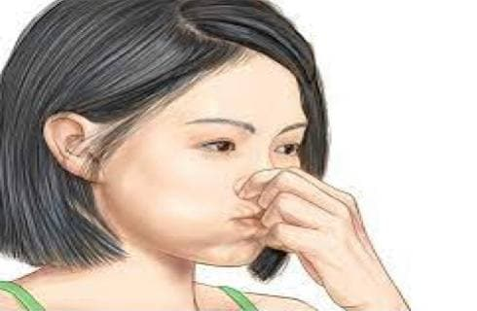
Determinants of venous return
What is the effect of Valsalva maneuver on venous return?
What is Valsalva maneuver?
It is forceful expiration against a closed glottis.
What is the effect on VR?
Intrapleural pressure become positive which is transmitted to the large veins in the chest decrease venous return.

Slide 25
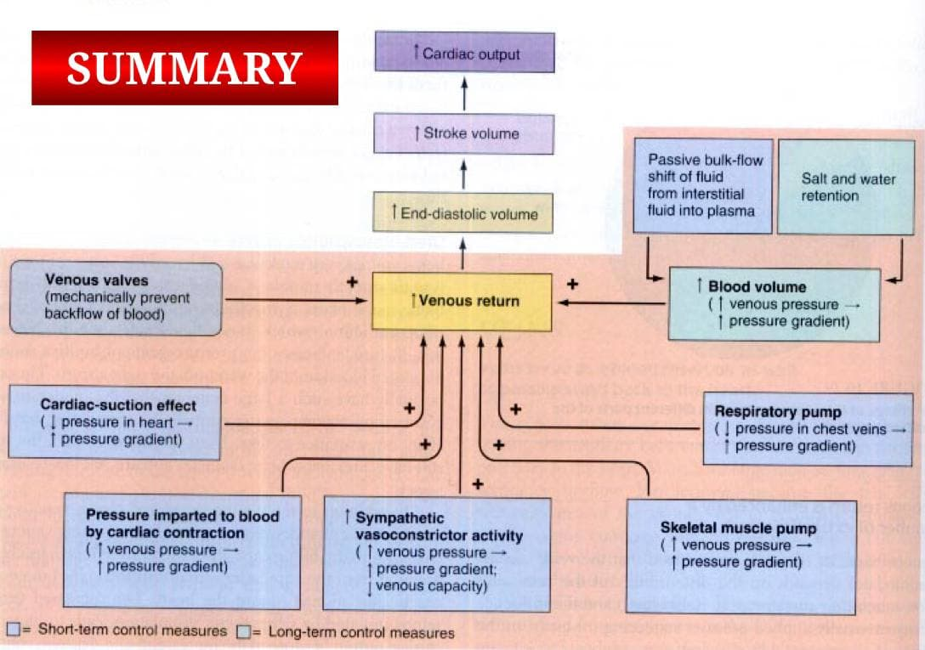
Summary

Slide 26
MCQs
Q1: Which type of vessel has the highest resistant
A- Venous | B- Artery | C- Arterioles | D- Capillary vessels
Q2: Which of the following is a structural and functional characteristic that helps distinguish between arteries and veins?
A- The vein wall is thicker than arterial wall | B- Veins are less compliant than arteries | C- Veins are volume reservoirs and arteries are pressure reservoirs | D- Veins are volume reservoirs and arteries are pressure reservoirs
Q3 Most blood volume is found in the?
A- Venules and Veins | B- Arteries | C- Lung | D- Heart
Q4: What is the role of venous valves?
A- Help the skeletal muscle pump to return blood to the heart | B- Concentrate the blood in supine position | C- Help the gravitational effect of the upright posture | D- Increase the capacity of the vein volume

Slide 27
SAQs
Q1: What is Venous Return?
Q2: What is Mean Circulatory Pressure?
Q3: Venous Return is to the Central Venous Pressure?
3: There is an inverse relationship between venous return and right atrial pressure (RAP).
2: It is the pressure nearest to the tissues and is about 7 mm Hg.
1: Venous return (VR) is the flow of blood from the periphery to the heart (Rt atrium)
1: C 2: C 3: A 4: A

Slide 28
Team Leaders
THANK YOU
Saleh aldeligan
Qusai Alsultan
Raghad Alkhudair
Raghad Alnadeef
Team Members
Othman Aldraihem
Abdulaziz Alqahtani
Abdullah Alshahri
Saad Al Hammad
MOHAMMED ALDAWSARI
Ahmad Almarshed
Rayan Alahmari
ABDULRAHMAN BINBAKHIT
Abdulaziz Alymni
Faisal Alkhunein
Abdullah Alqarni
Raid Almadi
Mohammad Alrashed
Abdulrahman bin Ateeq
Amer Alghamdi
Mishal Alsuwayegh
Nawaf alturki
Hussam Aleid
Raid almadi
Mohammed AlShehri
Nouf Aldhalaan
Amani Alotaibi
Shahed bukhari
Shahad Aljeri
Maha Alkoryshy
Alhnouf Hadi
Mayssam Aljaloud
Hissa Alshiqari
Mashael Albugami
Renad Alayidh
Ghada Binslmah
Razan Alsulami
Shaden albassam
Razan Almanjomi
Reem Alhazmi
Dhai hamdan
Shahad alaskar
Haifa Almuddahi
Reema alquraini
deema aljuribah
Kadi Khalid aldossari
Farah alhalafi
Theme was done by Mohammad Alrashed
Physio442@gmail.com
Editing File

