Slide 1
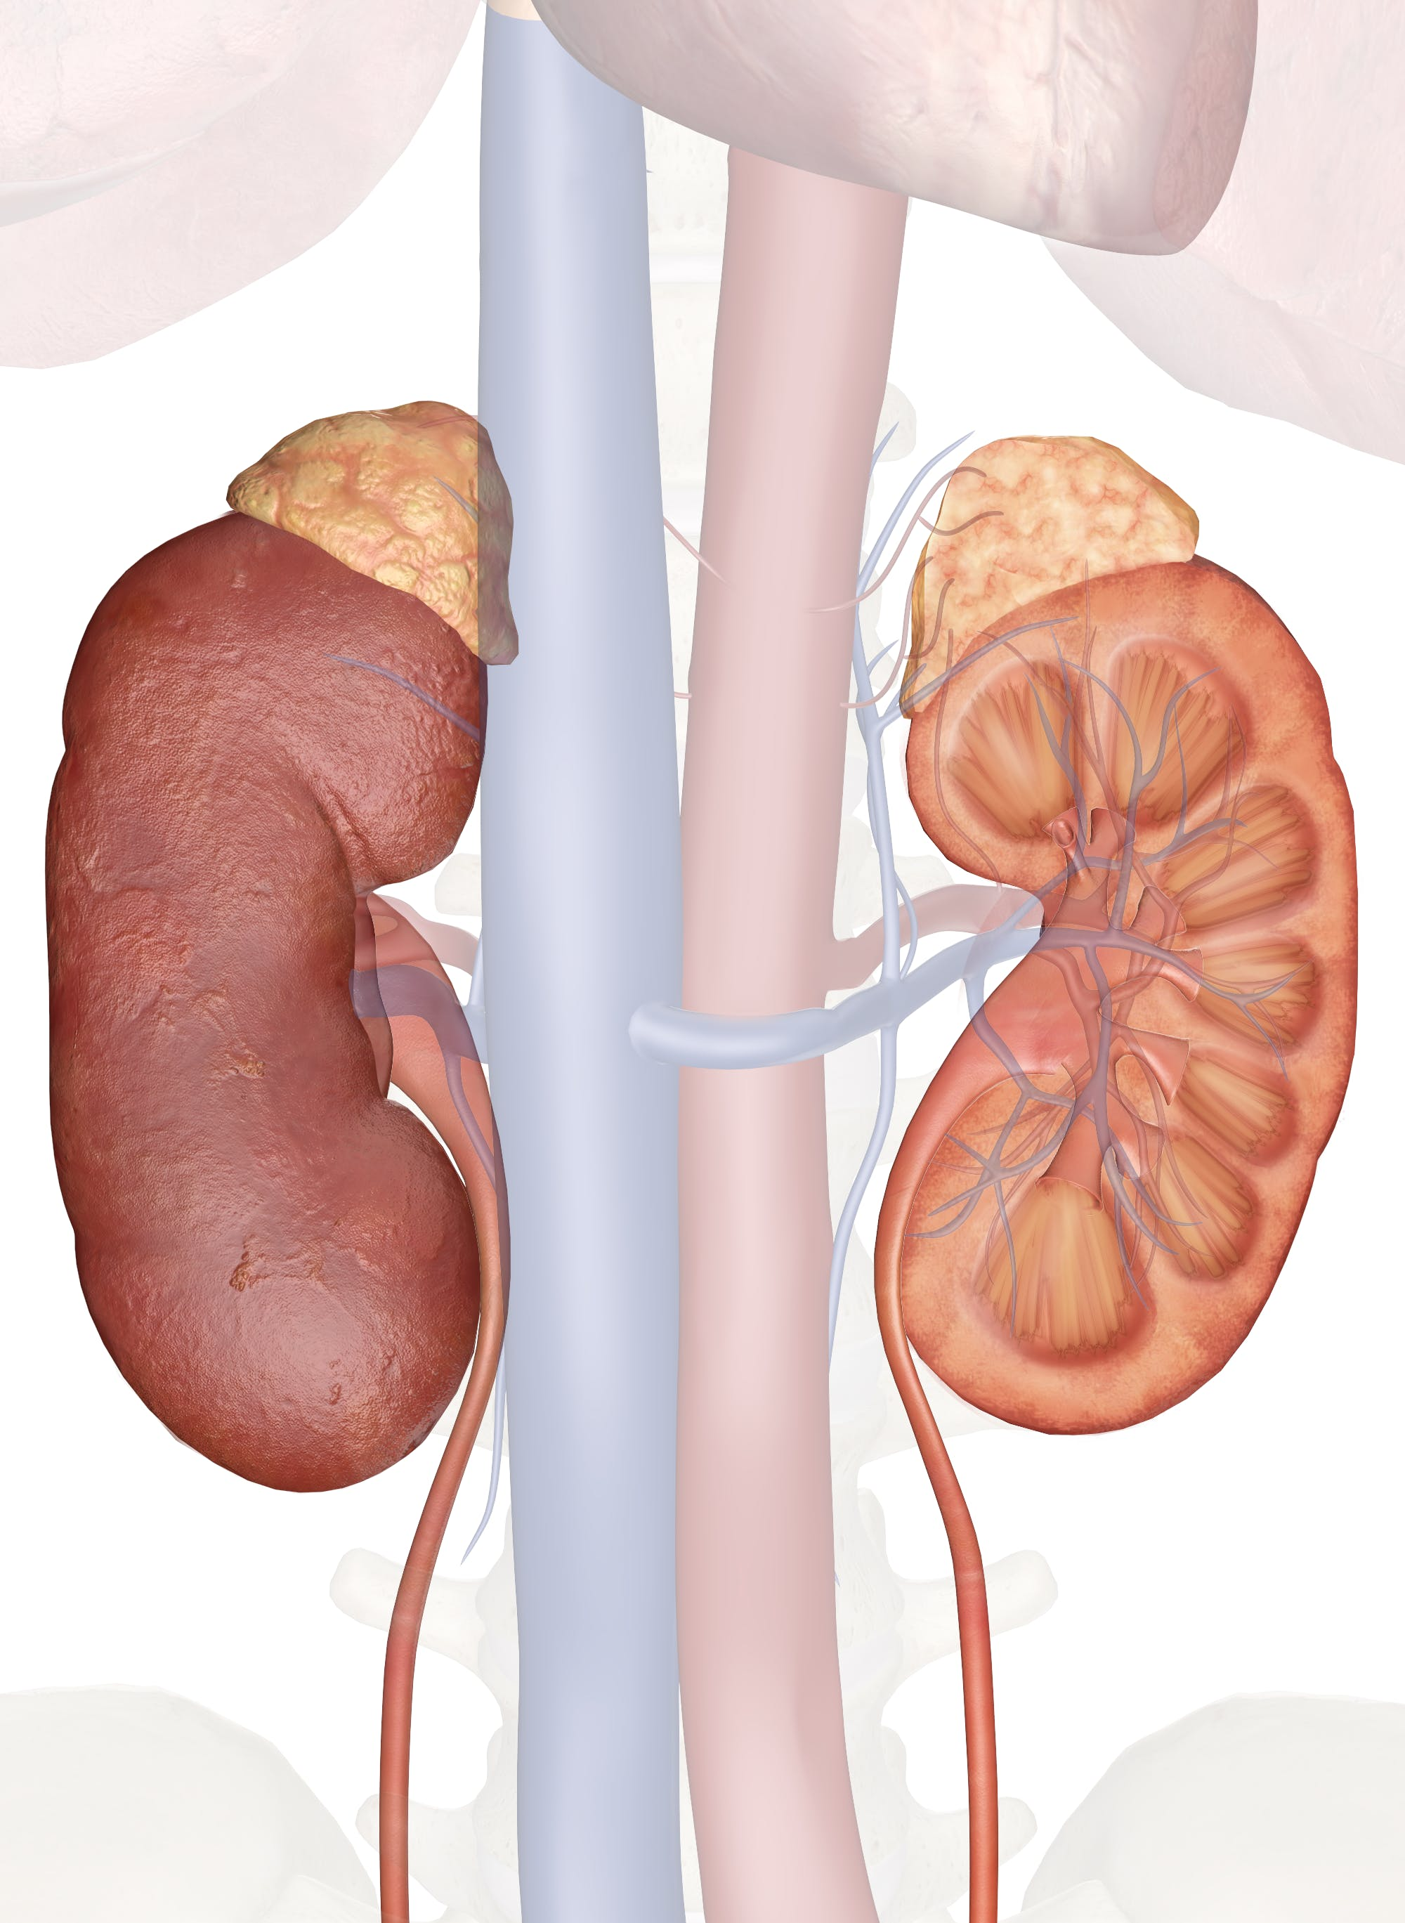
Anatomy of the Kidney
Dr Sameerah Y Shaheen
sshahee@ksu.edu.sa
08/05/22

Slide 2
Objectives
By the end of the lecture, the student should be able to describe the:
Anatomical features of the kidneys:
position, extent, relations, hilum, peritoneal coverings.
Internal structure of the kidneys:
Cortex, medulla and renal sinus.
The vascular segments of the kidneys.
The blood supply and lymphatics of the kidneys.

Slide 3
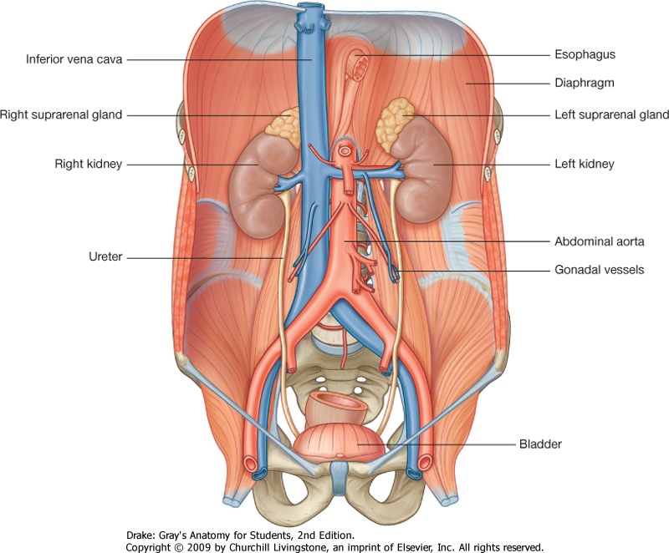
Where are the kidney situated?
Position: the kidneys lie in the retroperitoneal cavity * against the posterior abdominal wall.
The right kidney lies approximately 1 cm lower than the left.
?!
In the supine position, the kidneys extend from approximately upper border of T12 vertebra to center of body of L3 vertebra.
With contraction of the diaphragm during respiration, both kidneys move downward in a vertical direction, high of one vertebra, 1 inch, 2.5 cm.
Notes:
* Which means sits behind the peritoneum

Slide 4
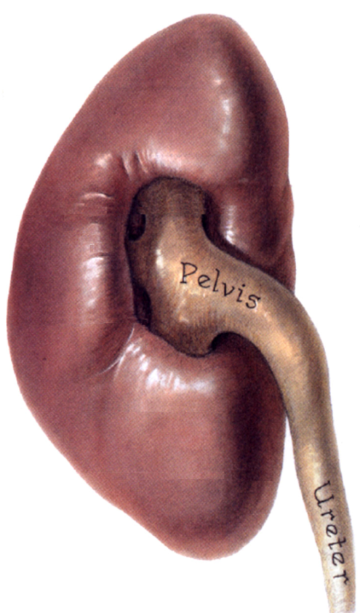
Color, Shape & Dimensions
The kidney is a reddish brown, bean-shaped organ with the dimensions 12 x 6 x 3cm.
Although they are similar in size and shape, the left kidney is slightly longer and slenderer than the right kidney, and nearer to the midline.
Each kidneys has:
Convex upper & lower ends.
Convex lateral border.
Convex medial border at both ends, but its middle shows a vertical slit called the hilum.
Internally the hilum extends into a large cavity called the renal sinus.
Convex lateral border
Hilum
Renal sinus
Renal sinus

Slide 5
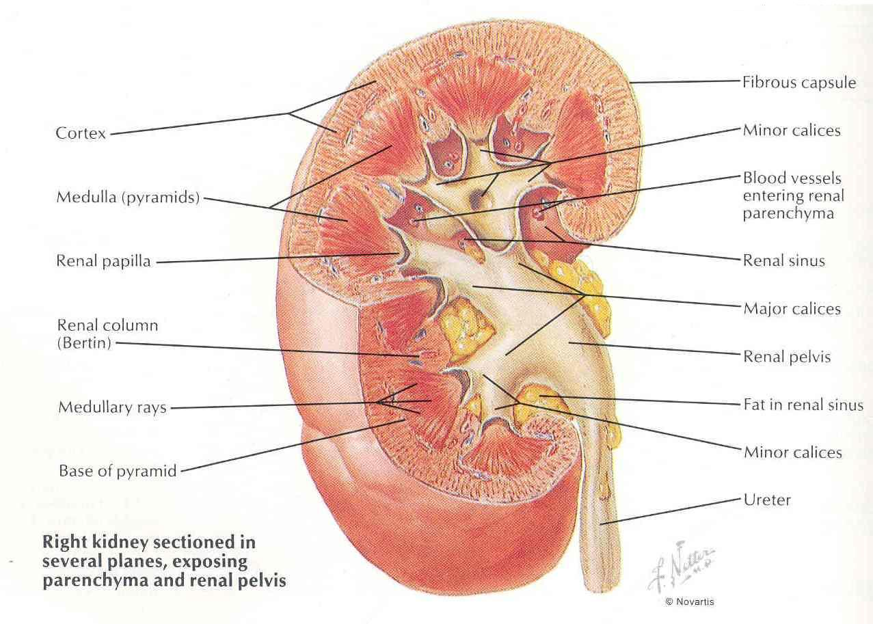
Hilum and Renal sinus
Organization of structures at the hilum of the kidney
The hilum transmits, from anterior to posterior, the renal vein, renal artery & the ureter (VAU). Lymph vessels & sympathetic fibers also pass through the hilum.
The renal sinus contains the upper expanded part of the ureter called the renal pelvis.
Perinephric fat is continuing into the hilum and the sinus and surrounds all these structures.

Slide 6
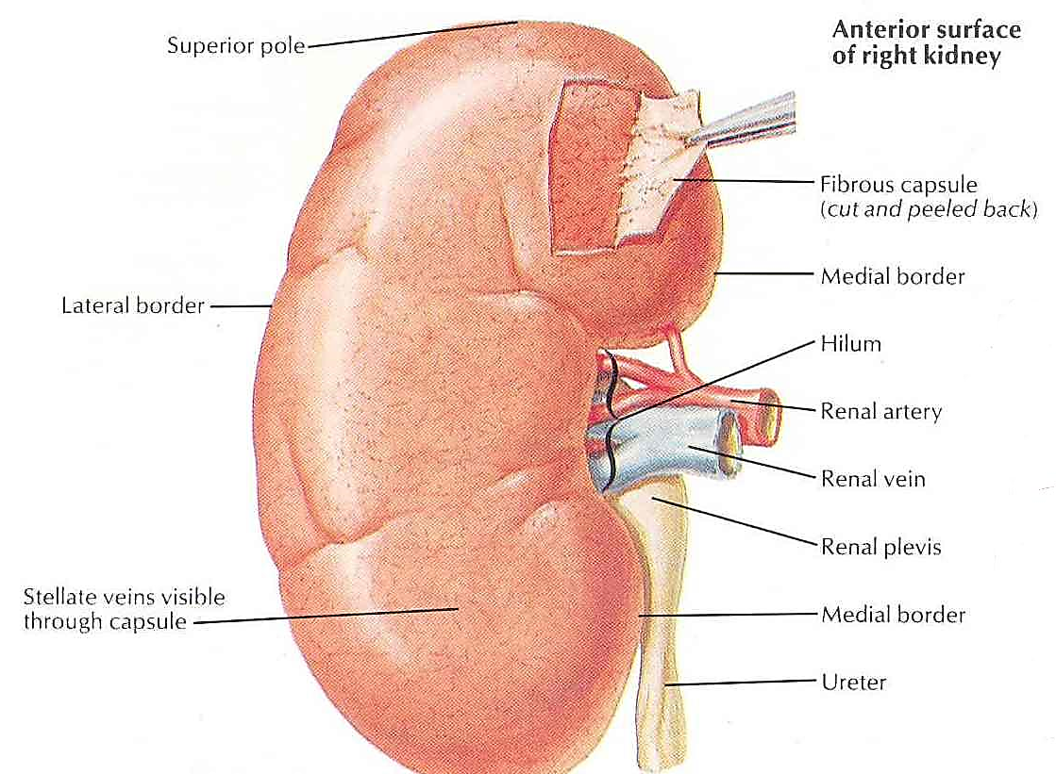
What are the coverings of the kidneys?
From within outwards the coverings are:
Fibrous capsule:
Thin membrane surrounds the kidney
and is closely adherent to its outer surface.
Can be easily separated from the surface
of the kidney.
Perirenal (Perinephric) fat:
Covers the fibrous capsule. The fat
is abundant at the borders of the kidney & extends into the renal sinus.
loss of this fat results in nephroptosis kidneys.
Notes:
The kidneys themselves are surrounded by fat

Slide 7
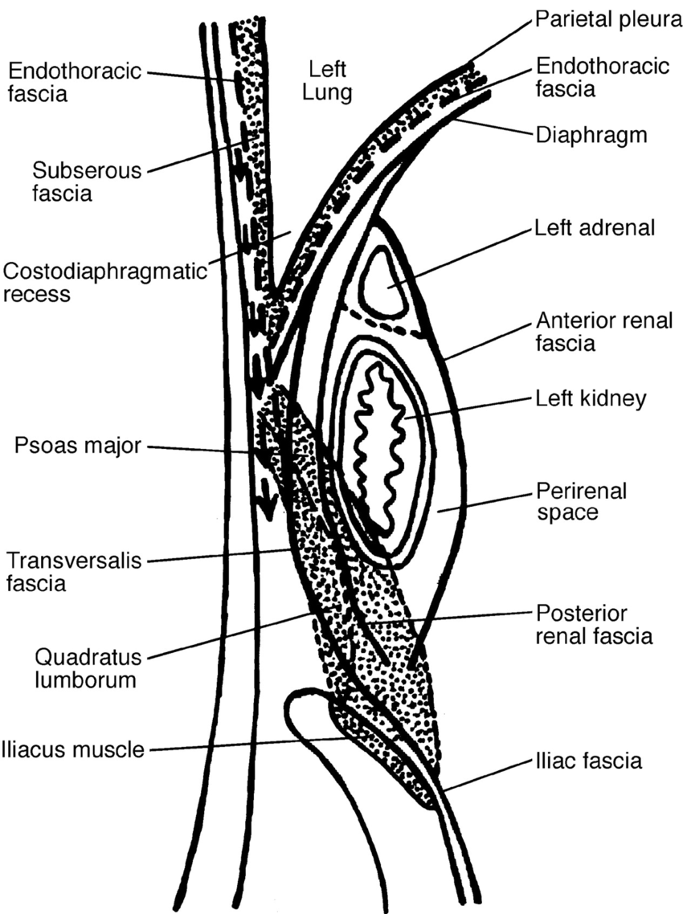
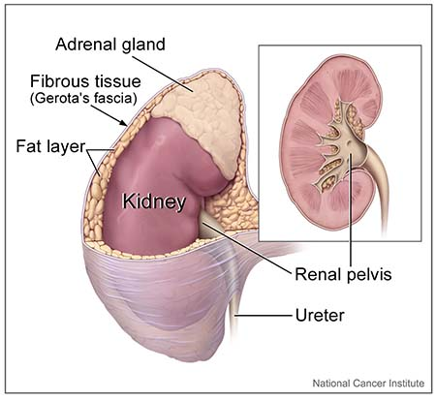
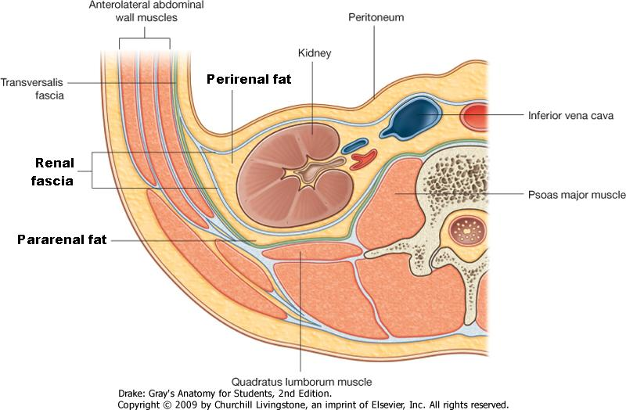
What are the coverings of the kidneys?
From within outwards the coverings are:
Renal fascia:
Condensation of areolar C.T that lies outside
the Perirenal fat and encloses the kidney
and the suprarenal gland. It extends medially and surrounds the large vessels (IVC, aorta).
Also, it extends down and wraps around the ureter and go down towards the pelvis.
Renal fascia
Blood from ruptured kidney or pus from
perinephric abscess go down the renal fascial
compartment into pelvis. The midline attachment
of renal fascia to the large vessels prevents inward movement.

Slide 8
What are the coverings of the kidneys?
From within outwards the coverings are:
Pararenal (Paranephric) fat:
Lies external to the renal fascia, is more abundant posteriorly & towards the lower pole of the kidney. Is part of the retroperitoneal fat.
The Perirenal fat, Renal fascia and Pararenal fat support the kidneys and hold them in position on the posterior abdominal wall.

Slide 9
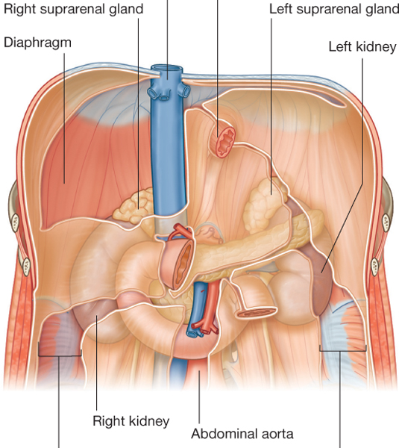
Anterior Relations of the kidneys
The anterior surface of both kidneys are related to numerous structures, some with an intervening layer of peritoneum and others lie directly against the kidney without peritoneum.

Slide 10
Left kidney: the anterior surface of left kidney is partly covered by peritoneum:
A small part of the superior pole, along the medial border, is covered by left suprarenal gland.
The rest of the superior pole is covered by the intraperitoneal stomach and spleen.
The retroperitoneal (body) of pancreas and splenic vessels cross the middle part of the anterior surface.
Its lower lateral part is directly related to the left colic flexure and beginning of descending colon.
Its lower medial part is covered by the intraperitoneal jejunum.
Notes:
Intraperitoneal organs are separated from the anterior surface of the kidneys by a layer of peritoneum.
Retroperitoneal organs lie in direct contact with the surface of the kidneys.

Slide 11
Right kidney: the anterior surface of right kidney is partly covered by peritoneum:
A small part of the upper pole is covered by right suprarenal gland.
The rest of the upper part of anterior surface is related to the liver and is separated by a layer of peritoneum.
The 2nd part of duodenum lies directly in front of the kidney close to its hilum.
The lower lateral part is directly related to the right colic flexure and, on its lower medial side, is related to the intraperitoneal small intestine.

Slide 12
Posterior Relations of the kidneys
Posteriorly, the right and left kidneys are almost related to similar structures.
Left kidney:
Diaphragm
Costodiaphragmatic recess of the pleura
11th & 12th ribs; last intercostal space
Psoas major
Quadratus lumborum transversus abdominis.
Subcostal (T12),
iliohypogastric & ilioinguinal nerves (L1).
Right kidney:
Diaphragm
Costodiaphragmatic recess of the pleura
12th rib, last intercostal space
Psoas major
Quadratus lumborum, transversus abdominis.
Subcostal (T12),
iliohypogastric & ilioinguinal nerves (L1).

Slide 13
Vertebrocostal & Renal Angles
The angle between the last rib and the lateral border of erector spinae muscle is occupied by kidney and is called the ‘Renal angle’
The Vertebrocostal angle is occupied by the lower part of the pleural sac.
Erector spinae
What care should be taken in exposure of kidneys from behind when 12th rib is to be excised?
Push up the pleura which crosses the medial half of the 12th rib.
Vertebro-costal angle
Renal angle

Slide 15
Internal structure
Renal column
Renal pyramid
Each kidney consists of an outer renal cortex and an inner renal medulla.
The renal cortex is a continuous band of pale tissue that completely surrounds the renal medulla.
Extensions of the renal cortex, the renal columns project into the inner aspect of the kidney, dividing the renal medulla into discontinuous aggregations of triangular-shaped tissue, the renal pyramids.
Cortex
Medulla

Slide 16
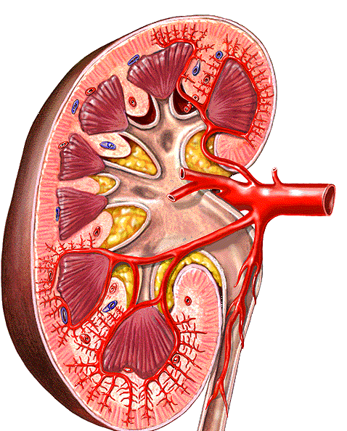
Base
Apex, Renal papilla
The bases of the renal pyramids are directed outward, toward the cortex, while the apex of each renal pyramid projects inward, toward the renal sinus.
The apical projection (renal papilla) is surrounded by a minor calyx.
In the renal sinus, several minor calices unite to form a major calyx, and two or three major calices unite to form the renal pelvis, which is the funnel-shaped superior end of the ureters.
Minor calyx
Major calyx
Renal pelvis

Slide 17
Blood supply of the kidney

Slide 18
Blood supply of the kidney
The renal artery arises from the aorta at the level of the second lumbar vertebra.
Together, the renal arteries direct 25% of the cardiac output towards the kidneys.
The right renal artery passes behind the IVC.

Slide 19
Arterial Supply
Lobar
arteries
Interlobar arteries
Each renal artery divides into 5 segmental arteries that enter the hilum of the kidney, 4 in front of the renal pelvis and one behind it.
They are distributed to the different segments of the kidney.
Each segmental artery gives rise to number of lobar arteries, each supplies a renal pyramid.
Before entering the renal substance, each lobar artery gives off two or three interlobar arteries.
Segmental arteries

Slide 20
Arterial Supply
Interlobar arteries
Arcuate arteries
The interlobar arteries run toward the cortex on each side of the renal pyramid.
At the junction of the cortex and the medulla, the Interlobar arteries give off the arcuate arteries, which arch over the bases of the pyramids.
The arcuate arteries give off several interlobular arteries that ascend in the cortex and give off the afferent glomerular arterioles.
and extend further to become efferent arterioles.
Interlobular arteries

Slide 21
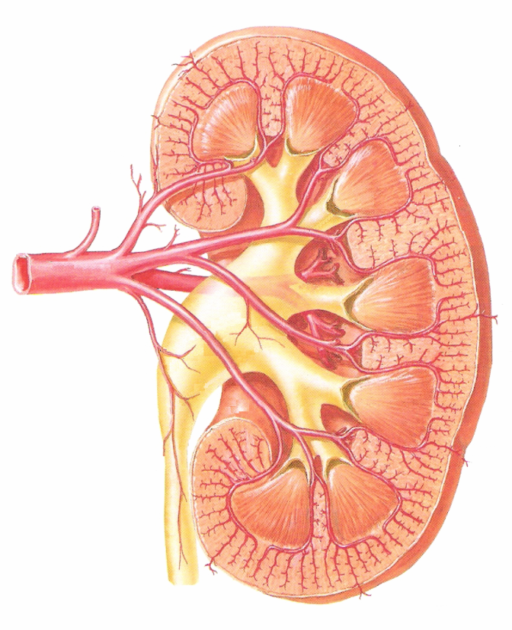
Segmental branches & vascular segments of kidneys
1
3
5
4
1
2
3
5
4
2
Each kidney has 5 segmental branches and is divided into 5 vascular segments:
Apical.
Caudal.
Anterior Superior.
Anterior Inferior.
Posterior.
What is the clinical importance of vascular segments of kidney?
Useful in doing incisions for segmental resection of the kidney or opening to remove a stone from pelvicalyceal system.
The vascular segments of the kidney provide avascular planes in between them forming the bloodless line, making it possible to remove individual or multiple diseased segments or for doing a partial nephrectomy.
Notes:
NB. Renal vascular segment anatomy is important for the renal surgeons since the vascular segments of the kidney provide avascular planes in bet them making it possible to remove individual or multiple diseased segments (segmental resection or segmentectomy) or for doing a partial nephrectomy.

Slide 22
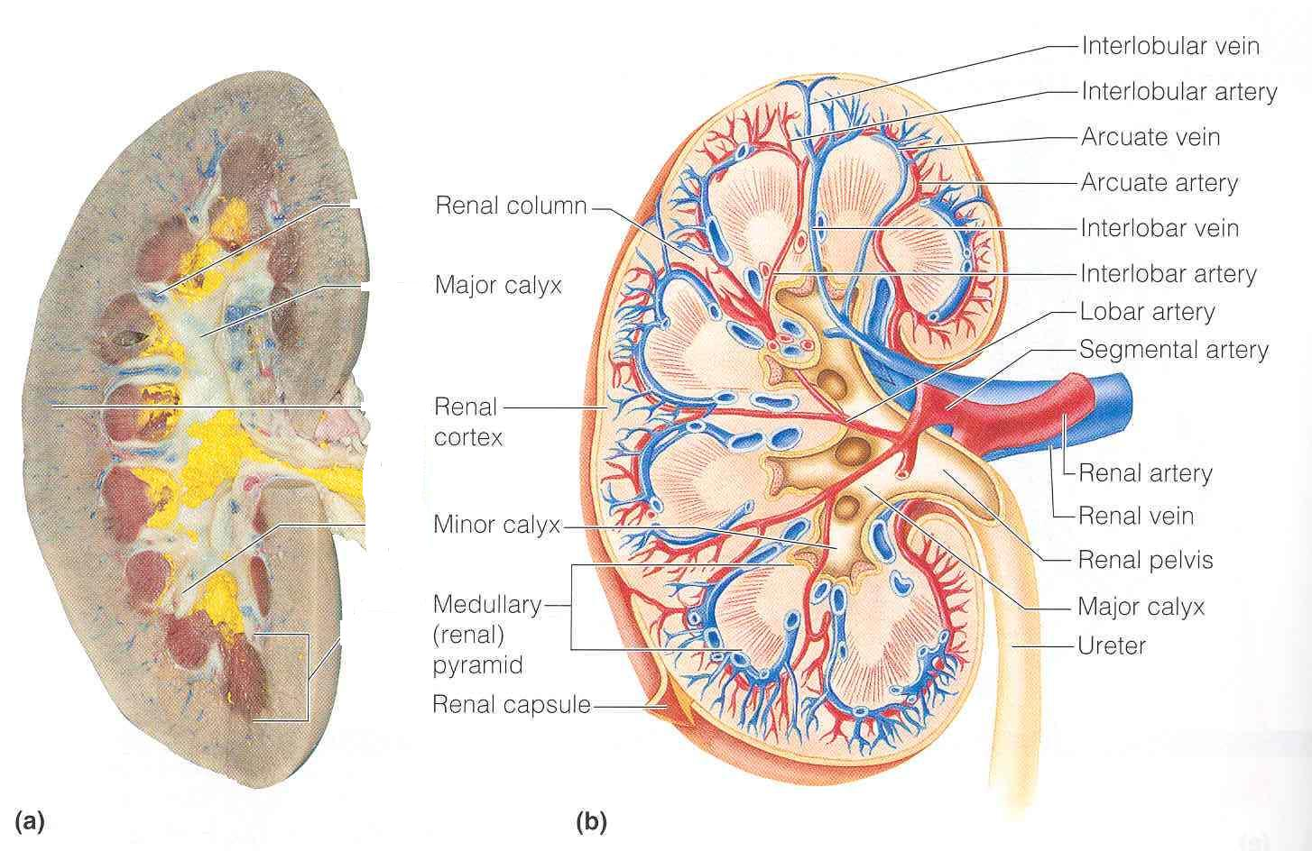
Blood Supply of the kidney
Abdominal aorta
Renal artery
Segmental arteries
lobar arteries
Interlobar arteries
Arcuate arteries
Interlobular arteries
afferent glomerular arterioles
Inferior vena cava
Renal vein
Interlobar veins
Arcuate veins
Interlobular veins

Slide 23
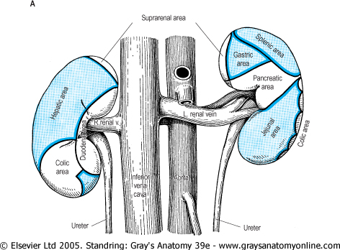
Venous Drainage of the kidney
Both renal veins drain to the inferior vena cava.
The left renal vein is three times longer than the right (7.5 cm and 2.5 cm) as it courses in front of the aorta to drain into the IVC.
So, for this reason the left kidney is the preferred side for live donor nephrectomy.
It runs from its origin in the renal hilum, posterior to the splenic vein and the body of pancreas, and then across the anterior aspect of the aorta, just below the origin of the superior mesenteric artery.
The left gonadal vein enters it from below and the left suprarenal vein, usually receiving one of the left inferior phrenic veins, enters it above but nearer the midline.
The left renal vein enters the inferior vena cava a little above the right vein.
The right renal vein is behind the 2nd part of the duodenum and sometimes behind the lateral part of the head of the pancreas.

Slide 24
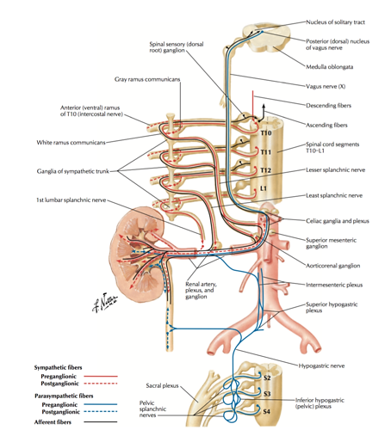
Lymphatic Drainage:
The lymph vessels follow the arteries.
Lymph drains to the lateral aortic lymph nodes around the origin of the renal artery.
Nerve Supply:
The nerve supply is the renal sympathetic plexus. The afferent fibers that travel through the renal plexus enter the spinal cord in the 10th , 11th, and 12th thoracic nerves.

Slide 25
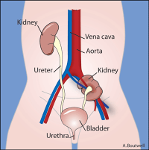
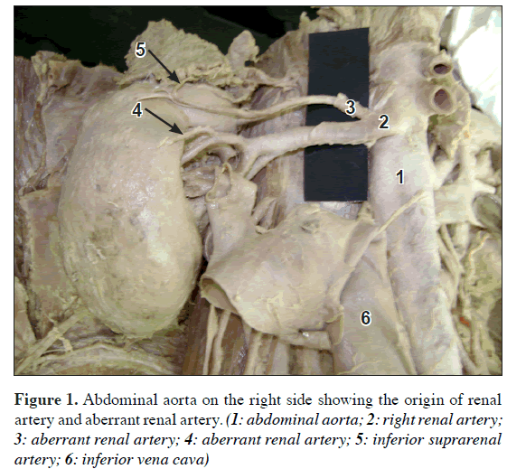
Embryology kidney
Kidneys develop in the pelvis then migrate up.
The common developmental abnormalities of the kidney:
Pelvic kidney: failure of ascent of kidney from lower lumbar or sacral region.
Aberrant renal arteries: the kidney has more than one renal artery which supply the kidney without passing through hilum.
Horseshoe kidney: fusion of lower poles of two kidneys.
Congenital polycystic kidney.
Congenital absence of one kidney.
Accessory kidney.

Slide 26
How to identify that a given kidney is right or left:
The hilum is directed medially.
The renal vessels are anterior to the pelvis
The ureter is directed inferiorly.
Kidney location:
1- kidneys extends from T12-L3.
2-kidney hilum is L2 (L1).
3-Ribs 11 & 12 envelop left kidney &
Rib 12 envelops right kidney.
Anterior view
Posterior view

Slide 27
Thank you

