Slide 1
Renal Pathology Infection of the upper & lower urinary tract
May 2022
Reference: Robbins & Cotran Pathology and Rubin’s Pathology
Sufia Husain
Associate Professor
Pathology Department
College of Medicine
KSU, Riyadh

Slide 2
Objectives
Objectives:
At the end of the two lectures the students will be able to:
Recognize the predisposing factors for infections of the kidney and urinary tract.
Describe the different types of infections in the kidney and urinary tract.
Recognize acute and chronic pyelonephritis.
Describe the causes of urinary tract obstruction.
Recognize drug induced nephritis.
Key Outlines:
Urinary Tract Obstruction: causes and clinical manifestations in children and adults.
Infections of the Urinary Tract: Predisposing Factors and Clinical Manifestations.
Pathology of Acute and Chronic Pyelonephritis including causes and complications of urolithiasis.
Drug induced interstitial nephritis and renal necrosis.

Slide 3
Lecture outline for 2 lectures
Upper urinary tract infection or inflammation
Tubulointerstitial nephritis
Acute pyelonephritis
Chronic pyelonephritis
Drug induced tubulointerstitial nephritis
Urinary tract outflow obstruction
Causes
Urolithiasis
Hydronephrosis
Lower urinary tract infection
Ureteritis
Cystitis

Slide 4
Tubulointerstitial nephritis
Tubulointerstitial nephritis is inflammatory disease primarily involving the renal tubules and interstitium. It can be in the form of:
Acute pyelonephritis
Chronic pyelonephritis
Drug induced tubulointerstitial nephritis

Slide 5
Acute Pyelonephritis

Slide 6
Acute Pyelonephritis
Acute pyelonephritis is an acute suppurative inflammation of the upper urinary tract (kidney & renal pelvis) caused by bacterial infection. It typically follows infection of the lower urinary tract.
The most common causative organism is enteric gram-negative rods Escherichia coli. Other organisms include Proteus, Klebsiella, Enterobacter and Pseudomonas.
There are two routes by which bacteria can reach the kidneys:
Ascending infection (more common) from the lower urinary tract: bacteria ascends from the urethra into the urinary bladder and up the ureters to the kidneys.
Through the bloodstream/hematogenous (less common) e.g. from an infected heart valve in endocarditis, miliary tuberculosis etc.
Robbins basic pathology, 9th Ed Elsevier 2013

Slide 7
Acute Pyelonephritis: predisposing factors
Urethral instrumentation e.g. catheterization and cystoscopy.
Obstruction: obstruction at the level of the urinary bladder (by stones, benign prostatic hypertrophy etc.) →incomplete emptying of bladder and increased residual urine → stasis of urine in bladder → allows bacteria to multiply → bacteria ascend up the ureters and infect the kidneys
Incompetence of the vesicoureteral orifice → allows reflux of bladder urine to ascend up into the ureter (normally ureteral insertion into the bladder is a competent one-way valve that prevents retrograde flow of urine). About 1/3rd of children with UTI have vesicoureteral reflux (due to a congenital defect of the valve).
Gender: UTI most commonly affects females (anatomically predisposed because of the close proximity of the urethra to the rectum and the short urethra).
Pregnancy: Asymptomatic bacteriuria occurs in 10% of pregnant women, out of which some develop acute pyelonephritis.
Preexisting renal lesions
Diabetes mellitus: diabetic glycosuria predisposes to infection by providing a rich medium for bacterial growth. Diabetics also have increased risk of complications of pyelonephritis e.g. septicemia, necrotizing papillitis and recurrence of infection.
Immunosuppression & immunodeficiency

Slide 8
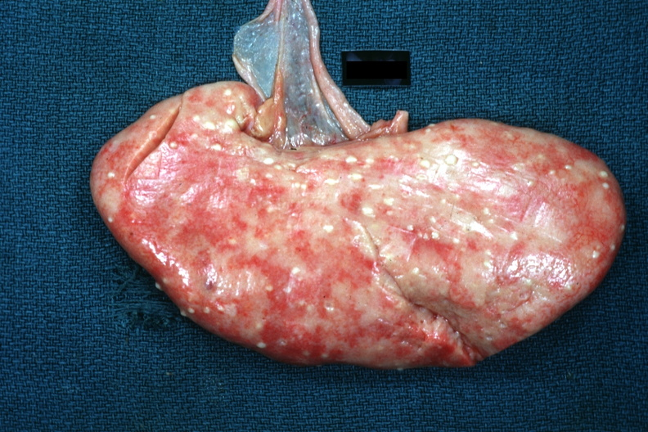
Acute Pyelonephritis: morphology
Macroscopic
The kidney may be enlarged and swollen and show small yellow/ white subcapsular and cortical microabscesses (pus = suppurative necrosis).
Rarely the kidney may become filled with large amounts of pus in the renal pelvis, calyces and ureter called pyonephrosis.
Pathology Education Informational Resource (PEIR) Digital Library
http://peir.path.uab.edu/library/_data/i/upload/2013/08/01/
20130801100330-254c35a8-me.jpg
Pathology Education Informational Resource (PEIR) Digital Library
http://peir.path.uab.edu/library/_data/i/upload/2013/08/01
/20130801094534-b6b81959-me.jpg

Slide 9
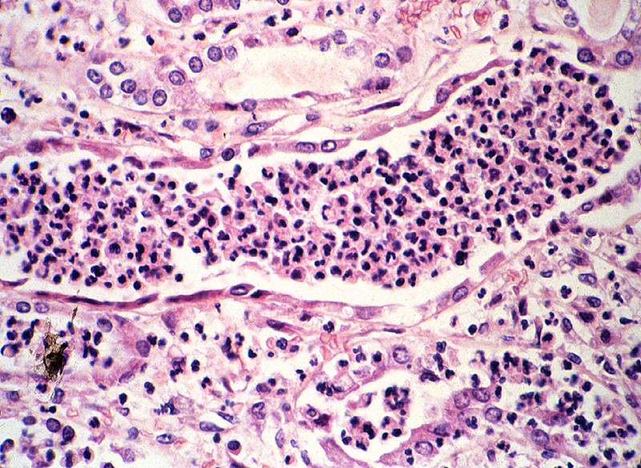
Acute Pyelonephritis: morphology
Microscopic
There is a dense acute tubulointerstitial inflammation (neutrophils) with tubular destruction. The neutrophils fill the tubules and collecting ducts.
The vessels and glomeruli often are preserved.
In severe cases → perinephric abscess.
https://web.duke.edu/pathology/Week14/images/large/path9-06 and 9-07.jpg

Slide 10
Acute Pyelonephritis:
Complications
Clinical features
Fever with chills and sweats.
Flank pain with costovertebral angle tenderness.
Dysuria, frequency and urgency.
Pyuria, hematuria.
Leukocytosis with neutrophilia.
Positive urine culture and wbc casts in the urine.
Differentiating upper from lower urinary tract infection is often clinically difficult.
Papillary necrosis
Pyonephrosis
Perinephric abscess
Chronic pyelonephritis
Septicemia

Slide 11
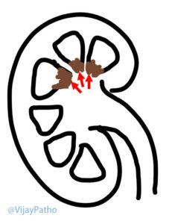
Papillary necrosis (necrotizing papillitis)
It is a type of pyelonephritis characterized by necrosis of the renal papillae (apex of renal pyramids).
It is seen in
diabetics with acute pyelonephritis
acute pyelonephritis with urinary tract obstruction.
analgesic abuse associated interstitial nephritis
Chronic liver disease
Renal transplant rejection
Infections e.g. tuberculosis
Sickle cell disease
Grossly: yellow white suppurative necrosis (pus) at the tips of renal papillae/ pyramids.
Microscopically: coagulative necrosis & microabscess at the tips of renal papillae.
Pathology Education Informational Resource (PEIR) Digital Library
http://peir.path.uab.edu/library/_data/i/upload/2013/08/01/20130801094931-333fc99e-me.jpg

Slide 12
Chronic Pyelonephritis

Slide 13
Chronic Pyelonephritis
It is a chronic tubulointerstitial inflammation of the kidney caused by repeated bouts of inflammation and healing → resulting in scaring of the involved kidney with deformed renal pelvis & calyces and gradual renal insufficiency.
It is caused by:
Chronic urinary obstruction (e.g. obstruction of the ureter by calculi (stones), tumor within the ureter, or extrinsic compression etc.)
Chronic reflux.
Macroscopy
The kidneys are small and contracted.
The surface of the kidney is irregularly scarred with areas of depression.
The cortex in thinned out and there is deformity and blunting of the pelvicalyceal system.

Slide 14
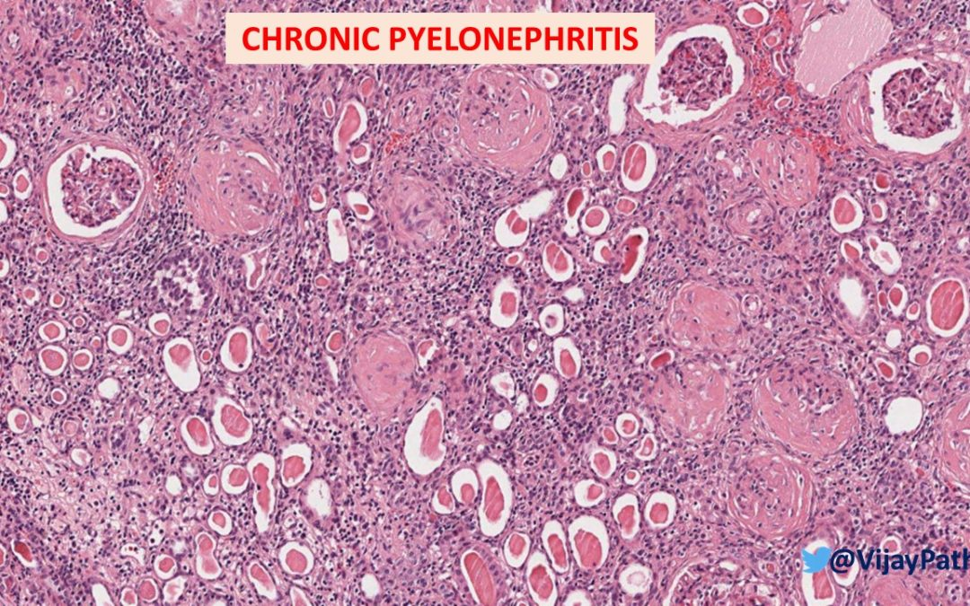
Chronic Pyelonephritis:
Microscopy
Tubules → tubular atrophy with thyroidization of tubules (tubules are filled with eosinophilic hyaline casts resembling colloid of thyroid gland).
Interstitium → interstitial fibrosis and chronic interstitial inflammation (lymphocytes and plasma cells)
Glomeruli → periglomerular fibrosis and glomerulosclerosis (black arrows)
Chronic pyelonephritis can ultimately can lead to renal failure (end stage renal disease)

Slide 15
Chronic Pyelonephritis: clinical features
Most patients have episodic symptoms of urinary tract infection or acute pyelonephritis.
Hypertension.
Some patients have a silent course until end-stage renal disease develops.
Imaging studies show deformed pelvicalyceal system and cortical scarring.

Slide 16
Drug induced tubulointerstitial nephritis

Slide 17
Drug induced tubulointerstitial nephritis
Drugs are an important cause of renal injury.
Drug-induced interstitial nephritis is an IgE (hypersensitivity) and T cell–mediated immune reaction to a drug. It is characterized by interstitial inflammation with many eosinophils.
It can be acute or chronic.
Implicated therapeutic drugs: penicillins (e.g. ampicillin), rifampicin, diuretics (thiazides), nonsteroidal anti-inflammatory agents, etc.
Microscopy
Interstitial infiltration by chronic inflammatory cells (lymphocytes and macrophages), typically with increased eosinophils.
Interstitial non-necrotizing granulomas with multinucleated giant cells +/-.
Tubular atrophy +/-.
The glomeruli are usually normal.
Clinical features
Abnormal renal function test after few days or weeks after exposure to the drug.
Urine: hematuria and eosinophils.
Can present as acute kidney injury (rising serum creatinine and oliguria).
It is important to diagnose this condition, because if remove the offending drug on time the injury maybe reversible.

Slide 18
Urinary Tract Obstruction (urinary outflow obstruction)

Slide 19
Obstruction in the outflow of urine
Causes of urinary tract outflow obstruction
Congenital anomalies
Urolithiasis
Benign prostate hyperplasia
Tumors (of prostate, cervix, urinary bladder etc.)
Inflammations (prostatitis, urethritis etc.)
Pregnancy
Others (paralysis of urinary bladder)

Slide 20
Urolithiasis

Slide 21
Urolithiasis/nephrolithiasis
Urolithiasis is formation of urinary calculi/stone along the urinary system e.g. kidney, bladder, ureters etc.
Renal pelvis and calyces are common sites for calculi formation (called nephrolithiasis).
Predisposing factors:
Metabolic factors: hypercalciuria, hyperphosphaturia, oxaluria, gout etc.
Persistently alkaline urine favors formation of calcium phosphate stones.
Persistently acidic urine favors formation of oxalate or uric acid stones.
Stasis of urine facilitates precipitation of salts and stone formation.
Chronic dehydration: concentrates urine and favors stone formation
For unknown reasons, renal stones are more common in men than in women.
There may be a familial tendency toward stone formation.

Slide 22
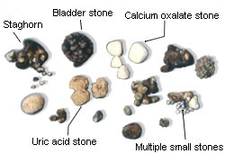
Urolithiasis
Morphology
Stones vary in composition.
Types of stones seen are:
Calcium stones: 75% of kidney stones are calcium oxalate or phosphate (radio-opaque).
Infection stones: 10% of stones are caused by infection → infection results in alkaline urine → leads to formation of magnesium ammonium phosphate stones. Infection stones can occasionally fill the pelvis and calyces to form large staghorn calculi.
Uric acid stones: are formed in acidic pH. Patients with hyperuricemia and gout are predisposed to uric acid stones, but it can also be seen in people with no hyperuricemia or gout. Pure uric acid stones are radiolucent.
Cystine stones: are uncommon.
Majority (80%) of the stones are unilateral
Common sites: are renal pelvis and calyces and urinary bladder
Commonly multiple stones are found in one kidney
Stones vary in size from few mm to large stones that dilate the entire renal pelvis.
They range from hard to soft, from smooth to rough
The staghorn calculi take the shape of the pelvicalyceal system. They are large stones are usually composed of magnesium ammonium phosphate

Slide 23
Urolithiasis
Clinical features
Complications
Recurrent infection
Hydronephrosis
Pyelonephritis
Pyoneohrosis
Acute urinary retention
Renal failure.
May be asymptomatic esp. stones lodged in the renal pelvis
Stone can erode the mucosa (ulceration) → hematuria.
Smaller stones can pass into the ureter, where they cause obstruction → intense episodes of flank pain radiating toward the groin known as renal or ureteral colic. They may pass out in urine → painful.
Stones obstruct urine flow →predispose to bacterial infection
Diagnosis and management
Majority, the diagnosis → made radiologically.
In the past most kidney stones required surgical removal, but now ultrasonic disintegration (lithotripsy) and endoscopic removal are effective.

Slide 24
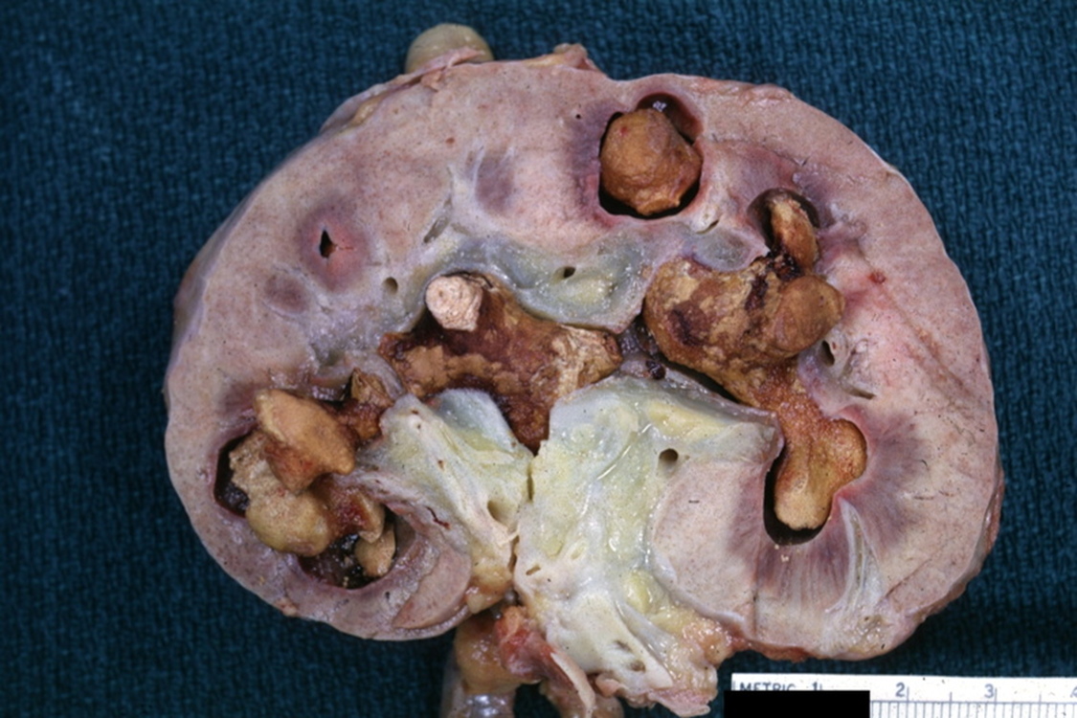
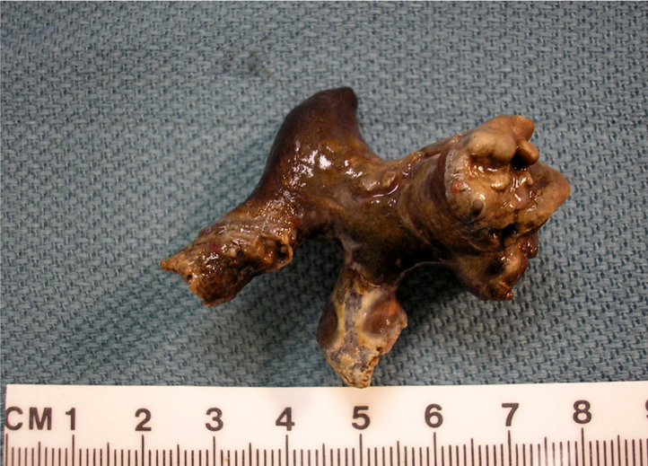
http://peir.path.uab.edu/library/_data/i/upload/2013/08/01/20130801095842-a9530c10-me.jpg
Staghorn calculi
Staghorn calculi
http://peir.path.uab.edu/library/_data/i/upload/2013/08/01/20130801094321-3468c066-me.jpg
Qiao's Pathology: Kidney - Staghorn Calculus
https://www.flickr.com/photos/jian-hua_qiao_md/5648360864/in/album-72157622371115615/

Slide 25
Hydronephrosis

Slide 26
Hydronephrosis
It is the dilation of the renal pelvicalyceal system with resultant renal parenchymal atrophy.
It is caused by (or is a complication of) the obstruction to the outflow of urine.
The obstruction can be acute or chronic and be at any level of the urinary tract.
Obstruction below the level of ureters causes bilateral hydronephrosis.
The obstruction can be:
Congenital: e.g. atresia of urethra.
Acquired:
Calculi
Benign prostatic hyperplasia
Tumors: of prostate, bladder, cervix tumors etc.
Inflammation: Prostatitis, ureteritis, urethritis
Neurogenic: Spinal cord damage with bladder paralysis
Pregnancy

Slide 27
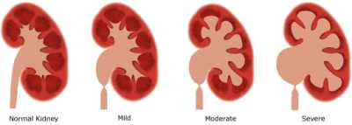
Hydronephrosis: pathogenesis
There is backflow of the urine into the kidney → the calyces and pelvis become markedly dilated → back flow in collecting ducts of kidney → ultimately back flow in renal cortex → renal cortical atrophy.
The obstruction also triggers an interstitial inflammatory reaction leading eventually to tubular atrophy and interstitial fibrosis.
Initially the glomeruli are spared but eventually they become sclerotic.
http://www.medfriendly.com/images/hydronephrosis.jpg

Slide 28
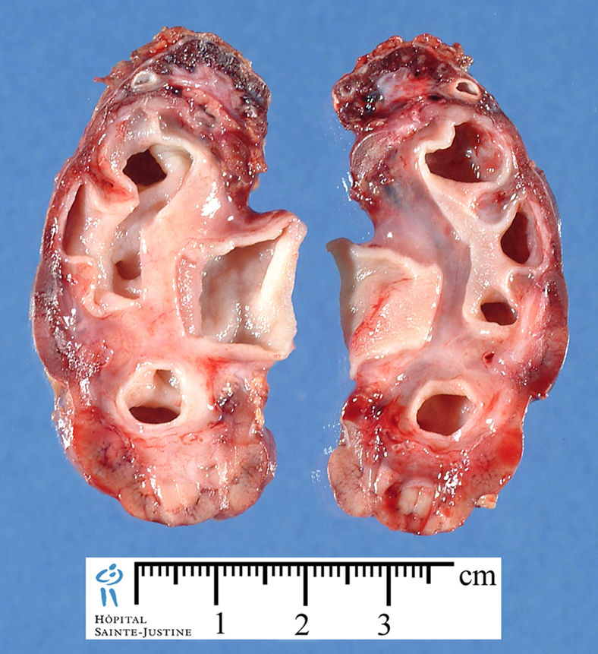
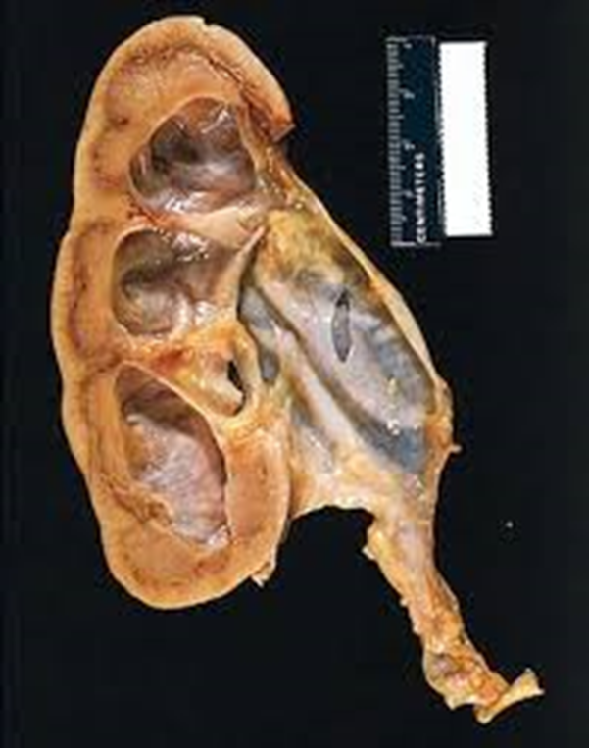
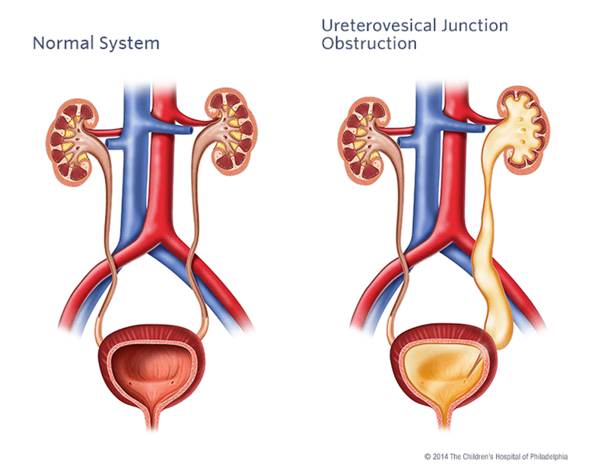
Hydronephrosis:
Gross morphology:
Initially enlarged kidney due to dilation of the renal pelvis and calyces
Followed by atrophy or compression of the renal parenchyma.
Depending on the level of the obstruction, one or both ureters may also be dilated (hydroureter)

Slide 29
Hydronephrosis: clinical features
Unilateral hydronephrosis may be silent/ asymptomatic for long periods
Bilateral hydronephrosis can leads to oliguria, anuria and renal failure
In hydronephrosis, the kidney is more susceptible to pyelonephritis, which causes additional injury
With time the changes become irreversible
Early diagnosis and timely removal of obstruction within a few weeks usually permits full return of function

Slide 30
Infections of the lower urinary tract

Slide 31
Lower urinary tract
Lower urinary tract = the ureters + urinary bladder + urethra.
The ureters, urinary bladder and urethra are lined by transitional epithelium (urothelium) except the terminal urethra which is lined by squamous epithelium.
Inflammation in lower urinary tract:
Ureteritis
Cystitis
Urethritis
Infection of the lower urinary tract is referred to as UTI (urinary tract infection).
Normal urothelium

Slide 32
Pathology
Ureteritis
Ureteritis is an inflammation of the ureters. It is a complication of descending or ascending infections; ureteritis is often associated with ureteral obstruction (e.g. calculi or extrinsic compression of ureter by an adjacent tumor/lymph node or pregnant uterus).
Cystitis
It is inflammation of the urinary bladder. It may be acute or chronic.
It is the most common site of urinary tract infection. Bacterial cystitis is most common form of cystitis. It is caused mainly by coliform bacteria e.g. E coli, Proteus vulgaris, Pseudomonas and Enterobacter spp.
Predisposing factors: bladder calculi, bladder outlet obstruction (e.g. prostatic hyperplasia), diabetes mellitus, immunodeficiency, radiation therapy, and chemotherapy, prior instrumentation or catheterization (often seen as a nosocomial infection in hospitalized patients, common in patients with indwelling catheters for prolonged periods).
The risk of cystitis is increased in females because of a short urethra, especially during pregnancy.

Slide 33
Cystitis: pathology
Acute cystitis : edema, hemorrhage and a neutrophilic infiltrate.
Chronic cystitis: lymphocytic, histiocytic and plasma cell infiltrate and fibrosis.
Special forms of cystitis:
Follicular cystitis: chronic inflammation with many lymphoid follicles
Eosinophilic cystitis: inflammation with prominent eosinophilic infiltrate.
Tuberculous cystitis: shows granulomatous cystitis with or without necrosis.
Hemorrhagic cystitis: shows mucosal hemorrhages. Seen in acute bacterial infection, adenovirus infection and bleeding diatheses (e.g., leukemia, treatment with cytotoxic drugs and disseminated intravascular coagulation).
Chronic interstitial cystitis (chronic pelvic pain syndrome): persistent, painful chronic cystitis typically affects middle-aged women; characterized by intermittent, suprapubic pain, urinary frequency, urgency, hematuria and dysuria without evidence of bacterial infection; urine cultures are usually negative; cause is unknown; refractory to treatment. Eventually → bladder fibrosis → contracted bladder.
Polypoid cystitis: bladder inflammation in which there is marked mucosal edema (resulting in polypoidal elevations).

Slide 34
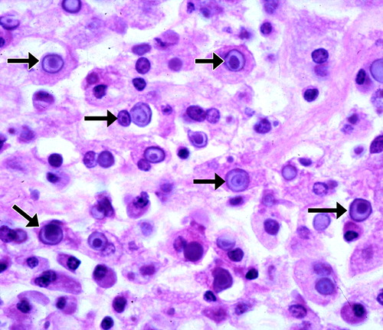
Special forms of cystitis contd…
Malakoplakia: uncommon; inflammatory disorder of unknown etiology. Seen in the bladder and other sites within and outside the urinary tract; characterized by plaques on the mucosal surface of the bladder. Histology shows a chronic inflammation with numerous macrophages. Some macrophages contain laminated, basophilic calcified bodies called Michaelis-Gutmann bodies (arrows).
https://doi.org/10.1148/rg.266065126

Slide 35
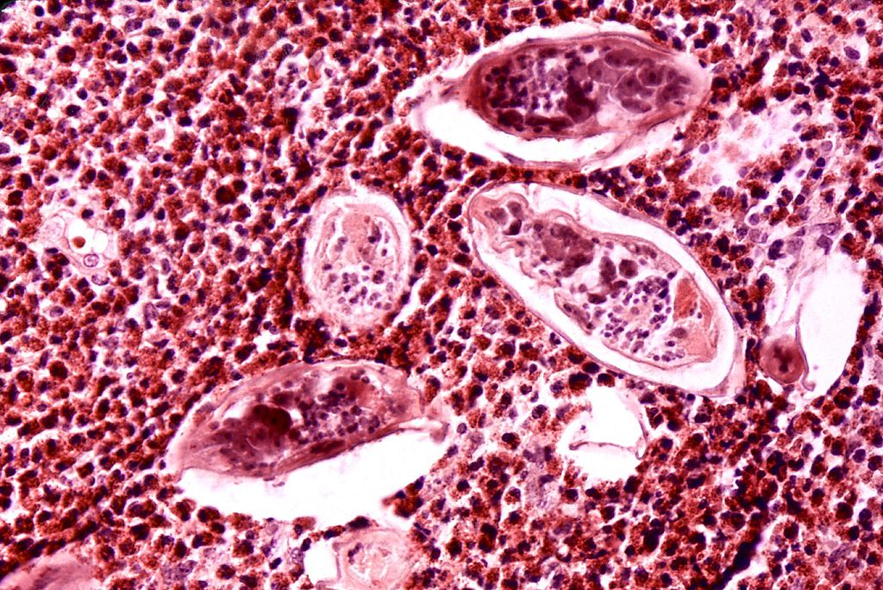
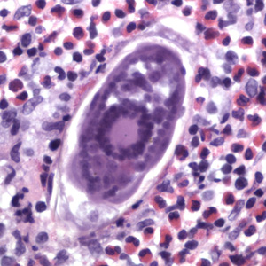
Special forms of cystitis contd…
Schistosomiasis: infection by parasitic flatworms called Schistosoma (Schistosoma hematobium) in which the worms may lay eggs in the wall of urinary bladder. These eggs ellicit a granulomatous reaction and an eosinophilic infiltrate. The ova can calcify and appear as grains of sand in bladder wall. Occasionally the entire urinary bladder becomes calcified → known as calcific cystitis. Chronic Schistosomiasis can predispose to squamous cell carcinoma of the urinary bladder.
Schistosoma eggs surrounded by inflammatory cells
Schistosoma egg surrounded by eosinophils
CDC/ Dr. Edwin P. Ewing, Jr. - This media comes from the Centers for Disease Control and Prevention&#039;s Public Health Image Library (PHIL), with identification number #35.
https://commons.wikimedia.org/w/index.php?curid=4342164

Slide 36
Acute and chronic cystitis: clinical features
Fever with chills
Excessive urinary frequency, painful burning urination (dysuria) and lower abdominal or pelvic discomfort.
Examination of urine usually reveals inflammatory cells and causative organism can be identified by urine culture.
Most cases of cystitis respond well to treatment with antimicrobial agents.

