Slide 1
Renal Pathology Rapid Progressive Glomerulonephritis Chronic kidney Disease
May 2022
Reference: Robbins & Cotran Pathology and Rubin’s Pathology
Sufia Husain
Associate Professor
Pathology Department
College of Medicine
KSU, Riyadh

Slide 2
Objectives for pathology lectures 5 & 6: Nephrotic and Nephritic Syndrome and Rapid Progressive Glomerulonephritis, Chronic kidney Disease,
At the end of the activity (2 lectures) the students will be able to:
Recognize the five major renal glomerular syndromes.
Describe the main differential pathological diagnosis for each syndrome.
Perform a clinico-pathological correlation.
Describe the patterns of injury of each syndrome.
Key Outlines:
The nephrotic syndrome: (Minimal change, FSGS, membranous, diabetes).
The nephritic syndrome: (Acute post streptococcal Glomerulonephritis GN, Lupus nephritis).
Asymptomatic Hematuria: IgA Nephropathy.
Rapidly progressive GN: (Crescentic GN)
The Chronic Renal Failure.

Slide 3
outline for lecture 6
Clinical manifestation of kidney disease
Rapidly progressive GN: (Crescentic GN)
Introduction
Light microscopy
Type I
Type II
Type III
The Chronic Renal Failure.
Introduction
Common causes
Clinical features
Light microscopy

Slide 4
Clinical manifestation of kidney disease
Nephritic syndrome | Results from glomerular injury → acute onset of hematuria (rbcs in urine), mild to moderate proteinuria, azotemia, edema & hypertension.
Nephrotic syndrome | heavy proteinuria (excretion of more than 3.5 g of protein/day in urine), hypoalbuminemia, severe edema, hyperlipidemia, and lipiduria.
Asymptomatic hematuria &/or non-nephrotic proteinuria | a sign of mild glomerular abnormalities e.g. IgA nephropathy.
Rapidly progressive glomerulonephritis | Results from severe glomerular injury → loss of renal function within days or weeks → hematuria, dysmorphic rbcs, rbc casts in urine, mild to moderate proteinuria.
Acute kidney injury | oliguria or anuria with recent onset of azotemia; can result from glomerular injury (e.g. crescentic glomerulonephritis), interstitial injury, vascular injury (e.g. TMA) or acute tubular injury/necrosis.
Chronic kidney disease | any chronic renal diseases that progresses to end stage kidney requiring dialysis and transplantation.
Urinary tract infection | affect the kidney (pyelonephritis) or the bladder (cystitis) → bacteriuria and pyuria (bacteria and leukocytes in urine).
Nephrolithiasis (renal stones) | renal colic, hematuria (without rbc casts).

Slide 5
Rapid progressive glomerulonephritis (RPGN) also called as crescentic glomerulonephritis (CrGN)

Slide 6
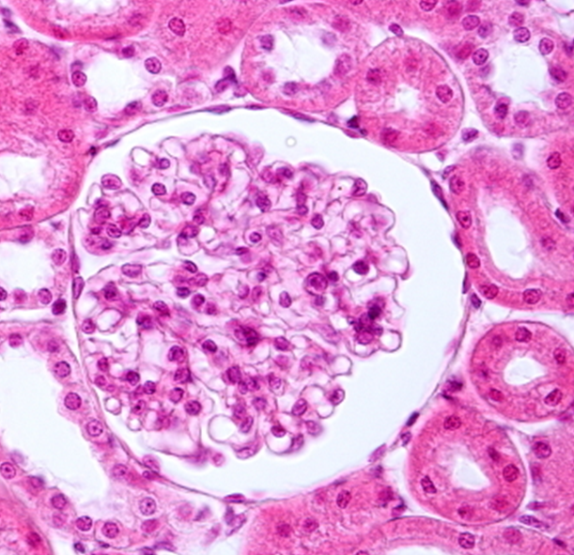
RPGN/CrGN
Normal glomerulus
Also known as Crescentic glomerulonephritis
Rapidly progressive glomerulonephritis (RPGN) is a clinical syndrome, characterized by
rapid & progressive loss/decline of renal function within weeks to months
Extensive glomerular crescent formation.
Patients present with nephritic syndrome and progress to acute renal failure. The prognosis is poor if untreated, even death.
Histologically there is severe glomerular injury → in the form of (1) crescent formation, (2) glomerular necrosis and (3) rupture of the glomerular basement membrane. Glomerular crescent formation is a characteristic finding in RPGN. Crescents are also called as glomerular extracapillary proliferations (i.e. proliferation outside the glomerular capillaries).
Crescents are formed
by proliferation of parietal epithelial cells that line the Bowman's capsule
and by migration of monocytes/macrophages into Bowman's space
Adnan MM et al. Case Rep Nephrol. 2014

Slide 7
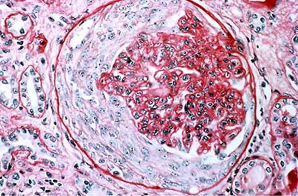
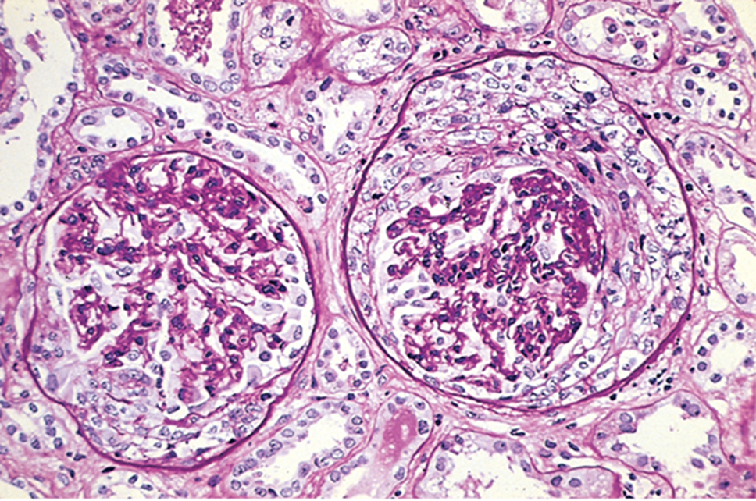
RPGN: Light Microscopy
Epithelial/cellular crescents are seen in majority (>50%) of the glomeruli that are sampled in a kidney biopsy.
It is called crescent because it has a crescent shape.
The crescents fill the Bowman's space and compress the glomerular capillary loops and can even rupture the GBM.
The glomeruli may also show necrosis.
Upon healing the crescents undergo fibrosis/scarring and are called fibrous crescents.

Slide 8
Based on cause (etiology) RPGN is divided into three types:
Types of RPGN/ CrGN
Type I RPGN = anti-glomerular basement membrane antibody–mediated Crescentic GN (about 12%): is characterized by the presence of auto antibodies directed against the glomerular basement membrane
Type II RPGN = immune complex mediated Crescentric GN (about 44%): here the crescents are seen in renal disease in which there is deposition of antigen antibody immune complexes e.g. SLE, IgA nephropathy, post-infectious GN etc.
Type III RPGN (Pauci-immune) ANCA-Associated Crescentric GN (about 44%): characterized by the presence of anti-neutrophil cytoplasmic antibodies (ANCA) e.g. granulomatosis with polyangitis (Wegener’s) and Microscopic polyangiitis.

Slide 9
Type I RPGN = Anti-glomerular basement membrane antibody disease (anti-GBM disease)
Anti-GBM antibody disease is a rare autoimmune disorder. In it there are auto-antibodies directed against an antigen that is normally present in the glomerular basement membrane (GBM).
On IF → characteristic linear staining/positivity with IgG immunoglobulin along the GBM (pic).
Patient’s serum is positive for anti-GBM antibodies.
When anti-GBM disease is associated with pulmonary hemorrhage (hemorrhagic pneumonitis) this combination is called as Goodpasture’s syndrome (in these patients, the anti-GBM antibodies also bind to pulmonary alveolar capillary basement membranes).

Slide 10
Type II RPGN = Immune complex mediated crescentric glomerulonephritis
It results from any immune complex mediated renal diseases in which there is deposition of antigen antibody immune complexes in the glomeruli. The crescents represent a more aggressive form of various immune complex mediated GNs, e.g.:
poststreptococcal GN,
Lupus nephritis (in systemic lupus erythematosus)
IgA nephropathy and Henoch-Schönlein purpura.
Etc.
A consistent finding in this form of GN is that:
on IF study there is positivity with various immunoglobulins and/or complements
and on EM study there are electron dense immune deposits.

Slide 11
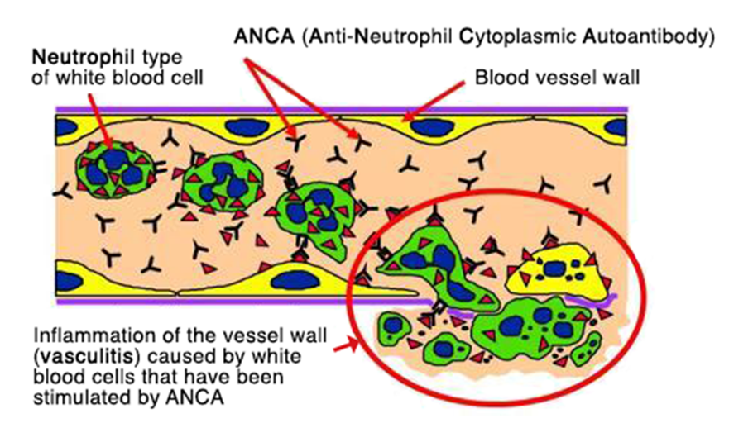
Type III RPGN = Pauci-immune ANCA-associated GN
It is called in pauci-immune GN because there is
no anti-GBM antibody
& no immune complex deposition (so IF is negative/almost negative and there are no deposits on EM).
Most patients have circulating antineutrophil cytoplasmic autoantibodies (ANCAs) in the blood. ANCA are autoantibodies that target antigens present in the neutrophil cytoplasm.
ANCA causes abnormal activation of neutrophil. As a result:
there is adhesion of the neutrophils to endothelial cells lining the capillaries (esp. glomerular capillaries)
Neutrophils release injurious products → that promote endothelial injury, vascular inflammation (vasculitis and fibrinoid necrosis of arteries and arterioles) and crescentic GN.
Note: RPGN type I and II are ANCA negative.
Pauci-immune cresentric GN is associated with systemic diseases like
granulomatosis with polyangitis (formerly called Wegener’s Granulomatosis)→ cANCA positive
microscopic polyangiitis → pANCA positive.

Slide 12
RPGN/ CrGN: clinical features
Present as rapid & progressive loss/decline of renal function within weeks to months, usually as nephritic syndrome that progresses to acute renal failure (marked oliguria and azotemia).
Proteinuria sometimes approaching nephrotic range may occur.
Timely diagnosis is important.
Treatment: Type I and Type III RPGN respond well to plasmapheresis (it removes pathogenic antibodies from the circulation), steroids and cytotoxic agents. Type II RPGN does not respond well to plasmapheresis, the original underlying disease needs to be treated.
Some patients require long-term dialysis or transplantation.

Slide 13
Chronic Renal Failure (CRF) or Chronic kidney disease (CKD)

Slide 14
Chronic Renal Failure (CRF)/ Chronic kidney disease (CKD)
Chronic kidney disease describes the slow or gradual loss of kidney function.
CKD can be the consequence of irreversible acute disease or progressive slow scarring in any type of chronic renal disease.
The end result is end stage kidney disease.
In end-stage kidney there is scarring of all 4 renal compartments: glomerular sclerosis, tubular atrophy, interstitial fibrosis and arteriosclerosis, regardless of the primary/original site of injury.
The prognosis is poor. Patients need with dialysis or transplantation otherwise death from uremia will results.
Dialysis and kidney transplantation allow long-term survival.

Slide 15
CRF/CKD: common causes
Chronic glomerulonephritis like RPGN, membranous GN, membranoproliferative GN, FSGS, IgA nephropathy, etc.
Diabetic Nephropathy
Hypertension
Reflux nephropathy in children
Polycystic kidney disease
Kidney infections & obstructions
Others

Slide 16
CRF/CKD: clinical features
In the early stages of chronic kidney failure → few signs or symptoms. Chronic kidney failure may not become apparent until your kidney function is significantly impaired.
Some patients are oliguric and some patients are not oliguric.
Gradual rise in BUN and serum creatinine.
High levels of urea in the blood can result in:
Azotemia (increased urea and creatinine)
Acidosis, hyperkalemia, Hypokalemia (due to failure of kidney to activate Vit D).
Abnormal fluid volume → changes in urine output e.g. initially increased urine output and later decreased urine output. The sodium and water retention can lead to volume overload and congestive cardiac failure.
Low levels of calcium → renal osteodystrophy
Anemia due to decreased erythropoietin.
Hypertension due to excess renin production.
Etc.

Slide 17
CKD: morphology
Grossly the kidneys are small and contracted with granular surface. Markedly damaged kidneys are designated "end-stage kidneys”.
Light microscopy:
Glomeruli → most of the glomerular are sclerosed (fibrosed/scarred) called glomerulosclerosis.
Tubules → show prominent atrophy with thyroidization of tubules (tubules are filled with eosinophilic hyaline casts resembling colloid of thyroid gland).
Interstitium → prominent interstitial fibrosis with lymphocytic infiltrate
Blood vessels→ show thick walled arteries and arterioles with narrowed lumen.
Hewitson, 2012 Fibrogenesis Tissue Repair. 5(Suppl 1):S14.
doi: 10.1186/1755-1536-5-S1-S14

Slide 18
End stage kidney Glomerulosclerosis and thyroidization of tubules
http://pathology.class.kmu.edu.tw/ch13/129-2.jpg

Slide 19
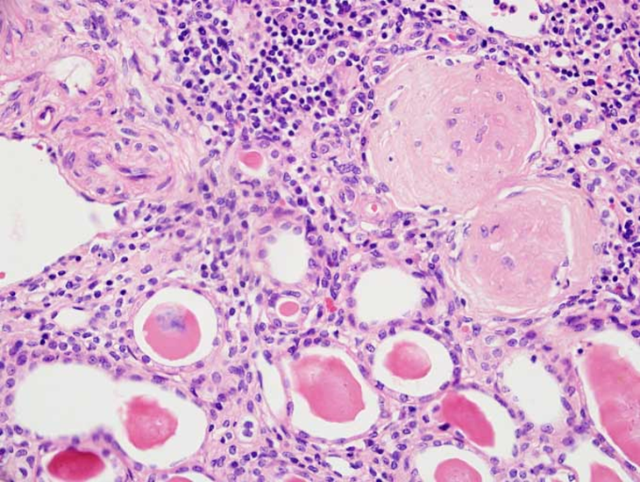
End stage kidney
http://peir.path.uab.edu/library/_data/i/upload/2013/08/01/20130801100717-c2bfd18e-me.jpg
http://www.iupui.edu/~pathol/c604_Systemic/labs/lab10/images/I-87.jpg

Slide 20
END

