Slide 1
Renal Pathology Acute kidney injury
May 2022
Reference: Robbins & Cotran Pathology and Rubin’s Pathology
Sufia Husain
Associate Professor
Pathology Department
College of Medicine
KSU, Riyadh

Slide 2
Acute kidney injury
Objectives:
Upon completion of this lecture the students will be able to:
Describe the guidelines of the renal biopsy.
Recognize the types of acute kidney injury.
Recognize the clinical manifestations of acute kidney injury.
Describe the pathological findings in acute kidney injury.
Key Outlines:
Brief review of the normal anatomy and histology of the kidney and urinary tract.
Terminology.
Etiology.
Pathophysiology.
Clinical manifestations with diagnostic approach.
Pathological evaluation: The four elements possibly implicated: Gross and histological findings.
Conclusion.

Slide 3
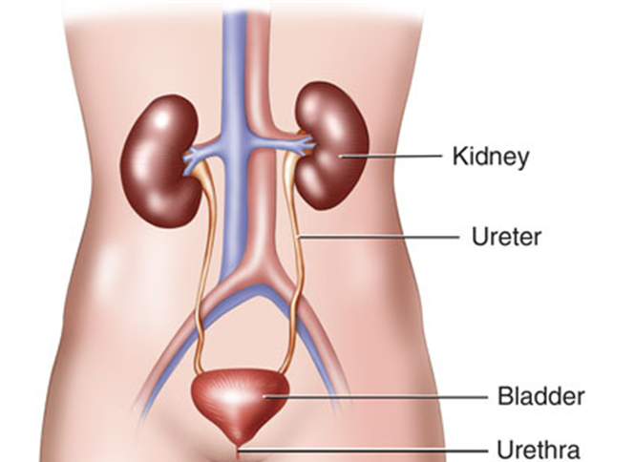
GROSS ANATOMY AND HISTOLOGY
http://www.kidneyalert.ca/uploads/1/0/5/4/10544203/7872649_orig.png

Slide 4
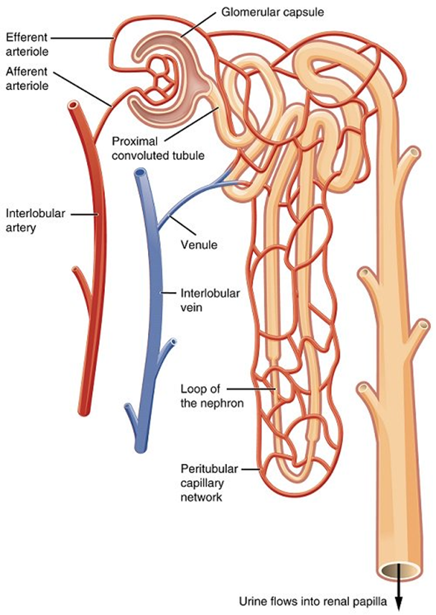
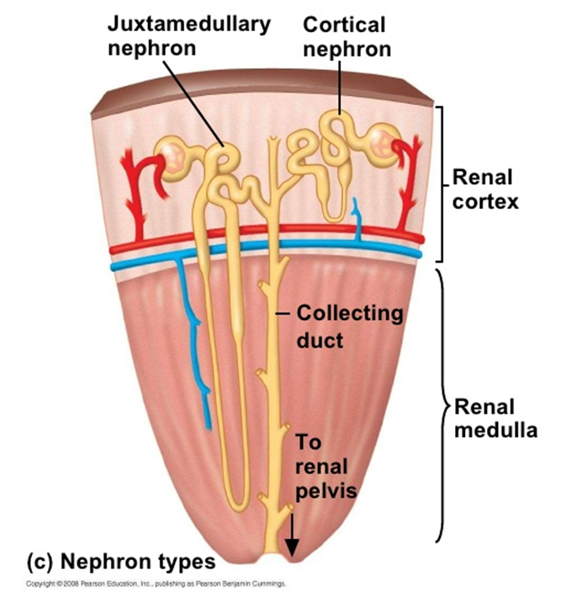
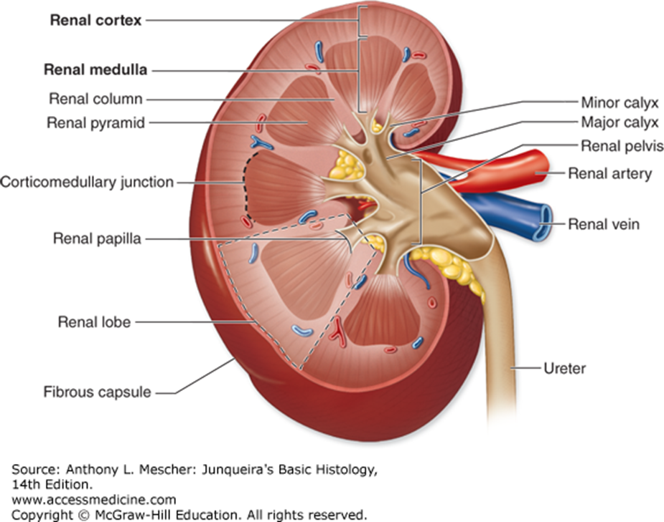
By OpenStax College - Anatomy & Physiology, Connexions Web site. http://cnx.org/content/col11496/1.6/, Jun 19, 2013., CC BY 3.0, https://commons.wikimedia.org/w/index.php?curid=30148538

Slide 5
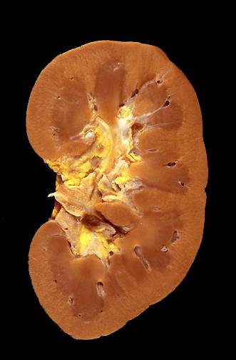
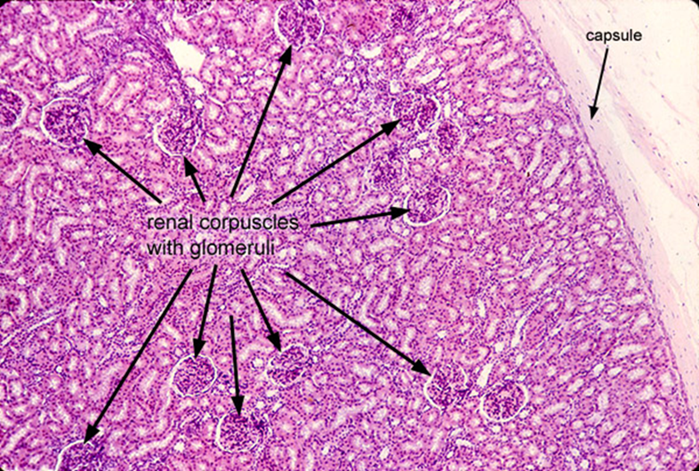
https://library.med.utah.edu/WebPath/RENAHTML/RENAL116.html

Slide 6
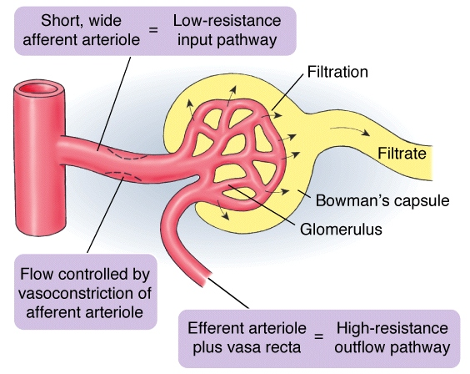
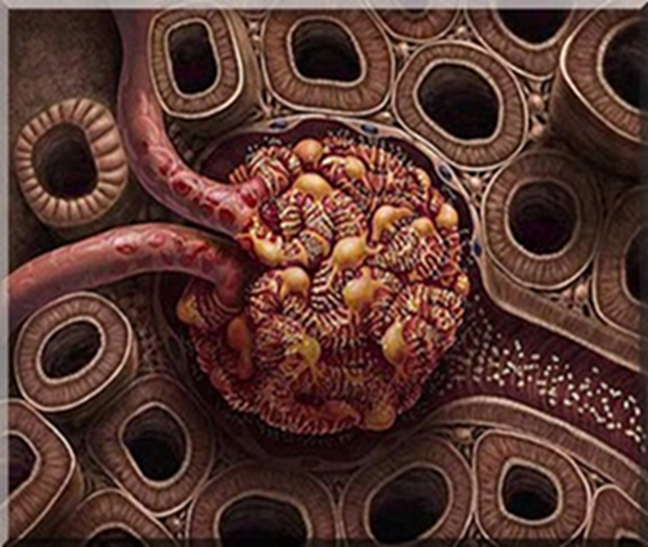
http://ib.bioninja.com.au/higher-level/topic-11-animal-physiology/113-the-kidney-and-osmoregu/ultrafiltration.html AND http://menu.bizzybeesevents.com/diagram_capsule_arteriole_bowman%27s_affterent.php

Slide 7
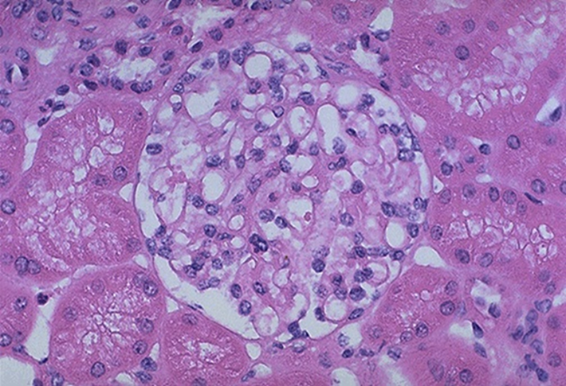
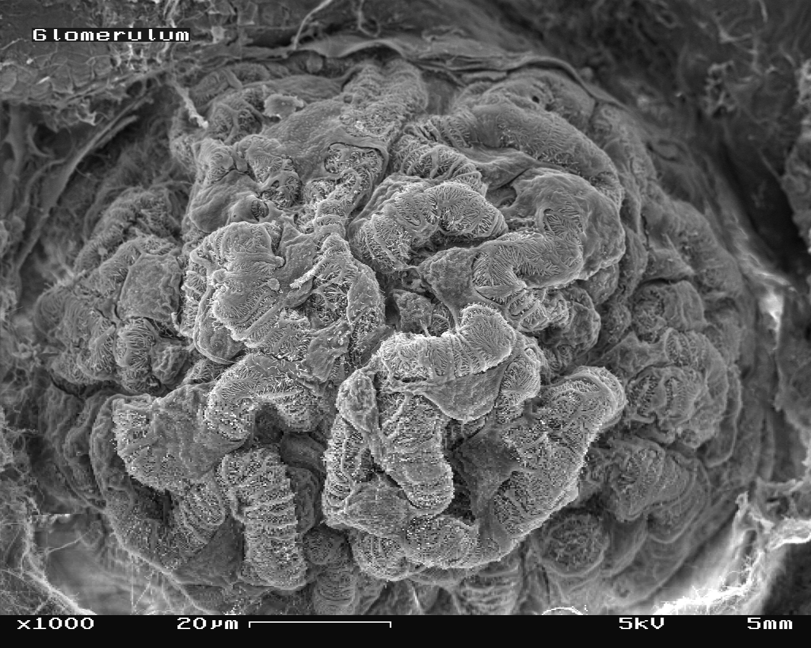
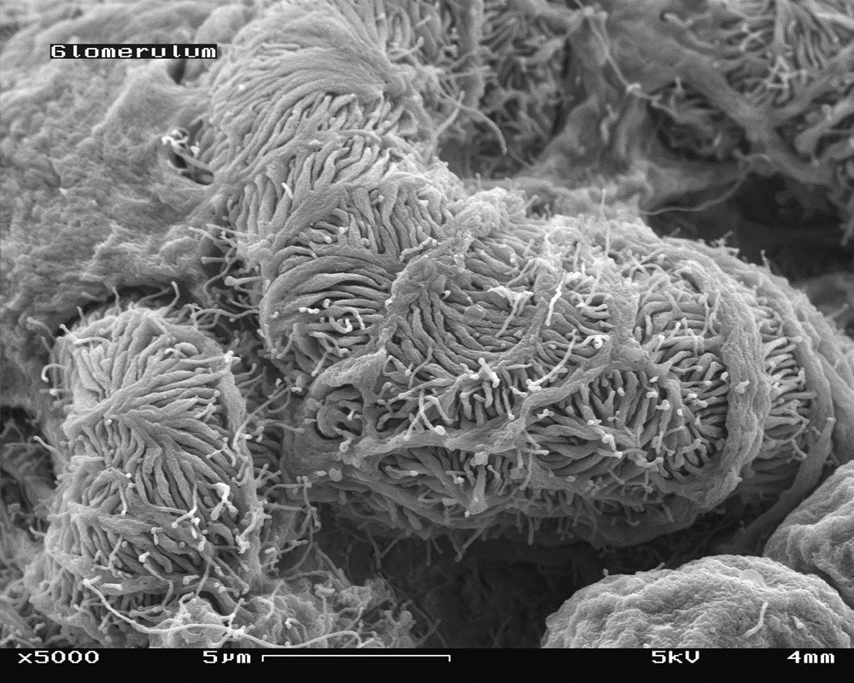
https://library.med.utah.edu/WebPath/RENAHTML/RENAL101.html
https://en.wikipedia.org/wiki/Glomerulus_(kidney)#/media/File:Glomerulum_of_mouse_kidney_in_Scanning_Electron_Microscope,_magnification_1,000x.GIF

Slide 8
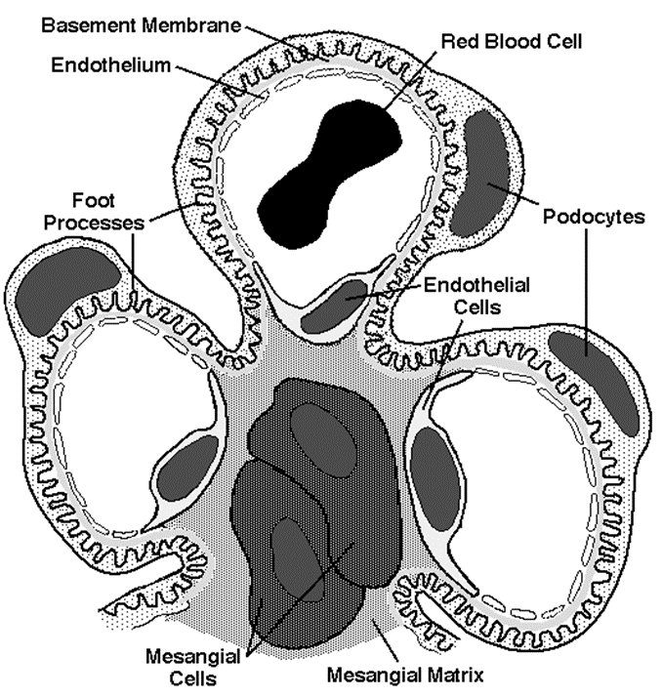
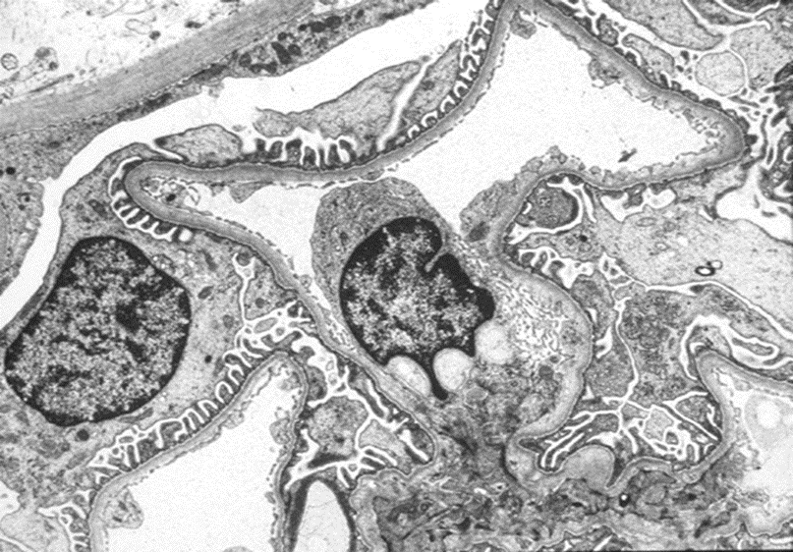
Glomerulus in Transmission EM
https://www.niddk.nih.gov/research-funding/at-niddk/labs-branches/kidney-diseases-branch/kidney-disease-section/glomerular-disease-primer/normal-kidney

Slide 9
Normal Kidney Function
Excretory function:
to detoxify blood, removal of toxins, nitrogenous wastes (urea and creatinine), drugs etc.
Homeostatic function:
maintain and regulate water balance and osmolality
maintain and regulate electrolyte balance (Na⁺, K^{+,} Ca²⁺, Cl⁻, Mg²⁺ ions etc.)
maintain and regulate acid-base balance (pH, H⁺ and HCO3⁻ ions).
Endocrine function:
secretes renin from the JGA cells → to regulate BP and electrolyte balance
secretes erythropoietin from the endothelial cells lining the cortical peritubular capillaries → to stimulate the bone marrow to produce rbcs
Kidney converts inactive Vit D3 to active 1,25- dihydroxycholecalciferol by alpha one hydroxylase enzyme under the influence of PTH → increases calcium absorption

Slide 10
https://www.weyburnreview.com/news/kidney-function-can-be-seen-using-new-tool-1.2216753

Slide 12
Terminology
Uremia: is a clinical syndrome associated with fluid, electrolyte, and hormone imbalances and metabolic abnormalities, which develops with deterioration of renal function. It is due to the accumulation of organic waste products that are normally cleared by the kidneys. The word uremia means urine in the blood. Uremia can be seen in both chronic kidney disease and acute kidney injury.
Azotemia: is abnormally high levels of nitrogen-containing compounds (such as urea, creatinine etc) in the blood. It can lead to uremia if not controlled. It is an elevation of blood urea nitrogen (BUN) and serum creatinine levels.
Oliguria: urine output less than 400 ml/24 hours
Anuria: urine output less than 200 ml/24 hours
Notes:
Creatinine clearance or filtration is dependent on the glomerular filtration rate (GFR).
GFR = Glomerular hydrostatic pressure – Bowman capsule hydrostatic pressure – glomerular oncotic pressure
Glomerular pressure is primarily dependent on renal blood flow.
In AKI → there is reduction in RBF → leads to decreasing GFR (this is the common pathologic pathway for AKI regardless of the cause).

Slide 13
RENAL PATHOLOGY

Slide 14
KIDNEY BIOPSY

Slide 15
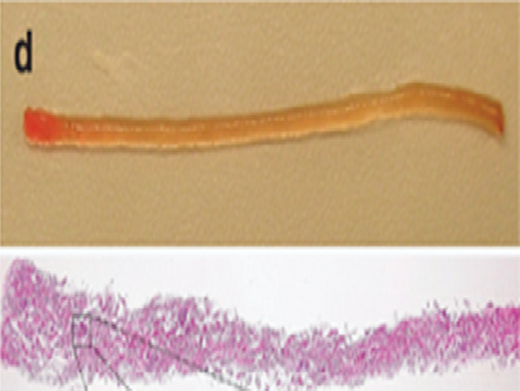
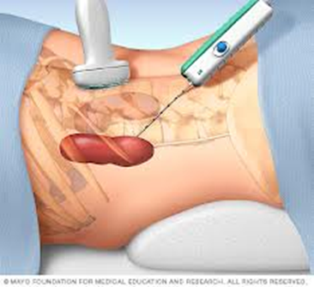
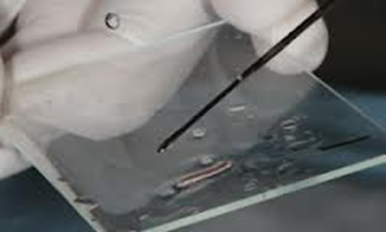
Kidney biopsy

Slide 16
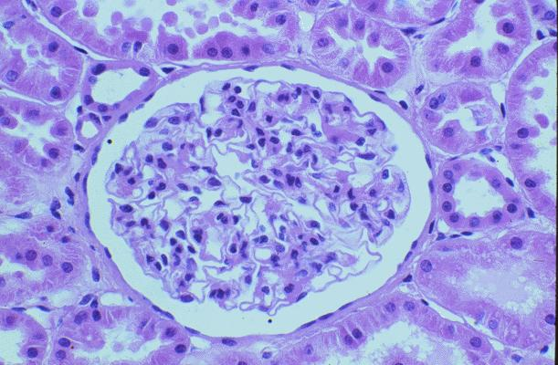
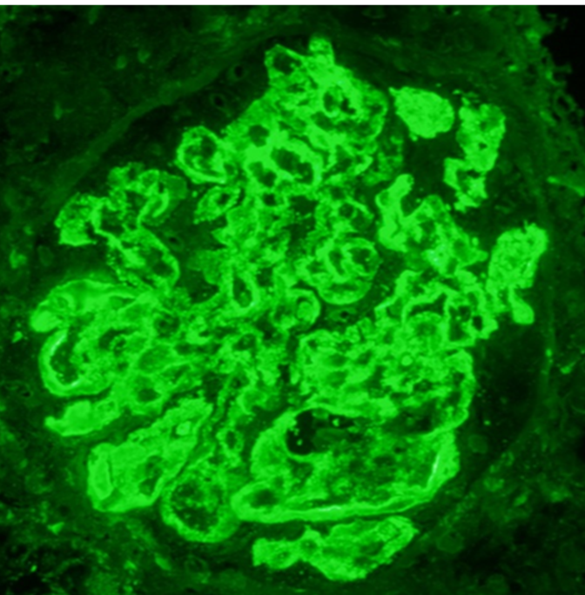
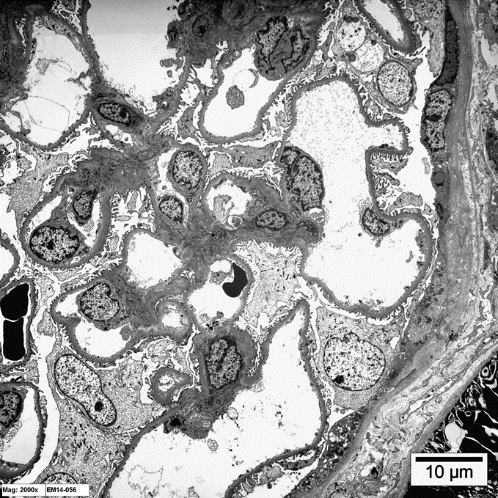
Kidney biopsy
LM
The tissue obtained is used to make slides for
Light microscopy (LM) to study the histology in renal cortex & medulla.
Immunofluorescence (IF) study is to detect
the presence of immunoglobulins (IgA, IgG, IgM) and complements (C3 and C1q) in the glomerular mesangium or in the wall of the glomerular capillary loops.
Electron microscopy (EM) (ultrastructural) study is to detect the presence or absence of
effacement of the epithelial cell (podocytes)foot processes.
electron dense immune complex deposits
If deposits are present then to identify the location of the deposits in the glomeruli (mesangial/paramesangial, subepithelial, subendothelial).
IF
EM

Slide 17
Renal (kidney) failure
Renal failure (renal insufficiency): is when the kidneys fail to adequately filter toxins and waste products from the blood.
In renal failure there is decrease in glomerular filtration rate and an elevated serum creatinine level.
Note: Creatinine clearance or filtration is dependent on the glomerular filtration rate (GFR).

Slide 18
Renal failure can be classified in 3 ways:
It can be acute or chronic
Acute is sudden onset, rapid reduction in urine output and usually reversible (acute kidney injury).
Chronic is gradually progressive with nephron loss and usually not reversible (chronic kidney disease).
It can be pre-renal, renal or post-renal
It can be oliguric, non-oliguric or anuric
Oliguric: the urine output is markedly decreased (usually it is less than 500 or 400 ml/day or urine output between 100ml/day and 400ml/day).
Non-oliguric: urine output greater than 400ml/day.
Anuric: urine output less than 100ml/day.
Note: sometimes more than 70% of renal function can be lost before it is clinically noticeable

Slide 19
ACUTE KIDNEY INJURY

Slide 20
Acute kidney injury (AKI) (previously called acute renal failure [ARF])
AKI is a syndrome defined by a sudden loss of renal function over several hours to days resulting in the accumulation of nitrogenous compounds such as urea and creatinine. It is characterized by
Sudden decrease in GFR (hours to days)
Accumulation of nitrogenous waste products.
Rapid rise in serum creatinine
Oliguria: the urine output is markedly decreased (usually it is less than 400 ml/day)
Fluid imbalance; electrolyte imbalance; acid-base disturbance; and mineral disorders.
Note: in AKI → there is reduction in renal blood flow/ renal perfusion → decrease in glomerular filtration rate (this is the common pathologic pathway for AKI regardless of the cause). The decreased GFR → activation of renin-angiotensin-aldosterone system. These physiologic changes result in increased sodium reabsorption, increased water retention, increased urinary creatinine concentration, increased urine specific gravity and increased urine osmolality. Acids are retained and HCO₃ is excreted.

Slide 21
Acute kidney injury (AKI)
Definition [based on Kidney Disease Improving Global Outcomes (KDIGO)]: AKI is defined by the presence of any one of the following:
Kidney Disease Improving Global Outcomes (KDIGO) Clinical Practice Guideline for Acute Kidney Injury. Kidney Int Suppl 2012;2:1-138.

Slide 22
Causes of AKI (etiologic classification)
AKI can be divided into pre-renal, renal or post-renal etiology.
Pre-renal (55-60%): the renal tubular and glomeruli are normal. Here the GFR is decreased due to reduced renal perfusion.
Renal/ intrarenal/ intrinsic (35-40%): is due to diseases of the kidney itself (which is associated with release of renal afferent vasoconstrictors)
Post-renal (5-10%):

Slide 23
Pre-renal causes of ARF (pre-renal azotemia)
Pre-renal pathology is the most common cause of ARF
It results from decreased renal perfusion (i.e. hypoperfusion or decreased effective blood flow to the kidney).
Initially the body tries to compensate but in severe hypoperfusion → GRF is markedly decreased → AKI.
The treatment of the cause restores the renal function.
Pre-renal causes of ARF are:
Anything that leads to renal hypoperfusion:
Hypovolemia: e.g. hemorrhage, volume depletion (dehydration or GIT fluid loss in vomiting, diarrhea), hypoalbuminemia, diuretics, third space losses (burns, peritonitis, muscle trauma) etc.
Impaired cardiac function (cardiac failure, myocardial infarction, massive pulmonary embolism)
Sepsis, septic shock.
Cirrhosis (it can cause renal vasoconstriction → kidney injury called “hepatorenal syndrome”)
Anaphylaxis
Other causes: surgery, NSAIDS and other nephrotoxic drugs etc.

Slide 24
Renal causes of AKI (intrinsic causes)
Diseases of the kidney → can lead to AKI.
The diseases of the kidney can be
glomerular
tubular
vascular
or interstitial
The disease may involve one or more of the above mentioned renal compartments.
Common causes include acute tubular injury/necrosis, acute interstitial nephritis and severe forms of active glomerulonephritis.
Note: the contrast medium/dye used in various radiological tests can occasionally induce AKI.

Slide 25
RENAL causes of AKI
Glomerular diseases | Tubular diseases |  | Vascular diseases | Interstitial and tubulo-interstitial diseases
There is glomerular injury in severe forms of active glomerulonephritis (GN) → leads to reduction in total filtration area → reduction in GFR. Examples include: Post infectious GN Rapid progressive crescentic GN Active autoimmune GN Etc. | Acute Tubular Injury/ Necrosis It can be ischemic cause or nephrotoxic cause |  | Various forms of vasculitis and emboli lead to reduced renal blood flow due to vascular obstruction or destruction, thus lowering the GFR e.g. Vasculitis Thromboembolic disease (renal artery/ renal vein thrombosis) Thrombotic microangiopathies (HUS/ TTP) Malignant hypertension | Acute Tubulo-interstitial Nephritis (TIN) e.g. Drug induced TIN Autoimmune TIN Infections TIN Rarely malignant infiltration in interstitium can cause AKI
 | Ischemic: prolonged ischemia to nephrons leads to tubular injury and necrosis | Toxic: toxicity to nephrons leads to tubular injury & necrosis I) Endogenous toxins Pigments and casts: Myoglobinuria (in Rhabdomyolysis) Hemeglobinuria Myeloma casts etc. II) Exogenous toxins Nephrotoxic drugs: Aminoglycosides (antibiotic). Amphotericin B Calcineurin inhibitors (e.g., tacrolimus) etc. Radiograph contrast medium (dyes induced toxicity)

Slide 26
Post renal causes of AKI/ ARF
Any obstruction to the outflow of urine:
Congenital or structural abnormality
Benign prostatic hyperplasia (older men)
Stones in the urinary tract
A tumor in the urinary tract (e.g. ureter, bladder, prostate, urethra).
External compression from the outside of the urinary tract (e.g. retroperitoneal fibrosis or tumors like carcinoma of cervix).

Slide 27
Summary of causes of AKI
Clin Biochem Rev 37 (2) 2016

Slide 28
Summary of causes of AKI

Slide 29
Note: Common causes of AKI
The kidney biopsy of a patient with AKI can show any of the previously mentioned causes. The common causes are:
Tubular cause: acute tubular injury/ acute tubular necrosis
Interstitial cause: acute tubulointerstitial nephritis (later lectures)
Glomerular cause:
Post infectious glomerulonephritis (later lectures)
Rapid progressive crescentic glomerulonephritis (later lectures)

Slide 30
Acute tubular injury/ necrosis
(tubular cause of AKI)

Slide 31
Acute tubular injury and Acute tubular necrosis
In acute tubular injury/ necrosis there is damage to the epithelial cells of the renal tubule and it leads to rapid decline of renal function (i.e. AKI) and presence of granular casts and tubular cells in urine. The damage can be induced by:
Ischemia leading to renal ischemic injury:
renal ischemia → reduction in GFR → acute tubular injury/ necrosis. The proximal tubule is most vulnerable to ischemia. [renal ischemia can be caused by any condition that causes prolonged persistent hypovolemia or circulatory shock e.g. extensive trauma, burns, hemorrhage, pancreatitis, incompatible blood transfusions, dehydration, septic shock, etc.]
Substances toxic to the kidney leading to nephrotoxic injury:
here the AKI is caused by direct injury of the tubules by toxins. Causes include:
Antibiotics: Aminoglycosides, Tetracyclines, Amphotericin, Cephalosporins etc.
Heavy metals: Mercury, Lead, Arsenic, Gold salts, Barium etc.
Others: Cisplatin, Doxorubicin, Carbon tetrachloride, Radiographic contrast agents, etc.

Slide 32
Acute tubular injury/ necrosis
Gross morphology
bilaterally enlarged & swollen kidneys (due to edema)
Cut surface shows a pale cortex and a dark & congested medulla
http://pathology.jcu.edu.au/Virtual%20Museum/Images/E.%20Urinary/ER-11.htm

Slide 33
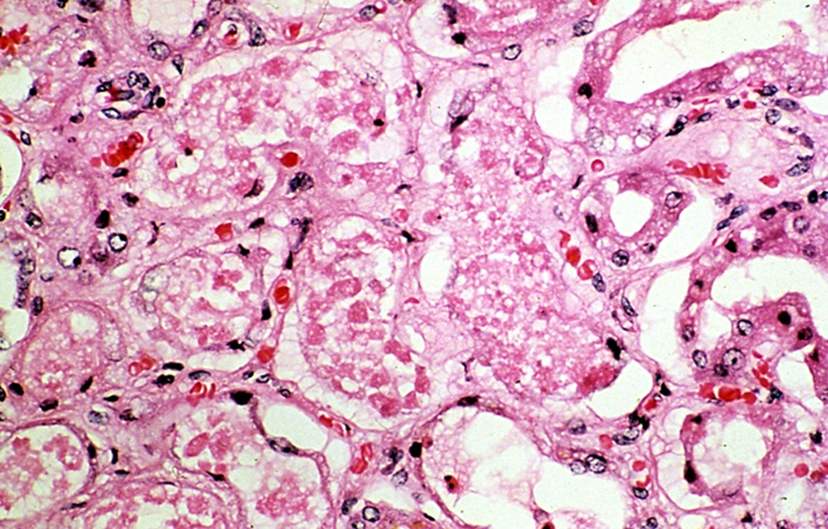
Acute tubular injury/necrosis
Histology:
Ranges from tubular epithelial cell swelling (in mild injury) to tubular epithelial cell necrosis (in severe injury).
The proximal tubules become dilated and irregular in shape.
The tubular epithelial cells become flattened (so the wall of the tubule becomes thin)
The tubules show loss of brush border.
In the necrotic tubular epithelial cells there is loss of nucleus and also there is sloughing (falling off) of necrotic cells into the lumen of the tubule.

Slide 34
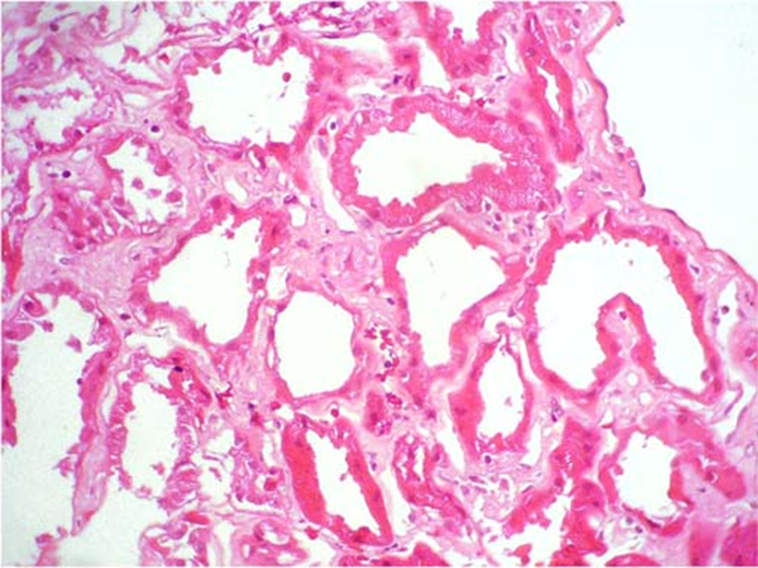
Acute tubular injury/ necrosis
Normal tubule

Slide 35
Clinical features of AKI:
Oliguria: Decreased urine output (occasionally urine output remains normal). Typically the urinary output is < 400 ml/day.
Defective elimination of metabolic waste, water, electrolytes, and acids from the body. Waste material is accumulated in the body which causes azotemia (→ nausea & vomiting), acid-base imbalance (→ acidosis) and electrolyte imbalance like hypernatremia and hyperkaliemia (→ abnormal heart rhythms, risk of heart failure, weakness and muscle paralysis).
Salt and water retention → generalized edema starting with swelling in your legs, ankles or feet.
Pulmonary edema (shortness of breath due to extra fluid on the lungs).
Other features: hypotension, nephritic syndrome, flank pain, fatigue, uremic encephalopathy, confusion, seizures or coma in severe cases
Sometimes acute kidney failure causes no signs or symptoms and is detected through lab tests done for another reason.

Slide 36
Treatment
Treat the underlying etiology.
Dialysis
Correction of fluid imbalance.
Correction of acidosis and electrolyte imbalance e.g. hyperkalemia:

Slide 37
Thank you

