Slide 1
PATHOLOGY OF TUMORS OF THE KIDNEY & URINARY TRACT
May 2022
Reference: Robbins & Cotran Pathology and Rubin’s Pathology
Sufia Husain
Associate Professor
Pathology Department
College of Medicine
KSU, Riyadh

Slide 2
OBJECTIVES
At the end of the lecture the students will be able to:
Recognize the benign tumors of the kidney.
Describe renal cell carcinoma and Wilm’s tumor.
Recognize transitional cell and squamous carcinoma of the urinary bladder.
Key Outlines:
Benign tumors of the kidney.
Renal Cell Carcinoma.
Wilm’s tumor (nephroblastoma).
Transitional Cell and Squamous Carcinoma of bladder.

Slide 3
LECTURE OUTLINE
Tumors of Kidney
Benign tumors of the kidney
Oncocytoma
Angiomyolipoma
Malignant tumors of the kidney
Renal Cell Carcinoma
Wilm’s tumor (nephroblastoma)
Tumors of urinary tract
Transitional cell neoplasms of urinary bladder
Squamous cell carcinoma of urinary bladder

Slide 4
NEOPLASMS OF KIDNEY

Slide 5
TUMORS OF THE KIDNEY
Benign Tumors
RENAL ONCOCYTOMA
ANGIOMYOLIPOMA
Malignant Tumors
RENAL CELL CARCINOMA
WILM’S TUMOR

Slide 6
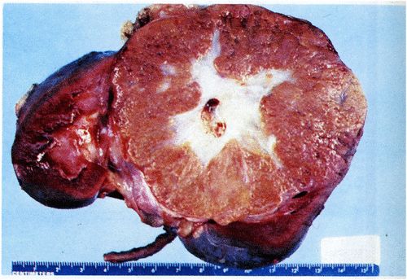
RENAL ONCOCYTOMA
Benign tumors that arises from the intercalated cells of the collecting ducts in the kidney.
Grossly: well circumscribed mahogany-brown colored tumor with a central stellate scar.
Microscopically: they are composed of uniform round polygonal cells with abundant, intensely eosinophilic and granular cytoplasm with uniform round and central nuclei. These cells are called as oncocytes or oncocytic cells.
Electron microscopy: there are numerous mitochondria in the cytoplasm.
Radiologically: they mimic renal cell carcinoma.
Complications: spontaneous hemorrhage.
Ali et al. Annals of Saudi Medicine, Vol 4 No. 4; 1984

Slide 7
ANGIOMYOLIPOMA
Angiomyolipomas benign neoplasm composed of admixture of blood vessels, spindle shaped smooth muscle cells and adipose tissue
The amount of each component is variable
They are usually associated with tuberous sclerosis syndrome.
(Note: adipose tissue = fat cells)
http://www.histopathology.guru/wp-content/uploads/2018/05/DSCN3356-p-1024x768.jpg

Slide 9
RENAL CELL CARCINOMA (RCC)
Renal cell carcinoma is the most common primary cancer of the kidney. It accounts for 80% of all renal cancers.
It arises from renal tubular epithelial cells.
Seen in men ranging from 50-60 years of age.
Men affected more than women.
Types of RCC
TYPES OF RCC | FREQUENCY (%)
Clear cell type | 65%
Papillary type | 10-15%
Chromophobe type | 5%
Others | 15%

Slide 10
RCC
Risk factors include:
Tobacco (smoked or chewed).
Acquired cystic kidney disease due to end stage renal disease 🡪 they predispose to papillary RCC (as a complication of chronic dialysis)
Chronic hypertension
Obesity
Occupational exposure to cadmium
Genetic: about 5% are inherited. Hereditary RCCs tend to be multifocal & bilateral & appear at a younger age than sporadic RCC.
Hereditary clear cell RCC 🡪associated with Von Hippel-Lindau (VHL) Syndrome in which there is an autosomal dominant germline mutation of VHL gene at chromosome 3 (VHL syndrome is characterized by cerebellar hemangioblastomas, retinal angiomas, clear cell RCC, pheochromocytoma and cysts in kidney).
Hereditary papillary RCC 🡪 associated with mutations in the c-MET protooncogene at chromosome 7. There is no association with the VHL gene.

Slide 11
RCC: CLEAR CELL TYPE
These are the most common type and arises from proximal tubular epithelial cells.
The majority of them are sporadic. Uncommonly associated with VHL disease.
Gross:
usually solitary and large.
cut surface: well circumscribed solid heterogenous partly yellow and partly hemorrhagic mass. May be cystic and necrotic.
Tumor commonly invades the renal vein. There may be direct invasion into the perinephric fat and adrenal gland.
http://web2.airmail.net/uthman/specimens/images/renal_cell_ca.html

Slide 12
RCC: CLEAR CELL TYPE
Microscopically:
Tumor is made up of cells with clear cytoplasm and sharp cell membrane. The cells are often arranged in sheets or nests. The stroma is highly vascularized. The nuclei can range from no atypia to marked atypia/pleomorphism. Some tumors exhibit marked degrees of anaplasia.
https://upload.wikimedia.org/wikipedia/commons/thumb/6/6d/Renal_clear_cell_ca_%281%29_Nephrectomy.jpg/1591px-Renal_clear_cell_ca_%281%29_Nephrectomy.jpg

Slide 13
RCC: papillary cell type
The tumors have a papillary growth pattern.
They can be sporadic or familial.
The familial forms are uncommon and show mutation in the MET proto-oncogene.
RCC: chromophobe cell type
The tumors are made up of chromophobic cells (they are acidophilic granular cells).
Note: papillary and chromophobe RCCs have a better prognosis than the clear cell RCC.

Slide 14
RCC: CLINICAL FEATURES
The incidence of RCC peaks in the sixth decade.
RCC is twice as frequent in men as in women.
Hematuria is the single most common presenting sign.
The classic clinical triad 🡪 hematuria, flank pain and a palpable abdominal mass.
Some patients develop polycythemia.
Uncommonly, these tumors produce paraneoplastic syndromes e.g. [a] secretion of a parathormone-like substance leads to hyperparathyroidism and hypercalcemia; [b] production of erythropoietin causes erythrocytosis, polycythemia; [c] release of renin results in hypertension [d] may present with Cushing syndrome, masculinization.
These tumor have a high tendency to invade the renal vein and metastasize.
Sometimes RCC is a silent and discovered only after metastasis.
The tumor spreads most frequently to the lungs and bones

Slide 16
WILMS TUMOR (NEPHROBLASTOMA)
It is malignant tumor arising from embryonic nephrogenic elements. It is composed of mixtures of blastemal, stromal, and epithelial cells.
The precursor lesion for the Wilms tumor is called as nephrogenic rests.
It is the most common primary tumor of the kidney in children
Most cases of Wilms tumor are sporadic and unilateral.
Some cases of Wilms tumor are familial with deletion of WT1 gene on chromosome 11p13.
Can be associated with WAGR syndrome, Denys Drash syndrome and Beckwith weidmann syndrome.

Slide 17
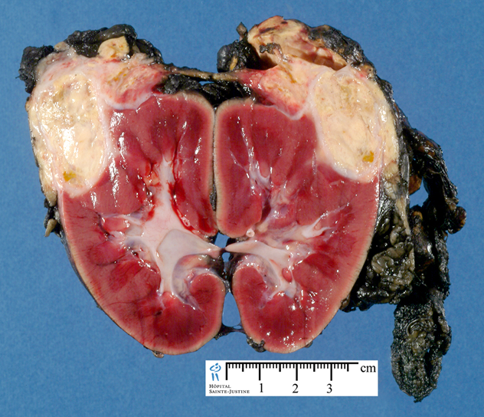
WILMS TUMOR: MORPHOLOGY
Gross:
Unilateral (10% bilateral), solitary, well circumscribed lesion.
By the time Wilms tumor is detected it is large.
Cut section: uniform, pale gray and soft in consistency (Fish flesh like)
The tumor may show foci of hemorrhage, cystic degeneration & necrosis

Slide 18
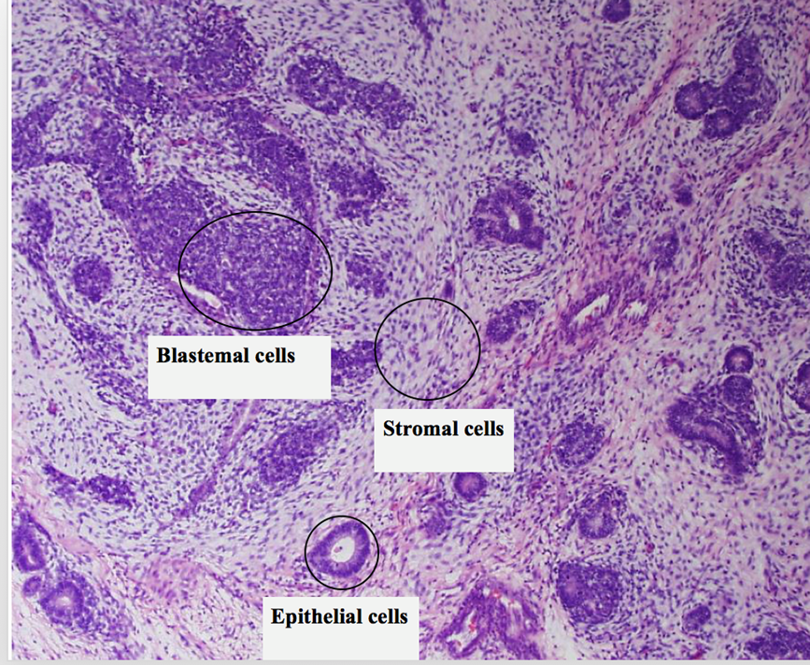
WILMS TUMOR:
Microscopy:
It is composed of the classical triphasic combination of (i.e. 3 patterns):
Blastemal component /cells: composed of densely packed small round blue cells with scanty cytoplasm and brisk mitosis
Epithelial component (immature epithelial cells): composed of immature primitive tubular structures (rosettes) and immature glomeruli.
Stromal component/ cells: composed of immature undifferentiated mesenchymal stromal cells (i.e. immature spindle cells and myxoid material).
Biphasic and monophasic patterns can also occur.
5% of tumors contain foci of anaplasia. Anaplasia is an indication of poor prognosis.
http://www.histopathology.guru/wp-content/uploads/2018/06/wilms-tumor-300x207.jpg

Slide 19
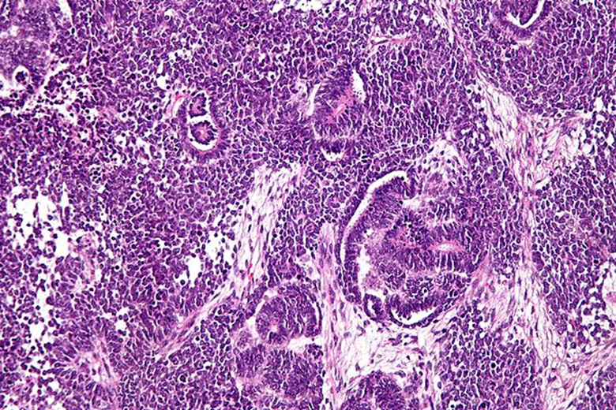
By Nephron - Own work, CC BY-SA 3.0, https://commons.wikimedia.org/w/index.php?curid=14818887

Slide 20
WILMS TUMOR:CLINICAL FEATURES
Clinical features
Wilms tumor usually presents between 1 and 3 years of age, and 98% occur before 10 years of age.
Most common presentation: abdominal mass with no other associated symptoms
Other signs or symptoms (seen in about 20% of cases): abdominal pain, hematuria, hypertension and anemia
Treatment and prognosis
Chemotherapy and radiation therapy combined with surgical resection, have dramatically improved the outlook of patients with this tumor.
The prognosis for Wilms' tumor is generally very good

Slide 21
TUMORS OF THE LOWER URINARY TRACT

Slide 22
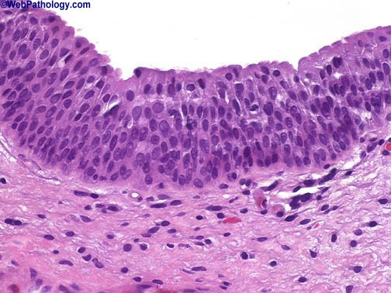
NORMAL UROTHELIUM

Slide 23
TUMORS OF THE LOWER URINARY TRACT
Tumors in the collecting system above the bladder are relatively uncommon
A small lesion in the ureter may cause urinary outflow obstruction and have greater clinical significance than a much larger mass in the large capacious bladder.
The types of urothelial tumors include the following:
Non invasive papillary lesions
Papilloma (benign)
PUNLMP (borderline)
Noninvasive papillary urothelial carcinoma low grade (malignant)
Noninvasive papillary urothelial carcinoma high grade (malignant)
Non invasive flat lesions
Flat urothelial carcinoma in situ
Invasive urothelial carcinoma (worst prognosis).

Slide 24
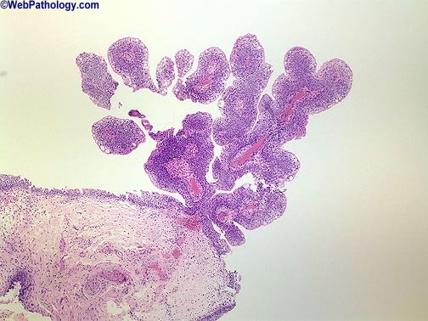
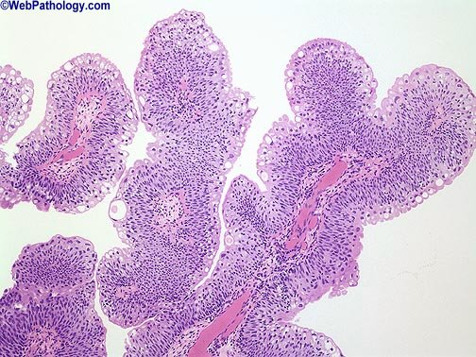
PAPILLOMA
are rare and benign.
They are non-invasive papillary tumor lined by benign transitional epithelium.
Usually solitary
Do not recur once removed.

Slide 25
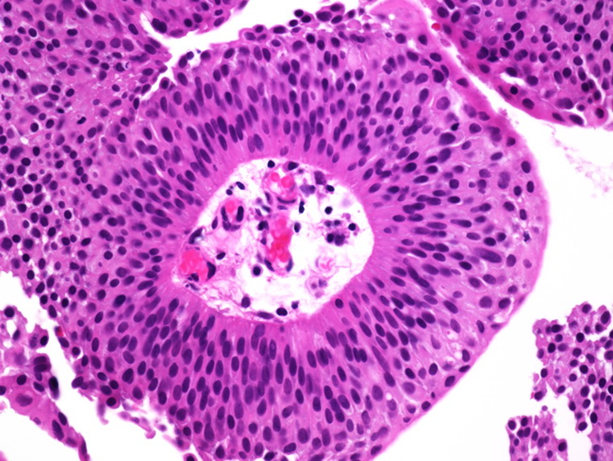
PAPILLARY UROTHELIAL NEOPLASM OF LOW MALIGNANT POTENTIAL (PUNLMP)
Uncommon.
They are non-invasive papillary tumors with nuclear features intermediate between papilloma and low grade papillary urothelial carcinomas
They may recur after removal.

Slide 26
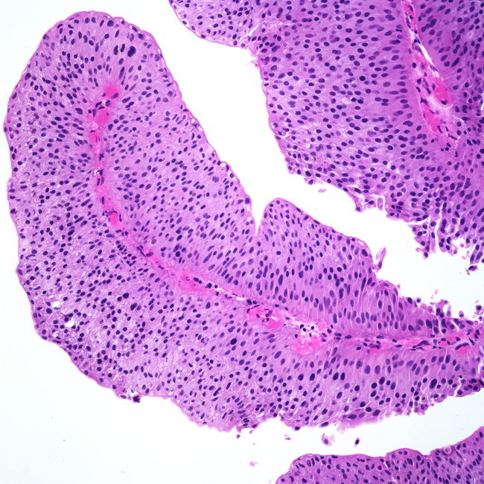
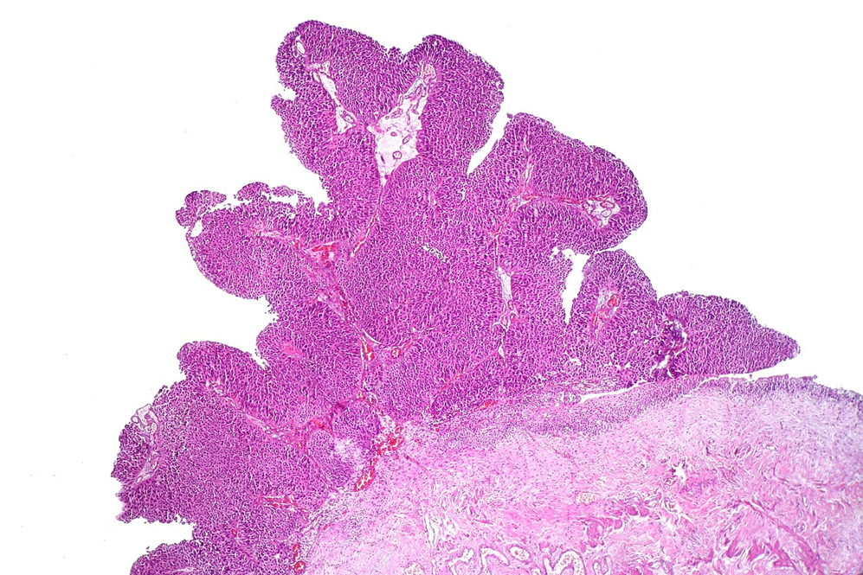
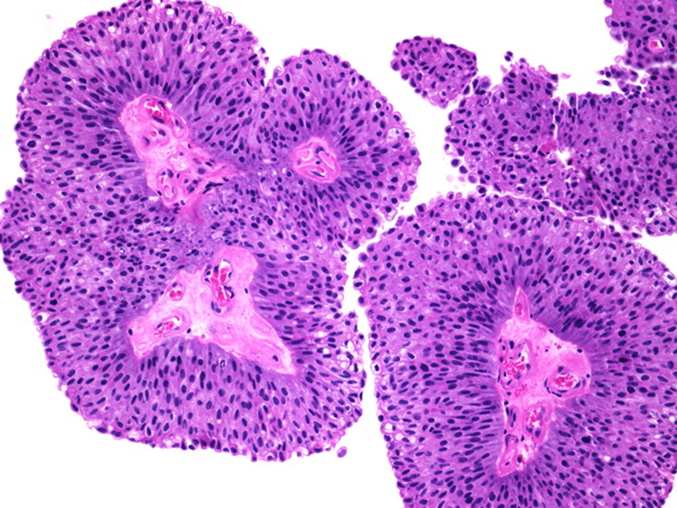
NONINVASIVE PAPILLARY UROTHELIAL CARCINOMA LOW GRADE
Non-invasive papillary tumors made up of papillary projections lined by malignant urothelial cells with mild atypia/ pleomorphism and mild mitotic activity.
By CoRus13 - Own work, CC0, https://commons.wikimedia.org/w/index.php?curid=72016202

Slide 27
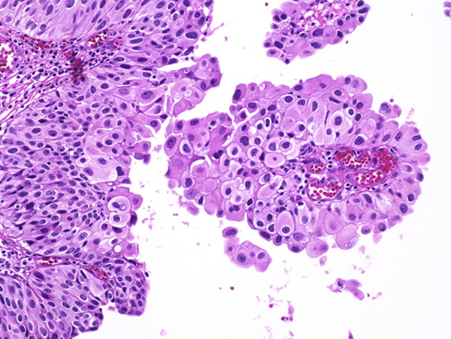
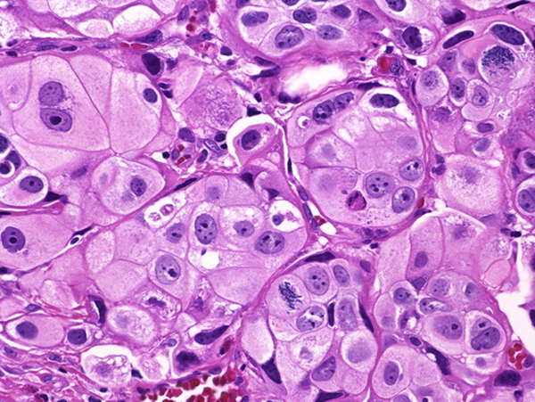
NONINVASIVE PAPILLARY UROTHELIAL CARCINOMA HIGH GRADE
Non-invasive papillary tumor made up of papillary projections lined by poorly differentiated malignant urothelial cells with marked atypia/ pleomorphism and significant (brisk) mitotic activity.
Majority of high grade papillary urothelial carcinomas progress 🡪 and they invade into the underlying lamina propria and the muscularis propria becoming 🡪 invasive urothelial carcinoma.

Slide 28
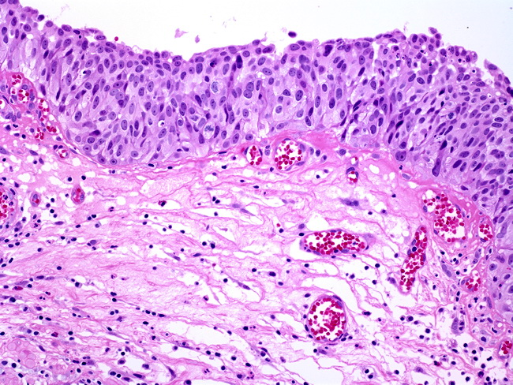
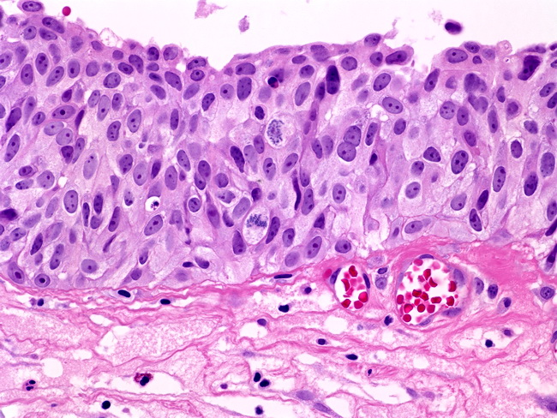
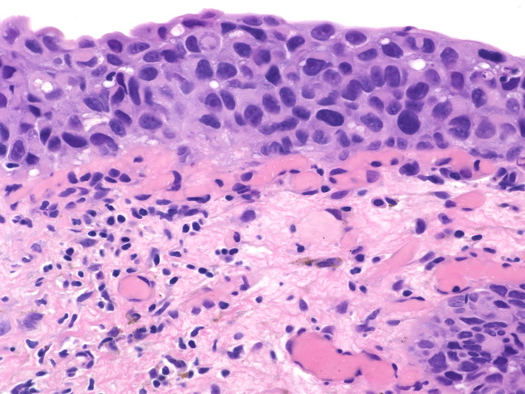
UROTHELIAL CARCINOMA IN SITU
Non-papillary, non-invasive flat lesions.
Tend to be multifocal.
There is the full-thickness dysplasia of the urothelium (hyperchromatic and pleomorphic cells with prominent nucleoli).
There may be excessive shedding of malignant cells in urine.
In about 50% of cases it is associated with subsequent invasion into the underlying lamina propria and the muscularis propria becoming 🡪 invasive urothelial carcinoma.

Slide 29
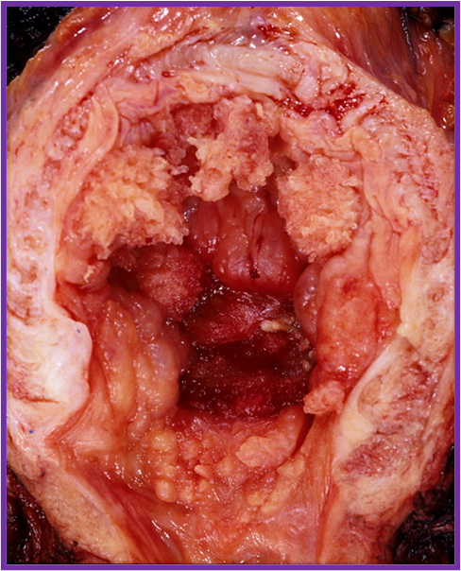
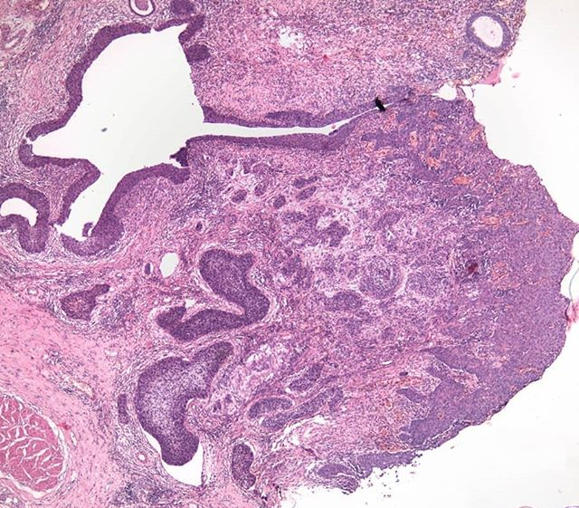
INVASIVE UROTHELIAL CARCINOMA
Invasive urothelial carcinoma usually progresses from a
High grade papillary urothelial carcinoma
and flat urothelial carcinoma in situ.
Among urothelial tumors they have the worst prognosis.
Microscopically, the tumor cells infiltrate beyond the basement membrane into the underlying tissue (the lamina propria and muscularis propria i.e. the detrusor muscle) in the form of irregular nests, lobules and single cells.
@andreafelso @ofpathology
https://gramho.com/profile/ffix_it/23398923249

Slide 30
UROTHELIAL CARCINOMA
More common in men.
Age: 50 to 70 years.
Predisposing factors:
Bladder tumors are more common in those exposed to chemicals called aromatic amines (arylamines) such as benzidine and beta-naphthylamine, which are sometimes used in the dye industry (aniline and Azo dyes).
Cigarette smoking and chronic cystitis
Chronic bladder irritation from stones or long term bladder catheters
Chemotherapy (long-term use of cyclophosphamide) and
Radiotherapy (previous exposure of the bladder to irradiation)
They are not familial.
Clinical Features
Painless hematuria is the dominant clinical presentation of all these tumors and less frequently as dysuria. Cystoscopy reveals the tumor.
Bladder cancers vary from exophytic, flat, ulcerated to deeply invasive.
Bladder cancer metastasize to regional lymph nodes, liver, lung, and bone.

Slide 31
NON-UROTHELIAL CARCINOMAS OF THE LOWER URINARY TRACT
are rare and have very poor prognosis.
Squamous cell carcinoma.
Adenocarcinoma.
Small cell neuroendocrine carcinoma.
Sarcomas (leiomyosarcoma, rhabdomyosarcoma)
Metastatic (from cervix, prostate etc).

Slide 32
Squamous cell carcinoma of the bladder develops in foci of squamous metaplasia.
Long standing Schistosoma haematobium infections can predispose to squamous cell carcinoma of the urinary bladder.

