Slide 1
INTRODUCTION TO RENAL ALLOGRAFT PATHOLOGY
May 2022
Reference: Robbins & Cotran Pathology and Rubin’s Pathology
Sufia Husain
Associate Professor
Pathology Department
College of Medicine
KSU, Riyadh

Slide 2
OBJECTIVES:
At the end of the lecture the students will be able to:
Recognize the concept of renal allograft.
Describe the pathology of rejection and differentiate acute cell-mediated and antibody-mediated rejection.
Differentiate between acute and chronic rejection.
Recognize the pathology of the principal infections inherent to renal transplantation.
Recognize the pathology of acute and chronic drug toxicity.
Key Outlines:
Acute T-cell mediated rejection.
Acute antibody-mediated rejection.
Pathology of chronic rejection.
Pathology of the principal infections of the renal allograft.
Pathology of acute and chronic drug toxicity.

Slide 3
LECTURE OUTLINE
Pathology of injury in kidney transplant
Harvest injury
Rejection: hyper-acute rejection, acute rejection (T-cell mediated and antibody mediated) and chronic rejection
Infections in the renal allograft.
Drug toxicity, acute and chronic.
Recurrence of primary disease
De-novo (new) disease

Slide 4
KIDNEY TRANSPLANT
End-stage renal disease (resulting from any cause) is treated by renal replacement therapy (e.g. hemofiltration, hemodialysis, peritoneal dialysis) or renal transplant.
Kidney transplantation is now a routine procedure in most large hospitals in the world.
The first kidney transplant between humans was conducted in 1933 by a Russian surgeon in Ukraine. The kidney was implanted in the groin under local anesthesia and the host survived four days.
The patient who donates the kidney is called as the “donor”.
The patient who receives the “new” transplant kidney is called as the “recipient”.
The transplanted (“new”) kidney is called “donor kidney”, “allograft” or “graft”.
The antigens present in the allograft kidney are called “alloantigens”.
The antibodies that are against alloantigens (that target the alloantigens) are anti-allograft antibodies and they are called “alloantibodies”.

Slide 5
KIDNEY TRANSPLANT
The donor kidney is placed in the recipients iliac fossa or groin region. The donor ureter is inserted into the bladder. The blood vessels are anastomosed.
The donor of the kidney can be from a living or a deceased person.

Slide 6
Pathology of injury in kidney transplant
Harvest injury
Rejection: hyper-acute rejection, acute rejection (T-cell mediated and antibody mediated) and chronic rejection
Infections in the renal allograft.
Drug toxicity, acute and chronic.
Recurrence of primary disease
De-novo (new) disease

Slide 7
HARVEST INJURY

Slide 8
HARVEST INJURY
At the time of transplant there can be tubular injury to the transplanted allograft kidney.
It is generally due to cold ischemia time or the mode of death of the donor.
It can lead to non-functioning kidney immediately after transplant (the patient develops anuria).
The good thing is that harvest kidney usually recover with appropriate management.

Slide 9
Pathology of injury in kidney transplant
Harvest injury
Rejection: hyper-acute rejection, acute rejection (T-cell mediated and antibody mediated) and chronic rejection
Infections in the renal allograft.
Drug toxicity, acute and chronic.
Recurrence of primary disease
De-novo (new) disease

Slide 10
REJECTION

Slide 11
REJECTION
Rejection is a major complication seen post-transplantation.
Transplant rejection occurs when transplanted tissue is rejected by the recipient's immune system and the recipient's immune system destroys the transplanted tissue.
There are different types of rejection:
Hyper-acute rejection
Acute rejection
acute T-cell mediated rejection
and acute antibody-mediated rejection.
Chronic rejection
chronic T-cell mediated rejection
and chronic antibody-mediated rejection.
Rejection has been classified by a system called as the Banff Classification

Slide 12
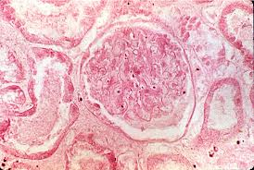
A) HYPERACUTE REJECTION
Rare
It is rejection of the allograft occurring immediately after implantation and perfusion of graft.
Occurs within minutes to hours after transplantation.
Gross
Cyanosis of graft minutes to hours after perfusion
Graft becomes swollen, hemorrhagic, and necrotic
Microscopic
Vasculitis, thrombosis, fibrinoid necrosis of blood vessels
Thrombi in glomeruli
Interstitial edema and hemorrhage
Infarct of the kidney (coagulative necrosis) and loss of graft.
https://tpis.upmc.com/tpis/images/H00021k.jpg
Notes:
Occurs within minutes to hours after transplantation in a pre-sensitized host (i.e. a preformed anti-donor antibody is already present in the recipient’s circulation and it is directed against some antigen that is present on the donor kidney). It leads to blood vessel damage, vasculitis, arterial thrombosis, fibrinoid necrosis of the blood vessel, hemorrhage, odema, infarct of the kidney (coagulative necrosis) and loss of graft.
These preformed antibodies that react against donor antigens, develop during a prior exposure of the recipient to donor derived antigens in connection with a blood transfusion, pregnancy or abortion.
HLA and endothelium associated ABO blood group antigens of the donor are the usual target for antibody mediated rejection. Immune reactions mediated by antibodies to the ABO blood group system have now become uncommon and are usually the result of technical errors.
Hyperacute rejection causes immediate and complete failure of the newly transplanted kidney. Prevention for this type of rejection is careful analysis of the match between the donor and the recipient.
Clinically: no urine output.
Grossly: kidney is cyanotic. The capsule bulges out due to marked edema and rupture of the graft may occur. Necrosis.
LM: acute arteritis and arteriolitis with fibrionoid necrosis of the vessels, thrombosis and ischemic/coagulative necrosis of renal parenchyma.

Slide 13
B) ACUTE REJECTION
Acute Rejection is the most common type of rejection in the newly transplanted kidney patient. It can occur within days or the first few months after surgery. Sometimes it can occur after years.
2 types
Acute T-cell mediated rejection/ acute cellular rejection.
Acute antibody-mediated rejection.

Slide 14
B) ACUTE REJECTION ACUTE T-CELL MEDIATED REJECTION (ACUTE TCMR)
It is a common form of rejection. It is an acute immune reaction by the recipient against the antigens present in the allograft (called alloantigens). It is mediated by T cells.
Classically it develops in the first 3 months after transplantation, but may erupt at any time, even after many years.
Clinically 🡪 there is loss of graft function and it presents as rising creatinine.
In acute TCMR there is infiltration of allograft by lymphocytes (mainly T-cells) and other inflammatory cells. The inflammation is primarily in the tubules (tubulitis) and the interstitium (together called tubulointerstitial inflammation) and may also involve the arteries called vasculitis/arteritis (+/- fibrinoid necrosis of arteries).
Acute TCMR responds well to immunosuppressive drug therapy.
Notes:
Clinical: rising serum creatinine over a few days, folllowed by signs of renal failure. Fever and graft tenderness +/-.
Gross: variable
LM: T-lymphocytes are the principal agents of acute cellular rejection. They travel to and recognize the allograft. In the allograft (new transplanted kidney) they infiltrate and damage the tubules (called as tubulitis) and the interstitium. The damage can be mild, moderate or severe depending on the extent of tubulitis and T-cell infiltration in the interstitium. This extent has been classified by Banff classification into grade I (A and B), grade II (A and B) and grade III.

Slide 15
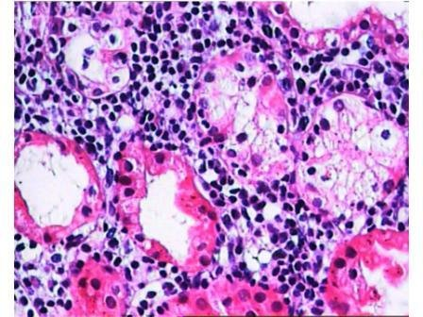
B) ACUTE REJECTION ACUTE T-CELL MEDIATED REJECTION.
MICROSCOPY
Tubulointerstitial inflammation with or without arteritis
Interstitial edema and sometimes hemorrhage
Note: glomerular usually not involved
https://pathology.uic.edu/assets/1/6/c4d_web.png
Pathology of Renal Transplantation by Javed I. Kazi and Muhammed Mubarak from Topics in Renal Biopsy and Pathology. April 2012. DOI: 10.5772/39182. Source: InTech
Notes:
Clinical: rising serum creatinine over a few days, folllowed by signs of renal failure. Fever and graft tenderness +/-.
Gross: variable
LM: T-lymphocytes are the principal agents of acute cellular rejection. They travel to and recognize the allograft. In the allograft (new transplanted kidney) they infiltrate and damage the tubules (called as tubulitis) and the interstitium. The damage can be mild, moderate or severe depending on the extent of tubulitis and T-cell infiltration in the interstitium. This extent has been classified by Banff classification into grade I (A and B), grade II (A and B) and grade III.

Slide 16
http://www.pathologyoutlines.com/imgau/kidneyacutechroniccellularrejectionsaglam9032_2 and 8973.jpg

Slide 17
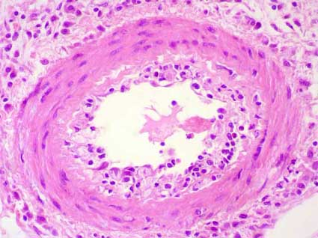
ARTERITIS (VASCULITIS)
https://www.kidneypathology.com/Imagenes/Rechazo/V2.w.jpg

Slide 18
A) ACUTE REJECTION ACUTE ANTIBODY-MEDIATED REJECTION (ACUTE ABMR)
Also called as acute humoral rejection.
It is an acute antibody mediated immune reaction.
It is mediated by the anti-allograft antibodies (alloantibodies) called donor specific antibodies (DSA).
In it the recipient already has preformed (i.e. present before transplantation) circulating anti-donor specific antibodies (DSA). These antibodies are directed against the endothelial cells in the allograft kidney 🡪 they attack the allograft endothelial cells in the blood vessels (esp. the endothelial cells of the glomeruli and peritubular capillaries) 🡪 resulting in rejection.
The microvasculature of the kidney (i.e. glomeruli and peritubular capillaries) is the main target.
Clinically there is loss of graft function presenting as rising creatinine.

Slide 19
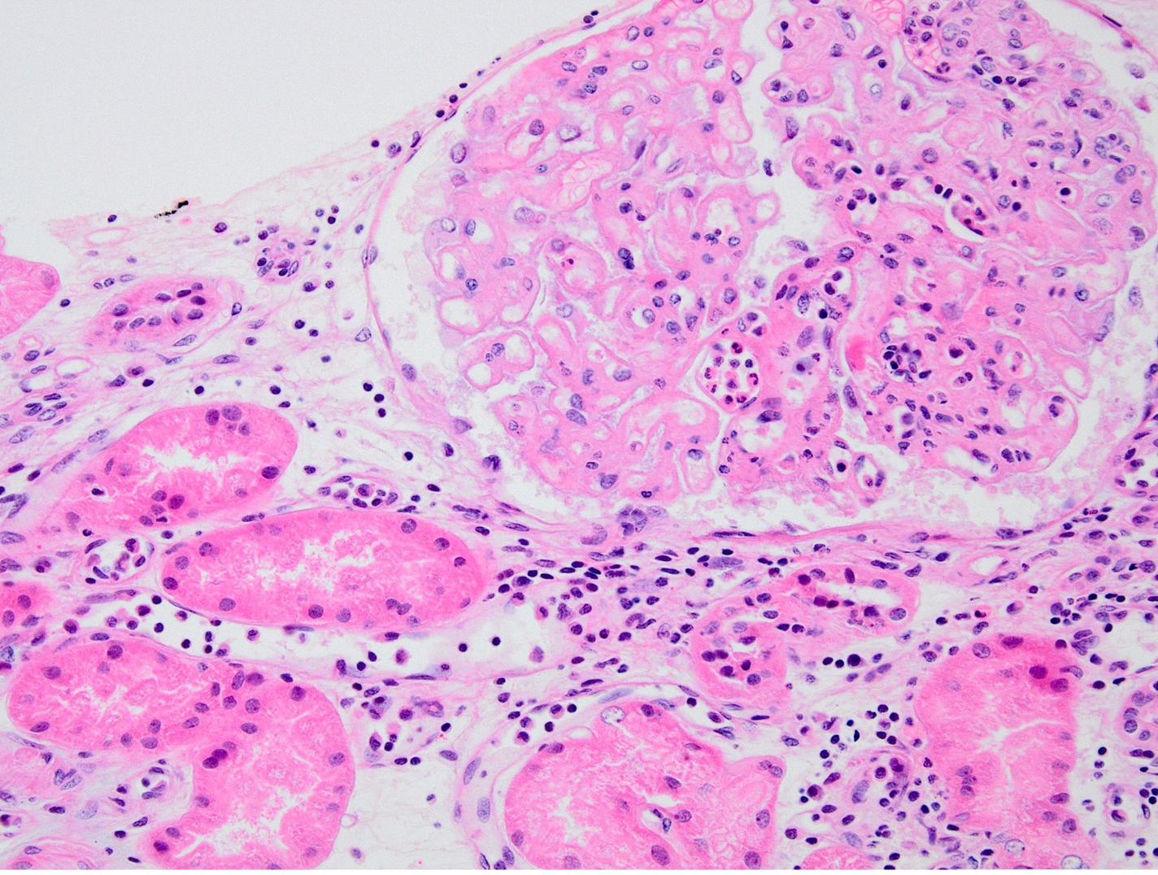
ACUTE REJECTION ACUTE ANTIBODY-MEDIATED REJECTION (ACUTE ABMR)
Microscopy:
Glomerulitis, capillaritis of the peritubular capillaries (peritubular capillaritis).
Positive C4d immunostain in the peritubular capillaries.
Acute tubular injury/ necrosis.
Arteritis +/- fibrinoid necrosis.
Acute thrombotic microangiopathy like picture
NOTE: arteritis/ vasculitis can be seen in both acute TCMR and acute ABMR.
Glomerulitis & peritubular capillaritis

Slide 20
C) CHRONIC REJECTION
Chronic rejection is the type of rejection that happens over an extended period of time and can eventually lead to loss of the graft.
Usually occurs after the first year of transplantation.
Persistent or recurrent episodes of TCMR or ABMR 🡪 lead to chronic changes in allograft 🡪 chronic rejection (chronic TCMR and chronic ABMR) 🡪 end stage allograft kidney (graft loss).
Clinically: gradual rise in serum creatinine. Patients presents with chronic graft dysfunction/ chronic renal failure, proteinuria and hypertension.
It does not respond to immunosuppressive therapy.
Additional information 🡪 Microscopy can show any or all of the following
Tubulitis and tubular atrophy.
Interstitial inflammation and fibrosis.
Arteries show intimal fibrosis with chronic inflammation called chronic transplant arteriopathy.
Glomeruli: global or focal segmental glomerulosclerosis
Chronic ABMR also shows a unique type of glomerular injury called transplant glomerulopathy.

Slide 21
Pathology of injury in kidney transplant
Harvest injury
Rejection: hyper-acute rejection, acute rejection (T-cell mediated and antibody mediated) and chronic rejection
Infections in the renal allograft.
Drug toxicity, acute and chronic.
Recurrence of primary disease
De-novo (new) disease

Slide 22
INFECTIONS OF THE RENAL ALLOGRAFT

Slide 23
INFECTIONS OF THE RENAL ALLOGRAFT
The patients who are recipients of allograft kidney are given various immunosuppressive drugs and are therefore immunosuppressed (immunocompromised). This makes such patients predisposed to various renal infections like Polyomavirus (SV40 virus), Adenovirus, Cytomegalovirus and Epstein–Barr virus (EBV).
The viruses primarily infect the tubules and cause tubulointerstitial inflammation and acute tubular injury. The infected tubular epithelial cells show viral changes in their nuclei.
Theses infections can lead to graft loss.
Infection with EBV can also lead to post transplant lymphoproliferative disorder (PTLD).

Slide 24
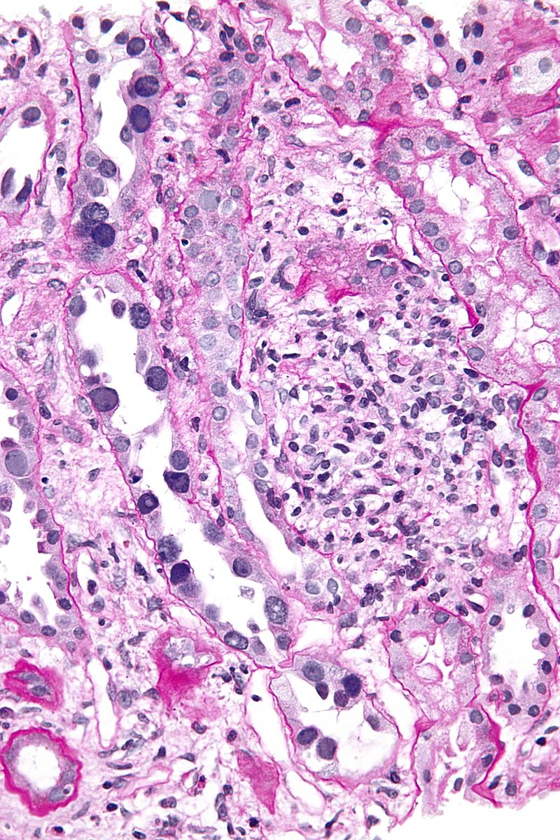
RENAL TUBULES SHOWING POLYOMAVIRUS INFECTION IN ALLOGRAFT KIDNEY (ARROWS)
By Nephron - Own work, CC BY-SA 3.0, https://commons.wikimedia.org/w/index.php?curid=17821564

Slide 25
Pathology of injury in kidney transplant
Harvest injury
Rejection: hyper-acute rejection, acute rejection (T-cell mediated and antibody mediated) and chronic rejection
Infections in the renal allograft.
Drug toxicity, acute and chronic.
Recurrence of primary disease
De-novo (new) disease

Slide 26
DRUG TOXICITY

Slide 27
DRUG TOXICITY
Calcineurin inhibitors (CNIs) are immunosuppressive drugs given to the recipients in order to decrease the recipients immune system's response to the transplanted kidney and therefore help suppress acute rejection.
Examples of CNI drugs: cyclosporine and tacrolimus
The problem is that CNIs are also nephrotoxic and can cause acute or chronic damage to the graft. They can cause acute CNI toxicity and chronic CNI toxicity in the kidney
Blood tests show:
Rising serum creatinine,
Elevated levels of CNI in blood

Slide 28
ADDITIONAL INFORMATION
Acute CNI toxicity shows:
acute tubular injury
isometric vacuolization of proximal tubules
acute thrombotic microangiopathy like picture.
Chronic CNI toxicity shows:
striped interstitial fibrosis
tubular atrophy
Microcalcifications
nodular arteriolar hyalinosis
chronic thrombotic microangiopathy like picture.

Slide 29
Pathology of injury in kidney transplant
Harvest injury
Rejection: hyper-acute rejection, acute rejection (T-cell mediated and antibody mediated) and chronic rejection
Infections in the renal allograft.
Drug toxicity, acute and chronic.
Recurrence of primary disease
De-novo (new) disease

Slide 30
RECURRENCE OF PRIMARY DISEASE AND DE-NOVO (NEW) DISEASE

Slide 31
RECURRENT & DE-NOVO DISEASE
5) Recurrence of primary disease
6) De-novo (new) disease/ glomerulonephritis
The primary disease which lead to end stage kidney and eventual transplant can recur as early as 6 months post-transplant.
It is the development of another kidney disease in the renal allograft, different from the disease the patient originally suffered from.
It is rare.

Slide 32
END

