Slide 1
Urinary tract infection
1st yr medicine
KSU
Dr. Aliah Alshanwani
Dep. of Pharmacology

Slide 2
Notes:
The kidneys filter the blood to remove the waste and produce the urine that is collected by ...store it ...
urethra -- the tube that transports urine from the bladder to the outside of the body

Slide 3
Urinary tract infections (UTIs)
1. Upper urinary tract (kidney & ureters) infections: pyelonephritis
2. Lower urinary tract (bladder, urethra & prostate): cystitis, urethritis & prostatitis (more common).
** Upper urinary tract infections are more serious.
Notes:
Bacterial infection of the urinary system involves:
Renal pelvis
So the main danger is that the spreading of the untreated bacteria infection from the bladder or the lower part to one or both kidneys

Slide 4
UTI
It is the 2nd most common infection (after RTIs)
It is often associated with some obstruction of the flow of urine
It is more common in women more than men
30:1 (Why ?)
Incidence of UTI increases in old age (10% of men & 20% of women).
Notes:
That's because
1- the urethra is located close to the anus (the short distance between the urethra & anus). So bacteria like E coli in the large intestine and anus can easily escape the anus and invade the urethra
2- Or Sexually transmitted infection as the urethra is close to the vagina
3- Women also have shorter urethras that allow quick access of bacteria to the bladder

Slide 5
What are the causes of UTI
Normally urine is sterile. Bacteria comes from digestive tract to opening of the urethra.
Obstruction of the flow of urine (e.g. kidney stone)
Enlargement of prostate gland in men (common cause)
Catheters placed in urethra & bladder
Not drinking enough fluids
Waiting too long to urinate
Large uterus in pregnant women
Poor toilet habits (wiping back to front for women)
Disorders that suppress the immune system (diabetes &
cancer chemotherapy).
Notes:
Symptoms:
Pain or burning during urination
The urge to urinate often
Pain in the lower abdomen
Urine that is cloudy or foul-smelling
Some people may have no symptoms
Prostatitis or obstruction of the urethra by an enlarged prostate
Water to flush out the bacteria from bladder

Slide 6
Bacteria responsible of UTIs
Gm-ve bacteria (most common):
E. coli (approx. 80% of cases)
Proteus mirabilis
Klebsiella
Pseudomonas aeruginosa
Gm+ve bacteria (less common):
Staphylococcus saprophyticus (Approx. 20%)
Mycoplasma, Chlamydia trachomatis & Neisseria gonorrhea (limited to urethra, unlike E. coli may be sexually transmitted).
Notes:
The most common bacteria is E Coli, a common bacteria found in the GIT
Enterobacteria: Proteus mirabilis, Klebsiella, Pseudomonas aeruginosa
They usually take urine sample & they make urine culture to test w bacteria causing the infection & according to that they give the AB

Slide 7
UTI can be:
Simple:
Infections do not spread to other parts of the body & go away readily with treatment (Due to E. coli in most cases).
Complicated:
Infections spread to other parts of the body & resistant to many antibiotics, thus more difficult to cure. {Due to hospital- acquired bacteria (E. coli, Klebsiella, Proteus, Pseudomonas, enterococci, staphylococci)}.
Notes:
The main danger associated with untreated UTIs is that the infection may spread from the bladder to the kidneys & to other body organs
Especially patients with already kidney problems this can cause kidney failure.

Slide 8
Treatment of UTI
Antibiotics:
1- Co-trimoxazole (SMX + TMP), p.o.
2- Nitrofurantoin, p.o.
3- Tetracyclines, e.g. Doxycycline, p.o.
4- Aminoglycosides, e.g. Gentamicin
5- Cephalosporins (e.g. Ceftriaxone & Ceftazidime)
6- Quinolones, e.g. Ciprofloxacin, p.o.
Notes:
All forms of symptomatic bacterial UTI require antibiotics.
5 & 6 previously discussed in RTIs

Slide 9
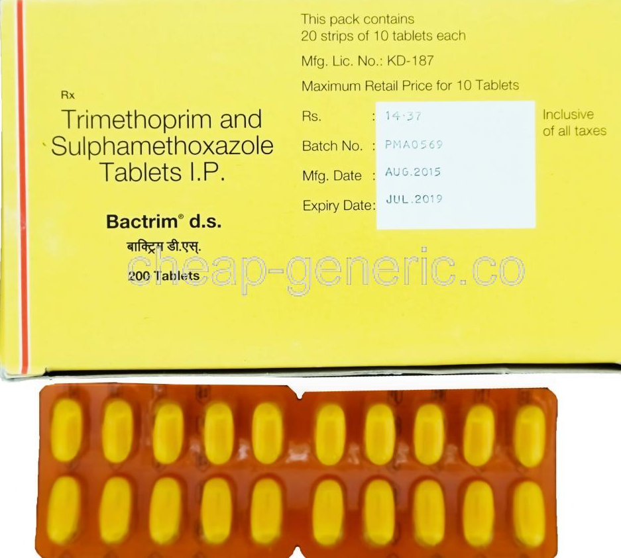
Co-trimoxazole (Bactrim, Septra) Sulfamethoxazole-Trimethoprim (SMX) (TMP)
Alone, each agent is bacteriostatic
Together they are bactericidals (synergism)
The optimal ratio of TMP to SMX in vivo is 1:20.
(formulated 1(TMP): 5(SMX); 160 mg TMP + 800 mg SMX; 80 mg TMP + 400 mg SMX; 8 mg TMP + 40 mg SMX).
Notes:
the total effect is greater than the sum of the individual effects
optimal ratio : the peak plasma conc is 1:20
Each part of TMP is given with 5
A combination of TMP-SMX is effective tr for a wide variety of infections including P jiroveci pneumonia, shigellosis, systemic salmonella infections, UTIs, prostatitis, & some nontuberculous mycobacterial infections. It is active against most Staphylococcus aureus strains, both methicillin-susceptible & methicillin-resistant, & against RT pathogens such as pneumococcus, Haemophilus sp, Moraxella catarrhalis, & K pneumoniae (but not Mycoplasma pneumoniae).
HE, the increasing prevalence of strains of E coli (up to 30% or >) & pneumococci that are resistant to TMP-SMX must be considered before using this combination for empiric therapy of upper UTIs or pneumonia.

Slide 10
MECHANISM OF ACTION
P-Aminobenzoic Acid (PABA)
Dihydropteroate
synthetase
Dihydrofolate
Dihydrofolate
reductase
Tetrahydrofolate
Purines & DNA synthesis
Sulfonamides*
Trimethoprim*
* Inhibit gm-ve & gm+ve bacteria
Notes:
This pathway is important for FA synthesis w is imp for nucleic acid synthesis of the susceptible organisms
Sulfonamide-susceptible organisms, unlike mammals, cannot use exogenous folate but must synthesize it from PABA.
As a structural analog of PABA, Sulfa, it inhibit DiHydro.. And Folate synthesis
Sulfonamides Ex: Sulfacytine, sulfamethizole, (Short acting), SMX, sulfapyridine, (intermediate)
Trimethoprim selectively inhibit bacterial DHFR & thus inhibit Folate synthesis
These 2 drugs selectively inh bacterial FA synthesis
This combination provides synergistic activity for the inhibition of FA synthesis

Slide 11
Absorption, metabolism & Excretion (PK):
Sulfonamides
- Mainly given po/ (or IV)
- Rapidly absorbed from stomach & small intestine
- Widely distributed to tissues & body fluids (including CNS, CSF), placenta & fetus
- Absorbed sulfonamides bind to serum protein (approx. 70% )
- Metabolized in the liver by the process of acetylation
- Eliminated in the urine, partly as such & partly as acetylated derivative.
Notes:
N-Acetylation is a phase II conjugation reaction mediated in humans by the polymorphic N-acetyltransferase 2 (NAT2) and N-acetyltransferase 1 (NAT1).

Slide 12
PK
TMP
Usually given orally/ IV, alone or in combination with SMX
Well absorbed from the gut
Widely distributed in body fluids & tissues (including CSF)
More lipid soluble than SMX
Protein bound (approx. 40 %)
60% of TMP or its metabolite is excreted in the urine
It’s a weak base, concentrates in the prostatic & vaginal fluids (> acidic than plasma).
Notes:
TMP is > lipid soluble than SMX, it has larger volume of distribution
TF, it has > antibacterial activity in prostatic & vaginal fluids than many other antimicrobial drugs.

Slide 13
ADVERSE EFFECTS (TMP+SMX)
1. GIT- Nausea, vomiting
2. Allergy
3. Hematologic
a) Acute hemolytic anemia
a. hypersensitivity b. G6PD deficiency
b) Megaloblastic anemia due to TMP.
Drug interactions
Displace bilirubin- if severe – kernicterus
Potentiate warfarin, oral sulfonylurea hypoglycemics.
Notes:
Acute hemolytic anemia due to
A n b
G6PD: glucose 6 phosphate dehydrogenase deficiency
Intrinsic causes
Hereditary (inherited) hemolytic anemia can be due to :
Defects of RBCs membrane production (as in hereditary spherocytosis and hereditary elliptocytosis)
Defects in hemoglobin production (as in thalassemia, sickle-cell disease and congenital dyserythropoietic anemia)
Defective red cell metabolism (as in glucose-6-phosphate dehydrogenase deficiency and pyruvate kinase deficiency)
Extrinsic like autoimmune.
TMP produces the predictable adverse effects of an antifolate drug, especially megaloblastic anemia, leukopenia, & granulocytopenia.
TMP inhibits folate reductase & thus FA synthesis >> folate deficiency & megaloblastic anemia
Megaloblastic anemia occurs when your body produces RBCs that are larger than normal & you have a low RBC count
DI for this Drug combination:
Bilirubin is a brownish yellow substance found in bile
Kernicterus is a very rare type of brain damage that occurs in a newborn with severe jaundice. It happens when a substance in the blood, called bilirubin, builds up to very high levels & spreads into the brain tissues. This causes permanent brain damage
Inhibit the metabolism of warfarin

Slide 14
CONTRAINDICATIONS (TMP+SMX)
1. Pregnancy
2. Nursing mother
3. Infants under 6 weeks
4. Renal or hepatic failure
5. Blood disorders.
Notes:
5 like anemia

Slide 15
Nitrofurantoin
Antibacterial Spectrum:
- Bactericidal for gm-ve & gm+ve bacteria
- Effective against E. coli & Staph. saprophyticus, but other common UT gm-ve bacteria may be resistant.
Notes:
Staphylococcus saprophyticus (gm+ve)

Slide 16
Mechanism of action of nitrofurantoin
Sensitive bacteria reduce the drug to an active agent (by bacterial reductase) that inhibits various enzymes & damages DNA.

Slide 17
PK of nitrofurantoin
Absorption is complete after oral use
Metabolized (75%) & excreted so rapidly that no systemic antibacterial action is achieved
Concentrated in the urine (25% of the dose excreted unchanged)
Urinary pH is kept < 5.5 (acidic) to enhance drug activity
It turns urine to a dark orange-brown (harmless).
Notes:
Urinary antiseptics are oral agents that exert antibacterial activity in the urine but have little /no systemic antibacterial effect. Their usefulness is limited to lower UTIs.
levels within 30 minutes of oral administration
It is desirable to keep urinary pH below 5.5, which greatly enhances drug activity by avoiding milk and antacids.

Slide 18
Adverse effects of nitrofurantoin
GI disturbances: bleeding of the stomach, nausea, vomiting & diarrhea (must be taken with food)
Headache and nystagmus
Hemolysis in patients with G6PD deficiency
Contraindications:
Patients with G6PD deficiency >>> anemia
Neonates
Pregnant women (after 38 wks of pregnancy).
Notes:
Its main SE is on GIT
Nystagmus: Involuntary rapid eye movement
Patients with G6PD deficiency + Nitro >>>Anemia
Category B (no risk) but not used close to delivery due to the potential risk of hemolytic anemia in the newborn

Slide 19
Therapeutic Uses of nitrofurantoin
It is used as urinary antiseptic.
Its usefulness is limited to lower uncomplicated UTI’s & cannot be used for upper UT or systemic infections.
Dose: 50-100 mg, po q 6h/7 days
Long acting: 100 mg twice daily.
Notes:
Nitrofurantoin is not recommended for the treatment of pyelonephritis, prostatitis because of extremely poor tissue penetration & low blood levels

Slide 20
Tetracyclines (e.g. Doxycycline)
It is a long-acting tetracycline
Mechanism of action
Bacteriostatic, Inhibits protein synthesis by binding reversibly to bacterial 30S ribosomal subunits.
Against gm+ve & gm-ve bacteria.
Notes:
EX. ChlorTCN, OxyTCN, Minocycline, Doxycycline,,,,,, differ from each others in PK

Slide 21
Doxycycline (Cont.’)
PK
Usually given po
Absorption is 90-100%
Absorbed in the upper s. intestine & best in absence of food
Food & di & tri-valent cations (Ca²⁺, Mg²⁺, Fe²⁺, AL³⁺) impair drug absorption & reduce its effectiveness
Protein binding 40-80 %
Distributed well, including CSF
Cross placenta & excreted in milk
Largely metabolized in the liver.

Slide 22
Doxycycline (Cont’.)
Side effects
1. GIT: nausea, vomiting , diarrhea & epigastric pain (give with food)
2. Thrombophlebitis – i.v
3. Hepatic toxicity (prolonged therapy with high dose)
4. Brown discolouration of teeth – children
5. Deformity or growth inhibition of bones – children
6. Phototoxicity (sensitivity to sunlight)
7. Vertigo
8. Superinfections (alter the intestinal flora due to broad spectrum activity).
Notes:
GIT: due to direct local irritation of the intestinal tract.
Can easily bind to Ca in the bone/teeth forming complex
superinfection with yeasts

Slide 23
Contraindications of doxycycline
Pregnancy
Breast feeding
Children (below 10 yrs).

Slide 24
Therapeutic Uses of Doxycycline
Treatment of UTI’s due to many gm-ve & gm+ve bacteria including Mycoplasma & Chlamydia, 100 mg p.o bid for 7 days
Prostatitis.
Notes:
Againist many gm-ve & +ve bacteria including Mycoplasma & chlamydia : gm+ve anaerobic ST bacteria

Slide 25
Aminoglycosides
e.g. GENTAMICIN, i.m, i.v.
Bactericidal antibiotics
Inhibits protein synthesis by binding to 30S bacterial ribosomal subunits
Active against gm-ve aerobic organisms
Poorly absorbed orally
Cross placenta.
Notes:
Are the most useful gp vs gm-ve bacteria
Ex: Streptomycin, neomycin, gentamycin, tobramycin,
30S subunit of the bacterial ribosome, interrupting protein synthesis

Slide 26
Gentamicin (CONT’)
Excreted unchanged in urine
More active in alkaline medium
Adverse effects :
Ototoxicity
Nerve damage (e.g. vestibular nerve)
Nephrotoxicity
Neuromuscular blocking effect.
Notes:
Nerve damage like vestibular nerve damage
Antibiotic activity of aminoglycosides is heavily dependent on pH
All Ags if the therapy continued > 5 days at higher doses, in elderly and impaired renal function
Dose 1 mcg/ml
Neuromuscular blocking : paralysis of skeletal muscle that can cause respiratory paralysis. Affecting presynaptic Ach release at the motor nerve end-plate.

Slide 27
Gentamicin (CONT’)
Therapeutic uses in UTI’s
Severe infections caused by gm-ve organisms (pseudomonas or enterobacter) infection.
Notes:
Pseudomonas aeruginosa (jinosa) gm-ve

Slide 28
Cephalosporins, (Detail was explained in respiratory lec.) 3rd generation cephalosporins
Ceftriaxone & Ceftazidime
Mainly effective against gm-ve bacteria
Acts by inhibition of cell wall synthesis
Bactericidal
They are given parenterally
Given in severe / complicated UTIs
& acute prostatitis.

Slide 29
Fluoroquinolones (Detail was explained in respiratory lec.)
e.g. Ciprofloxacin
Active against gm-ve aerobic organisms
Mechanism of action
Inhibits bacterial DNA gyrase enzyme & cell division resulting in bacterial cell death
Clinical use
UTI caused by multidrug resistance organisms as pseudomonas
Prostatitis (acute/ chronic).
Notes:
Include: levofloxacin, ciprofloxacin, moxifloxacin, norfloxacin , ofloxacin , & gemifloxacin
DNA gyrase is important bacterial enz for genes transcription & DNA replication.

Slide 30
Ciprofloxacin ….Adverse effects
GIT: Nausea, vomiting, diarrhea
CNS effects: confusion, insomnia, headache, anxiety
Damage of growing cartilage (reversible arthropathy)
Photosensitivity (avoid excessive sunlight).
Notes:
An arthropathy is a disease of a joint. Arthritis is a form of arthropathy

Slide 31
Thank you

