Slide 1
Abnormalities in acid-base balance

Slide 2
Objectives
To explain the principles of blood gas and acid-base analysis
To interpret blood gas analysis and diagnose various acid base disorders
Describe causes of acid base disorders
Understand use of acid base nomograms

Slide 3
Abnormalities in Acid-Base Balance
Many critical illnesses can disturb acid-base balance.
Acid-base disturbances may indicate an underlying disease or organ damage.
Accurate interpretation of acid-base disturbances requires the following:
Arterial blood gases.
Plasma electrolytes.
Knowledge of the compensatory physiologic mechanisms.
(Appel & Downs. 2008. Understanding acid-base balance)

Slide 4
Abnormalities in Acid-Base Balance

Slide 5
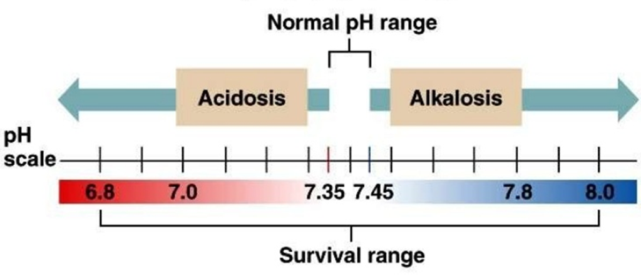
Abnormalities in Acid-Base Balance
Acidosis
Alkalosis
$$\frac{ HCO3−}{PCO2}$$
↑↑ PCO2
↓↓ HCO3-
↓↓ PCO2
↑↑ HCO3-
Respiratory
Metabolic
Respiratory
Metabolic

Slide 6
Primary Acid-Base Disorders
Defence mechanism of the body
Compensatory/secondary response
There are 4 primary acid-base disorders
Respiratory acidosis
Respiratory alkalosis
The kidney compensates
“Renal compensation”
Metabolic acidosis
Metabolic alkalosis
The lung compensates
“Respiratory compensation”
If a person develops any of these disorders,
What will the body try to do?

Slide 7
Fundamentals in Acid-Base Disorders
Acid-base disorders are classified by changes in pH, PCO₂ and HCO₃⁻
There are 4 primary acid-base disorders:
Respiratory acidosis: ↑ PCO₂
Respiratory alkalosis: ↓ PCO₂
Metabolic acidosis: ↓ [HCO₃⁻]
Metabolic alkalosis: ↑ [HCO₃⁻]
The body normally attempts to correct the primary acid-base disturbances by a secondary or compensatory response trying to restore pH towards normal.
The kidneys compensate for primary respiratory disorders.
The lungs compensate for primary metabolic disorders.
(Dooley & Sisson. Acid-base disorders)

Slide 8
Primary Acid-Base Disturbances
Primary acid-base disorders
Acidosis
Respiratory
Metabolic
Alkalosis
Respiratory
Metabolic
Decreased ventilation
Inhibition of respiratory center
Lung damage
Airway obstruction
COPD
Loss of HCO3- or gain of H+
Renal tubular acidosis
Diarrhea
Diabetes
Ingestion of acids (alcohol or aspirin)
Ch. renal failure
Increased ventilation
Psychoneurosis
High altitude
Mechanical overventilation
Pregnancy
Excess HCO3- or loss of H+
Diuretics except CAI
Hyperaldosteronism
Vomiting gastric contents
Ingestion of antacids

Slide 9
Respiratory Acidosis
Respiratory acidosis = ↓ pH + ↑ PCO2
Due to alveolar hypoventilation.
Causes of respiratory acidosis
Alveolar hypoventilation
Depression of respiratory center
Opioid ingestion
Head injury
Lung disease
COPD
Pneumonia
Pulmonary edema

Slide 10
Respiratory Alkalosis
Respiratory alkalosis = ↑ pH + ↓ PCO2
Due to alveolar hyperventilation.
Causes of respiratory alkalosis
Alveolar hyperventilation
Mechanical hyperventilation
Anxiety

Slide 11
Metabolic Alkalosis
Metabolic alkalosis = ↑ pH +↑ [HCO₃⁻]
Due to loss of acids.
Due to gain of HCO₃⁻
Causes of metabolic alkalosis
Loss of acids
Vomiting gastric contents
Loop & thiazide diuretics
Hyperaldosteronism.
Gain of HCO₃⁻
Ingestion or administration of alkaline products
(Appel & Downs. 2008. Understanding acid-base balance; Dooley & Sisson. Acid-base disorders)

Slide 12
Metabolic Acidosis
Metabolic acidosis = ↓pH due to ↓ [HCO₃⁻]
Due to acid gain.
Due to loss of HCO3
Causes of metabolic acidosis
Gain of acids
↑acid production
Lactic acidosis
Diabetic ketoacidosis
Salicylate poisoning
Starvation
Loss of HCO₃⁻
Through kidneys
RTA
CAI
Aldosterone deficiency
Through GIT
Diarrhea
↓ acid elimination
Renal failure
(Appel & Downs. 2008. Understanding acid-base balance; Dooley & Sisson. Acid-base disorders)

Slide 13
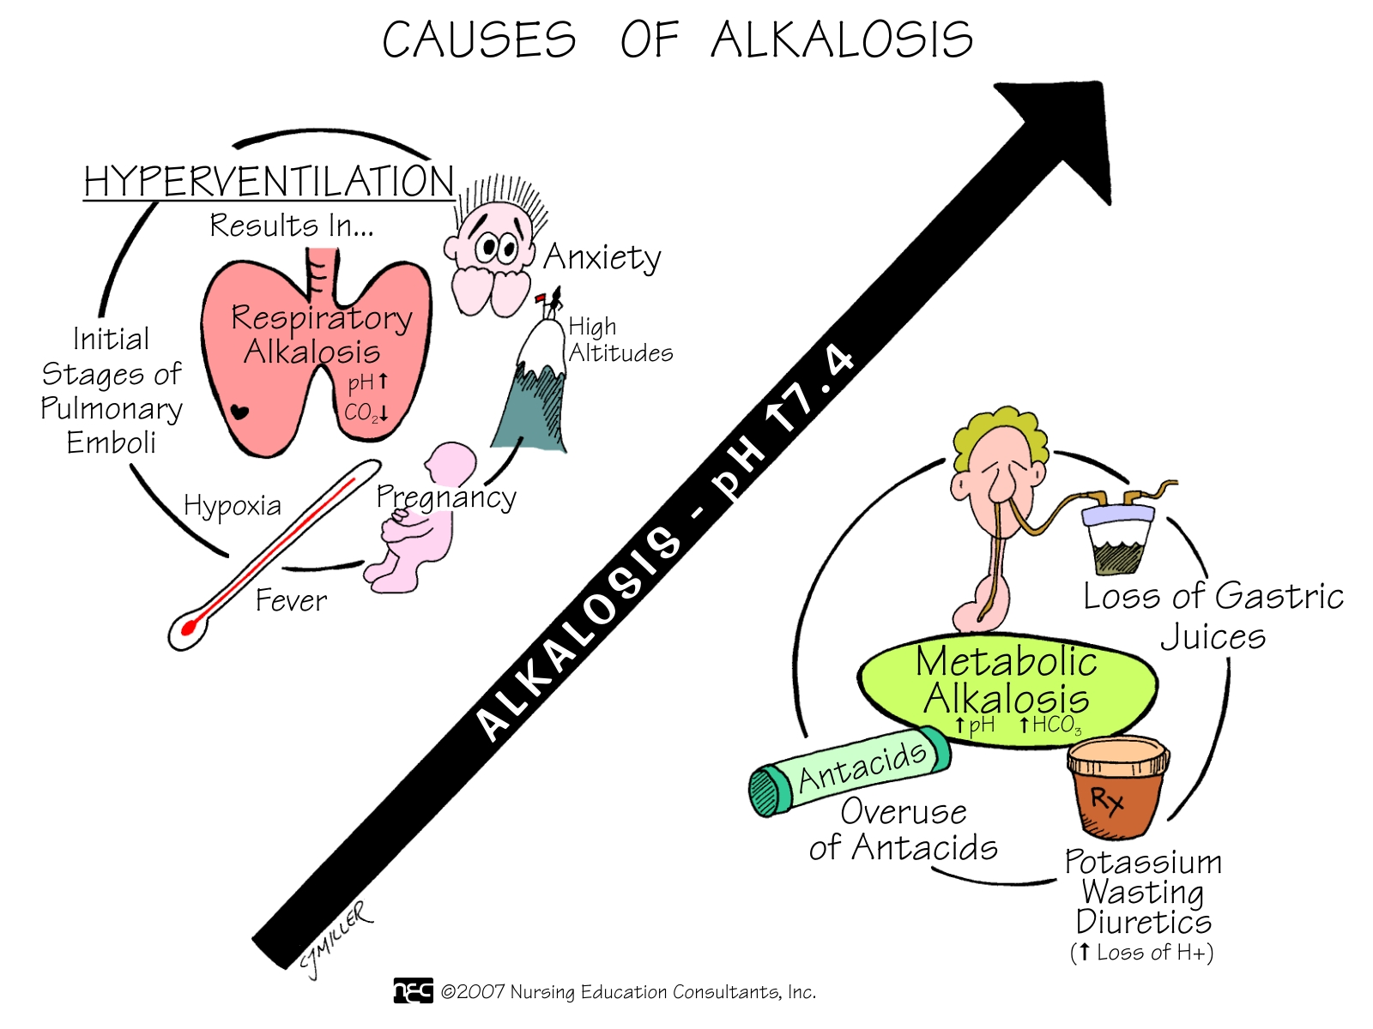

Slide 14
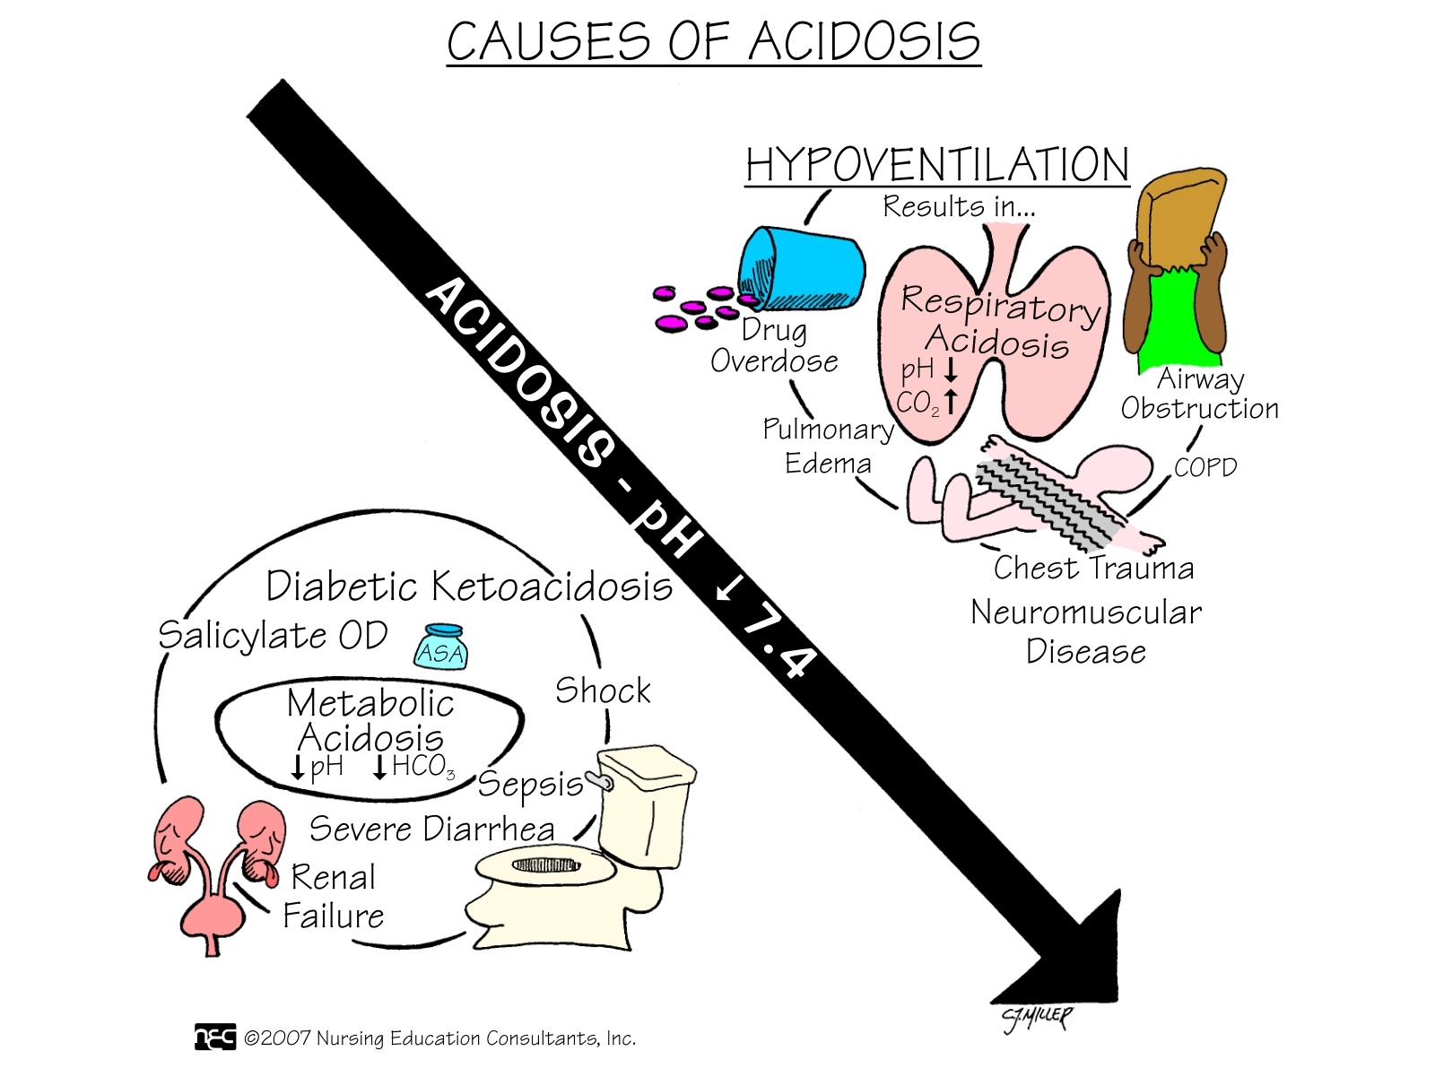

Slide 15
Compensatory Mechanisms
Primary Disturbance | Compensatory Mechanism
Respiratory Acidosis | Increase HCO3
Respiratory Alkalosis | Decrease HCO3
Metabolic Acidosis | Decrease PCO2
Metabolic Alkalosis | Increase PCO2

Slide 16
Summary of Primary Acid-Base Disorders

Slide 17
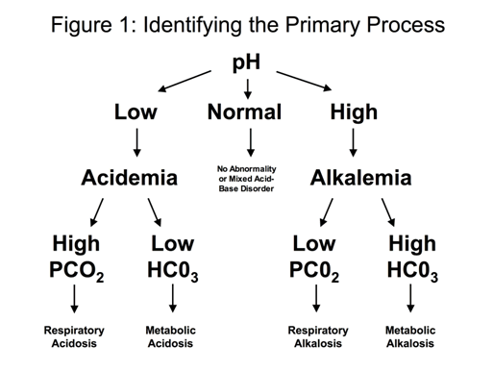
Interpretation of Acid-Base Disturbances
Normal values;
pH =7.35-7.45
PCO2 =35-45 mmHg
HCO3-= 22-28 mmol/L

Slide 18
Simple Acid-Base Disturbances
 | pH | PCO2 (mmHg) | HCO3 (mEq/L)
Normal | 7.35-7.45 | 35-45 | 22-28
Respiratory acidosis | Decrease | Increase | Increase
Respiratory alkalosis | Increase | Decrease | Decrease
Metabolic acidosis | Decrease | Decrease | Decrease
Metabolic alkalosis | Increase | Increase | Increase

Slide 19
Case study 1
A patient known to have COPD presented with 3-day history of fever, SOB, and cough productive of yellowish sputum. His ABGs showed:
pH = 7.25
PCO2 = 80 mmHg.
[HCO₃⁻] = 34 mEq/L.

Slide 20
Case study 2
A 21 year old man with IDDM presents to ER with mental status changes, nausea, vomiting, abdominal pain and rapid respirations. His ABGs showed:
pH = 7.2
PCO2 = 20 mmHg
[HCO₃⁻] = 8 mEq/l
Check this video:
https://www.youtube.com/watch?v=raEKXVfuWTo

Slide 21
Case study 3
A 2-year old child who is lethargic and dehydrated has a 3-day history of vomiting. His ABGs showed:
pH = 7.56
PCO2 = 44 mmHg
[HCO₃⁻] = 37 mEq/l

Slide 22
Case study 4
A 20-year old student suffered a panic attack while awaiting an exam. Her ABGs showed:
pH = 7.6
PCO2 = 24 mmHg.
[HCO₃⁻] = 23 mEq/L.

Slide 23
Other Acid-Base Disorders
Simple acid-base disorders
Mixed acid-base disorders
Result from a single primary abnormality with appropriate physiologic compensation.
Result from multiple primary processes.

Slide 24
Mixed Acid-Base Disturbances
Occurs when a patient has more than one primary acid base disorder that occur at the same time.
Examples:
Respiratory alkalosis/acidosis along with a metabolic acidosis/alkalosis.
Two metabolic acid-base disorders occurring simultaneously.

Slide 25
Case study 5
A 69 year old patient known to have COPD presented with a 3-day history of abdominal pain and diarrhea. His ABGs showed;
pH = 6.96
PCO2 = 55mmHg
[HCO₃⁻] = 12 mmol/L

Slide 26
Thank you

Slide 27
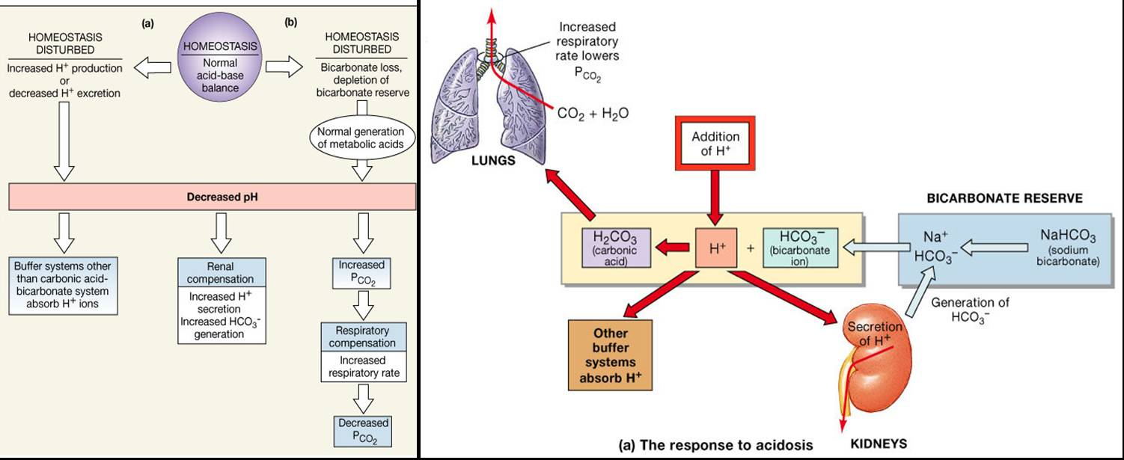
Body’s Response to Acidosis

Slide 28
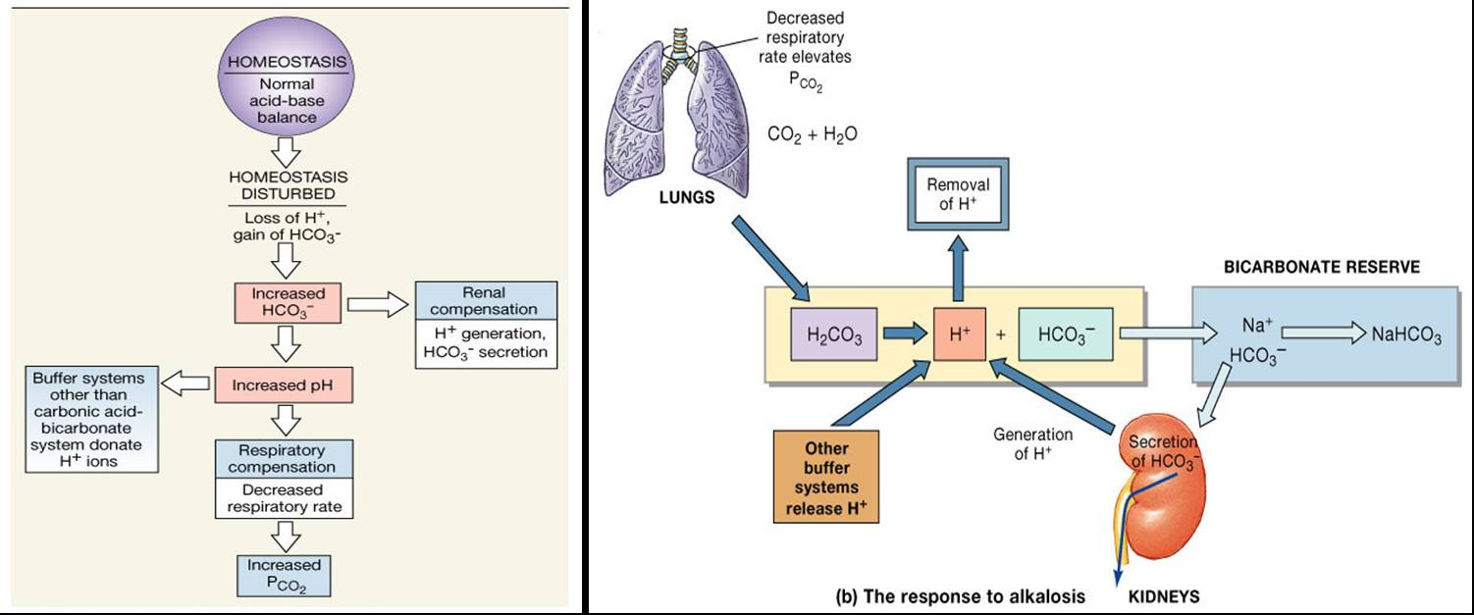
Body’s Response to Alkalosis

