Slide 1
acid-base Tutorial

Slide 2
Objectives
The principle of electrical neutrality in physiology.
Define anion gap and its significance in interpreting acid-base disorders.
Acid-base problems.

Slide 3
The Principle of Electrical Neutrality
Concentration of anions & cations in plasma must be equal to maintain electrical neutrality.
Example of plasma cations; sodium, potassium, magnesium, etc. The major cation = Na+
Examples of plasma anions; chloride, bicarbonate, lactate, albumin, etc. The major anions = Cl- & HCO3-

Slide 4
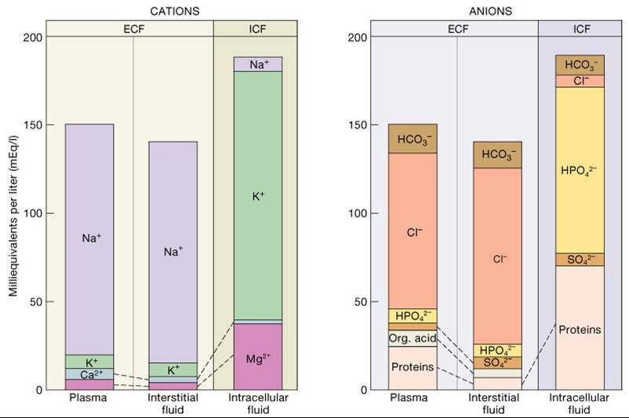
However, not all plasma anions and cations are measured. Only the major ones Na⁺, Cl⁻ and HCO₃⁻ are measured → the amount of unmeasured anions > unmeasured cations → this is where the concept of anion gap came from.

Slide 5
Anion Gap
Is a diagnostic concept.
There is no real anion gap in plasma.
But because only the major anions and major cations get routinely measured. And because the amount of unmeasured anions exceed unmeasured cations → Anion gap.
Anion gap = It is the difference between unmeasured anions and unmeasured cations in plasma. Normally 8-16 mEq/L.
Plasma anion gap = [Na⁺] – [HCO₃⁻] – [Cl⁻]
= 144 – 24 – 108 = 12 mmol/L

Slide 6
Changes in Anion Gap
Plasma anion gap = [Na⁺] – [HCO₃⁻] – [Cl⁻]
= 144 – 24 – 108 = 12 mmol/L
Anion gap will increase (> 16 mmol/L) if;
Unmeasured anions increase.
Unmeasured cations decrease.
It can help in the differentiation between causes of metabolic acidosis.

Slide 7
Anion Gap in Metabolic Acidosis
Plasma anion gap = [Na⁺] – [HCO₃⁻] – [Cl⁻]
= 144 – 24 – 108 = 12 mmol/L
Metabolic acidosis
Increased anion gap
Normal anion gap
(hyperchloremic)
Diabetes
Lactic acidosis
CRF
Aspirin poisoning
Methanol poisoning
Ethanol poisoning
Starvation
Diarrhea
RTA
CAI
Addison’s disease

Slide 8
Case study 1
A teenage girl was brought by her mother to the ER drowsy. The girl looked emaciated and very thin. Her mother reported that she has not been eating for several days now. Her ABGs showed;
pH = 7
PO2 = 90 mmHg.
PCO2 = 42 mmHg.
[HCO₃⁻] = 17 mmol/L.
O2 saturation = 95%
[Na⁺] = 145 mmol/L
[Cl⁻] = 108 mmol/L

Slide 9
Case study 2
After being left unsupervised, a two-year-old boy is found by his parents in the family garage near an open bottle of antifreeze. He is minimally responsive and has the following laboratory values: a blood pH of 6.83, pCO2 of 40 mmHg; a sodium level of 142 mEq/L, chloride level of 106 mEq/L and a bicarbonate level of 6 mEq/L. Which of the following defines the acid-base disorder in this patient?

Slide 10
Case study 3
A 5-year-old boy presented to ER with altered level of consciousness. His mother says that he’s been having severe diarrhea for 5 days now. His ABGs showed;
pH = 7.1
PO2 = 90 mmHg.
PCO2 = 32 mmHg.
[HCO₃⁻] = 17 mmol/L.
O2 saturation = 95%
[Na⁺] = 145 mmol/L
[Cl⁻] = 115 mmol/L

Slide 11
Thank you

