Slide 1
REGULATION OF GFR

Slide 2
Glomerular Filtration Rate (GFR)
Defined as: The volume of filtrate produced by both kidneys per min
Averages 125 ml/min
Totals about 180L/day (45 gallons)
So most filtered water must be reabsorbed or death would ensue from water lost through urination
GFR is directly proportional to the NFP
An increase in NFP GFR
A decrease in NFP GFR
Changes in GFR normally result from changes in
glomerular blood pressure.
NFP = net filtration pressure
Notes:
‹#›

Slide 3
GFR = 125 ml/min
180 L /day
1% excreted

Slide 4
Why is it important to have the GFR regulated?

Slide 5
Regulation of GFR Glomerular Filtration Rate
If the GFR is too high:
Fluid flows through tubules too rapidly to be absorbed
Urine output rises
Creates threat of dehydration and electrolyte depletion
If the GFR is too low:
Fluid flows sluggishly through tubules
Tubules reabsorb wastes that should be eliminated
Azotemia develops (high levels of nitrogen-containing substances in the blood).

Slide 6
Regulation of GFR
GFR controlled by adjusting glomerular blood pressure through the following mechanisms:
- Autoregulation
- Sympathetic control
- Hormonal mechanism: renin and angiotensin

Slide 7
Effect of Arterial BP on GFR
↑↑ ABP → ↑↑ GFR.
However, the body maintains constant GFR over an ABP range of 75-160 mmHg.
Why? And how?

Slide 8
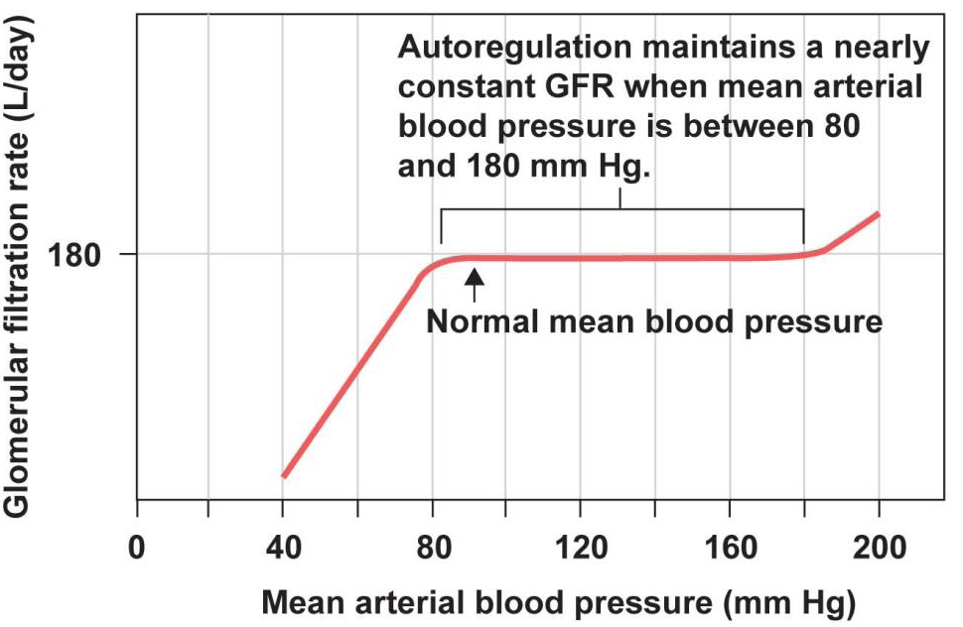
Autoregulation (intrinsic)
It is the relative constancy of GFR and renal blood flow in response to changes in blood pressure range from 75 to 160 mmHg.
That means in a normal kidneys, a decrease in arterial blood pressure as low as 75 mmHg, or an increase as high as 160 mmHg causes a change in GFR by only a few percentage.
However, autoregulation is not perfect but it prevents potentially great changes in GFR , with changes in blood pressure, therefore, kidney continue to excrete waste.

Slide 9
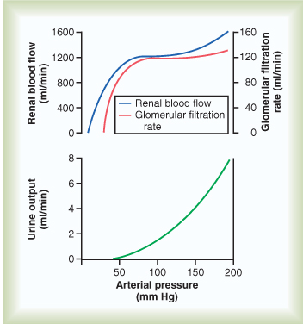
AUTOREGULATION OF GFR
GFR remains constant over a large range of values of BP
75-160 mmHg

Slide 10
How autoregulation takes place?

Slide 11
Auto-regulation of GFR
Refer to feedback mechanisms intrinsic to the kidney that keep the renal blood flow and GFR relatively constant despite fluctuations in ABP.
These mechanisms operate over an ABP ranging between 75-160 mmHg.
Achieved by 2 major mechanisms:
Myogenic auto-regulation.
Tubulo-glomerular feedback mechanism.

Slide 12
Renal Autoregulation of GFR
↑ BP → constrict afferent arteriole, & dilate efferent
↓ BP → dilate afferent arteriole, & constrict efferent
Stable for BP range of 75 to 160 mmHg (systolic)
Cannot compensate for extreme BP changes

Slide 13
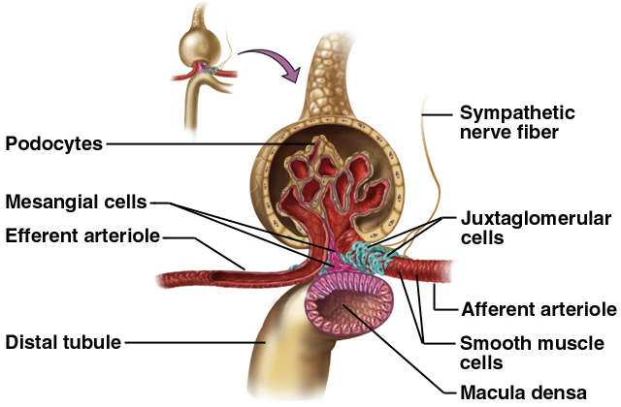
Juxtaglomerular Apparatus
-secrete Renin
- monitor salinity

Slide 14
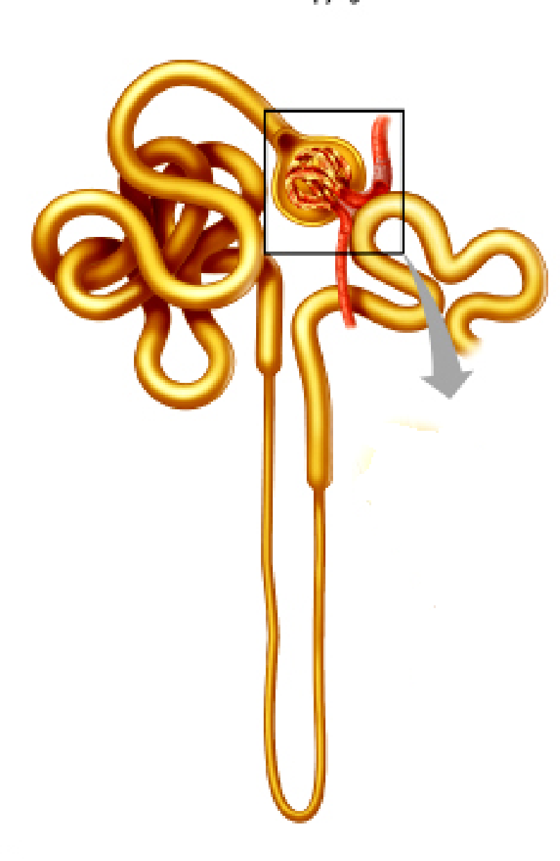
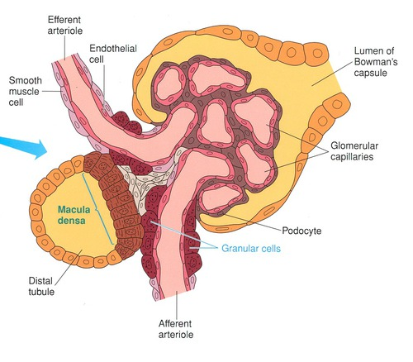
Tubulo-glomerular Feedback
Release Renin
↓↓ NaCl
Juxtaglomerular cells
Angiotensinogen II
Vasodilation of afferent arteriole
Vasoconstriction of Efferent arteriole
↑↑ GFR

Slide 15
Mechanism of autoregulation
Tubuloglomerular feedback mechanism:
ABP delivery of NaCl to the macula densa cells, which are capable of sensing this change , this will cause two effects:
1- decrease in resistance of the afferent arterioles (i.e. vasodilatation) glomerular hydrostatic pressure to normal levels.
2- increase in renin release from JG cells Ang II constrict efferent arteriole glomerular hydrostatic pressure & GFR to normal.

Slide 16
Mechanism of autoregulation, cont…….
Myogenic mechanism:
It is the intrinsic capability of blood vessels to constrict when blood pressure is increased. The constriction prevents excess increase in renal blood flow and GFR when blood pressure rises.
When blood pressure decreases the myogenic mechanism reduces vascular resistance and the vessel dilates.

Slide 17
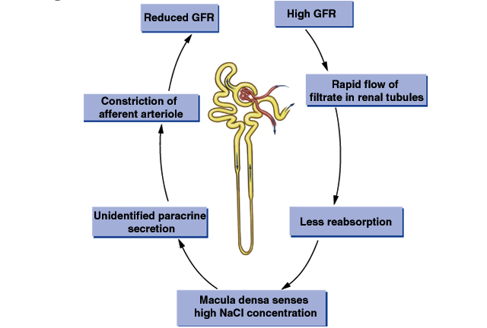
Example of autoregulation

Slide 18
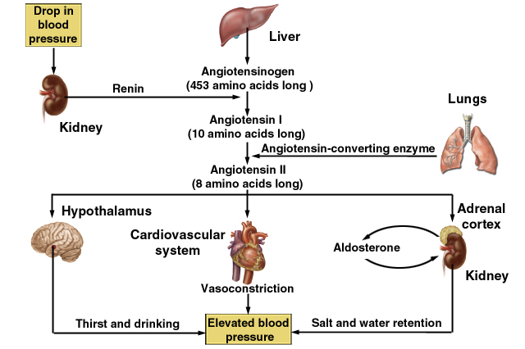
Hormonal Control of GFR
-efferent arterioles

Slide 19
Effects of Angiotensin II

Slide 20
Sympathetic Control of GFR (Extrinsic)
When the sympathetic nervous system is at rest:
Renal blood vessels are maximally dilated
Autoregulation mechanisms prevail
Under stress:
Norepinephrine is released by the sympathetic nervous system
Epinephrine is released by the adrenal medulla
Afferent arterioles constrict and filtration is inhibited
Note: during fight or flight blood is shunted away from kidneys
The sympathetic nervous system also stimulates the renin-angiotensin mechanism. This induces vasoconstriction of efferent arteriole.

Slide 21
إنما يخشى الله من عباده العلماء

