Slide 1
Renal Clearance

Slide 2
Concept of clearance
Clearance is the volume of plasma that is completely cleared of a substance each minute.
Example:
Renal clearance of Substance X is defined as the ratio of excretion rate of substance X to its concentration in the plasma:
C_{X} = (U_{X} X V)/ P_{X}

Slide 3
Clearance Equation
C_{X} = (U_{X} X V)/ P_{X}
C_{X} = Renal clearance (ml/min)
U_{X} X V = excretion rate of substance X
U_{X} = Concentration of X in urine
V = urine flow rate in ml/min
Amount of substance excreted = (Amount filtered –
Amount reabsorbed+ Amount secreted)
U_{x} V = GFR x P_{x} ± T_{x}

Slide 4
What is the importance of renal clearance?
To quantify several aspects of renal functions:
rate of glomerular filtration
Rate of blood flow
Assess severity of renal damage
Tubular reabsorption.
Tubular secretion of different substances.

Slide 6
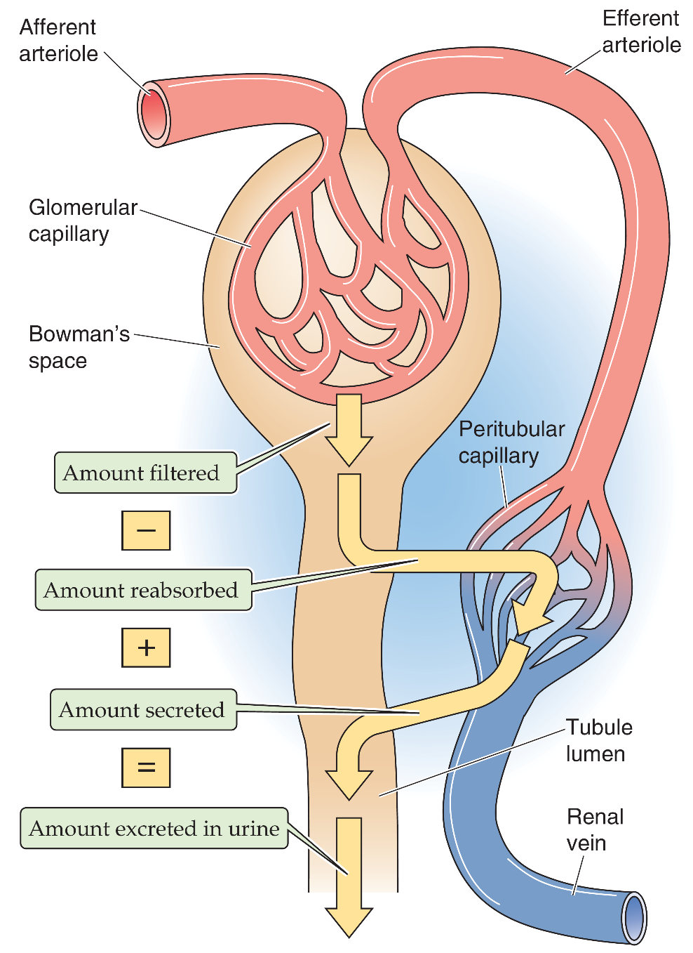
Clearance
Clearance method
Volume of plasma which is completely cleared of a substance per unit time.
amount excreted = amount filtered – amount reabsorbed + amount secreted
amount filtered per minute = GFR . P_{x} (filtered load)
amount excreted per minute = Ṽ . U_{x} (excretion rate)
‹#›
Notes:
Why we measure GFR? The level of GFR and its magnitude of change over time are vital to:
• the detection of kidney disease
• understanding its severity
• making decisions about diagnosis, prognosis, and treatment.
Clearance of a solute is the volume of plasma (per unit time) needed to supply the amount of solute that appears in the urine. This CLEARANCE method uses the amount balance of an I.V. injected test substance such as inulin.
Summary of important points:
Clearance is a “quantitative concept” which is useful for evaluating several aspects of renal function. If one liter of plasma contains one milligram of a substance, and we remove that entire mg, then the clearance is one liter (not one mg). If we removed one tenth of a mg, then the clearance would be one tenth of a liter. Renal clearance describes the removal of substances from “a volume of” plasma (excretion) per time period (usually per minute).
If a substance is not excreted then the renal clearance is zero. If a substance could be 100% removed from plasma, then the clearance would be the entire volume of plasma processed by the kidneys ( = renal plasma flow, ml/min !!). Para-amino-hipuric acid (PAH) is almost entirely removed from plasma by the kidneys (85-90%), so the clearance of PAH is almost equal to RPF (actually 85-90% of RPF). Similarly, if a substance (like inulin) is freely filtered, but not reabsorbed or secreted, then the amount excreted (removed) = the amount filtered. Thus the clearance of inulin is equal to the volume filtered, the glomerular filtration rate (GFR).
‹#›

Slide 8
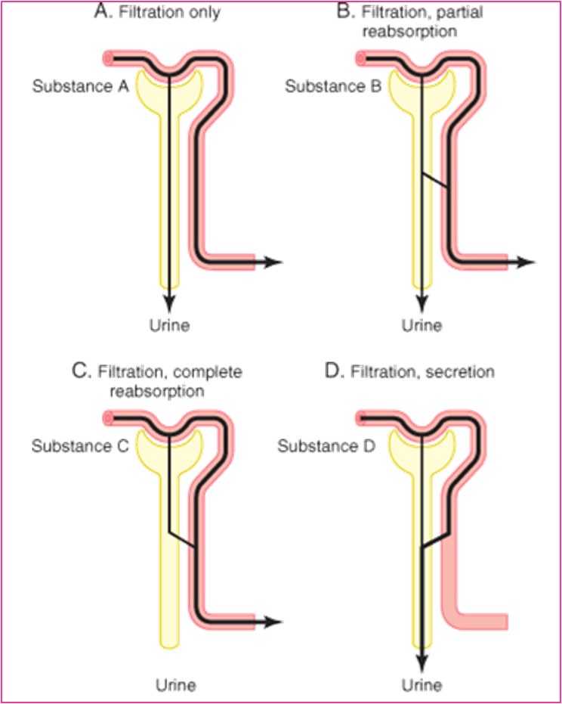

Slide 9
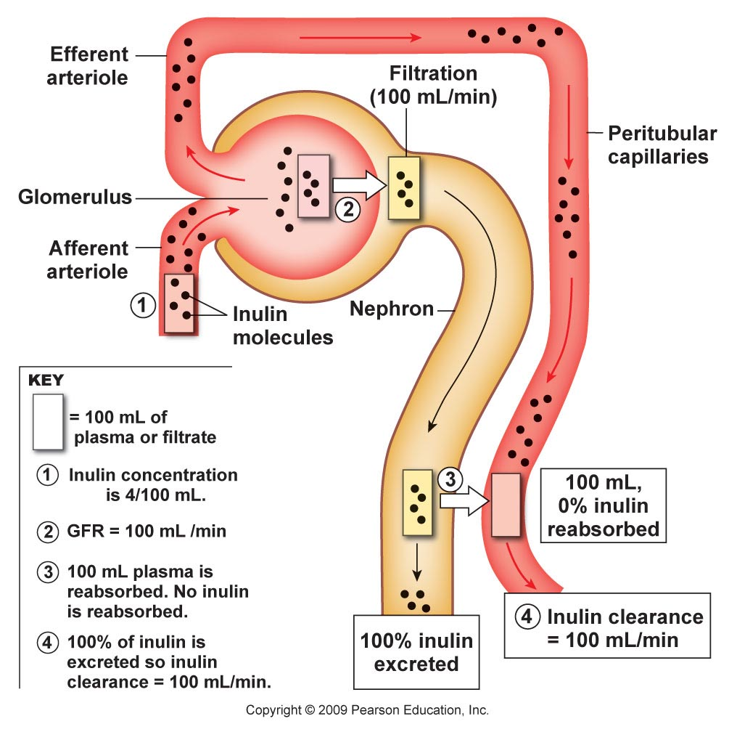
Nephron Excretion & Clearance
Notes:
‹#›

Slide 10
Nephron Excretion & Clearance
Inulin
A plant product that
is filtered but not reabsorbed or secreted
Used to determine
GFR
and therefore nephron function

Slide 11
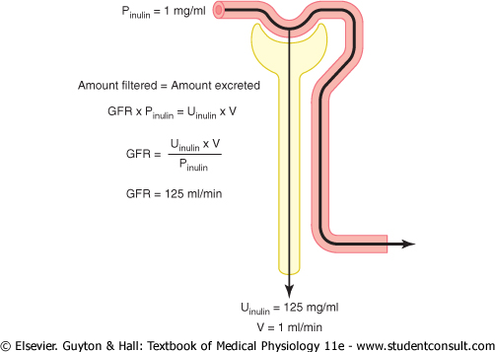

Slide 12
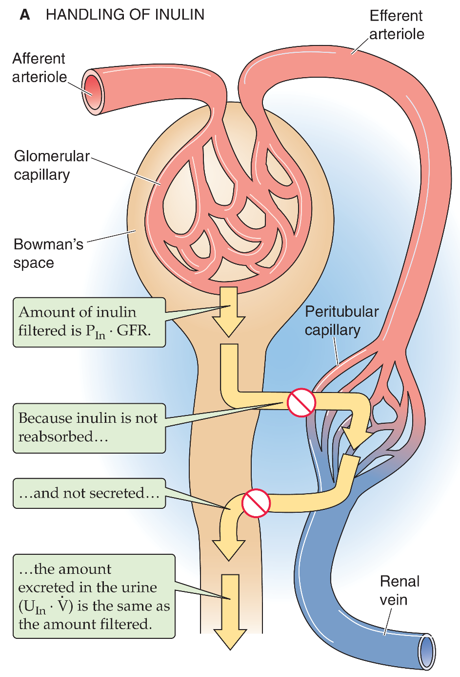
Clearance = GFR
Criteria of substance:
1. freely filtered
2. NOT reabsorbed, NOT secreted or metabolized in the nephron
amount filtered per minute = amount excreted per minute
■ e.g., inulin
GFR . [P]_{Inulin} =
[U]_{Inulin} . Ṽ
[U]_{Inulin} . Ṽ
Cl_{Inulin} = GFR =
[P]_{Inulin}
‹#›
Notes:
Cl, clearance.
Some substances are handled by the kidneys in a very specific fashion and this can be useful in determining kidney function.
example: if it were possible for the kidneys to completely remove a substance from plasma then the clearance of that substance is identical to RPF!
example: if a substance is freely filtered but is not transported by the tubules, then that which is filtered is also excreted. Therefore, only the filtrate is "cleared" and the clearance of that substance is identical to the GFR!
‹#›

Slide 13
Example
if Plasma conc. of inulin = 1mg/100ml
Urinary conc of Inulin = 120 mg /100ml
Urine flow (UV) = 1 ml /min then, the clearance of inulin will be?
C = 120 ml/min

Slide 14
Criteria of a substance used for GFR measurement:
a)freely filtered
b)not secreted by the tubular cells,
c)not reabsorbed by the tubular cells.
d)should not be toxic
e)should not be metabolized
f)easily measurable.
examples of such a substance:
Creatinine (endogenous):
by-product of skeletal muscle metabolism

Slide 15
Criteria of a substance used for GFR measurement, cont……
Inulin (exogenous):
It is a polysaccharide with a molecular weight of about 5200 and it fits all the above requirements.

Slide 18
Measurement of renal blood flow
Substances used for measurement of GFR are not suitable for the measurement of Renal Blood Flow. Why?
Inulin clearance only reflects the volume of plasma that is filtered and not that remains unfiltered and yet passes through the kidney.
It is known that only 1/5 of the plasma that enters the kidneys gets filtered.
Therefore, other substances to be used with special criteria.
To measure renal blood flow we will have to measure renal plasma flow first and then from the hematocrit we calculate the actual blood flow

Slide 19
Use of PAH Clearance to Estimate Renal Plasma Flow
Paraminohippuric acid (PAH) is freely filtered and secreted
and is almost completely cleared from the renal plasma
1. amount enter kidney =
RPF x P_{PAH}
~
2. amount entered = amount excreted
3. ERPF x P_{pah} = U_{PAH} x V
~ 10 % PAH
remains
ERPF =
U_{PAH} x V
P_{PAH}
ERPF = Clearance PAH
Notes:
‹#›

Slide 20
Measurement of renal plasma flow:
For the measurement of renal plasma flow, we will again need a substance that is
a)freely filtered
b)rapidly and completely secreted by the renal tubular cells
c)not reabsorbed
d)not toxic
e)and easily measurable
Example of such substance:
Para-aminohippuric acid (PAH)
90% of plasma flowing through the kidney is completely cleared of PAH.

Slide 21
PAH clearance: example
If the concentration of PAH in the urine and plasma and the urine flow are as follows:
Conc. of PAH in urine=25.5 mg/ml
Urine flow=1.1 ml/min
Conc of PAH in arterial blood=0.05 mg/ml
Then CPAH or Renal Plasma Flow=
(25.5 x 1.1)/0.05 = 560 ML/ min

Slide 22
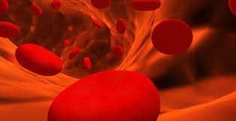
How to measure renal bl flow?

Slide 23
PAH clearance: example
If the concentration of PAH in the urine and plasma and the urine flow are as follows:
Conc. of PAH in urine=25.5 mg/ml
Urine flow=1.1 ml/min
Conc of PAH in arterial blood=0.05 mg/ml
Then CPAH or Renal Plasma Flow=
(25.5 x 1.1)/0.05 = 560 ML/ min
Lets say the hematocrit is 45%, then renal blood flow will be:
(560 x 100)/(100-45)= 1018 ml/min

Slide 24
Renal Clearance gives an indication of kidneys function.

Slide 25
Clearance can also be used to determine renal handling of a substance.
Clearance values can also be used to determine how the nephron handles a substance filtered into it. In this method the clearance for inulin or creatinine is calculated and then compared with the clearance of the substance being investigated.

Slide 27
Comparison of clearance of a substance with clearance of inulin
1) = inulin clearance; only filtered not reabsorbed or secreted
2) < inulin clearance; reabsorbed by nephron tubules
3) > inulin clearance; secreted by nephron tubules

Slide 28
Calculation of tubular reabsorption or secretion from renal clearance
Substances that are completely reabsorbed from the tubules (amino acids, glucose), clearance = zero because the urinary secretion is zero.
Substances highly reabsorbed (Na), its clearance < 1% of the GFR.
Reabsorption rate can be calculated=
Filtration rate- excretion rate
= (GFR X P*)-(U* X V)
* The substance needed to be assessed.

Slide 29
Calculation of tubular reabsorption or secretion from renal clearance, cont…….
If excretion rate of a substance is greater than the filtered load, then the rate at which it appears in the urine represents the sum of the rate of glomerular filtration + tubular secretion:
Secretion* = (U* X V)- (GFR X P*).
* indicate the substance

Slide 30
Q: Given the following information for a freely filterable substance
GFR = 120 mL/min
Plasma concentration = 3 mg/mL
Urine flow rate = 2 mL/min
Urine concentration = 10 mg/mL
we can conclude that:
a) the kidney tubules reabsorbed 340 mg/min
b) the kidney tubules reabsorbed 200 mg/min
c) the kidney tubules secreted 200 mg/min
d) the kidney tubules secreted 340 mg/min
e) Net transport is 0 mg/min
Amount Filtered per minute = (GFR X [Sub]_{plasma})
= 120 ml/min X 3 mg/ml = 360 mg/min
Amount excreted per minute = ([sub]_{urine} X Urine flow rate)
= 2 ml/min X 10 mg/ml = 20 mg/min
Amount Filtered per minute > Amount excreted per minute
Amount transported per minute = Filtered – Excreted
= 360 - 20 = 340 mg/min
Notes:
Substances that are present in the filtrate at the same concentration as found in the plasma are said to be freely filtered. (Note that freely filtered does not mean all filtered. The amount filtered is in exact proportion to the fraction of plasma volume that is filtered.) Many low-molecular-weight components of blood are freely filtered. Among the most common substances included in the freely filtered category are the ions sodium, potassium, chloride, and bicarbonate; the neutral organics glucose and urea; amino acids; and peptides like insulin and antidiuretic hormone (ADH).
‹#›

Slide 31
Filtration fraction
It is the ratio of GFR to renal plasma flow

