Slide 1
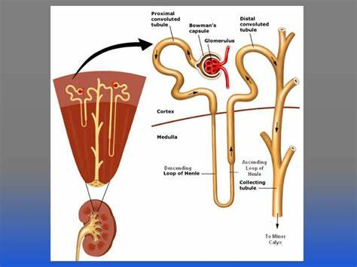
Tubular Processing of Filtrate-1
Dr. Maha Alenazy
Physiology department
maldahmashi@ksu.edu.sa
mahaenazy@gmail.com

Slide 2
Objectives:
• Define tubular reabsorption, tubular secretion, transcellular and paracellular transport.
• Identify and describe mechanisms of tubular transport
• Describe tubular reabsorption of sodium and water
• Revise tubulo-glomerular feedback and describe its physiological importance
• Identify and describe mechanism involved in Glucose reabsorption
• Study glucose titration curve in terms of renal threshold, tubular transport maximum, splay, excretion and filtration
• Identify the tubular site and describe how Amino Acids, HCO3 - , P04 - and Urea are reabsorbed

Slide 3
Tubular processing
Glomerular filtration
Tubular processing

Slide 4
Review of important points
Osmolality : Volume of particles per kg of solvent (moles of solute/kg of solvent)
So in renal physiology: Urine osmolality is used to measure the number of dissolved particles [solutes (i.e. ions, electrolytes)] per unit of water in the urine.
What changes osmolality in filtrate and then resulting urine? Glomerular filtration + tubular processing (i.e. reabsorption and secretion)
Do you remember how much was the osmolality of the glomerular filtrate upon/ glomerular filtration?
300mOsm/L
Tubular reabsorption
What about the osmolality in the different parts of the nephron? How does it change and what substances move across and how?
Focus of today’s lecture and tomorrow’s
Tubular processing
Tubular secretion

Slide 5
Tubular processing of ultrafiltrate
The ultrafiltrate gets modified as it passes through the nephron tubules until excretion.
Definitions:
Tubular reabsorption: reabsorption of substances from the glomerular filtrate to the peritubular capillaries
Tubular secretion: secretion of substances from the peritubular capillary blood to the tubular fluid.
Excretion: removal of water and solutes from body in urine

Slide 6
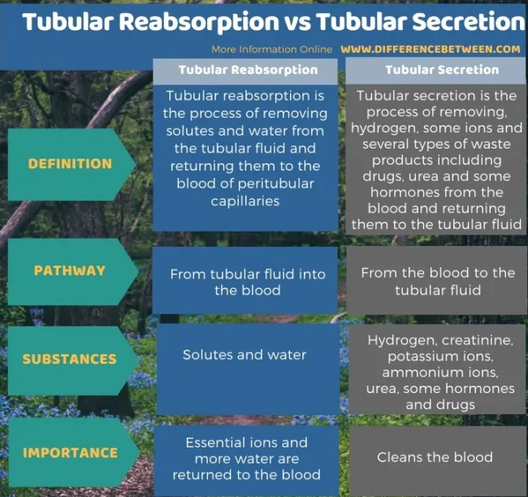
“2618 Nephron Secretion Reabsorption” By OpenStax College – Anatomy & Physiology, Connexions Web site. Jun 19, 2013 (CC BY 3.0)

Slide 7
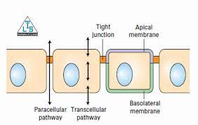
Tubule lumen
Transcellular transport: substances travel through the cell, passing through both the apical membrane and basolateral membrane
Paracellular transport: the transfer of substances across an epithelium by passing through the intercellular space (tight junctions) between the cells
Blood

Slide 8
Introductions: recap !
Kidney filters about 180L/day of protein and cell free filtrate by the glomerulus
Nevertheless, humans normally excrete 0.5-1.5L of urine daily
Where is the remaining 178.5L of filtered fluid?

Slide 9
Tubular reabsorption
Glomerular filtration is nonselective process while tubular processing is highly selective

Slide 10
Filtrate processing in the different parts of the nephron

Slide 11
The histological structure of each part of the nephron is designed to fit its function

Slide 12
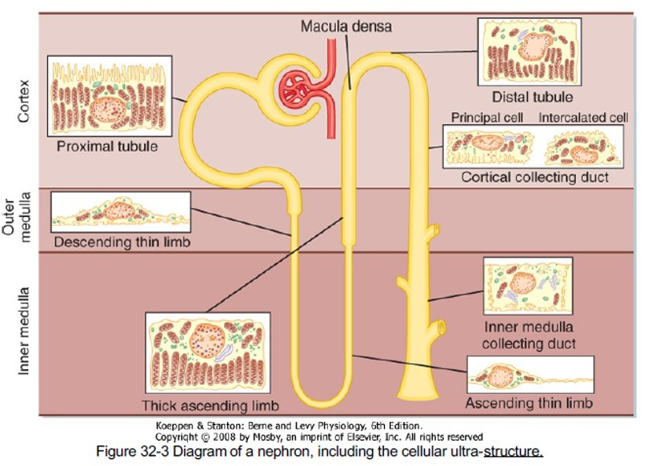

Slide 13
Tubular reabsorption and secretion

Slide 14
How does the nephron reabsorb substances?
Reabsorption is a 2 step process:
Transport substances from the tubular lumen to the interstitial fluid (IF)
Transport substances from IF to the peritubular capillaries
From tubular lumen to IF:
1. Transport involves both active and passive processes.
2. This transport can be transcellular and/or paracellular routes.
From IF to peritubular capillary blood:
By ultrafiltration (Bulk Flow)

Slide 15
Transport mechanism across the tubule
Active transport
Passive transport
Requires energy.
Substances move substances against their electrochemical gradient.
Doesn’t require energy
Substances move down their electrochemical gradient
Example
Types
Primary Active
Secondary Active
Passive diffusion: Osmosis. E.g. water and solutes like Cl- and urea
Directly coupled to an energy source. E.g. Na+-K+ ATPase
indirectly coupled to an energy source.
Carrier protein
e.g. Glucose and aa

Slide 16
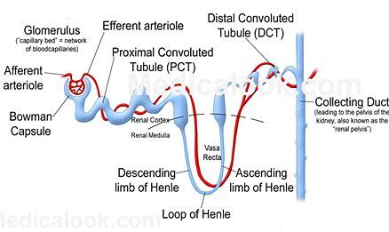
Tubular reabsorption in each part of the nephron

Slide 17
Filtrate processing in PCT
Glucose and Amino acids (aa) 100%
Most reabsorption occurs in PCT because
Highly metabolic cells
Extensive brush border
Lots of mitochondria
Water and Na+ 65%
reabsorption
Secretion
Bile salts
Urea
Toxins
PAH
Catecholamines
drugs

Slide 18
Na+ reabsorption in PCT
Different types of transporter proteins:
co transporter (same direction as Na+ movement)
Exchangers (opposite direction of Na+ movement
Basolateral Na+-K+ ATPase pumps 3Na+ out and 2 K+ inside the cell
As 65-70% of Na+ reabsorbed in PCT, H2O is obligated to follow (osmosis) (65-70% of H2O+ reabsorbed in PCT)..this is called obligatory water reabsorption
Na+
Na+
3 Na+
Na+
ATPase
Na+
Na+
2 K+
Na+
Na+
This results in
Na+
Na+
Na+
Na+
Decrease Na+ concentration inside the cell
NBC
Na+
HCO3-
paracellular
This gradient favors passive entry of Na+ into the tubular cell across the apical membrane via transporter protein
transcellular

Slide 19
Glucose reabsorption in PCT
Basolateral Na+-K+ ATPase pumps 3Na+ out and 2 K+ inside the cell
Na+
Na+
3 Na+
ATPase
Amino acids (also lactate, phosphate) are reabsorbed the same way as glucose
SGLT
Gluc
Na+
Gluc
2 K+
This results in
Na+
Gluc
Gluc
Na+
Na+
GLUT
Decrease Na+ concentration inside the cell
Gluc
But each have their own cotransporter specific for them. High selectivity and specificity int in this process.
This gradient favors passive entry of Na+ into the tubular cell across the apical membrane via SGLT carrying Glucose with it
transcellular

Slide 20
Relationship between Plasma Glucose plasma concentration and Glucose urine excretion
Important points to consider
Features of this glucose titration curve
Glucose Plasma Threshold
Transport maximum (Tm) : what is it and why does it occur?
What happens if blood glucose level increased to 400mg/dl

Slide 21
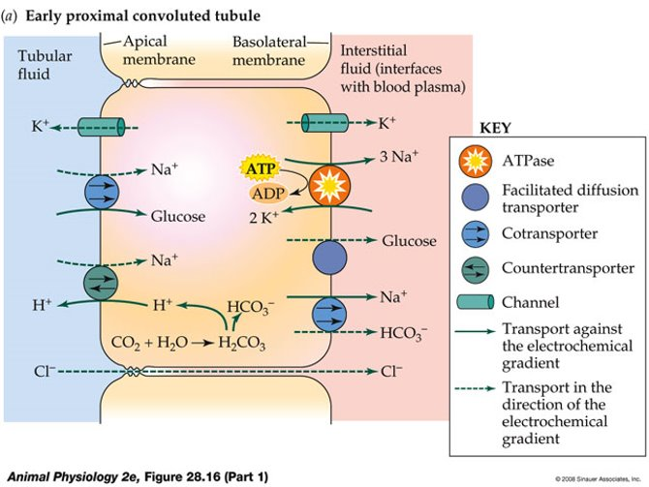

Slide 22
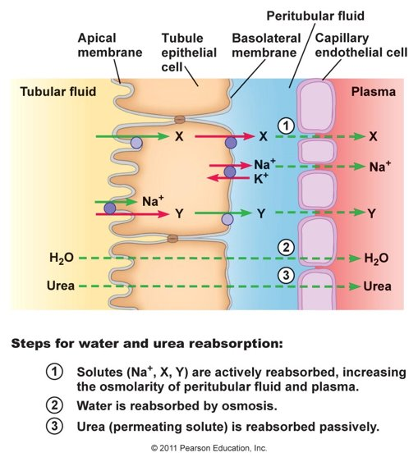
Water reabsorption in PCT
Water is reabsorbed via
transcellular route
paracellular route
Transcellualr transport of water is facilitated by water channels aquaporins (AQP1)

Slide 23
Differences in Na+ along the PCT
1st half
2nd half
Na+ reabsorption is coupled via symporters with
Glucose
aa
Lactate
Phosphate
While
H+ is via antiporter
Na+ reabsorption is coupled to Cl-….why?
Na+
Glu
aa
Lactate
phosphate
H2O
Cl-
1st half
2nd half

Slide 24
Na+ Cl- reabsorption in 2nd half of PCT
Anion includes formate, oxalate, and sulfate

Slide 25
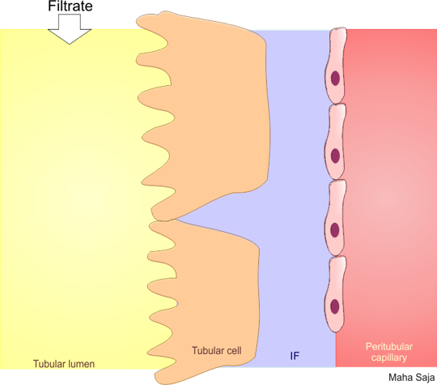
CO2 in blood diffuses via the basolateral membrane inside the epithelial cells
HCO3- reabsorption in PCT
H+ binds to HCO3- inside the tubule then same reaction happens to form H2CO3 as it reacts with CA present on basolateral membrane.
it combines with H2O present inside the cell. It will form H2CO3 via CA. This reaction is weak so H2CO3 dissociates to H+ and HCO3-. HCO3- will be pushed to the blood via the basolateral membrane
Na+
Na+
3 Na+
+
H+
NHE3
ATPase
HCO3-
Na+
Na+
2 K+
Na+
CA
H+
H2CO3
HCO3-
About 90%
HCO3-
Na+
H2CO3
CO2
H2O
CA
diffusion
+
CO2
+
CO2
CO2 and H2O leave while HCO3- made indirectly inside the cell get reabsorbed inside of filtered
H2O
NA+/K+ causes Na+ conc to fall inside cell so Na+ enters cell down its gradeint via specialized channel in exchange of H+ which leaves cells against its gradient

Slide 26
Hydrogen ions secretion in PCT
Basolateral Na+-K+ ATPase pumps 3Na+ out and 2 K+ inside the cell
Na+
Na+
3 Na+
H+
NHE3
ATPase
Na+
2 K+
Na+
This results in
Na+
H+
HCO3-
Na+
H2CO3
Decrease Na+ concentration inside the cell
+
H2O
CO2
This gradient favors passive entry of Na+ into the tubular cell across the apical membrane via NHE in exchange with H+

Slide 27
Organic cations and anions secretion
Organic cations
Endogenous: creatinine, dopamine, Epinephrine, norepinephrine
Exogenous: Atropine, Morphine, Amiloride, procainamide
Organic anions
Endogenous: Bile salts, oxalate, urate, vitamins (ascorbate, folate).
Exogenous: Acetazolamide, furosemide, salicylates, penicillin

Slide 29
Thank you

