Slide 1
Tubular processing of filtrate – 2
Dr. Maha Alenazy
Physiology department
maldahmashi@ksu.edu.sa
mahaenazy@gmail.com

Slide 2
Objectives
• Identify and describe the characteristic of loop of Henle, distal convoluted tubule and collecting ducts for reabsorption and secretion
• Identify the site and describe the influence of aldosterone on reabsorption of Na+ in the late distal tubules.
K+ regulation

Slide 3
Loop of Henle

Slide 4
Thin descending limb of loop of Henle is:
highly permeable to water but
moderately permeable to solutes
Thick Ascending limb of loop of Henle is impermeable to water and solutes are reabsorbed
Descending limb
Ascending limb
H+
25% of Na+, Cl-, K+ are reabsorbed via
Active transport of 1Na+, 2Cl-, and 1K+
Na+
Cl-
K+
Ca+2
Mg+2
20% H2O
Diffusion

Slide 5
Na+ reabsorption in TAL
Basolateral Na+-K+ ATPase pumps 3Na+ out and 2 K+ inside the cell
Na+
3 Na+
Na+
Na+
Loop diuretics block NKCC2
Na+
2CL-
NKCC2
ATPase
Na+
K+
Na+
2 K+
This results in
Na+
Na+
K+
Na+
Na+
Na+
Decrease Na+ concentration inside the cell
NHE3
H+
Mg+2
Ca+2
paracellular
e.g. Lasix blocking 25% of filtered load (bcus triple transporter)
This gradient favors passive entry of Na+ into the tubular cell across the apical membrane via NKCC2 along with CL- and K+
Apical membrane
Basolateral membrane

Slide 6
Distal convoluted tubule (DCT) and collecting duct (CD)

Slide 7
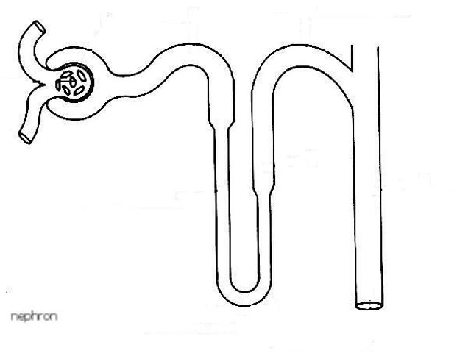
Transport across the distal tubule
The late part of the DCT resembles cortical CD as it has two important kinds of cells:
Principle cells which reabsorbs Na+ and H2O while secreting K+.
Intercalated cells Type A which reabsorbs K+ and secretes H+
The early part of the DCT resembles the thick ascending loop of Henle. Its impermeable to water but pumps solutes actively
So,
its called the diluting segment.
5% Na+ is reabsorbed here
It reabospbs 5% NaCL
Early part
late part
Impermeable to urea
Principle cells are controlled by Aldosterone
In the late part of the DCT, H2O permeability is controlled by ADH
It reabospbs 5% NaCL
Intercalated cells Type A regulates acid-base balance

Slide 8
Transport mechanism in the early part of the distal convoluted tubule
Basolateral Na+-K+ ATPase pumps 3Na+ out and 2 K+ inside the cell
Na+
3 Na+
Na+
Na+
NCC
ATPase
CL-
2 K+
Thiazide diuretics block NCC
This results in
Na+
Na+
Na+
Decrease Na+ concentration inside the cell
Blocks transporter carrying 5% of filtered load
This gradient favors passive entry of Na+ into the tubular cell across the apical membrane via NCC along with CL-
Apical membrane
Basolateral membrane

Slide 9
Late distal convoluted tubule and collecting duct
+
Aldosterone
Na+ channel blockers
Aldosteorne anatgonists (e.g. spironolactone)
Principle cells use channels for Na+ and K+ specific to each which is different than other parts of the nephron that use carrier
K+ sparing diuretics

Slide 10
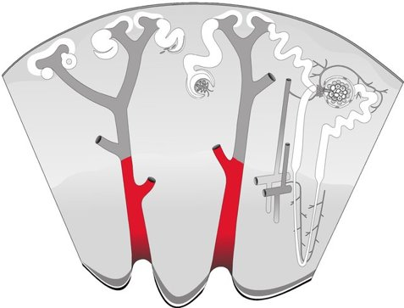
Medullary collecting duct
Reabsorbs about 3% of filtered Na+
ADH controls permeability to H2O (ADH affects since late DCL)
Permeable to urea
Secretes H+

Slide 11
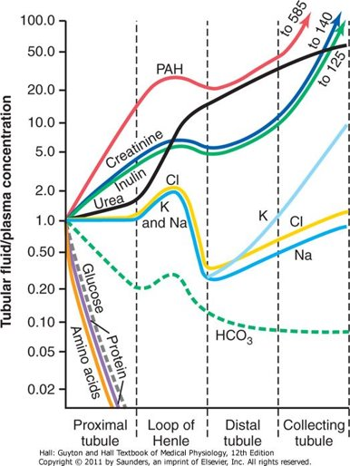
Summary of all solutes’ concentrations along the tubular segments

Slide 12
Regulation of tubular reabsorption

Slide 13
Factors influencing tubular reabsorption regulations
1. physical forces that govern reabsorption
2. Hormonal and neuronal mechanism

Slide 14
Tubules can increase their absorption in response to increase tubular load → glomerulo-tubular balance
Physical factors regulating tubular reabsorption
Hydrostatic pressure (P) which pushes fluid out
Oncotic pressure (П) which pulls fluid in

Slide 15
Physical forces that govern tubular reabsorption
Pc is influenced by the following:
ABP
Aff and Eff arteriolar resistance
Пc is influenced by the following:
FF
Systemic plasma colloid osmotic pr.
reabsorptions
Net absorptive force
10mmHG
Pc
Forces favoring reabsorption:
Пc =32mmHg and PIF= 6. so total is 38
While
Forces opposing reabsorption:
Pc =13 and ПIF =15 . So total is 28
П c
P IF
П IF
Forces favoring reabsorption = 38 > forces opposing it =28
Result: net absorptive force = 38-28 = 10mmHG

Slide 16
Hormonal regulation of tubular reabsorption
Hormone | Stimulated by
Angiotensin II | Renin, Low ABP, low BV, low NaCL,
Aldosterone | Angiotensin II
ADH | Low ABP, low BV
ANP | Stretch sensors stimulated to high BV
Action
- Stimulates Na+ and H2O reabsorption in PCT. increases efferent vasoconstriction, so : it reduced peritubular capillary hydrostatic pressure increasing net tubular reabsorptive force Reduces renal blood flow and hence increases filtration fraction in the glomerulus which increases colloid pressure in the peritubular capillaries (this process increases tubular reabsorption) - It stimulated Aldosterone production stimulating Na+ reabsorption and K+ secretion
P Cells to reabsorb Na+ and secrete K+ in DCT/CD
H2O reabsorption in CD (AQP1)
Blocks Na+/ H2O reabsorption in distal parts of nephron DCT and CD. It is opposite of aldosterone.
Parathyroid hormone (PTH) | Low Ca2 | Lowers PO4- reabsorption while increasing Ca+2 reabsorption

Slide 17
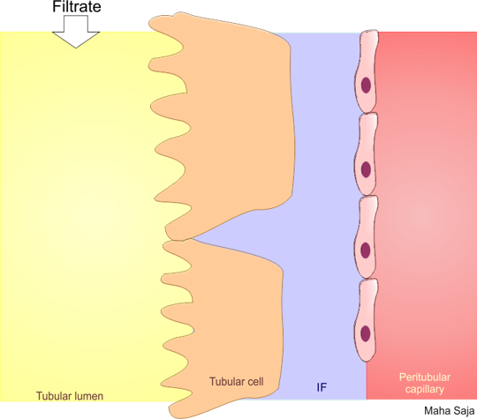
HPO4- processing: PTH influence in HPO4- secretion
PKA
3Na+
cAMP
ATP
2K+
Adenyl Cyclase
Ca+2
PTH-→ HPO4- secretion in PCT which is accompanied by increase Ca+2 reabsorption in the DCT and collecting dust as well as increase in Mg+ reabsorption in loop of Henle
-
phosphorylation
Na+
ATP
+
Gs
+
HPO4-
Na+
Na+
PTHR
HPO4-
Na+
PTH
Na+
HPO4-

Slide 18
ADH (late part of DCT and CD)
PKA
3Na+
cAMP
ATP
2K+
phosphorylation
Adenyl Cyclase
Na+
ATP
+
AQP2
Gs
Na+
V2
H2O
AQP2
ADH
Na+
Na+
H2O
HPO4-

Slide 19
Regulation of K+

Slide 20
Potassium
One of the most abundant cations in the body
98% in ICF and 2% in ECF
K I > K o → 150mEq/L >3.5-5mEq/L
Importance of K+
Cell volume regulation
Cell pH regulation
Resting membrane potential
Cardiac and neural activity

Slide 21
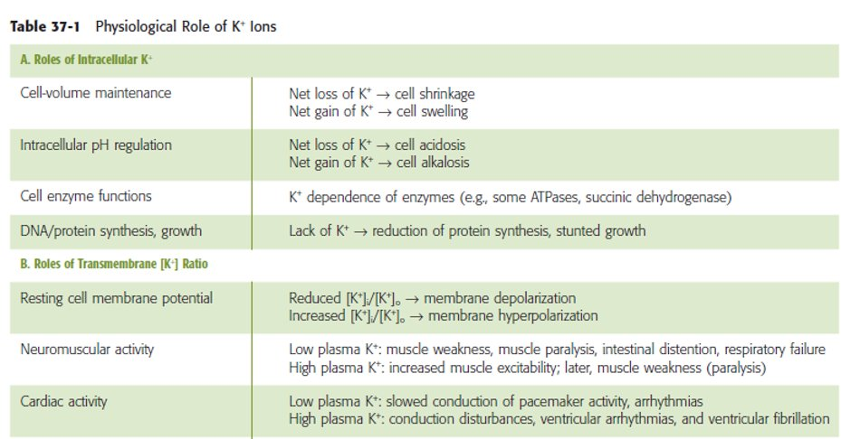
The importance of K+ metabolism

Slide 22
K+ homeostasis
Diet 50-200 mEq/day
2%
98%
Body protection against hyperkalemia after meals
Absorption of 40mEq of K+
If K+ concentration increases in ECF to about 2mEq/L difference this is dangerous so we need to regulate and control!
K+ output:
GI loss about 5-10%
Renal excretion about 90-95%

Slide 23
Renal regulation of K+ concentration takes time so what does the body do to regulate this vital ion as quickly as possible?
Solution
Cellular shift

Slide 24
Cellular shift

Slide 25
Cellular defense mechanism against K+ abnormalities
Cellular shift
Renal excretion
Conc of K+ is high in ECF---→ shift K+ into the cell
Conc of K+ is low in ECF → shift K+ out of the cell
Increased excretion in case of high K+ concentration and
Decreased excretion in case of low K+ concentration

Slide 26
Factors that can shift K+ in and out of the cell
Shift K+ out
Shift K+ in
Insulin
Aldosterone
β- adrenergic stimulation
Insulin deficiency
Aldosterone deficiency
β- adrenergic blockers
H+
K+
H+
K+
Acidosis
H+
Alkalosis
H
Cell lysis
Strenuous exercise
ECF osmolarity

Slide 27
Factors affecting K+ distribution between ICF and ECF

Slide 28
Physiologic factors affecting K+ distribution between ICF and ECF
Aldosterone
Insulin
Epinephrine

Slide 29
Pathophysiologic factors affecting K+ distribution between ICF and ECF
Acid base disturbance
Change in plasma osmolality
Cell lysis
Excercise
How do these factors affect K+ distribution between ICF and ECF?

Slide 30
Renal K+ excretion

Slide 31
If K+ intake is low, only 1-3% of filtered K+ will be excreted
If K+ intake is normal to high, 10-15% of filtered K+ will be excreted.
About 65% reabsorbed by PCT
About 25-30% reabsorbed by TAL
5-10% enters the distal portions of the nephron

Slide 32
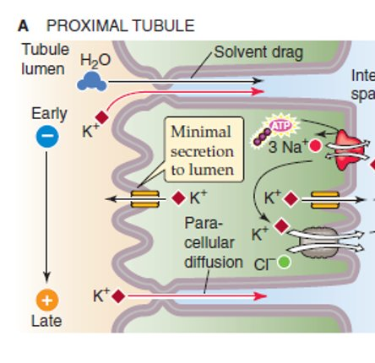
In the PCT, K+ reabsorption is a passive process ….how?
Water reabsorption is through paracellular route and drags K+ with it (solvent drag).

Slide 33
K+ handling by TAL: by Secondary active transport via the apical triple transporter (NKCC2)

Slide 34
K+ handling by the distal portions of the nephron
High K+ intake, increased K+ secretion
Principle cells
Aldosterone
+
Low K+ intake, decreased K+ secretion
Na+ and water reabsorption & K+ secretion
α-intercalated cells
In K+ depletion, increased K+ readoption
Secrete H+ and reabsorb K+

Slide 35
Factors regulating K+ secretion
Factors stimulating K+ secretion:
ECF K concentration
Aldosterone
tubular flow rate
Factors decreasing K+ secretion:
Acidosis H+

Slide 36
Thank you

