Slide 1
Concentration of urine
Dr. Maha Alenazy
Physiology Department
maldahmashi@ksu.edu.sa
mahaenazy@gmail.com

Slide 2
Objectives
Identify and describe
how the loop of Henle is a “counter current multiplier” while the vasa recta is a “counter current exchanger” and their roles in concentrating urine.
Explain
what happens to osmolarity of tubular fluid in the different segments of loop of Henle upon concentrated urine production.
Explain
The factors that enable the loop of Henle to make a concentrated medullary gradient.
Differentiate
between water diuresis and osmotic diuresis.
Learn about
the clinical correlates of diabetes mellitus and diabetes insipidus.

Slide 3
Kidney regulation of h2o excretion
In case of water excess in the body
In case of water deficit in the body
Large volume of diluted urine
small volume of concentrated urine
50mOsm/L
Urine osmolarity
1200mOsm/L

Slide 4
Obligatory urine volume
The minimal volume of urine that needs to be excreted to get rid of the metabolism waste products from the body
It is determined by the maximal concentrating ability of the kidney.
70kg human needs to excrete 600mOsm of solutes per day.
How to calculate the obligatory urine volume?
(600mOsm/day)/(1200mOsm/L) = 0.5L/day

Slide 5
The importance of regulating water independent of solutes
To maintain a constant solute concentration in ECF
To keep ECF osmolarity constant
Normal osmolarity of ECF:
About 300mOsm/L
Factors determining the osmolarity of ECF:
Osmolarity = amount of solutes / volume of ECF (water)

Slide 6
Why is keeping ecf osmolarity important?
To keep a constant concentration of solutes & electrolytes in the ECF is important for normal cellular function

Slide 7
Water balance
Daily intake:
Fluids ingested: (2100ml)
From metabolism: (200ml)
-------------------
Total intake: 2300ml
Daily loss:
Insensible loss: (700ml)
sweat: (100ml)
feces: (100ml)
Urine (1400ml)
-------------------
Total loss: 2300ml

Slide 10
Osmosis if the movement of water across a semipermeable membrane from an area of low solutes concentration to high solutes concentration.
It’s a passive mechanism

Slide 11
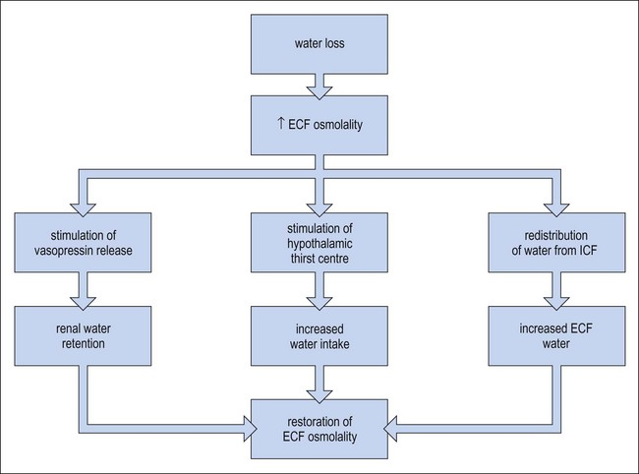

Slide 12
How the kidney handles h2o
ADH dependent
Isotonic
65%
Hypo-osmotic
What happens to the osmolarity of the filtrate as it passes through the nephron?
300
cortex
300
100
H2O
Water deficient so we need water back to the system
solutes
400
500
600
700
800
900
1000
1100
1200
medulla
ADH
H2O
20%
Medulla is hypertonic
1200
Hyper-osmotic
Water excess conditions, no ADH so water leaves

Slide 13
H20 handling by the kidney
Water deficit state
Water excess state

Slide 14
Concentrated urine formation
There are two important factors in forming concentrated urine:
The hyperosmotic medullary intersititum
ADH/AVP
If body osmolarity is around 300mOsm/L, how did the renal medulla interstitium become hyperosmotic?
Due to accumulation of Na+ and urea in renal interstitium

Slide 15
Hyperosmotic renal medulla
Hyperosmotic renal medulla is maintained by
Countercurrent multiplier mechanism
Urea recirculation (recycling)

Slide 16
Countercurrent multiplier mechanism

Slide 17
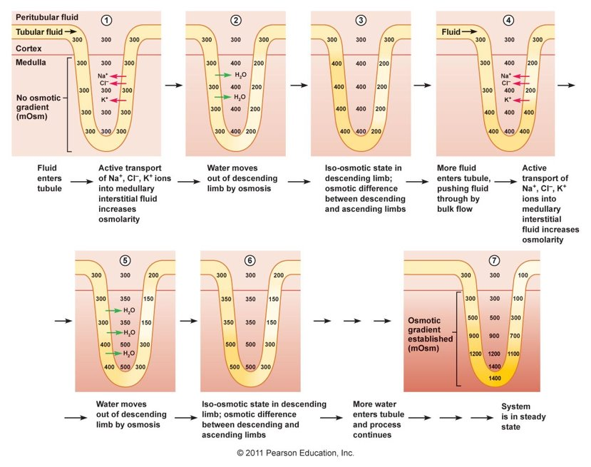
Countercurrent multiplier mechanism

Slide 18
Urea recirculation (recycling)
PT reabsorbs about 50% urea
Urea is the major nitrogen waste in the body.
It’s made in the liver by product of protein metabolism
ADH causes water reabsorption
20-60% of urea is excreted in a healthy person depending on urine flow rate and hydration state
ADH causes water and urea reabsorption
tDLH & tLAH secrete about 50% urea

Slide 19
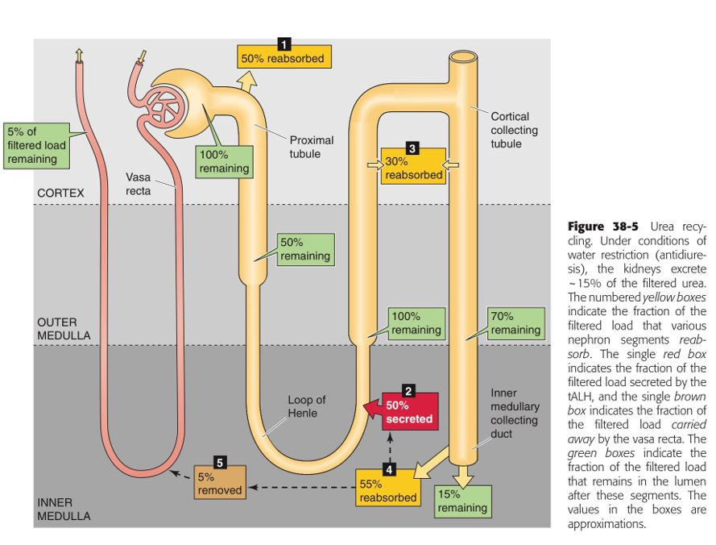

Slide 20
The vasa recta
Question: why doesn’t the blood that flow through the vasa recta wash out the medullary hyperosmotic gradient?
1. medullary blood flow is low (< 5% of renal blood flow)
2. the vasa recta serve as a counter current exchanger

Slide 21
the vasa recta is a counter current exchanger

Slide 22
the vasa recta is a counter current exchanger

Slide 23
The regulation of ecf osmolarity

Slide 24
Ecf osmolarity
Water
Osmolarity = amount of solute/volume of ECF
ECF osmolarity is governed by two main mechanisms:
1. thirst mechanism
2. Osmoreceptor ADH system

Slide 26
Antidiuretic hormone (ADH)

Slide 27
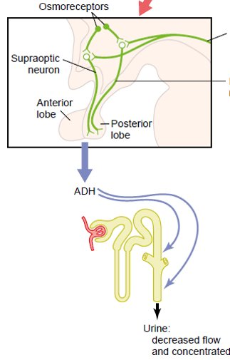
How osmoreceptors detect change in osmolarity?

Slide 28
ADH secretion stimulants
Osmotic
Hemodynamic
Most important!
Osmolarity of ECF
1% change in ECF osmolarity can significantly change ADH secretion
Blood volume and arterial blood pressure in the vascular system
5-10% in BV and/or ABP is required for ADH release.
ADH is more sensitive to osmotic changes than hemodynamic changes (1% change stimulates ADH while hemodynamic differences need to reach 5-10% to stimulate ADH

Slide 29
Factors that can alter ADH secretion
Increase ADH | Decrease ADH
Nausea | ANP
Hypoxia
Angiotensin II
Drugs: Morphine Nicotine | Drugs: Alcohol

Slide 30
ADH mechanism of action

Slide 31
Water balance
Increased firing and sending signal to posterior pituitary
Release ADH from post. pituitary
Shrinking of osmoreceptor cells in the hypothalamus
Water retention to decrease osmolarity
Osmolality 300mOsm/L
Increased water reabsorption by the kidneys
Increased osmolality (dehydration)
Diluted urine as osmolarity is increased
Decreased osmolality (over drinking)
Decreased H2O reabsorption by the kidney
Decreased ADH secretion by post. Pituitary
Inhibiting osmoreceptor cells in the hypothalamus

Slide 32
Thirst mechanism: conscious desire for water

Slide 33
Thirst and adh mechanism importance

Slide 34
Abnormalities in ADH secretion
Inadequate ADH effect (e.g. Diabetes insipidus): causes can be:
Central: low ADH secretion from post pituitary, polyurea, polydipsia
Nephrogenic: mutation in V2 receptors or AQP2, cant respond to ADH, polyurea, polydipsia
Excessive ADH “SIADH”:
High ADH levels, water retention, ECF hypo-osmotic, urine hyper-osmotic

Slide 35
Water diuresis vs. osmotic diuresis
Water diuresis | Osmotic diuresis
Increased urine flow rate but NO change in urine solutes excretion | Increased urine flow rate AS WELL AS urine solutes excretion
Causes: Excess water intake Lack of ADH Defect in ADH receptor in the distal segment of the nephron (nephrogenic diabetes insipidus) | Causes: Increased plasma glucose level (DM) Increased levels of poorly reabsorbed solutes and anions Diuretic drugs (Lasix)
Diuresis is mainly due to decreased water reabsorption in the distal segment of the nephron. No change in water reabsorption proximally. | Diuresis is mainly due to decreased solutes reabsorption in PCT or LOH. This solute reabsorption reduction causes water reabsorption reduction proximally and distally

Slide 36
Water diuresis vs. osmotic diuresis
Water diuresis | Osmotic diuresis
Increased urine volume is a result from increased excretion of pure water. | Increased urine volume is a result from increased excretion of osmotically active solutes which pulls water with them.
Urine osmolality falls far below plasma osmolality | Urine osmolality falls but remains above plasma osmolality
Only about 15% filtered load of water reaching distal segments may remain unabsorbed and excreted in urine (max urine volume 20 ml/min) | Due to decreased water in all segments of the nephron, a much greater fraction of filtered water maybe excreted volume more than 20 ml/min
ADH administration will stop diuresis if due to lack of ADH. ADH administration will not be effective in nephrogenic diabetes insipidus | ADH administration will not stop diuresis

Slide 37
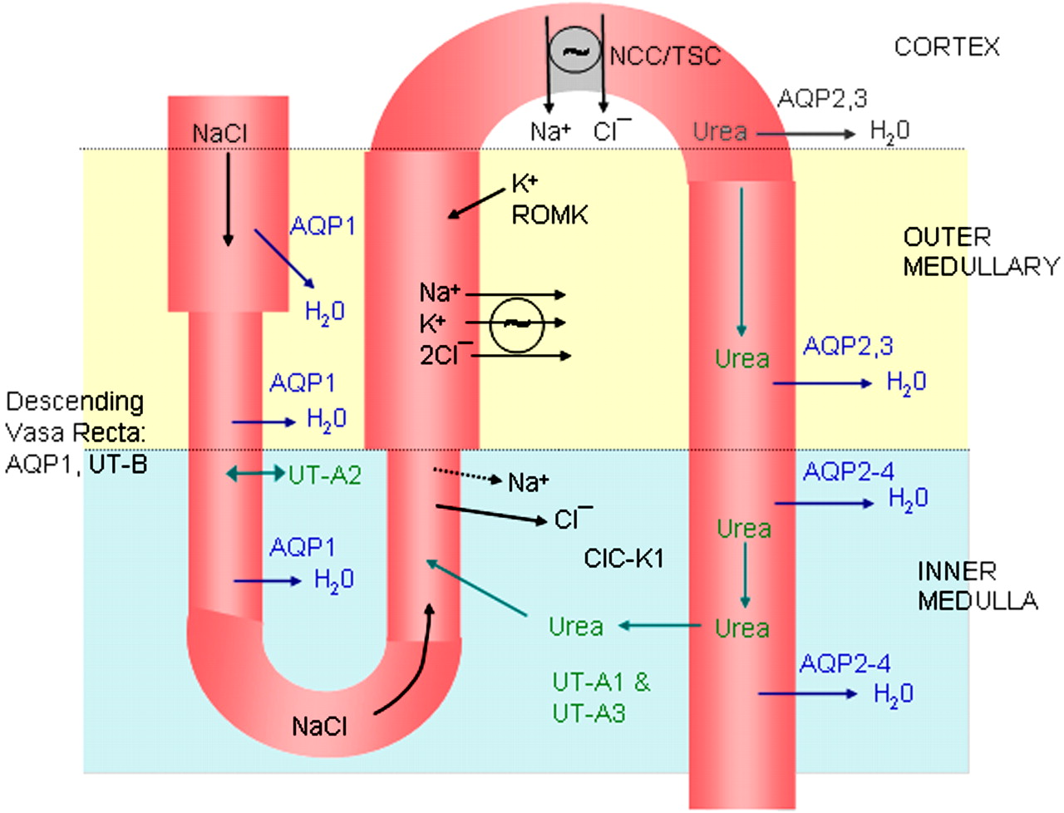
Review!

Slide 38
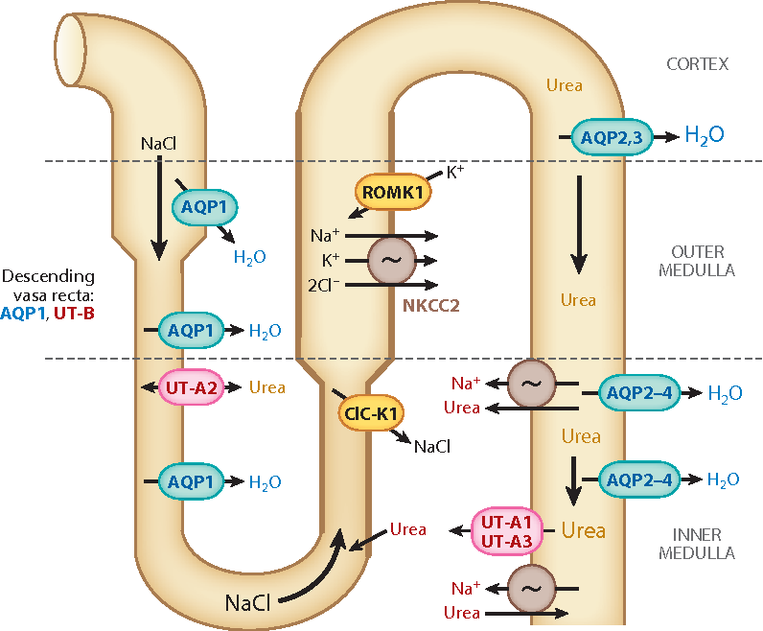
Review!

Slide 39
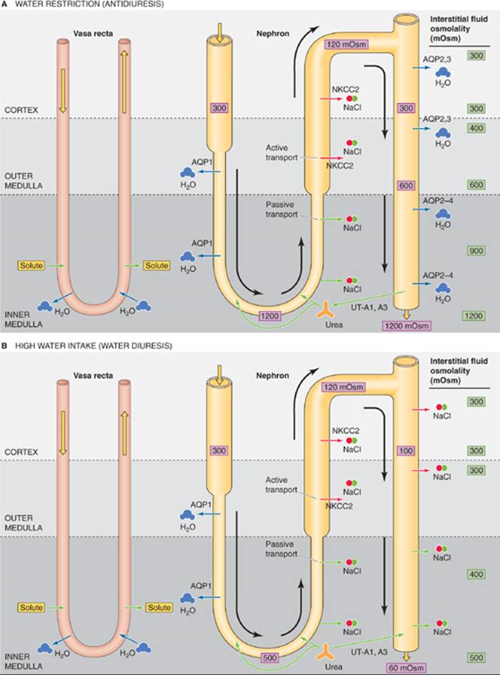
summary-1

Slide 40
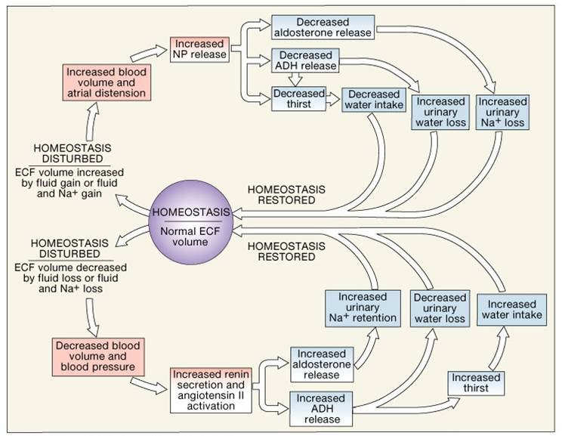
Summary-2

Slide 41
Thank you

