Slide 1
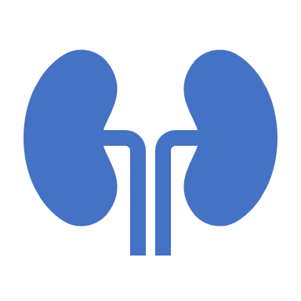
Extracellular fluid regulation
Dr. Maha Alenazy
Physiology department
maldahmashi@ksu.edu.sa
mahaenazy@gmail.com

Slide 2
Objectives
Identify and describe the role of sensors and effectors in the renal regulation of body fluid volume.
1
Describe the role of the kidney in regulating body fluid volume and osmomality
2
Identify the site and describe the influence of aldosterone on reabsorption of Na+ in the late distal tubules
4
Understand the role of ADH in the reabsorption of water and urea
3

Slide 3
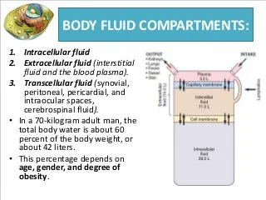
Body fluids

Slide 5
What factors are controlled in ECF regulation?
ECF volume
ECF osmolarity
Why should ECF volume and osmolarity be regulated?
Controlling ECF volume regulates blood pressure and therefore affects tissue perfusion
Controlling ECF osmolarity regulates cell volume and therefore affects cell function

Slide 6
ECF fluid regulation
ECF volume
ECF osmolarity
The two systems use different regulatory hormones and sensors
Regulated by
Regulated by
Adjusting total body Na+ content
Adjusting total body water content
Focus of today’s lecture
discussed in the last lecture
Na+ excretion
Water excretion

Slide 7
Why Na+ regulates ECF?

Slide 8
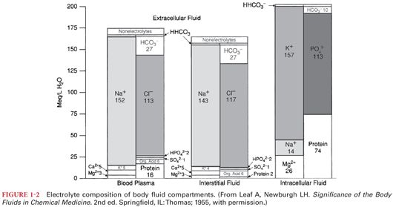
Na+ is main osmotic component of ECF

Slide 9
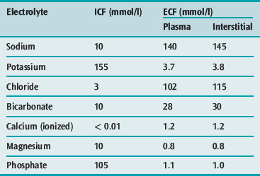

Slide 10
ECF volume
Most abundant cation in ECF is Na+
Most abundant anion in ECF are Cl- and HCO3-
How is the body volume linked to Na+ regulation?

Slide 11
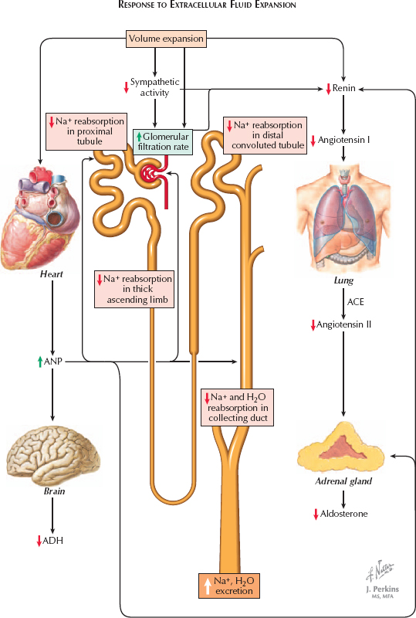
How is the body volume linked to Na+ regulation?
Na+ is the main osmotic constituent of ECF, when Na+ moves, it drags water with it
Increased Na+ concentration in ECF
What about the opposite?
Increased ECF osmolarity
Increased H2O kidney reabsorption
Stimulate thirst response
Increased ECF volume

Slide 12
How is the body volume linked to Na+ regulation?

Slide 13
Na+ balance
Input:
Dietary intake input: RDA: 1.5-2.3g/day
Western diet content: 7g/day
output:
kidney is most important. Minor pathways under normal conditions → GI loss and sweat.

Slide 14
Na+ distribution in the body
65%→ ECF
5-10% → ICF
25-30% → Bones
Exchangeable

Slide 15
ECV volume regulation
What does the body sense?
What are these sensors?
How do these sensors execute their actions?

Slide 16
What does the body sense?
The body doesn’t sense ECF volume per say but in fact it senses effective circulating volume (ECV)
What is effective circulating volume (ECV)?
It is the functional blood volume which reflects the extent of tissue perfusion in specific regions as evidenced by the pressure in their blood volume.
Therefore, ECV reflects circulation adequacy ..fullness and pressure in the vessels

Slide 17
Effective circulating volume (ECV)
Normal ECF → normal ECV → normal ABP and adequate tissue perfusion
But …
Decrease in ECF → decrease in ECV → decrease in ABP and tissue perfusion
Increase in ECF → increase in ECV → increase in ABP and tissue perfusion

Slide 18
What are these sensors?
ECV volume is sensed by baroreceptors.
low blood pressure baroreceptors
High blood pressure baroreceptors

Slide 19
How do these sensors execute their actions?
We first need to understand what are the effectors?
Change in ECV (ECF volume)→ affects ECV sensors “baroreceptors” → This generates 4 hormonal/ neural pathways
RAAS
Sympathetic NS
ADH
ANP

Slide 20
RAAS
Decrease in ECV→ decrease in baroreceptors stretch in afferent arterioles → renin release by the granular cells (Juxtagolm. cells) → angiotensin I to Angiotensin II → increased vasoconstriction and stimulation to adrenal gland to cause → increased ADH secretion retaining water, and increased aldosterone causing increased Na+ reabsorption from tubule

Slide 21
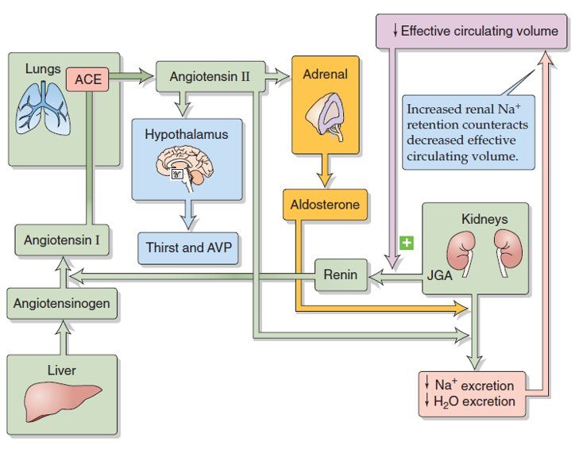
Low ABP → low NaCl concentration at macula densa → renal perfusion

Slide 22
Sympathetic nervous system (SNS)
Low ECV
Stimulate CNS
Direct
indirect
Increased Na+ reabsorption
Increased renal vascular resistance
Stimulate renin release

Slide 23
Atrial natriuretic peptide (ANP)
ANP promotes Na+ excretion (Natriuresis)
ANP is secreted by atrial myocytes in response to stretch
Low ECV
Decreased ANP release
Decreased Na+ excretion

Slide 24
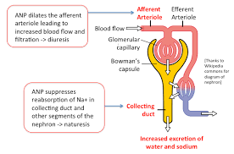
Atrial natriuretic peptide (ANP)

Slide 25
Antidiuretic hormone (ADH)
Very Low ECV
ADH (AVP) release

Slide 26
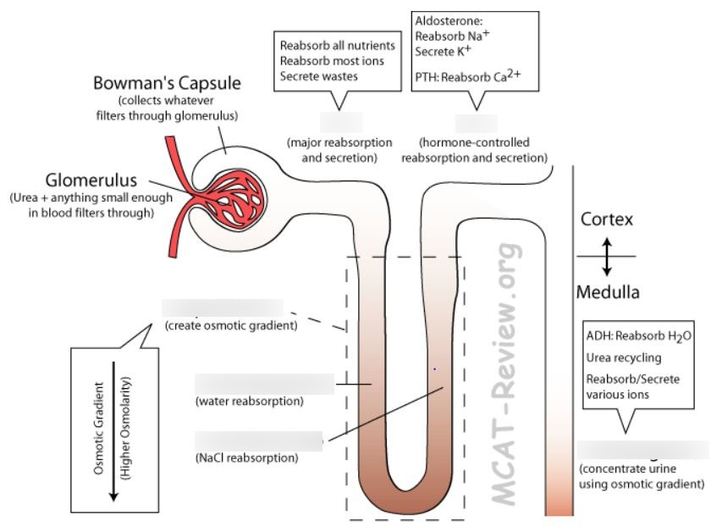

Slide 28
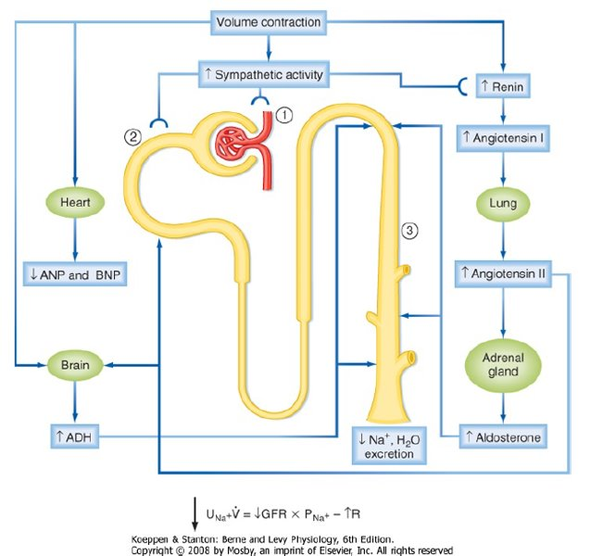
Summary

Slide 29
Summary

Slide 30
Thank you

