Slide 1
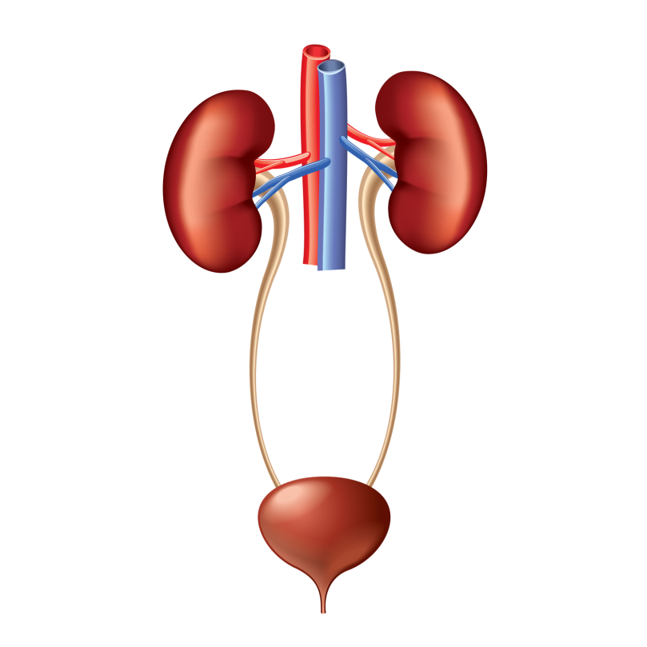
Micturition
Dr. Maha Saja
MBBS, MSc Physiology, PhD
Msaja@ksu.edu.sa
Office 8, level 3

Slide 2

Objectives
At the end of this session, students should be able to:
Define micturition.
Identify and describe the functional anatomy of the urinary bladder.
Describe the neural control of the urinary bladder and sphincters.
Describe the mechanism of filling and emptying of the urinary bladder.
Cystometrogram.
Explain the neurogenic control of the micturition reflex and its disorders.

Slide 3
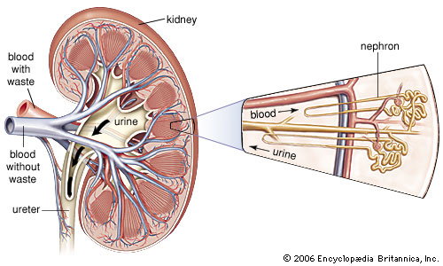
Introduction
GFR ≈ 125ml/min
Tubular reabsorption ≈ 124 ml/min
Rate of urine formation ≈ 1 ml/min

Slide 4
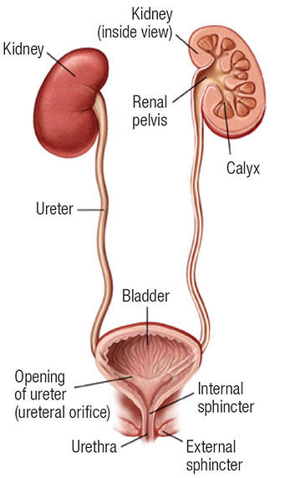
Introduction
Ureters conduct urine to bladder
How??
Urine is stored in the bladder until voiding

Slide 5
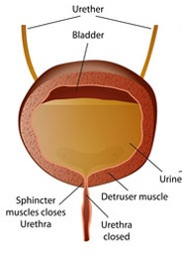
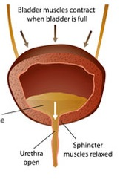
Functions of the Lower UT
The lower urinary tract = bladder + urethra
Functions of the bladder & urethra
Urine storage
Voiding (Micturition)
Wall contracts with open outlet
Wall relaxed with closed outlet
Store without leakage
Empty when appropriate

Slide 6
Introduction
To understand how the lower urinary tract performs this function, one must understand:
Functional anatomy of the bladder.
Neural control of the bladder.

Slide 7
Functional Anatomy of the bladder

Slide 8
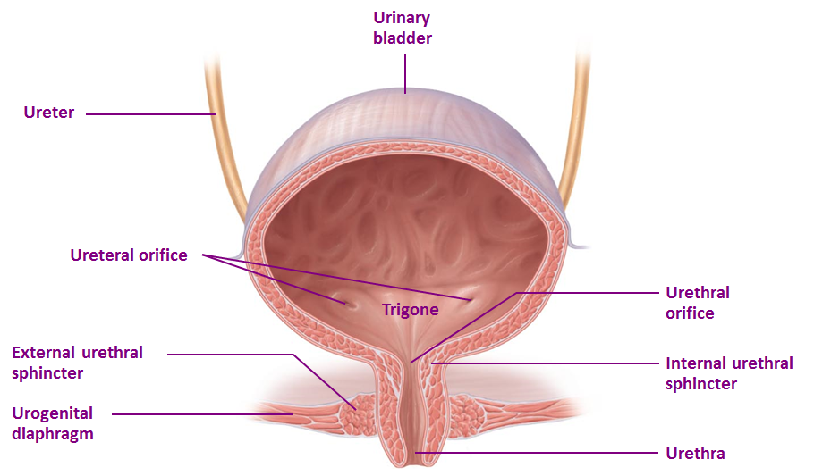
Functional Anatomy of the Bladder
Bladder has two parts: body & neck.
What is the trigone?
How many sphincters are there and how are they different?

Slide 9
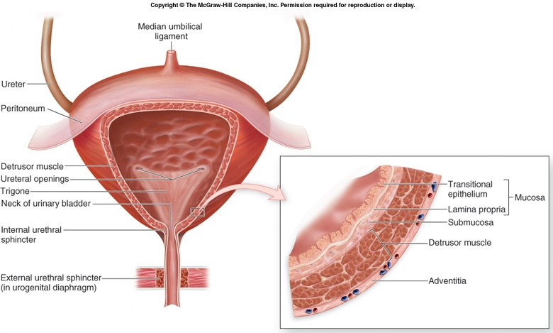
Functional Anatomy of the Bladder
Bladder wall has 4 layers;
  Mucosa → transitional epithelium → has folds “rugae”.
  Submucosa → loose connective tissue.
  Smooth muscle layer → Detrusor muscle → the main muscle of micturition.
  Serosa

Slide 10
Urine Transport from Kidney to Bladder
Urine is transported through the ureters.
Urine is propelled through the ureter and into the bladder by the help of peristalsis.
Peristalsis is thought to be initiated by pacemaker cells in the renal pelvis.
Sympathetic stimulation → inhibits peristalsis.
Parasympathetic stimulation → enhance peristalsis.

Slide 11
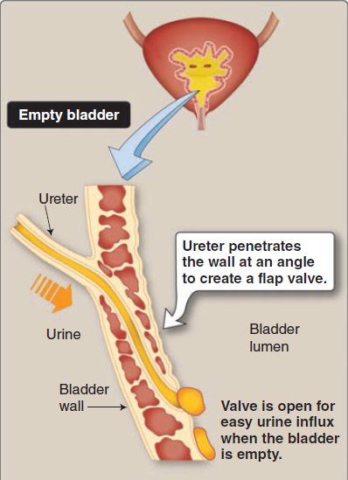
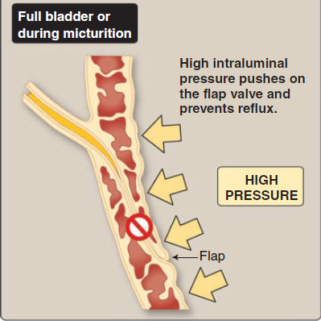
Ureterovesical Junction
(Preston R., Wilson T. Lippincott’s illustrated reviews Physiology. 2013)

Slide 12
Innervation of the bladder & urethra

Slide 13
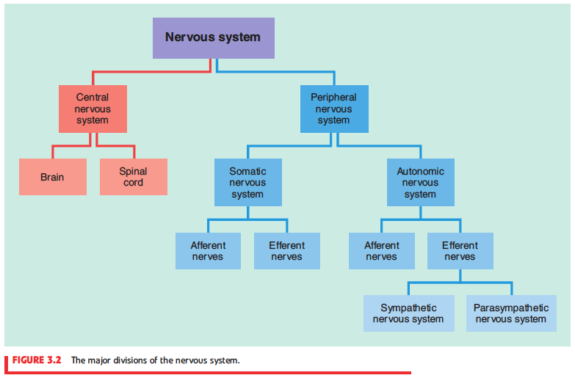
A General Look at the Nervous System

Slide 14
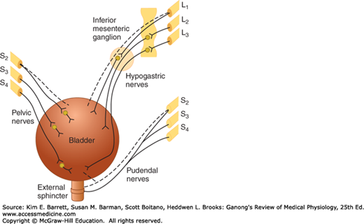
Neural Innervation of the bladder
Parasympathetic
Sympathetic
Contracts bladder (M2/M3)
Relaxes int. sphincter (NO)
Relaxes bladder (β3 adrenergic)
Contracts int. sphincter (α1 adrenergic)
Nerve supply of the LUT:
Somatic (S2-S4).
Autonomic
  Parasympathetic (S2-S4).
  Sympathetic (T11-L2).
Somatic
Contracts ext. sphincter (Ach→ Nicotinic R)

Slide 15
Neural Innervation of the bladder
Neural innervation of the LUT
Autonomic nerves
Parasympathetic
(Pelvic n.)
Sympathetic
(Hypogastric n.)
Somatic nerves
Pudendal nerve
Afferent n.
Efferent n.
Afferent n.
Efferent n.
Afferent n.
Efferent n.
Enter at S2-S4
Sensory info about degree of stretch in post. urethra
Leave at S2-S4
Motor to detrusor (contraction) and internal sphincter (relaxation)
Enter at T11-L2
Sensory info about fullness or pain in bladder
Leave at T11-L2
Motor to detrusor (relaxation) and internal sphincter (contraction)
Enter at S2-S4
Sensory info from perineum
Leave at S2-S4
Motor to external sphincter (contraction)

Slide 16
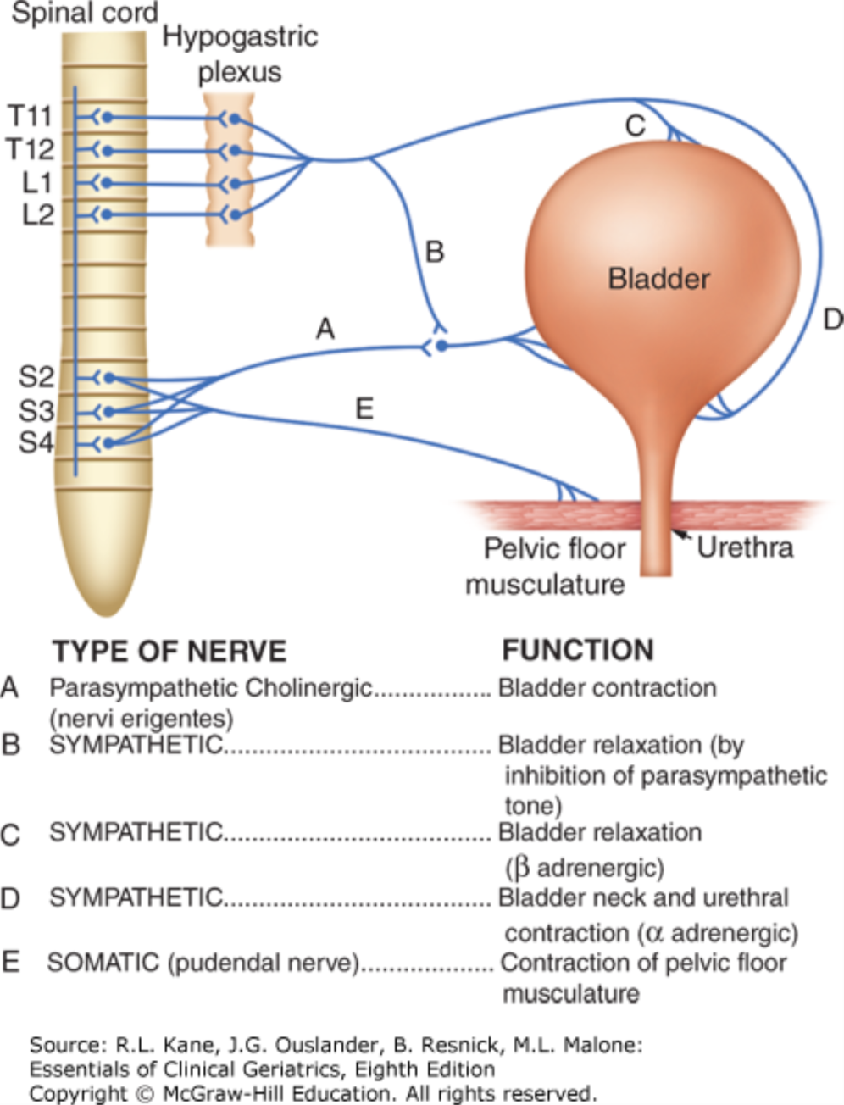
Peripheral nerves involved in micturition.
Source: Incontinence, Essentials of Clinical Geriatrics, 8e
Citation: Kane RL, Ouslander JG, Resnick B, Malone ML. Essentials of Clinical Geriatrics, 8e; 2017 Available at: https://accessmedicine.mhmedical.com/ViewLarge.aspx?figid=178119724 Accessed: April 09, 2018
Copyright © 2018 McGraw-Hill Education. All rights reserved

Slide 17
The micturition reflex

Slide 18
Micturition
Micturition = the process by which the urinary bladder empties when it becomes full.
Micturition is a visceral function → under control of the autonomic nervous system.
How is micturition different from other visceral functions?

Slide 19
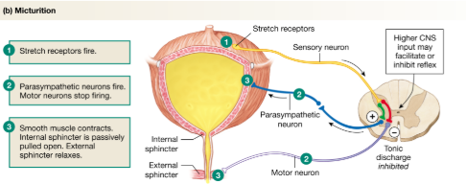
The Micturition Reflex
Filling of bladder
Stretches the wall
Stimulate stretch receptors
Excite parasympathetic efferent and inhibit pudendal discharge
Signals are carried through pelvic nerve to sacral center

Slide 20
The Micturition Reflex
It is a autonomic reflex that can be facilitated or inhibited by higher centres.
Occurs in two steps:
  Progressive filling of the bladder until a threshold is reached.
  At the threshold, a nervous reflex is initiated “micturition reflex” to empty the bladder.
If the conditions for emptying are favourable → emptying will occur.
If the conditions for emptying are unfavourable → reflex is inhibited, however, there is the conscious desire to urinate.

Slide 21
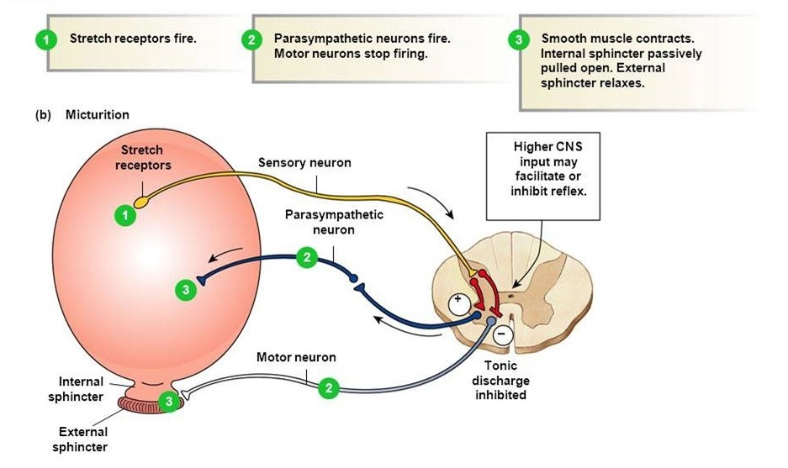
The Micturition Reflex-infants
An autonomic spinal reflex.
Involuntary-Not yet under higher CNS control.
Between 2-3 years of age-they learn to control it and becomes voluntary.

Slide 22
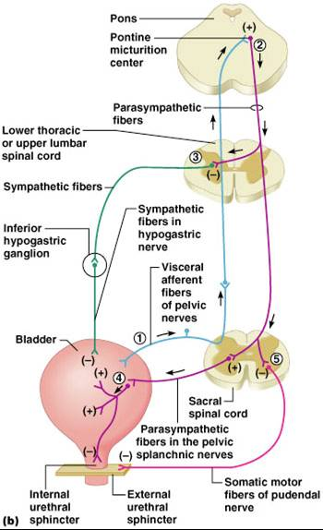
The Micturition Reflex-Adults
An autonomic spinal reflex.
Is controlled by higher CNS centres;
  Brain stem (Pons).
  Cerebral cortex.
Control is either inhibitory or facilitatory.
Voluntary.

Slide 23
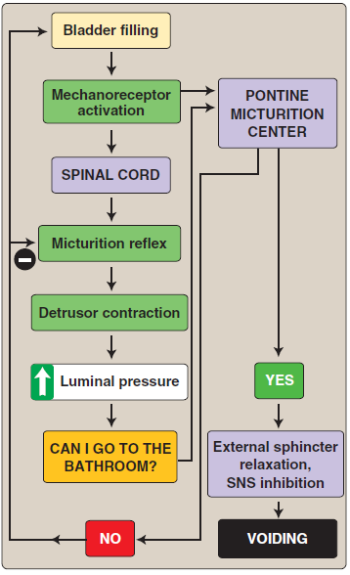
The Micturition Reflex

Slide 24
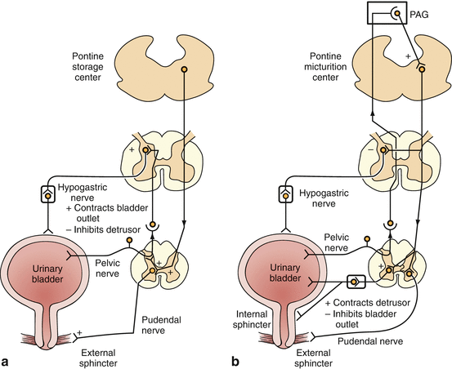
Summary
Lateral pontine center
Medial pontine center

Slide 25
The Cystometrogram

Slide 26
Filling of the Bladder-Bladder Tone
Bladder tone = the relationship between bladder volume and pressure (intravesical pr.).
The relationship between bladder volume and intravesical pressure can be studied using cystometry.
The volume-pressure record is called a cystometrogram.

Slide 27
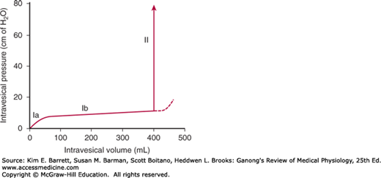
The Cystometrogram
Three phases:
Ia = an increase in IVP (0 to ≈10 cm H2O) at an initial increase in volume from 0 to ≈50ml).
Ib = filling of bladder from 50 to ≈400ml of urine causes no significant increase in IVP. Why??
II = volumes > 400ml will cause a steep increase in IVP triggering the micturition reflex.

Slide 28
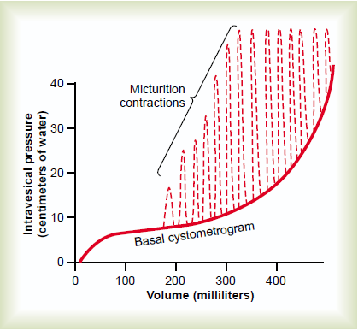
The Cystometrogram
Superimposed on the basal cytometrogram are periodic sharp increases in IVP that may last a few seconds to more than a minute.
These peaks are called “micturition waves”.. What are they caused by?
(Guyton & Hall. Textbook of Medical Physiology, 14th ed.)

Slide 29
Bladder Sensations at Different Urine Volumes
Urine volume of ≈ 150 –300 ml ⇒ first urge to void.
From ≈ 300 –400 ml ⇒ sense of bladder fullness.
From ≈ 400 –600 ml ⇒ sense of discomfort.
From ≈ 600 –700 ml ⇒ sense of pain.
Micturition reflexes start to appear at the first stage and progressively increase in intensity as the volume increases. Micturition reflexes can be voluntarily suppressed.
At ≈ 700 ml ⇒ break point ⇒ micturition can not be suppressed.

Slide 30
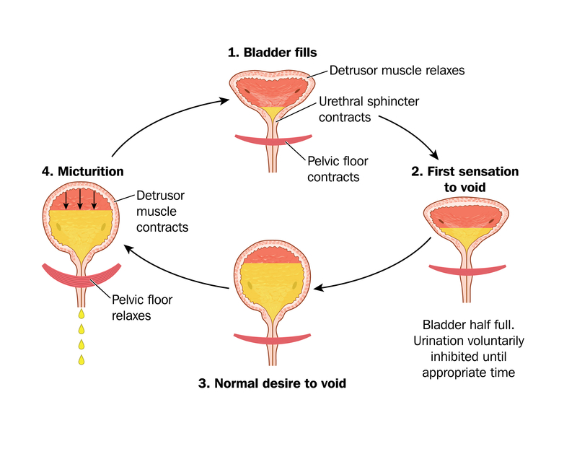

Slide 31
Abnormalities in micturition

Slide 32
Abnormalities in Micturition
Generally speaking;
  Lesions above the sacral center (UMN lesions) → Overactive bladder.
  Lesions below the sacral center (LMN lesions) → Flaccid bladder.
Increased tone of bladder wall
Hypertrophy of bladder wall
Reduced capacity
Involuntary contractions of detrusor
High IVP
Decreased tone of bladder wall
Thin (mild hypertrophy) of bladder wall
large capacity
Lack of voluntary contractions of detrusor
Low IVP
(Smith & Tanagho’s General Urology, 18th ed)

Slide 33
Abnormalities in Micturition
Lesions above the sacral center:
Most lesions above the level of the cord where sacral micturition reflex takes place will cause an overactive bladder.
Injury can be in the cerebral cortex, cerebellum, brain stem, spinal cord (above S2 level).
Due to loss of inhibitory impulses coming from higher centers → overactive hypertonic bladder that is sensitive to small changes in volume.
Common lesions include, dementia, cerebrovascular accidents, MS and Parkinson’s.

Slide 34
Abnormalities in Micturition
Lesions affecting the afferent sensory nerves (Deafferentation):
Results in an atonic or hypotonic (flaccid) bladder.
Injury of afferent nerves → loss of perception of bladder fullness + micturition reflex cannot be initiated → bladder overstretching → thinning of the wall and ineffective contractions.
Retention of urine with overflow.
Causes e.g. tabes dorsalis (syphilis), long-standing diabetes and pernicious anemia.

Slide 35
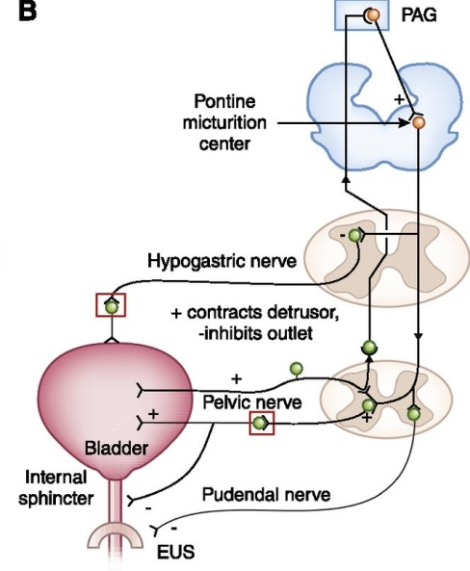
Lesions affecting the afferent sensory nerves
Lesion in the afferent sensory fibers that carry stretch sensation from bladder wall
Feeling of bladder fullness is lost
Cannot initiate the reflex
The bladder cannot empty urine but urine continues to collect
Urine will collect until pressure in bladder becomes high causing dribbling of urine
Overflow incontinence

Slide 36
Abnormalities in Micturition
Lesions affecting the nerve supply of bladder (Denervation):
Results in an atonic or hypotonic (flaccid) bladder.
Injury to pelvic nerves affecting both afferent & efferent nerves→ loss of nerve signals to bladder→ bladder loses tone and become flaccid and distended.
In chronic state of this “decentralized bladder” → small uncoordinated contractions start appearing and the bladder wall hypertrophies.
Causes e.g. AHC disease (poliomyelitis), iatrogenic factors such as surgery or radiation, herniated disc and tumours in the cauda equina.
N.B. many of these conditions produce a mixed picture (LMN & UMN lesions) → the bladder is weak and spastic.
(Boron & Boulpaep. Medical Physiology; Smith & Tanagho’s General Urology, 18th ed)

Slide 37
Abnormalities in Micturition
Damage to spinal cord above the sacral region:
The micturition reflex is intact, but lost higher center control.
There are several phases:
Acute phase
(Spinal shock)
Recovery from spinal shock
Loss of facilitatory impulses from CNS
↓
Micturition reflex is inhibited
↓
Bladder fills but cannot void
(overflow incontinence)
Micturition reflex recovers
↓
Not controlled by CNS
↓
Bladder fills and voids automatically
(Automatic bladder)
Bladder needs to be emptied periodically by catheterization

Slide 38
Lesions affecting the spinal cord above the sacral region
Lesion in the spinal cord above the sacral center
Loss of facilitatory impulses from higher centers
Spinal shock phase
Micturition reflex is inhibited
Urine will collect until pressure in bladder becomes high causing dribbling of urine
Overflow incontinence
Micturition reflex regains function but not under CNS control
Automatic
bladder
Recovery

Slide 39
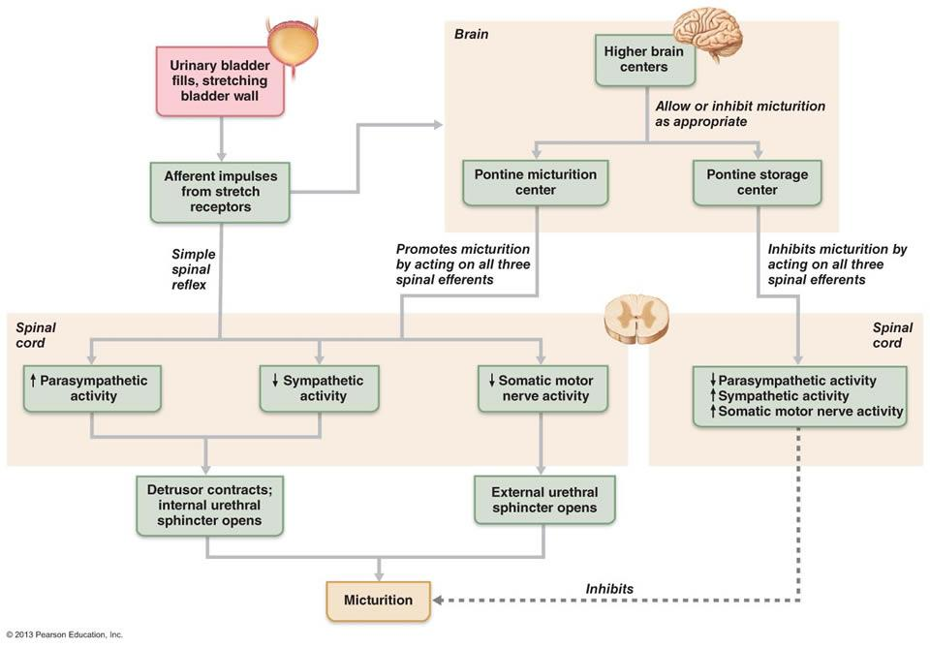
Summary

Slide 40
Thank you

