Slide 1
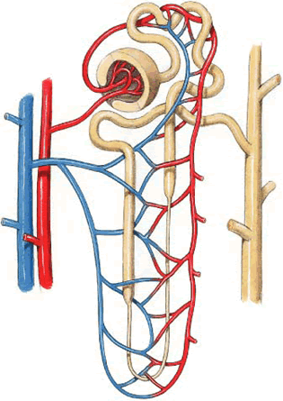
Acid-base balance
Dr. Maha Saja
MBBS, MSc Physiology, PhD
msaja@ksu.edu.sa

Slide 2
Objectives
Define: acid and base.
Explain what is meant by strong and weak acids and bases.
List and identify the names/formulas for the common strong acids and strong bases.
To explain the role of Henderson-Hasselbalch equation in acid-base regulation.
To define buffer system and discuss the role of blood buffers and to explain their relevant roles in the body.
To describe the role of kidneys in the regulation of acid-base balance.
To describe the role of lungs in the regulation of acid-base balance.

Slide 3
Contents
What are acids and bases?
What is meant by a weak and a strong acid or base?
What is the normal pH of body fluids?
Why is it important to keep body fluid pH within certain limits?
What are the body’s defense mechanisms against changes in blood pH: body buffers, the lungs and the kidney.
Understand the role of the kidney in regulating pH of body fluids.

Slide 4
Acid-Base Balance
Acid-base balance is concerned with the precise regulation of free (unbound) hydrogen ion (H⁺) concentration in body fluids.
Normally, [H⁺] = 0.00004 mEq/L (40 nEq/L).
Why is it important to control [H⁺]?
(Sherwood L. Human physiology: from cells to systems. 4th ed. 2001; Guyton & Hall. Textbook of medical physiology. 13th ed. )

Slide 5
Why Should [H⁺] be Tightly Controlled?
Slight deviations in [H⁺] have profound effects on enzyme and protein activity and thus the body’s metabolic activity in general.
Changes in [H⁺] affects K⁺ levels in the body.
(Sherwood L. Human physiology: from cells to systems. 4th ed. 2001; Guyton & Hall. Textbook of medical physiology. 13th ed. )

Slide 6
Why is the Body’s [H⁺] Constantly Changing?
A number of processes can alter [H⁺] concentration in the body, such as;
Metabolism of ingested food.
GI secretions.
Generation of acids & bases from amino acid/protein metabolism.
Changes in CO₂ production.
(Vander’s Renal Physiology. 8th ed)

Slide 7
Acid-Base Fundamentals
An Acid = a molecule that can release H⁺ in a solution.
  H2CO3 (carbonic acid)
  HCl (hydrochloric acid)
A base = a molecule that accepts H⁺ in a solution.
  Bicarbonate ions (HCO₃⁻).
  Hydrogen phosphate (HPO₄⁻²)
What is the difference between carbonic & hydrochloric acid?

Slide 8
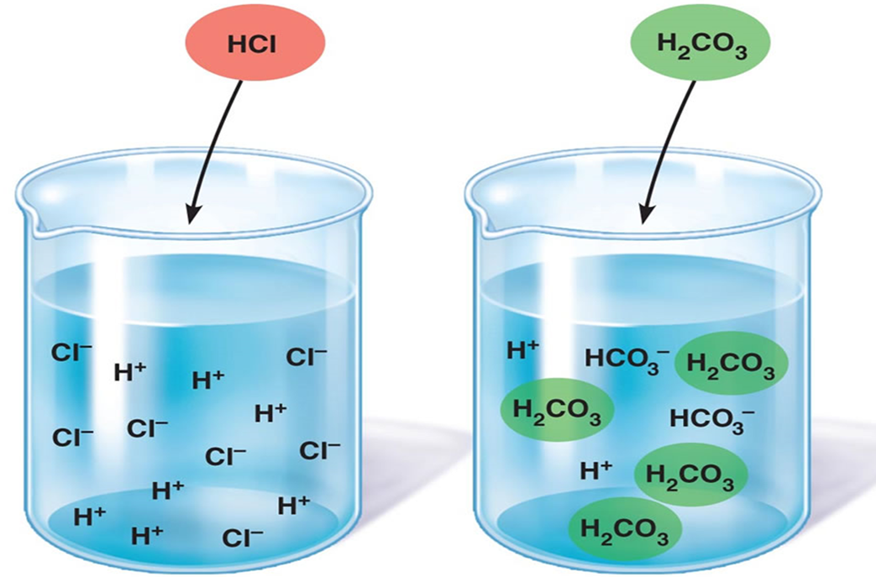
Strong vs Weak Acids & Bases
Strong acids dissociate rapidly and release large amounts of H⁺
in solution
Weak acids dissociate incompletely and less strongly releasing small amounts of H⁺
in solution

Slide 9


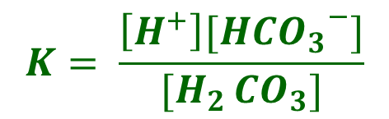
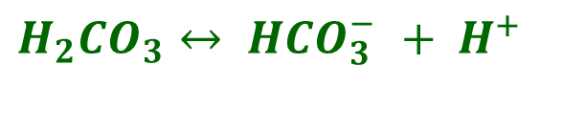
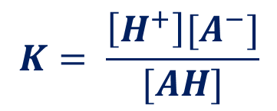
Weak Acids
$$AH ↔ A^{−}+ H^{+}$$
$$Acid ↔Conjugate base+H^{+}$$
The extent to which a given acid dissociates in solution is constant. And is known as the dissociation constant (K).
$$K= \frac{\left[H^{+}\right][A^{−}]}{[AH]}$$
$$K= \frac{\left[H^{+}\right][{{HCO}_{3}}^{−}]}{[H_{2 }{CO}_{3}]}$$
${H_{2}CO}_{3}↔ {{HCO}_{3}^{−} + H}^{+ }$

Slide 10
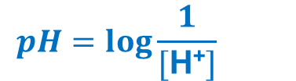
[H⁺] & the pH
What is pH?
  pH is a way of expressing H⁺ ion concentrations.
  If the [H⁺] increase → pH will decrease (more acidic)
  If the [H⁺] decrease → pH will increase (more alkaline)
What is the normal pH of the ECF?
  Normally pH= 7.35-7.45
$$pH=log\frac{1}{[\text{H}\text{+}]}{}$$
pH < 6.8
Death
Acidosis
Alkalosis
pH > 8
Death
pH= 7.35-7.45
(Guyton & Hall. Textbook of medical physiology. 13th ed. )

Slide 11
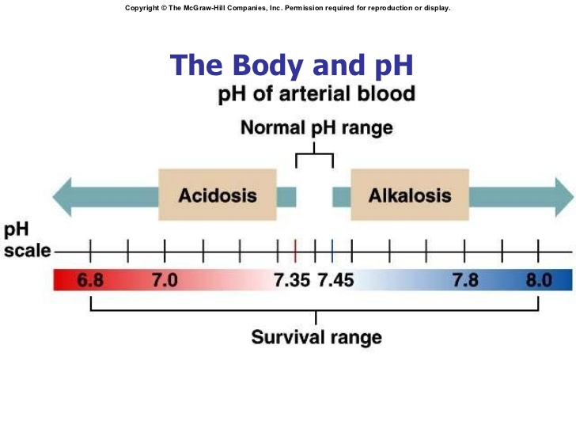

Slide 12
pH and H⁺ Concentration of Body Fluids
 | [H⁺] (mEq/L) | pH
Extracellular fluid
Arterial blood | 4.0 X 10⁻⁵ | 7.4
Venous blood | 4.5 X 10⁻⁵ | 7.35
IF | 4.5 X 10⁻⁵ | 7.35
Intracellular fluid | 1 X 10⁻³ to 4 X 10⁻⁵ | 6-7.4
Urine | 3 X 10⁻² to 1 X 10⁻⁵ | 4.5-8
Gastric HCl | 160 | 0.8
(Guyton & Hall. Textbook of medical physiology. 13th ed. )

Slide 13
Acid Production by the Body
The body produces large amounts of acids on daily basis as by products of metabolism.
  Metabolism of dietary proteins.
  Anaerobic metabolism of carbs and fat.
Acids in the body are of two kinds:
  Volatile (CO₂)
  Non-volatile “fixed” (sulfuric acid, lactic acid) (daily acid load ≈ 50-100 mEq/day) (0.8 mEq/kg/d).
(Vander’s Renal Physiology. 8th ed ; Guyton & Hall. Textbook of medical physiology. 13th ed. )

Slide 14
The Body’s Defense Against Changes in [H⁺]
Three main systems:
Body fluid buffers.
  Works within seconds.
Lungs
  Works within minutes.
Kidneys
  Works within hours-days.
  The most powerful of the three.

Slide 15
Body Fluid buffers

Slide 16
What is a Buffer?
A buffer = a solution that resists changes in pH upon addition of small amount of acids or bases.
Acid
Base
Buffer
Buffer
Neutralizes small additions of bases/acids
pH remains constant

Slide 17
How do Buffers work?
A buffer is a mixture of a weak acid and a weak base that are in equilibrium.
To be more accurate, its either made of:
  A weak acid and its conjugated base (H₂CO₃ & NaHCO₃).
  A weak base and its conjugated acid (NH₃ & NH₄⁺).
How does a buffer do its job?

Slide 18
How does a buffer do its job?
Bicarbonate buffer solution
H2CO3
NaHCO3
HCl
If we add a strong acid to the solution
HCl
H2CO3
Cl-
NaHCO3
H+
HCO3-
Cl-
NaHCO3
H2CO3
Na+
H+
H+
HCO3-
H+
Na+
HCO3-
HCO3-
H2CO3
The strong acid is converted into a weaker acid

Slide 19
How does a buffer do its job?
Bicarbonate buffer solution
H2CO3
NaHCO3
NaOH
If we add a strong base to the solution
NaOH
H2CO3
OH-
NaHCO3
Na+
HCO3-
OH-
NaHCO3
H2CO3
Na+
H+
H+
Na+
HCO3-
Na+
HCO3-
HCO3-
NaHCO3
The strong base is converted into a weaker base

Slide 20
Chemical Buffer Systems in the Body
There are 3 chemical buffers in the body;
The Bicarbonate buffer system.
The phosphate buffer system.
Proteins.
They are the 1st line of defence against changes in pH i.e. [H⁺], act within seconds.
Some are more powerful extracellularly and others are more powerful intracellularly.

Slide 21
The Bicarbonate Buffer System
Composed of:
  A weak acid (H2CO3).
  Its conjugated base (NaHCO3).
CA
NaHCO3
Na+ + HCO₃⁻

Slide 22
The Bicarbonate Buffer System
H₂CO₃ forms in the body by the reaction of CO₂ & H₂O
CO₂ + H₂O H₂CO₃
H₂CO₃ ionizes weakly to form small amounts of H⁺ & HCO₃⁻
H₂CO₃ H⁺ & HCO₃⁻
The second component is NaHCO3 which dissociates to form Na⁺ & HCO₃⁻
NaHCO3 Na⁺ & HCO₃⁻
Carbonic anhydrase

Slide 23
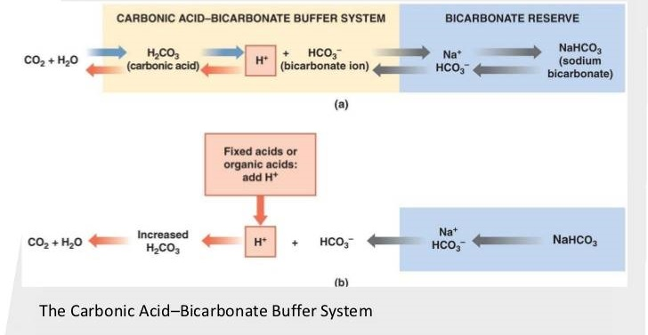
The Bicarbonate Buffer System
Putting it all together;
This is the main ECF buffer system
What happens if you add a base or an acid to the system?

Slide 24
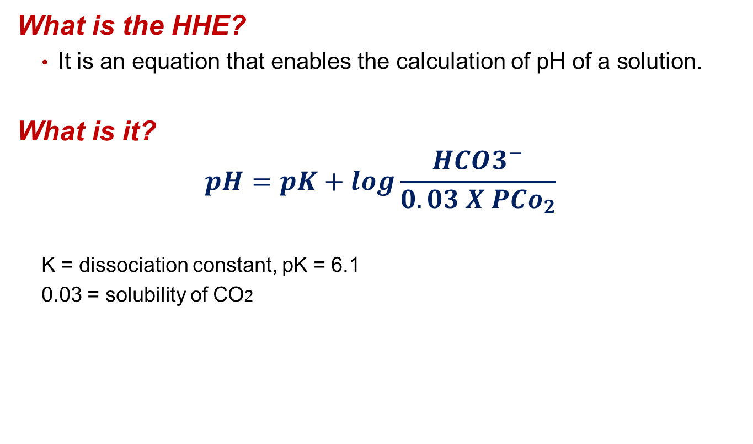
The Henderson-Hasselbalch Equation
What is the HHE?
  It is an equation that enables the calculation of pH of a solution.
What is it?
$$pH=pK+log\frac{HCO3^{−}}{0.03 X PCo_{2}}$$
  K = dissociation constant, pK = 6.1
  0.03 = solubility of CO2

Slide 25
The Henderson-Hasselbalch Equation
How was it derived?
H2CO3 and its dissociated ions are always in equilibrium → the products of the reaction on one side of the equation are proportional to the product on the other side.
Since H2CO3 is a weak acid, it will not dissociate completely and the concentration of its products will depend on its dissociation constant (K)
H₂CO₃ H⁺ + HCO₃⁻
[H₂CO₃] α [H⁺ ] X [HCO₃⁻]
K X [H₂CO₃] = [H⁺ ] X [HCO₃⁻]

Slide 26
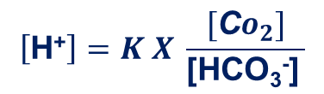
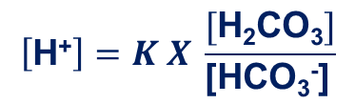
The Henderson-Hasselbalch Equation
Based on the previous equation, [H⁺] can be expressed as follows;
Because H₂CO₃ can rapidly dissociate into CO2 and H2O. And since CO2 is much easier to measure it can replace H₂CO₃ in the equation;
$$\left[\text{H}\text{+}\right]=K X \frac{[\text{H}\text{2}\text{CO}\text{3}]}{\text{[}\text{HCO}\text{3}\text{−}\text{]} }$$
$$\left[\text{H}\text{+}\right]=K X \frac{[\text{C}o_{2}]}{\text{[}\text{HCO}\text{3}\text{−}\text{]} }$$
This is Henderson’s equation
(1908)
It means that;
↑ [CO2] →↑ [H⁺]
↑ [HCO₃⁻] → ↓ [H⁺]

Slide 27
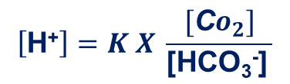
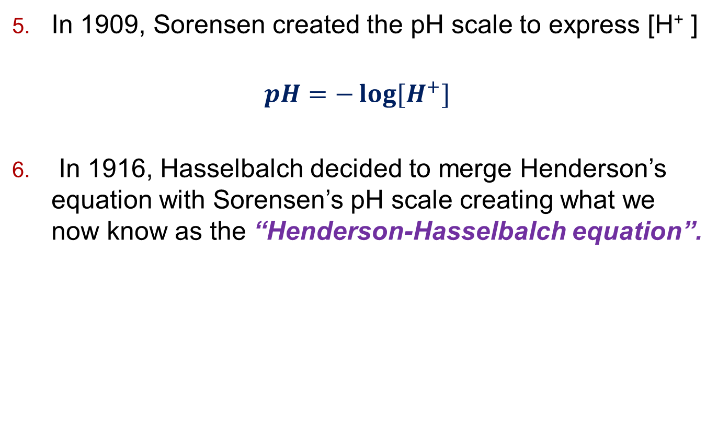
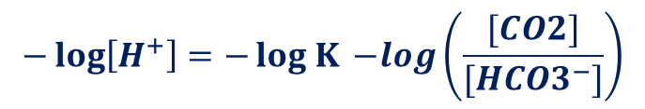
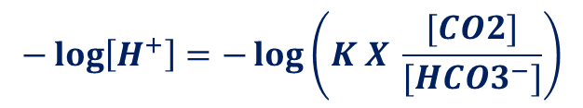
The Henderson-Hasselbalch Equation
In 1909, Sorensen created the pH scale to express [H⁺ ]
$$pH=−\log{[H^{+}}]$$
In 1916, Hasselbalch decided to merge Henderson’s equation with Sorensen’s pH scale creating what we now know as the “Henderson-Hasselbalch equation”.
$$\left[\text{H}\text{+}\right]=K X \frac{[\text{C}o_{2}]}{\text{[}\text{HCO}\text{3}\text{−}\text{]} }$$
$$−\log\left[H^{+}\right]=−\log\left(K X \frac{[CO2]}{[HCO3^{−}]}\right)$$
$$−\log\left[H^{+}\right]=−log K{ −log\left(\frac{[CO2]}{[HCO3^{−}]}\right)}$$

Slide 28
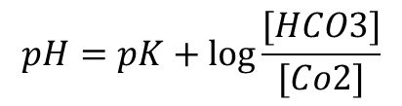
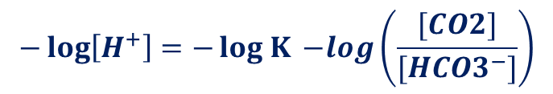
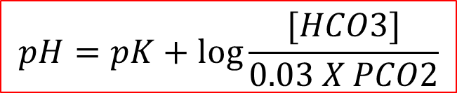
The Henderson-Hasselbalch Equation
$$−\log\left[H^{+}\right]=−log K{ −log\left(\frac{[CO2]}{[HCO3^{−}]}\right)}$$
$$pH=pK+\log{\frac{[HCO3]}{[Co2]}}$$
This is Henderson-Hasselbach equation
(1908)
Since it is much easier to measure PCO2 rather than dissolved [CO2] and because dissolved CO2 is proportional to PCO2 multiplied by the solubility of CO2 (0.03 mmol/mmHg) → [CO2] was replaced by PCO2 X 0.03
$$pH=pK+\log{\frac{[HCO3]}{0.03 X PCO2}}$$
Ta-Da

Slide 29
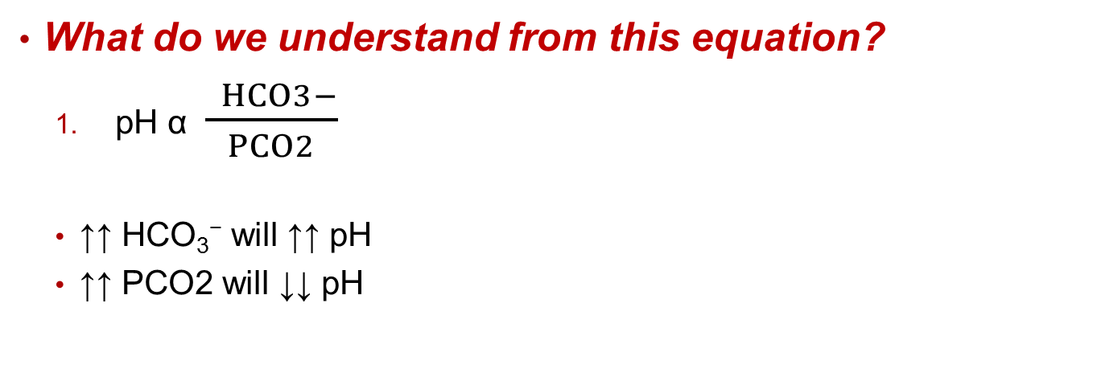
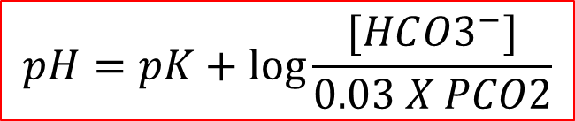
The Bicarbonate Buffer System
CA
$$pH=pK+\log{\frac{[HC{O3}^{−}]}{0.03 X PCO2}}$$
What do we understand from this equation?
  pH α $\frac{ HCO3−}{PCO2}$
  ↑↑ $\text{HCO}\text{3}\text{−}$ will ↑↑ pH
  ↑↑ PCO2 will ↓↓ pH
Regulated by kidneys
Regulated by lungs
Each element of the buffer system is regulated

Slide 30
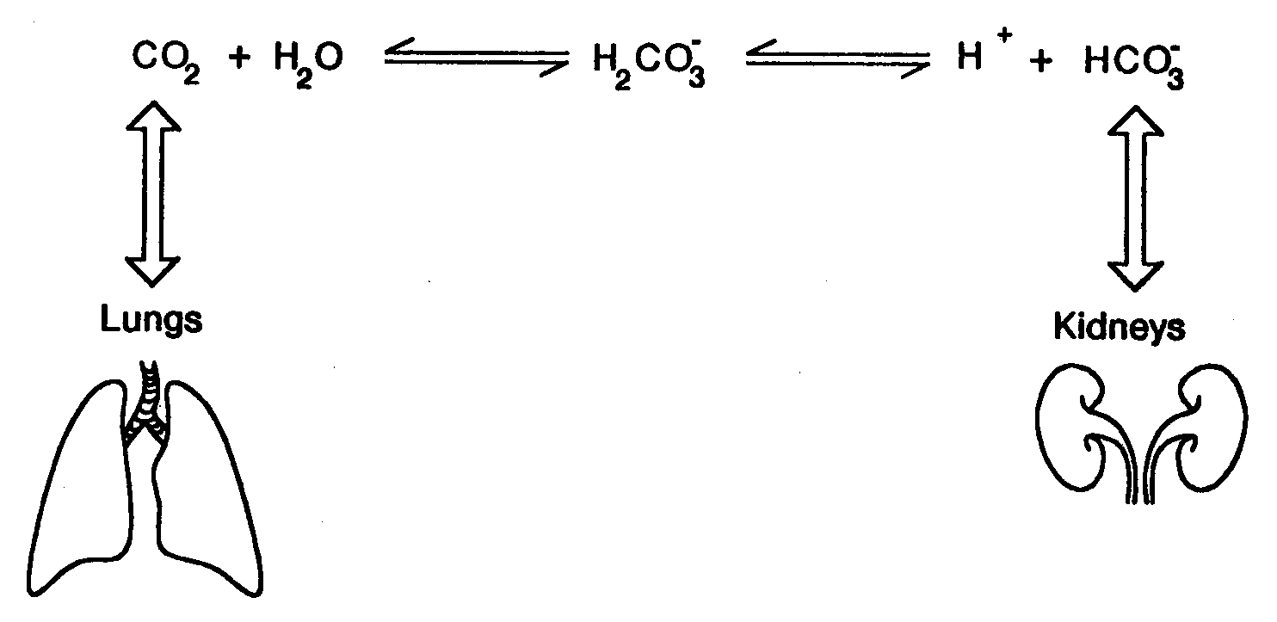
Summary of the Bicarbonate Buffer System
Why is it the most important buffer system in the ECF?

Slide 31
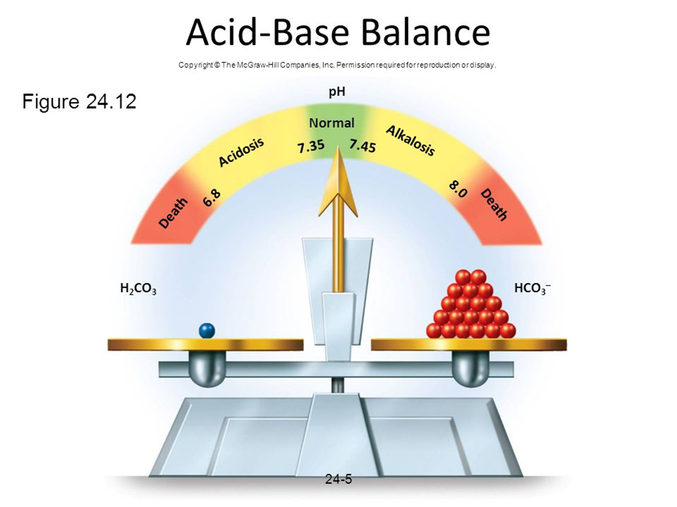
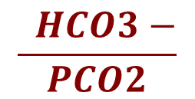
$$\frac{ HCO3−}{PCO2}$$
Ratio of
is ≈ 20:1

Slide 32
Other Buffering Systems
The phosphate buffer:
Plays a major role in buffering intracellular & renal tubular fluid.
Composed of;
  H₂PO₄⁻ (dihydrogen phosphate)
  HPO₄⁻² (Hydrogen phosphate)
Proteins:
Contributes to buffering inside cells.
E.g. Hb.

Slide 33
Summary of Body’s Buffering Systems
Buffer systems do not work independently in body fluids but actually work together.
A change in the balance in one buffer system, changes the balance of the other systems.
Buffers do not reverse the pH change, they only limit it.
Buffers do not correct changes in [H⁺] or [HCO₃⁻], they only limit the effect of change on body pH until their concentration is properly adjusted by either the lungs or the kidney.

Slide 34
respiratory regulation of acid-base balance

Slide 35
Respiratory Regulation of A/B
2nd line of defence against acid-base disturbances in the body.
HOW?
  By modulating CO₂ excretion.
↑↑ Ventilation (↑ RR) → ↓↓ PCO2 → ↓↓ [H⁺]
↓↓ Ventilation (↓ RR)→ accumulation of CO2→ ↑↑ PCO2. → ↑↑ [H⁺]
Normally, PCO2 = 40 mmHg (35-45 mmHg)

Slide 36
Respiratory Regulation of A/B
What happens in cases of acidosis or alkalosis?
Acidosis (↑↑ [H⁺] in ECF) → stimulate ventilation → ↑↑ ventilation (RR) → ↓↓ PCO2 → ↓↓ [H⁺]
Alkalosis (↓↓ [H⁺] in ECF) → inhibit ventilation → ↓↓ ventilation (RR) → accumulation of CO2→↑↑ PCO2 → ↑↑ [H⁺]

Slide 37
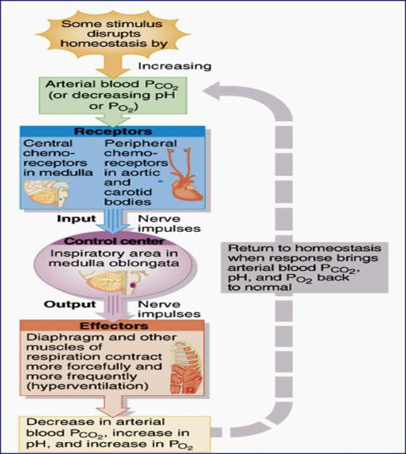
Respiratory Regulation of CO2

Slide 38
Renal regulation of acid-base balance

Slide 39
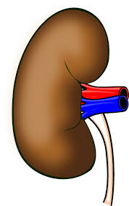
Renal Regulation of A/B Balance
3rd line of defence against acid-base disturbances and the most powerful.
It regulates by excreting either an acidic or alkaline urine.
Acid excess in ECF
Base excess in ECF
pH= 4.5
pH= 8
Kidney excretes acidic urine
Kidney excretes alkaline urine

Slide 40
Renal Regulation of A/B Balance
HOW?
Secreting H⁺
Reabsorbing HCO₃⁻
Generating “new” bicarbonate ions.

Slide 41
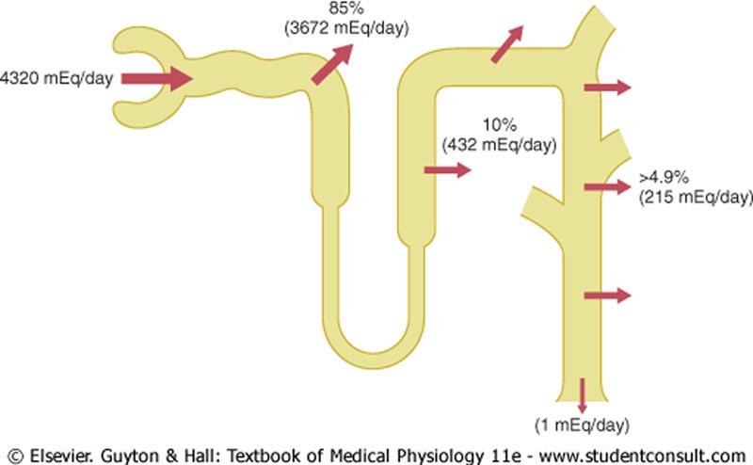
Overview HCO₃⁻ Reabsorption by the Renal Tubules
Filtered load of HCO3-
Reabsorption of HCO3- is linked to H+ secretion

Slide 42
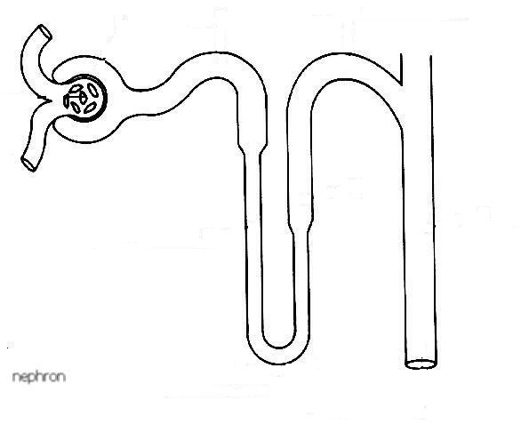
Overview H+ secretion by the Renal Tubules
Secondary active transport
Primary active transport
H⁺ ATPase
Na⁺ - H⁺ Exchanger
H+ secretion occurs in all tubular segments except thin descending & ascending loops of Henle

Slide 43
How are these processes accomplished?

Slide 44
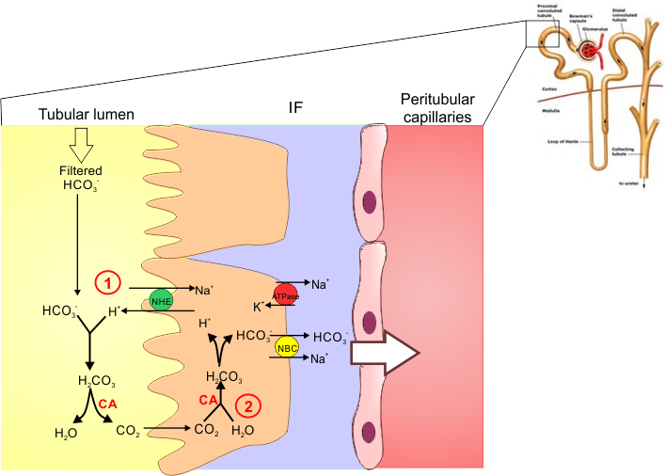
How is HCO₃⁻ Reabsorbed by the tubules?
What happens at the PCT, TAL and early DT?
The PCT reabsorbs, “reclaims”, 80-90% of the filtered HCO₃⁻.
HCO₃⁻ reabsorption is linked to H⁺ secretion.

Slide 45
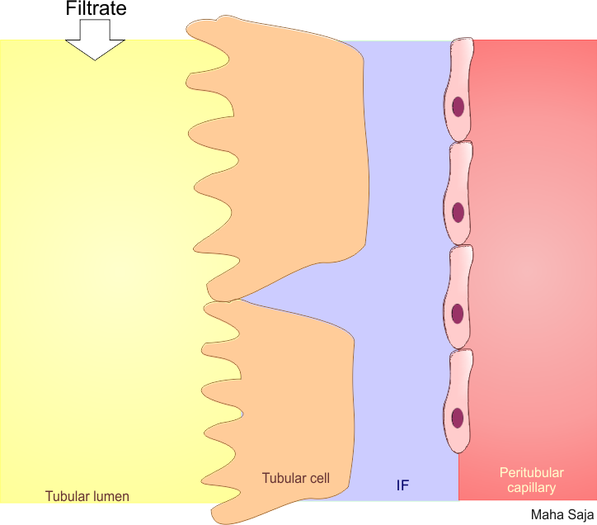
How Does the Proximal Tubular Segments Reabsorb HCO₃⁻?
Secreted H+ binds to filtered HCO3- in the tubular lumen
↓ [Na⁺]_{i}
2 K⁺
HCO₃⁻
Na⁺
Na⁺
ATPase
Na⁺
NHE3
H⁺
3 Na⁺
Forming H2CO3 which dissociates into H2O & CO2
HCO₃⁻
H⁺
HCO₃⁻
HCO₃⁻
H₂CO₃
H₂CO₃
CO₂ + H₂O
H₂O + CO₂
CO2 diffuses through tubular cell membrane and react with water forming H2CO3 inside the cell
Basolateral
membrane
Apical

Slide 46
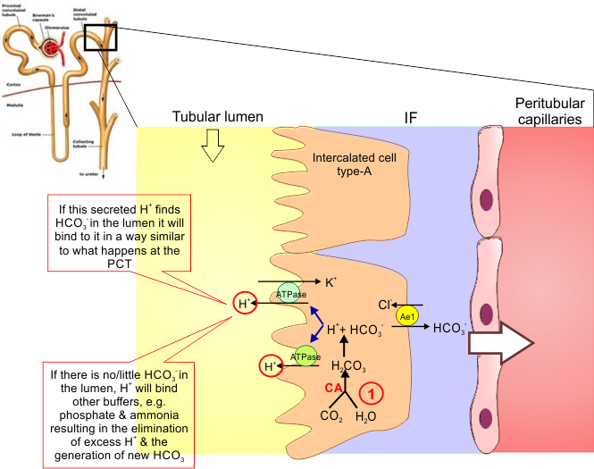
What happens at the late DT & CD?

Slide 47
What happens at the late DCT & CT?
The filtrate arriving at the DCT & CT is low in HCO₃⁻.
The distal segments of the nephron are characterised by the presence of “intercalated cells” capable of actively secreting H⁺ through H⁺-ATPase and H⁺-K⁺ ATPase present on their apical membrane (Type-A intercalated cells).
Only a limited number of H⁺ can be excreted in its free form in urine.
Lowest possible urine pH=4.5 → ≈ 0.04 mmol/L of free H⁺.
How does the kidney excrete the extra H⁺?
(Vander’s Renal Physiology. 8th ed)

Slide 48
Non-Bicarbonate Buffers in the Tubular Lumen?
The extra H⁺ secreted will need to be buffered in the tubular lumen
2 main non-bicarbonate buffers in the tubule
Filtered
Synthesized
Phosphate buffer system
Ammonia buffer system
NH₄⁺ ↔ NH₃ + H⁺
H₂PO₄⁻ ↔ HPO₄⁻² + H⁺
(acid)
(base)
(acid)
(base)

Slide 49
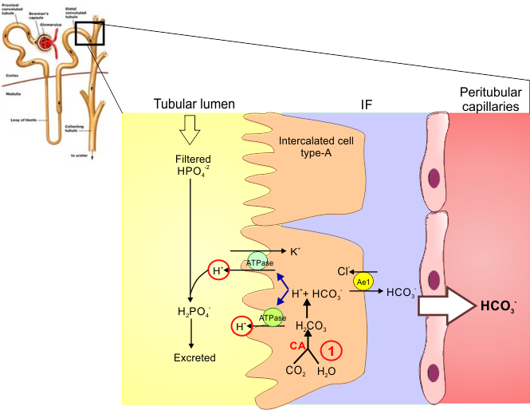
Excretion of H⁺ and Generation of New HCO₃⁻
The phosphate buffer system
Excretion of H⁺ as phosphate is capable of handling a limited amount of H⁺ and will not be enough to rid the body of its daily acid load nor if there is unusually high acid production.
(Vander’s Renal Physiology. 8th ed ; Guyton & Hall. Textbook of medical physiology. 13th ed. )

Slide 50
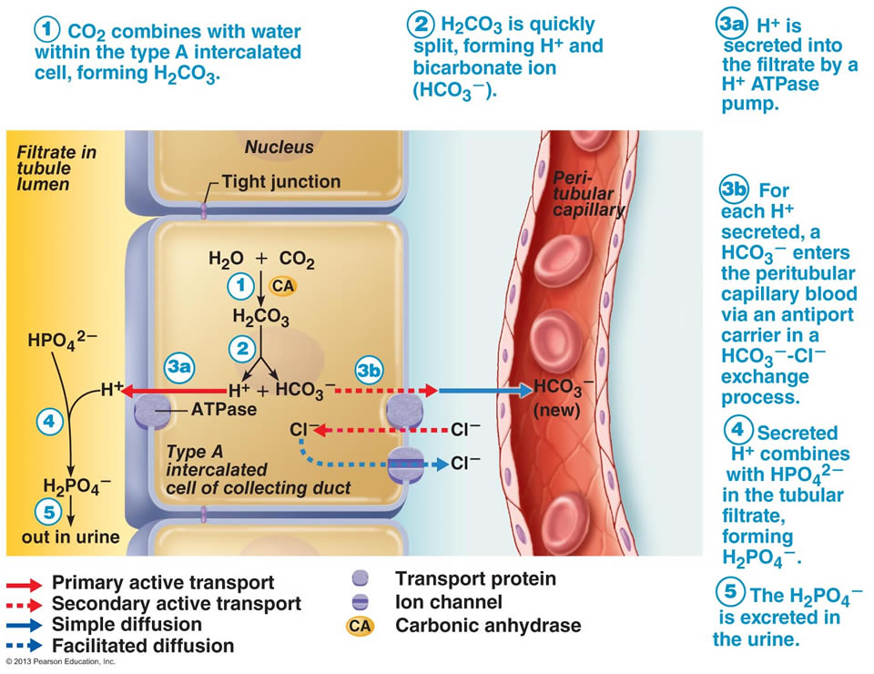

Slide 51
Excretion of H⁺ and Generation of New HCO₃⁻
The Ammonia Buffer System
Renal tubular cells, especially PCT, are capable of generating ammonium (NH₄⁺) “ammoniagenesis” which is then excreted in urine carrying with it H^{+.}
The rate of ammoniagenesis can be modified according to the needs of the body.
Quantitatively, the ammonia buffer system is more important than the phosphate buffer system for H⁺ excretion in urine.
It is the most important system in case of acidosis.

Slide 52
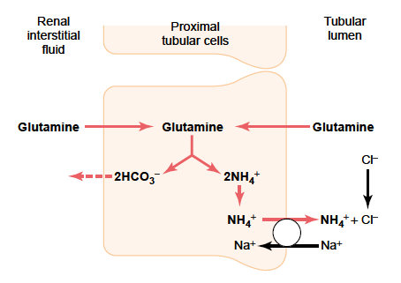
The Ammonia Buffer System

Slide 53
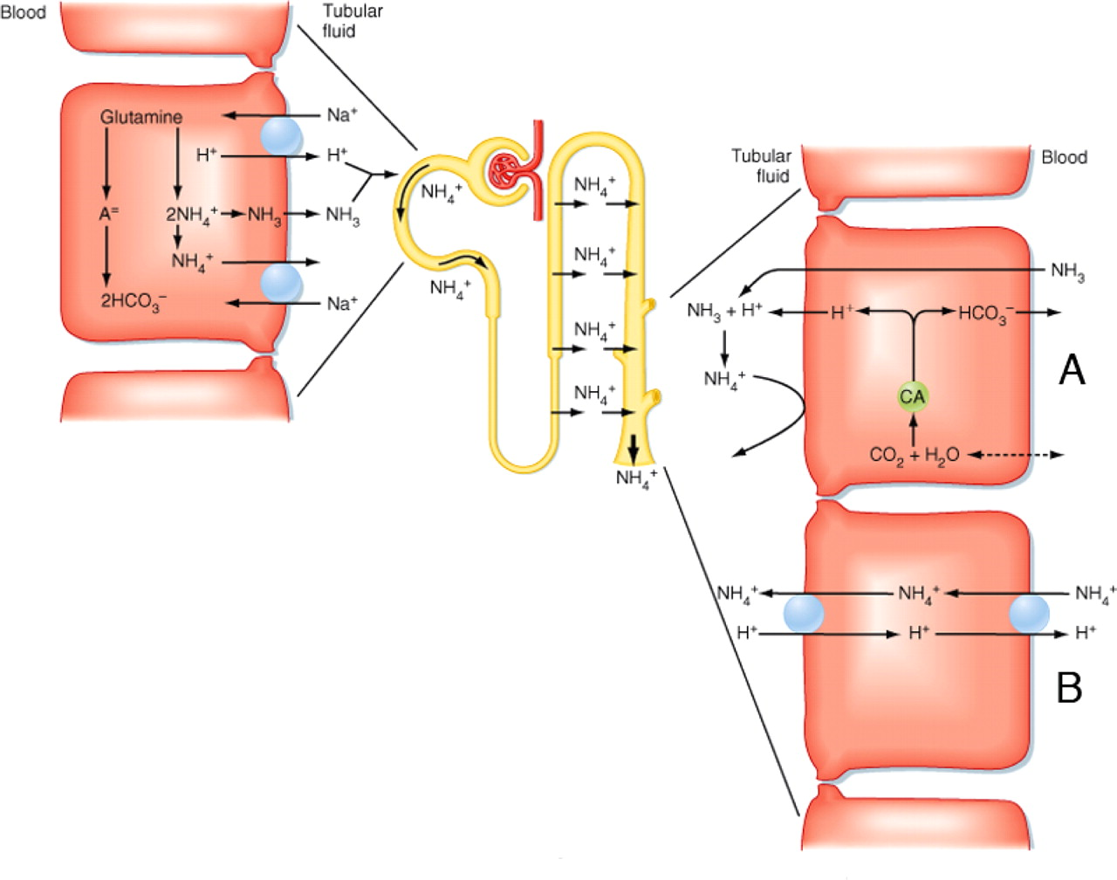
Ammonia buffer system

Slide 54
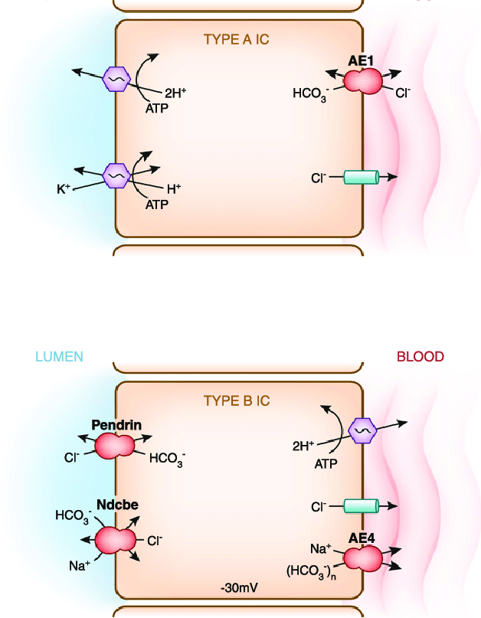
Type A vs Type B Intercalated Cells
Two types of IC cells have been identified:
α-IC (type A-IC)
β-IC (type B-IC)
Type A-IC → secrete hydrogen
Type B-IA → secrete bicarbonate

Slide 55
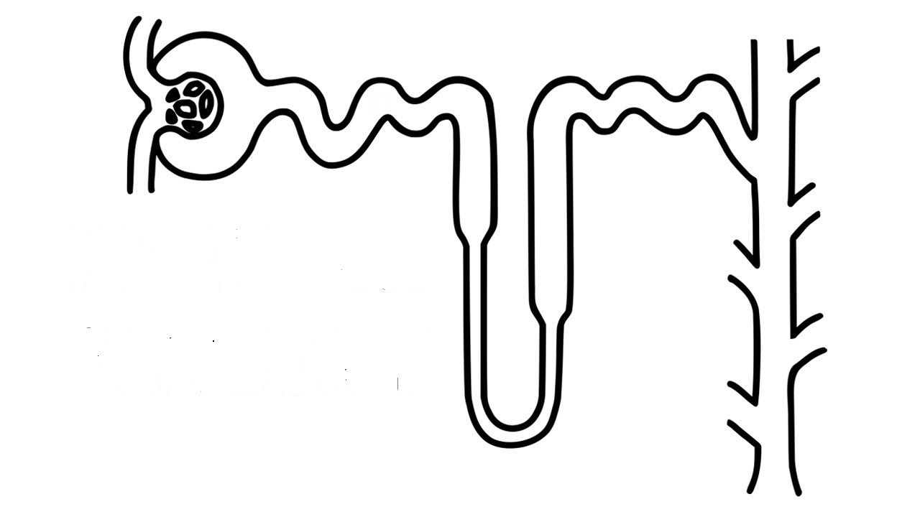
The Overall Scheme of Renal Excretion of Acids & Bases
To excrete acid:
Freely filter HCO₃⁻
Reabsorb the majority of filtered HCO₃⁻
Reabsorb some additional HCO₃⁻
Secrete H⁺ (titrate filtered bases, i.e. HPO₄⁻²) and secrete NH₄⁺
Excrete acidic urine containing NH₄⁺
1.
4.
2.
3.
To excrete base:
Freely filter HCO₃⁻
Reabsorb the majority of filtered HCO₃⁻
Reabsorb some additional HCO₃⁻
Secrete some HCO₃⁻
Excrete alkaline urine containing HCO₃⁻
5.
(Adapted with modification from Vander’s Renal Physiology. 8th ed)

Slide 56
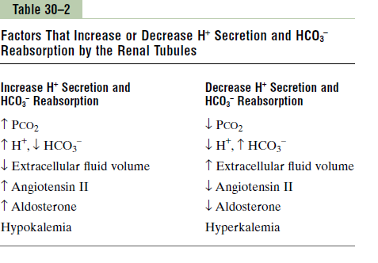
Factors Affecting H⁺ Secretion and HCO₃⁻ Reabsorption

Slide 57
Thank you

