Slide 1
2
Anatomy of Ureters, Bladder & Urethra
____________
Renal Block
Editing File
Color Index:
Main Text
Male’s Slides
Female’s Slides
Important
Doctor’s Notes
Extra Info

Slide 2
Objectives
Describe the course of ureter & identity the site of ureteric constrictions
Describe the important relations & identify certain areas (trigone, uvula vesicae) in the base of urinary bladder
List the blood supply, lymphatic drainage & nerve supply of urinary bladder
Differentiate between male & female urethra regrading length, structure, course & function
Click Here for the Team’s Summary!

Slide 3
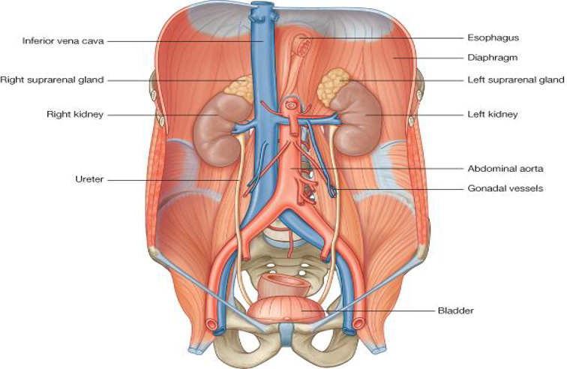
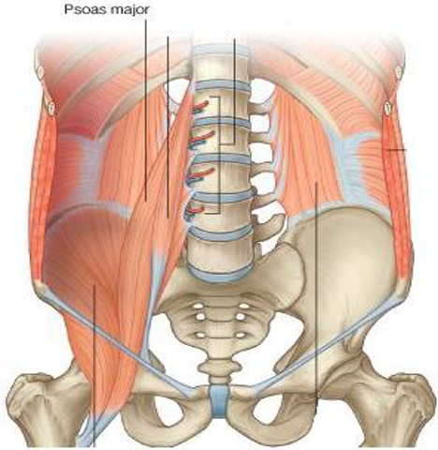
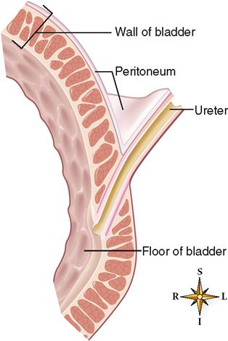
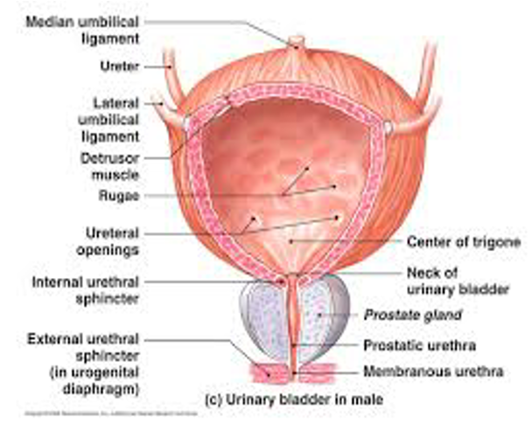
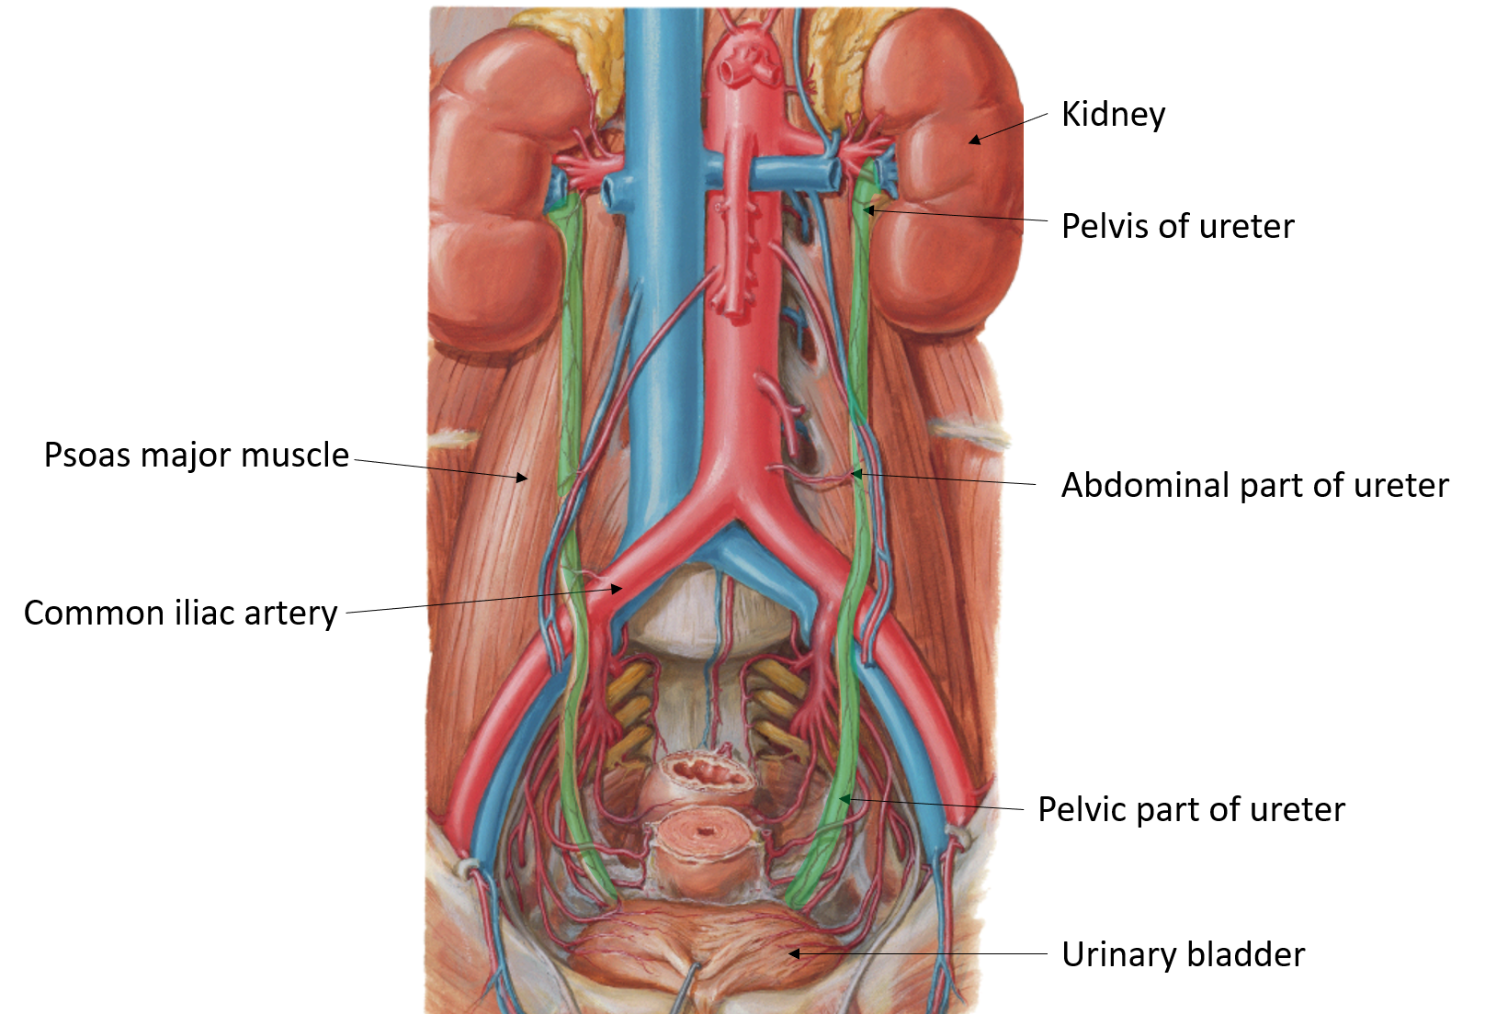
1
Ureter
Definition: It is a muscular tube transporting urine from kidney to the posterior surface of urinary bladder.
Length: 25 – 30 cm (10-12 in)
Beginning: It begins as a continuation of renal pelvis (or pelvis of the ureter)
The Course of the Ureter
In abdomen: It descends anterior to psoas major muscle (opposite the tips of lumbar transverse processes).
It crosses anterior to the end (bifurcation) of common iliac artery
to enter the pelvis.
In pelvis & termination: It runs downward & backward to the level of ischial spine.
It curves forward to open in upper lateral angles of the base of urinary bladder.
It runs obliquely for ¾ inch in wall of bladder before opening
(valve-like part).
This valve-like part closes during contraction of bladder preventing the backflow of urine
Functional valve

Slide 4
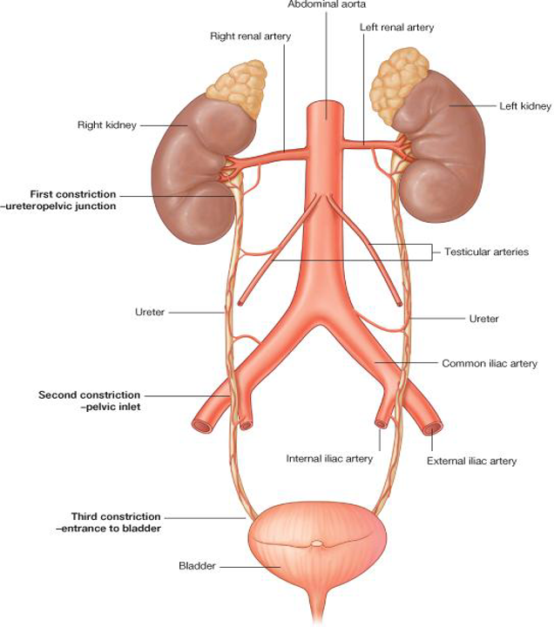
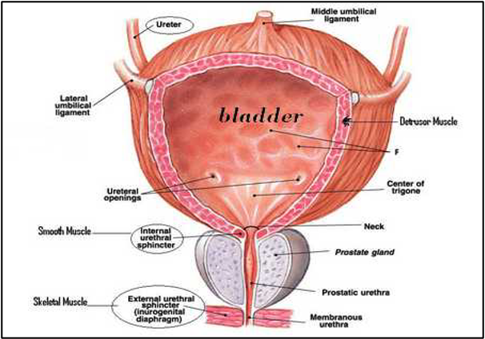
2
Ureter
Potential sites of stone formation
Site of Constriction
(Obstruction-Stone impaction)
Arterial Supply
Ureteropelvic junction
Upper end =
Branch of
Renal artery
Middle portion =
Branch of
Gonadal artery/
testicular or ovarian artery
Pelvic inlet
(site of crossing of common iliac artery)
Middle portion =
Branch of
Common iliac artery
In pelvis =
Branch of
Internal iliac artery
Entrance of bladder
Shape of Urinary Bladder
It’s pelvic organ. It has the shape of three-sided pyramid placed on one of its
angle (NECK).
It has:
1
Apex: directed anteriorly (forward)
2
Base: directed posteriorly
Continue with urethra
Anterior view
3
Superior surface
4
Two infero-lateral surface
Posterior view

Slide 5
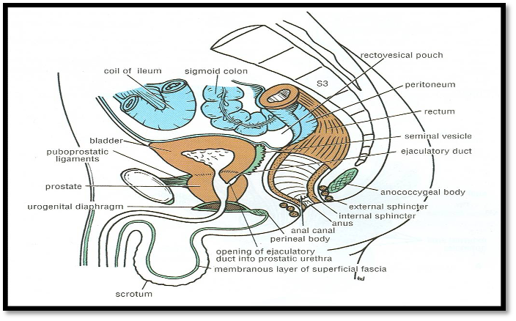
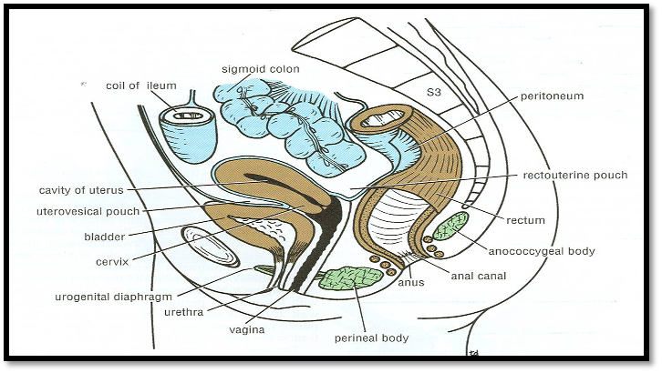
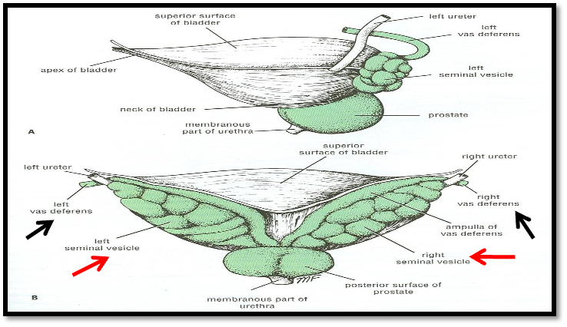
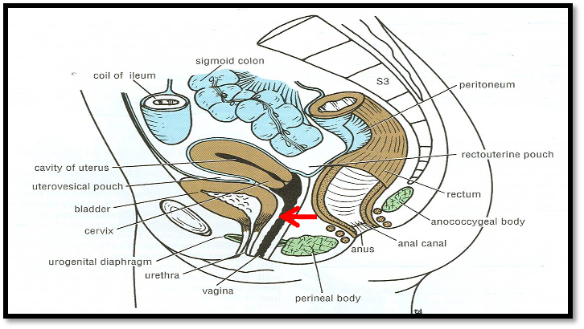
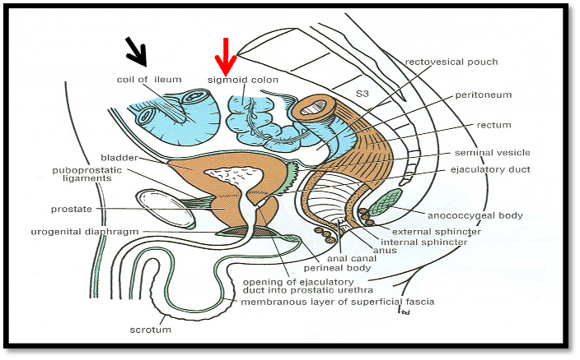
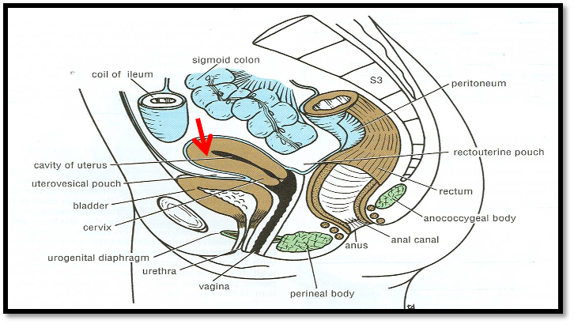
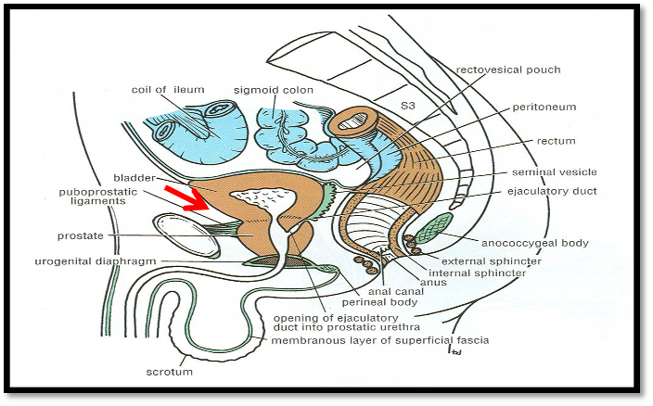
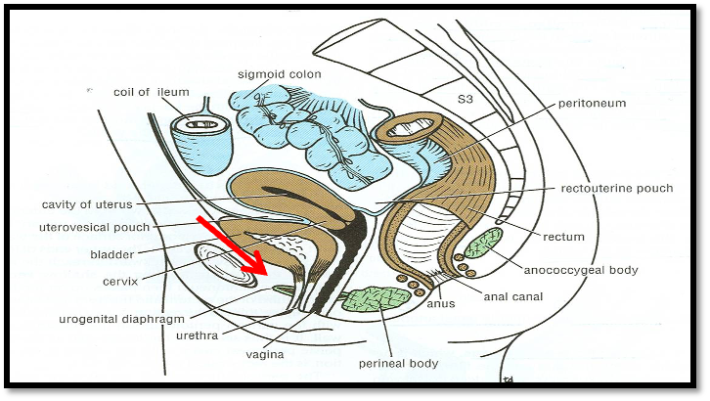
3
Urinary Bladder
 | Relations | Male | Female
Apex (Same in Male & Female) | -Is directed forward -Is related anteriorly to upper border of symphysis pubis -Is connected to umbilicus by the Median umbilical ligament (remnant of urachus)
Base | Is directed backward -In male: Is related to vas deferens & seminal vesicle of both sides -In female: Is related to vagina
Superior Surface | -In male: Is related to coils of ileum & sigmoid colon or pelvic colon -In female: Is related to the uterus
Infero- lateral Surfaces (Same in Male & Female) | Are related to retropubic fat separating them from pubic bones Retropubic fat: -Accommodates distention of bladder -Continuous with anterior abdominal wall. -Rupture of bladder ——> escape of urine to anterior abdominal wall
Neck | - Is the lowest & most fixed part of urinary bladder. - Is continuous with urethra. - Is related to (lies behind) lower border of symphysis pubis In male: Is related to upper surface of prostate gland (inferiorly, it rests on the base of prostate)

Slide 6
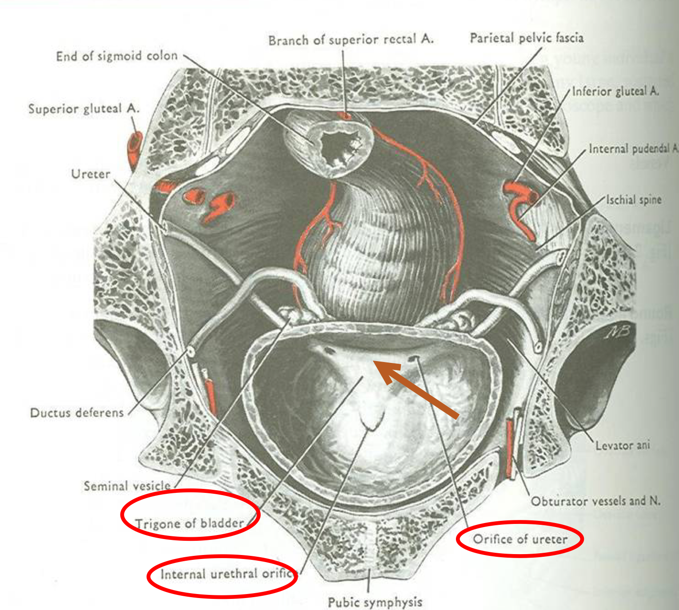
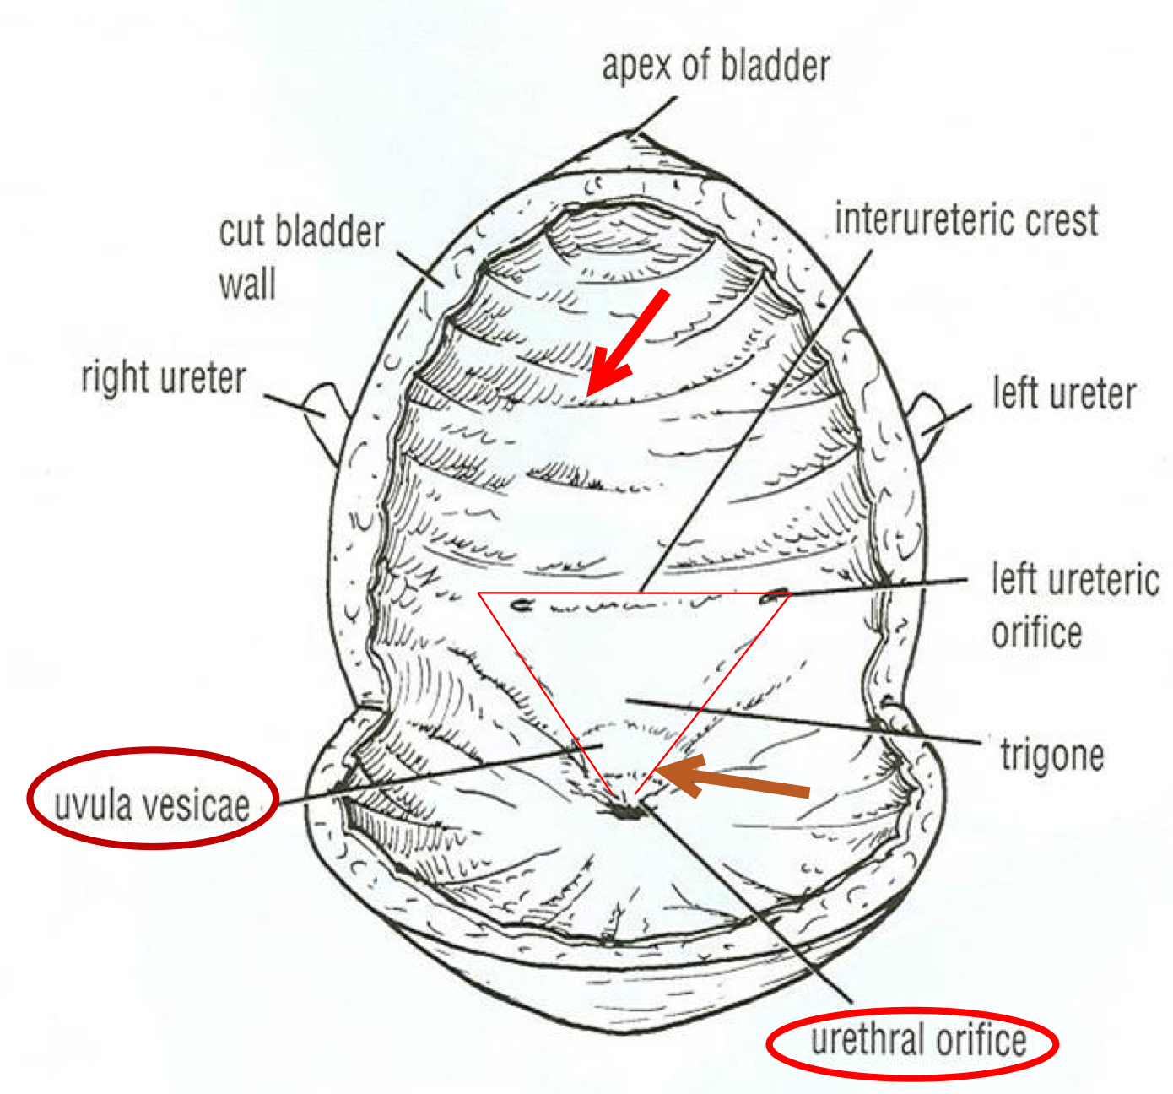
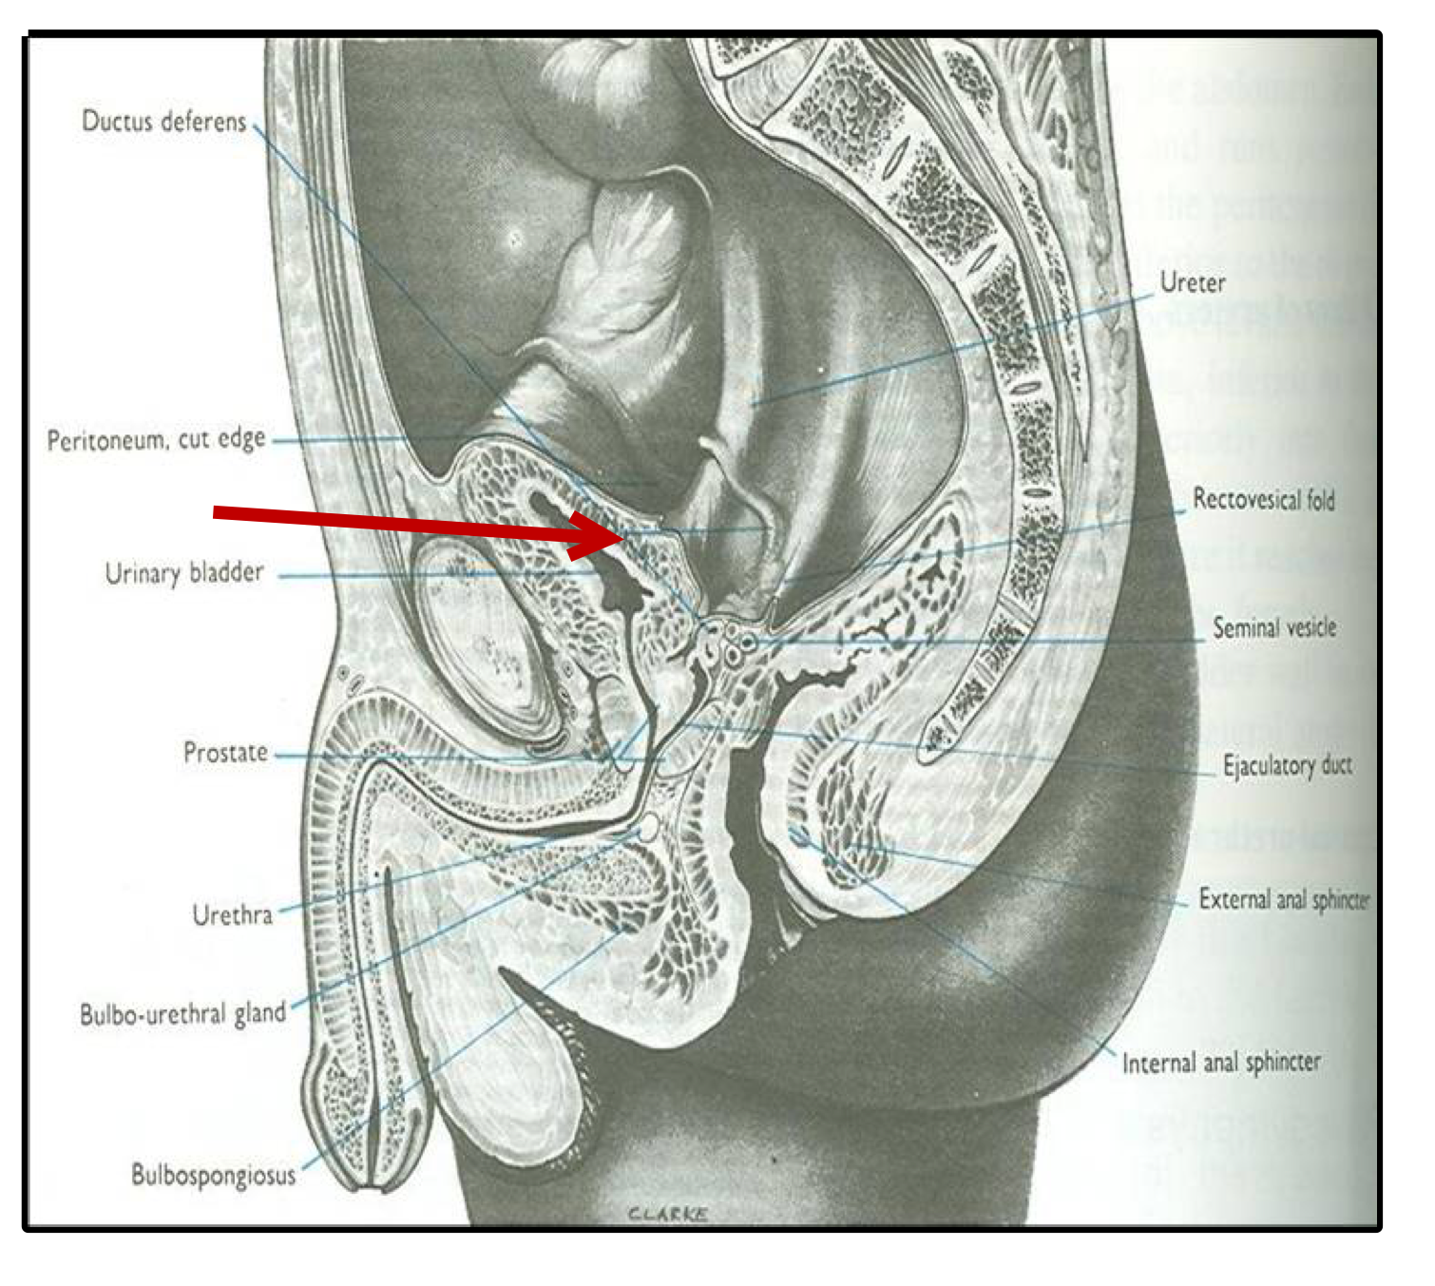
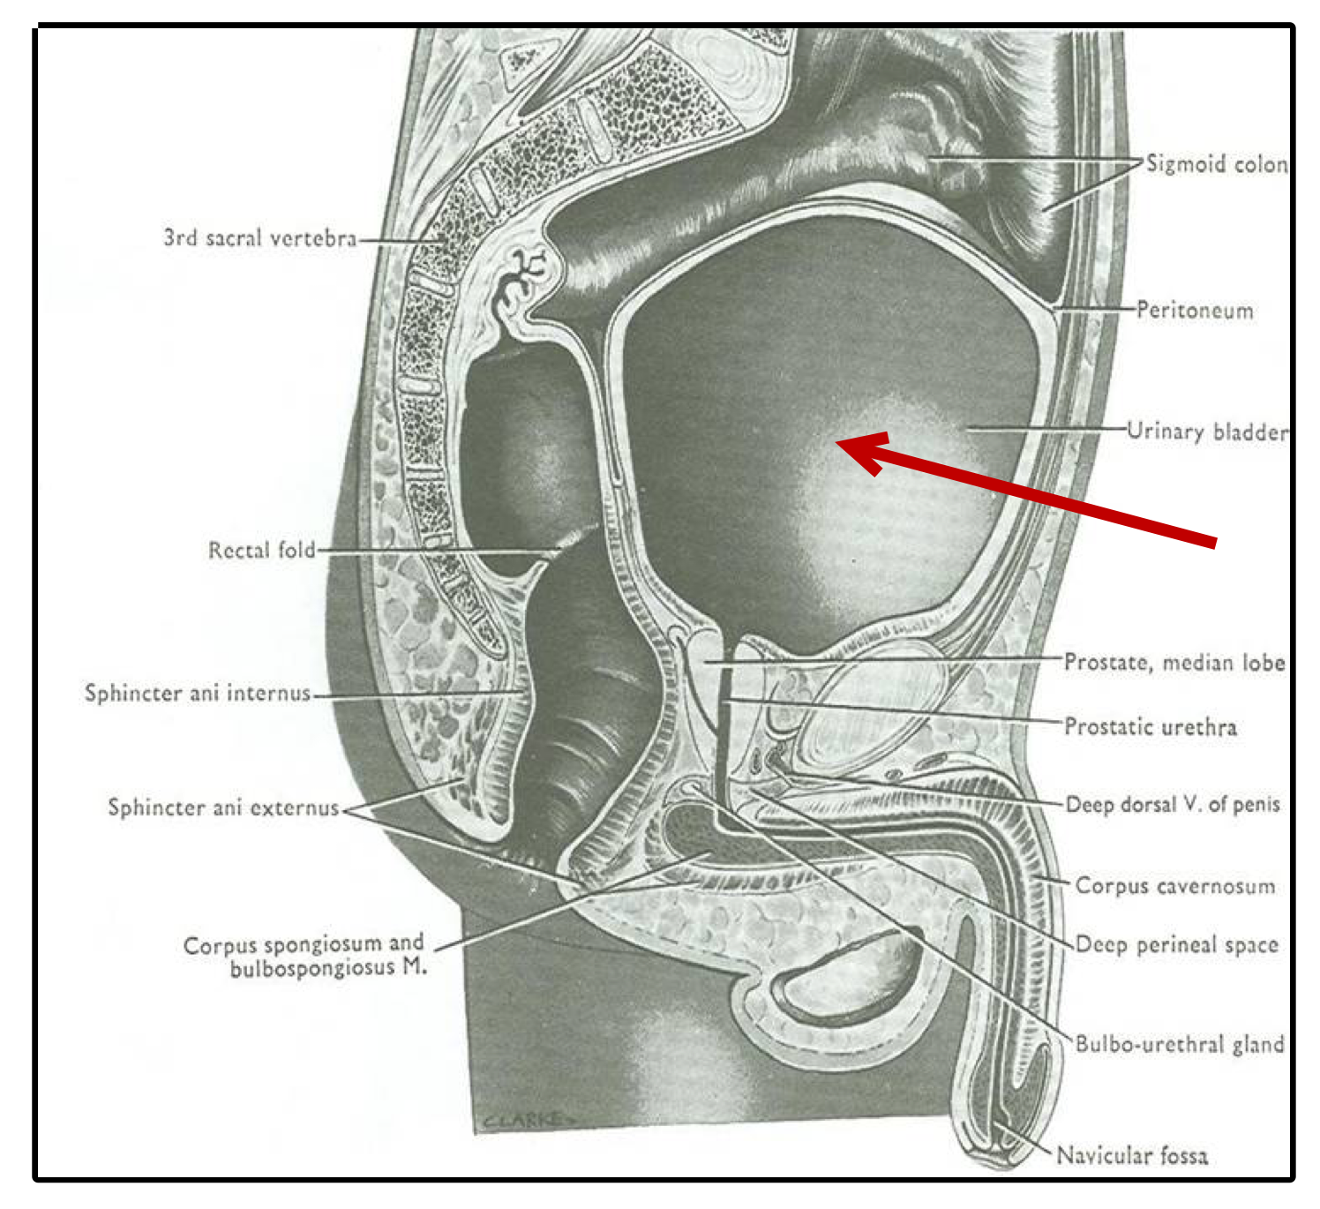
4
Urinary Bladder (Interior)
Uvula vesicae: elevation behind internal urethral orifice, produced by median lobe of prostate gland.
Mucous membrane is folded.
Trigone: a triangular area in base of bladder bounded by the 2 ureteric orifices & internal urethral orifice.
Its mucous membrane is elastic
(not folded).
Capacity
Empty
Distended
- Empty bladder is a pelvic organ.
- Accommodates from 300 – 500 ml of urine.
Is circular in shape.
Bulges into abdominal cavity.

Slide 7
5
Urinary Bladder (Position)
Only in Boys’ Slides
Is found in abdomen until age of 6 years
Begins to enter the enlarging pelvis from age of 6 years onward
Is found entirely in pelvis at puberty
A median sagittal section of a newborn female child
Urinary Bladder (Supply)
Arteries | from internal iliac artery
Viens | into internal iliac vein
Lymph | into internal iliac lymph nodes
Nerves | - Parasympathetic: through pelvic splanchnic nerves from S2, 3, 4 - Sympathetic: from L1, 2 through hypogastric nerves. (Female’s dr: Important) - Sensory: transmitting pain due to overdistention of bladder (via general visceral afferent fibres from bladder to CNS)
Picture
Autonomic Regulation of the Bladder

Slide 8
6
Urethra
Male
(LENGTH: 20 CM)
PROSTATIC URETHRA: (Length=3 cm)
- Widest & most dilatable
- Extends from neck of bladder inside prostate gland
MEMBRANOUS URETHRA: (Length=1 cm)
-Surrounded by external urethral sphincter
PENILE (SPONGY) URETHRA: (Length=16 cm)
-Extends inside penis & opens externally through external urethral orifice (narrowest part of whole urethra).
Structures openings into prostatic urethra:
1. Ejaculatory ducts:
containing sperms & secretion of seminal vesicles.
2. Ducts of prostate gland.
Female
(LENGTH: 4 CM)
- Has only urinary function.
- Extends from neck of urinary bladder to open externally through the external urethral orifice
(anterior to the vaginal opening). (Female’s dr: probable MCQ question)
(Female’s dr: measurements are important)
Intravenous Urogram (IVU,IVP)
A urogram (Post micturation):
Demonstrates a bladder stone,
or any obstruction in the urinary system.

Slide 9
Summary
URETER:
- Beginning: as continuation of renal pelvis
- Course: descends anterior to: psoas major & end (bifurcation) of common iliac artery.
- Termination: opens at upper lateral angle of base of urinary bladder
- Sites of constriction: at uteropelvic junction, at pelvic inlet, at site of entrance of bladder
- Arterial supply: renal, gonadal, common & internal iliac arteries
URINARY BLADDER:
- Apex: related to symphysis pubis, continuous with median umbilical ligament
- Base: related to vas deferens & seminal vesicle (in male) & to vagina (in female)
- Superior surface: related to coils of ileum & sigmoid colon (in male)
& to uterus (in female)
- Inferolateral surfaces: related to retropubic fat
- Neck: continuous with urethra, related to upper surface of prostate gland (in male)
- Trigone: lies in the base of bladder, bounded by ureteric orifices &
internal urethral orifice, its mucous membrane is elastic
- Uvula vesicae: dilatation behind internal urethral orifice,
produced by the median lobe of the prostate gland
- Supply: internal iliac (artery, vein, lymph nodes)
- Nerves: parasympathetic (S2,3,4), sympathetic (L1,2)
MALE URETHRA:
- Function: both urinary & genital
- Length: 20 cm, divided into prostatic (3 cm), membranous (1 cm) & penile ( 16 cm)
- Course: Extends from neck of bladder to opens externally through external urethral orifice (narrowest part of whole urethra)
FEMALE URETHRA:
- Function: urinary only
- Length: 4 cm
- Course: Extends from neck of bladder to external urethral orifice
(anterior to vaginal opening)

Slide 10
Quiz
MCQs
*first 2 questions are from doctor’s slides.
Q1: Which one of the following structures is related to the inferolateral surface of the urinary bladder?
A- Prostate gland
B- Sigmoid colon
C- Retropubic fat
D- Seminal vesicle
Which one of the following is the site of uvula vesicae?
A- In the superior surface of urinary bladder.
B- Behind the internal urethral orifice.
C- Between the 2 ureteric orifices.
D- In relation to the apex of urinary bladder
Q3: Which of the following is directed posteriorly in
the bladder
A- Apex
B- Base
C- superior surface
D- inferiolateral surface
Q4: The umbilicus is connected to apex by
A- Median umbilical ligament
B- Medial umbilical ligament
C- Lateral umbilical ligament
D- inferior umbilical ligament
Q5: The superior surface of the bladder in male is related to
A- coils of jejunum
B- rectum
C- pelvic colon
D- uterus
Q6: The length of the ureter is ………
A. 20 - 25
B. 20 - 30
C. 25 - 30
D. 15 - 25
Q7: Uvula vesicae is an elevation caused
A. Lower lobe of prostate
B. Symphysis pubis
C. Anterior lobe of prostate
D. Median lobe of prostate
Q8: Which Is the first common site of constriction of the ureters
A. Ureteropelvic junction
B. Pelvic inlet
C. Level common iliac artery bifurcation
D. Bladder entrance
SAQs
Answers: 1.C 2.B 3.B 4.A 5.C 6.C 7.D 8.A
Q1: What is the structure that is related to base of the bladder in male and female?
Male: vas deferens & seminal vesicle
Female: Vagina
Q2: What is the significance in which ureters run obliquely in the bladder wall before opening?
They form functional valve-like part preventing the urine backflow during bladder contraction
Q3: List the sites of constriction of the Ureter.
1. At ureteropelvic junction
2. At pelvic inlet (site of crossing of common iliac artery)
3. At site of entrance to bladder

Slide 11
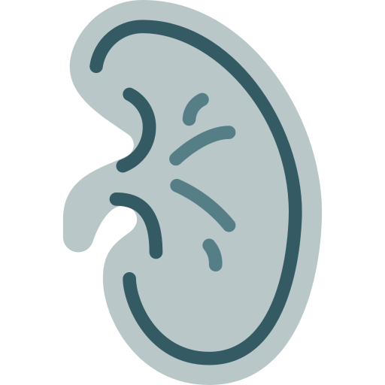
Members Board
Team Leaders
Mohammad AlRashed
Najla AlDhbiban
Team Members
Faisal AlOmar
Mishal AlSuwayegh
Abdullah AlSalem
Saud AlTaleb
Abdullah AlNajres
Feras AlMasoud
Abdulkarim Salman
Mayssam AlJaloud
Fatima Halawi
Ghada BinSlimah
Nouf AlDalaqan
Shaden AlBassam
Maha AlKoryshy
Rahaf AlMotairi
Haifa AlAmri
Alhnouf AlYami

