Slide 1
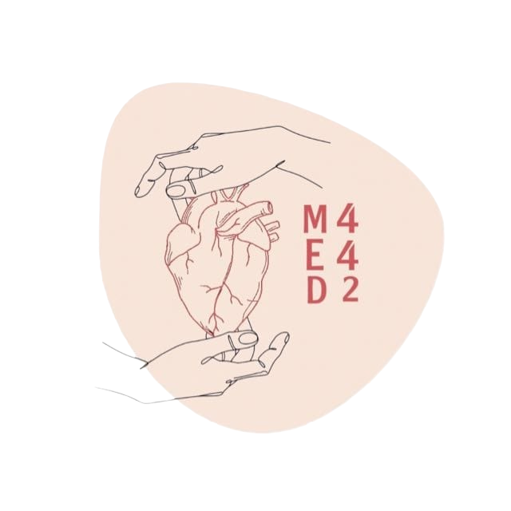
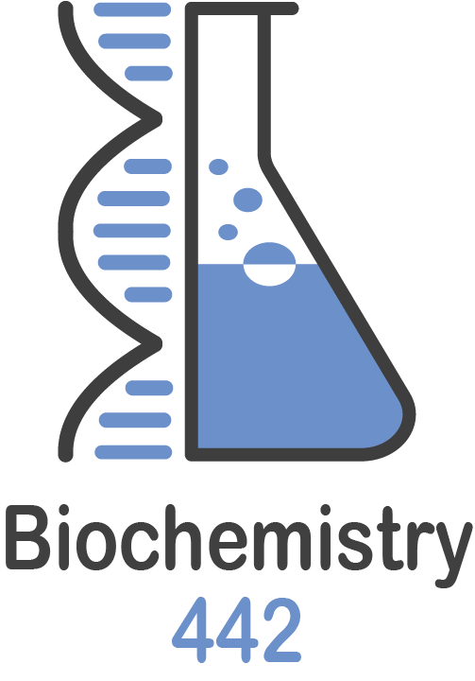
Kidney Stones
Lecture Number 1
Color Index:
● Main text
● Important
● Notes
● Boys slides
● Girls slides
● Extra

Slide 2
Objectives
Discuss the general physiological and pathological factors that favor kidney stones formation
List the types of kidney stones, their chemical constituents and characteristics
Identify the etiological causes of each type of kidney stone
Discuss the diagnosis, treatment and prevention of kidney stones

Slide 3
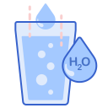
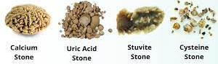
kidney Stones
- Renal calculi ( kidney stones ) are formed in renal tubules, ureter or bladder (usually kidney stones form in kidney then move into ureter and bladder)
- Composed of metabolic products present in glomerular filtrate
- These products are in high conc.
- Near or above maximum solubility*When you add one spoon of sugar into a glass of water the sugar will dissolve, here the sugar is the solute and the water is the solvent. Now, if you continue to add the solute without limitation , you will reach a point that solvent can’t dissolve more solute, this point called maximum solubility so the solute starts to precipitate and this is the first step to form kidney stones..
Types of kidney stones :
Calcium salts
Uric acid
Mg ammonium PO4
(Struvite)
Cystine
Other (xanthine ,etc)

Slide 4
Conditions Causing Kidney Stones Formation :
1- High conc. of metabolic products in glomerular filtrate due to:
2- Changes in urine pH normal range(4.5 - 8.0) due to:
- Low urinary volume (with normal renal function) due to restricted fluid intake
-Increased fluid loss from the body e.g. sweating
-Increased excretion of metabolic products forming stones
-High plasma volume (high filtrate level)
-Low tubular reabsorption from filtrate
-Bacterial infection :because the bacteria split urea into ammonia and other alkaline waste products (make the urine more alkaline)
Causes Precipitation of salts at different PH .
A persistently acidic urine → promotes uric acid precipitation
A persistently alkaline urine (due to upper urinary tract infection)→promotes Mg Ammonium Phosphate crystals (Struvite stones)

Slide 5
Conditions Causing Kidney Stones Formation
3- Deficiency of stone-forming inhibitors due to:
4- Urinary stagnation due to:
- Citrate, pyrophosphate, glycoproteins inhibit growth of calcium phosphate and calcium oxalate crystals
- In type I renal tubular acidosis, hypocitraturia leads to renal stones
hypocitraturia caused either by failure to reabsorb bicarbonate or by insufficient secretion of hydrogen ions
- obstruction of urinary flow.
Urine stagnation in a place makes it more susceptible to infections and tends to form stones... Imagine that you put an open glass of water in a room for several days, what do you expect to happen?

Slide 6
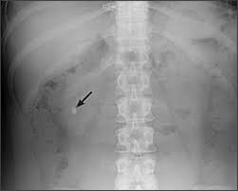
Calcium Salt Stones
Overview
80% of kidney stones contain calcium :
Mostly Ca-Oxalate and less often Ca-Phosphate
Depends on
The type of salt depends on :
1 - Urine pH 2-Availability of oxalate
General appearance
– White, hard, radio-opaque (visible in X-ray )
– Calcium oxalate: present in ureter (small).
– Calcium PO4 : staghorn calculi especially in renal pelvis (large) .
Causes
1- Hypercalciuria
-Increased urinary calcium excretion :
Men: > 7.5 mmols/day
Women > 6.2 mmols/day
– Due to hypercalcemia (most often due to 1ary hyperparathyroidism)
- sometimes, Ca++ salts stones are found with no hypercalcemia
2- Hyperoxaluria:
- Causes the formation of calcium oxalates without hypercalciuria
- Diet rich in oxalates
- Increased oxalate absorption in fat malabsorption
3- Primary hyperoxaluria:
- Due to inborn errors
-Urinary oxalate excretion:
> 400 μmol/24 Hours
Treatment
1- Treatment of primary causes such as infection, hypercalcemia, hyperoxaluria
2- Oxalate-restricted diet
3- Increased fluid intake (if no glomerular failure)
4- Acidification of urine (by dietary changes) because Calcium salt stones are formed in alkaline urine

Slide 7
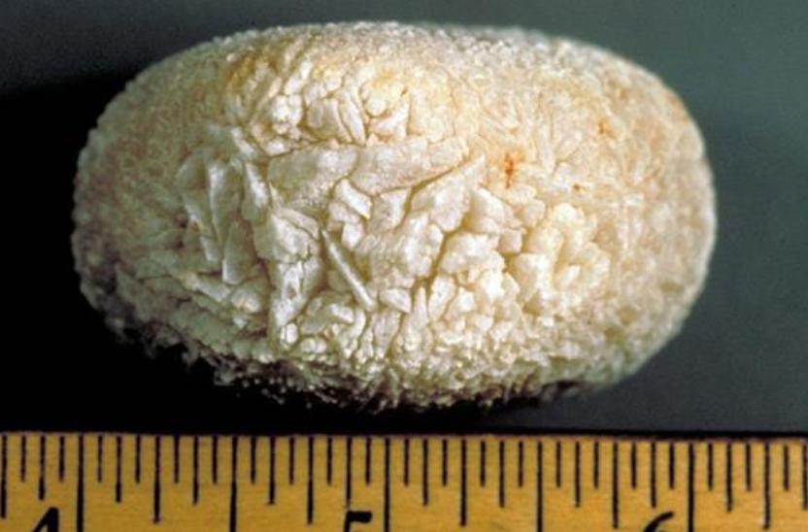
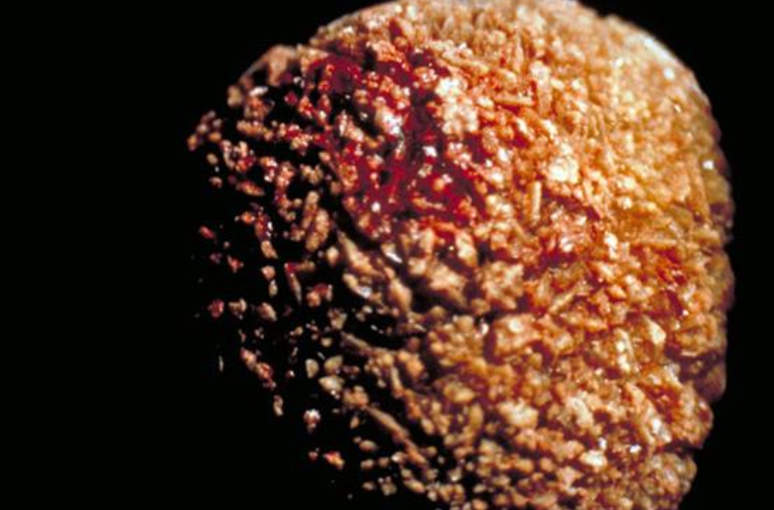
Uric Acid Stones
Overview
-About 8% of renal stones contain uric acid.
Depends on
1-Urine pH ( in acidic urine, low pH ).
2-Meat consumption makes the urine more acidic while fruit consumption alkalizes the urine.
General appearance
– Small, friable (breaks easily ) , yellowish.
– May form staghorn ( if it’s big ) Mostly not
Staghorn kidney stones are large, solid growths (calculi) that form in the kidneys where urine is formed, As the stones grow bigger and harden (calcify), they take resemble the horns of a stag deer, giving the condition its name.
– Radiolucent ( plain x-rays cannot detect easily ) it can’t be seen normally on x-ray .
- it is visualized by ultrasound or i.v. pyelogram.
IV-pyelogram (IVP) is an x-ray examination of the kidneys, ureters and urinary bladder that uses iodinated contrast material injected into veins, we use contrast to highlight urinary tract to see how the kidneys remove the dye and how it’s been collected in urine
Causes
– May be associated with hyperuricemia ( with or without gout )
– Form in acidic urine.
Treatment
– Treatment of cause of hyperuricemia.
– Purine-restricted diet because purine is a precursor of uric acid.
– Alkalinization of urine ( by dietary changes e.g: fruit and vegetables )
– Increased fluid intake.

Slide 8
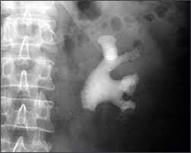
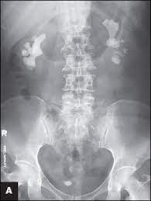
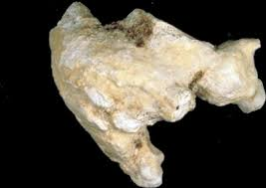
Mg Ammonium PO4 Stones (Struvite Kidney Stones)
Overview
About 10% of all renal stones contain Mg ammonium PO4 .
Also called struvite kidney stones .
Struvite (magnesium ammonium phosphate) is a phosphate mineral that naturally found in the earth. Its geological name is struvite.
Depends on
Urine pH ( in high pH which means alkaline urine ).
General appearance
– Commonly associated with staghorn calculi.
– 75% of staghorn stones are of struvite type.
(Mostly alkaline stones form staghorn calculi)
Causes
– Associated mainly with chronic urinary tract infection :
Microorganisms ( such as from Proteus genus ). Proteus organisms tend to produce urease that alkalinize the urine by metabolizing urea into ammonia causing urine pH to become alkaline leading to stone formation.
Treatment
– Treatment of infection.
– Urine acidification.
– Increased fluid intake (doesn’t help a lot in this type).
– In some cases, it may require complete stone removal (percutaneous nephrolithotomy).

Slide 9
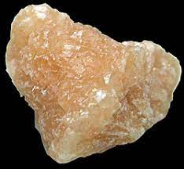
Cystine Stones
Stones :
▫ Radio-opaque (calcium , struvite )
▫ Radio-lucent (uric acid , cysteine )
overview
A rare type of kidney stone.
Cystine is the oxidized dimer form of the amino acid cysteine. It is a white solid that is slightly soluble in water.
Depends on
1- Urine pH ( acidic urine , low pH ).
2- Diet which make the urine more acidic such as meat.
General appearance
– Soluble in alkaline urine.
– Faint radio-opaque (is a type between radiopaque and radiolucent نص نص ).
causes
1- Due to homozygous cystinuria which is an inherited autosomal recessive disease that is characterized by high concentrations of the amino acid cystine in the urine
2- Form in acidic urine.
treatment
– Increased fluid intake.
– Alkalinization of urine ( by dietary changes ) e.g: fruit, vegetables and milk.
– Penicillamine ( binds to cysteine to form a compound more soluble than cystine ).
penicillamine is a breakdown product of penicillin, which was isolated from the urine of patients with liver disease who receive penicillin

Slide 10
Lab Investigations for Kidney Stones
If stone has not formed:
If stone has formed and removed:
This type of investigation identifies causes that may contribute to stone formation:
- Serum calcium ,uric acid and PTH “parathyroid hormone” analysis. (hyperthyroidism leads to hypercalcemia → hypercalciuria → stone formation)
- Urinalysis: volume, calcium,oxalates and cystine levels
- Urine pH > 8 suggests urinary tract infection which can lead to ( Mg ammonium PO4 stones ).
Urinary tract imaging:
- CT scan.
- Ultrasound.
- I.V. pyelogram.
Chemical analysis of stone helps to:
- Identify the cause.
by confirming the shape → type of stone → the cause
- Advise patient on prevention and future recurrence. Because if the person is a stone former, the chances of recurrence is quite high and can reach >50%

Slide 11
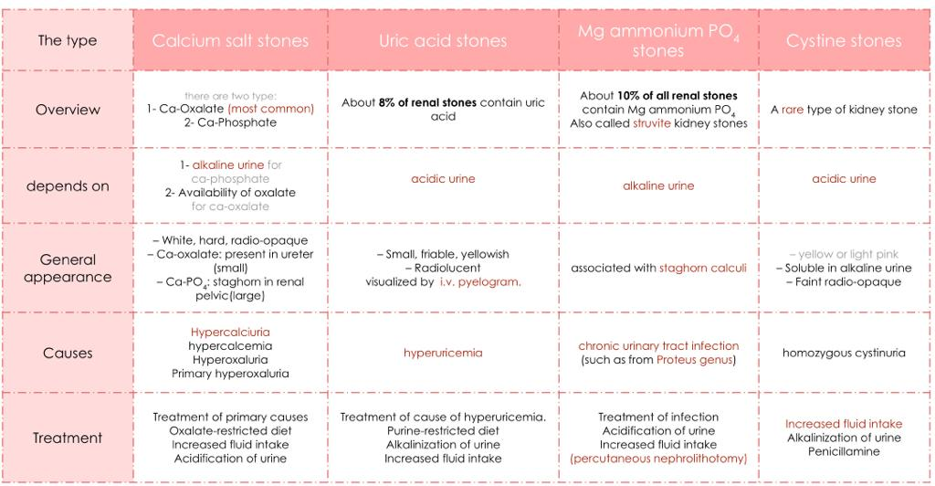
Summary of Kidney Stones
Thanks to 439 ❤

Slide 12
MCQs
Q1:What’s the concentration of products that forming kidney stones ?
A : above maximum solubility | B:below maximum solubility | C:both A&B | D:neither
Q2: The most common type of kidney stones :
A: Calcium salt stones | B: Uric acid stones | C: Mg ammonium PO4 stones | D:Cystine stones
Q3 : Which of the following conditions can cause calcium salt stones :
A: Hypercalciuria | B: Hyperoxaluria | C: hyperuricemia | D: both A+B
Q4: What is the treatment of Uric acid stones ?
A: Alkalinization of urine | B: Urine acidification. | C: Penicillamine | D: None of the above
Q5: homozygous cystinuria cause which of the following?
A: Uric acid stones | B: struvite kidney stones | C: Cystine stones | D: Calcium salt stones
Q6:Which of the following is commonly associated with staghorn calculi?
A: Uric acid stones | B: struvite kidney stones | C: Cystine stones | D: Calcium salt stones
Q4:A Q5:C Q6:B
Answers : Q1:A Q2:A Q3:D

Slide 13
SAQs
Q1: enumerate the types of kidney stones ?
Q2: enumerate the conditions that causing kidney stones formation ?
Q3: List the Urinary tract imaging types ?
Q1 : slide 3
Q2: slide 4+5
Q3: - CT scan, Ultrasound and I.V. pyelogram.

Slide 14
Our Team
Leaders
Team members
Raseel Alwehibi
Mashael Alsuliman
Hoor Aloraini
Nouf Aldhalaan
Fatima Halawo
Sara Alotaebe
Mohammed Ibn Saqyan
Abdulrahman Ateeq
Muhannad almuadi
Khaled Abdulaziz
Ahmad Almarshed
Ali Al-Jabaan
Abdul Rahman Al Qurashi
Abdullah Al Shehri
أخي لن تنال العلم إلا بستة
سأنبيك عن تفصيلها ببيان
ذكاء وحرص واجتهاد وبلغة
وصحبة أستاذ وطول زمان
محمد بن ادريس الشافعي
Biochemksumed442@gmail.com
Editing files

