Slide 1
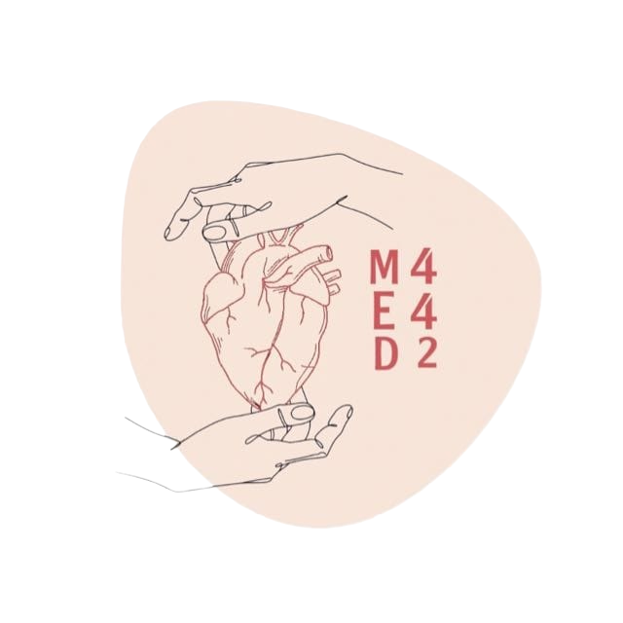
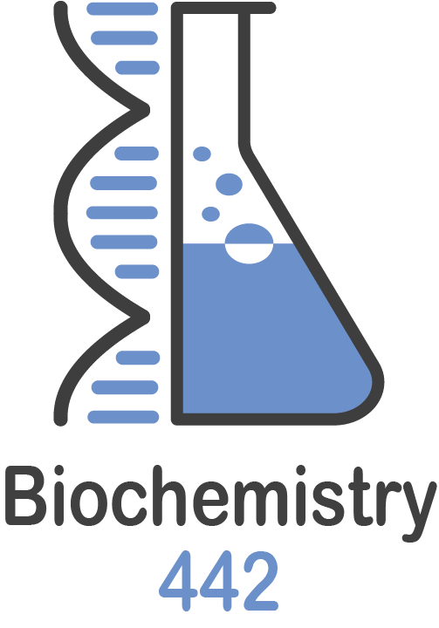
Renal Function Tests (RFTs)
Color Index:
● Main text
● Important
● Notes
● Boys slides
● Girls slides
● Extra
Lecture number 2

Slide 2
objectives
To have a knowledge about functional units and normal functions of the kidney.
To have an idea about some examples of renal disease.
To know laboratory routine kidney function tests (KFTs).
To know other laboratory KFTs.

Slide 3
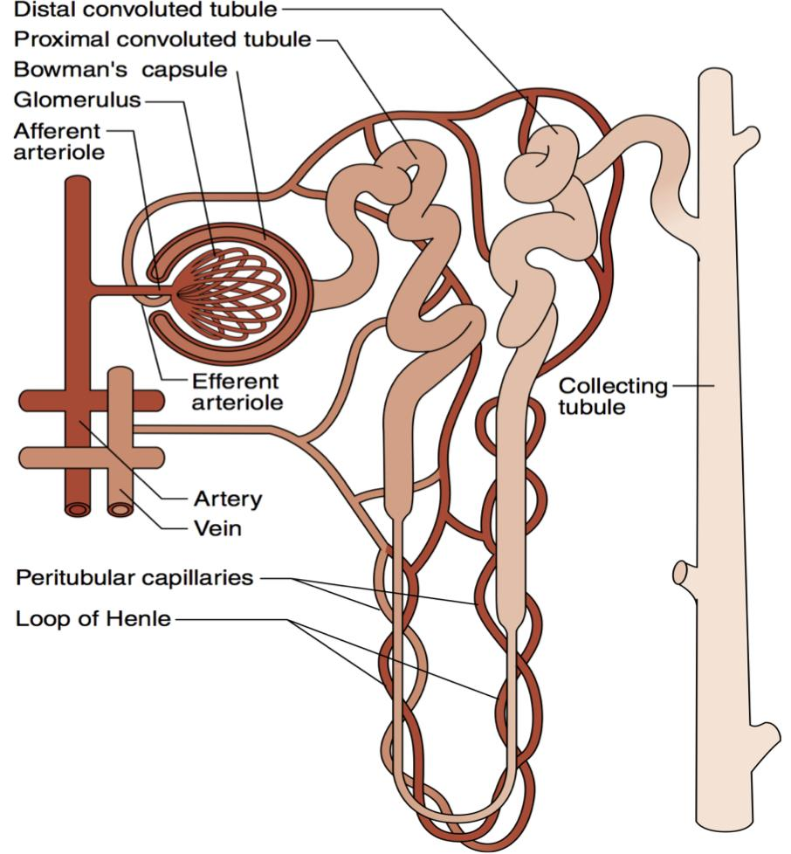
Functional units:
Kidney Functions
The nephron is the functional unit of the kidney.
Each kidney contains about 1,000,000 to 1,300,000 nephrons.
The nephron is composed of glomerulus and renal tubules.
The nephron performs its homeostatic function by ultra filtration at glomerulus and secretion and reabsorption at renal tubules.
Regulation of
Excretion of
Hormonal Function
Metabolic Function
-water and electrolyte balance.
-acid base balance.
-arterial blood pressure.
-secretion of erythropoietin.
-activation of vitamin D.
-activation of angiotensinogen
by renin.
-site for gluconeogenesis.
-metabolic waste products.
-foreign chemicals.

Slide 4
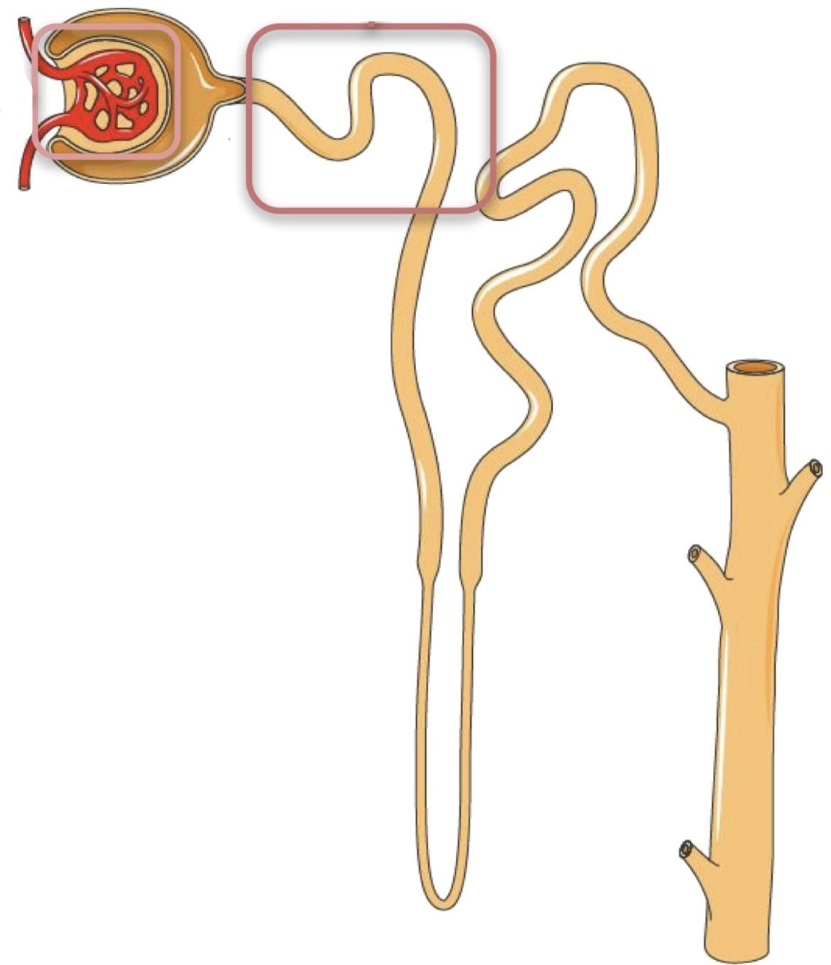
In Male slides Only
Each nephron is a complex apparatus comprised of five basic parts:
1- Glomerulus
2- Proximal Convoluted Tubule
Functions to filter incoming blood.
Returns the bulk of each valuable substance back to the blood circulation.
• 75% of the water, sodium, and chloride.
• 100% of the glucose (up to the renal threshold).
• almost all of the amino acids, vitamins, and proteins.
• varying amounts of urea , uric acid, and ions, such as magnesium , calcium and potassium. (With the exception of water and chloride ions “because they reabsorbed passively” , the process is active that is the tubular epithelial cells use energy to bind and transport the substances across the plasma membrane to the blood).
• Secretes products of kidney tubular cell metabolism, such as hydrogen ions, and drugs, such as penicillin.
Factors facilitate filtration:
● high pressure in the glomerular
capillaries, which is a result of their
position between two arterioles.
● the semipermeable glomerular
basement membrane, which has a
molecular size cutoff value of
approximately 66,000 Da.
The volume of blood filtered per minute is the glomerular filtration rate (GFR), and its determination is essential in evaluating renal function.

Slide 5
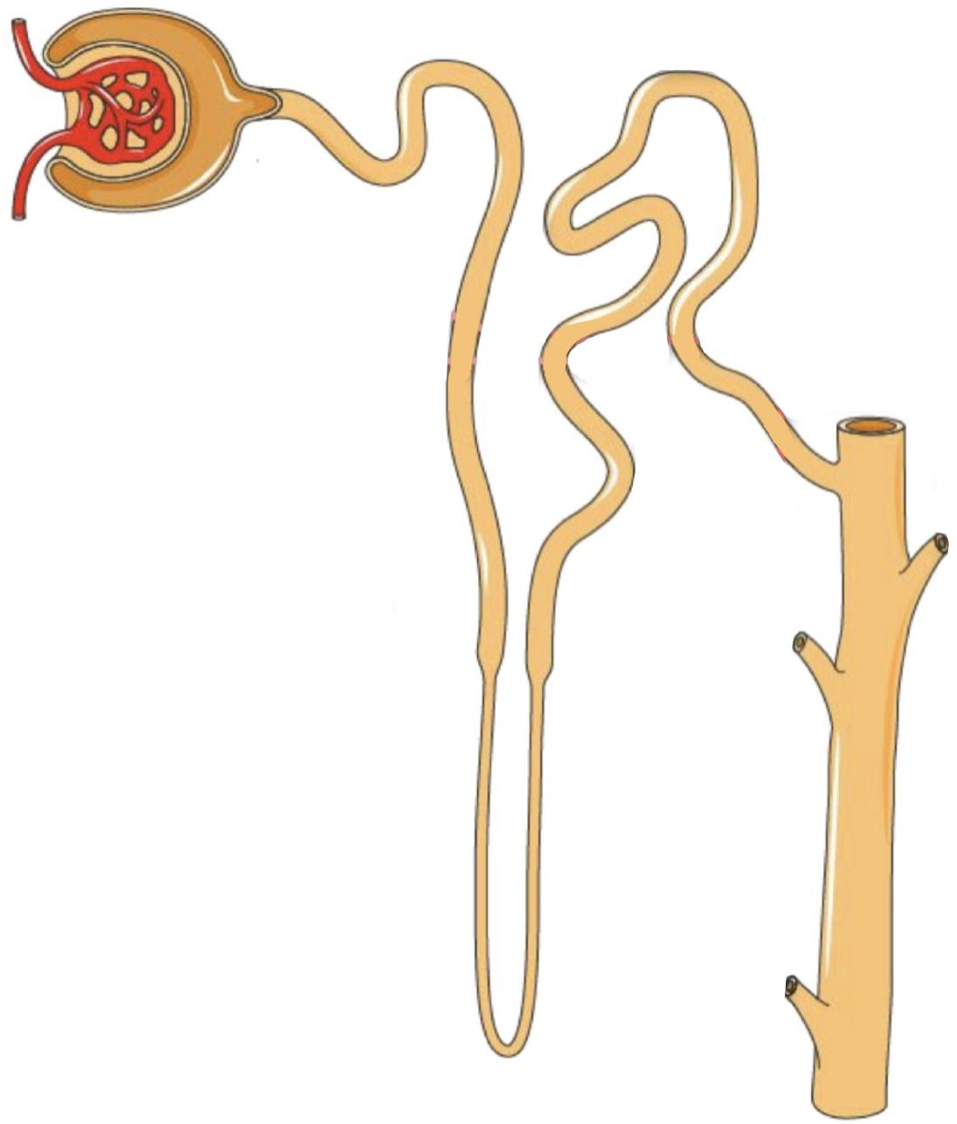
In Male slides Only
3- Loop of Henle
Facilitates the reabsorption of water, sodium, and chloride.
4- Distal Convoluted Tubule
The osmolality in the medulla in this portion of the nephron increases steadily from the corticomedullary junction inward .
● The filtrate entering this section of
the nephron is close to its final
composition (which is urine).
● Effects small adjustments to achieve
electrolyte and acid-base homeostasis
(under the hormonal control of both
antidiuretic hormone “ADH” and aldosterone).
5- Collecting Duct
● The collecting ducts are the final site for either
concentrating or diluting urine.
● The hormones ADH and aldosterone act on this
segment of the nephron to control reabsorption
of water and sodium.
● Chloride and urea are also reabsorbed here (partially).
● The collecting ducts in the medulla are highly
permeable to urea so urea will diffuse down its
concentration in gradient out of the tubule and into the
medulla interstitium, increasing its osmolality.
The distal convoluted tubule is much shorter than the proximal tubule, with two or three coils that connect to a collecting duct.

Slide 6
Renal diseases:
Examples of renal disease
Many diseases affect renal function.
In some, several functions are affected.
In others, there is selective impairment of glomerular function or one or more of tubular functions.
Most types of renal diseases cause destruction of complete nephron.
Renal calculi (stones).
Renal obstruction and Renal calculi (stones).
Renal hypertension.
Renal failure (acute and chronic).
1
2
5
3
4
Tubular disease:
Proximal or distal tubular renal acidosis (TRA).
Glomerular disease:
-Acute and chronic glomerulonephritis.
-Nephrotic syndrome.

Slide 7
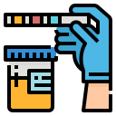
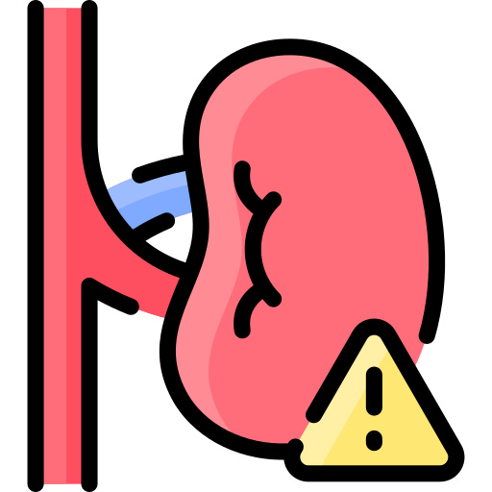
Routine KFTs include the measurement of:
Serum creatinine (Cr).
Serum urea.
Creatinine clearance.
Electrolyte.
Both serum Cr and creatinine clearance are used as kidney function tests to :
Confirm the diagnosis of renal disease.
Give an idea about the severity of the disease.
Follow up the treatment.

Slide 8
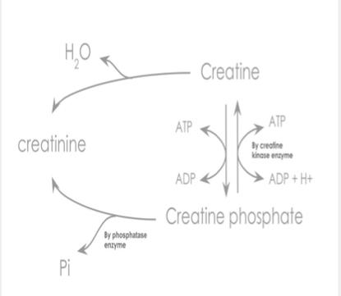
Serum creatinine (55-120 μmol/L in adult):
Unit is very important
Creatinine is the end product of creatine catabolism.
Creatinine is NOT reabsorbed by the renal tubules.
98% of the body creatine is present in the muscles where it functions as store of high energy in the form of creatine phosphate.
Plasma creatinine is an endogenous substance not affected by diet.
Plasma creatinine remains fairly constant throughout adult life.
About 1-2 % of total muscle creatine or creatine phosphate pool is converted daily to creatinine through the spontaneous, non enzymatic loss of water or phosphate.
Creatinine in the plasma is filtered freely at the glomerulus and secreted by renal tubules (10 % of urinary creatinine).
We can ignore it

Slide 9
Creatinine clearance:
The glomerular filtration rate (GFR) provides a useful index of the number of functioning glomeruli.
It gives an estimation of the degree of renal impairment by disease.
What does clearance mean??
There is a limitation of this equation which is the the volume of urine because maybe there will be some mistakes during collecting the urine.
Clearance is the volume of plasma cleared from the substance excreted in urine per minute.
It could be calculated from the following equation:
U = Concentration of creatinine in urine μmol/l
Clearance (ml/min) = U x V
P
V = Volume of urine per min
P = Concentration of creatinine in serum (plasma) μmol/l

Slide 10
Accurate measurement of GFR by clearance tests requires determination of the concentration in plasma and urine of a substance that is:
Creatinine clearance: Count.
In the 20-40 year old adults.
Freely filtered at glomeruli.
Creatinine clearance is usually about 110 ml/min.
Neither reabsorbed nor secreted by tubules.
In individuals over 8o years of age
Its concentration in plasma needs to remains constant throughout the period of urine collection.
It falls slowly but progressively to about 70 ml/min. ? Decrease in muscle mass
Better if the substance is present endogenously.
Easily measured.
In Children.
Not costly
Creatinine meets most of these criteria.
Except that creatinine is secreted by 5-10%,
The GFR should be related to surface area, when this is done, results are similar to those found in young adults.

Slide 11
Cockcroft-Gault Formula for Estimation of GFR
As indicated above, the creatinine clearance is measured by using a 24-hour urine collection, BUT this does introduce the potential for errors in terms of completion of the collection.
An example is the Cockcroft-Gault Formula:
GFR = K x (140 – age) x Body weight
Serum creatinine (μmol/L)
An alternative and convenient method is to employ various formulae devised to calculate creatinine clearance using parameters such as :
K is a constant that varies with sex:
1.23 for male
1.04 for females.
serum creatinine level,
sex,
age,
weight of the subject.
The constant K is used as females have a relatively lower muscle mass.
How to convert creatinine concentration from MG/DL to micromol/L ?
THE CONVERSION FACTOR IS ( 88.4 ) e.g:
1mg/dl = 88.4 micromol/l
Cockcroft-Gault Formula for Estimation of GFR: Limitations
It should not be used if :
Serum creatinine is changing rapidly in bodybuilding
The diet is unusual, e.g., strict vegetarian
Low muscle mass, e.g., muscle wasting
Obesity
We said that creatinine is an endogenous substance not affected by diet.
BUT here it is affected indirectly by causing a decrease in muscle mass due to the diet.
First 3 points affect (serum creatinine) and forth point affect body weight in the equation

Slide 12
Serum Cr is a better KFT than creatinine clearance because:
Normal adult reference values:
Serum creatinine is more accurate.
Female’s Dr: no numbers in the exam even in the cases they will give you the reference values
Serum creatinine level is constant throughout adult life
Urinary excretion of creatinine is 0.5 - 2.0 g per 24 hours in a normal adult, varying according to muscular weight.
Creatinine clearance is only recommended in the following conditions:
Serum creatinine : 55 – 120 μmol/L
Creatinine clearance: 90 – 140 ml/min (Males)
80 – 125 ml/min (Females)
Patients with early ( minor ) renal disease.
Assessment of possible kidney donors.
A raised serum creatinine is a good indicator of impaired renal function
Detection of renal toxicity of some nephrotoxic drugs.
But normal serum creatinine does not necessarily indicate normal renal function as serum creatinine may not be elevated until GFR has fallen by as much as 50%
Cr : creatinine
KFT : kidney function test

Slide 13
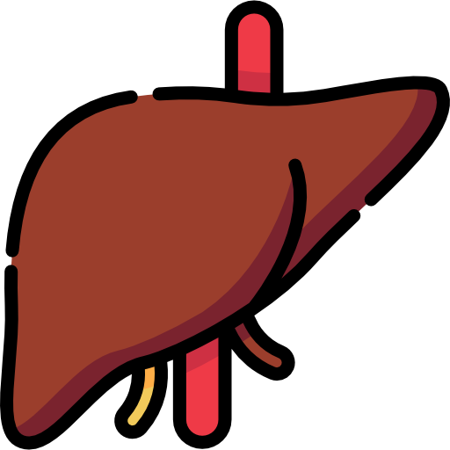
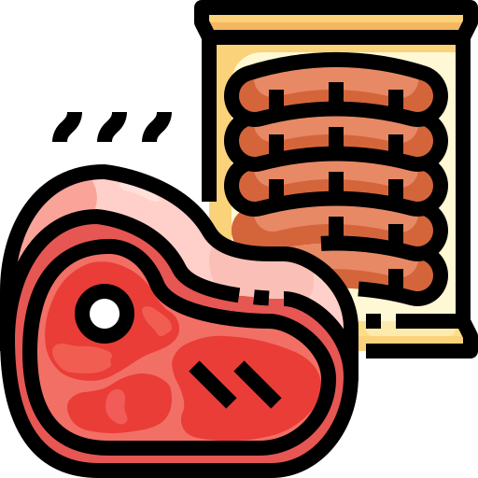
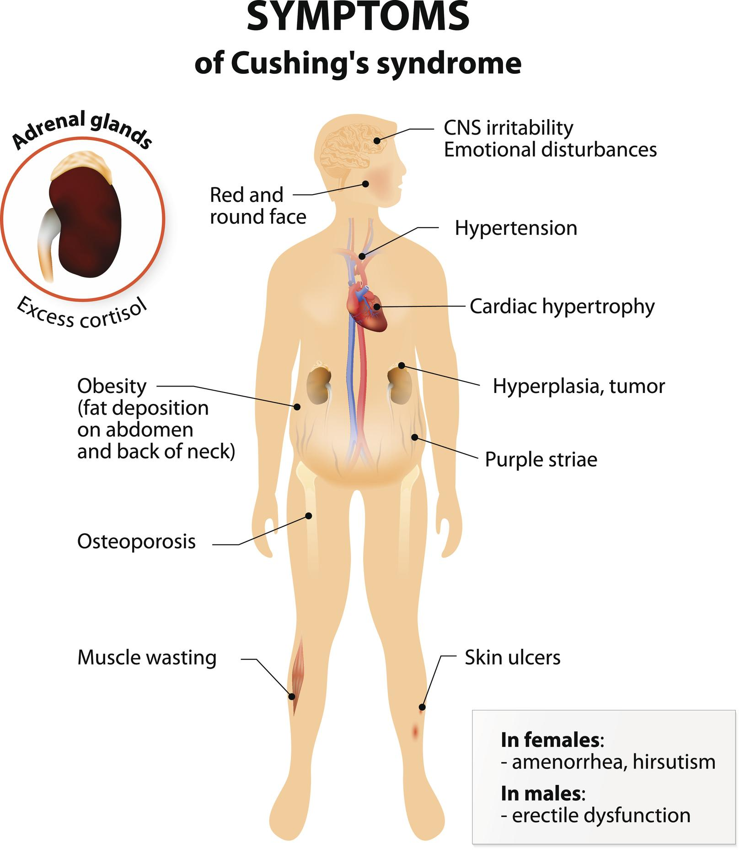
Serum Urea ( 2.5-6.6 mmol/L) in adult:
Note that the serum urea is higher than serum creatinine due to the unit mmol is higher than μmol
Urea is formed in the liver from ammonia released from deamination of amino acids.
Amino Acid
Ammonia
Urea
Ammonia has no charge, so it could defuse to the brain from BBB. Thus it’s harmful and should be converted to urea
As a kidney function test, serum urea is inferior to serum creatinine because:
High protein diet increases urea formation. Unlike creatinine
Any condition of high proteins catabolism (Cushing syndrome, diabetes mellitus, starvation, thyrotoxicosis)­ increase urea formation.
50 % or more of urea filtered at the glomerulus is passively reabsorbed by the renal tubules.

Slide 14
Normal values of Internal Chemical Environment controlled by the Kidneys:
Examples of other KFTs:
SODIUM | 135 to 145 mEq/L
POTASSIUM | 3.5 to 5.5 mEq/L
CHLORIDES | 100 to 110 mEq/L
BICARBONATE | 24 to 26 mEq/L
CALCIUM | 8.6 to 10 mg/dl
MAGNESIUM | 1.6 to 2.4 mg/dl
PHOSPHORUS | 3.0 to 5.0 mg/dl
URIC ACID | 2.5 to 6.0 mg/dl
pH | 7.4
CREATININE | 0.8 to 1.4 mg/dl
BUN (Blood Urea Nitrogen) | 15 to 20 mg/dl
Cystatin C.
Microalbumin.
β2-Microglobulin (11,800 Da).
Myoglobin (16,900 Da)
Numbers are not important
Remember that microalbumin means a small amount of Albumin not another type
Female’s Dr said: no number have to be memorized here
Male’s Dr said: This table is useful but you don’t need to memorize it

Slide 15
MCQs
Answers : Q1:B Q2:A Q3:C Q4:B Q5:C Q6:A
Q1/ which of the following is one of the kidney’s hormonal Functions:
A/ activation of vitamin C | B/ activation of vitamin D | C/ activation of vitamin B | D/ activation of vitamin A
A/ dysfunction of complete nephron | B/ impairment of glomerular function | C/ destruction of tubular functions | D/ vasoconstriction of afferent arteriole
A/ serum creatinine | B/ serum urea | C/ urea clearance | D/ creatinine clearance
Q2/ most types of renal diseases cause:
Q3/ which of the following is not used to measure kidney function:
Q4/ serum creatinine level in adults is :
A/ 0.5g - 2g | B/ 55-120 μmol/L | C/ 70 ml/min | D/ 55-120 mmol/L
A/creatinine is constant | B/ urea levels increase with high protein intake | C/serum urea is inferior to serum creatinine | D/ none
A/ liver | B/ kidneys | C/ muscles | D/ not formed endogenously
Q5/ serum urea is superior to serum creatinine As a kidney function test because:
Q6/ urea is formed in :

Slide 16
SAQs
Q1/ both serum Cr and creatinine clearance are used as kidney function test to?
Q2 / enumerate 4 requirements for accurate measurement of GFR by clearance tests
Q3 / enumerate the limitations of Cockcroft-Gault Formula .
Q1 1- confirm the diagnosis of renal disease.
2- give an idea about the severity of the disease.
3- follow up the treatment.
Q2 - Freely filtered at glomeruli.
Neither reabsorbed nor secreted by tubules.
ts concentration in plasma needs to remains constant throughout the period of urine collection.
Better if the substance is present endogenously
Easily measured.
Q3 serum creatinine is changing rapidly / The diet is unusual, e.g., strict vegetarian
Low muscle mass, e.g., muscle wasting / Obesity

Slide 17
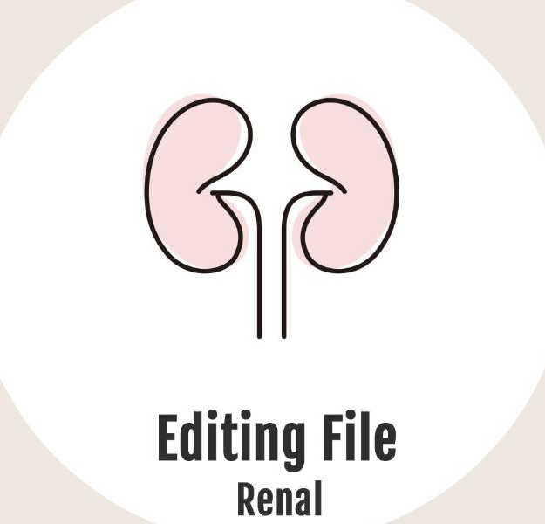
Our Team
Leaders
Team members
Raseel Alwehibi
Mashael Alsuliman
Hoor Aloraini
Nouf Aldhalaan
Fatima Halawo
Sara Alotaebe
Mohammed Ibn Saqyan
Abdulrahman Ateeq
Muhannad almuadi
Khaled Abdulaziz
Ahmad Almarshed
Ali Al-Jabaan
Abdul Rahman Al Qurashi
Abdullah Al Shehri
بقدر الكد تكتسب المعالي
ومن طلب العلا سهر الليالي
ومن رام العلى من غير كد
أضاع العمر في طلب المحال
تروم العز ثم تنام ليلا ؟
يَغُوصُ البحر من طَلَبَ اللآلي
محمد بن إدريس الشافعي
Biochemksumed442@gmail.com
Editing files

