Slide 1
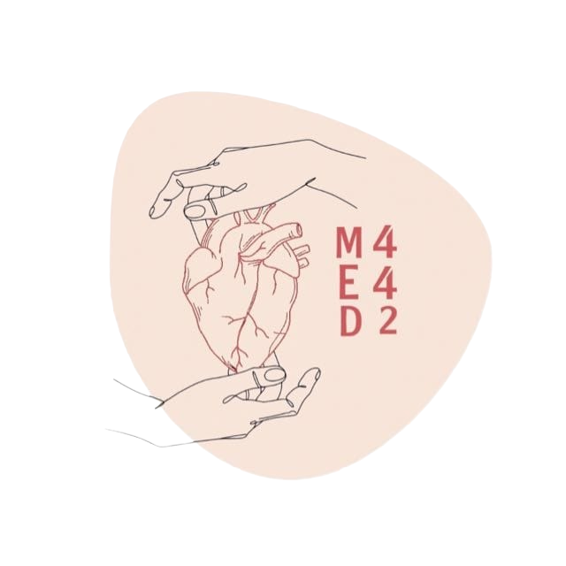
Chemical Examination of Urine
Color Index:
● Main text
● Important
● Notes
● Boys slides
● Girls slides
● Extra
Lecture number 3
Click here
for an amazing summary
by Shatha Almutib

Slide 2
objectives
Upon completion of this lecture, students should be able to:
Differentiate between normal and abnormal constituents of the urine including; Proteins, sugars, ketone bodies, nitrite, bile pigments, blood etc.
Know the clinical conditions in different types of proteinuria, hematuria and glycosuria etc.
To differentiate between pre-renal, renal and post-renal proteinuria with clinical examples of each

Slide 3
Overview
Boys slides
1
Introduction.
5
Glycosuria: fructosuria, galactosuria.
2
Normal composition of urine.
6
Ketonuria.
3
Abnormal composition of urine.
7
Hematuria: hemoglobinuria.
Pre- renal (multiple myeloma,not the kidney itself → it’s related to cardiovascular and circulatory system for example ).
4
Proteinuria:
Renal.
Post-- renal.

Slide 4
Urine
Urine is a fluid excreted by humans and most animals.
Normal urine excretion by a healthy person is about 1.5 L per day
It’s formed in the kidneys (renal glomeruli).
The fluid undergoes chemical changes before it’s excreted as urine.

Slide 5
Normal Composition of Urine
(Urine contains mainly of water about 95%, and solutes about 5%)
SAQ: list 3 organic and inorganic ?
Major inorganic constituents:
Major organic (contains carbon & hydrogen) constituents:
Non- protein nitrogen compounds (Urea, ammonia, creatinine).
Sodium.
Potassium.
Organic acids (compounds found as an intermediate in many pathways, e.g. uric acid..
Chloride.
Sugars (in very small amounts).
Small amounts of Ca, Mg, sulfur and phosphates.
Traces of proteins, vitamins, hormones, pigments (means very small need unique machine to be indicated).
Traces of Fe, Cu, Zn, I2.

Slide 6
Abnormal Composition of Urine
Normal urine contains small amount of protein:
< 200 mg/day.
Excretion of more than this level causes proteinuria
Proteinuria
Excretion of abnormal amounts in urine.
Proteinuria has three types:
Pre- renal.
Renal.
Post- renal.
Proteins

Slide 7
Pre-renal Proteinuria
1 | Some diseases or conditions increase plasma levels not involving the kidneys. (before reaching the kidneys)
2 | Causes increased filtration of these proteins in the kidneys.
3 | This exceeds the normal reabsorption capacity of renal tubules.
4 | Results in overflow of proteins in the urine.
5 | Multiple myeloma: Cancer (proliferative disorder) of antibody- producing plasma cells (keep in mind that antibodies are proteins). Causes pre-renal proteinuria.
6 | The serum contains elevated levels of light- chain monoclonal antibodies Bence-Jones protein.
7 | This protein is filtered in the kidneys in high amounts exceeding the tubular reabsorption capacity. Hence excreted in the urine.
8 | Bence-Jones protein coagulates (cloudy appearance) at 40-60 ℃ and dissolves at 100 ℃.
9 | Multiple myeloma cases are diagnosed by: Serum electrophoresis. Immunoelectrophoresis (Immunofixation).
Important to know that bence-jones protein is caused by multiple myeloma
The normal body produces several antibodies (immunoglobulin) G,M, & E). however, in case of multiple myeloma, only one immunoglobulin (IgG) is produced>
(The gold standard diagnostic method is a biopsy of the bone marrow).

Slide 8
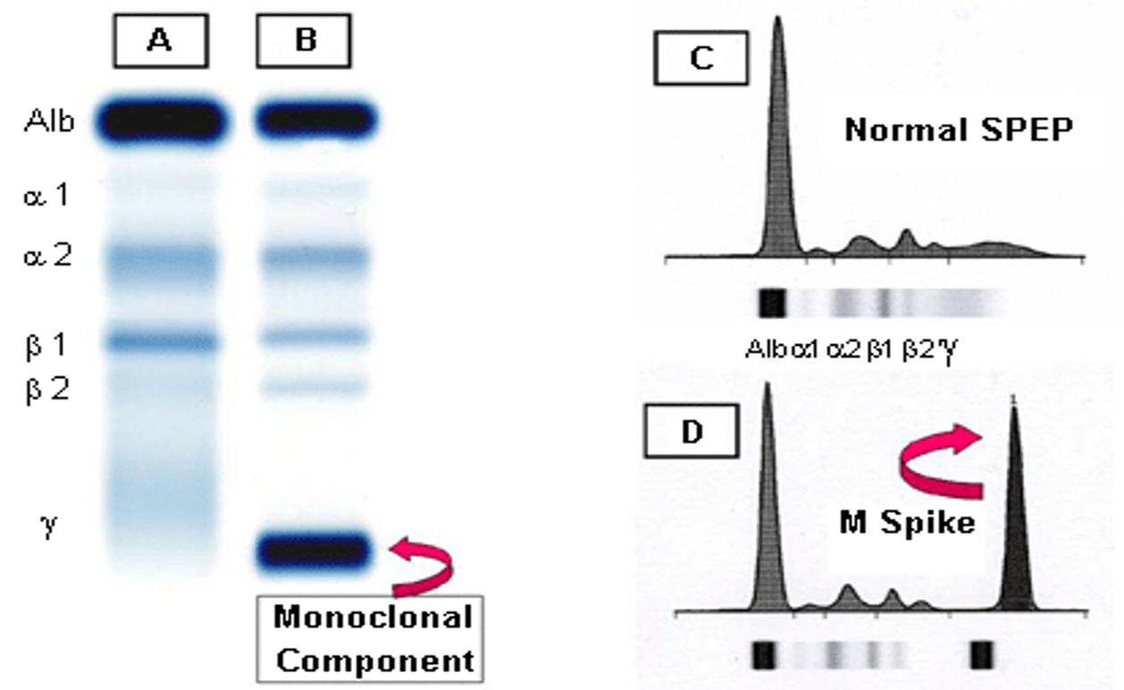
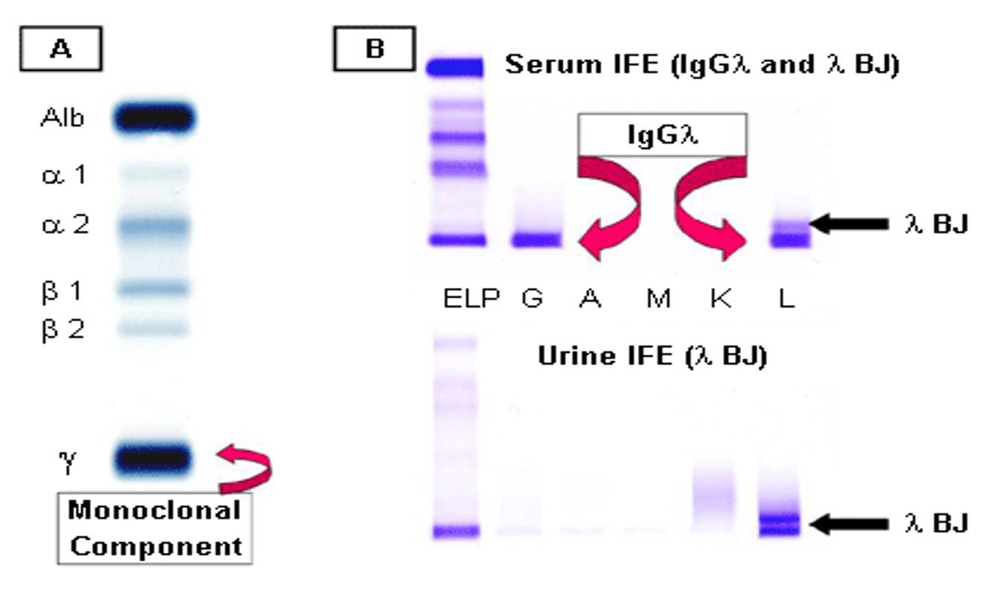
Pre-renal Proteinuria
Alb: Always stained in dark color since albumin is usually i high amounts
A: Normal serum
B: Multiple myeloma (M component in gamma region)
C: Densitometry of “A” showing the 5 zones of the high resolution agarose electrophoresis.
D: Densitometry of “B” (M component is called M Spike “M stands for monoclonal which s cancer”)
A: Serum protein electrophoresis showing the M component
B: Serum and urine immunofixation (the detection of immunoglobulins in serum or urine by adding an antigen to the antibody, and then precipitation occurs) electrophoresis

Slide 9
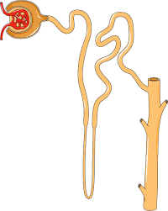
Renal proteinuria
This slide is important
Associated with renal diseases.
A) Glomerular proteinuria | B) Tubular proteinuria
High glomerular permeability causes filtration of high molecular weight proteins. Example: glomerulonephritis | Low tubular reabsorption with normal glomerular Permeability Causes excretion of low molecular weight proteins. Example: chronic nephritis
C) Orthostatic (postural) proteinuria | D) Microalbuminuria
Definition: A form of persistent benign or physiological proteinuria and occurs frequently in young adults. Due to: periods spent in a vertical posture (bodyposition) or during muscular exercise and disappears in horizontal posture. Pathogenesis: increased pressure on the renal vein in the vertical position . | Definition: Presence of small amounts of albumin in the urine 20–200 mg/L Normal range of albumin in urine (5-10 mg/day). Diagnosed by: special tests for detection such as nephrometry because it can’t be detected by ordinary urine testing like Electrophoresis. Early indicator of glomerular dysfunction. Due to: - Uncontrolled diabetes mellitus. - Hypertension.

Slide 10
Post-renal proteinuria
Ketonuria
Proteins are added to the urine after kidney filtration While passing through the lower urinary
tract (ureters, bladder, urethra, prostate, vagina).
Due to:
- Lower urinary tract infection most common .
- Trauma.
- Tumors.
- Stones.
The causes are very important
Under normal conditions our body use glycogen as an energy source. but once the glycogen reserve is over, fatty acids from adipose tissue will undergo β-oxidation to produce acetyl CoA. After that acetyl CoA will undergo chemical reactions to produce ketone bodies which can be used to make energy for many tissues in our body.
Presence of: ketones, acetone, acetoacetic acid and β-hydroxybutyric acid in urine.
(low glucose or carb in the body ketone bodies production from the liver as an energy source ) due to:
Diabetic ketoacidosis Unbalanced diet: high fat & Low CHO diet. Phenylketonuria (PKU)
Complication of type 1 diabetes inborn error of amino acid metabolism
Starvation Prolonged vomiting
Because your body start to breakdown fatty acids after consuming all the glycogen stores

Slide 11
glycosuria
This slide is important
Presence of sugar in urine.
The causes are very important
A) Glucosuria | B) Fructosuria | C) Galactosuria
Presence of: detectable amount of glucose in urine. | Presence of: fructose in urine. | Presence of: galactose in urine.
Cause: (causes are important)
1) Diabetes mellitus: - Plasma glucose level exceeds the renal threshold. Renal threshold for glucose is: 180 mg/dL. 2) Renal disease (renal glucosuria): - Normal plasma glucose level with proximal tubular malfunction.(it cannot reabsorb glucose back to the circulation) - Decreased renal threshold (so even someone with normal plasma glucose level can develop glucosuria) as observed in : Gestational diabetes “سكر الحمل” Fanconi’s syndrome ( inadequate reabsorption in the proximal renal tubules) | 1) Nutritional/Alimentary: - High fructose intake .(ex:juices،fruits ) 2) Metabolic: Low amount of one of these enzymes in the liver : - Fructokinase - Aldolase B | 1) Nutritional/Alimentary: - High galactose intake like drinking too much milk. 2) Metabolic: Low amount of one of these enzymes in the liver : - Galactokinase - Galactose-1-PO4 uridyl transferase

Slide 12
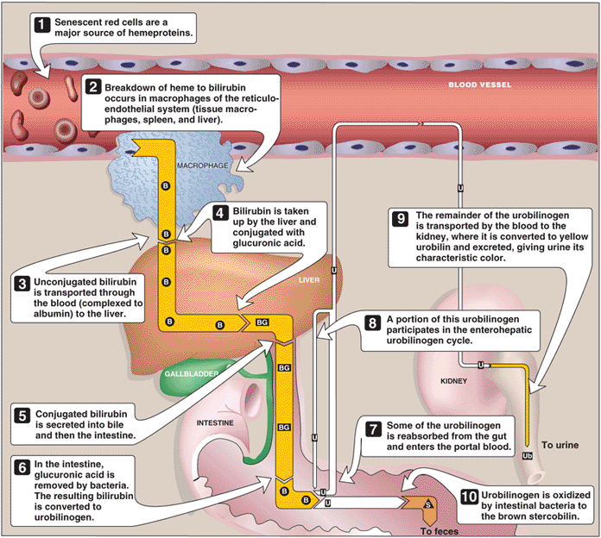
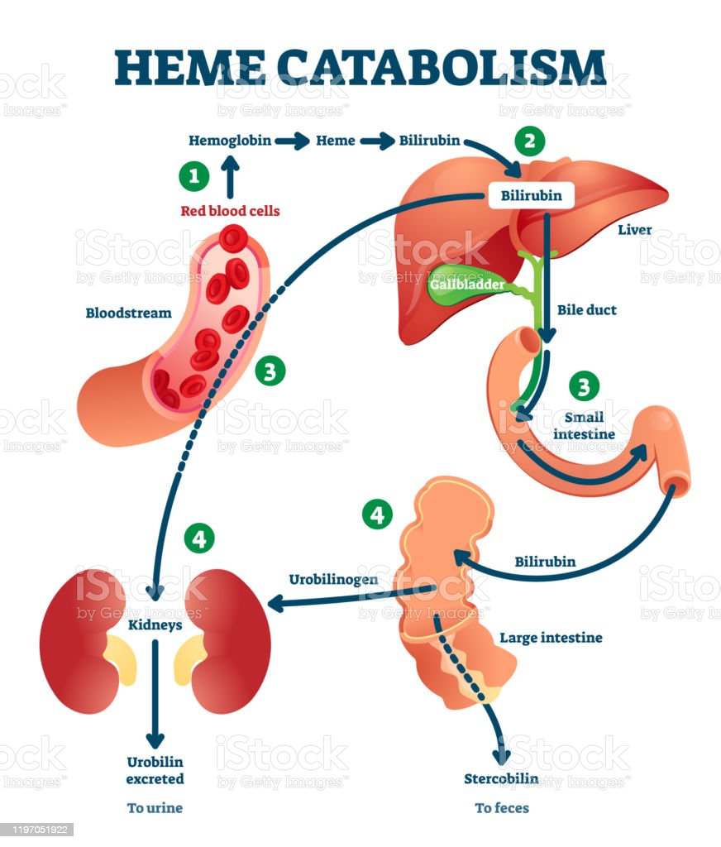
Catabolism of heme
Males dr: Not very important slide you will take it next year.
B = bilirubin; BG = bilirubin diglucuronide;
U= urobilinogen; Ub = urobilin; S = stercobilin.
Extra picture: this is what males dr mentioned about heme catabolism.
Bilirubin is water insoluble so it has to get processed in the liver

Slide 13
Choluria
Nitrites
The causes are very important
Presence of bile, bilirubin and bile salts in urine.
A) Bilirubin / Bile salts
normally no bilirubin is detected in urine.
(normally it goes from the liver to gallbladder and intestine, it shouldn’t be in the plasma and urine).
It is detected in:
Hepatocellular damage.
Obstruction of bile duct due to:
- stones (extrahepatic).
- hepatic tumors (intrahepatic).
(These conditions force bilirubin to go to kidneys and then seen in urine)
B) Urobilinogen
normally present in trace amounts.
(it gives as the color of the urine)
High urobilinogen is found in:
Hemolytic anemia ( destruction of RBCs
Bilirubin urobilinogen in urine ).
Hepatocellular damage.
Positive nitrite test indicates bacteria in urine (but negative test don’t exclude infection).
(Why? Because Nitrate reduction to nitrite is catalyzed by nitrate reductases (NAR) in the bacteria).

Slide 14
blood
 | Hematuria | Hemoglobinuria
Presence of : | Detectable amount of blood in urine (not ruptured). | Hemolyzed blood in urine (ruptured RBCs) (we can see hemoglobin)
Due to: | 1) Acute / chronic glomerulonephritis. 2) Local disorders of kidney and genitourinary tract : - Trauma. - cystitis. - Renal calculi. - Tumors. 3) Bleeding disorders : - Hemophilia. | 1) Hemoglobinopathies : - Sickle cell anemia. - Thalassemia. 2) Malaria (P. falciparum). 3) Transfusion reaction : - Blood group incompatibility.

Slide 15
MCQs
Q1 Multiple myeloma is diagnosed by:
A- Serum electrophoresis. | B- Immunofixation. | C- immunoelectrophoresis. | D- All of the above.
Q2 Multiple myeloma is characterized by the presence of which protein?
A- Bence- Jones. | B- Bonse- Jone. | C- Albumin. | D- A & B.
Q3 which of the following is not considered normal composition of urine?
A- Cl. | B- Uric acid. | C- Albumin. | D- none of the above.
Q4-B Q5-D Q6-A
Answers : Q1- D Q2- A Q3- C
Q4 which of the following is a cause of ketonuria?
A- Galactokinase deficiency. | B- Diabetic ketoacidosis. | C- Hemophilia. | D- Fanconi’s syndrome
Q5 in case of high bilirubin which of the following could be the cause?
A- infection. | B- Gestational diabetes. | C- Starvation | D- Hepatocellular damage.
Q6 The presence of hemolyzed blood in urine is known as?
A- Hemoglobinuria. | B- Hematuria. | C- Galactosuria. | D- ketonuria.

Slide 16
SAQs
Q1 Name the composition of normal urine and 3 examples of each one.
Q2 Which disease causes pre-renal proteinuria?
Q3 list the causes of fructosuria.
Q1 slide 5
Q2 Multiple myeloma
Q3 slide 11

Slide 17
Our Team
Leaders
Team members
Raseel Alwehibi
Mashael Alsuliman
Hoor Aloraini
Nouf Aldhalaan
Fatima Halawo
Sara Alotaebe
Mohammed Ibn Saqyan
Abdulrahman Ateeq
Muhannad almuadi
Khaled Abdulaziz
Ahmad Almarshed
Ali Al-Jabaan
Abdul Rahman Al Qurashi
Abdullah Al Shehri
سهري لتنقيح العلوم ألذ لي
من وصل غناية وطيب عناق
وتمايلي طربا اًلحل عويصةٍ
أشهى وأحلى من مدامة ساقي
وصرير أقلامي على أوراقها
احلى من الدوكاء و العشاق
أأبيت سهران الدجى وتبيته
نوما وتبغي بعد ذاك لحاقي الزمخشري
Biochemksumed442@gmail.com
Editing files

