Slide 1
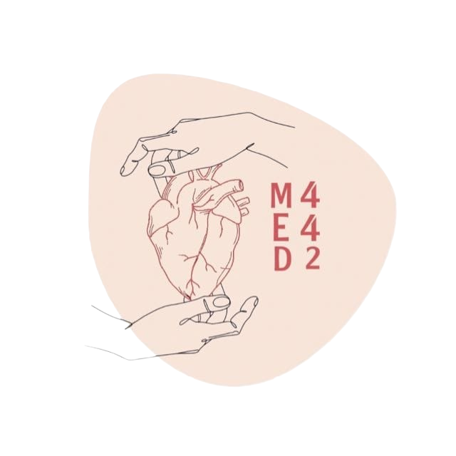
Inborn Errors of Amino Acid Metabolism
Color Index:
● Main text
● Important
● Notes
● Boys slides
● Girls slides
● Extra
Lecture Number 4

Slide 2
objectives
There are no objectives from 2022 slides

Slide 3
Normal Pathway of Phenylalanine / Tyrosine
1
PKU
2
Albinism
Phenylalanine
Phenylalanine hydroxylase (PAH)
Tyrosine
Tyrosinase
DOPA
3
(BH₄)
Tetrahydrobiopterin
(BH₂)
Dihydrobiopterin
Tyrosinase
(BH₄)
Tetrahydrobiopterin
(BH₂)
Dihydrobiopterin
p-Hydroxyphenyl pyruvate
2A
2B
DOPAquinone
Dopamine
BH₄ is a cofactor for the enzyme PAH
It is also used in the synthesis of Serotonin from Tryptophan
Homogentisic acid (HA)
leuco DOPA
chrome
Norepinephrine
Homogentisic acid oxidase
Alkaptonuria
DOPAchrome
Epinephrine
Maleylacetoacetic acid
(BH₄)
Tetrahydrobiopterin
(BH₂)
Dihydrobiopterin
Melanin
Fumarate
Acetoacetate
Tryptophan
Serotonin
TCA cycle
(citric acid cycle)

Slide 4
Inborn Errors of Amino Acid Metabolism
Disease of inborn errors of amino acid metabolism.5
It’s Caused by enzyme loss or deficiency due to
gene loss or gene mutation
Enzyme or Cofactors deficiency lead to product deficiency and substrate accumulation.
Cofactor
Enzyme + Substrate Product
Excess Deficient
Homocystinuria
Phenylketonuria (PKU)
Maple Syrup Urine Disease
Albinism
Alkaptonuria
Due to deficiency of phenylalanine hydroxylase enzyme
Due to deficiency of branched α chain
Due to tyrosinase deficiency
Due to defects in homocysteine metabolism
Due to deficiency of homogentisic acid oxidase

Slide 5
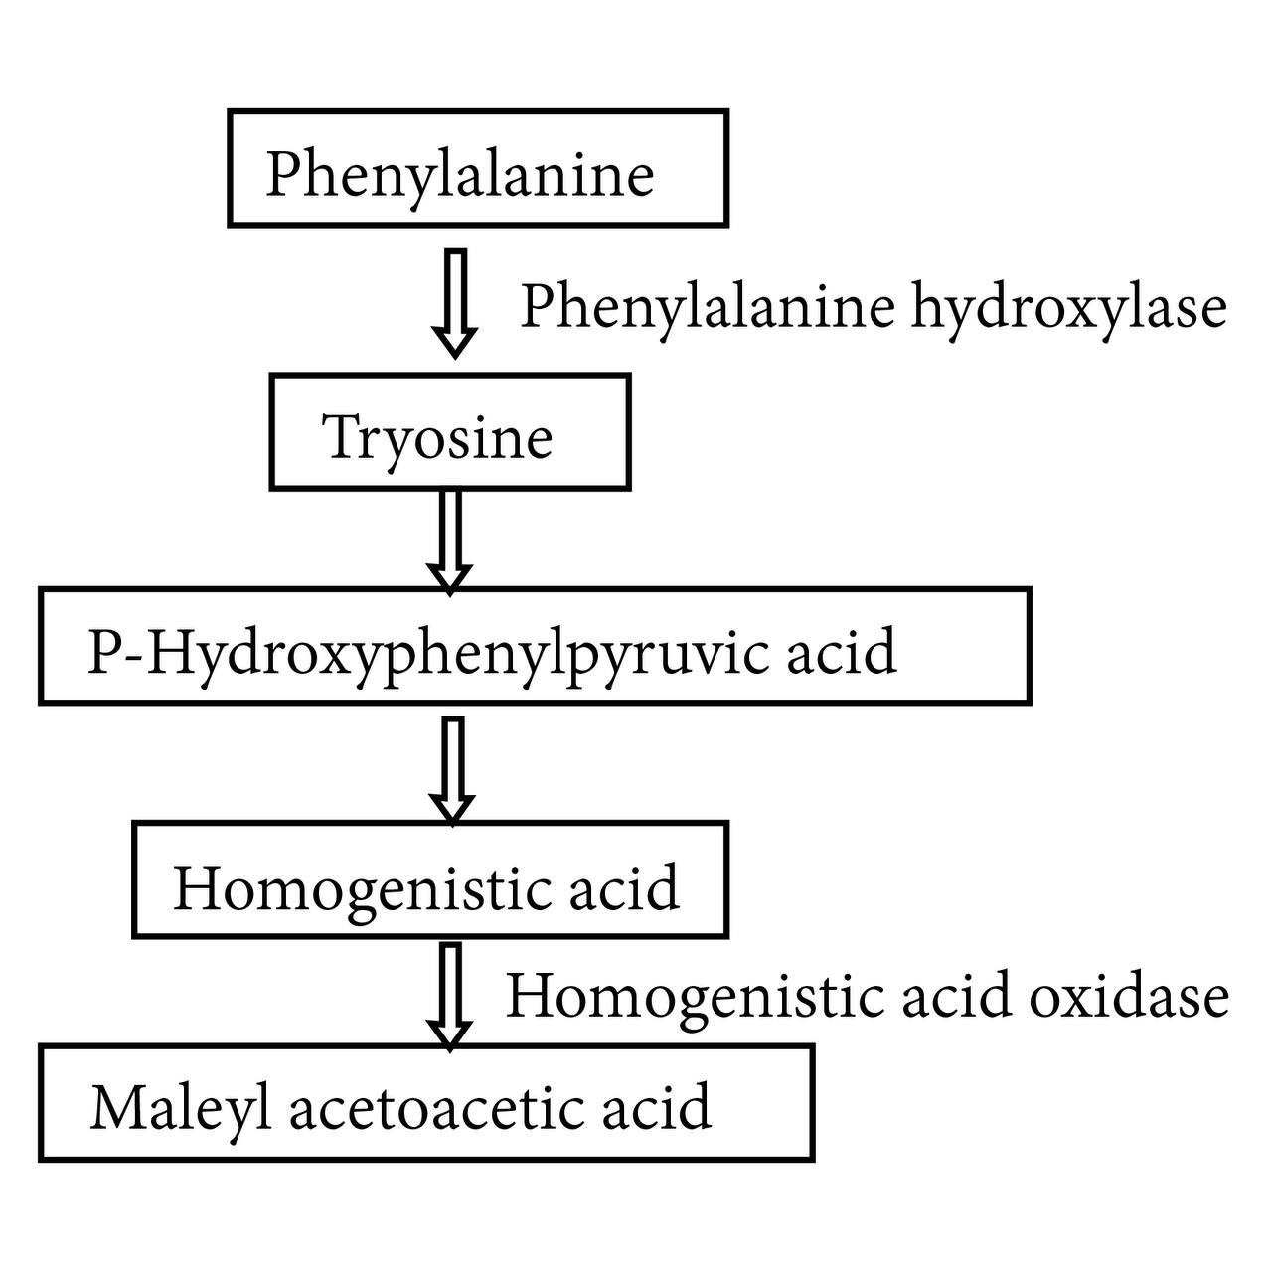
Phenylketonuria (PKU)
Most common disease of amino acid metabolism
Due to deficiency of phenylalanine hydroxylase enzyme
Results in hyperphenylalaninemia
1-Classical PKU
To convert from phenylalanine into Tyrosine we need phenylalanine hydroxylase and its cofactor
If there is deficiency in the enzyme it’s Classic PKU
If there is deficiency in Co factor it’s Atypical PKU
Important to know even the enzyme normal and the deficiency in cofactor the reaction will NOT happen
Accumulated
The enzyme (deficient)
Deficient

Slide 6
2-Atypical hyperphenylalaninemia
Due to deficiency of BH4 Caused by the deficiency of:
Dihydropteridine reductase
Dihydrobiopterin synthetase
pterin-4a- Carbinolamine dehydratase
2
1
Even if phenylalanine hydroxylase level is normal
Conversion of Phe to Tyr requires tetrahydrobiopterin (BH4)
3
The enzyme will not function
without BH
Hence phenylalanine is accumulated
4
Enzyme + Substrate Product
Cofactor
phenylalanine hydroxylase Phenylalanine BH4 Tyrosine
-
Accumulate
Deficient

Slide 7
Melanin
Catecholamine
No or less Tyrosine
Tyrosine
Epinephrine
Tyrosine
If I don’t have Tyrosine the results I will not have Melanin
As well as if I don’t BH4 I will not have Malenin
Tetrahydrobiopterin
O2
If I don’t have Tyrosine I will not have Catecholamine
If I don’t have BH4 I will not have Catecholamine
To convert from Tyrosine into Catecholamine we need The Cofactor(BH4) so here there is deficiency in BH4 the results I will not get Catecholamine
Dopa
Dihydrobiopterin
H2O
DOPAquinone
3,4-Dihydroxyphenylalanine (Dopa)
Norepinephrine
LeucoDOPAchrome
No or less Melanin
Light skin in PKU patients
Dopamin
DOPAchrome
Melanin
Serotonin
So we need to know If I don’t have BH4
I will NOT have
Tyrosine
Neurotransmitter (Catecholamine)
Serotonin
Melanin
To convert from Tryptophan into serotonin we need BH4
If I don’t have BH4 I will not have serotonin
Tryptophan
Tryptophan hdroxylase
5-Hydroxytryptophan
Petrine-4a-
carbinilamine
Tetrahydrobiopterin
+
O2
If I don’t have Tyrosine I will NOT have
Melanin
Catecholamine
Serotonin

Slide 8
Characteristics of PKU
Phe will not be converted to Tyr
Tyr will not be converted to catecholamine neurotransmitters ,Synthesis of catecholamines requires BH4
Tryptophan will not be converted to serotonin (a neurotransmitter) as it requires BH4
In the absence of BH4
Elevated phenylalanine in tissues, plasma,urine (because it’s accumulated)
Phe is degraded to phenyllactate, phenylacetate, and phenylpyruvate(phenylalanine it will find another pathways to convert into,they are toxic compounds)
These compound will Give urine a mousy odor
In case if Phe
elevated

Slide 9
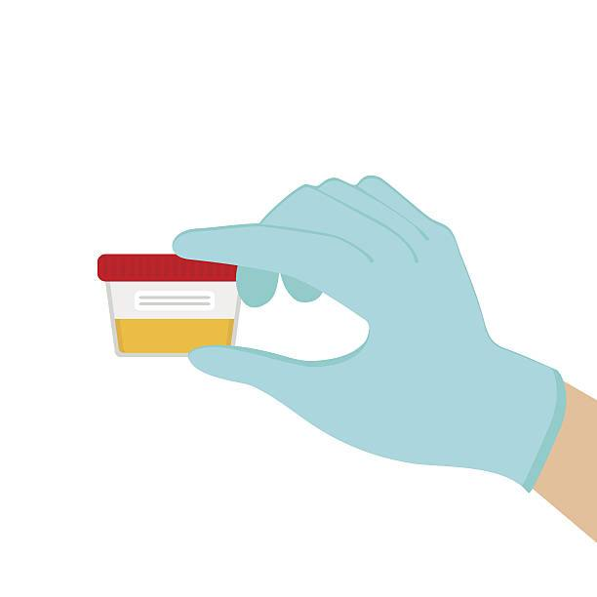
Characteristics of PKU
CNS symptoms : (because there is no neurotransmitter)
Mental retardation
failure to walk or talk
seizures
Hypopigmentation (no Melanin)
There is 2 cause of hypopigmentation
Deficiency of melanin(because there is deficiency in Tyrosine the result melanin won’t form)
Hydroxylation of tyrosine by tyrosinase is
inhibited by high phenylalanine concentration .
(If I have a lot of phenylalanine it will inhibit Tyrosinase this is the enzyme we need to convert neurotransmitter and melanin)
Urine
Mousy door
Diagnosis
Prenatal (before birth) | detecting gene mutation in fetus
Neonatal (in infants) | measuring blood phenylalanine levels
Treatment
Life long phe-restricted diet

Slide 10
Maple Syrup Urine Disease
Due to deficiency of branched chain α-ketoacid dehydrogenase
The enzyme decarboxylates leucine, isoleucine and valine
These aa accumulate in blood
Symptoms: mental retardation, physical disability, metabolic acidosis, etc.
The disease is characterized by Maple syrup odor in the urine
unlike the PKU that has a mousy odor
Types of MSUD
Classic type | Intermediate and intermittent forms | Thiamin-responsive form
Most common, due to little or no activity of α-ketoacid dehydrogenase | Some enzyme activity, symptoms are milder | High doses of thiamin increases α-ketoacid dehydrogenase activity

Slide 11
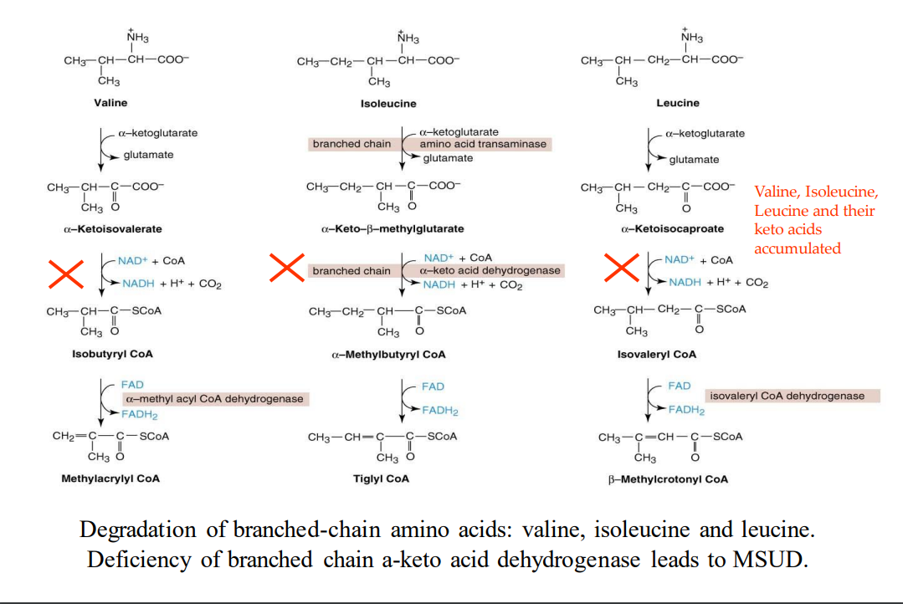
Step 1 is the removal of the amino group. after this removal, we are left with Keto acids
Step 2 Then, it should be decarboxylated by the enzyme " a-keto acid dehydrogenase " which is deficient in MSUD
Treatment of MSUD :
Limited intake of leucine, isoleucine and valine

Slide 12
Albinism
مرض المهق ويختلف عن البهاق
A disease of tyrosine metabolism
Tyrosine is involved in melanin production
Melanin is a pigment of hair, skin, eyes
Due to tyrosinase deficiency
Melanin is absent in albino patients
Symptoms of Albinism :
Hair and skin appear white
Vision defects
photophobia

Slide 13
Albinism
Tyrosinase
Tetrahydrobiopterin (BH4)
dihydrobiopterin (BH2)
Tyrosinase
Deficiency of “tyrosinase” leads to albinism
Melanin

Slide 14
Homocystinuria
Due to defects in homocysteine metabolism
Deficiency of cystathionine β-synthase
Converts homocysteine to cystathione
High plasma and urine levels of homocysteine
High plasma homocysteine is a risk factor for :
atherosclerosis and heart disease
Skeletal abnormalities, osteoporosis, mental retardation, displacement of eye lens

Slide 15
pathway explanation :
Methionine degradation pathway
1.methionine is converted to homocysteine in several steps
Vitamin B12
Methionin
THF
2. homocysteine in normal will converted to cystathionine by enzyme " cystathionine B-synthase” and its cofactor (Vit B6)
S-Adenosyl methionine
Methionine synthase
3. if there is deficiency in this enzyme the homocysteine wil converted back to methionine by "methionine synthase” and its cofactors (vit B12) +(tetrahydrofolate,THF) and folic acid and cycle will keep going on.
Homocysteine
S- Adenosyl Homocysteine
Vitamin B6
Cystathione B-synthase
Deficiency of cystathione β-synthase leads to hyperhomocystinuria / hyperhomocysteinemia
so, as you see, methionine and its metabolites accumulated and the final product that we want will be deficient (cystine)
Cystathionine
Cysteine

Slide 16
Homocysteinemia
Hyperhomocysteinemia is also associated with:
Neural tube defect (spina bifida)
Vascular disease (atherosclerosis)
Heart disease
Treatment:
Oral administration of vitamins B₆, B₁₂ and folate
Vitamin B₆ is a cofactor for cystathionine β-synthase
Methionine-restricted diet
The co-factors are important

Slide 17
Alkaptonuria
A rare disease of tyrosine degradation
Due to deficiency of homogentisic acid oxidase
Homogentisic acid is accumulated in tissue and cartilage
Homogentisic aciduria: elevated homogentisic acid in urine
Characteristics of Alkaptonuria :
Homogentisic acid is oxidized to dark pigment in urine over time
Arthritis, black pigmentation of cartilage and tissue
Usually asymptomatic until adulthood

Slide 18
Alkaptonuria
Degradation of tyrosine
Tyrosine
Treatment :
Restricted intake of tyrosine and phenylalanine reduces homogentisic acid and dark pigmentation
P-hydroxyphenyl pyruvate
Homogentisic acid
Homogentisic acid oxidase
Deficiency of homogentisic acid oxidase leads to alkaptonuria
Maleylacetoacetic
Fumarate
Acetoacetate
TCA cycle
(citric acid cycle)

Slide 19
Summary
Disease | Substrate | Deficiency | Symptoms
PKU | Phenylalanine | Enzyme Phenylalanine hydroxylase | Phenylalanine accumulation + Tyrosine deficiency, CNS symptoms, Hypopigmentation & melanin deficiency, Mousy odor of urine
 |  | CoFactor Tetrahydrobiopterin (BH₄)
Albinism | Tyrosine (or DOPA) | Tyrosinase | White hair, skin, eyes, Vision defects, Photophobia
Alkaptonuria | Homogentisic acid (HA) | Homogentisic acid oxidase | Pigmentation of urine, cartilage, and tissue.
MSUD | Leucine, isoleucine and valine | Branched chain α‐ketoacid dehydrogenase

Slide 20
MCQs
Q1 )All of these are required for BH4 synthesis except:
Dihydropteridine reductase | B) Dihdropyridine dehydrogenase | C) Dihydrobipterin synthase | D) carbonolamine dehydratase
Q2) In case of atypical phenylketonuria, which one will not be deficient:
Tyrosine | B) Cystine | C) Neurotransmitter | D) Serotonin
Q3) Which amino acid won’t be affected by maple syrup urine disease:
Cystine | B) valine | C) Isoleucine | D) Leucine
B B A
Answers : Q1 Q2 Q3

Slide 21
MCQs
Q4)In absence of BH4, phenylalanine will not convert into :
A)Chatecholamine | B)Serotonin | C)Tryptophan | D)Tyrosine
Q5) Methionine-restricted diet is treatment of:
A) Homocystinuria | B) MSUD | C)Albinism | D)Alkaptonuria
Q6) someone who suffers from photophobia he has:
A)Albinism | B)Homocystinuria | C)MSUD | D)PKU
Answers : Q4 D Q5 A Q6 A

Slide 22
MCQs
Q7) Which enzyme is deficient in homocystinuria :
Tyrosine | B) BH4 | C) Homogentisic acid oxidase | D) Cystathionine beta synthase
Q8) which of the following is caused by tetrahydrobiopterin deficiency :
PKU | B) albinism | C) maple syrup urine disease | D) carbinolamine dehydratase
Q9)Which enzyme is deficient in Albinism :
Tyrosinase | B) Branched chain alpha ketoacid dehydrogenase | C) Phenylalanine hydroxylase | D) Dihydropteridine reductase
Answers : Q7 Q8 Q9
D A A

Slide 23
SAQs
Q1 In PKU phenylalanine is degraded to:
Q2 what is treatment of phenylketonuria:
Q3 A patient recently suffered from arthritis and in the past he noticed his earlobes becoming slightly blackish in color what’s your diagnosis? What’s the enzyme that’s most probably deficient?
Q1 phenyllactate, phenylacetate, phenylpyruvate
Q2 ph-restricted diet
Q3 Alkaptonuria , Homogentistic acid oxidase.

Slide 24
Our Team
Leaders
Team members
Raseel Alwehibi
Mashael Alsuliman
Hoor Aloraini
Nouf Aldhalaan
Fatima Halawi
Sara Alotaebe
Mohammed Ibn Saqyan
Abdulrahman Ateeq
Muhannad al-muadi
Khaled Abdulaziz
Ahmad Almarshed
Ali Al-Jabaan
Abdul Rahman Al Qurashi
Abdullah Al Shehri
تركُ النفوس بلا علم ولا أدب
كترك المريض بلا طب ولا آسِ
أحمد شوقي
Special thanks to the amazing team 439
Biochemksumed442@gmail.com
Editing files

