Slide 1
1
Development of the Kidneys & Ureters
____________
Renal Block
Editing File
Color Index:
Main Text
Male’s Slides
Female’s Slides
Important
Doctor’s Notes
Extra Info

Slide 2
Objectives
Identify the embryological origin of kidneys & ureters.
Differentiate between the 3 systems of kidneys during development.
Describe the development of collecting & excretory parts of permanent kidney.
Describe the fetal kidney & identify the pre- and postnatal changes that occur in the kidney.
Enumerate the most common anomalies of kidneys & ureters.
Click Here for the Team’s Summary!

Slide 3
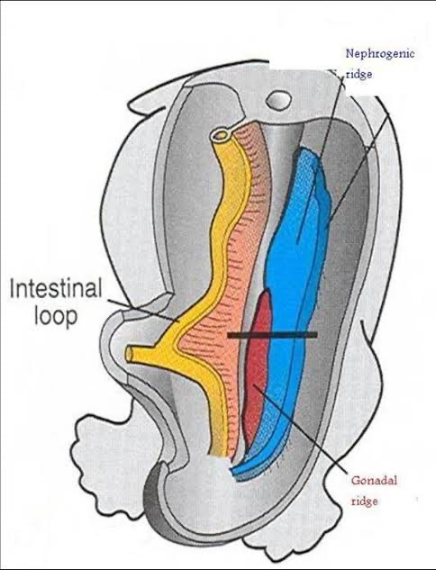
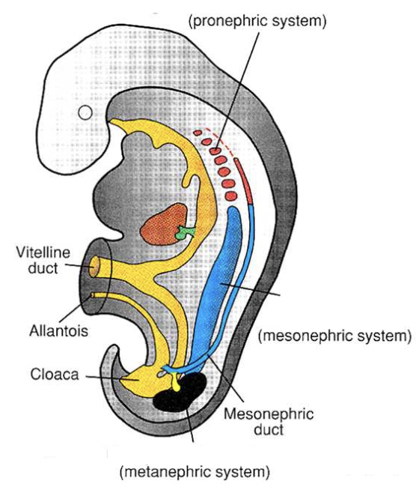
1
Development Of kidney
The Embryological origin of Renal system: intermediate mesoderm .
Differentiates into:
1- Nephrogenic ridge (cord): forms kidneys & ureters
2- Gonadal ridge: forms gonads (testes or ovaries)
- appears at beginning of 4th week in cervical region
- analogous to kidney of fish
- formed of tubules & a duct
- not function in human
- disappears
- appears at end of 4th week in thoracic & abdominal regions
- analogous to kidney of amphibians
- formed of tubules & a duct
- function temporarily
-The duct: In male: forms genital duct
- In both sexes: forms ureteric bud
- appears at 5th week in pelvis
- starts to function at 9th week
Three Systems of Kidney Develops:
1
Pronephric System:
2
Mesonephric System:
3
Metanephric system:
Notes:
Cant find first pic in a good quality

Slide 4
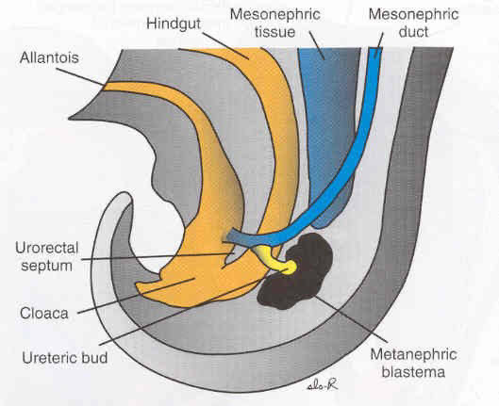
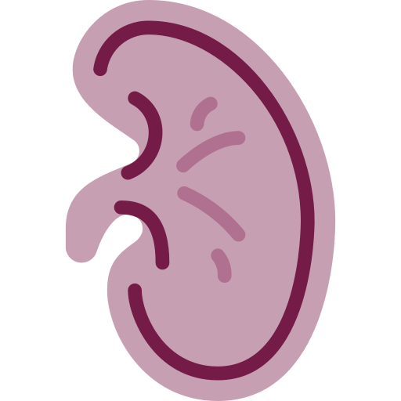
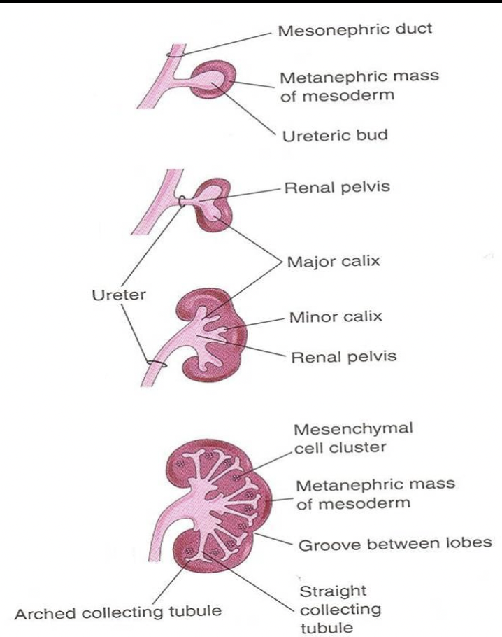
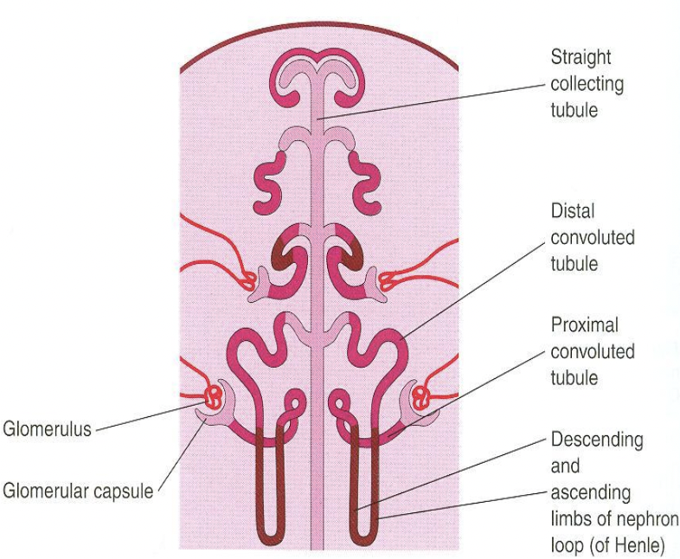
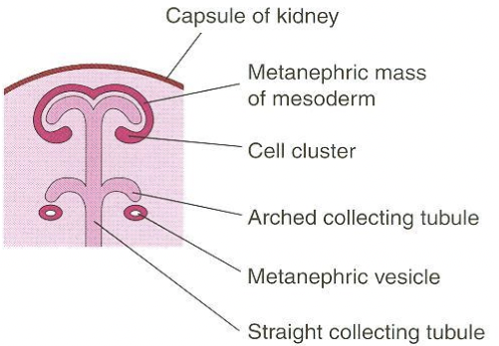
2
Metanephrons (Permanent Kidney )
Formed of 2 Origins
1-Ureteric Bud:
derived from mesonephric duct,
it gives
Collecting Part of the Kidney:
1- Ureteric bud elongates & penetrates metanephric mass.
2- Stalk of ureteric bud forms ureter & its cranial end forms renal pelvis.
3- Branching of renal pelvis gives 3 major calyces. Branching of major calyces gives minor calyces.
4- Continuous branching gives straight & arched collecting tubules
2-Metanephric Blastema (Mass):
derived from nephrogenic cord,
it gives;
Excretory Part of the Kidney:
-Each arched collecting tubule is surrounded by a cap of metanephric mass forms (metanephric vesicle).
-The metanephric vesicle elongates to form an S-shaped metanephric tubule.
-The end of each tubule forms Glomerular (Bowman’s) capsule.
-Each glomerular capsule is invaginated by capillaries (Glomerulus).
-The tubule lengthens to form: Proximal & Distal convoluted tubules + Loop of Henle
The Nephron: (Functional Unit of Kidney)
Formed by fusion of:
1-Excretory tubule (from metanephric mass (cap).
2-Arched collecting tubule (from ureteric bud).
-At Full Term: each kidney contains: 800,000 – 1,000,000 nephrons

Slide 5
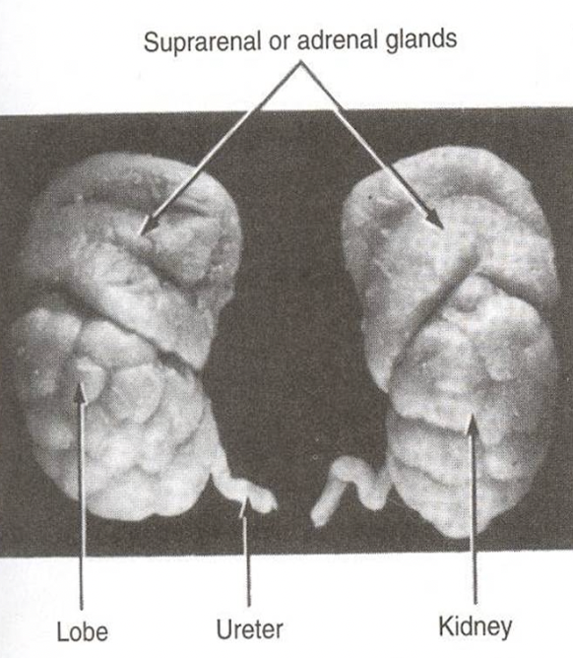
3
Changes Of The Kidney
1
During Development:
(By 9th week)(Before birth)
-Change in position: The kidney ascends from pelvis to abdomen & attains its adult position, caudal to suprarenal gland.
-Change in blood supply: As the kidney ascends, its blood supply changes from renal branches of common iliac arteries into renal branches of abdominal aorta.
-Rotation: Initially, hilum (site of entry & exit of vessels & nerves) is ventral then rotates medially about 90° & becomes medial.
2
The Fetal kidney:
Glomerular filtration begins at 9th week.
At 9th week, kidney attains its adult position & receives its supply from renal artery, Abdominal aorta & its hilum is rotated medially.
Kidney is subdivided into lobes that are visible externally, Lobulation diminishes at the end of fetal period (Criteria of fetal kidney).
Nephron formation is complete at birth.
3
After Birth:
1) Increase in size: due to elongation of tubules and increase in connective tissue
between tubules (not due to increase in number of nephrons).
2) Disappearance of kidney lobulation.

Slide 6
4
Congenital Anomalies
1
Pelvic kidney: failure of ascent of one kidney (ureter is short)
Horseshoe kidney: the poles of both kidneys (usually the lower poles) fuse: the kidneys have a lower position than normal but have normal function
2
3
Unilateral renal agenesis: due to absence of one ureteric bud
4
Supernumerary kidney: due to development of 2 ureteric buds
5
Right Side: malrotation of kidney
Left Side: bifid ureter & supernumerary kidney
1
2
3
4
5

Slide 7
Summary
Important
Kidneys & ureters origin:
from nephrogenic ridge (cord) of intermediate Mesoderm.
During development, 3 systems appear:
1) Pronephric: in cervical region, not function.
2) Mesonephric: in thorax & abdomen, function temporarily, mesonephric duct gives ureteric bud.
3) Metanephric: in pelvis, permanent kidney.
Ureteric bud gives:
ureter + collecting part of kidney (calyces, straight & arched collecting tubules).
Metanephric mass gives:
excretory part of kidney (Bowman capsule, proximal & distal convoluted
tubules, loop of Henle).
By 9th week:
1) Glomerular filtration begins.
2) Kidney attains its adult position.
3) Kidney receives its arterial supply from aorta.
4) Kidney completes rotation.
At full term:
1) Nephron formation is complete.
2) Lobulation of kidney diminishes.
After birth:
1) Lobulation of kidney disappears.
2) Kidney increases in size due to elongation of existing tubules not due to increase in number of nephrons.

Slide 8
Quiz
Q1: Which one of the following events happens by 9th week?
A- Nephron formation is complete | B-Disappearance of kidney lobulation | C- Kidney attains its adult position | D- Metanephric system appears
Q2: Which one of the following structures is a derivative of the ureteric bud?
A- Major calyces | B- Loop of Henle | C- Glomerulus | D- Proximal convoluted tubule
Q3: At which of these does the pronephric system appear?
A- 3rd week | B- 4th week | C- 5th week | D- 9th week
Q4: Which one of the following congenital anomalies is due to the absence of the ureteric bud?
A- Horseshoe kidney | B- Renal agenesis | C- Bifid ureter | D-Supernumerary kidney
Q5: What is the Embryological origin of Renal system?
A- Lateral mesoderm | B- paraxial mesoderm | C- intermediate mesoderm | D- embryonic ectoderm
Q6: Which of the following comes from the blastema?
A- Minor calyces | B- Pelvis | C- Bowman's capsule | D- Ureter
Answers: 1.C 2.A 3.B 4.B 5.C 6.C

Slide 9
Members Board
Team Leaders
Mohammad AlRashed
Najla AlDhbiban
Team Members
Faisal AlOmar
Mishal AlSuwayegh
Abdullah AlSalem
Saud AlTaleb
Abdullah AlNajres
Feras AlMasoud
Abdulkarim Salman
Mayssam AlJaloud
Fatima Halawi
Ghada BinSlimah
Nouf AlDalaqan
Shaden AlBassam
Maha AlKoryshy
Rahaf AlMotairi
Haifa AlAmri
Alhnouf AlYami

