Slide 1
2
Development of Bladder and Urethra
____________
Renal Block
Editing File
Color Index:
Main Text
Male’s Slides
Female’s Slides
Important
Doctor’s Notes
Extra Info

Slide 2
Objectives
Describe the cloaca and the formation of the urogenital sinus.
Discuss the division of the urogenital sinus into various parts and name the adult organs that are derived from each part.
Describe how the caudal parts of the mesonephric ducts and ureter are absorbed into the urogenital sinus and the significance of this embryonic event.
Discuss the position of the urachus and its significance and fate.
Describe the various anomalies concerned with the urinary bladder and urethra.
Click Here for the Team’s Summary!
We Highly Recommend you watch this video before studying this lecture!

Slide 3
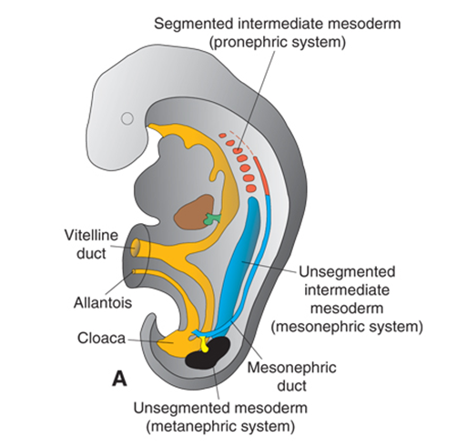
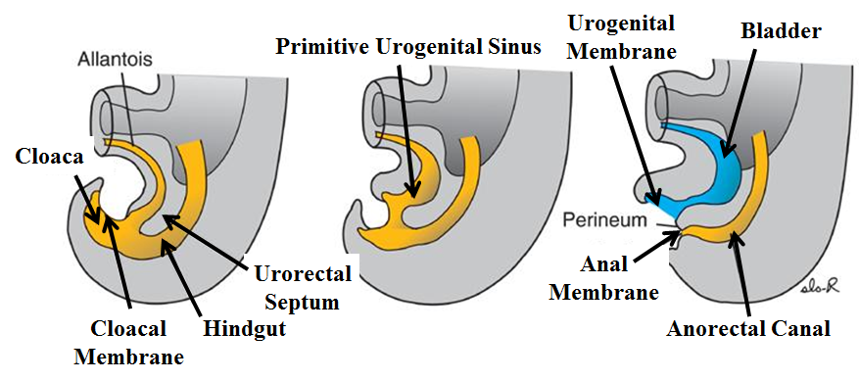
1
Cloaca
The cloaca is the dilated terminal part of the hind gut.
It is endodermal–lined cavity; developed from endoderm.
It receives the allantois and the mesonephric ducts. (one on each side)
Allantois
Its floor is closed by the cloacal membrane.
Cloaca
Mesonephric Duct
Cloacal Membrane
A mesodermal urorectal septum divides the cloaca and the cloacal membrane into:
Ventral Part
Dorsal Part
1
the primitive urogenital sinus that communicates with the allantois and the mesonephric ducts.
1
the anorectal canal that forms the rectum and upper part of anal canal.
2
Its ﬂoor is the urogenital membrane.
2
Its floor is the anal membrane.
Primitive Urogenital Sinus
Urorectal Septum
Anal Membrane
Anorectal Canal
Primitive Urogenital Sinus
Divided into 3 parts
A Cranial; Vesical Part:
forms most of the bladder and continuous with the allantois
2
1
Middle; Pelvic Part:
forms main part of male urethra and entire female urethra.
Caudal; Phallic Part:
grows towards genital tubercle and shares in the formation of the male urethra.
3
Vesical
Pelvic
Phallic

Slide 4
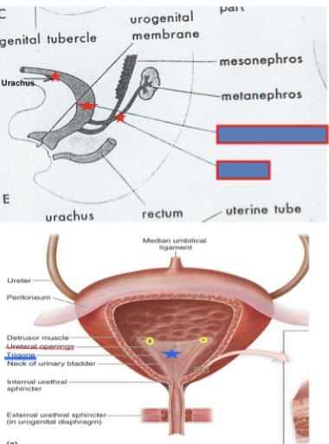
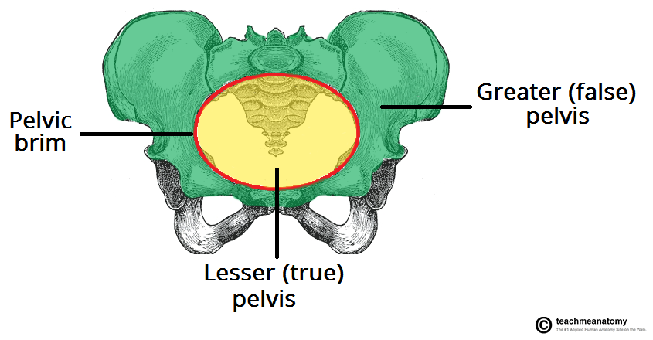
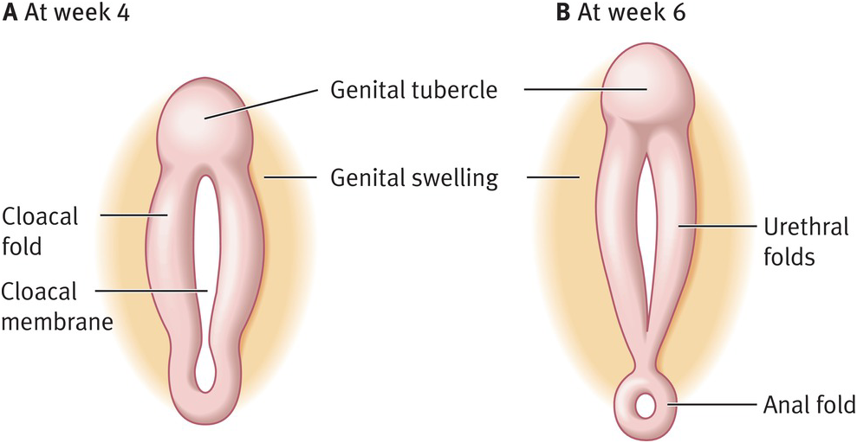
2
Urinary Bladder
It develops mainly from the vesical part of the urogenital sinus.
The trigone is derived from the absorbed (caudal ends) proximal part of the mesonephric ducts.
The epithelium is endodermal in origin, of the urogenital sinus.
Urinary Bladder
Ureter
The other layers are derived from the splanchnic mesoderm.
The allantois is at first continues with the bladder, then it becomes a thick fibrous cord urachus which extends from apex of the bladder to the umbilicus.
At birth (in adult), it is represented by the median umbilical ligament.
After absorption of the mesonephric ducts to form the trigone, the ureters open separately in the bladder.
1
2
In infants and children the bladder is an abdominal organ, It starts to enter the greater pelvis at about 6 years and becomes a pelvic organ until after puberty.
Urethra
Indifferent stage
1
Genital Tubercle (Mesenchymal Elevation):
2
Two Urethral Folds:
3
Two Labioscrotal
(Cloacal):
develops at the cranial end of the cloacal membrane.
develop on either side of the urogenital membrane.
From the phallic part of urogenital sinus.
Lateral folds develop on
either side of the urethral folds.
Labioscrotal Folds
Later On:
The 2 urethral folds in male fuse with each other to close the penile urethra so; spongy urethra is formed by tubulization of the urethral folds.
The 2 urethral folds in female remain separate to form labia minora.

Slide 5
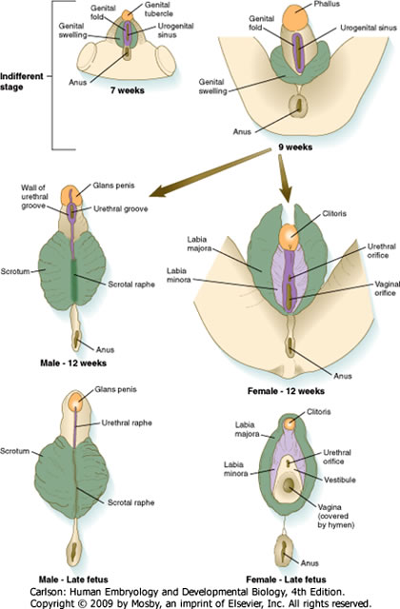
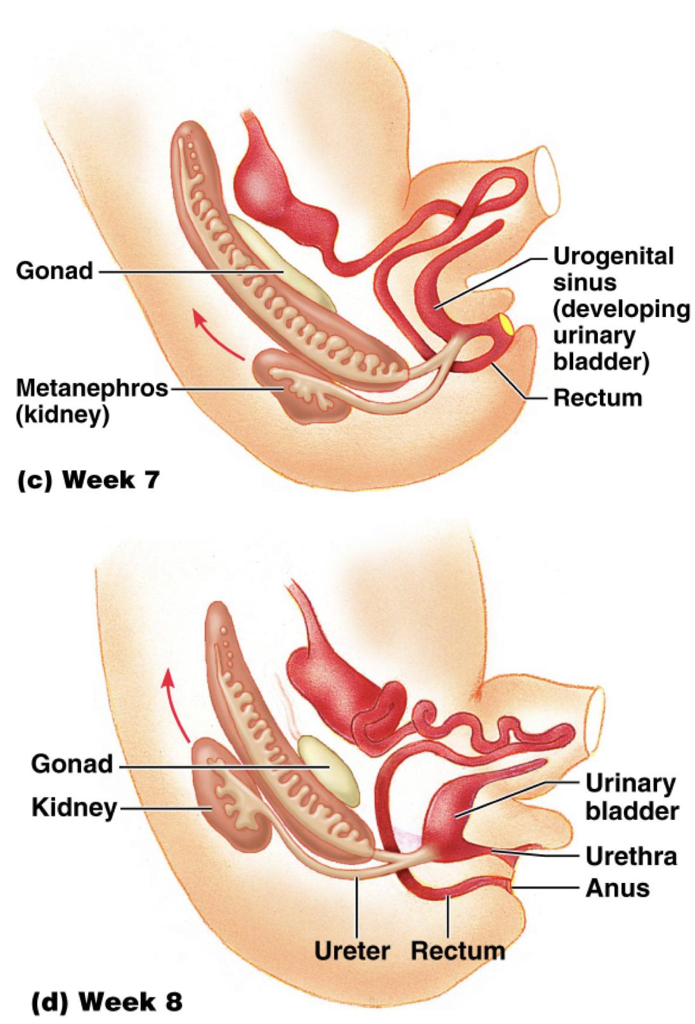
3
Female Urethra
The entire female urethra is derived from endoderm of the pelvic (middle) part of the urogenital sinus.
The external urethral oriﬁce opens dorsal to the glans clitoris.
Pelvic Part
Male Urethra
The genital tubercle elongates forming the phallus, which is the precursor of the penis.
Most of the male urethra; prostatic, membranous and spongy parts is derived from endoderm of the pelvic middle and phallic parts of urogenital sinus.
2 urethral folds in male fuse with each other to close the penile urethra.
The most distal (terminal) part of male urethra in glans penis starts as ectodermal solid cord that grows towards the root of penis to meet the spongy urethra , later it canalizes.

Slide 6
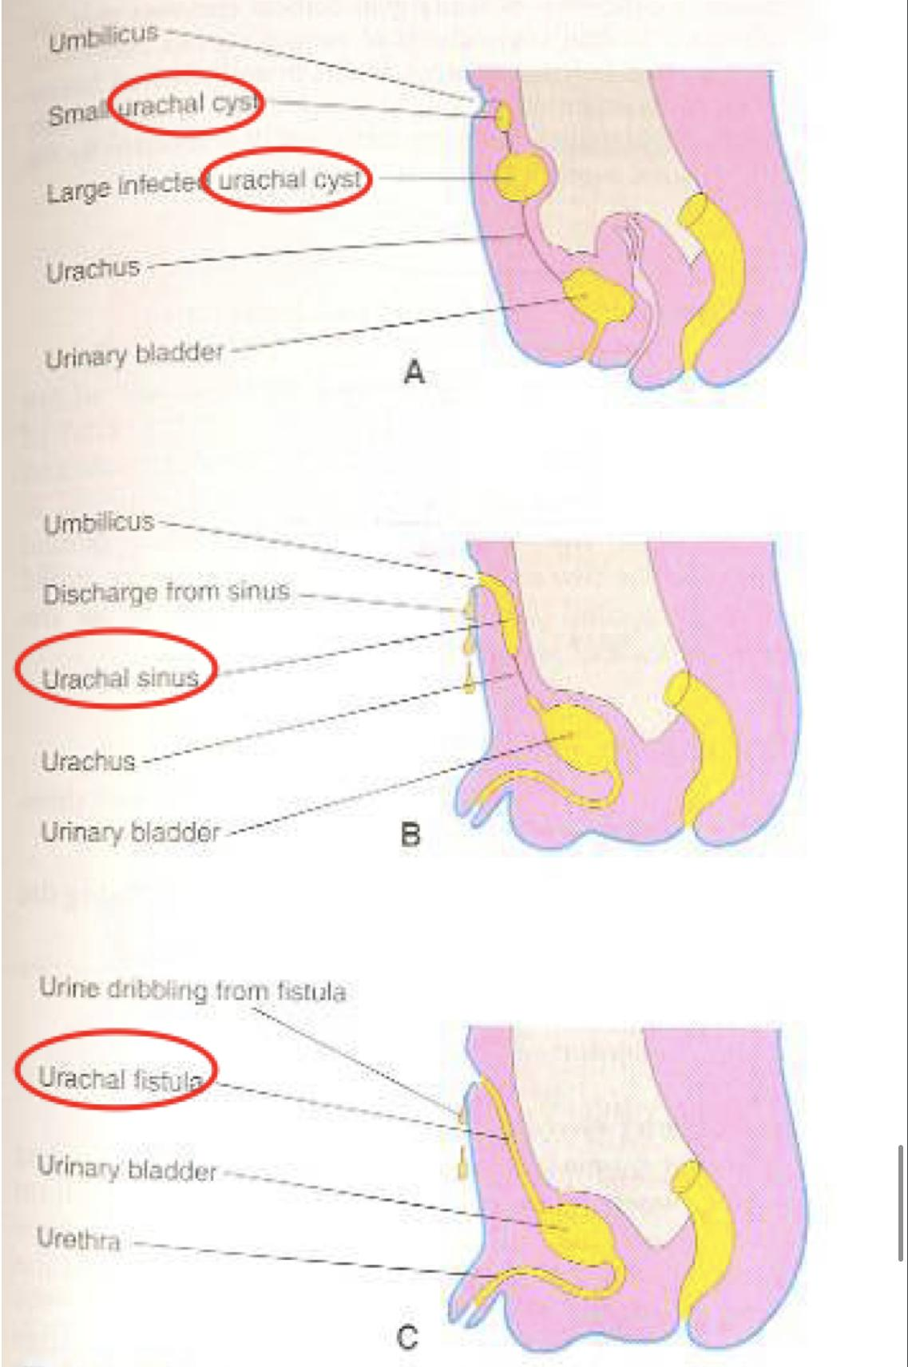
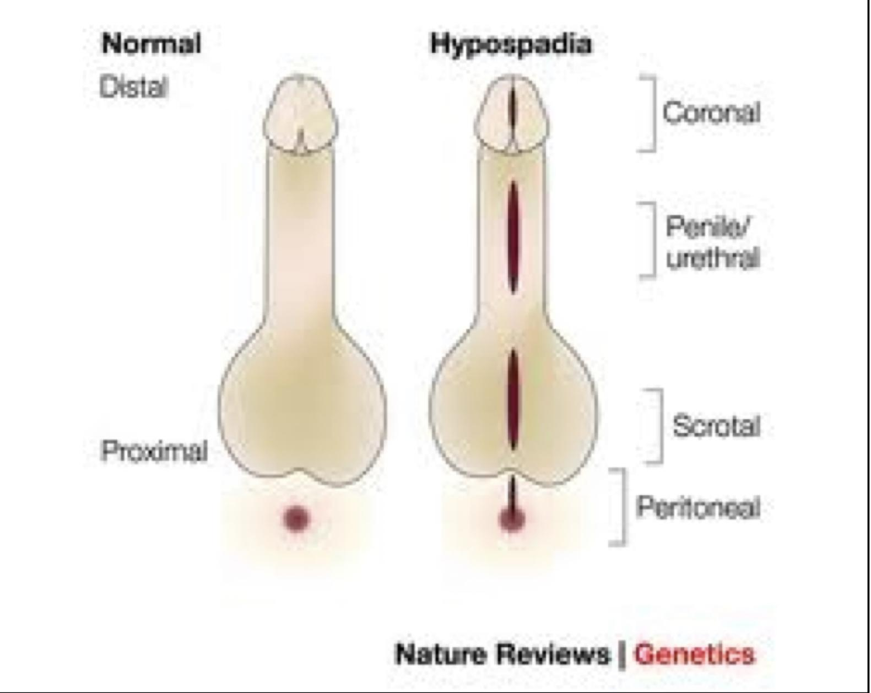
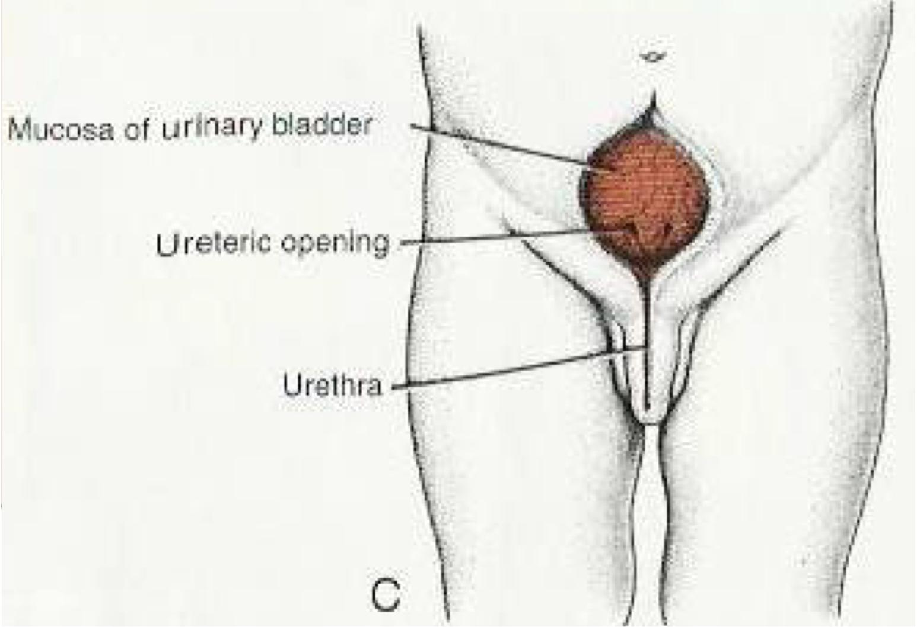
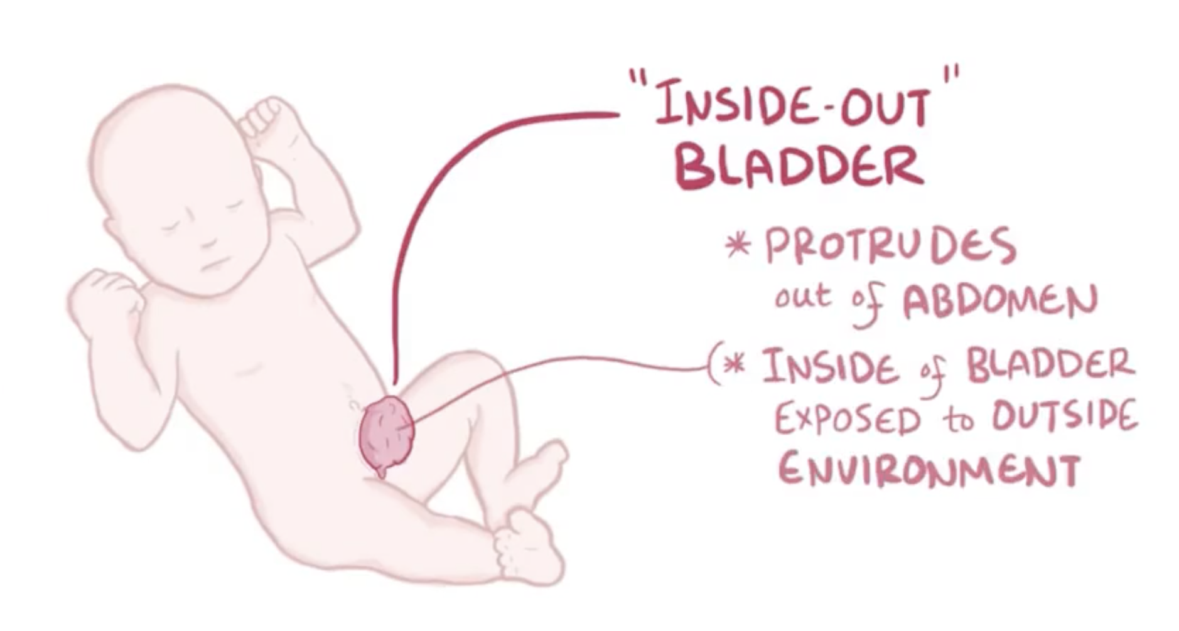
4
Anomalies
1
Urachal Anomalies
2
Urethral Anomalies
Urachal cyst persistence or remnant of epithelial lining of urachus.
1
Hypospadius : is the most common anomaly, with incomplete fusion of the urethral folds, and abnormal openings of the urethra occur along the ventral (inferior) aspect of the penis.
Epispadius : is a rare abnormality, in which the urethral meatus is found on the dorsum of penis, it is most often associated with exstrophy of the bladder.
1
2
Urachal sinus discharge serous fluid from the umbilicus.
Urachal fistula the entire urachus remains patent and allows urine to escape from the umbilicus.
2
3
3
Exstrophy of the Bladder
(Ectopia Vesica); exposure of the posterior wall of the bladder due to a defect in the anterior abdominal wall and anterior wall of the bladder.
NB from female’s Dr
Bladder exstrophy is a congenital abnormality that occurs when the skin over the lower abdominal wall does not form properly. The bladder is open and exposed on the outside of the abdomen; it is associated with epispadius.
In epispadias, the urethral meatus is found on the dorsum of penis.

Slide 7
Quiz
*First 4 questions are from Female’s Dr
Q1: The urinary bladder is mainly developed from which one of the following ?
A- Vesical part of the urogenital sinus. | B- Pelvic part of the urogenital sinus. | C- Pallic part of the urogenital sinus. | D- Allantois
Q2: Which part of urogenital sinus forms the entire female urethra ?
A- Caudal part. | B- vesical part | C- pelvic part | D- All parts
Q3: The trigone of the urinary bladder is developed from one of the following?
A-Paramesonephric ducts | B- Mesonephric ducts | C- Allantois | D- Urogenital sinus.
Q4: The urethra in glans penis is developed from which one of the following ?
A- The vesical part of urogenital sinus | B- The pelvic part of urogenital sinus | C- The ectoderm | D- The splanchnic mesoderm
Q5: In infants when does the urinary bladder starts to enter the greater pelvis
A- 6 years | B- 3years | C- 1year | D- 8months
Q6: exposure of the posterior wall of the bladder due to a defect in the anterior abdominal wall and anterior wall of the bladder is which abnormality
A- Exstrophy of the bladder | B- Epispadius | C- urachal sinus | D- none
Answers: 1. A 2. C 3. B 4. C 5. A 6. A

Slide 8
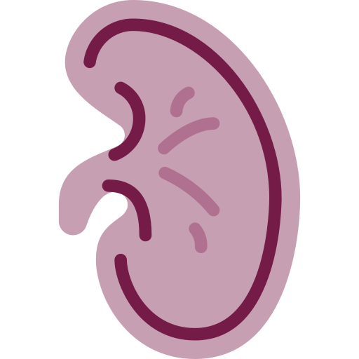
Members Board
Team Leaders
Mohammad AlRashed
Najla AlDhbiban
Team Members
Faisal AlOmar
Mishal AlSuwayegh
Abdullah AlSalem
Saud AlTaleb
Abdullah AlNajres
Feras AlMasoud
Abdulkarim Salman
Mayssam AlJaloud
Fatima Halawi
Ghada BinSlimah
Nouf AlDalaqan
Shaden AlBassam
Maha AlKoryshy
Rahaf AlMotairi
Haifa AlAmri
Alhnouf AlYami

