Slide 1
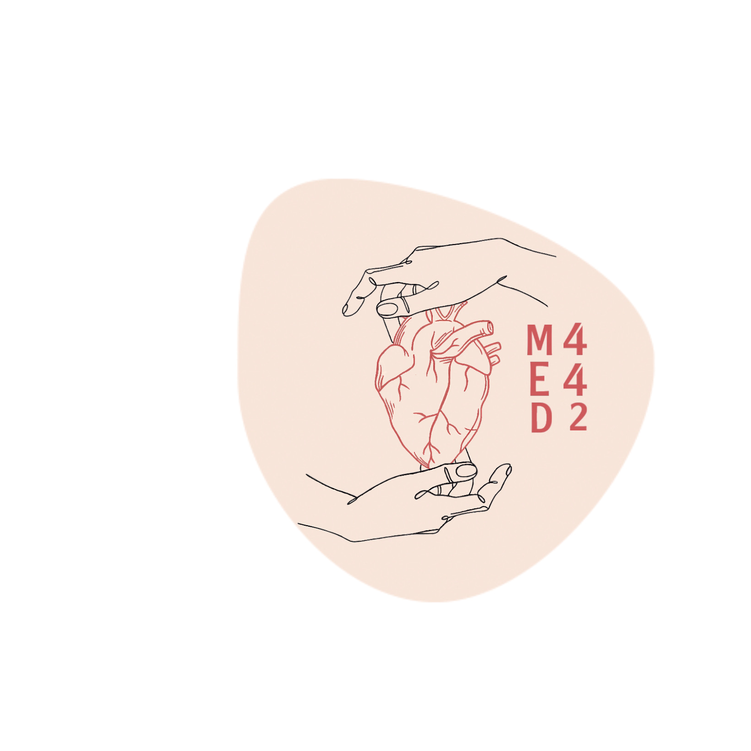
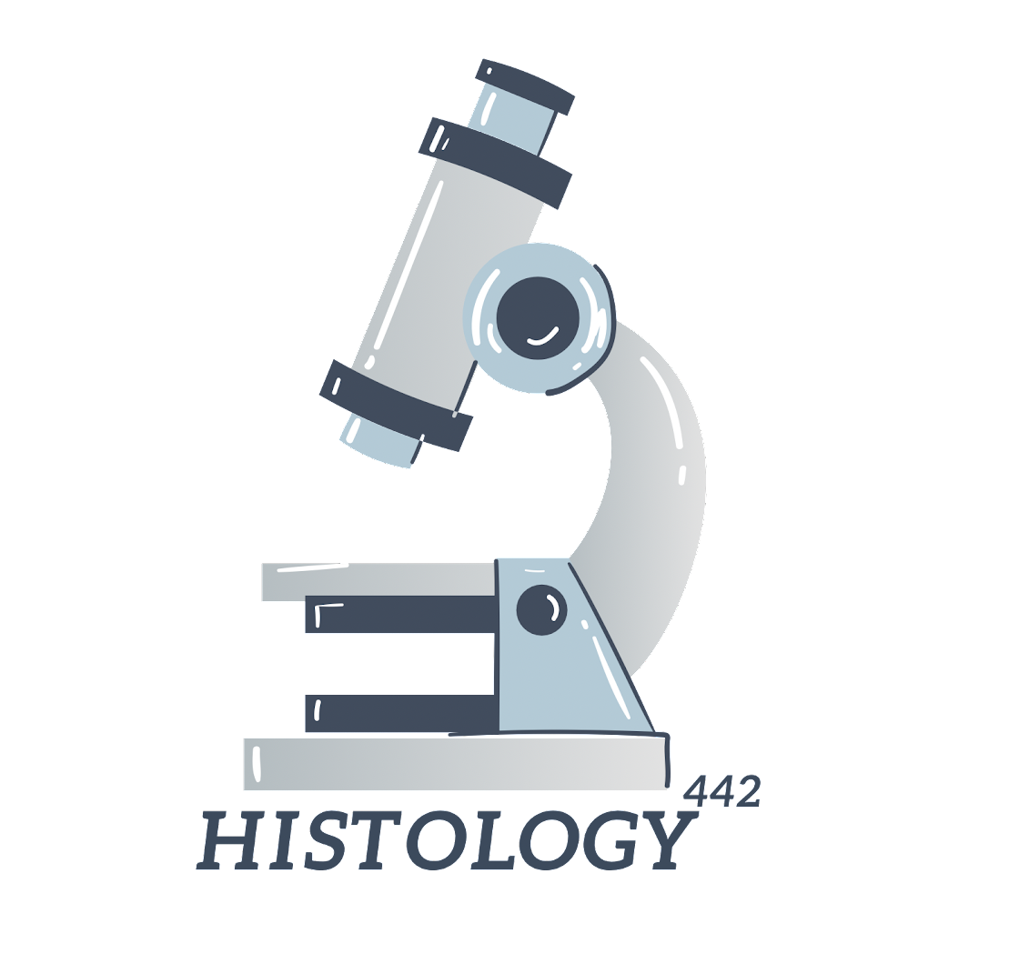
Histology of the Kidney
Color index:
-Main text
-important
-female slides
-male slides
-Dr.note
-Extra
Tap for Explaining video 10 min
Editing File

Slide 2
Objectives
By the end of this lecture, the student should be able to describe:
The microscopic structure of the renal cortex and medulla.
The histology of renal corpuscle, proximal and distal tubules, loop of Henle, and collecting tubules & ducts.
The histological structure of the juxtaglomerular apparatus.
The functional structures of the different parts of the kidney.

Slide 3
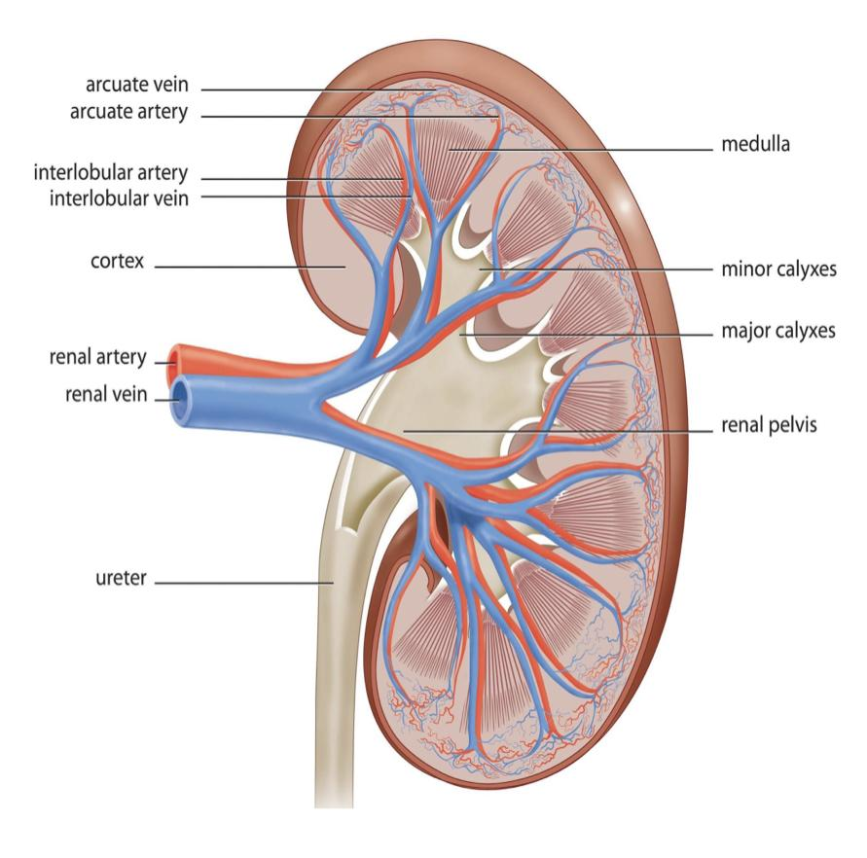
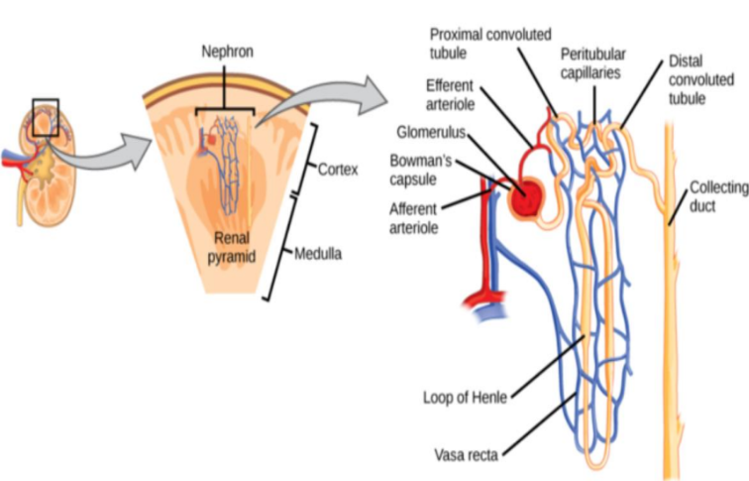
The Kidney
● Cortex: Dark brown and granular.
● Medulla: 6-12 pyramid-shape regions called renal pyramids
● The base of each pyramid is toward the cortex (cortico-medullary border)
● The apex (renal papilla) toward the hilum, it is perforated by 12 openings of the ducts of Bellini in region called area cribrosa. The apex is surrounded by a minor calyx.
● 3 or 4 minor calyces join to form 3 or 4 major calyces that form the renal pelvis.
● Pyramids are separated by cortical columns of Bertin.
Uriniferous tubule
The functional unit of the kidney, & each is formed of:
1. Nephron.
2. Collecting tubule.
- The uriniferous tubules are densely packed so that
the connective tissue stroma of the kidney is scant.
- The uriniferous tubules are separated
from the connective tissue stroma by a basal lamina.

Slide 4
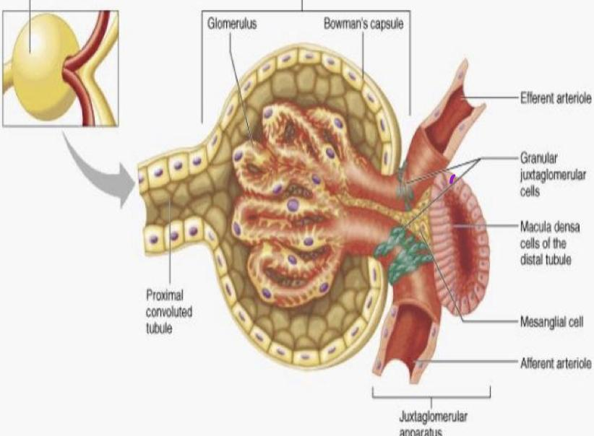
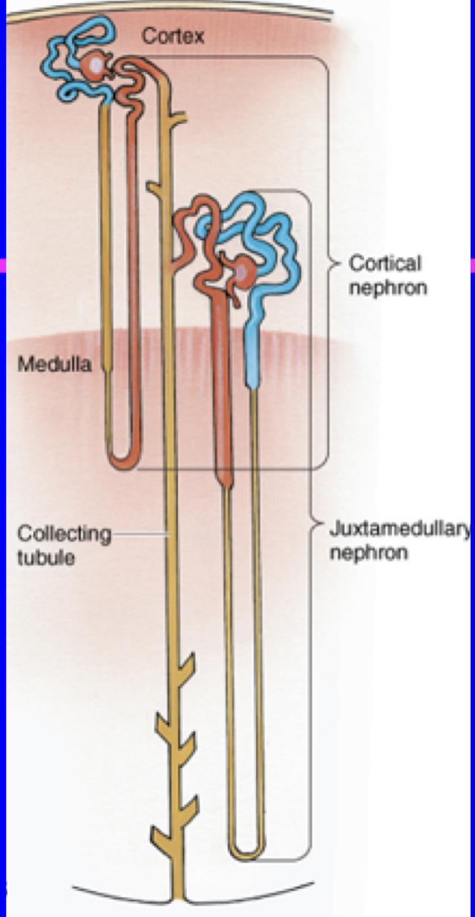
Nephron
Renal Corpuscle
1-About 1 million in each kidney.
2-There are 2 types of nephrons:
- Cortical nephrons.
- Juxtamedullary nephrons.
● Glomerulus; (tuft of fenestrated capillaries "without diaphragm”)
● Bowman’s capsule;
1. Parietal layer
2. Urinary space
3. Visceral layer or podocytes.
● Mesangial cells; (intra-glomerular cells).
It is formed of :
1. Renal corpuscle.
2. Proximal tubule.
3. Thin limbs of Henle’s loop.
4. Distal tubule

Slide 5
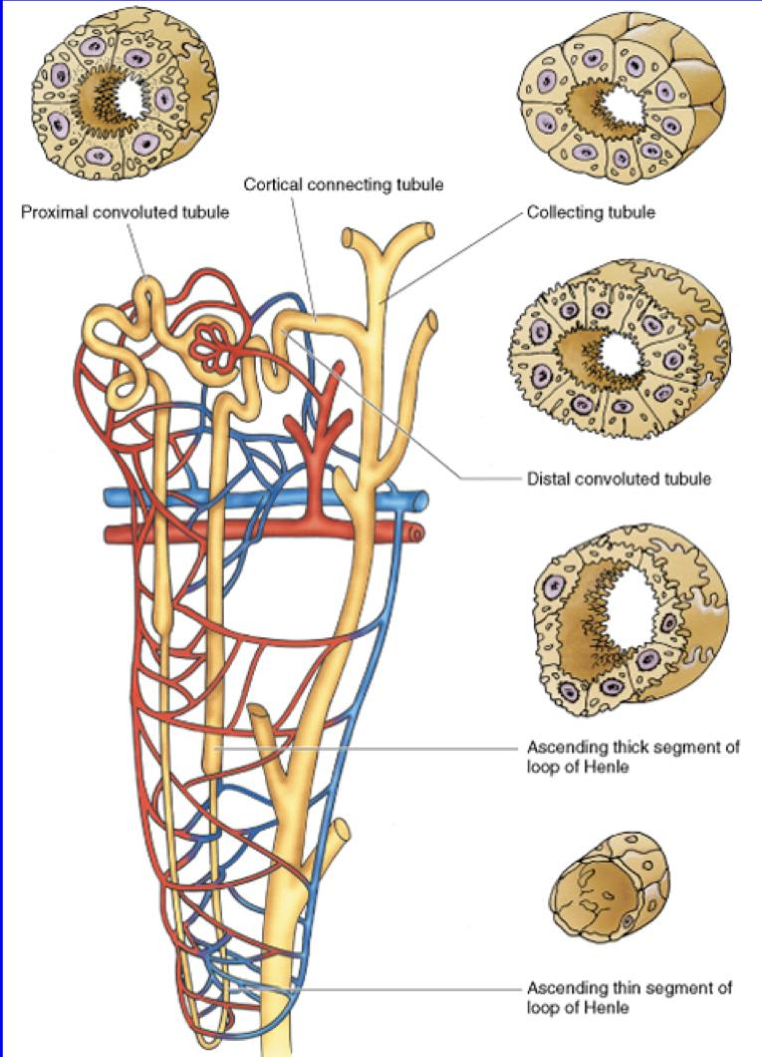
Glomerular Filtration Barrier
● Endothelial wall of the glomerular capillaries.
● The glomerular basal lamina (inner and outer laminae rarae and middle lamina densa).
● Visceral layer of Bowman’s capsule (podocytes)
● Podocytes have primary (major) processes and secondary (minor) processes “pedicles”.
● Between pedicles (on the surface of capillaries) there are ﬁltration slits that have ﬁltration slit diaphragms.
Renal Tubules

Slide 6
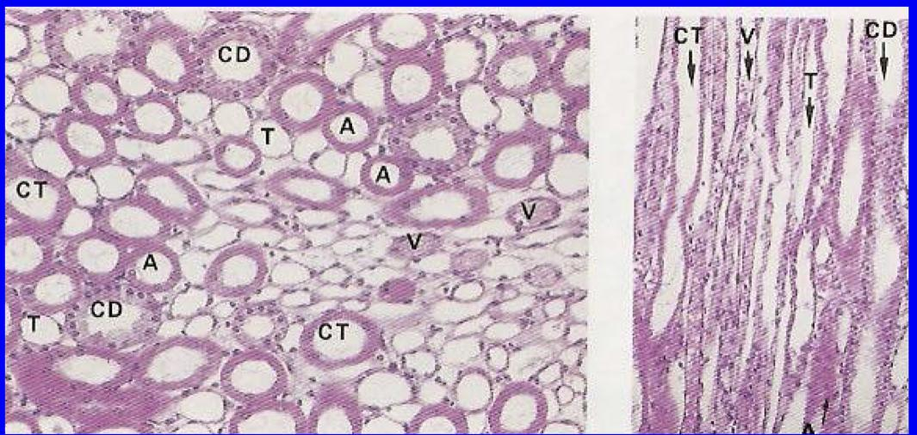
Proximal Convoluted Tubule
(microvilli) to
help reabsorption most components of the ﬁltrate of the plasma 70% and secreted into the interstitial because it’s rich of blood capillaries then
#med39
It is composed of simple cuboidal epithelium with acidophilic cytoplasm.
The cells have striated or brush border and lateral inter-digitations
They have a well-defined basal lamina.
Thin limbs of Henle’s loop
It has 3 regions:
1. Descending thin limb.
2. Crest of Henle’s loop.
3. Ascending thin limb.
NB: It is longer in juxta-medullary nephron than in cortical nephron. It is composed of simple squamous epithelium.

Slide 7
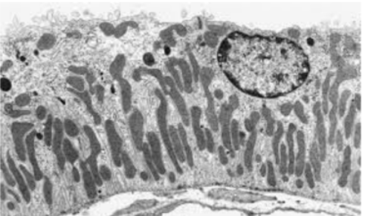
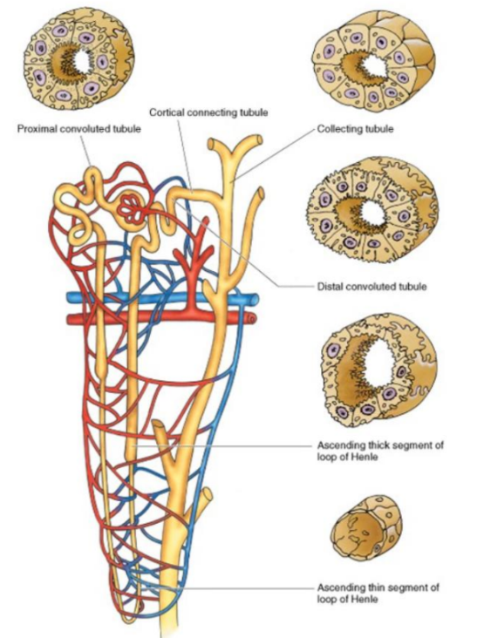
Distal Convoluted Tubule
It starts at the macula densa.
macula densa (tall columnar & narrow cells).
The Distal convoluted tubule is formed
of low cuboidal epithelium.
NB: Because distal convoluted tubules are much
shorter than proximal convoluted tubules, any
section of renal cortex presents many more
sections of proximal convoluted tubules.
Distal tubules drain into collecting tubules.
thin wall clear lumen
•No brush border
•Wider Lumen
•Have less microvilli than proximal convoluted tubule

Slide 8
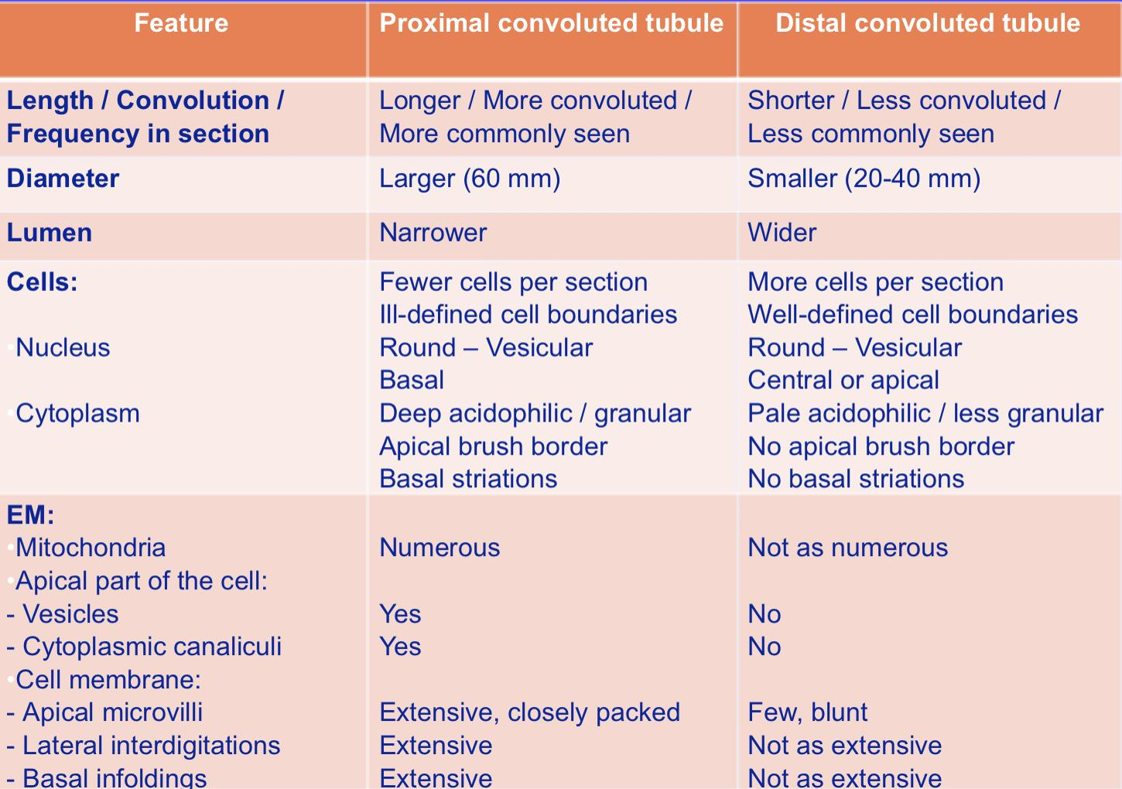

Slide 9
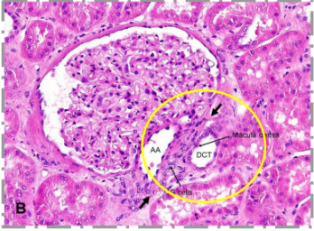
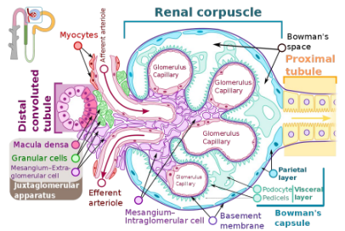
Juxtaglomerular Apparatus
It has 3 components :
1. The macula densa of distal tubule: tall cells with centrally-placed nuclei (Columnar cells). These cells send impulses to the juxtaglomerular cell through the extraglomerular mesangial cells to increase the secretion of renin when blood pressure decreases.
2. Juxtaglomerular cells of afferent glomerular arteriole (modified smooth muscles of tunica media ). Nuclei are round with granular cytoplasm . *they secrete renin
3. The extraglomerular mesangial cells.

Slide 10
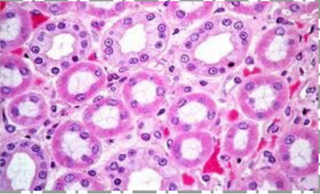
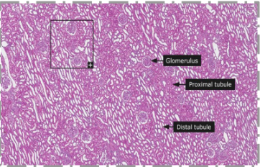
Collecting Tubules
Are composed of simple cuboidal epithelium.
They aren’t part of nephron.
They have 3 regions:
1. Cortical: Simple Cuboidal Epithelium
2. Medullary: Simple Cuboidal Epithelium.
3. Papillary ducts (ducts of Bellini): Simple Columnar Epithelium They open in area cribrosa. They are impermeable to water except in presence of ADH.
Area cribrosa is the tip of the renal papilla (apex) that meets the end of the ducts of Bellini.
Renal Interstitium
It is a very flimsy, scant amount of loose connective tissue that contains:
1-Fibroblast
2-Macrophages
3-Interstitial cells : They secrete medullipin I, which is converted in the liver into medullipin II, that lowers blood pressure.
Juxtaglomerular apparatus secretes renin that increases blood pressure, while renal
interstitium secretes medullipin that decreases blood pressure.

Slide 11
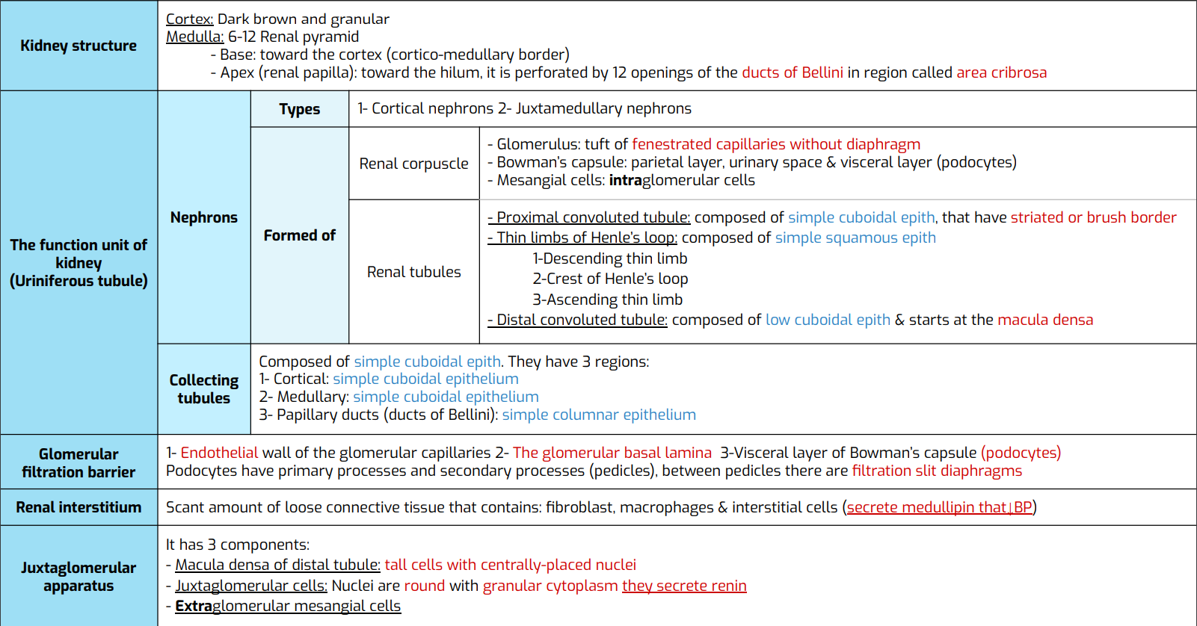
SUMMARY thanks to 439

Slide 12
Test yourself
Answers: 1.A 2.B 3.A 4.A 5.B
Q1: What are the tubules that densely packed?
A- Collecting tubule | B-Nephron | C-Glomerulus | D- ———-
Q2: Podocytes located in?
A- Glomerulus | B-Bowman’s capsule | C-Henle’s loop | D-In my heart
Q3: Which tubule has thick wall and brushy lumen?
A- Proximal convoluted tubule | B-Distal convoluted tubule | C-Collecting tubules | D-Smash
Q4: Macula densa found in?
A- Juxtaglomerular apparatus | B- Collecting tubules | C- Proximal convoluted tubule | D- Loop of henle
Q5: Which of the following secrete renin?
A- Juxtaglomerular cells | B- Juxtaglomerular cells | C- Macula densa | D- Extraglomerular mesangial cells

Slide 13
Meet The Team
BIG THANKS TO TEAM 439✨
Team Leaders
Alhnouf Al Yami
ابن تيمية:
"العِبْرَة بكَمَالِ النهايات لا بِنَقصِ البدايات"
Saad AlAngari
لا تيأس/ي
Team Members
Mohammed AlRashod
Ali Jabaan
Abdulkarim Salman
Maha AlZahrani
Reema AlQuraini
Aisha Bin Saran
Farah AlHalafi
442Histology@gmail.com

