Slide 1
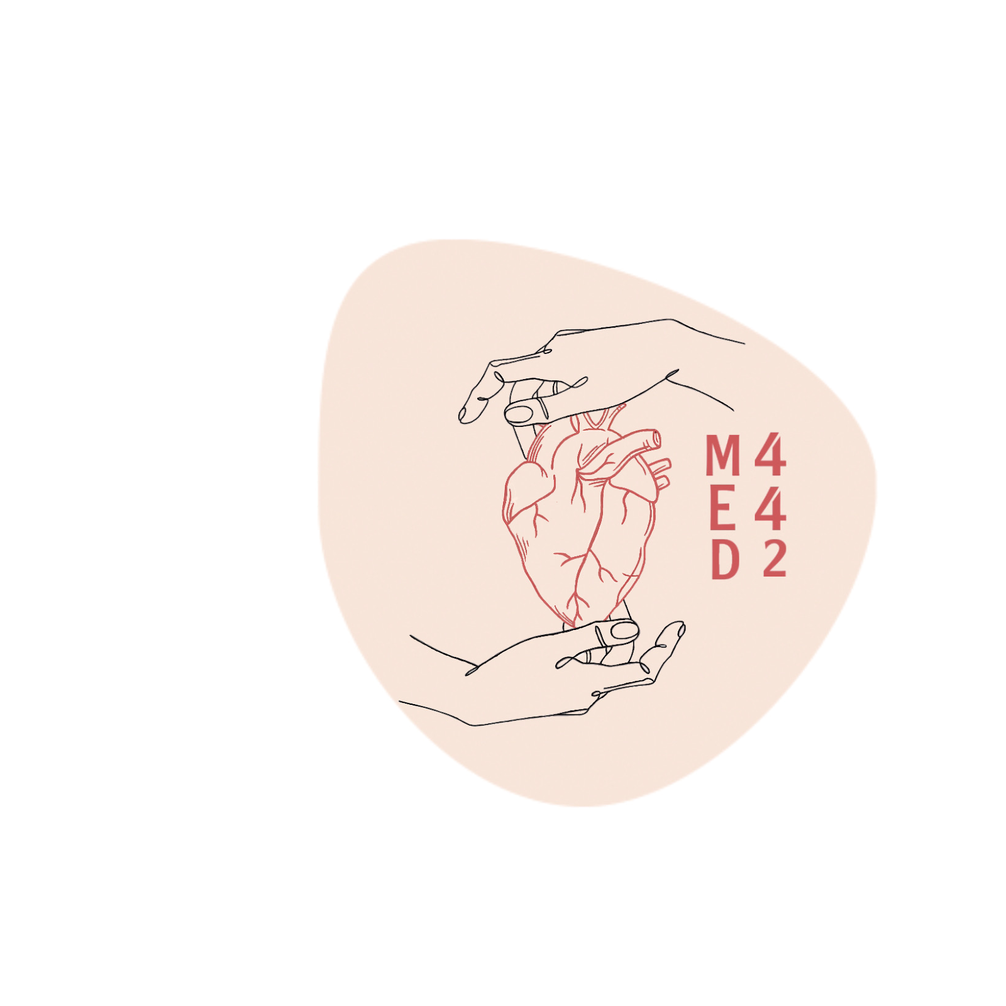
Histology of the Urinary Tract
Color index:
-Main text
-important
-female slides
-male slides
-Dr.note
-Extra
Editing File

Slide 2
Objectives
By the end of this lecture, the student should be able to describe:
The microscopic structure of renal pelvis and ureter .
The microscopic structure of the urinary bladder and male and females urethra .

Slide 3
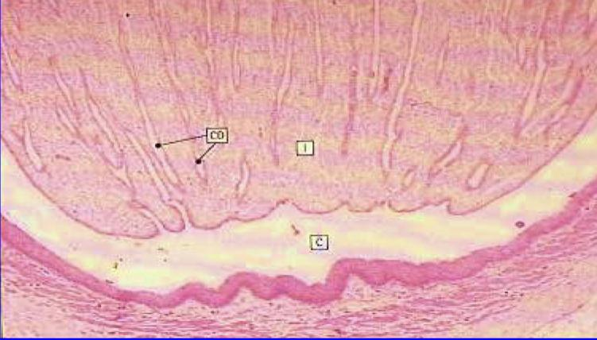
Renal calyces
1
Each calyx accepts urine from the renal papilla of renal pyramid.
2
They are lined with transitional epith. Lamina propria and smooth muscle.
Minor calyx merge to form major calyx ( with same lining tissue as minor calyx )
3
4
Major calyx open into renal pelvis .

Slide 4
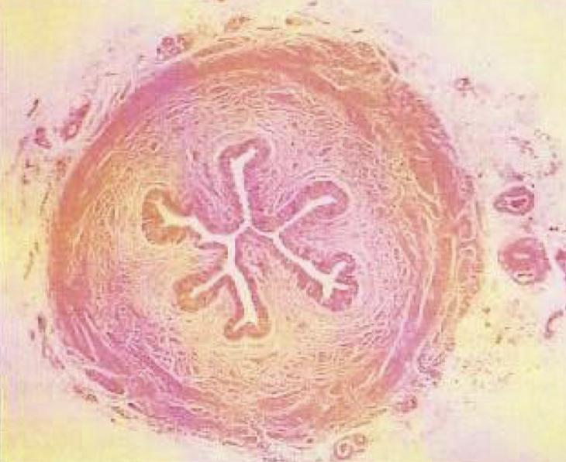
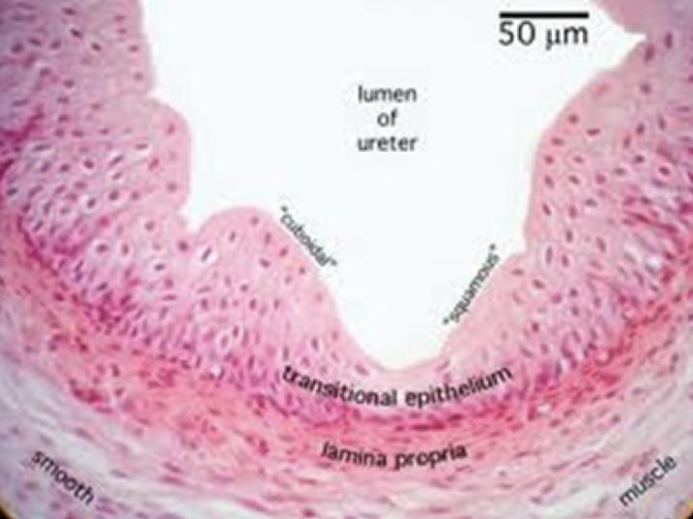
Ureter
Musclaris (Muscular coat)
Mucosa
Adventitia
Is formed of transitional epith.
And lamina propria.
In the upper 2/3:
Formed of 2 layers of smooth muscle.
1- Inner longitudinal.
2- Outer circular.
In the lower 1/3:
Formed of 3 layers of smooth muscle.
1- Inner longitudinal.
2- Middle circular.
3- Outer longitudinal.
Fibrous C.T covering
N.B No serosa

Slide 5
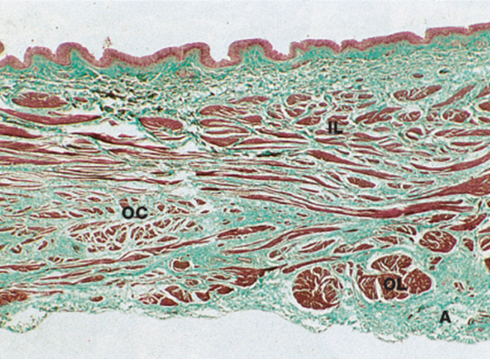
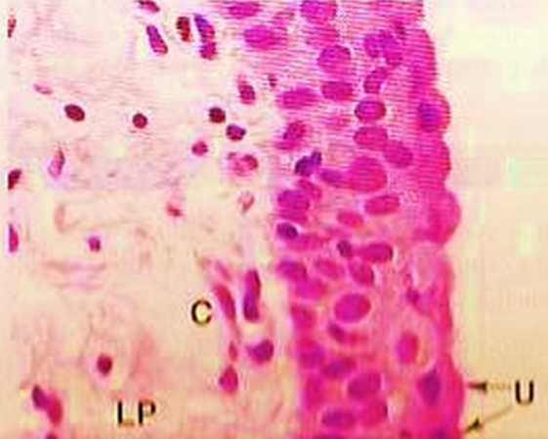
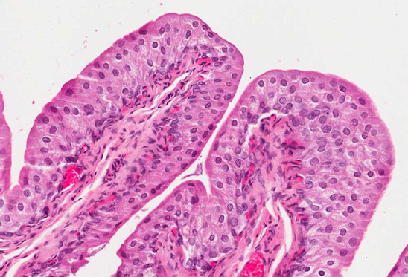
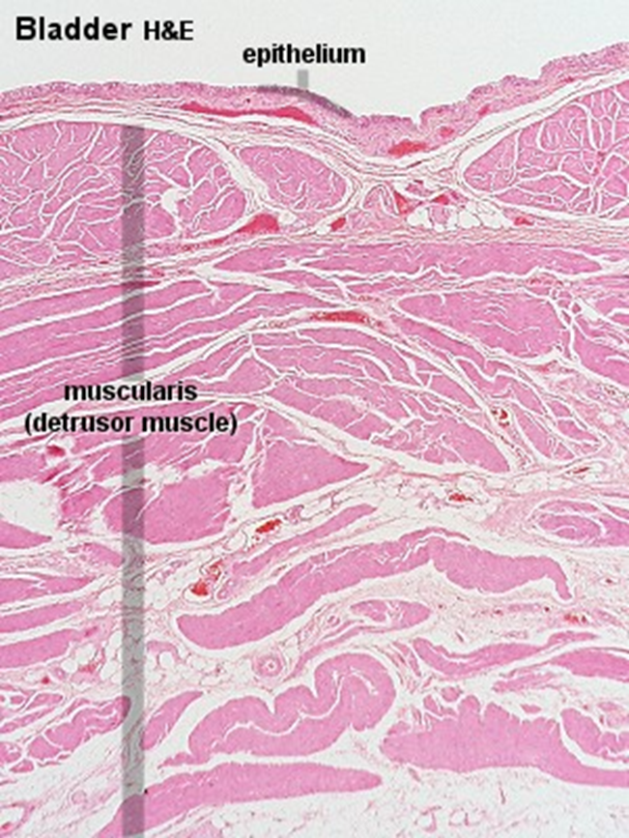
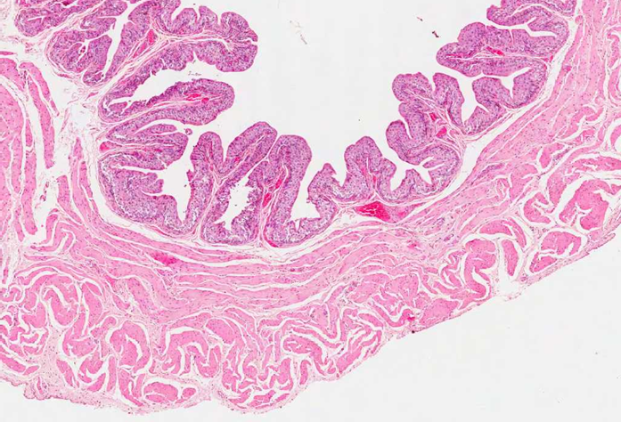
Urinary bladder
It has the same structure as the lower third of the ureter.
Superficial layer
3 layers of smooth muscle
outer covering
Adventitia or Serosa.
Transitional epithelium has dome-shaped cells (in empty bladder).
Inner and outer longitudinal (thin) and middle circular (thick) layers.

Slide 6
Urethra
Female urethra
It is short and lined by:
Epithelium
Sub-epithelial fibroelastic CT
Smooth muscle
1- Transitional epith. Near the bladder.
2. Pseudostratified columnar epith.
3. Stratified squamous non-keratinized epith
Contains glands of Littre (mucus-secreting glands).
Inner longitudinal and outer circular layers.

Slide 7
Urethra
Male urethra
It is long and is divided into 3 regions:
Penile (spongy) urethra: is lined with stratified columnar epith. with patches of pseudostratified columnar epithelium
Prostatic urethra: is lined with transitional epith
Membranous urethra: is lined with stratified columnar epith. with patches of pseudostratified columnar epithelium.
In navicular fossa (enlarged terminal portion): stratified squamous non-keratinized epith.
The lamina propria contains mucus-secreting glands of Littre

Slide 8
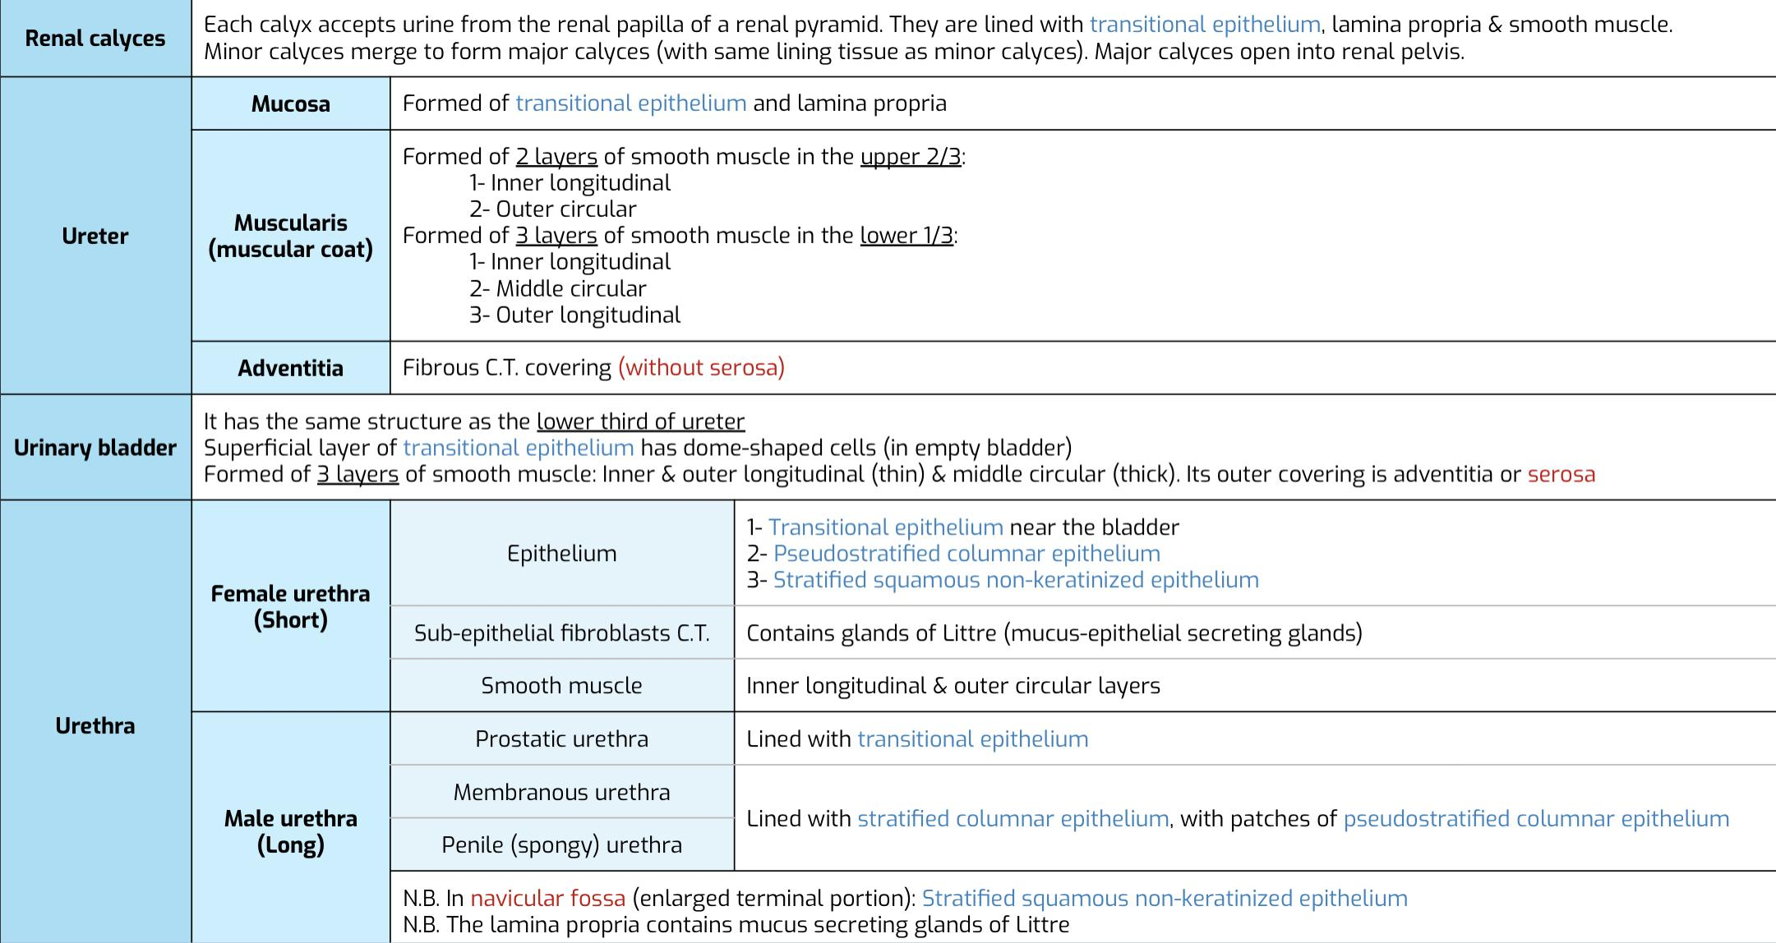
SUMMARY thanks to 439

Slide 9
Test yourself
Answers: 1.B 2.A 3.D 4.B 5A.
Q1: Each calyx accepts urine from ?
A- Fibrous | B- renal papilla | C- Adventia | D- navicular fossa
Q2: Which one of them lined with transitional epithelium ?
A- prostatic urethra | B- membranous urethra | C- penile urethra | D- navicular fossa
Q3: How many layers does the urinary bladder have?
A- 2 | B- 4 | C- 1 | D- 3
Q4: Sub-epithelial fibroelastic C.T in female contain?
A-stratified columnar epith | B- glands of littre | C- navicular fossa | D- all
Q5: Urinary bladder has the same structure as the ?
A- lower ureter | B- upper ureter | C-urethra | D- -

Slide 10
Meet The Team
BIG THANKS TO TEAM 439✨
Team Leaders
Alhnouf Al Yami
Saad AlAngari
Team Members
Mohammed AlRashod
Ali Jabaan
Abdulkarim Salman
Maha AlZahrani
Reema AlQuraini
Aisha Bin Saran
Farah AlHalafi
442Histology@gmail.com

