Slide 1
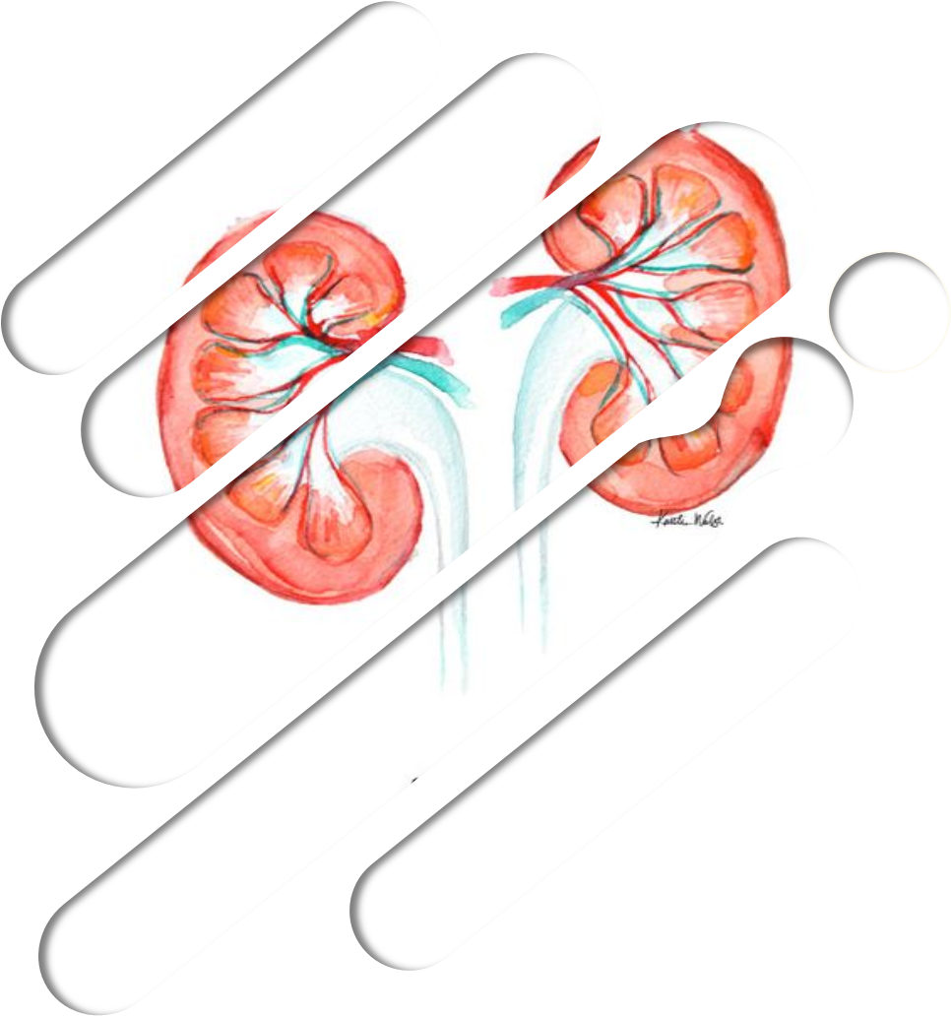
TRANSPLANTATION
Editing File
color Index:
Main Text
Female Slides
Male Slides
Important
Doctors Notes
Extra

Slide 2
objectives
To understand the diversity among human leukocyte antigens (HLA) or major histocompatibility complex (MHC)
To know the role of HLA antigens in transplant rejection
To be familiar with types of immune responses mediating transplant rejections and importance of tissue matching
To understand the principles of management after transplantation

Slide 3
Major histocompability complex & Transplantation
Major histocompatibility complex (MHC) proteins were discovered for the first time with the advent of tissue transplantation
The success of tissue and organ transplantation depends upon the donor’s and recipient’s “human leukocyte antigens” (HLA) encoded by HLA genes
HLAs are cell-surface proteins regulate the immune system
These proteins are allo-antigens
Allo-antigens activate alloimmunity which means activating of immune response to non-self antigens. e.g. blood groups considered allo-antigens
MHC Class I are glycoproteins found on surface of virtually all the nucleated cells:
Cytotoxic T cell kills virus infected cells in association with class I MHC proteins
MHC Class II glycoproteins are normally found on the surface of antigen presenting cells (macrophages, B cells, dendritic cells and Langerhans cells):
Helper T cell recognize antigen in association with class II MHC proteins
Genes for HLA proteins are clustered in the MHC complex located on the short arm of chromosome 6
HLA is same as/also called MHC complex
Three genes HLA-A, HLA-B and HLA-C code for Class I MHC proteins
HLA-D loci encode for Class II MHC proteins ie, DP, DQ and DR

Slide 4
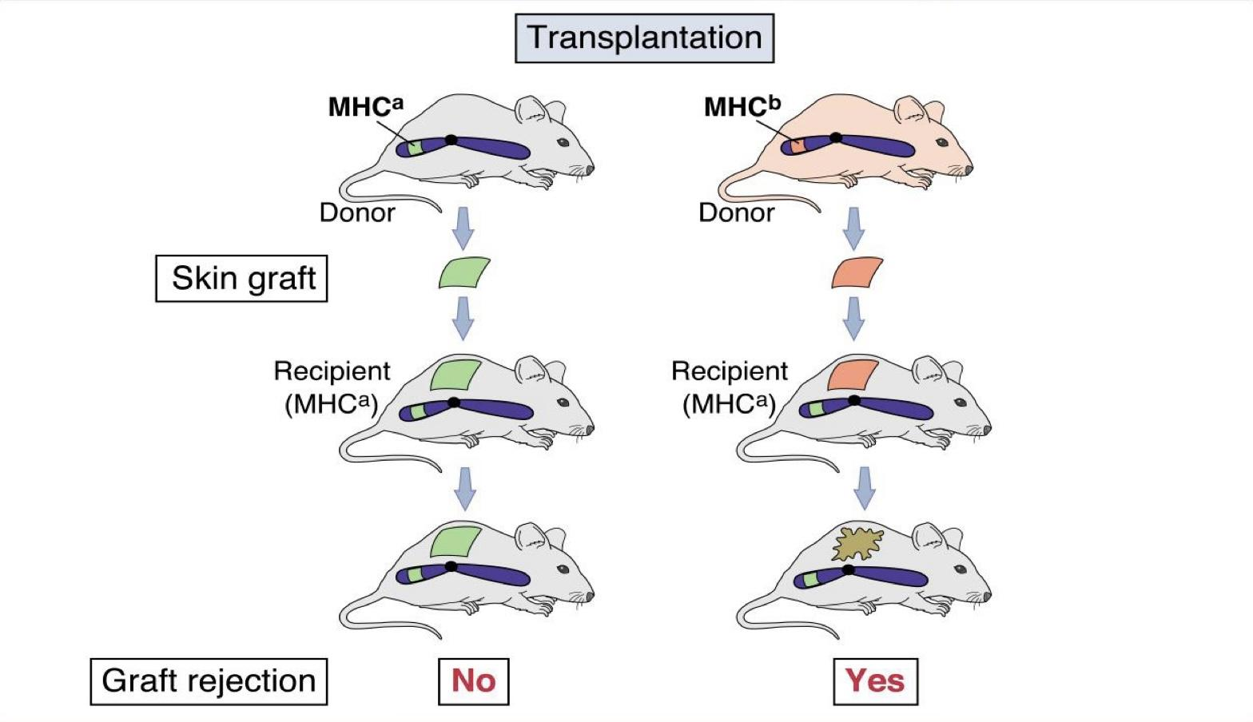
Major & Minor histocompability complex & Transplantation
Each individual has two “haplotypes” i.e, two sets of these genes one paternal and one maternal
MHC CLASS | I | II | III
Region |  | DP DQ DR | C2, C4, BF
Gene product | HLA-A HLA-B HLA-C | DP DQ DR | C’ proteins
Polymorphism | 47 88 29 | More than 300 HLA-D
A
B
C
TNF-α
TNF-β
Minor HLA genes – unknown:
They mount a weak immune response
Play role in chronic rejection of a graft
There are no laboratory tests to detect minor antigens
MHC alleles control allograft rejection:

Slide 5
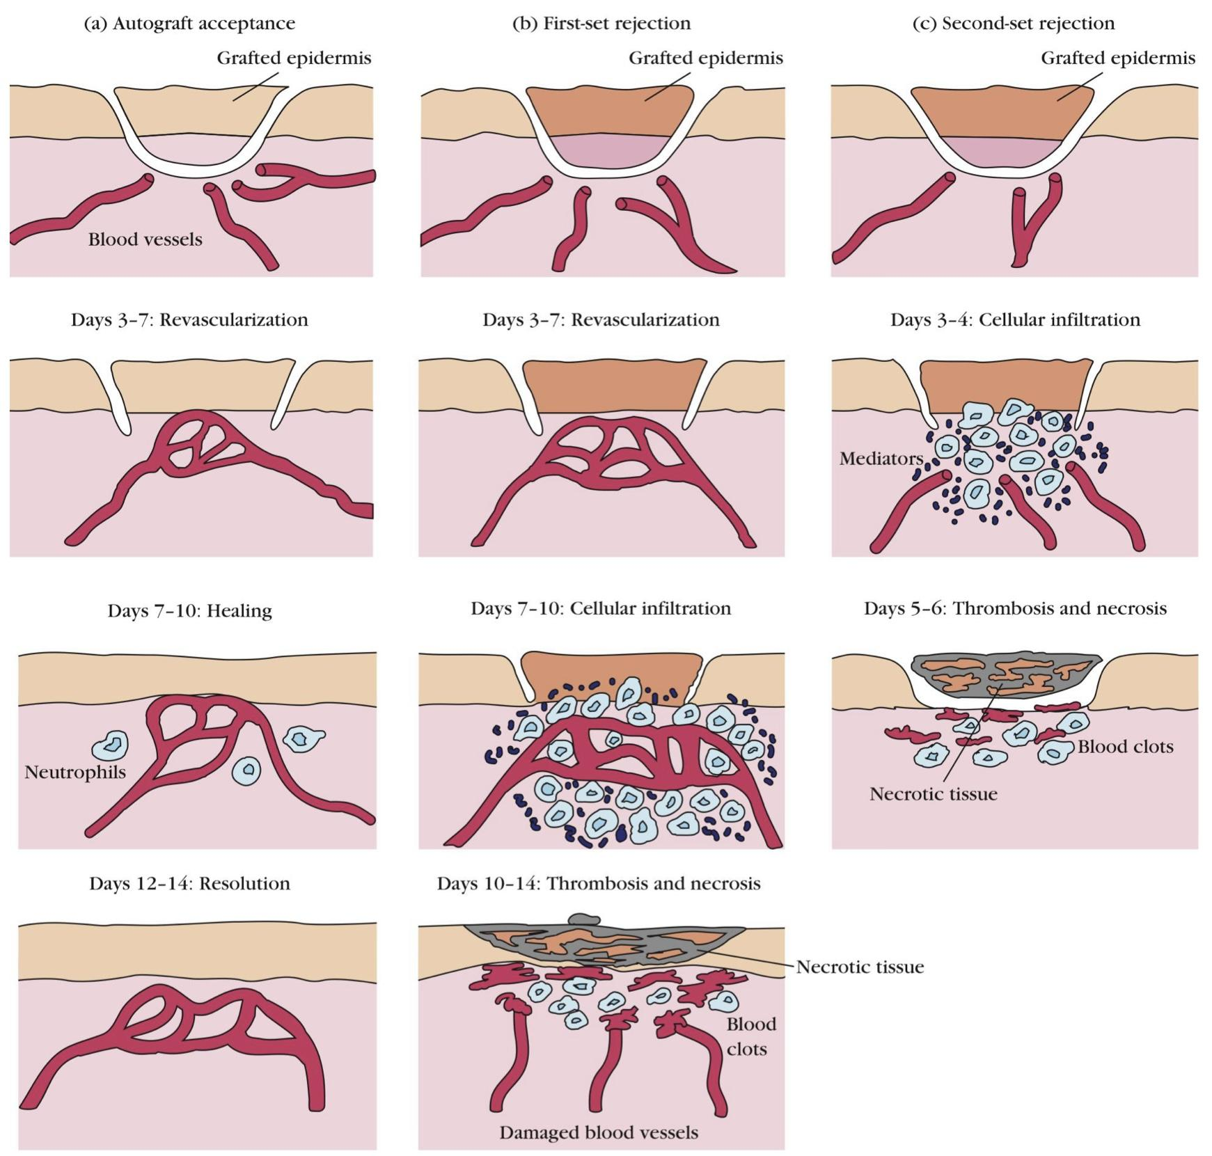
Transplantation
Types of transplantation:
Types of transplantation & rejection
Autografts, autologous grafts
Auto means self
Allogeneic grafts
Donor and recipient are same individual
Common in skin grafting; bone marrow
Most common one
1
Donor and recipient are same species, but genetically unrealated
Common heart, lung, kidney, liver graft
Syngeneic grafts or isografts
2
Allogeneic grafts cause rejection due to non-compatible HLAs
Donor and recipient are genetically identical
Animal models; identical twins
3
Xenogeneic grafts
Donor and recipient are different species
4
Different organisms. Under investigation
Artificial grafts
5
E.g : The story of a man who got a pig’s heart
* READ ABOUT IT *
Major Barrier to transplantation is the immune response:
T cells play primary role
B cells can/do play a role
Classic adaptive/acquired immune response (memory, specificity)
Memory in second transplantation/second set reaction
1st set versus 2nd set reactions:
(a): Autograft is accepted, no necrosis.
(b): 1st set rejection of the graft tissue happens if the graft was not previously sensitized / introduced to the recipient.
(c): 2nd set rejection happens if the 1st set rejection happened & then the same graft is introduced again to the same recipient.
The faster immune response against the grafted epidermis in second set is due to presence of memory cells caused by previous sensitization in 1st set reaction.
The result is faster cellular infiltration and necrosis

Slide 6
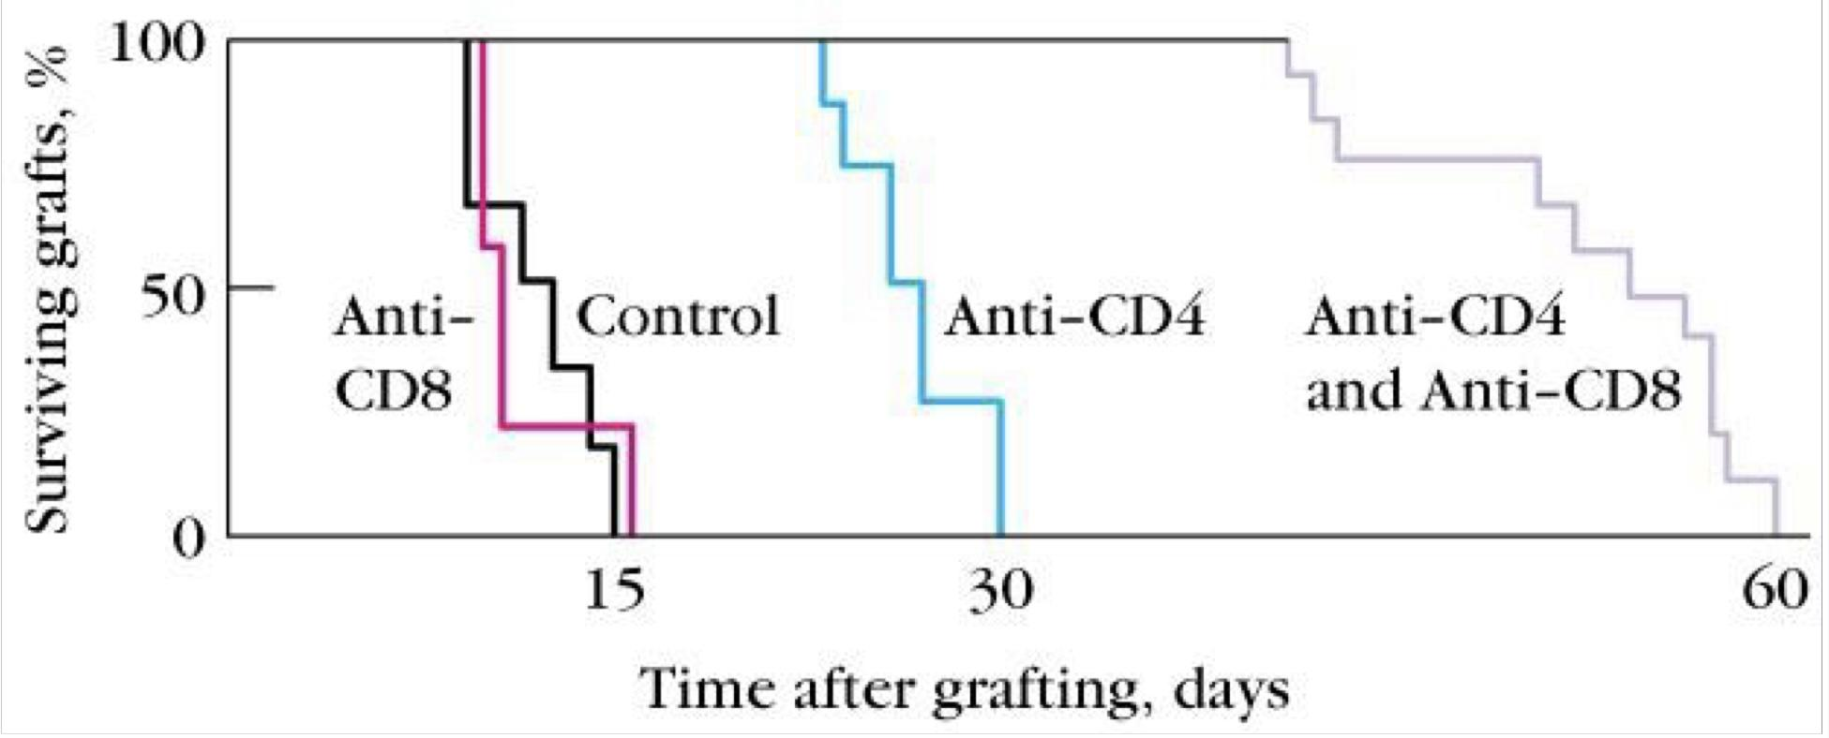
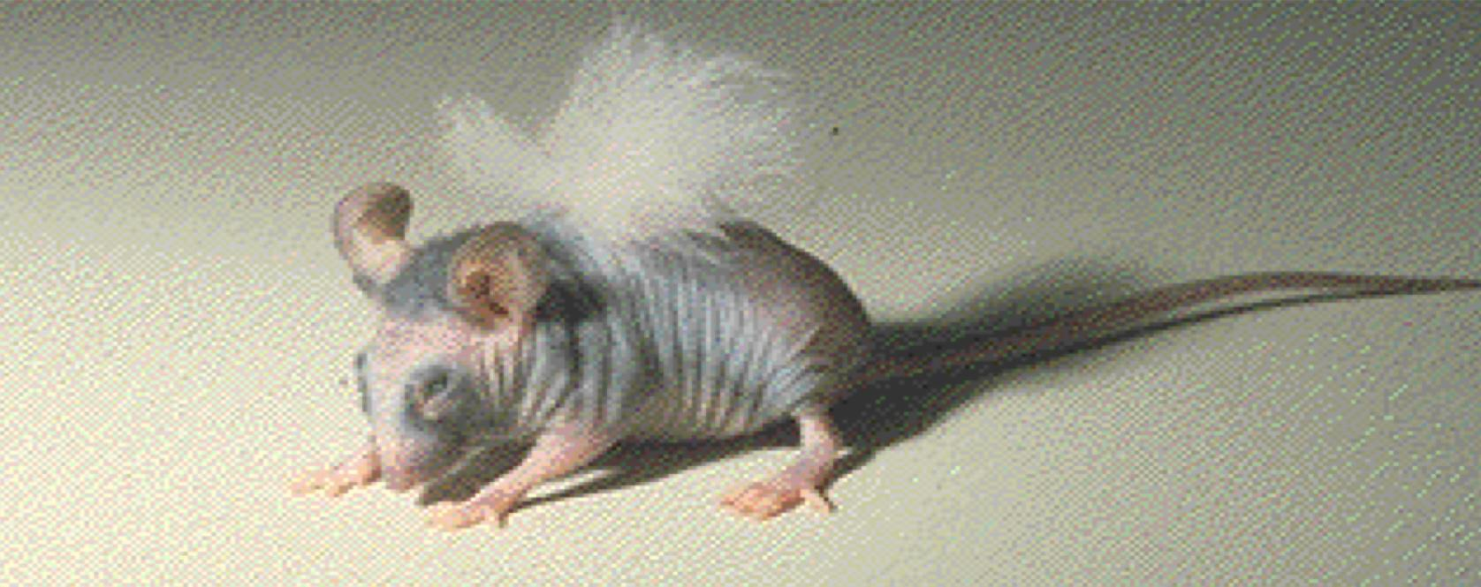
Role of CD4 versus CD8 T cells
Injecting recipient mice with monoclonal antibodies to deplete one or both types of T cells:
A recipient isn’t injected with immunosuppressants/ Anti-CD4 or Anti-CD8 monoclonal antibodies
A recipient is injected with Anti-CD8 monoclonal antibodies
A recipient is injected with Anti-CD4 monoclonal antibodies
A recipient is injected with both Anti-CD8 and Anti-CD4 monoclonal antibodies
The graph shows that CD4 role in rejection is more important than CD8
T cells play primary role in 1st and 2nd set rejection reactions:
Nude mice accept allografts (The mice don’t have T cells due to genetic modification resulting in absent thymus)
B cell deficient mice reject allografts
Nude mouse has a transplant of rabbit skin

Slide 7
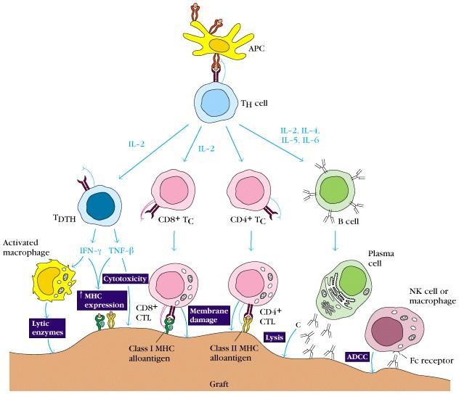
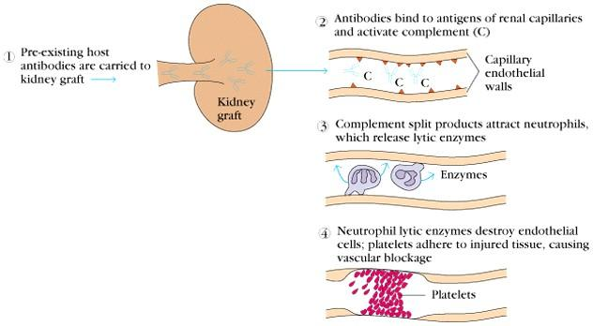
Mechanisms involved in Graft Rejection
Rejection Response
Clinical manifestations of graft rejection
Hyperacute rejection: very quick
1
The patient could die on the table immediately
Acute rejection: about 10 days
(cell mediated)
2
3
Chronic rejection: months-years (both)
Chronic Rejection
1
2
Main pathologic finding in chronic rejection is atherosclerosis of the vascular endothelium
3
This occurs months to years after engraftment
Main cause of chronic rejection is unknown
Minor histocompatibility antigen mismatch

Slide 8
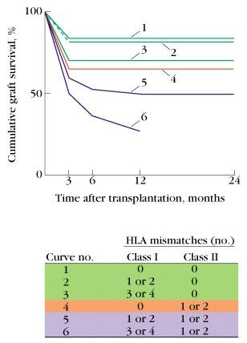
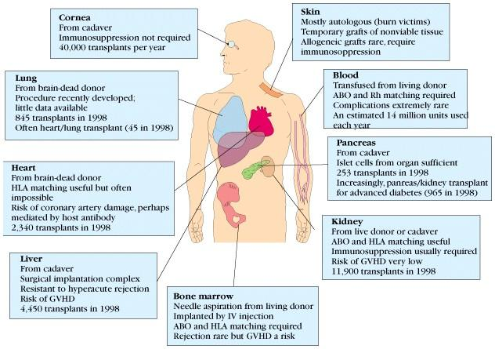
Graft-versus-Host (GVH) Reaction
HLA Typing in the Laboratory
The grafted organ
attacks the recipient’s body
Occurs in about two thirds of bone marrow transplants
Prior to transplantation laboratory test commonly called as HLA typing or tissue typing to determine the closest MHC match between the donor and recipient is performed
Methods
DNA sequencing by Polymerase Chain Reaction (PCR)
Serologic Assays
Mixed Lymphocyte Reaction (MLR)
Crossmatching – (Donor) lymphocytes +(Recipient) serum + complement.
Occurs because grafted immunocompetent T cells proliferate in the irradiated immunocompromised host and reject cells with foreign proteins resulting in severe organ dysfunction
Donor’s Tc cells play a major role in destroying the recipient’s cells
Symptoms are: maculopapular rash, jaundice, hepatosplenomegaly and diarrhea
GVH reactions usually end in infections and death
Tissue Matching
Effect of HLA class I & II matching on survival of kidney grafts
The safest because doesn’t get affected by the immune system

Slide 9
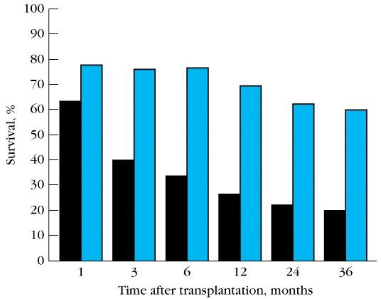
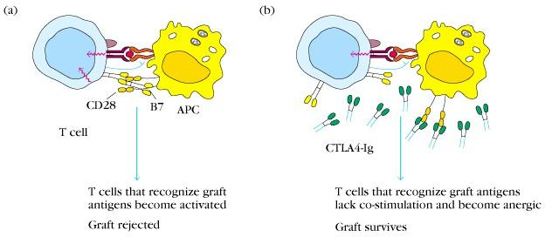
General Immunosuppression Therapy
1
Mitotic inhibitor: azathioprine
(pre & post)
Corticosteroids
2
3
Switching off the activation of T cell
Cyclosporin
4
Total lymphoid irradiation
By modified X-RAY we focus on certain organs like spleen or lymph nodes to make the patient’s immune system compromised
Specific Immunosuppression therapy
a) Monoclonal antibodies against T
cell components or cytokines
b) Agents blocking co-stimulatory signal
Still under investigations
Must be maintained for life
Susceptibility to infections
Downsides of Immunosuppressive Therapy
Due to :
1 - their weak immune system
2 - They can’t get vaccinated
Toxicity
Susceptibility to tumors

Slide 10
Take Home Messages
HLA or MHC molecule miss-match can stimulate humoral and cell mediated immunity which is the main cause of rejection of transplants
Cell mediated immune responses play a major role in transplant rejection
Tissue matching particularly for HLA-D antigens is important for successful transplantation
Immuno-suppresive therapy is usually required after transplantation
focused by female’s dr
01
- MHC class 1(CD8)
- MHC class 2(CD4)
- RBCs have NO MHC
02
-How many HLA-D ? 3
-What are the gene products? DP,DQ,DR
03
MCQs of -polymorphism
-Minor HLA
Eg.Minor HLA all except
-weak immune
-acute rejection ✅
-no laboratory tests
04
-What plays primary role? T-cells
-Second-set rejection (memory)
05
-What are the mechanisms of 1st 2nd set reactions

Slide 11
QUIZ
(MCQs are from females doctor)
1) MHC glycorproteins are normally NOT found on surface of:
A) RBCs | B) B cells | C) dendritic cells | D) macrophages
2) Which of the following plays a primary role in the immune response of transplantation?
A) B cells | B) Memory | C) T cells | D) Specificity
3) All of the following is true about minor HLA genes except:
A) They mount a weak immune response | B) There are no laboratory tests to detect minor antigen | C) Play a role in acute rejection of a graft | D) Play a role in chronic rejection of a graft
4) What plays a primary role in second-set rejection?
A- B cells | B- Memory | C- T cells | D- Specificity
5) How many HLA-D loci encode for Class II MHC proteins?
4 | B) 2 | C) 1 | D) 3
1- A
2- C
3- C
4- B
5- D

Slide 12
Team Leaders
Tharaa Alhowaish
Qusay Alsultan
Team Members
Noura Alshafi
Ahmad Almarshed
Sarah Alzahrani
Abdulrahman Alqurashi
Special thanks for Dena Alsuhaibani for the amazing theme!
immunologymed442@gmail.com

