Slide 1
Management of UTI
Editing File:

Slide 2
Recall the principal goal of management of urinary tract infection (UTI) and that antibiotics are the main treatment of UTI.
Discuss the factors that management of UTI depends on.
Describe the management/treatment of different conditions of UTI ( cystitis, pyelonephritis, catheter associated UTI ,etc.).

Slide 3
Goal of Management of UTI
The principal goal of management of UTI is to eradicate the offending organisms from the urinary bladder and tissues.
The main treatment of UTI is by antibiotics.
Management of UTI depends on: |  |  | Whether infection is complicated or uncomplicated.
 |  |  | Whether infection is primary or recurrent
 |  |  | Type of patient (pregnant ,child,Hospitalized or not, diabetic patient, severe infection ,etc)
 |  |  | Bacterial count.(specially asymptomatic)
 |  |  | Presence of symptoms. Important of UTI infection
Goal of Management of UTI
The principal goal of management of UTI is to eradicate the offending organisms from the urinary bladder and tissues.
The main treatment of UTI is by antibiotics.
Management of UTI depends on:
Whether infection
is primary or
recurrent.
Bacterial count.
(specially
asymptomatic)
Whether infection is complicated or uncomplicated.
Uncomplicated UTI
Type of patient (pregnant ,child,
Hospitalized or not, diabetic patient, severe infection ,etc)
Presence of
symptoms.
Important of UTI infection
Low-risk patient (woman) for recurrent infection: 3 days antibiotic (narrow
spectrum, oral) without urine test. Cure rate 94%.
Choice of antibiotic depend on susceptibility pattern (when susceptibility
test is done) of bacteria, it includes:
1
Amoxicillin
with or without clavulanic acid
2
Cephalosporins first or second generation
3
TMP-SMX
trade names: Bactrim, Septra, Cotrimoxazole
4
Nitrofurantoin
for long term use
5
Fluoroquinolone
ciprofloxacin or norfloxacin (not for pregnant women or children under 18 year).
first choice if other antibiotics are resistant.

Slide 4
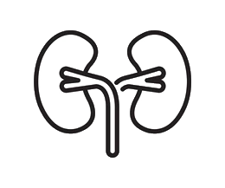
Relapsing infection
Relapse means that there’s a treatment failure
Treatment failure
Caused by :
Structural abnormalities
Abscesses
Treatment: Antibiotics used at the initial infection for 7-14 days.
Needs longer duration of therapy.
Recurrent infections
Recurrent infections Recurrent means that the patient will recover then get sick again
Patients with two or more symptomatic UTIs within 6 months |  |  |  |  | Patients with 3 or more symptomatic UTIs over a year
Need preventive therapy. (depend on the patient and the organism)
Antibiotic taken as soon as symptoms develop.
If infection occurs less than twice a year, a clean catch urine test should be taken for culture and treated as initial attack for 3 days.
Complicated UTI
Males |  | Comorbidities in paediatric patient |  | Spinal cord injury |  | Diabetes mellitus |  | Catheterization |  | age
Recurrent means that the patient will recover then get sick again
Patients with two or more symptomatic UTIs within 6 months
Patients with 3 or more symptomatic UTIs over a year
Need preventive therapy. (depend on the patient and the organism).
Complicated UTI :
Antibiotic taken as soon as symptoms develop.
age
Diabetes mellitus.
Comorbidities in paediatric patient.
If infection occurs less than twice a year, a clean catch urine test
should be taken for culture and treated as initial attack for 3 days.
Prophylactic antibiotics
Optional for patients who do not respond to other measures general practice such as: Diabetes and blood sugar control, hygiene and hydration.
Reduces recurrence by up to 95%.
Antibiotic taken at bedtime more effective.
Low dose antibiotic taken continuously for 6 months or longer, it includes : TMP-SMX, Nitrofurantoin, Cephalexin
Catheterization
Spinal cord injury.
Comorbidities in paediatric patient.

Slide 5
Management of Pyelonephritis
Uncomplicated
Complicated Moderate to Severe
Patients with fever, chills and flank pain but they are healthy, non-pregnant, female without relevant comorbidities and without structural or functional urinary tract abnormalities.
Can be treated at home with oral antibiotics for 14 days with one of the below :
Oral: Cephalosporins, Amoxicillin-Clavulanic acid, Ciprofloxacin or TMP-SMX. I.V: Ceftriaxone or Gentamicin then we switch to oral.
First dose may be given by injection.
Patients need hospitalization.
If fever and back pain continue after 72 hrs of antibiotic, imaging tests indicated to exclude abscesses, obstruction or other abnormality.
Antibiotics given by IV route for 3-5 days (or more) until symptoms are relieved for 24-48 hrs then we switch to oral.
-Many options can be used I.V. including Ceftriaxone or Meropenem (carbapenems) for resistant bacteria.
Treatment for specific populations
High risk for UTI (especially pyelonephritis) and Complications that’s why she should be screened for it
Antibiotics
during pregnancy includes Amoxicillin, Ampicillin, Cephalosporins, and Nitrofurantoin.
Team 439: Note: The two main populations that we screen and treat for asymptomatic bacteriuria are:
1-Pregnant women 2-Pre urologic procedure patients
Other patients (even old age or diabetic patients) that are asymptomatic with bacteriuria are not treated.
Pregnant women
with asymptomatic bacteriuria (evidence of infection but no symptoms) have 30% risk for acute pyelonephritis in the second or
third trimester.
Pregnant women
Pregnant women should NOT take Quinolones.
In asymptomatic bacteriuria: Screening and 3-7 days antibiotic needed.
Acute cystitis during pregnancy usually treated within 7 days of antibiotics.

Slide 6
Diabetic patients
Have more frequent and more severe UTIs.
treated for 7-14 days with antibiotics even patients with uncomplicated infections.
Note: Complicated UTIs (including diabetes) take the same medication as uncomplicated but with a longer duration (7-14 days) especially for cystitis.
Children with UTI
Usually treated with TMP-SMX or Cephalexin. (narrow spectrum)
Sometimes given as IV. (if unwell or with pyelonephritis)
Gentamicin may be recommended as resistance to Cephalexin is increasing.
Ciprofloxacin (Fluoroquinolones) is contraindicated along with Tetracyclines but it is not much used in UTI.
In male children it is important to look for the underlying cause of the infection. (such as undiagnosed anatomical issues e.g. VUR)
Common in children with UTI
Followed by oral treatment eg. amoxicillin-clavulanic acid or TMP-SMX .
5
Vesicoureteric Reflux (VUR)
1
4
Long-term antibiotic plus surgery used to correct VUR and prevent infections.
Acute kidney infection: use Cefixime (oral) or IV Ceftriaxone or Gentamicin a one daily dose for 2-4 days
2
3
Can lead to pyelonephritis and kidney damage.

Slide 7
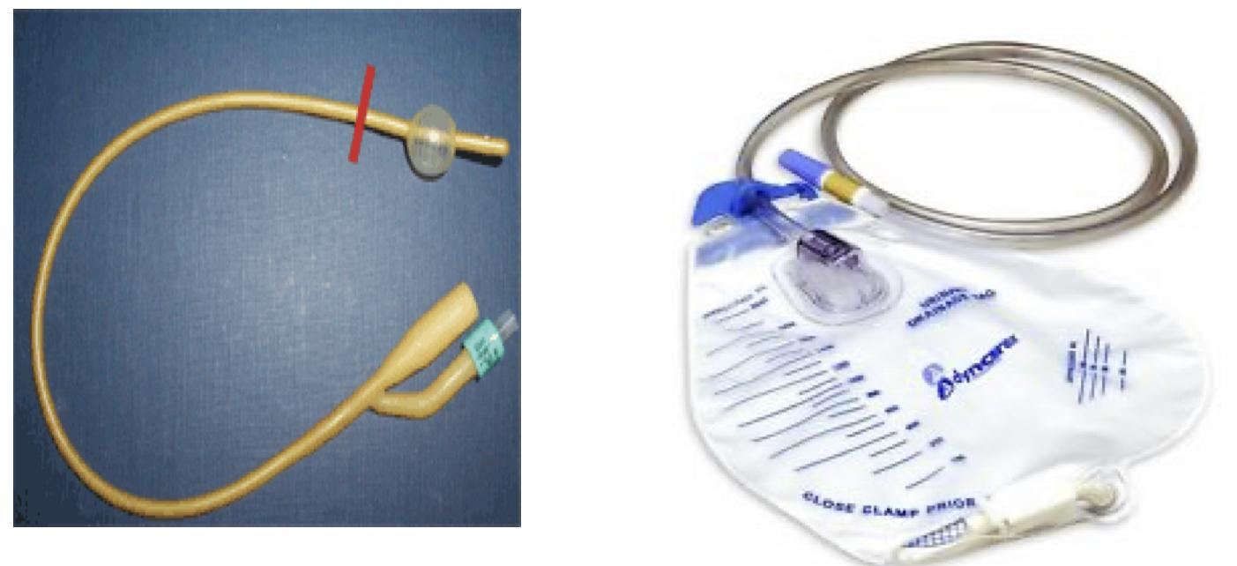
Urethritis in men
Most important causes:
Antibiotics
- Neisseria gonorrhoeae -Chlamydia trachomatis
A
C
IM Ceftriaxone + Doxycycline or Azithromycin.
Tests
B
Symptoms are generally very similar to cystitis with the addition of urethral discharge mostly caused by N.gonorrhoeae.
Management of catheter induced UTI:
Patients should also be tested for accompanying STD.
Overview
Very common.
Preventive measures.
Catheter should not be used unless absolutely necessary and they should be removed as soon as possible
Management of catheter induced UTI
Overview | Very common. Preventive measures. Catheter should not be used unless absolutely necessary and they should be removed as soon as possible
Intermittent use of catheters | If catheter is required for long it is best to be used intermittently. May be replaced every two weeks to reduce risk of infection and irrigating bladder with antibiotics between replacements. Daily hygiene and use of closed system to prevent infection.
Catheter induced infections | Catheterized patients who develop UTI with symptoms or at risk for sepsis should be treated for each episode with antibiotics and catheter should be removed, if possible. Associated organisms are constantly changing. May be multiple species of bacteria. Antibiotics use for prophylaxis is rarely recommended since high bacterial counts present and patients do not develop symptomatic UTI. Antibiotic therapy has little benefit if the catheter is to remain in place for long period.
Intermittent use of catheters
If catheter is required for long it is best to be used intermittently.
May be replaced every two weeks to reduce risk of infection and irrigating bladder with antibiotics between replacements.
Daily hygiene and use of closed system to prevent infection.
Overview
Catheterized patients who develop UTI with symptoms or at risk for sepsis should be treated for each episode with antibiotics and catheter should be removed, if possible.
Associated organisms are constantly changing.
May be multiple species of bacteria.
Antibiotics use for prophylaxis is rarely recommended since high bacterial counts present and patients do not develop symptomatic UTI.
Antibiotic therapy has little benefit if the catheter is to remain in place for long period.

Slide 8
 | Ampicillin | Amoxicillin | Ceftriaxone | Cephalexin | Fluoroquinolone | TMP-SMX (Bactrim, septra, cotrimoxazole) | Nitrofurantoin | Surgery
Cystitis
Uncomplicated for 3 days Unless pregnant = 7 days |  | ✓ | ✓ | ✓ | ✓only if first choice is resistant | ✓ | ✓long term use
Prophylactic |  |  |  | ✓low dose |  | ✓low dose | ✓low dose | ✓
 | Ampicillin | Amoxicillin | Ceftriaxone | Cephalexin | Fluoroquinolone | TMP-SMX | Nitrofurantoin | Surgery
Pyelonephritis
Uncomplicated 14 days 1st dose by injection |  | ✓ | ✓ | ✓ | ✓ | ✓
Pregnant women 3-7 days | ✓ | ✓ | ✓ | ✓ | # |  | ✓
Children |  |  | ✓ | ✓ Gentamicin if resistant |  | ✓
In moderate /severe cases: 1st: Antibiotic IV route 3-5 days. 2nd: If 24-48 hrs with no symptoms → treated 3rd: If returned after 72 hrs → imaging tests (to find abnormalities) In diabetes patients: 7-14 days
 | Gentamicin | Ceftriaxone | Cefixime | Amoxicillin | TMP-SMX | Surgery
Vesicoureteric reflux
Long term | 1 | 1 | 1 | 2 | 2 | ✓
Or
Or
Or
Urethritis in men
Ceftriaxone +Doxycycline Or +azithromyscin
Summary
Thanks to team Med439!!
Catheters
Replace every 2 wk Irrigate bladder with antibiotics

Slide 9
MCQs
1-C
2-B
3-D
4-A
5-c
6-D
1- A pregnant woman with cystitis came into the clinic, what should we give her and how long?
A-Amoxicillin 3 days | B-Quinolones 7 days | C- Cephalosporins 6 days | D-Nitrofurantoin 55 days
2-After surgery, the patient was put on a catheter. After a week, the patient’s urine had a very high bacterial count in the capsule. What’s the next step?
A-Treat with quinolones and replace catheter | B-Do not use antibiotics and replace catheter | C-Irrigate the bladder with antibiotics and do not use oral antibiotics | D-Remove catheter with treat with amoxicillin.
3-A man presented with painful and difficult urination and urethral discharge, how should we treat him?
A-Amoxicillin with gentamicin | B-Doxycycline with Azithromycin | C- Amoxicillin with ceftriaxone | D-Ceftriaxone with Azithromycin
4-A 6-years-old girl was brought to the hospital. Her mother complained of the child’s sudden bedwetting and foul-smelling urine. How should we treat her?
A-Cephalexin | B-Gentamicin | C-Tetracycline | D-Ciprofloxacin
5- A 5 Year old child with Vesicoureteral reflux (VUR) presented with fever , vomiting and flank pain. Pyelonephritis is suspected. Which empiric treatment is used?
A- TMP-SMX | B- Ciprofloxacin | C-Ceftriaxone | D-Ampicillin
6- Which of the following patients need treatment of asymptomatic bacteriuria?
A-Catheterized elderly man | B- Controlled diabetic mellitus patient | C- Hypertinsive patients | D- Pregnant Women
For more questions click here!
Explanations:
2- Why? Because we shouldn't take the sample from catheter capsule→ good culture for bacteria. Take fresh sample.
3-Because it is urethritis
4-Why not gentamicin? We use gentamicin only if there is resistance..

Slide 10
Cases/SAQs
From Boys’ Doctor
Q1: 30 Year old with frequency and painful urination, Urine analysis showed + Leukocyte esterase and nitrate, Microscopy revealed presence of WBCs and Bacteria.
What is the management?
What if she was diabetic?
Q2: 30 Year old Asymptomatic pregnant woman, Culture was positive for 100,000 CFU/ml E.Coli sensitive to all tested Antibiotics
Treatment?
Q3: 30 Year old with frequency and painful urination, Fever, Flank Pain and tenderness on exam area. Urine analysis showed + Leukocyte esterase and nitrate, Microscopy revealed presence of WBCs and Bacteria.
What is the management?
Q4: 4 Year old male child with Pyelonephritis.
What is the management?
Found to have VUR what is the management ? And why?
Answers Key
1A) 3 Days antibiotic: Amoxicillin or Nitrofurantoin
1B) Same thing but Longer duration
2A) Amoxicillin or IV Cephalexin
(Narrow Spectrum)
3A) 3-5 Days IV until get better then switch to Oral
Or
Oral for 14 days
It all depend on the case if it is mild or severe
4A) 3-5 Days IV until get better then switch to Oral
4B) Long term antibiotic + Surgery , to correct VUR and prevent infections

Slide 11
Microbiology Team⁴⁴²
Leaders
Deema Aljuribah | Mohammed Alghamdi
Members
Fatima Halawi | Ahmad bahmaid
Shahed Bukhari | Salman Albadr
Layan Alburikan | Hazem Almalki
Amani Alotaibi | Yazeed Hussien
Shahed Almarshad Shaden Alamri
Meshari Alshathri
Ali Dhafer
Abdulaziz was here
Microbiology442@gmail.com

