Slide 1
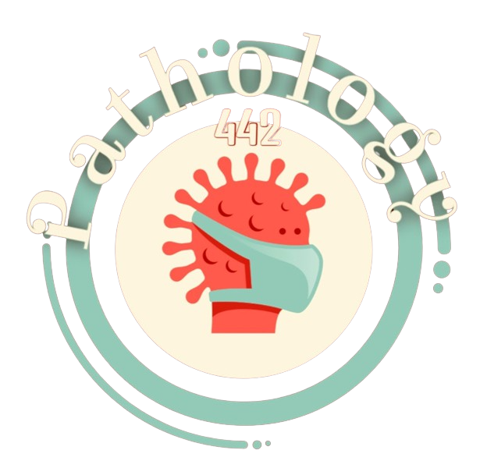
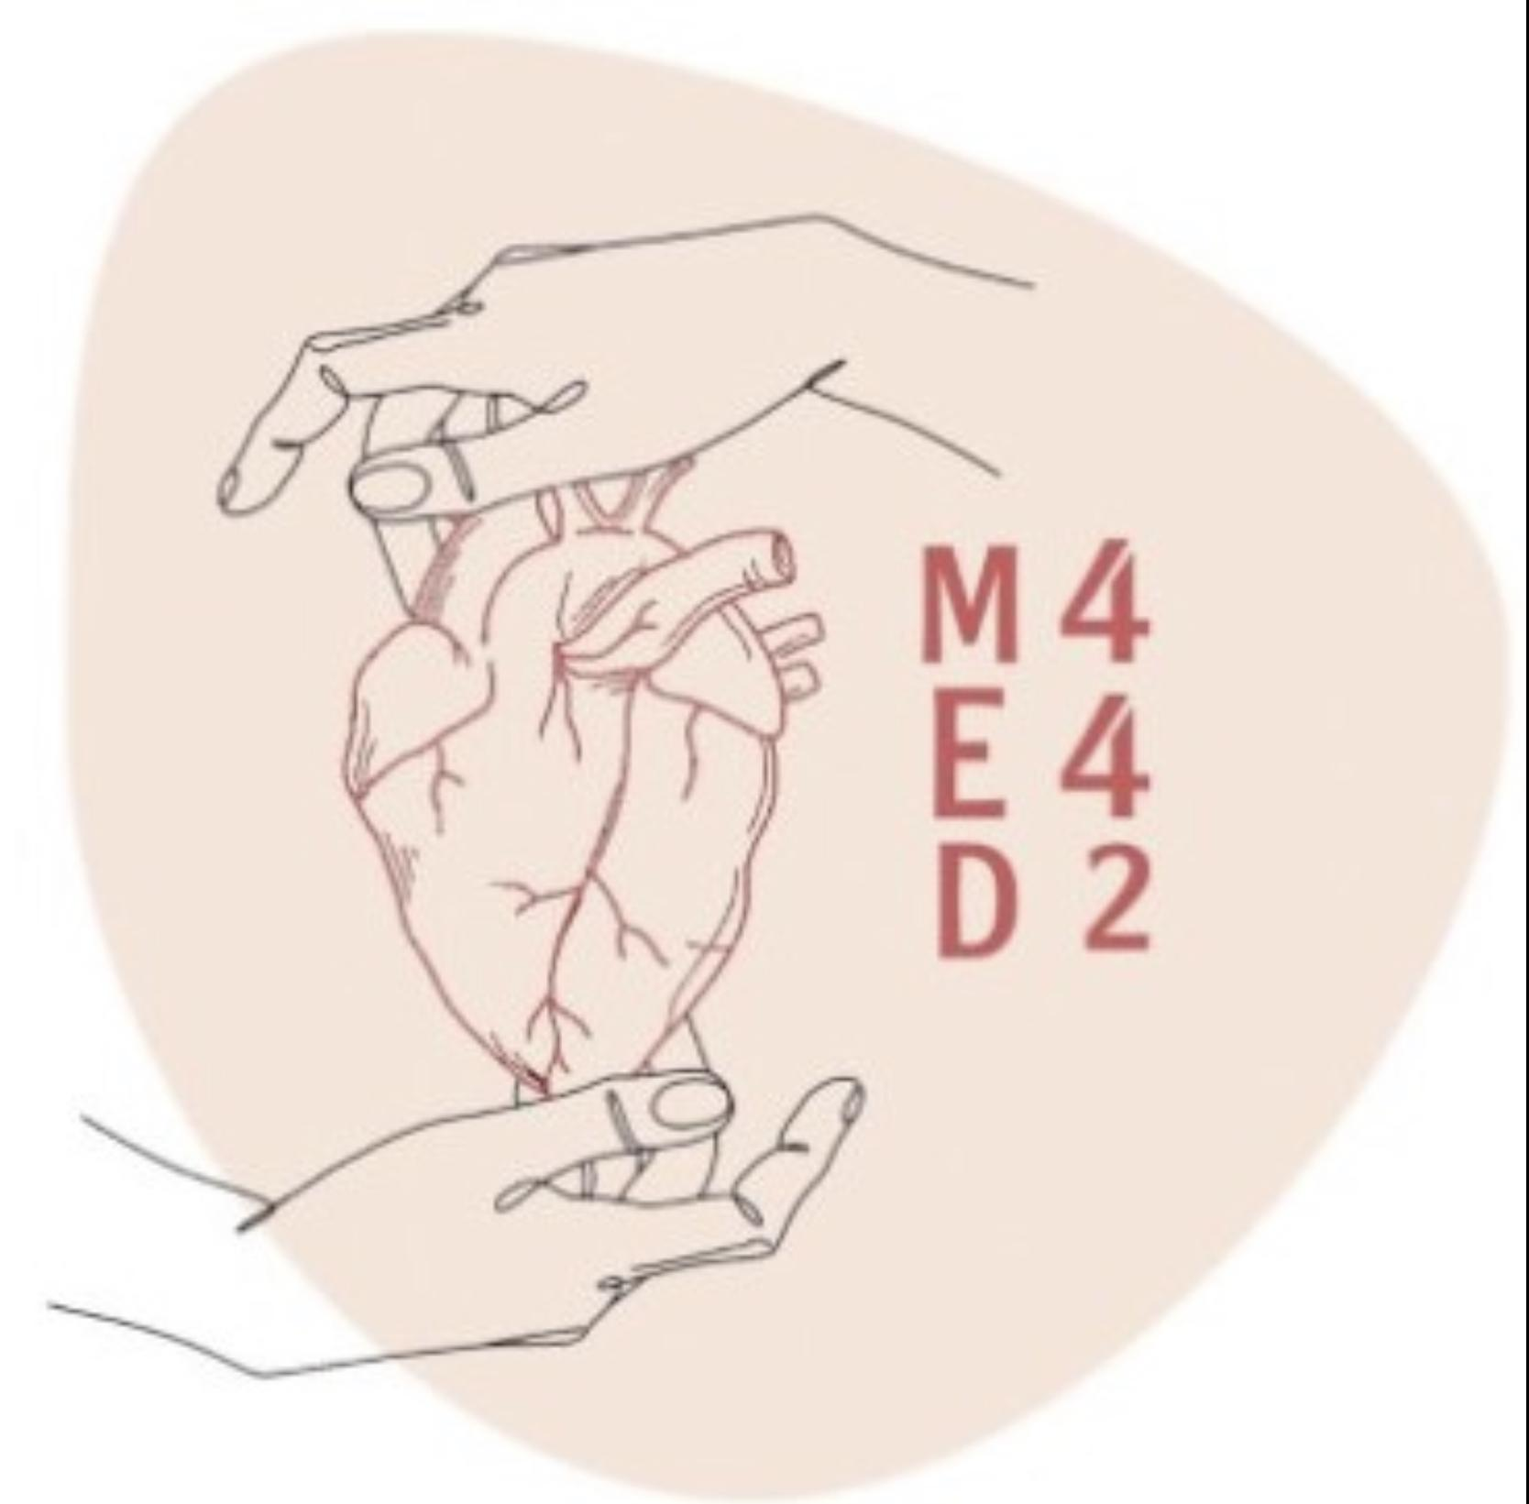
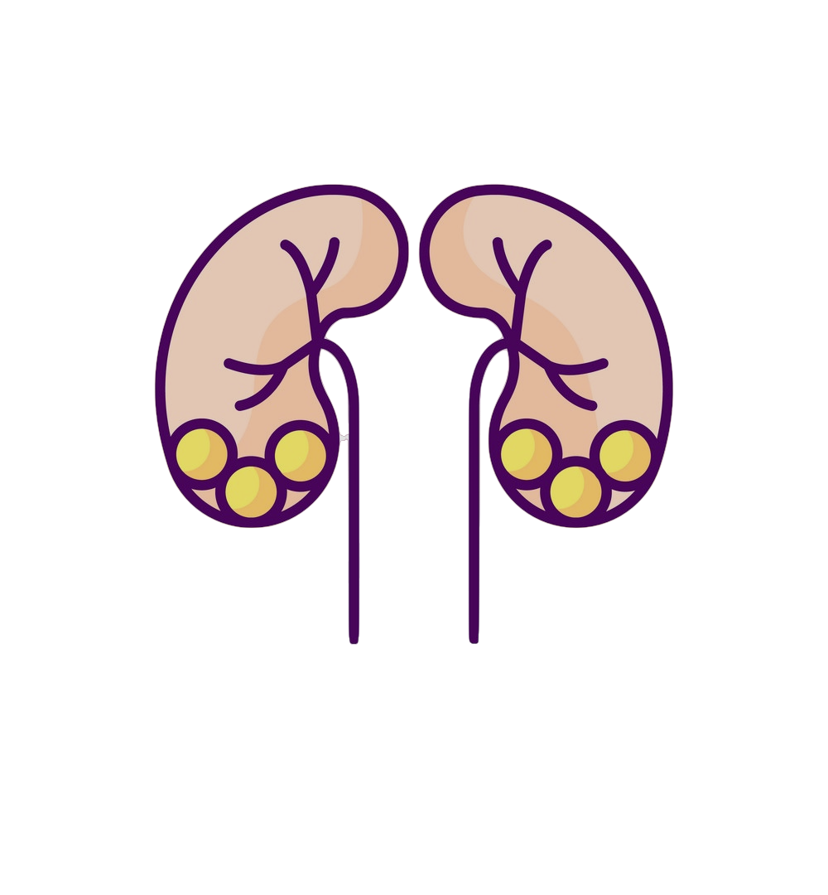
Pathology
L1
Acute kidney injury
Editing File
- Color Index:
Main Text
Male’s Slides
Female’s Slides
Important
Doctor’s Notes
Extra Info

Slide 2
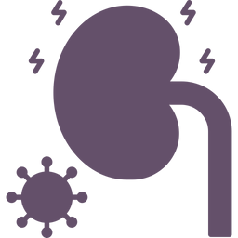
Objectives
Upon completion of this lecture the students will be able to:
Describe the guidelines of the renal biopsy.
Recognize the types of acute kidney injury.
Recognize the clinical manifestations of acute kidney injury.
Describe the pathological findings in acute kidney injury.
Key Outlines:
Brief review of the normal anatomy and histology of the kidney and urinary tract.
Terminology.
Etiology.
Pathophysiology.
Clinical manifestations with diagnostic approach.
Pathological evaluation: The four elements possibly implicated: Gross and histological findings.
Conclusion.

Slide 3
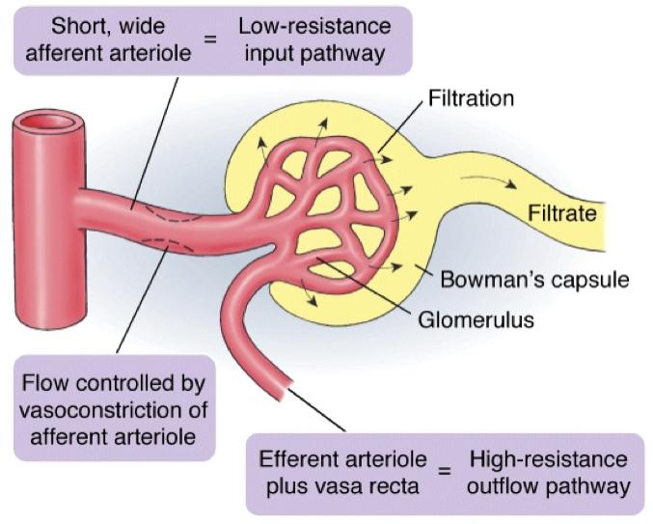
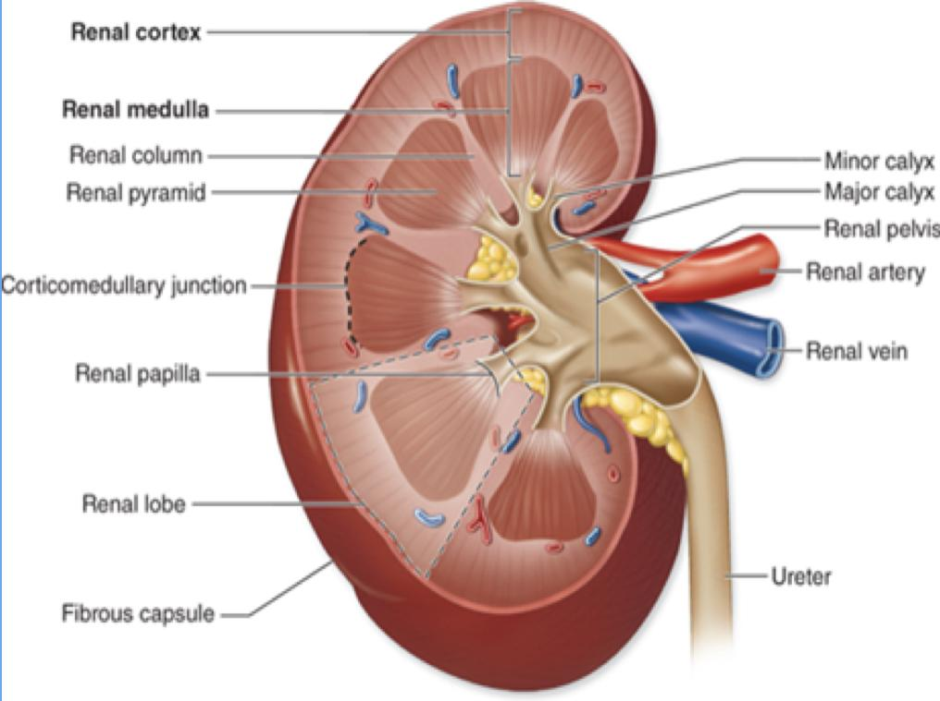
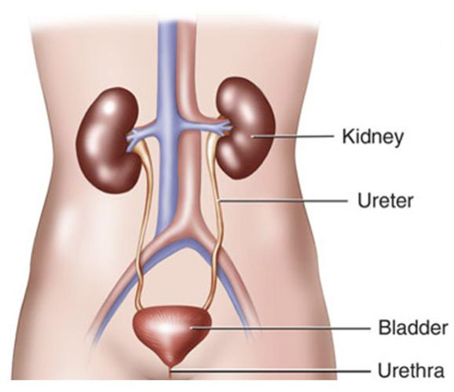
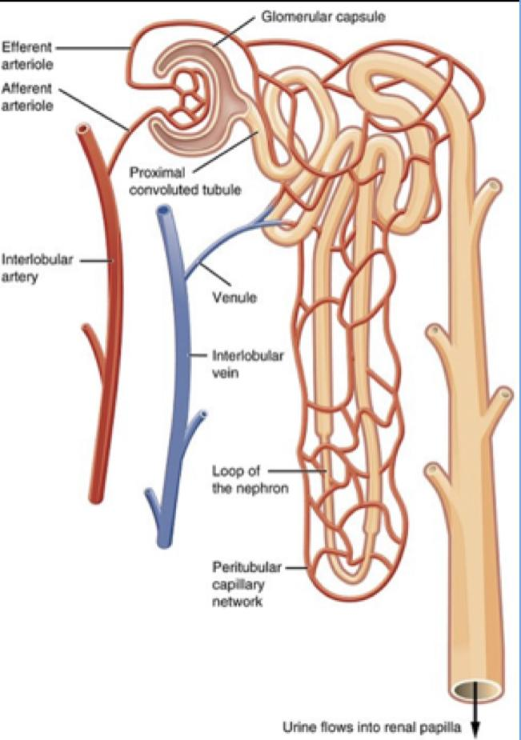
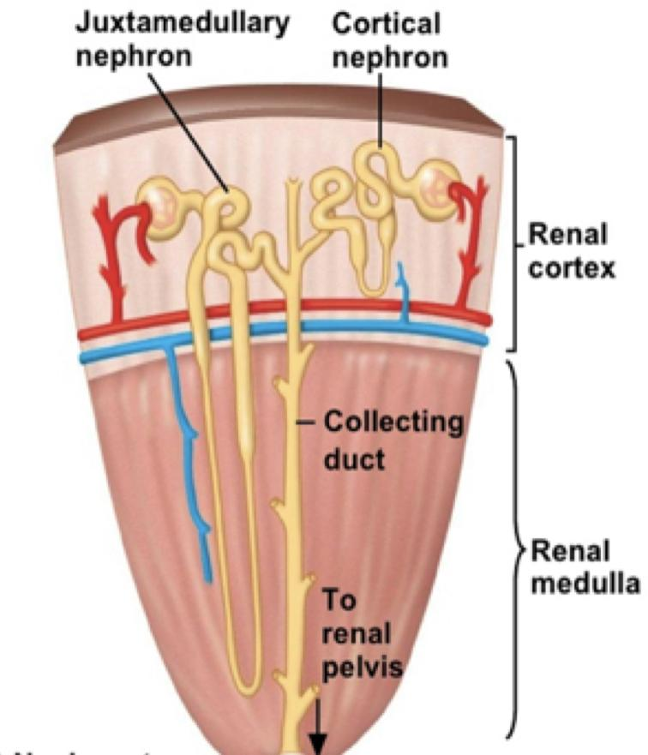
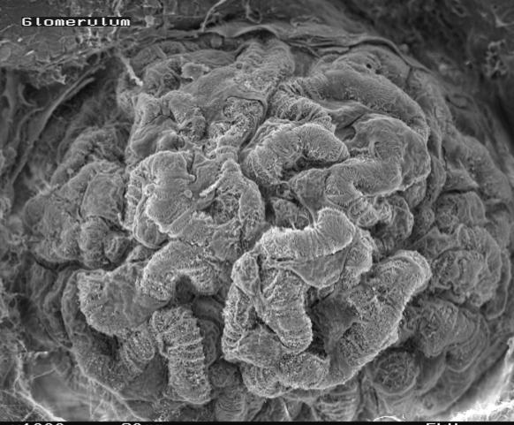
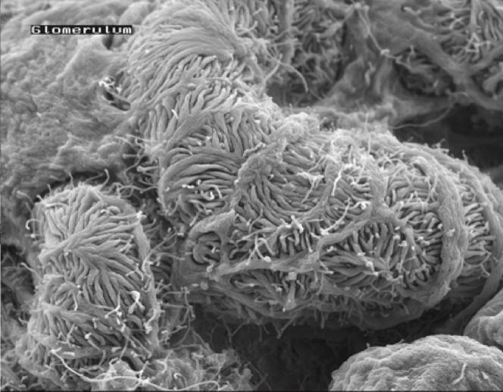
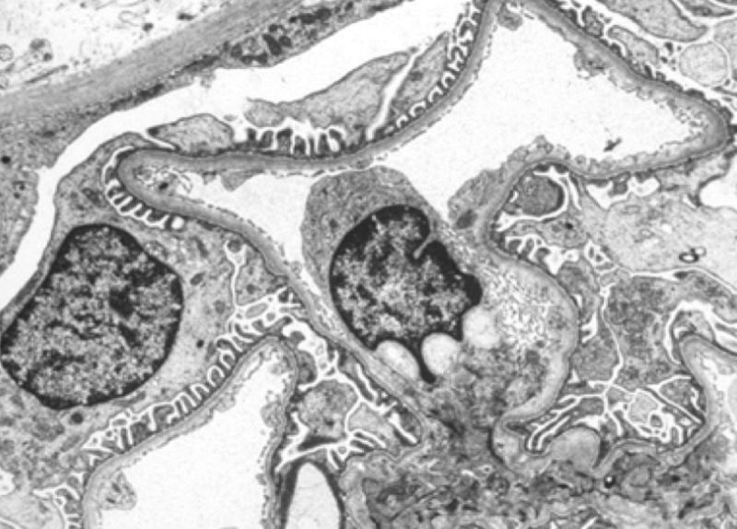
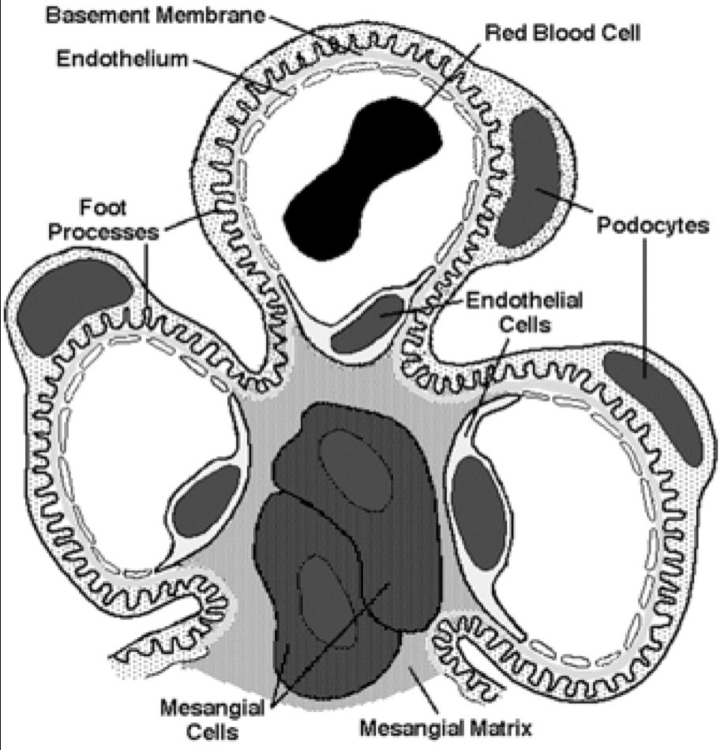
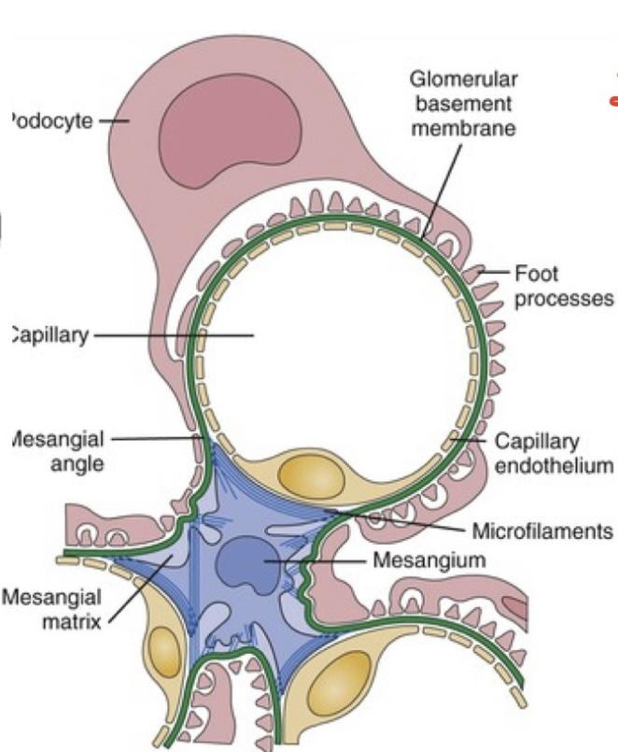
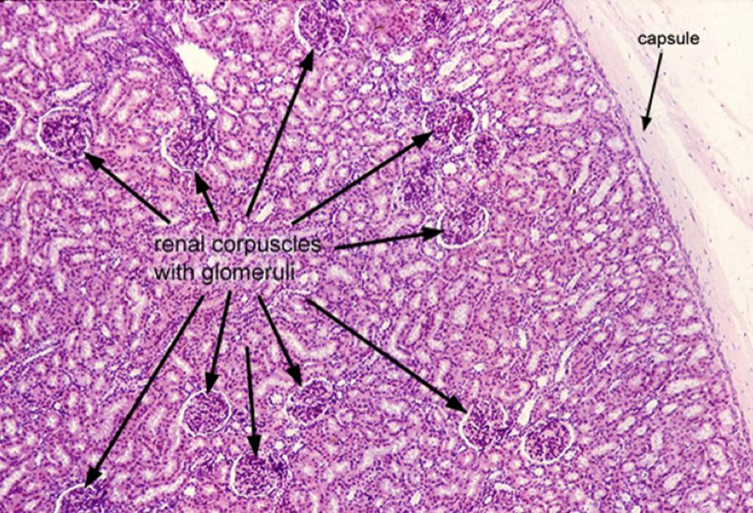
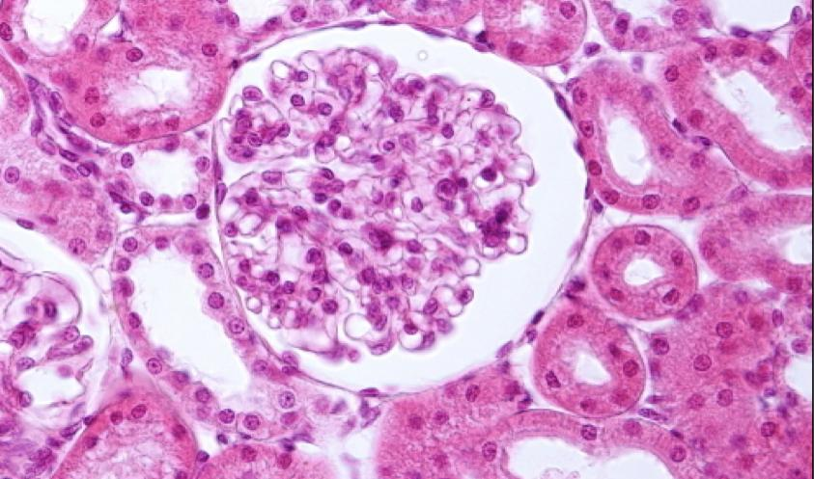
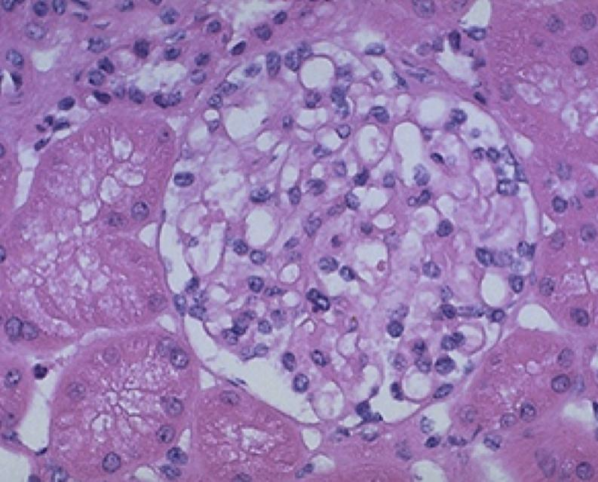
Introductory slide
Anatomy of the kidney
Histology of the glomerulus
Scanning EM
Under the
(LM)
Under the
(EM)
Under the
(EM)
Transmission
(Cross section)
EM
Under the
(LM)

Slide 4
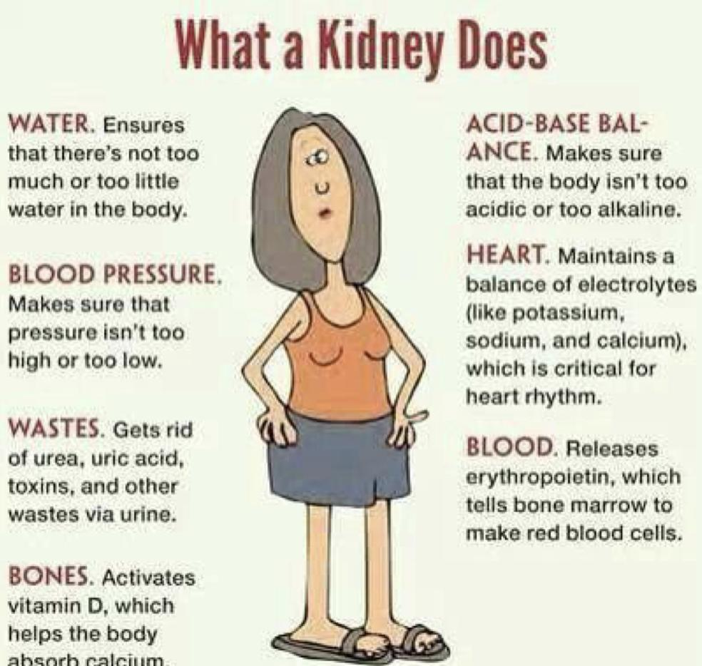
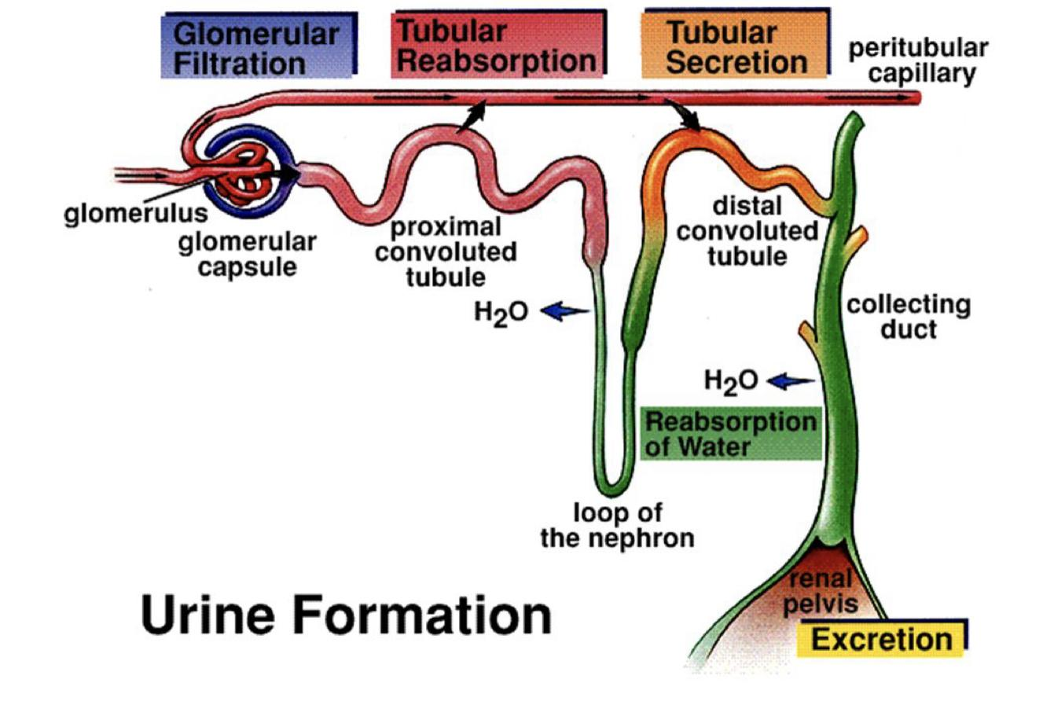
Normal Kidney Function
1
Excretory function:
Detoxify blood, removal of toxins, nitrogenous wastes (urea and creatinine), drugs etc.
2
Homeostatic function:
Maintain and regulate water balance and osmolality.
Maintain and regulate electrolyte balance (Na+, K+, Ca2+, Cl-, Mg2+ ions etc) .
Maintain and regulate acid-base balance (pH, H+ and HCO3- ions).
3
Endocrine function:
Secretes renin from the JGA cells to regulate BP and electrolyte balance.
Secretes erythropoietin from the endothelial cells lining the cortical peritubular capillaries to stimulate the bone marrow to produce RBCs.
Converts inactive Vit D3 to active 1,25 dihydroxycholecalciferol by alpha one hydroxylase enzyme under the inﬂuence of PTH (Parathyroid hormone) → increases calcium absorption.

Slide 5
Important terminology
Uremia
is a clinical syndrome associated with ﬂuid, electrolyte, and hormone imbalances and metabolic abnormalities, which develops with deterioration of renal function.
due to the accumulation of organic waste products that are normally cleared by the kidneys.
uremia means urine in the blood. Uremia can be seen in both chronic kidney disease and acute kidney injury.
Azotemia
Is abnormally high levels of nitrogen-containing compounds (such as urea, creatinine etc) in the blood.
It can lead to uremia if not controlled.
It is an elevation of blood urea nitrogen (BUN) and serum creatinine levels.
Oliguria
Urine output is markedly less than 400 ml/24 hours
Anuria
Urine output less than 200 ml/24 hours
Renal Failure
(Insufficiency)
is when the kidneys fail to adequately filter toxins and waste products from the blood.
In renal failure there is decrease in glomerular filtration rate and an elevated serum creatinine level.
Note: Creatinine clearance or filtration is dependent on the glomerular filtration rate (GFR).

Slide 6
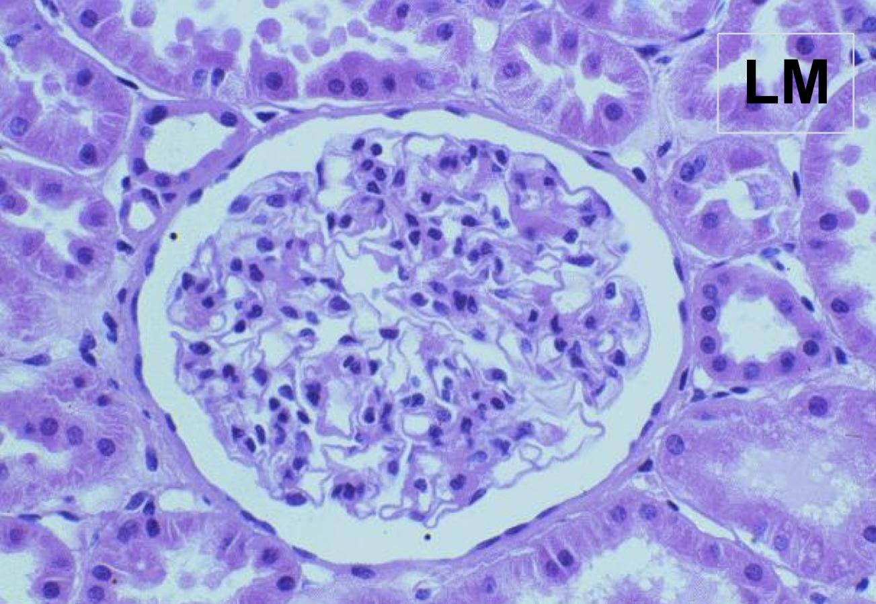
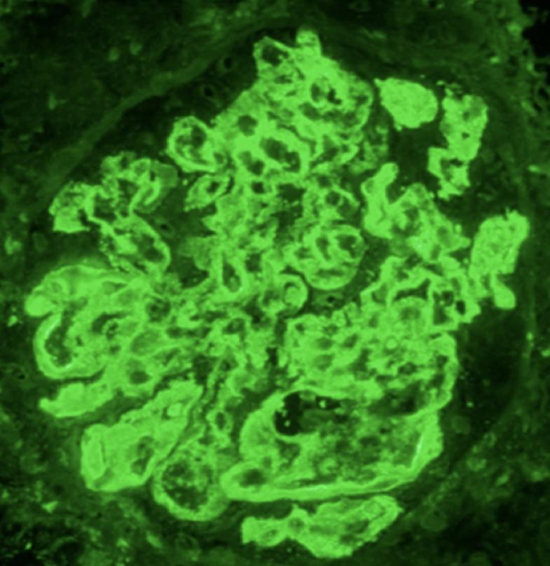
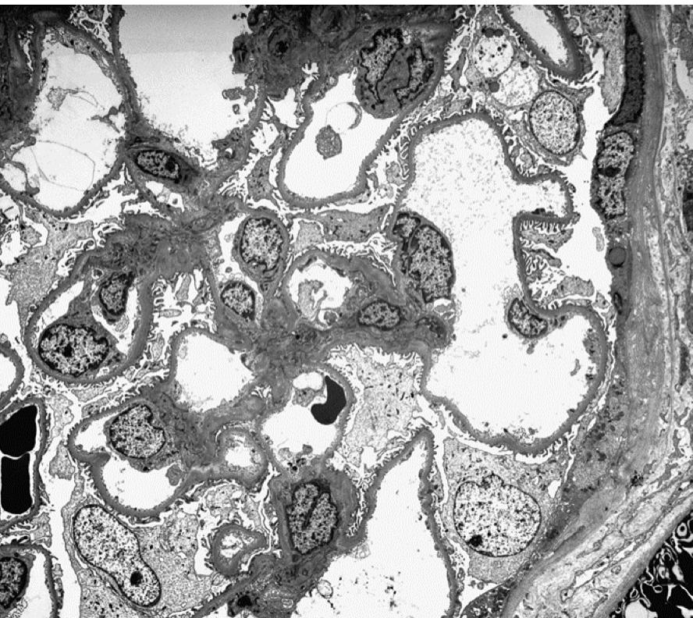
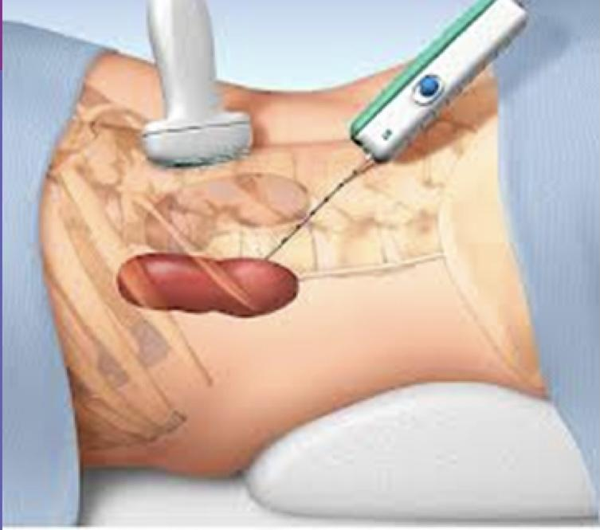
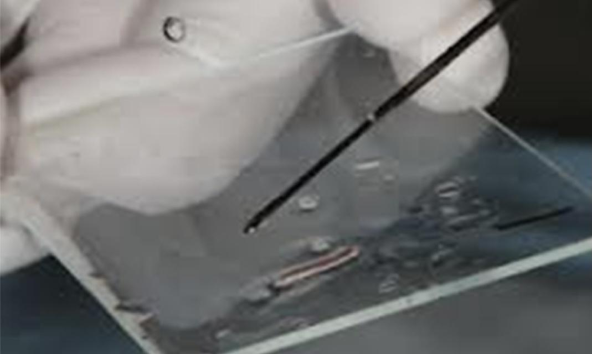
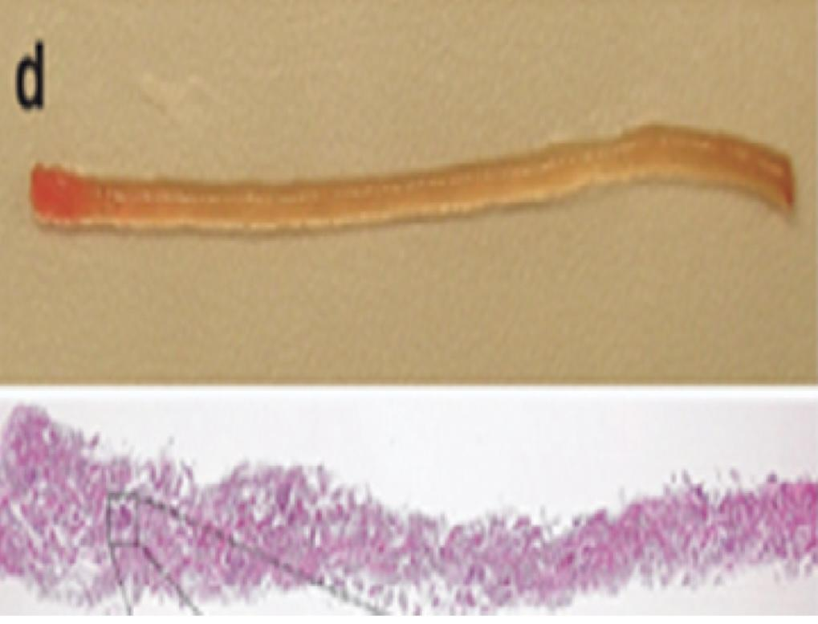
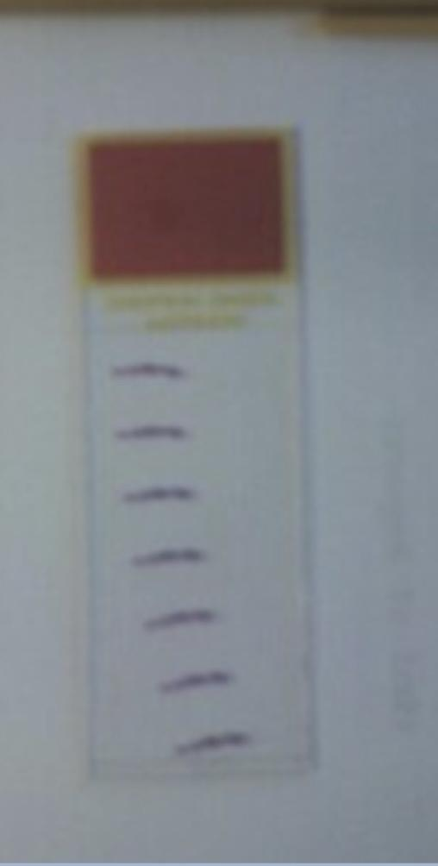
Kidney biopsy
The tissue obtained is used to make slides for:
Light microscopy (LM) :
to study the histology in renal cortex & medulla.
Immunofluorescence (IF) :
study is to detect:
the presence of immunoglobulins (IgA, IgG, IgM) and complements (C3
and C1q) in the glomerular mesangium or in the wall of the glomerular capillary loops.
Electron microscopy (EM)
(ultrastructural) :
study is to detect the presence or absence of:
effacement of the epithelial cell (podocytes)foot processes.
electron dense immune complex deposits
If deposits are present then to identify the location of the deposits in the glomeruli (mesangial/paramesangial, subepithelial, subendothelial).

Slide 7
Renal failure classiﬁcation
Based on Duration
Acute
Chronic
Sudden onset.
Rapid reduction in urine output.
Usually reversible.
Gradually progressive with nephron loss.
Usually not reversible.
Based on Etiology
1- Pre-Renal
3- Post-Renal
2- Renal
(55-60%)
The renal tubular and glomerular function are normal. Here the GFR is decreased due to reduced renal perfusion.
(35-40%)
Is due to diseases of the kidney itself (which is associated with release of renal afferent vasoconstrictors).
(5-10%)
Occurs when obstruction in the urinary tract below the kidneys causes waste to build up in the kidneys.
Based in the urine output
Non-oliguric
Anuric
Oliguric
Urine output less than 400ml/day
Urine output greater than 400ml/day
Urine output less than 100ml/day
NOTE: sometimes more than 70% of renal function can be lost before it is clinically noticeable.

Slide 8
Acute kidney injury
Definition
(previously called acute renal failure [ARF])
AKI is a syndrome defined by a sudden loss of renal function over several hours to days resulting in the accumulation of nitrogenous compounds such as urea and creatinine.
It is characterized by:
Note: the contrast medium/dye used in various radiological tests can occasionally induce AKI.
Rapid rise in serum creatinine
Accumulation of
nitrogenous waste products.
Sudden decrease in GFR (hours to days)
Oliguria: the urine output is markedly decreased (usually it is less than 400 ml/day)
Fluid imbalance; electrolyte imbalance; acid-base disturbance; and mineral disorders.
Pathogenesis Of Acute Kidney Injury
Note:In AKI if there is reduction in renal blood flow/ renal perfusion decrease in glomerular filtration rate (this is the common pathologic pathway for AKI regardless of the cause). The decreased GFR activation of renin-angiotensin-aldosterone system. These physiologic changes result in increased sodium reabsorption, increased water retention, increased urinary creatinine concentration, increased urine specific gravity and increased urine osmolality. Acids are retained and HCO 3 is excreted.

Slide 9
Based on Kidney Disease Improving Global Outcomes(KDIGO) AKI is deﬁned by the presence of any one of the following:
1- Pre-Renal azotemia
It results from Decreased renal perfusion/hypoperfusion (i.e. decreased effective blood flow to the kidney.
Initially the body tries to compensate but in severe hypoperfusion → GFR is markedly decreased → AKI
The treatment of the cause Restores the renal function.
Is the most common cause of acute renal failure (ARF).
(important to know all of them because it may come as cases) + MCQs
Hypovolemia: e.g. hemorrhage, volume depletion (dehydration or GIT ﬂuid loss in vomiting, diarrhea), hypoalbuminemia, diuretics, third space losses (burns, peritonitis, muscle trauma) etc.
Impaired cardiac function (cardiac failure, myocardial infarction, massive pulmonary embolism).
Pre Renal causes of ARF are: Anything that leads to renal Hypoperfusion:
Sepsis, septic shock.
Cirrhosis (it can cause renal vasoconstriction → kidney injury called “hepatorenal syndrome”)
Anaphylaxis.
Other causes: surgery, NSAIDS and other nephrotoxic drugs etc.

Slide 10
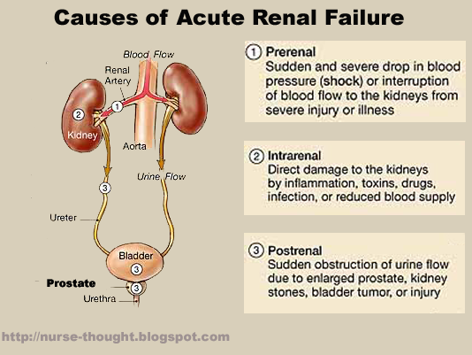
2- Renal causes of AKI (intrinsic)
Glomerular diseases | Tubular diseases |  | Vascular diseases | Interstitial & tubulo- interstitial diseases
There is glomerular injury in severe forms of active glomerulonephritis (GN) >> leads to reduction in total filtration area >> reduction in GFR. Examples include: Post infectious GN Rapid progressive crescentic GN Active autoimmune GN Etc. | Acute Tubular Injury/ Necrosis It can be ischemic cause or nephrotoxic cause |  | Various forms of vasculitis and emboli lead to reduced renal blood flow due to vascular obstruction or destruction, thus lowering the GFR e.g. • Vasculitis • Thromboembolic disease (renal artery/ renal vein thrombosis) • Thrombotic microangiopathies (HUS/ TTP) • Malignant hypertension | Acute Tubulo-interstitial Nephritis (TIN) e.g. • Drug induced TIN • Autoimmune TIN • Infections TIN Rarely malignant infiltration in interstitium can cause AKI
 | Ischemic: prolonged ischemia to nephrons leads to the tubular injury and necrosis | Toxic: toxicity to nephrons leads to tubular injury & necrosis I) Endogenous toxins Pigments and casts: • Myoglobinuria (in Rhabdomyolysis) • Hemeglobinuria • Myeloma casts etc. II) Exogenous toxins Nephrotoxic drugs: • Aminoglycosides (antibiotic). • Amphotericin B • Calcineurin inhibitors (e.g., tacrolimus) etc. Radiograph contrast medium (dyes induced toxicity)
3- Post renal causes of AKI/ ARF
Any obstruction to the outﬂow of urine:
Congenital or structural abnormality
Benign prostatic hyperplasia (older men)
Stones in the urinary tract
A tumor in the urinary tract (e.g. ureter, bladder, prostate, urethra).
External compression from the outside of the urinary tract (e.g. retroperitoneal fibrosis or tumors like carcinoma of cervix).

Slide 11
Note: Common causes of AKI
The kidney biopsy of a patient with AKI can show any of the previously mentioned causes.
The common causes are:
Tubular cause: acute tubular injury/ acute tubular necrosis
Interstitial cause: acute tubulointerstitial nephritis (later lectures)
Glomerular cause:
Post infectious glomerulonephritis (later lectures)
Rapid progressive crescentic glomerulonephritis (later lectures)
Acute tubular injury and Acute tubular necrosis
In acute tubular injury/ necrosis there is damage to the epithelial cells of the renal tubule and it leads to rapid decline of renal function (i.e. AKI) and presence of granular casts and tubular cells in urine. The damage can be induced by: | Ischemia leading to renal ischemic injury: renal ischemia > reduction in GFR > acute tubular injury/ necrosis. The proximal tubule is most vulnerable to ischemia. [renal ischemia can be caused by any condition that causes prolonged persistent hypovolemia or circulatory shock e.g. extensive trauma, burns, hemorrhage, pancreatitis, incompatible blood transfusions, dehydration, septic shock, etc.]
 | 2. Substances toxic to the kidney leading to nephrotoxic injury: here the AKI is caused by direct injury of the tubules by toxins. Causes include: Antibiotics: Aminoglycosides, Tetracyclines, Amphotericin, Cephalosporins etc. Heavy metals: Mercury, Lead, Arsenic, Gold salts, Barium etc. Others: Cisplatin, Doxorubicin, Carbon tetrachloride, Radiographic contrast agents, etc.

Slide 12
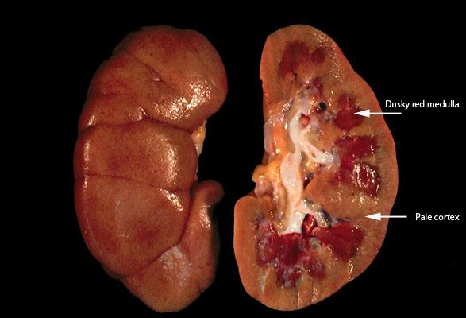
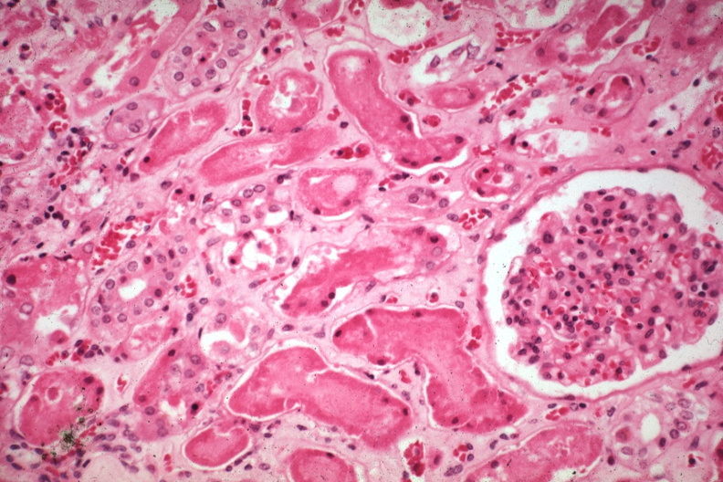
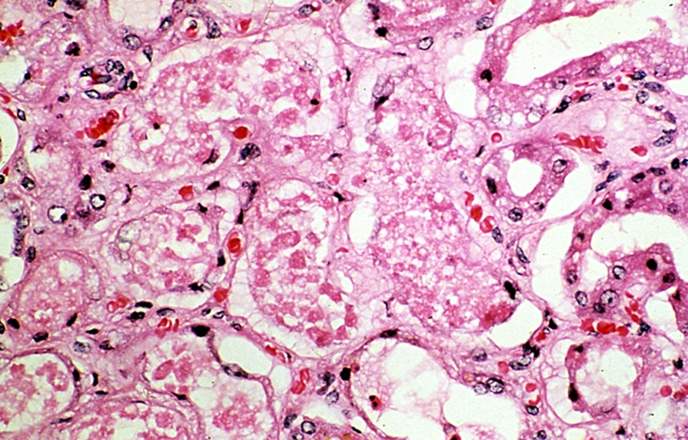
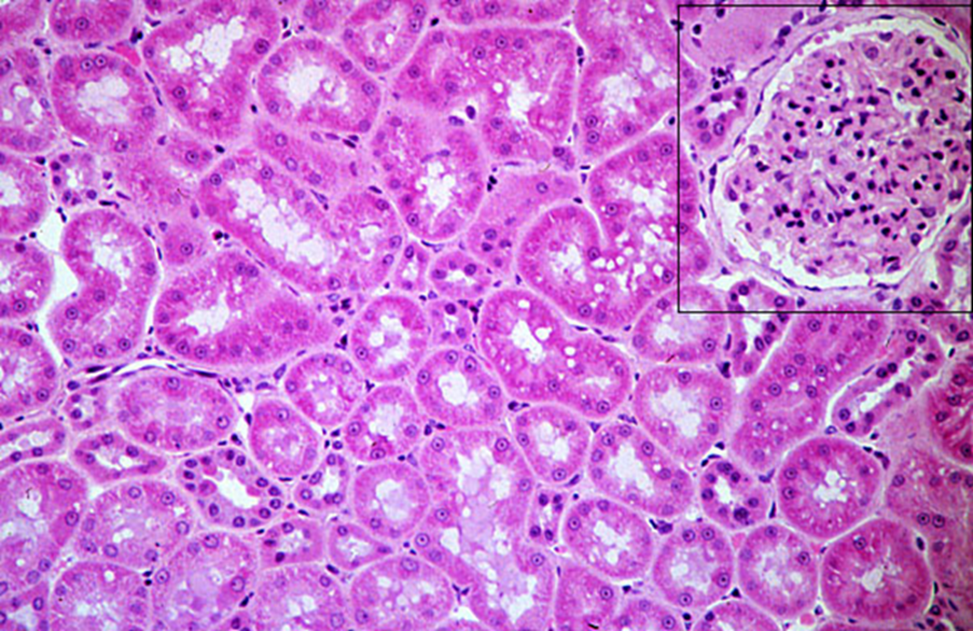
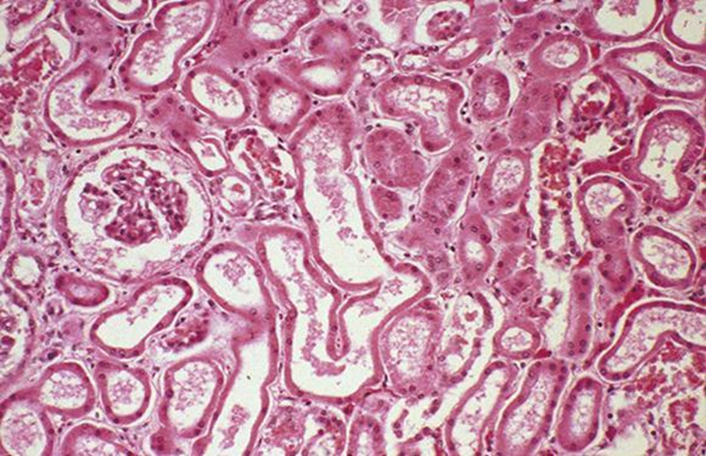
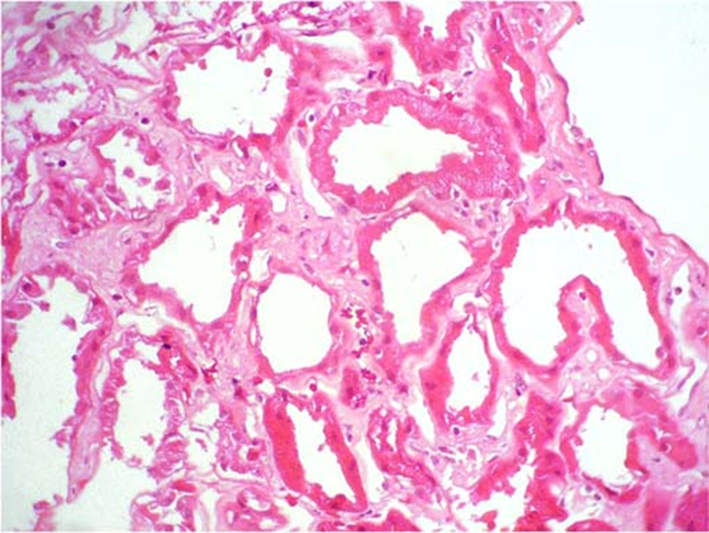
Gross morphology
bilaterally enlarged & swollen kidneys (due to edema)
Cut surface shows a pale cortex and a dark & congested medulla
Histology
tubular epithelial cell | Ranges from tubular epithelial cell swelling (mild injury) to tubular epithelial cell necrosis (severe injury). The tubular epithelial cells become flattened (so the wall of the tubule becomes thin) and show loss of brush border. In the necrotic tubular epithelial cells there is loss of nucleus and also there is sloughing (falling off) of necrotic cells into the lumen of the tubule.
proximal tubules | The proximal tubules become dilated and irregular in shape
distal tubules. | Casts may be present in the lumen of the distal tubules.
Interstitium → mild edema.
Later as healing begins there is regeneration of the tubular epithelial cells
Ranges from tubular epithelial cell swelling (mild injury) to tubular epithelial cell necrosis (severe injury).
The proximal tubules become dilated and irregular in shape
The tubular epithelial cells become flattened (so the wall of the tubule becomes thin) and show loss of brush border.
In the necrotic tubular epithelial cells there is loss of nucleus and also there is sloughing (falling off) of necrotic cells into the lumen of the tubule.
Casts may be present in the lumen of the distal tubules.
Interstitium → mild edema.
Later as healing begins there is regeneration of the tubular epithelial cells
Normal tubule | Acute tubular injury/ necrosis

Slide 13
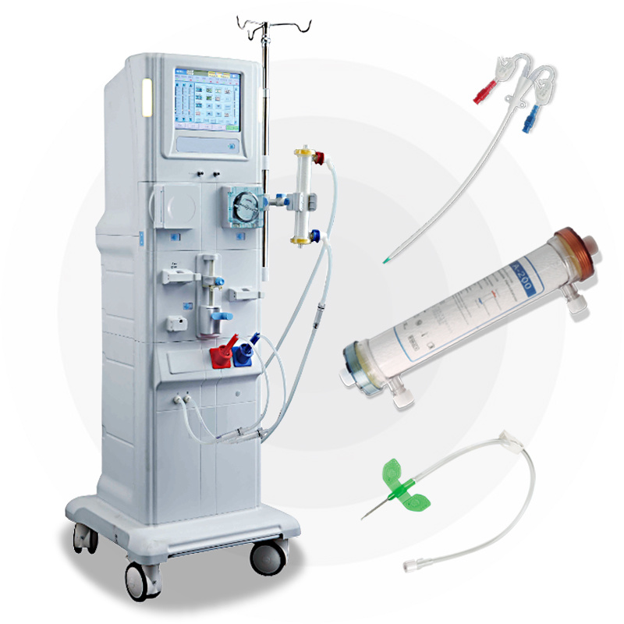
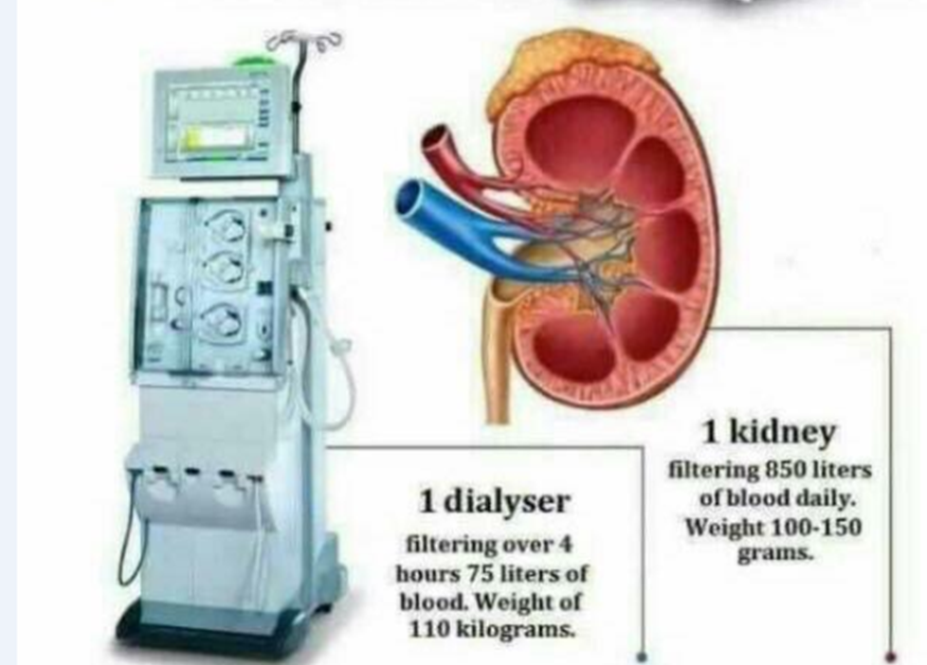
Clinical features of AKI
Oliguria: Decreased urine output (occasionally urine output remains normal). Typically the urinary output is < 400 ml/day.
Defective elimination of metabolic waste, water, electrolytes, and acids from the body. Waste material is accumulated in the body which causes azotemia (> nausea & vomiting), acid-base imbalance (> acidosis) and electrolyte imbalance like hypernatremia and hyperkaliemia (> abnormal heart rhythms, risk of heart failure, weakness and muscle paralysis).
Salt and water retention > generalized edema starting with swelling in your legs, ankles or feet.
Pulmonary edema (shortness of breath due to extra fluid on the lungs).
Other features: hypotension, nephritic syndrome, flank pain, fatigue, uremic encephalopathy, confusion, seizures or coma in severe cases
Sometimes acute kidney failure causes no signs or symptoms and is detected through lab tests done for another reason.
Treatment
Treat the underlying etiology.
Dialysis
Correction of fluid imbalance.
Correction of acidosis and electrolyte imbalance e.g hyperkalemia

Slide 14
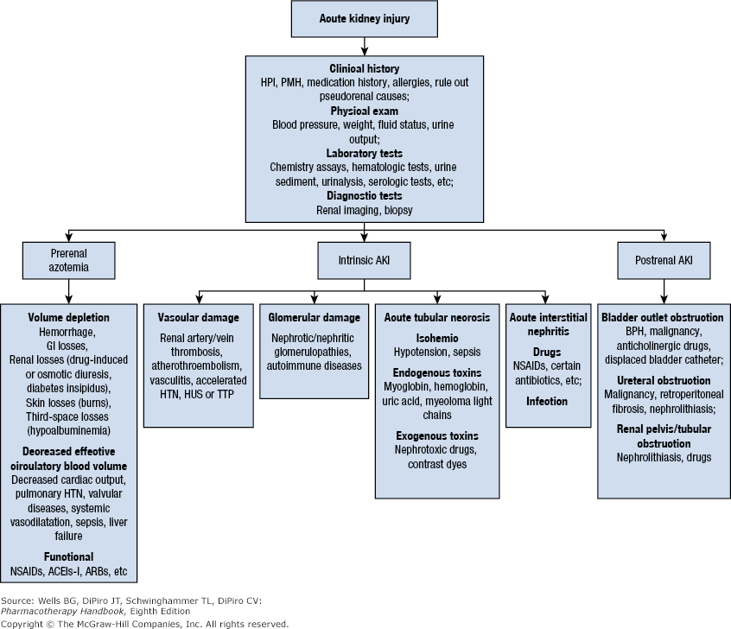
Summary of causes of AKI :

Slide 15
Summary
Renal Failure | Renal failure (Renal insufficiency): Is when the kidneys fail to adequately filter toxins and waste products from the blood. In renal failure there is decrease in glomerular filtration rate(GFR) and an elevated serum creatinine level. Treatment: treat the cause
Renal failure classification
Based on Duration
Acute |  |  | Chronic
Sudden onset Rapid reduction in urine output Usually reversible |  |  | Gradually progressive with nephron loss Usually NOT reversible
based on Urine output
Oliguric |  | Non-oliguric |  | Anuric
Urine output less than 400cc/24hr |  | Urine output greater than 400cc/24hr |  | Urine output less than 100cc/24hr
based on Etiology (MCQs)
Pre-Renal |  | Renal |  | Post-Renal
(55-60%) The renal tubular and glomerular function are normal. Here the GFR is decreased due to reduced renal perfusion. |  | (35-40%) Is due to diseases of the kidney itself (could be vascular or glomerular , tubular, interstitial. ) |  | (5-10%) Occurs when obstruction in the urinary tract below the kidneys causes waste to build up in the kidneys.
Reduced renal perfusion due to : |  |  | Tubular Diseases (Acute tubular injury/ Necrosis)
- Hypovolemia: e.g. hemorrhage, volume depletion (dehydration or GIT fluid loss in vomiting, diarrhea),hypoalbuminemia, diuretics, third space losses (burns, peritonitis, muscle trauma) etc. - Impaired cardiac function (cardiac failure, myocardial infarction, massive pulmonary embolism). Sepsis, septic shock. Cirrhosis (it can cause renal vasoconstriction à kidney injury called “hepatorenal syndrome”) Anaphylaxis Other causes: surgery, NSAIDS and other nephrotoxic drugs etc.
Gross morphology
Histological morphology
Toxicity to nephrons leads to tubular injury & necrosis
Toxicity to nephrons leads to tubular injury & necrosis
prolonged ischemia to nephrons leads to tubular injury and necrosis.
Endogenous toxin
Pigments and casts:
- Myoglobinuria
(in Rhabdomyolysis)
- Hemoglobinuria
- Myeloma casts etc.
Exogenous toxin
Nephrotoxic drugs:
- Aminoglycosides
(antibiotic).
- Amphotericin B
- Calcineurin inhibitors
(e.g.,tacrolimus) etc.
Radiographic contrast medium
(dyes induced toxicity)
-Bilaterally enlarged & swollen kidneys (due to edema).
-Cut surface shows a pale cortex and a dark & congested medulla.
• Ranges from tubular epithelial cell swelling (mild injury) to tubular epithelial cell necrosis (severe injury). • The proximal tubules are dilated with thinning of tubular wall. • The tubular epithelial cells are ﬂattened and show loss of brush border • Hyaline, granular and pigmented casts are present in the lumen of the distal tubules. • The interstitium has mild edema •Later as healing begins there is subsequent regeneration of the tubular epithelial cells

Slide 16
Quiz
Q1) Most common etiology of renal failure:
Pre-Renal cause
Post-Renal cause
Renal cause
Intrinsic cause
Q2) When the urine output is less than 400cc/24hr it’s:
Oliguric
Non-oliguric
Anuric
None of the above
Q3) abnormally high levels of nitrogen-containing compounds
Uraemia
Azotemia
Anuric
Oliguria
Q4) Is studying the histology in renal cortex & medulla.
LM
EM
IF
Ultrasound
Q5) Treatment of acute tubular injury and acute tubular necrosis includes all but the following.
Treat the underlying etiology
Dialysis
Correction of fluid imbalance.
surgery
Q6) In typical patient with acute kidney injury which feature is most likely to be present.
Oliguria ( urinary output is < 400 ml/day)
fever
coma
hypokalemia
Q7) Which one of the following cause nephrotoxic injury?
hemorrhage
incompatible blood transfusions
Radiographic contrast agents
dehydration
Answer: Q1/A Q2/A Q3/B Q4/A Q5/D Q6/A Q7/ C

Slide 17
Members
Members
Team Leaders
Maha Alkoryshy
Manar Alzahrani
Hassan Alabdullatif
Team Members
Hoor Aloraini
Farah alhalafi
Shahad Alsalahi
Nouf Aldhalaan
Jana alhazmi
Mayssar Alshobaki
Rahaf Almutairi
layan Aldoukhi
Atheer Alahmari
Walaa AlMutawa
Fatima Halawi
Omar Alkadhi
Emad Almutairi
Rakan Alromayan
Ali Alzahrani
Saad Alahmari
Malik halees
Khalid Alrasheed
Nawaf Alturki
Pathology442@gmail.com
Theme was done by Shatha Almutib

