Slide 1
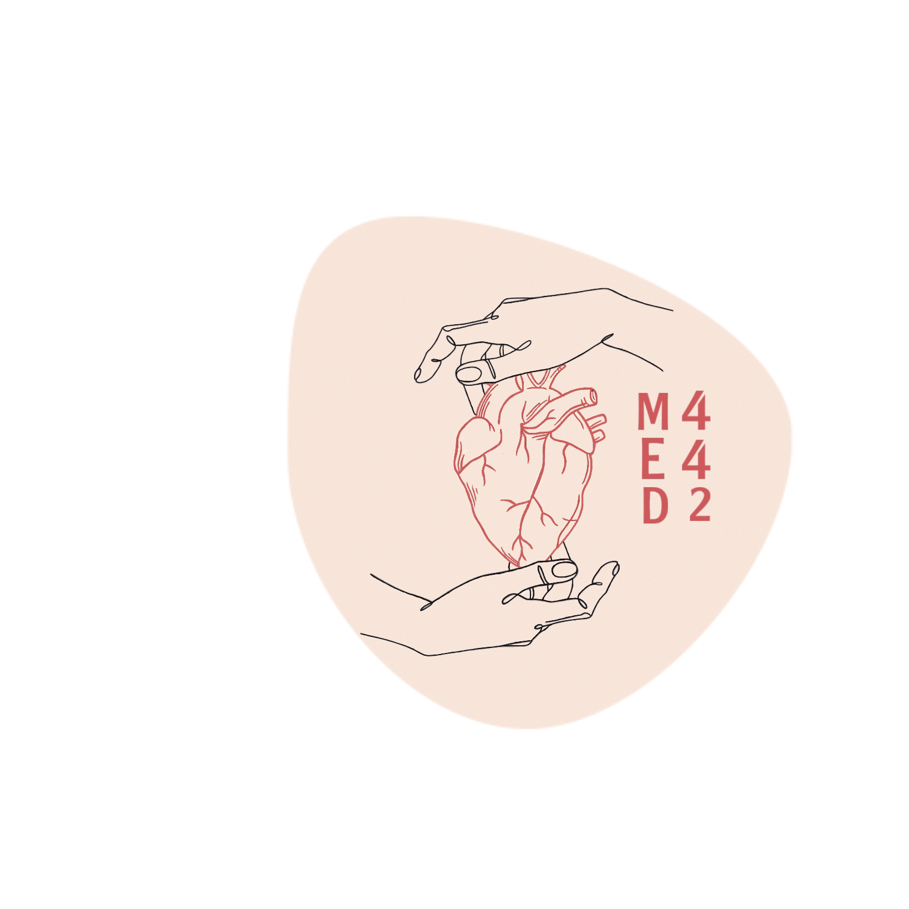
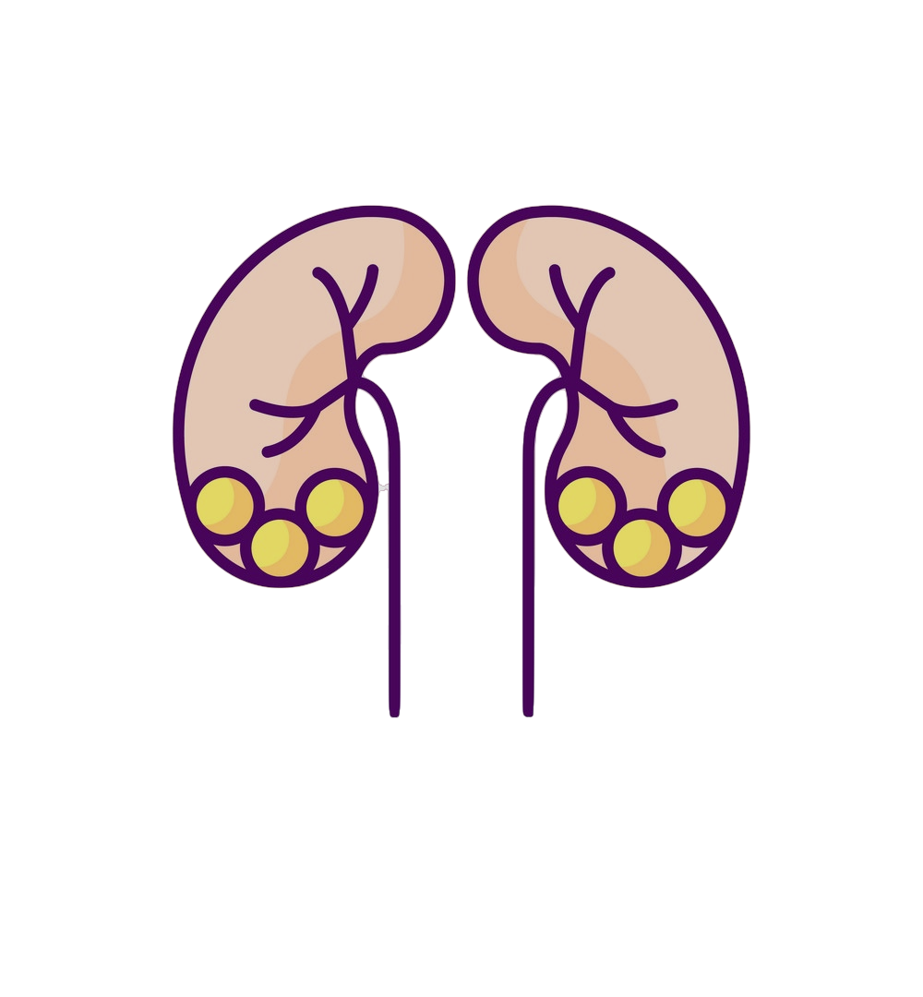
Pathology
L2
L3
“Infection of upper & lower urinary tract”
Editing File
- Color Index:
Main Text
Male’s Slides
Female’s Slides
Important
Doctor’s Notes
Extra Info

Slide 2
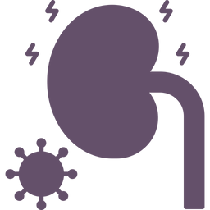
Objectives
Recognize the predisposing factors for infections of the kidney and urinary tract.
Describe the different types of infections in the kidney and the urinary tract.
Recognize acute and chronic pyelonephritis
Describe the causes of urinary tract obstruction.
Recognize drug induced nephritis.
Key outlines:
Urinary Tract Obstruction: causes and clinical manifestations in children and adults.
Infections of the Urinary Tract: Predisposing Factors and Clinical Manifestations.
Pathology of Acute and Chronic Pyelonephritis including causes and complications of urolithiasis.
Drug induced interstitial nephritis and renal necrosis.

Slide 3
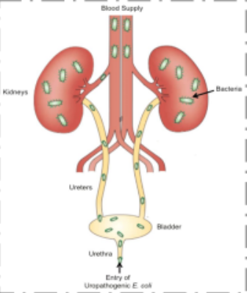
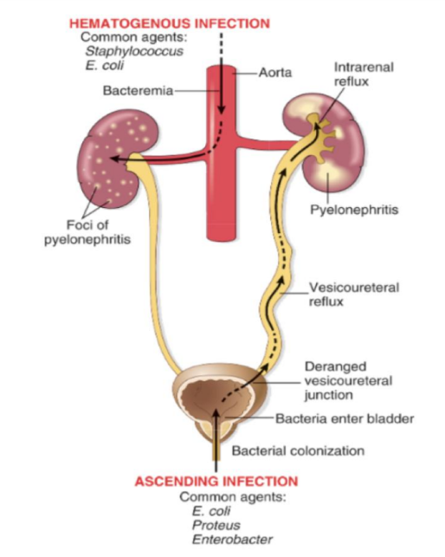
1
Infections of the upper urinary tract
Tubulointerstitial nephritis
Definition
Tubulointerstitial nephritis is inflammatory disease primarily involving the renal tubules and interstitium (inflammation or infection).
Types
It can be in the form of:
Acute pyelonephritis
They are serious if untreated, and need biopsy to detect if there’s kidney injury or renal failure
Chronic pyelonephritis
Drug induced tubulointerstitial nephritis
ACUTE PYELONEPHRITIS
Definition
Acute pyelonephritis is an acute suppurative (neutrophilic) inflammation of the upper urinary tract (kidney & renal pelvis) caused by bacterial infection which typically follows infection of the lower urinary tract.
The most common
causative organisms
Routes of transmission
enteric gram-negative
rods Escherichia coli
Proteus spp.
Klebsiella
Enterobacter
Pseudomonas
Ascending infection from the lower urinary tract(more
common): bacteria
ascends from the urethra
into the urinary bladder and
up the ureters to the
kidneys.
Through the bloodstream/
hematogenous
(less common) e.g.
from an infected heart valve
in endocarditis, miliary
tuberculosis etc.
Predisposing factors
Important because they will be repeated million times during the lecture
Urethral
instrumentation
e.g.
catheterization
and cystoscopy.
Incompetence of the vesicoureteral orifice
→ allows reflux of bladder urine to ascend up into the ureter (normally ureteral insertion into the bladder is a competent one-way valve that prevents retrograde flow of urine). About 1/3rd of children with UTI have vesicoureteral reflux (due to a congenital defect of the valve).
Pregnancy
Asymptomatic
bacteriuria occurs
in 10% of
Pregnant women, out of which
some develop
Acute pyelonephritis
Diabetes mellitus
diabetic glycosuria predisposes
to infection by providing a rich medium for bacterial growth. Diabetics also have increased
risk of complications of pyelonephritis e.g.
septicemia, necrotizing papillitis and recurrence of infection.
Obstruction
obstruction at the level of the urinary bladder (by
stones, benign prostatic hypertrophy etc.) →
incomplete emptying of bladder and increased
residual urine → stasis of urine in bladder → allows bacteria to multiply → bacteria ascend up the ureters and infect the kidneys.
Gender
UTI most commonly affects
females (anatomically
predisposed because of the
close proximity of the urethra to
the rectum and the short
urethra).
Pre-existing
renal lesions
Immunosuppression
& immunodeficiency

Slide 4
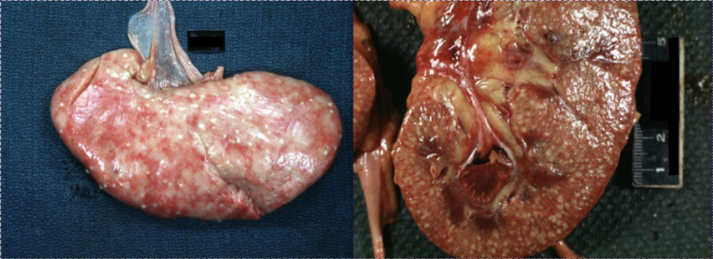
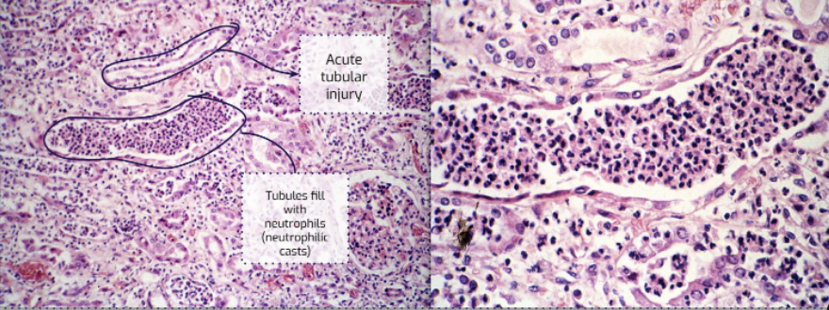
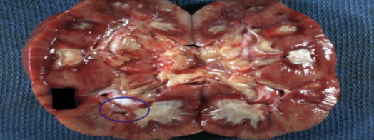
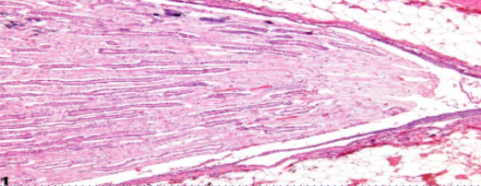
2
Infections of the upper urinary tract
ACUTE PYELONEPHRITIS
Morphology
Macroscopic
Microscopic
◦ The kidney may be enlarged and swollen and show small
yellow/white subcapsular and cortical microabscesses
(pus = suppurative necrosis).
◦ Rarely the kidney may become filled with large amounts of pus in the renal pelvis, calyces and ureter called pyonephrosis.
◦ There is a dense acute tubulointerstitial inflammation
(neutrophils) with tubular destruction. The neutrophils fill the tubules and collecting ducts.
◦ The vessels and glomeruli often are preserved.
◦ There is possibility of regeneration .
◦ In severe cases → perinephric abscess
The abscess can be inside the kidney or around it
Clinical features
Complications
● Fever with chills and sweats (those always with every bacterial infection)
● Flank pain with costovertebral angle tenderness.
● Dysuria, frequency and urgency.
● Pyuria (Pus in the urine), hematuria.
● Leukocytosis with neutrophilia.
● Positive urine culture and wbc casts in the urine.
● Differentiating upper from lower urinary tract infection is often clinically difficult.
● Septicemia.
● Chronic pyelonephritis (If untreated).
● Papillary necrosis.
● Pyonephrosis. (pus collected in the renal pelvis)
● Perinephric abscess(.Pus around the kidney(renal parenchyma or perinephric space)
Papillary necrosis (necrotizing papillitis)
Definition
It is a type of pyelonephritis characterized by necrosis of the renal papillae (apex of renal pyramids).
Seen in: (Predisposing factors)
Macroscopic Microscopic
● Diabetics with acute pyelonephritis.
● Acute pyelonephritis with urinary tract obstruction.
● Analgesic abuse associated interstitial nephritis.
● Chronic liver disease.
● Infections e.g. tuberculosis.
● Sickle cell disease.
● Renal transplant rejection.
Yellow white
Suppurative necrosis
(pus) at the tips of renal papillae
/pyramids.
coagulative necrosis & microabscess at
the tips of renal papillae.

Slide 5
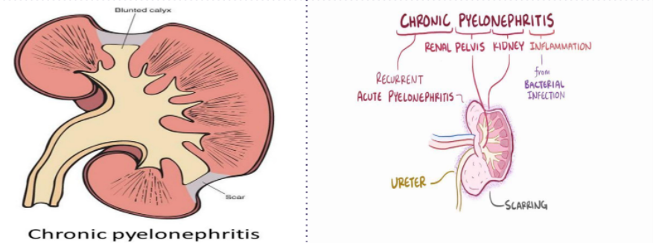
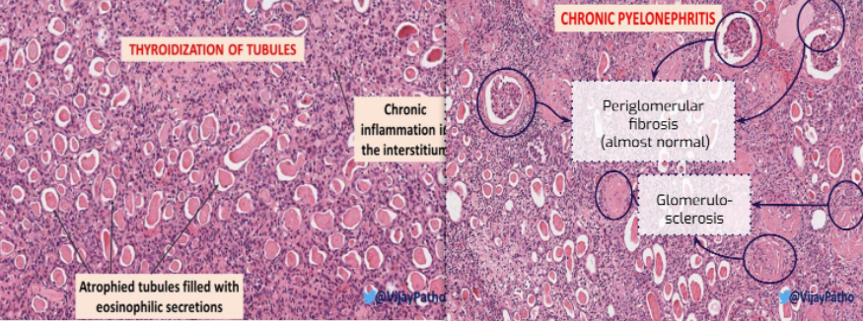
3
Infections of the upper urinary tract
Chronic Pyelonephritis
Definition
- It is a chronic tubulointerstitial inflammation of the kidney caused by repeated bouts of inflammation and healing.
- resulting in scarring of the involved kidney (so that part of kidney will be lost) with deformed renal pelvis & calyces and gradual renal insufficiency.
Caused by
● Recurrent chronic urinary tract infection.
● Chronic urinary obstruction (e.g. obstruction of the ureter by calculi (stones), tumor within the ureter, or extrinsic compression etc.).
● Chronic reflux.
Macroscopic Microscopic
- Nonfunctioning kidney.
- Tubules →tubular atrophy with thyroidization of tubules (tubules are filled with eosinophilic hyaline casts resembling colloid of thyroid gland).
- Interstitium → interstitial fibrosis and chronic interstitial
inflammation (lymphocytes and plasma cells)
- Glomeruli → periglomerular fibrosis and glomerulosclerosis
Chronic pyelonephritis can ultimately lead to renal failure (end stage renal disease)
- The kidneys are small and contracted
due to fibrosis.
- The surface of the kidney is irregularly scarred
with areas of depression.
- The cortex in thinned out.
- There is deformity and blunting (dilating) of the pelvicalyceal system.
Clinical features
● Most patients have episodic symptoms of urinary tract infection or acute
pyelonephritis.
● Hypertension.
● Some patients have a silent course until end-stage renal disease develops.
● Imaging studies show deformed pelvicalyceal system and cortical scarring.

Slide 6
4
Infections of the upper urinary tract
Drug induced tubulointerstitial nephritis
Drugs are an important cause of renal injury.
Drug-induced interstitial nephritis is an IgE (hypersensitivity) and T cell–mediated immune reaction to a drug. It is characterized by interstitial inflammation with many eosinophils.
It can be acute or chronic
Implicated therapeutic drugs: penicillins (e.g. ampicillin), rifampicin, diuretics (thiazides), nonsteroidal anti-inflammatory agents, etc.
Clinical features
Microscopic
❖ Abnormal renal function test after few days or weeks after
exposure to the drug.
❖ Urine: hematuria and eosinophils.
❖ Can present as acute kidney injury (rising serum creatinine and
oliguria) GFR
❖ It is important to diagnose this condition, because if remove the
oﬀending drug on time the injury may be reversible.
❖ Interstitial inﬁltration by chronic inﬂammatory cells (lymphocytes and macrophages), typically with increased eosinophils.
❖ Interstitial non-necrotizing granulomas with multinucleated
giant cells +/- (+/- : it might be present and it might be not )
❖ Tubular atrophy +/- due to healing with ﬁbrosis.
❖ The glomeruli are usually normal until the patient rich the end stage
renal disease
Urinary tract obstruction
Definition | Obstruction in the outﬂow of urine
Causes | ❖ Congenital anomalies ❖ Urolithiasis (Stones in the urinary tract ) ❖ Benign prostate hyperplasia (In older men) ❖ Tumors (of prostate, cervix,urinary bladder) ❖ Inﬂammations (prostatitis, urethritis etc.) ❖ Pregnancy due to compress on urinary tract ❖ Others (paralysis of urinary bladder)

Slide 7
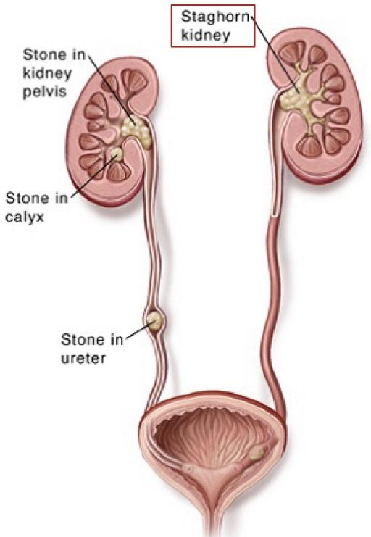
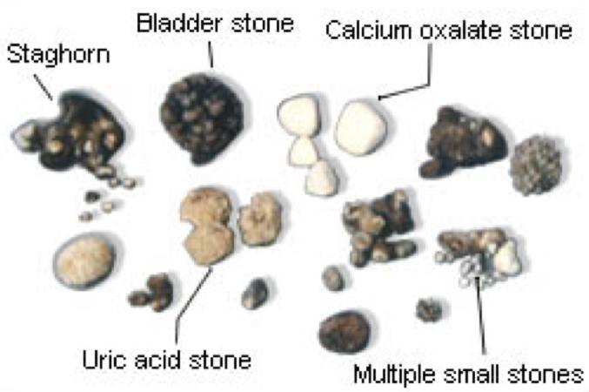
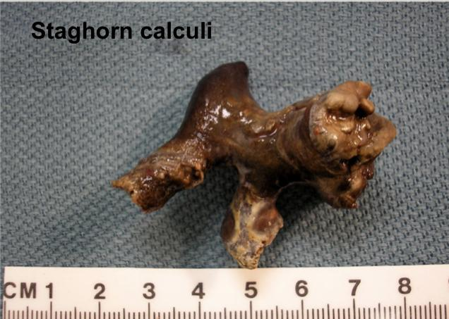
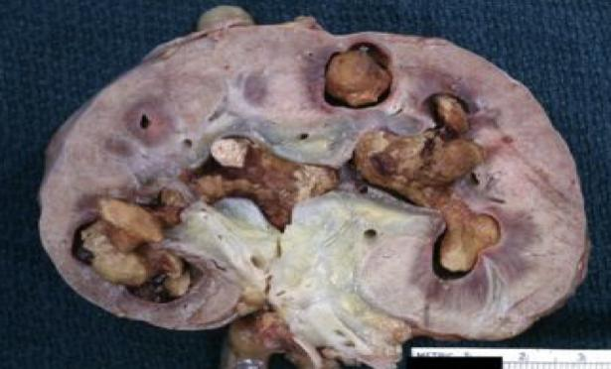
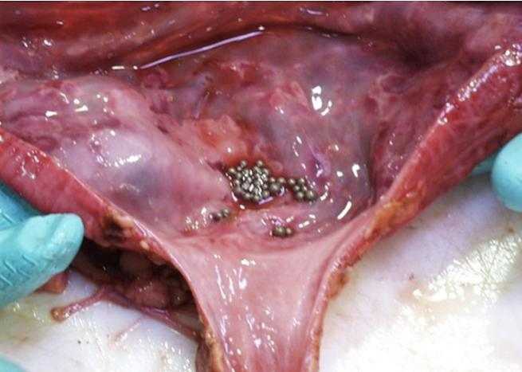
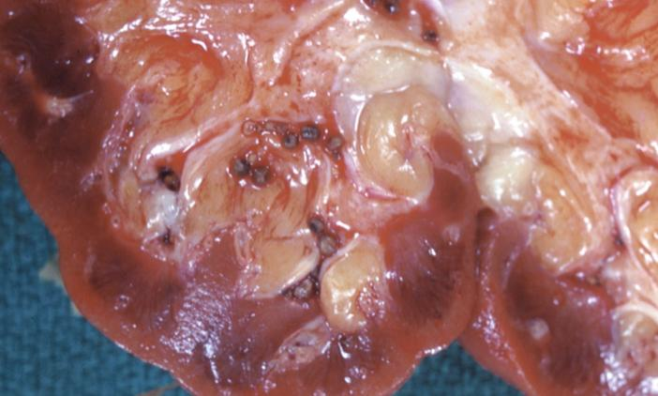
5
Infections of the upper urinary tract
Urolithiasis/nephrolithiasis
Definition
Formation of urinary calculi/stone along the urinary system e.g. kidney “inside the renal pelvis”, bladder, ureters etc.
Common sites for calculi formation
Renal pelvis and calyces (called nephrolithiasis), urinary bladder.
● Metabolic factors: hypercalciuria, hyperphosphaturia, oxaluria, gout
● Persistently alkaline urine favors formation of calcium phosphate stones
● Persistently acidic urine favors formation of oxalate or uric acid stones
● Stasis of urine facilitates precipitation of salts and stone formation
● Chronic dehydration: concentrates urine and favors stone formation
● For unknown reasons, renal stones are more common in men than in women
● There may be a familial tendency toward stone formation.
Predisposing factors
Calcium stones
75% of kidney stones are calcium oxalate or phosphate (radio-opaque).
Infection stones
10% of stones are caused by infection →infection results in alkaline urine → leads to formation of magnesium ammonium phosphate stones. Infection stones can occasionally ﬁll the pelvis and calyces to form large staghorn calculi.
Types of
stones
Uric acid stones
are formed in acidic pH. Patients with hyperuricemia and gout are predisposed to uric acid stones, but it can also be seen in people with no hyperuricemia or gout. Pure uric acid stones are radiolucent
Cystine stones
are uncommon.
❖ Majority (80%) of the stones are unilateral
❖ Commonly multiple stones are found in one kidney
❖ They range from hard to soft, from smooth to rough
❖ Stones vary in size from few mm to large stones that dilate the entire renal pelvis
❖ The staghorn calculi take the shape of the pelvicalyceal system
They are large stones are usually composed of magnesium ammonium phosphate
Morphology
❖ May be asymptomatic “if the stones are small” esp. stones lodged in the renal pelvis
❖ Stone can erode the mucosa “epithelium” (ulceration) → hematuria.
❖ Smaller stones can pass into the ureter, where they cause obstruction → intense
episodes of ﬂank pain radiating toward the ”thigh” groin known as renal or
ureteral colic. They may pass out in urine → painful.
❖ Stones obstruct urine ﬂow → predispose to bacterial infection
Clinical
features
“Depends on where the” stones are located
Complications
❖ Recurrent infection. ❖ Pyelonephritis “Acute or chronic “ ❖ Renal failure
❖ Hydronephrosis ❖ Acute urinary retention ❖ Pyonephrosis.
Diagnosis & management
❖ Majority, the diagnosis → made radiologically.
❖ In the past most kidney stones required surgical removal, but now management
ultrasonic disintegration (lithotripsy) and endoscopic removal are now eﬀective.

Slide 8
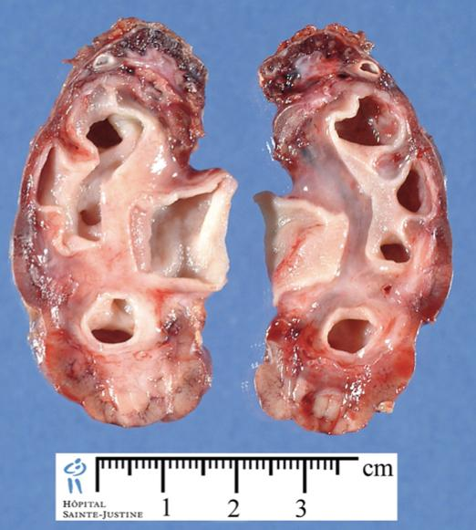
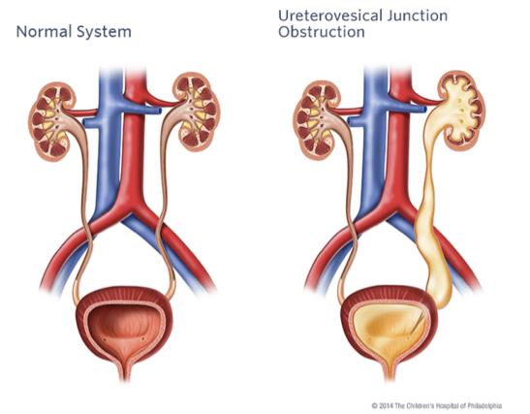
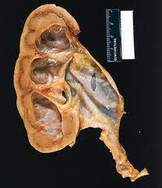
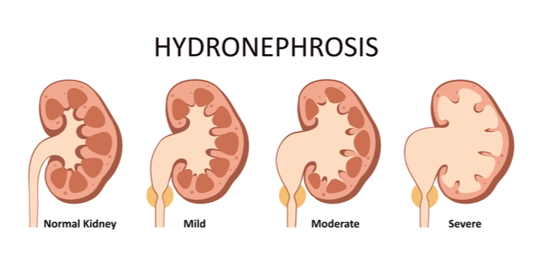
6
Infections of the upper urinary tract
Hydronephrosis
Definition
It is the dilation of the renal pelvicalyceal system with resultant renal parenchymal atrophy.
Caused by
❖ Complication of the obstruction to the outﬂow of urine
❖ The obstruction can be acute or chronic and be at any level of the urinary tract
❖ Obstruction below the level of ureters causes bilateral hydronephrosis e.g.in urethra
❖ Acquired :-
Calculi, Benign prostatic hyperplasia, Tumors (of prostate,bladder,cervix ,tumors )
Inﬂammation (Prostatitis, ureteritis, urethritis), Neurogenic (Spinal cord damage
with bladder paralysis) , Pregnancy
❖ Congenital :-
Atresia of urethra
obstructions can be
❖ Initially enlarged kidney due to dilation of the renal pelvis and
calyces
❖ Followed by atrophy or compression of the renal parenchyma
❖ Depending on the level of the obstruction, one or both ureters
may also be dilated (hydroureter)
Morphology
❖ Unilateral hydronephrosis may be silent/ asymptomatic for long periods
“because the other kidney compensate)
❖ Bilateral hydronephrosis can leads to oliguria, anuria and acute renal failure
❖ In hydronephrosis, the kidney is more susceptible (predispose) to pyelonephritis
which causes additional injury
❖ With time the changes become irreversible even when we ﬁx the obstruction.
❖ Early diagnosis and timely removal of obstruction within a few weeks usually
permits full return of function
Clinical features
Pathogenesis
There is backﬂow of the urine into the kidney
The calyces and pelvis become markedly dilated
Renal cortical atrophy
Ultimately back ﬂow in renal cortex
Back ﬂow in collecting ducts of kidney
The obstruction also triggers an interstitial inﬂammatory reaction
Tubular atrophy and interstitial ﬁbrosis
Initially the glomeruli are spared but eventually (slowly) hey become sclerotic.

Slide 9
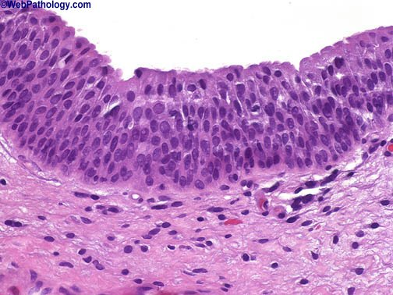
7
Infections of the lower urinary tract
Lower urinary tract = ureters + urinary bladder + urethra
Normal urothelium
The ureters, urinary bladder and urethra are lined by transitional epithelium (urothelium) except at the terminal urethra which is lined by squamous epithelium. (like skin)
Inflammation in lower urinary tract:
Ureteritis
Cystitis (female dr: most common & most important)
Urethritis
Infection of the lower urinary tract is referred to as UTI (urinary tract infection).
ureteritis
Definition
Ureteritis is an inflammation of the ureters. It is a complication of descending or ascending infections; ureteritis is often associated with ureteral obstruction (e.g. calculi or extrinsic compression of ureter by an adjacent tumor/lymph node or pregnant uterus).
cystitis
Definition
Inflammation of the urinary bladder. may be acute or chronic.
It is the most common site of urinary tract infection.
The risk of cystitis is increased in females because of a short urethra, especially during pregnancy.
Causes
Bacterial cystitis is most common form of cystitis. It is caused mainly by coliform bacteria e.g. E coli, Proteus vulgaris, Pseudomonas and Enterobacter spp.
Predisposing factors
bladder calculi, bladder outlet obstruction (e.g. prostatic hyperplasia), diabetes mellitus, immunodeficiency, radiation therapy, and chemotherapy, prior instrumentation or catheterization (often seen as a nosocomial infection in hospitalized patients, common in patients with indwelling catheters for prolonged periods).

Slide 10
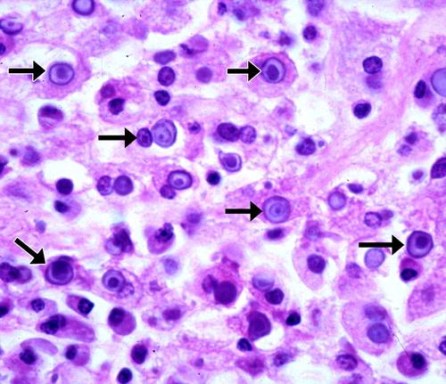
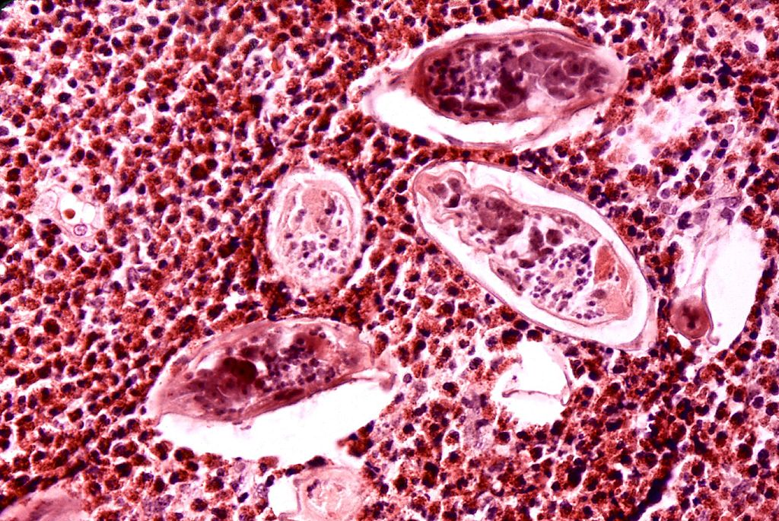
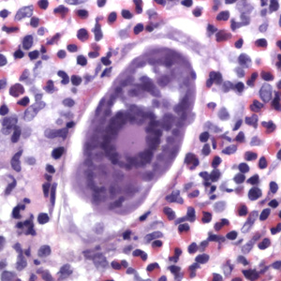
cystitis
Special forms of cystitis:
Follicular cystitis: | chronic inflammation with many lymphoid follicles
Eosinophilic cystitis: | inflammation with prominent eosinophilic infiltrate.
Tuberculous cystitis: | shows granulomatous cystitis with or without necrosis. (TB origin)
Hemorrhagic cystitis: | shows mucosal hemorrhages. Seen in acute bacterial infection, adenovirus (viral) infection and bleeding diatheses (conditions) (e.g., leukemia, treatment with cytotoxic drugs and disseminated intravascular coagulation).
Chronic interstitial cystitis (chronic pelvic pain syndrome): | persistent, painful chronic cystitis typically affects middle-aged women; characterized by intermittent, suprapubic pain, urinary frequency, urgency, hematuria and dysuria without evidence of bacterial infection; urine cultures are usually negative; cause is unknown; refractory to treatment. Eventually 🡪 bladder fibrosis 🡪 contracted bladder.
Polypoid cystitis: | bladder inflammation in which there is marked mucosal edema (resulting in polypoidal elevations).
Malakoplakia: | uncommon; inflammatory disorder of unknown etiology. Seen in the bladder and other sites within and outside the urinary tract; characterized by plaques on the mucosal surface of the bladder. Histology shows a chronic inflammation with numerous macrophages. Some macrophages contain laminated, basophilic calcified bodies called Michaelis-Gutmann bodies (arrows).
Schistosomiasis: | infection by parasitic flatworms called Schistosoma (Schistosoma hematobium) in which the worms may lay eggs in the wall of urinary bladder. These eggs ellicit a granulomatous reaction and an eosinophilic infiltrate. The ova can calcify and appear as grains of sand in bladder wall. Occasionally the entire urinary bladder becomes calcified 🡪 known as calcific cystitis. Chronic Schistosomiasis can predispose to squamous cell carcinoma of the urinary bladder.
8
(pic from Girls slides)
Schistosoma eggs surrounded by inflammatory cells (eosinophils)

Slide 11
9
Acute and chronic cystitis and their clinical features
Cont. cystitis
Acute cystitis : edema, hemorrhage and a neutrophilic infiltrate. |  | Chronic cystitis: lymphocytic, histiocytic and plasma cell infiltrate and fibrosis. Chronic cystitis: a predominance of lymphocytes and fibrosis. Occasionally there are numerous lymphoid follicles called follicular cystitis or dense infiltrates of eosinophils eosinophilic cystitis.
Clinical features
Fever with chills
Excessive urinary frequency, painful burning urination (dysuria) and lower abdominal or pelvic discomfort.
Examination of urine usually reveals inflammatory cells and causative organism can be identified by urine culture.
Most cases of cystitis respond well to treatment with antimicrobial agents.

Slide 12
10
summary
Upper UTI
infection |  | causes | Predisposing factors | morphology | Clinical features
 | Acute pyelonephritis | 1-Enteric gram negative rods (E.coli) 2-Proteus spp. 3-Klebsiella 4-Enterobacter 5-Pseudomonas (usually from lower urinary tract infection spread or from bloodstream) | - Urethral Instrumentation - Incompetence of the vesicoureteral orifice - Diabetes mellitus - Pregnancy - Obstruction - Gender (females) - Pre-existing - renal lesions -immunosuppression & immunodeficiency | macro: → enlarged and swollen kidney and show small yellow/white subcapsular and cortical microabscesses → Rarely the kidney may become filled with large amounts of pus. micro: → The neutrophils fill the tubules and collecting ducts. → The vessels and glomeruli often are preserved. | ● Fever with chills and sweats ● Flank pain ● Dysuria, frequency and urgency. ● Pyuria, hematuria. ● Positive urine culture and wbc casts in the urine.
 | Chronic pyelonephritis | 1- Recurrent chronic urinary tract infection. 2- Chronic urinary obstruction (stones or tumors…) 3- Chronic reflux. | :) | macro: → The kidneys are small and contracted, and The surface of the kidney is irregularly scarred with areas of depression. → blunting (dilating) of the pelvicalyceal system. micro: → tubular atrophy with thyroidization of tubules → interstitial fibrosis and chronic interstitial inflammation | ● Mostly episodic symptoms of urinary tract infection ● Hypertension. ● Imaging show deformed pelvicalyceal system and cortical scarring.
 | Drug induced (is an IgE (hypersensitivity) and T cell–mediated immune reaction to a drug) | Drugs usage (eg. penicillins (e.g. ampicillin), rifampicin, diuretics (thiazides), nonsteroidal anti-inflammatory agents, etc.) | (: | micro: → Interstitial inﬁltration by chronic inﬂammatory cells , typically with increased eosinophils. → Interstitial non-necrotizing granulomas with multinucleated giant cells → Tubular atrophy | ● hematuria and eosinophils in urine ● Can present as acute kidney injury
Tubulointerstitial nephritis

Slide 13
11
summary
Upper UTI
infection |  | causes | Predisposing factors | morphology | Clinical features
Urolithiasis/ nephrolithiasis (Formation of urinary calculi/stone along the urinary system) Types of stones: 1- calcium stones 2- uric acid stones 3- cystine stones 4- infection stones |  | =) | ● Metabolic factors: hypercalciuria, hyperphosphaturia, oxaluria ● Persistently alkaline urine ● Persistently acidic urine ● Stasis of urine ● Chronic dehydration ● more common in men than in women ● There may be a familial tendency toward stone formation | ❖ Majority (80%) of the stones are unilateral. ❖ Commonly multiple stones are found in one kidney. ❖ They range from hard to soft, from smooth to rough. ❖ Stones vary in size. ❖ The staghorn calculi take the shape of the pelvicalyceal system. | - May be asymptomatic - Smaller stones can pass into the ureter, where they cause obstruction leading to intense episodes of ﬂank pain radiating toward the ”thigh” groin - They may pass out in urine → painful.
Hydronephrosis (It is the dilation of the renal pelvicalyceal system with resultant renal parenchymal atrophy) Can be chronic or acute… |  | 1- Complication of the obstruction to the outﬂow of urine. 2- Obstruction below the level of ureters causes bilateral hydronephrosis | (= | ❖ Initially enlarged kidney, Followed by atrophy or compression of the renal parenchyma. ❖ Depending on the level of the obstruction, one or both ureters may also be dilated (hydroureter). | ●Unilateral hydronephrosis may be asymptomatic for long periods ● Bilateral hydronephrosis can leads to oliguria, anuria and acute renal failure
Papillary necrosis (It is a type of pyelonephritis characterized by necrosis of the renal papillae) |  | More commonly seen in: ● Diabetics with acute pyelonephritis. ● Sickle cell disease. ● Acute pyelonephritis with urinary tract obstruction. ● Renal transplant rejection. ● Chronic liver disease. ● infections Morphology : Yellow white Suppurative necrosis (pus) at the tips of renal papillae

Slide 14
12
summary
lower UTI
infection |  | causes | Predisposing factors | Clinical features
ureteritis |  | is an inflammation of the ureters. It is a complication of descending or ascending infections; and it is often associated with ureteral obstruction (e.g. calculi or extrinsic compression of ureter by an adjacent tumor/lymph node or pregnant uterus).
Cystitis (inflammation of the urinary bladder) |  | most commonly bacterial, mainly by coliform bacteria (e.g. E. coli, Proteus vulgaris, Pseudomonas and Enterobacter spp). | ● bladder calculi ● bladder outlet obstruction ● diabetes mellitus ●immunodeficiency, radiation therapy, and chemotherapy ●prior instrumentation (often in hospitalized patients) ●higher risk of cystitis in females (because of a short urethra), especially during pregnancy. | 1- Fever with chills 2- Excessive urinary frequency, painful burning urination (dysuria) and lower abdominal or pelvic discomfort. 3- Examination of urine usually reveals inflammatory cells.
Special types of cystitis
Follicular cystitis
Tuberculous cystitis
Chronic interstitial cystitis
Malakoplakia
Eosinophilic cystitis
Hemorrhagic cystitis
Polypoid cystitis
Schistosomiasis

Slide 15
Quiz
Which of the following is The most common
causative organism for acute pyelonephritis
Q1
A. Proteus spp.
B. Klebsiella
C. Enterobacter
D. all of them
Which of the following is a Complication
for acute pyelonephritis
Q2
A. Septicemia.
B. Chronic pyelonephritis
C. Pyonephrosis
D. all of them
What is the Most common type of kidney stone?
Q3
A. Infection stones
B. Uric acid stones
C. Cystine stones
D. Calcium stones
Q4
A 36-year-old woman presents with advanced cervical carcinoma, and a
CT scan shows widespread pelvic spread. If this condition is not surgically corrected, the patient’s kidneys will most likely develop which of the following conditions?
A. hydronephrosis
B. Staghorn calculi
C. Urethritis
D. Urolithiasis
A 40 years old lady came in with persistent suprapubic pain along with frequency, urgency and dysuria, however urine culture was negative. What is the most likely diagnosis?
Q5
A. follicular cystitis
B. hemorrhagic cystitis
C. polypoid cystitis
D. chronic interstitial cystitis
Answers: 1-D 2- D 3-D 4-A 5-D

Slide 16
Members
Members
Team Leaders
Maha Alkoryshy
Manar Alzahrani
Hassan Alabdullatif
Team Members
Hoor Aloraini
Farah alhalafi
Shahad Alsalahi
Nouf Aldhalaan
Jana alhazmi
Mayssar Alshobaki
Rahaf Almutairi
layan Aldoukhi
Atheer Alahmari
Walaa AlMutawa
Fatima Halawi
Omar Alkadhi
Emad Almutairi
Rakan Alromayan
Ali Alzahrani
Saad Alahmari
Malik halees
Nawaf Alturki
Khalid Alrasheed
pathology442@gmail.com
Theme was done by Shatha Almutib

