Slide 1
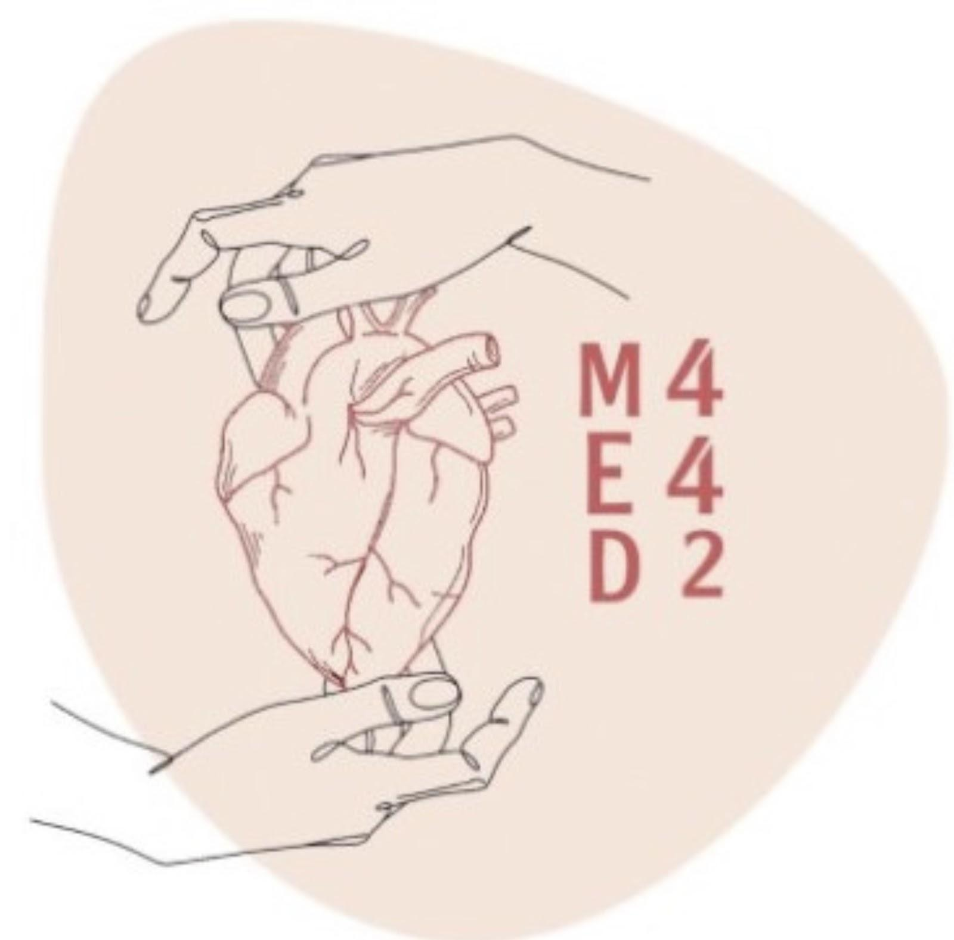
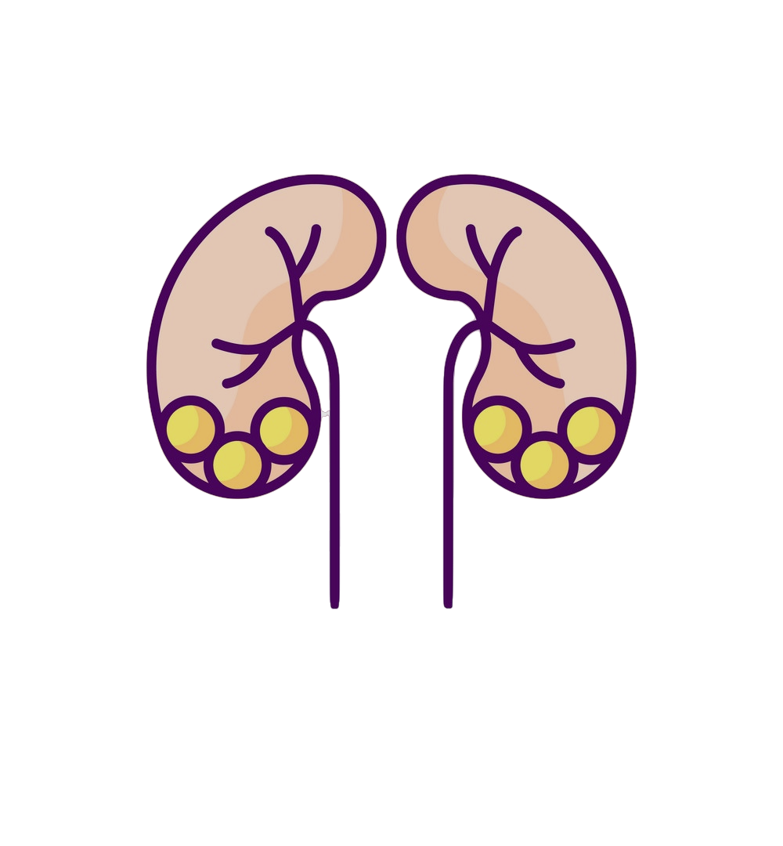
Pathology
L4
Rapid Progressive Glomerulonephritis/Chronic Kidney Disease
Editing File
- Color Index:
Main Text
Male’s Slides
Female’s Slides
Important
Doctor’s Notes
Extra Info

Slide 2
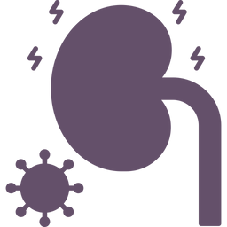
Objectives
Recognize the five major renal glomerular syndromes.
Describe the main differential pathological diagnosis for each syndrome.
Perform a clinico-pathological correlation.
Describe the patterns of injury of each syndrome.
Key Outlines:
The nephrotic syndrome: (Minimal change, FSGS, membranous, diabetes).
The nephritic syndrome: (Acute post streptococcal Glomerulonephritis GN, Lupus nephritis).
Asymptomatic Hematuria: IgA Nephropathy.
Rapidly progressive GN: (Crescentic GN)
The Chronic Renal Failure.

Slide 3
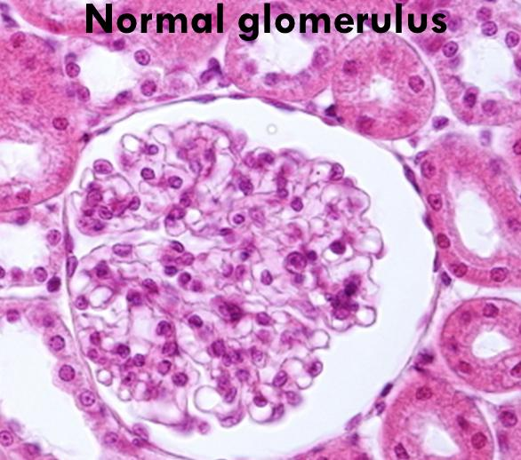
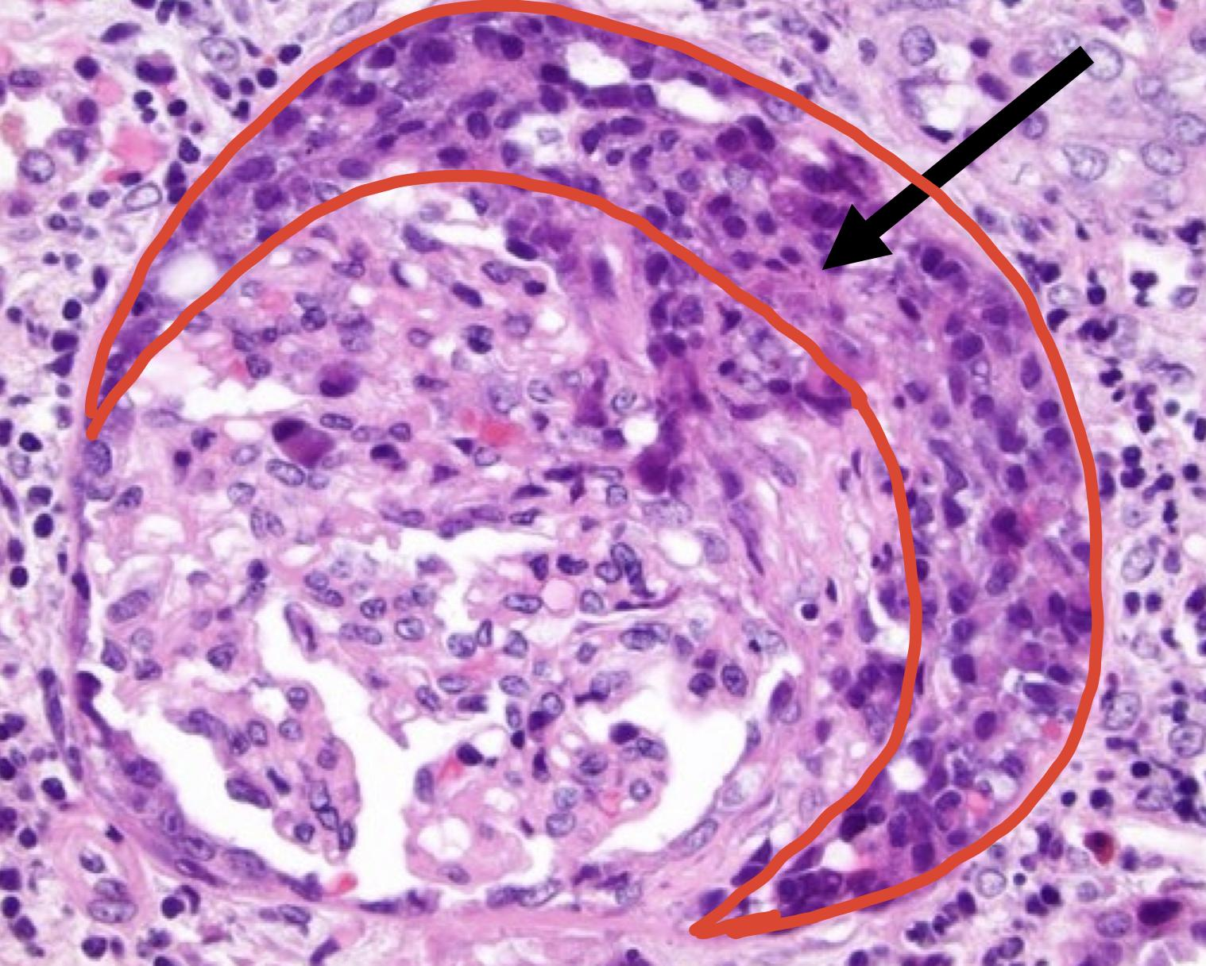
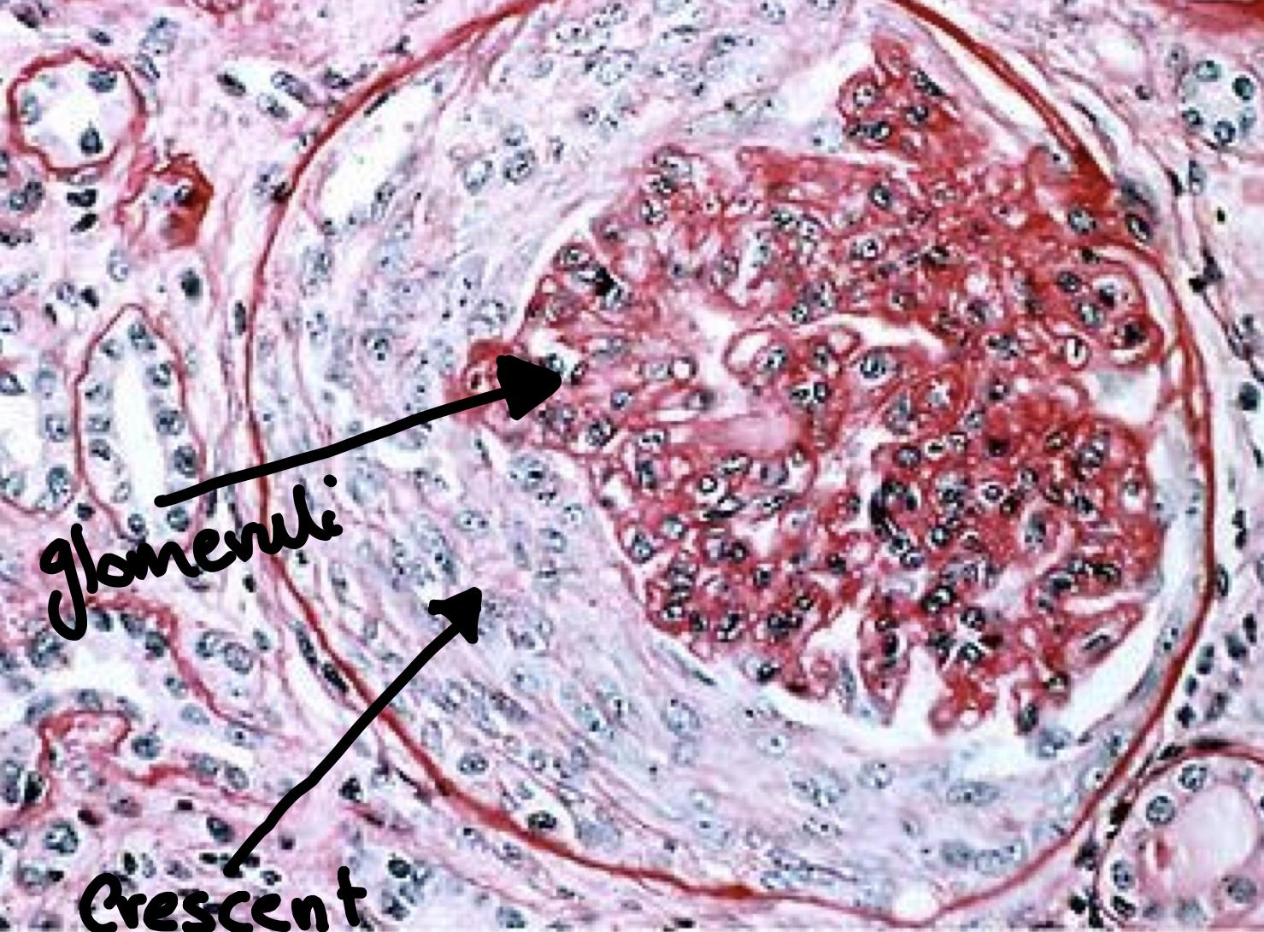
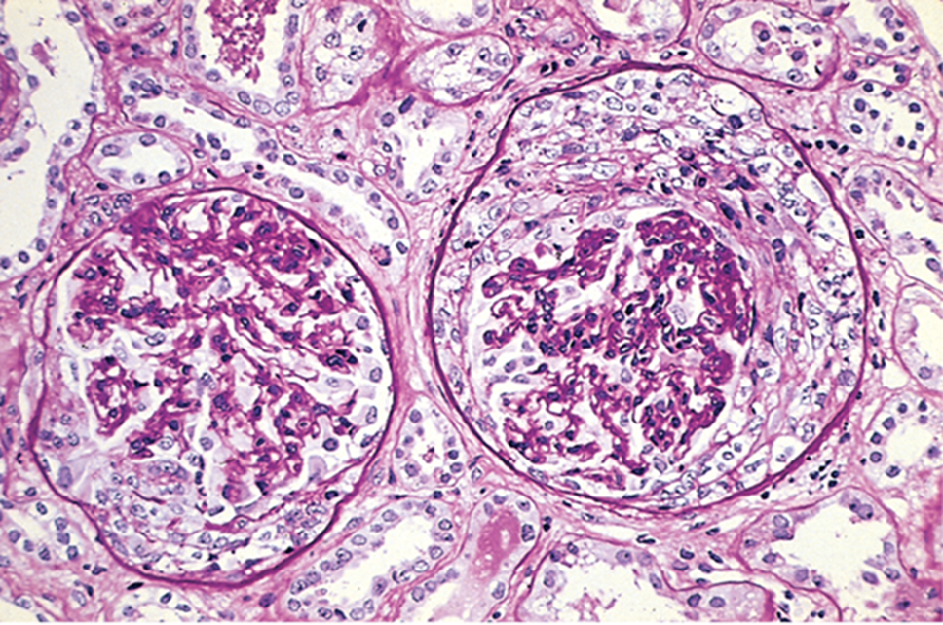
Rapid Progressive glomerulonephritis (RPGN)
(Also called crescentic glomerulonephritis)
Definition | It is a clinical syndrome (not a final diagnosis, a collection of clinical features that could be caused by several things which will be the diagnosis). Its characterized by: Rapid progressive loss/decline of renal function within weeks to months Extensive glomerular crescent formation In order for us to to call something as RPGN, sampled kidney biopsy must show more than 50% of glomeruli having crescents.
Morphology | Histologically,there is severe glomerular injury → in the form of: 1. Crescent formation 2. Glomerular necrosis 3. Rupture of the glomerular basement membrane. Glomerular crescent (characteristic finding in RPGN) What are they? Glomerular extracapillary proliferations (i.e. proliferation outside the glomerular capillaries) Why are they called crescents? Because it has a crescent shape. شكل هلال How are they formed? Proliferation of parietal epithelial cells that line the Bowman’s capsule. Migration of monocytes/macrophages into Bowman’s space. The glomeruli may also show necrosis. Crescent formation fills up bowman’s space and compresses the glomerular capillary loops and can even rupture the GBM. Upon healing (or when u treat it) the crescents undergo fibrosis/scarring and are called fibrous crescents. (Instead of cells filling up bowman’s space, the whole area will be fibrotic).
Clinical features | Present as rapid & progressive loss/decline of renal function within days/weeks to months, usually as nephritic syndrome that progresses to acute renal failure (marked oliguria and azotemia). Timely diagnosis is important. Some patients require long-term dialysis or transplantation. Mild to moderate proteinuria sometimes approaching nephrotic range may occur. Hematuria, dysmorphic RBCs, RBC casts in urine
Prognosis | Patients present with nephritic syndrome and progress to acute renal failure, the prognosis is poor if untreated, even death. (Poor prognosis)

Slide 4
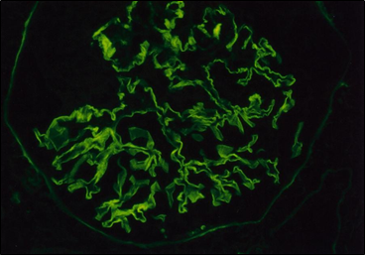
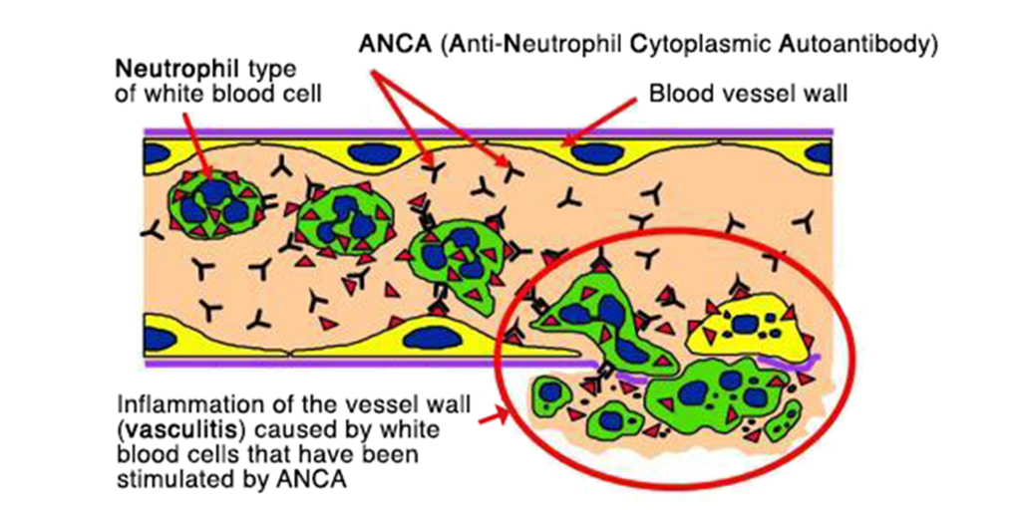
Types of RPGN or CRGN
Based on cause (etiology) RPGN is divided into three types:
Type I RPGN (12%) = Anti-Glomerular Basement Membrane antibody disease (anti-GBM disease)
Etiology | A rare autoimmune disorder. It’s characterized by presence of auto-antibodies directed against an antigen that is normally present in the glomerular basement membrane (GBM).
Diagnosis | IF: characteristic linear staining or positivity with IgG immunoglobulin along the GBM (pic) Patient’s serum is positive for anti-GBM antibodies (helpful in diagnosis).
Goodpasture’s syndrome | When anti-GBM disease is associated with pulmonary hemorrhage (hemorrhagic pneumonitis) this combination is called as Goodpasture’s syndrome (in these patients, the anti-GBM antibodies also bind to pulmonary alveolar capillary basement membranes).( involvement of both the kidneys and lungs).
Treatment | Responds well to plasmapheresis (it removes pathogenic antibodies from the circulation), steroids and cytotoxic agents.
Type II RPGN (44%)=Immune Complex Mediated Crescentic Glomerulonephritis
Etiology | It results from any immune complex mediated renal diseases in which there is deposition of antigen-antibody immune complexes in the glomeruli. The crescents represent a more aggressive form of various immune complex mediated GNs Examples(If any immune-mediated GN shows crescents it would fall under this category) Poststreptococcal GN Lupus nephritis (in systemic lupus erythematosus) IgA nephropathy and Henoch-Schönlein purpura
Diagnosis | IF: shows positivity with various immunoglobulins and/or complements (depends on etiology, if IgA nephropathy we would see IgA antibodies in the mesangium). EM: shows electron dense immune deposits. Negative anti-GBM antibody & negative ANCA
Treatment | Type II RPGN does not respond well to plasmapheresis, the original underlying disease needs to be treated.
Type III RPGN (44%)=Pauci-Immune ANCA-associated GN
Etiology | Most patients have circulating antineutrophil cytoplasmic autoantibodies (ANCAs) in the blood. ANCA are autoantibodies that target antigens present in the neutrophil cytoplasm. ANCA causes abnormal activation of neutrophil. As a result: There is adhesion of the neutrophils to endothelial cells lining the capillaries (especially glomerular capillaries) Neutrophils release injurious products that promote endothelial injury, vascular inflammation (vasculitis and fibrinoid necrosis of arteries and arterioles) and crescentic GN. Associated with systemic diseases like: Granulomatosis with polyangitis (formerly called Wegener’s Granulomatosis) cANCA positive Microscopic polyangiitis pANCA positive.
Diagnosis | It’s called Pauci(Few)-Immune GN because there is: No anti-GBM antibody (not like type I) no immune complex deposition (so IF is negative/almost negative and there are no deposits on EM).(not like type II) Note: RPGN type I and II are ANCA negative.
Treatment | Responds well to plasmapheresis (it removes pathogenic antibodies from the circulation), steroids and cytotoxic agents.

Slide 5
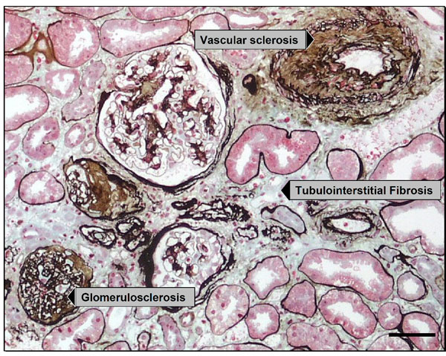
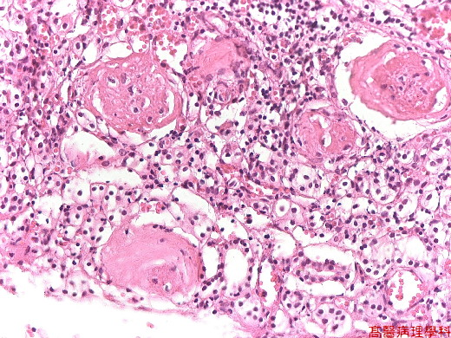
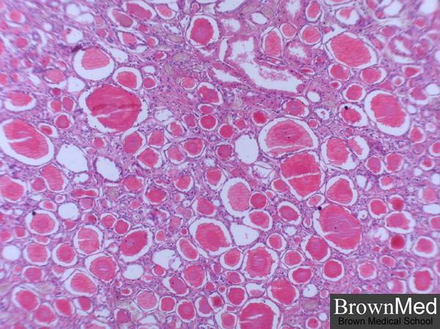
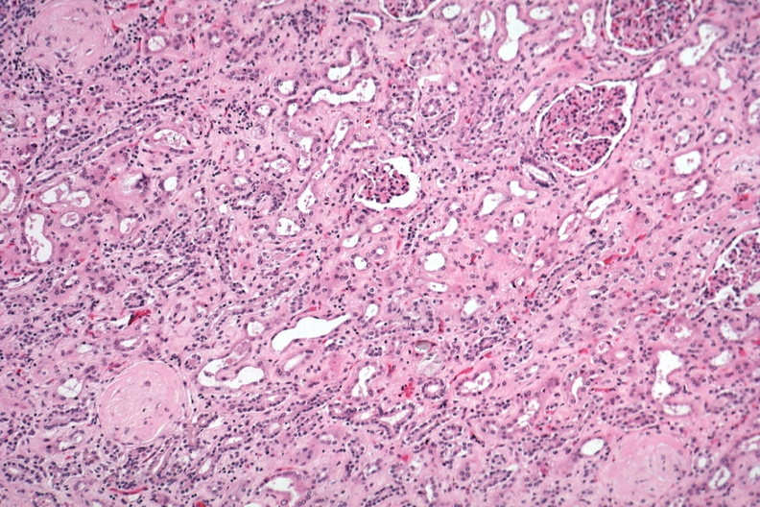
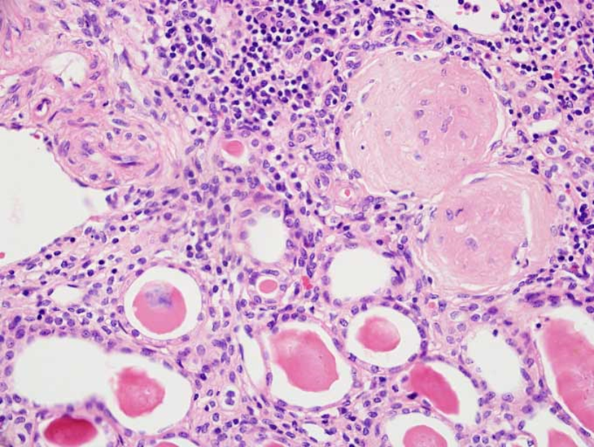
Chronic Renal Failure (CRF)/ Chronic Kidney Disease (CKD)
Definition | Chronic kidney disease describes the slow or gradual loss of kidney function, can be a consequence of irreversible acute disease or progressive slow scarring in any type of chronic renal disease. The end result is end stage kidney disease and transplantation.
End Stage Kidney Disease | It’s the scarring of all 4 renal compartment: (regardless of the original site of injury) Glomerulus: glomerular sclerosis. Tubules: tubular atrophy. Interstitium: interstitial fibrosis . Blood vessels: arteriosclerosis.
Prognosis | Poor. Patients need dialysis or transplantation otherwise death from uremia will result. Dialysis and kidney transplantation allow long-term survival
Common Etiology | Chronic glomerulonephritis like RPGN, membranous GN, membranoproliferative GN, FSGS, IgA nephropathy, etc. Diabetic Nephropathy Hypertension Reflux nephropathy in children Polycystic kidney disease Kidney infections & obstructions Others
Clinical features | In the early stages of chronic kidney failure → few signs or symptoms. Chronic kidney failure may not become apparent until your kidney function is significantly impaired. Some patients are oliguric and some patients are not oliguric Gradual rise in BUN and serum creatinine. High levels of urea in the blood can result in: Azotemia (increased urea and creatinine) Acidosis, hyperkalemia, hypokalemia (due to failure of kidney to activate Vit D) Abnormal fluid volume → changes in urine output e.g. initially increased urine output and later decreased urine output. The sodium and water retention can lead to volume overload and congestive cardiac failure. Low levels of calcium → renal osteodystrophy Anemia due to decreased erythropoietin Hypertension due to excess renin production Etc.
Morphology
Grossly | The kidneys are small and contracted with granular surface. Markedly damaged kidneys are designated "end-stage kidneys”.
Microscopically | Glomeruli→ most of the glomerular are sclerosed (fibrosed/scarred) called glomerulosclerosis. Tubules→ show prominent atrophy with thyroidization of tubules (tubules are filled with eosinophilic hyaline casts resembling colloid in thyroid gland). Interstitium→ prominent interstitial fibrosis with lymphocytic infiltrate. Blood vessels→ show thick walled arteries and arterioles with narrowed lumen.
End stage kidney
Glomerulosclerosis and thyroidization of tubules

Slide 6
Summary
RPGN/CrGN Types | LM | IF | EM | Characterized
Type I RPGN anti-glomerular basement membrane antibody–mediated | - Crescents formation (glomerular extracapillary proliferations - crescents fill the Bowman's space and compress the glomerular capillary loops and can even rupture the GBM - fibrous crescents (Upon healing the crescents undergo fibrosis/scarring) | linear staining/positivity with IgG along the GBM |  | respond well to plasmapheresis Goodpasture’s syndrome: anti-GBM disease is associated with pulmonary hemorrhage (hemorrhagic pneumonitis)
Type II RPGN immune complex mediated |  | positivity with various immunoglobulins and/or complements | electron dense immune deposits | -poststreptococcal GN, -Lupus nephritis (SLE) -IgA nephropathy and Henoch-Schönlein purpura. does not respond well to plasmapheresis Negative anti-GBM antibody & negative ANCA
Type III RPGN (Pauci-immune) ANCA-Associated |  | negative/almost negative immune complex deposition | no deposits | respond well to plasmapheresis associated with systemic diseases like: -granulomatosis with polyangitis (Wegener’s Granulomatosis) cANCA positive - microscopic polyangiitis : pANCA positive.
Chronic Renal Failure (CRF)/ Chronic kidney disease (CKD) end result is end stage kidney disease | LM | IF | EM | Characterized
 | scarring of all 4 renal compartments: -glomerulosclerosis (sclerosed glomerular) -atrophy with thyroidization of tubules (filled with eosinophilic hyaline casts resembling colloid of thyroid gland) -interstitial fibrosis with lymphocytic infiltrate -thick walled arteries and arterioles with narrowed lumen |  |  | Grossly the kidneys are small and contracted with granular surface common causes •Chronic glomerulonephritis like RPGN, membranous GN, membranoproliferative GN, FSGS, IgA nephropathy, etc. •Diabetic Nephropathy •Hypertension •Reflux nephropathy in children •Polycystic kidney disease •Kidney infections & obstructions

Slide 7
Quiz
Q1
A 32-year-old man complains of recurrent hematuria since his youth. The hematuria typically occurs following upper respiratory tract infections. Vital signs are normal. Urinalysis shows proteinuria, hematuria, and a few red blood cell casts. Laboratory studies disclose normal levels of BUN and creatinine. The ANA and ANCA tests are negative. Which of the following is the most likely diagnosis?
Amyloid nephropathy
Berger disease (IgA nephropathy)
Wegener granulomatosis
Goodpasture’s syndrome
Which on has pANCA positive?
Q2
Wegener’s Granulomatosis
microscopic polyangiitis
granulomatosis with polyangitis
Henoch-Schönlein purpura
Q3
A patient come to the hospital complaining from flank pain and have hematuria and mild proteinuria , doctors expecting RPGN and they discover that the patient have negative ACNA so what is possible could have ?
A.I and II c- II and III
B.I and III
C.II and III
D.All of them
Q4
1- A 65 year old male patient has a glomerular filtration rate of 55 mL/min and azotemia ,he suffered from pain in the bones and the electrolytes analysis shows low Ca2 , K2 in addition he has a low pH , The patient has a history of uncontrolled hypertension and coronary artery disease , what are the diagnosis?
A. Chronic kidney disease
B. Acute Kidney injury
C.UTI
D.None
Q1: D, Q2:B,Q3:A,Q4:A

Slide 8
Members
Members
Team Leaders
Maha Alkoryshy
Manar Alzahrani
Hassan Alabullatif
Team Members
Hoor Aloraini
Farah alhalafi
Shahad Alsalahi
Nouf Aldhalaan
Jana alhazmi
Mayssar Alshobaki
Rahaf Almutairi
layan Aldoukhi
Atheer Alahmari
Walaa AlMutawa
Fatima Halawi
Omar Alkadhi
Emad Almutairi
Rakan Alromayan
Ali Alzahrani
Saad Alahmari
Malik halees
Khalid Alrasheed
Nawaf Alturki
Pathology442@gmail.com
Theme was done by Shatha Almutib

