Slide 1
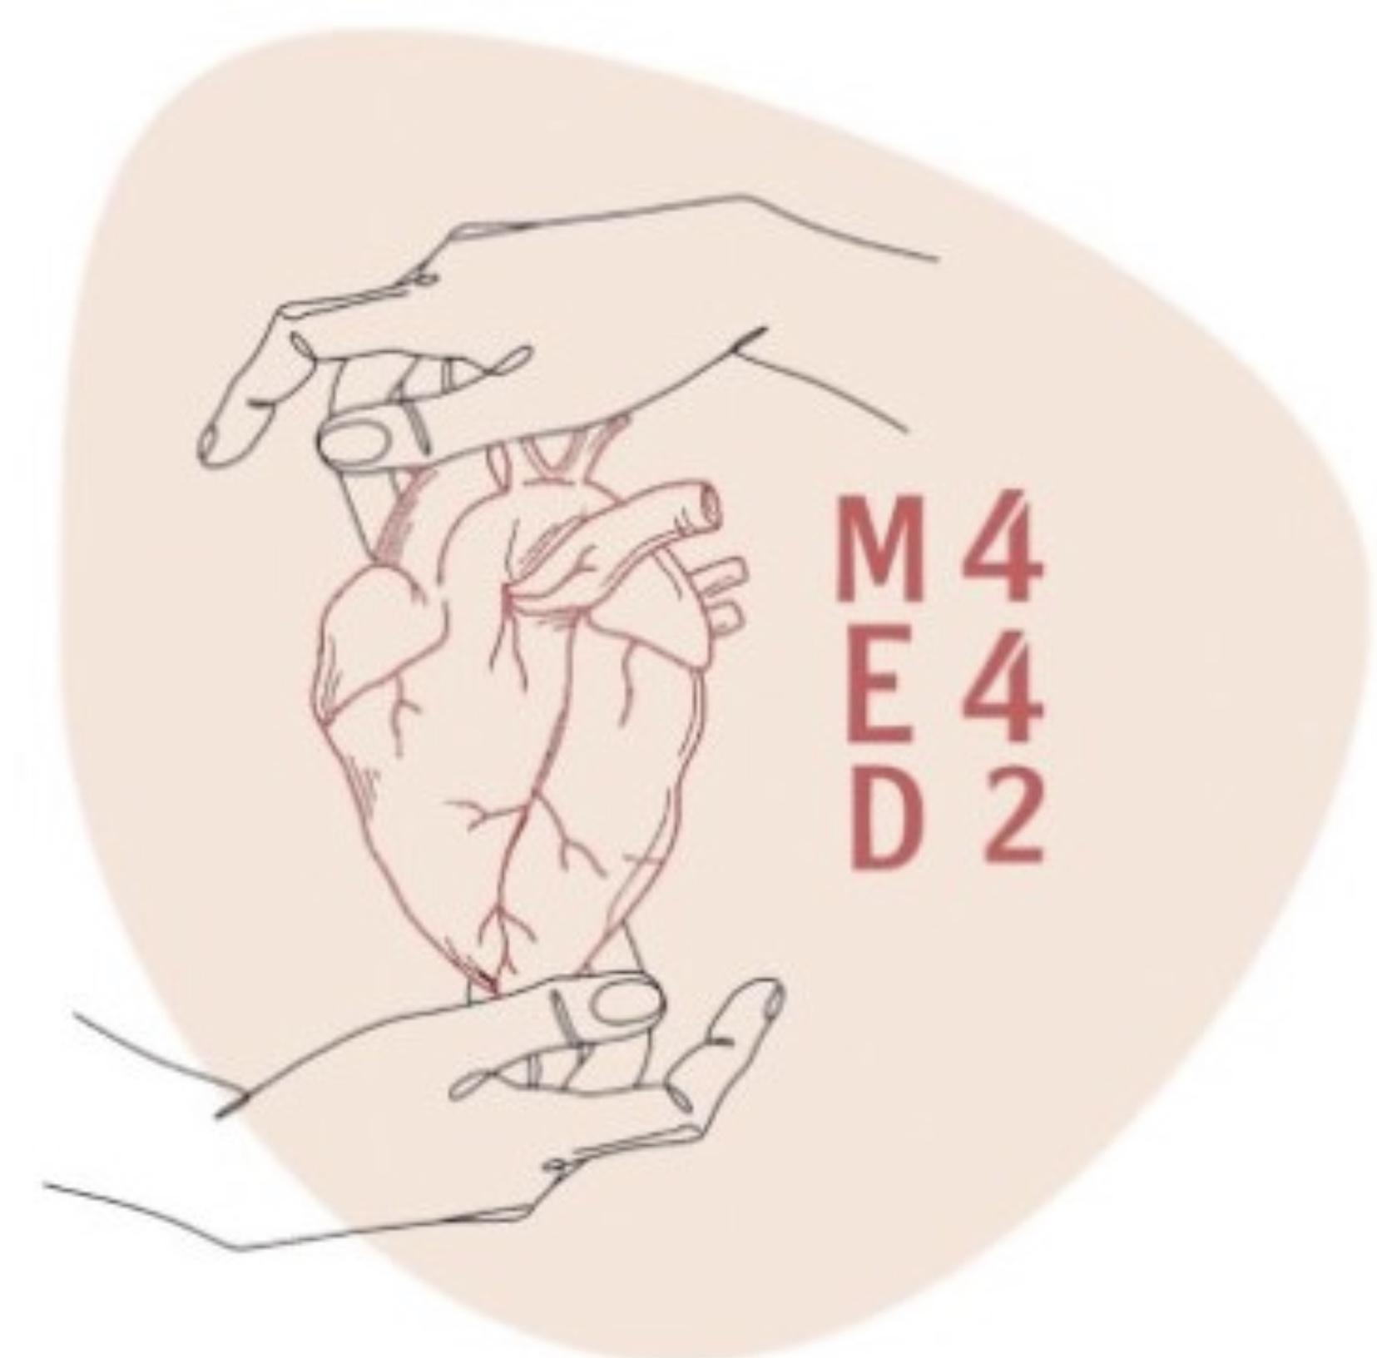
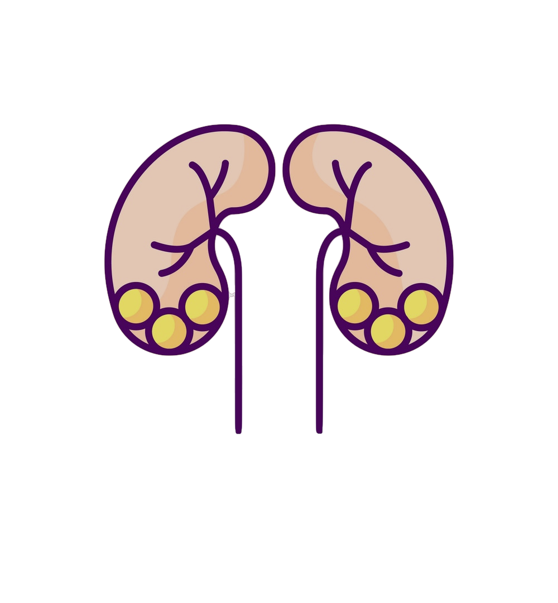
Pathology
L5
Tumors of the Kidney & Urinary Tract
Editing File
- Color Index:
Main Text
Male’s Slides
Female’s Slides
Important
Doctor’s Notes
Extra Info

Slide 2
Objectives
At the end of the lecture the students will be able to:
Recognize the benign tumors of the kidney
Describe renal cell carcinoma (RCC) & Wilm’s tumor
Recognize transitional cell and squamous carcinoma of the urinary bladder
Key Outlines
Benign tumors of the kidney
Renal Cell Carcinoma
Wilm’s tumor (nephroblastoma)
Transitional Cell and Squamous Carcinoma of bladder

Slide 3
Tumors of the Kidney
Malignant
Benign
Renal Cell Carcinoma(RCC)
Wilm’s tumor (nephroblastoma)
Oncocytoma
Angiomyolipoma
Types
Clear Cell
65%
Papillary (10-15%)
Chromophobe (5%)
Other rare types (15%)
Tumors of the Urinary Tract
Transitional cell neoplasms of urinary bladder
Squamous cell carcinoma of urinary bladder

Slide 4
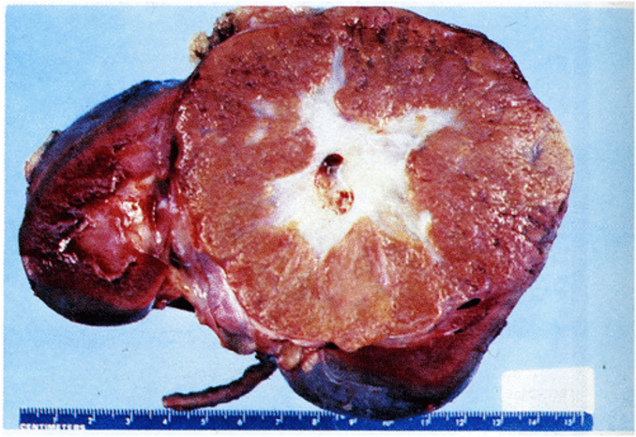
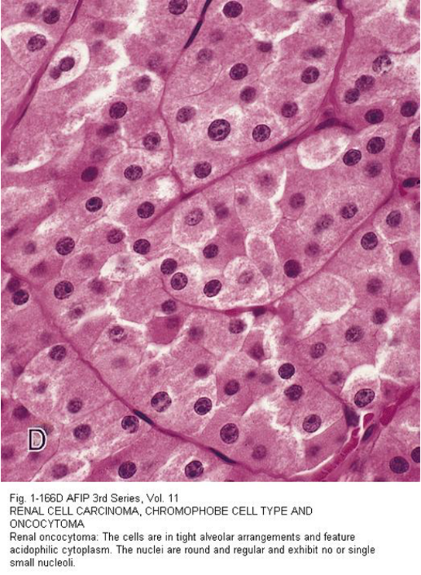
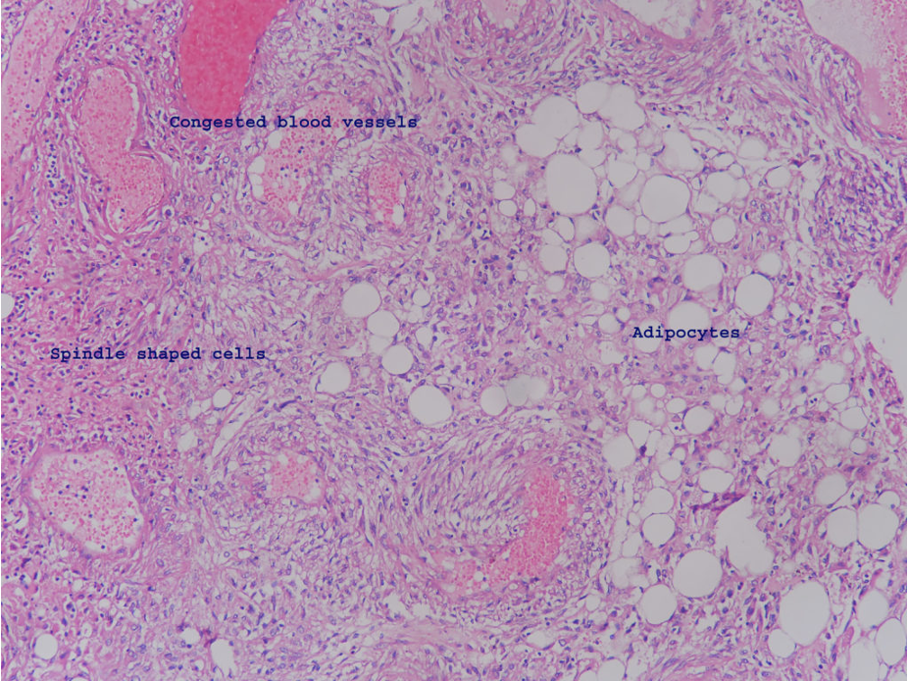
Benign Tumors
1 | Renal Oncocytoma
Definition | Benign tumors that arises from intercalated cells of collecting ducts in kidney
Morphology | Grossly | well-circumscribed mahogany-brown colored tumor with central stellate scar
 | Micro- scopically | Uniform, round, polygonal cells with abundant, intensely eosinophilic & granular cytoplasm Uniform round and central nuclei These cells are called as oncocytes OR oncocytic cells
 | Electron Microscopy | Numerous mitochondria in the cytoplasm
 | Radiology | Mimic renal cell carcinoma (RCC)
Complications | spontaneous hemorrhage
2 | Angiomyolipoma
Benign neoplasm composed of admixture of: Blood vessels (angio) Spindle-shaped smooth muscle cells (myo) Adipose tissue (lipo) The amount of each component is variable Usually associated with tuberous sclerosis syndrome (Note: adipose tissue = fat cells)

Slide 5
Malignant Tumors
1 |Renal Cell Carcinoma ( RCC)
Definition | Arises from renal tubular epithelial cells
Epidemiology | The most common primary cancer of the kidney. Accounts for 80% of all renal cancers Men affected more than women (RCC is twice as frequent in men as in women) Seen in men ranging from 50-60 years of age (incidence of RCC peaks in sixth decade)
Risk Factors | Genetic Uncommon but it’s present ~5% are inherited. Hereditary RCCs tend to be multifocal & bilateral & appear at a younger age than sporadic RCC | Hereditary clear cell RCC: associated with Von Hippel-Lindau (VHL) Syndrome: autosomal dominant germline mutation of VHL gene at chromosome 3, characterized by cerebellar hemangioblastomas, retinal angiomas, clear cell RCC, pheochromocytoma & cysts in kidney Hereditary papillary RCC: associated with mutations in c-MET proto-oncogene at chromosome 7. NO association with VHL gene
 | Non-Genetic | Tobacco (smoked or chewed) Acquired cystic kidney disease due to end-stage renal disease → they predispose to papillary RCC (as a complication of chronic dialysis) Chronic hypertension Obesity Occupational exposure to cadmium
Clinical Features | Hematuria is the single most common presenting sign Classic clinical triad: hematuria, flank pain & a palpable abdominal mass Some patients develop polycythemia Uncommonly, these tumors produce paraneoplastic syndromes: Secretion of parathormone-like substance → hyperparathyroidism → hypercalcemia Production of erythropoietin → erythrocytosis, polycythemia Release of renin → in hypertension May present with Cushing syndrome, masculinization These tumor have a high tendency to invade the renal vein → metastasize Sometimes RCC is silent → discovered only after metastasis The tumor spreads most frequently to the lungs and bones
MCQs
How to memorize it ? RCC it’s 3 letters ( chromosome 3 )

Slide 6
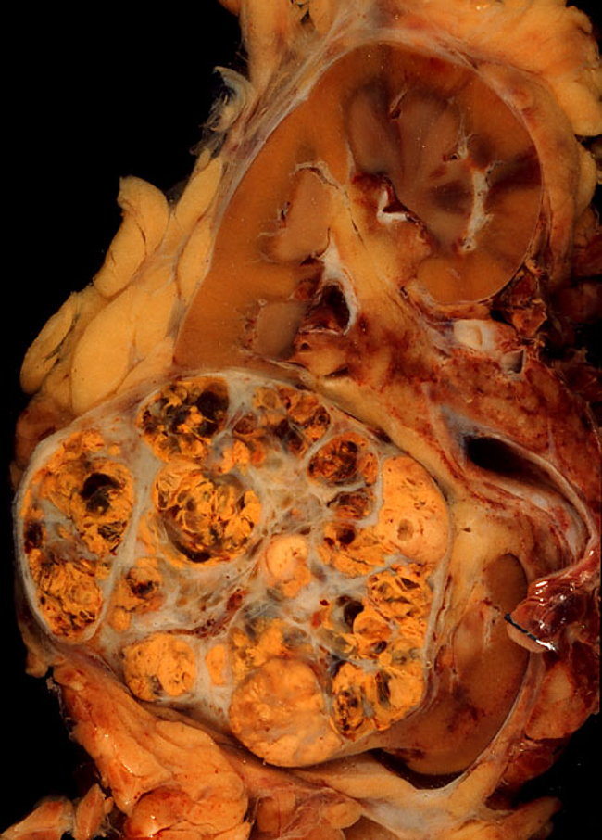
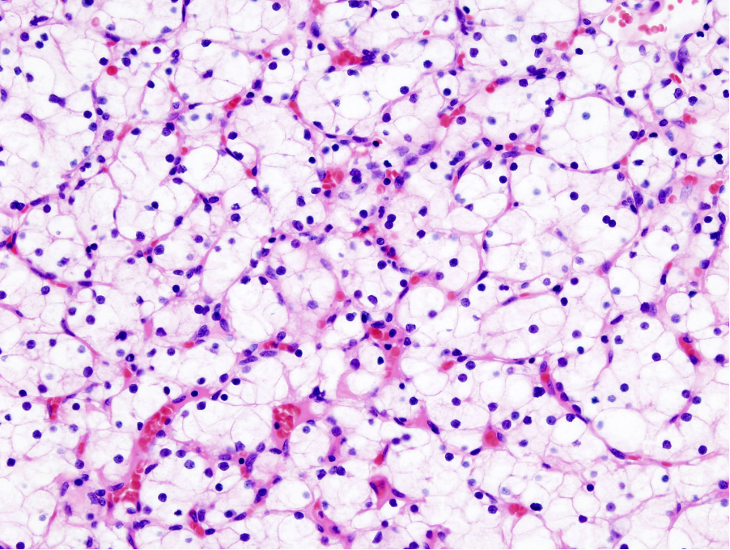
Types of RCC
1 | Clear Cell Type
Definition | Arises from proximal tubular epithelial cells
Epidemiology | Most common type majority of them are sporadic. Uncommonly associated with VHL disease ( chromosome 3 )
Morphology | Gross | Usually solitary & large cut surface: well circumscribed, solid, heterogeneous (it has multiple appearances) , partly yellow and partly hemorrhagic mass. May be cystic and necrotic Commonly invades renal vein There may be direct invasion into the perinephric fat and adrenal gland
 | Micro- scopically | Tumor is made up of cells with clear cytoplasm (hence, the name) & sharp cell membrane cells often arranged in sheets or nests Stroma is highly vascularized. Nuclei can range from no atypia to marked atypia/pleomorphism Some tumors exhibit marked degrees of anaplasia
2 | Papillary Cell Type
Tumors have a papillary growth pattern Can be sporadic or familial. Familial forms are uncommon and show mutation in the MET proto-oncogene ( chromosome 7)
3 | Chromophobe Cell Type
Tumors are made up of chromophobic cells (acidophilic granular cells) NOTE: papillary and chromophobe RCCs both have better prognosis than the clear cell type
The scary thing about RCC it’s invade the renal vein very fast so that means it’s everywhere because renal vein drain into inferior vena cava then to the right side of the heart then to the whole body In lung, Brian, Bone….. systemic effect
The name of this type came because the cytoplasm is clear

Slide 7
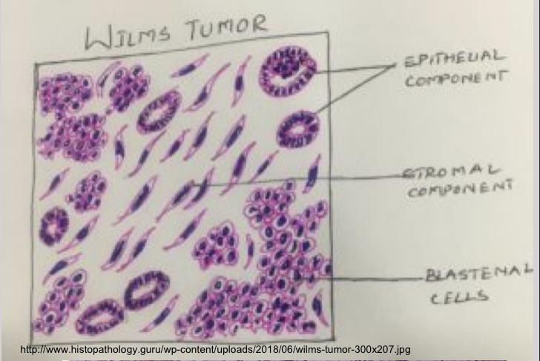
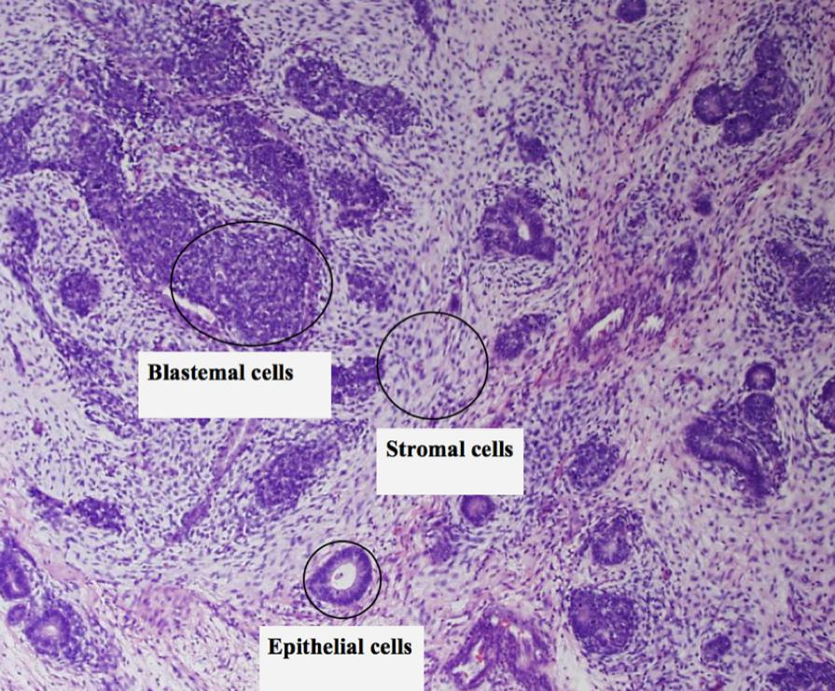
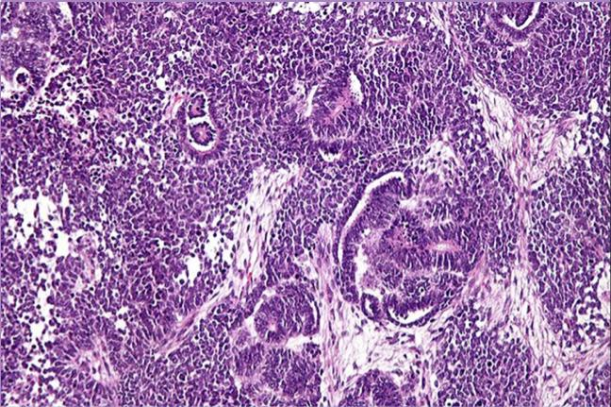
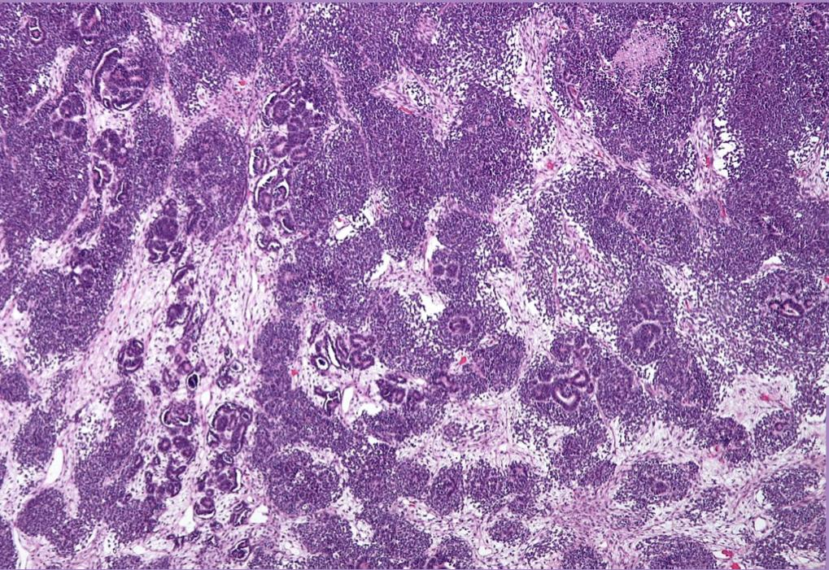
Wilms tumor (nephroblastoma)
Definition | It is a malignant neoplasm arising from embryonic nephrogenic elements composed of mixtures of blastemal, stromal , and epithelial tissue.
The Precursor lesions for the wilms tumor is called as Nephrogenic rests Can be associated with WAGR syndrome,Denys Drash syndrome and Beckwith wiedemann syndrome. It is the most common primary tumor of the kidney in children Most cases of Wilms tumor are sporadic and unilateral. Some cases of Wilms tumor are familial with deletion of WT1 gene on chromosome 11p13.
Morphology
Gross | Unilateral (10% bilateral), solitary, well circumscribed lesion. By the time Wilms tumor is detected it is large. Cut section: uniform, pale gray and soft in consistency (Fish ﬂesh like). The tumor may show foci of hemorrhage,cystic degeneration & necrosis
Microscopy | It is composed of the classical triphasic combination of: Blastemal component/cells : composed of densely packed small round blue cells with scanty cytoplasm and brisk mitosis. Epithelial component(immature epithelial cells) : composed of immature primitive tubular structures (rosettes) and immature glomeruli. Stromal component/ cells: composed of loose immature stroma of undifferentiated mesenchymal cells (i.e.immature spindle cells and myxoid material).
 | Biphasic and monophasic patterns can also occur. 5% of tumors contain foci of anaplasia. Anaplasia is an indication of poor prognosis.
Remember that Wilma tumor have deletion on WT1 gene How to memorize it ? Both start with W

Slide 8
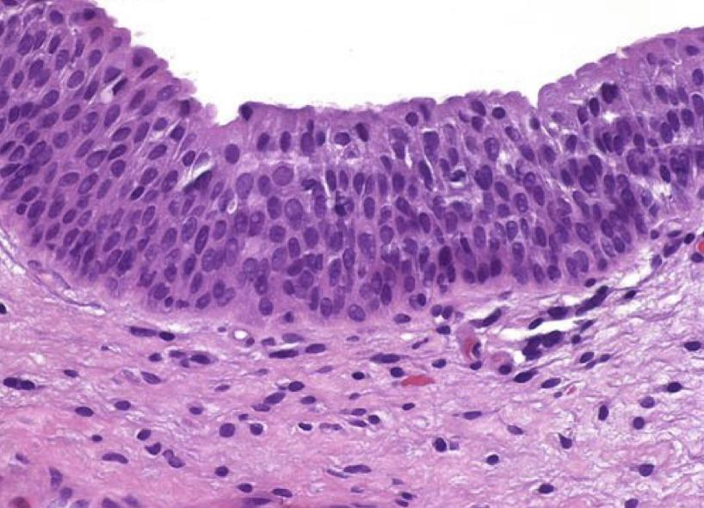
2 | Wilms tumor (nephroblastoma)
Clinical features
Treatment & Prognosis
Wilms tumor usually presents between 1 and 3 years of age, and 98% occur before 10 years of age.
Chemotherapy and radiation therapy combined with surgical resection, have dramatically improved the outlook of patients with this tumor.
Most common presentation: Abdominal mass with no other associated symptoms
Other sign or symptoms (seen in about 20%) of cases: Abdominal pain, hematuria, hypertension and anemia.
The prognosis for Wilms' tumor is generally very good.
Tumor of the lower urinary tract Urothelial carcinoma
Tumors in the collecting system above the bladder are relatively uncommon.
A small lesion in the ureter may cause urinary outﬂow obstruction and have greater clinical signiﬁcance than a much larger mass in the large capacious bladder.
Types of urothelial tumors
Normal urothelium
A)Non invasive papillary lesion
B)Non invasive flat lesion (flat urothelial carcinoma in situ)
C) Invasive urothelial carcinoma
(worst prognosis)
White
Papilloma
(Benign)
PUNLMP
(Borderline)
Noninvasive papillary urothelial carcinoma low grade (malignant)
Noninvasive papillary urothelial carcinoma high grade (malignant)

Slide 9
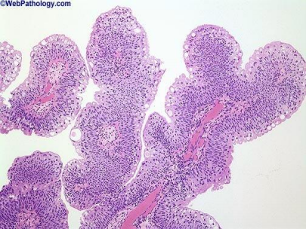
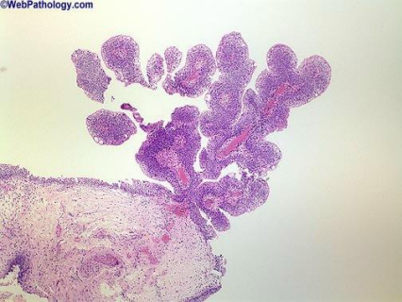
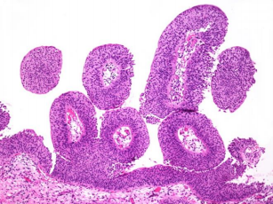
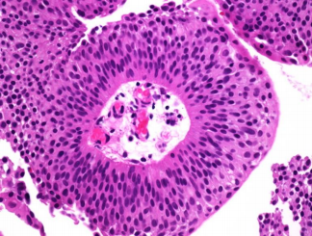
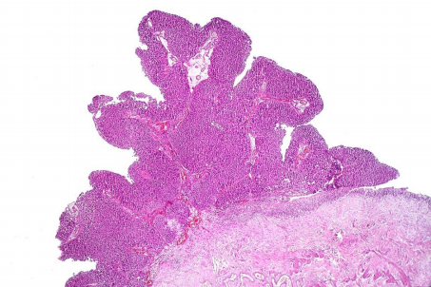
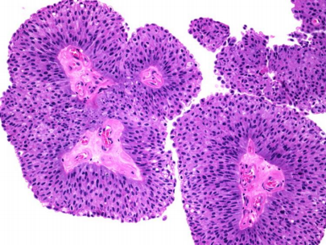
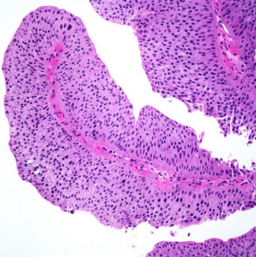
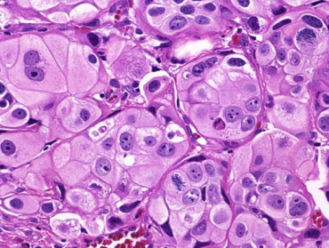
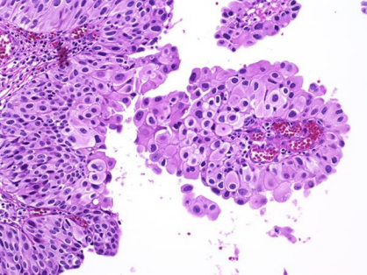
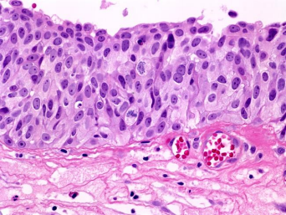
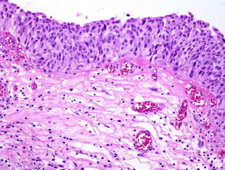
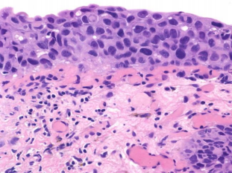
Types of urothelial tumors
A.Non invasive papillary lesions
Papilloma (Benign) | - They are non-invasive papillary tumor lined by benign transitional epithelium. -Rare and benign -Usually solitary. -Do not recur once removed.
PUNLMP (Borderline) | - Uncommon. -They are non-invasive papillary tumors with nuclear features intermediate between papilloma and low grade papillary urothelial carcinomas - may recur after removal.
Noninvasive papillary urothelial carcinoma low grade (Malignant) | - Non-invasive papillary tumors made up of papillary projections lined by malignant urothelial cells with mild atypia / pleomorphism and mild mitotic activity.
Noninvasive papillary urothelial carcinoma high grade (Malignant) | -Non-invasive papillary tumor made up of papillary projections lined by poorly differentiated malignant urothelial cells with marked atypia/ pleomorphism and signiﬁcant (brisk) mitotic activity. -Majority of high grade papillary urothelial carcinomas progress → and they invade into the underlying lamina propria and the muscularis propria becoming → invasive urothelial carcinoma
B.Non invasive flat lesions
Flat urothelial carcinoma in situ | - Non-papillary, non-invasive flat lesions. - Tend to be multifocal. - There is the full-thickness dysplasia of the urothelium (hyperchromatic and pleomorphic cells with prominent nucleoli). - There may be excessive shedding of malignant cells in urine. (useful for diagnosis) - In about 50% of cases it is associated with subsequent invasion into the underlying lamina propria and the muscularis propria becoming → invasive urothelial carcinoma.

Slide 10
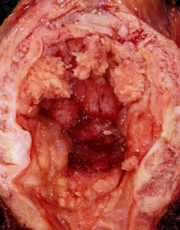
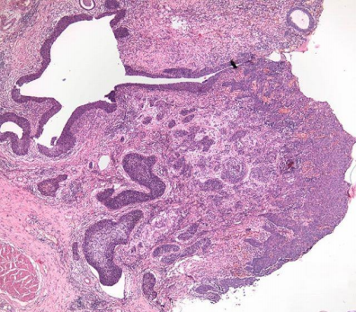
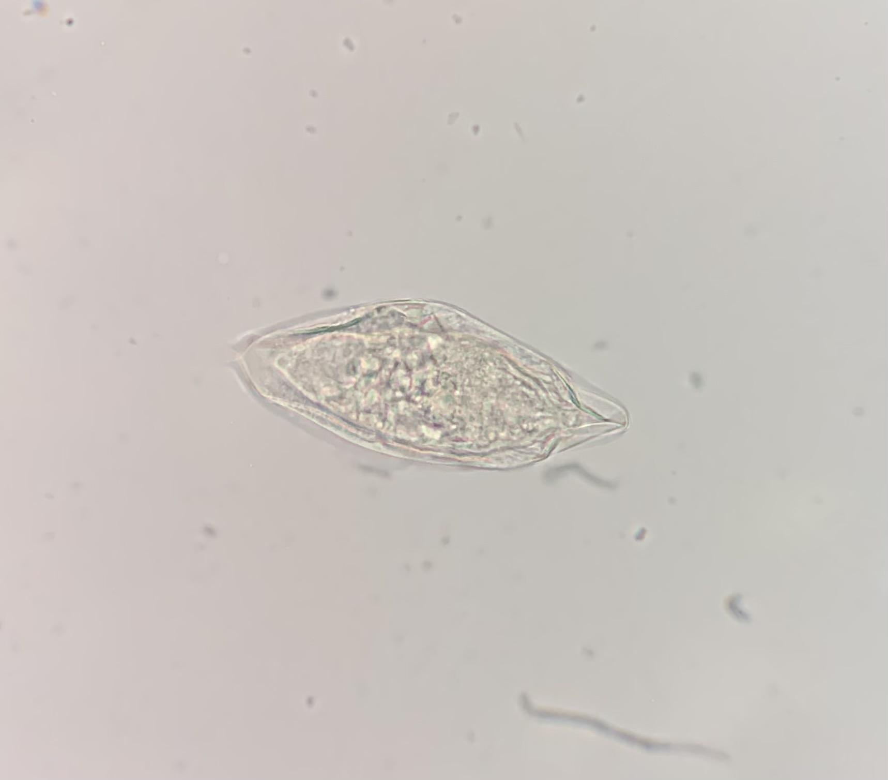
C.Invasive urothelial carcinoma
Invasive urothelial carcinoma usually progresses from: 1. High grade papillary urothelial carcinoma 2. flat urothelial carcinoma in situ. Among urothelial tumors they have the worst prognosis. - Microscopically: the tumor cells infiltrate beyond the basement membrane into the underlying tissue (lamina propria and muscularis propria i.e. the detrusor muscle) in the form of irregular nests, lobules and single cells
Urothelial Carcinoma
Common | More in men Age: 50 to 70 years.
Clinical Features | Painless hematuria is the dominant clinical presentation of all these tumors and less frequently as dysuria. Cystoscopy reveals the tumor. Bladder cancers vary from exophytic, flat, ulcerated to deeply invasive. Bladder cancer metastasize to regional lymph nodes, liver, lung, and bone
Predisposing Factors | Bladder tumors: are more common in those exposed to chemicals called aromatic amines (arylamines) such as benzidine and beta-naphthylamine). which are sometimes used in the dye industry(aniline and Azo dyes). Cigarette smoking and chronic cystitis. Chronic bladder irritation from stones or long term bladder catheters. Chemotherapy (long-term use of cyclophosphamide). Radiotherapy. (previous exposure of the bladder to irradiation) They are not familial.
Non-Urothelial neoplasms are rare and have very poor prognosis.
- Squamous cell carcinoma - Small cell neuroendocrine carcinoma - Adenocarcinoma - Sarcomas (leiomyosarcoma rhabdomyosarcoma) - Metastatic (from cervix, prostate etc)
Squamous cell carcinoma of the bladder | Squamous cell carcinoma of the bladder develops in foci of squamous metaplasia. Long standing Schistosoma haematobium infections can predispose to squamous cell carcinoma of the urinary bladder.

Slide 11
Summary
Benign tumors of the kidney
1 | Renal Oncocytoma
Arise from | intercalated cells of the collecting ducts in the kidney.
Gross | well circumscribed mahogany-brown colored tumor with a central stellate scar.
Microscope | uniform round polygonal cells with abundant, intensely eosinophilic and granular cytoplasm with uniform round and central nuclei. Called “oncocytes or oncocytic cells”
EM | numerous mitochondria in the cytoplasm.
Radiology | mimic renal cell carcinoma.
Complicate | spontaneous hemorrhage.
2 | Angiomyolipoma
composed | of admixture of blood vessels, spindle shaped smooth muscle cells and adipose tissue
associated | with tuberous sclerosis syndrome.
Malignant tumors of the kidney
1 | Renal cell carcinoma (RCC)
Arise from | renal tubular epithelial cells.
Types | Clear cell type | Arises | proximal tubular epithelial cells. - Associated with Von Hippel-Lindau (VHL) Syndrome chromosome 3
 |  | Gross | - solitary and large. - well circumscribed solid heterogenous partly yellow and partly hemorrhagic mass May be cystic and necrotic. - commonly invades the renal vein - direct invasion into the perinephric fat and adrenal gland.
 |  | Microscop | - clear cytoplasm and sharp cell membrane. - often arranged in sheets or nests. - stroma is highly vascularized - nuclei can range from no atypia to marked atypia pleomorphism. - Some tumors exhibit marked degrees of anaplasia .
 | papillary cell type | - papillary growth pattern. - can be sporadic or familial. (associated with mutations in the c-MET protooncogene at chromosome 7)
 | chromophobe cell type | - made up of chromophobic cells. (acidophilic granular cells) -Note: papillary and chromophobe RCCs have a better prognosis than the clear cell RCC.

Slide 12
Summary
Malignant tumors of the kidney
1 | Renal cell carcinoma cont.
Risk factors | - Tobacco - Acquired cystic kidney disease - Chronic hypertension “predispose to papillary RCC (as a complication of chronic dialysis)” - Obesity - Occupational exposure to cadmium - Genetic:*Hereditary clear cell RCC→ mutation of VHL gene at chromosome 3 *papillary RCC→ c-MET protooncogene at chromosome 7.
Clinical Features | - sixth decade. - common in men - hematuria, flank pain and a palpable abdominal mass. - Some patients develop polycythemia. - produce paraneoplastic syndromes - invade the renal vein and metastasize - sometimes silent and discovered only after metastasis (spreads most frequently to the lungs and bones)
2 | Wilms tumor (Nephroblastoma)
Arise from | Embryonic nephrogenic elements
Gross | - Unilateral, solitary, well circumscribed lesion. - detected it is large. - uniform, pale gray and soft in consistency (Fish flesh like) - show foci of hemorrhage, cystic degeneration & necrosis - precursor lesion for the Wilms tumor is called as nephrogenic rests.
Microscop composed of | Blastemal component | densely packed small round blue cells with scanty cytoplasm and brisk mitosis
 | Epithelial component | immature primitive tubular structures (rosettes) and immature glomeruli.
 | Stromal component | immature undifferentiated mesenchymal stromal cells (i.e.immature spindle cells and myxoid material).
Clinical features | - abdominal mass - abdominal pain, hematuria, hypertension and anemia. - Common in children (1-3years) -familial with deletion of WT1 gene on chromosome 11p13. -associated with WAGR syndrome, Denys Drash syndrome and Beckwith weidmann syndrome.
Treatment, prognosis | - Chemotherapy and radiation therapy combined with surgical resection. - prognosis for Wilms' tumor is generally very good
Tumors of the lower urinary tract
urothelial tumors
Non invasive papillary lesions
Papilloma (benign) | rare and benign. non-invasive papillary tumor lined by benign transitional epithelium. Usually solitary Do not recur once removed

Slide 13
Summary
Tumors of the lower urinary tract
urothelial tumors
Non invasive papillary lesions cont.
Punlmp (borderline) | non-invasive papillary tumors with nuclear features intermediate between papilloma and low grade papillary urothelial carcinomas may recur after removal.
Non invasive papillary urothelial carcinoma low grade (malignant) | Non-invasive papillary tumors made up of papillary projections lined by malignant urothelial cells with mild atypia pleomorphism and mild mitotic activity.
Non invasive papillary urothelial carcinoma high grade (malignant) | Non-invasive papillary tumor made up of papillary projections lined by poorly differentiated malignant urothelial cells with marked atypia
Non invasive flat lesions
Flat urothelial carcinoma in situ | multifocal. full-thickness dysplasia of the urothelium excessive shedding of malignant cells in urine. associated with subsequent invasion into the underlying lamina propria and the muscularis propria becoming → invasive urothelial carcinoma.
Invasive urothelial carcinoma (worst prognosis)
progresses from | High grade papillary urothelial carcinoma flat urothelial carcinoma in situ
Microscopical | infiltrate beyond the basement membrane into the underlying tissue
common in | men- 50 to 70 years.
Predisposing factors | - exposed to chemicals called aromatic amines -Cigarette smoking and chronic cystitis -Chronic bladder irritation - Chemotherapy - Radiotherapy
Clinical Features | - Painless hematuria - less frequently as dysuria -Cystoscopy reveals the tumor.
Non-Urothelial neoplasms are rare and have very poor prognosis.
Squamous cell carcinoma - Small cell neuroendocrine carcinoma Adenocarcinoma - Sarcomas (leiomyosarcoma rhabdomyosarcoma) Metastatic (from cervix, prostate etc)
Squamous cell carcinoma of the bladder | Long standing Schistosoma haematobium infections can predispose to squamous cell carcinoma of the urinary bladder.

Slide 14
Quiz
Which of the following kidney tumors most common in children?
Q1
RCC Clear Cell Type
RCC Papillary Cell Type
Nephroblastoma
Urothelial Carcinoma
Smoking is a risk factor associated with RCC
Q2
True
False
Schistosoma haematobium can predispose to which of the following?
Q3
RCC
SCC of Urinary Bladder
Wilms Tumor
Invasive urothelial carcinoma
tuberous sclerosis syndrome is associated with?
Q4
Renal Oncocytoma
Angiomyolipoma
Noninvasive papillary urothelial carcinoma
Wilms tumor

Slide 15
Quiz
Mutations in the c-MET protooncogene at chromosome 7 are risk factor in?
Q5
RCC Papillary Cell Type
RCC CLear Cell Type
RCC Chromophobe Cell Type
SCC of urinary bladder
Patient presented with hematuria and flank pain Upon investigation, microscopic findings showed cells arranged in nests with clear eosinophilic cytoplasm. What is the most likely diagnosis?
Q6
Angiomyolipoma
RCC Clear Cell Type
RCC Chromophobe Cell Type
SCC
Which of the followeing is the most common subtype of renal cell carcinmoa?
Q7
Clear Cell
Chromophobic
Papillary
Collecting Duct
Whcih of the following chromsomes is most likely to be mutated in renal cell carcinoma cells?
Q8
Chrosmosome 17
Chrosmosome 3
Chrosmosome 5
Chrosmosome 22
Answer Key: 1- C 2- A 3- B 4- B 5- A 6- B 7- A 8- B

Slide 16
Members
Members
Team Leaders
Maha Alkoryshy
Manar Alzahrani
Hassan Alabdullatif
Team Members
Hoor Aloraini
Farah alhalafi
Shahad Alsalahi
Nouf Aldhalaan
Jana alhazmi
Mayssar Alshobaki
Rahaf Almutairi
layan Aldoukhi
Atheer Alahmari
Walaa AlMutawa
Fatima Halawi
Omar Alkadhi
Emad Almutairi
Rakan Alromayan
Ali Alzahrani
Saad Alahmari
Malik halees
Khalid Alrasheed
Nawaf Alturki
Pathology442@gmail.com
Theme was done by Shatha Almutib

