Slide 1
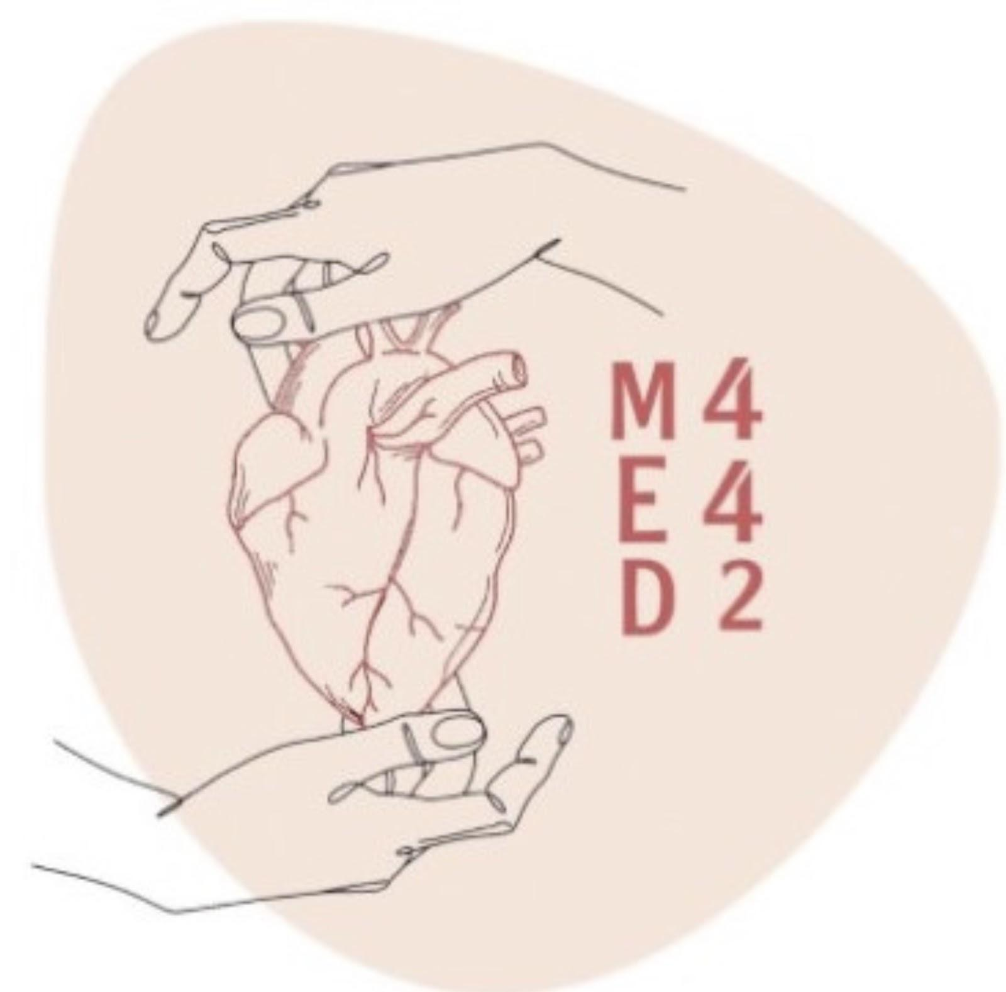
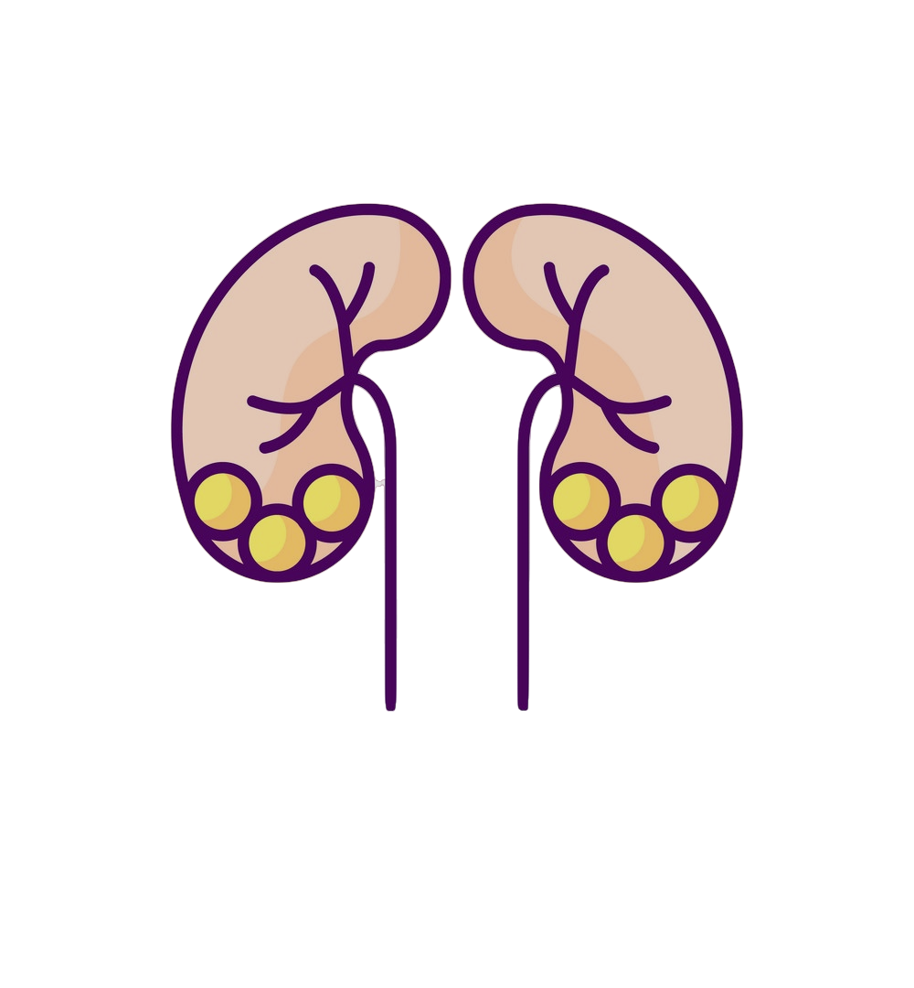
Pathology
L6
Nephrotic/Nephritic syndrome
A complete playlist for the lecture:
1
4
2
5
3
6
Editing File
- Color Index:
Main Text
Male’s Slides
Female’s Slides
Important
Doctor’s Notes
Extra Info

Slide 2
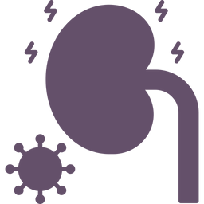
Objectives
Recognize the five major renal glomerular syndromes.
Describe the main differential pathological diagnosis for each syndrome
Perform a clinico-pathological correlation.
Describe the patterns of injury of each syndrome.
Key Outlines
The nephrotic syndrome: (Minimal change, FSGS, membranous, diabetes).
The nephritic syndrome: (Acute post streptococcal Glomerulonephritis GN, Lupus nephritis).
Asymptomatic Hematuria: IgA Nephropathy.
Rapidly progressive GN: (Crescentic GN)
The Chronic Renal Failure.

Slide 3
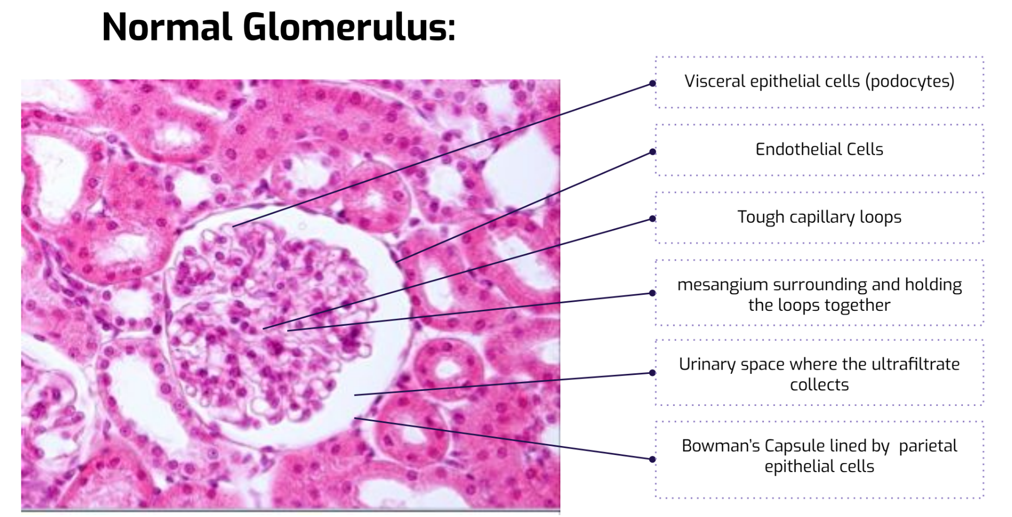
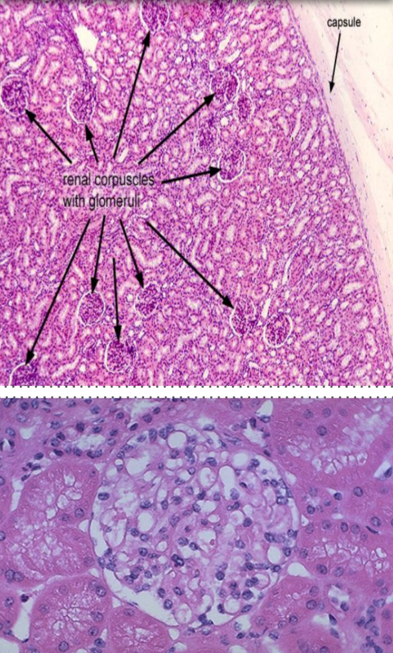
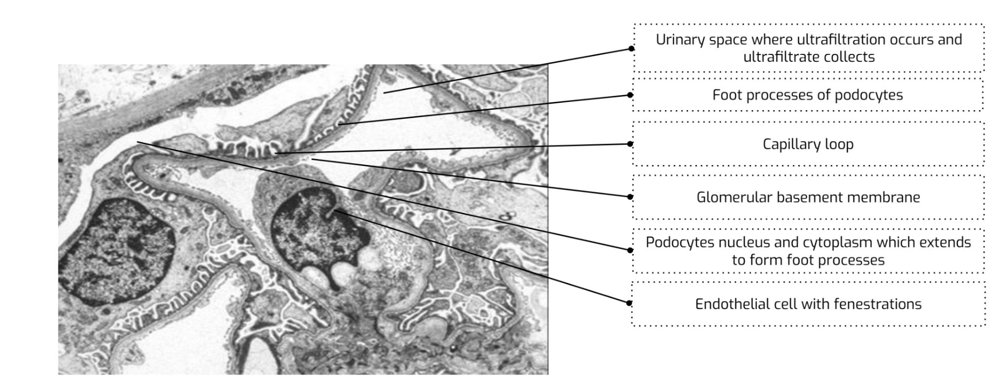
Histology of a kidney
Note That:
- The glomerular basement membrane (GBM) is a crucial structure formed by podocytes of epithelial cells (mainly) and podocytes of endothelial cells as well
- Podocytes lie outside the GBM with their foot processes
- The mesangium (mesangial cells) act like a glue to hold the structure together
- In cases of pathology these structures will be effaced or damaged and the podocyte or foot processes will not be seen, instead a thicker membrane of damaged podocytes is seen.
- In the capillary loops lies blood which contains plasma, proteins, RBCs and inflammatory cells.

Slide 4
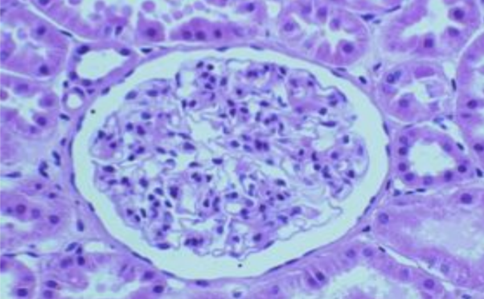
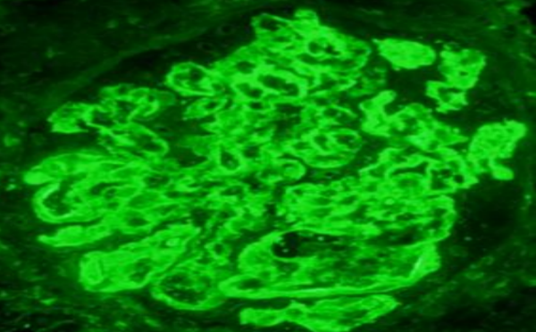
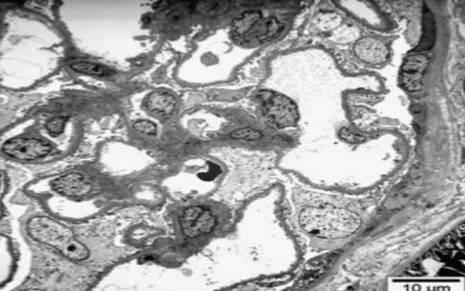
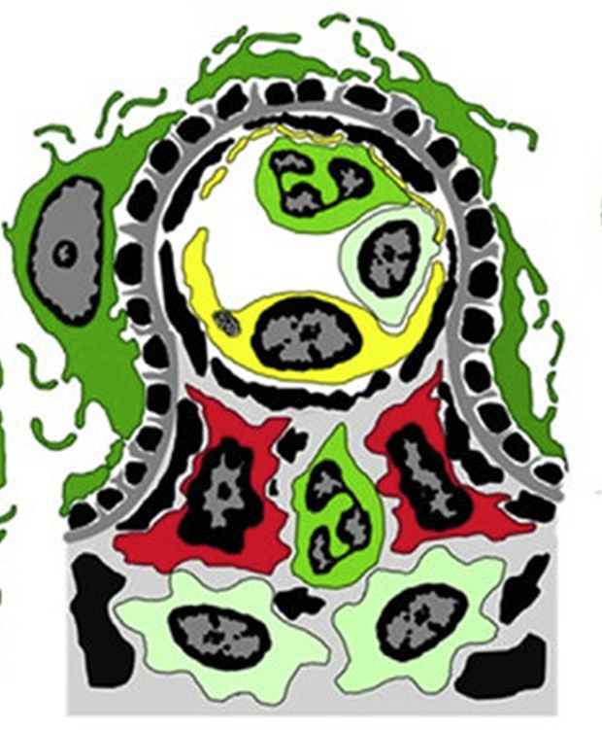
Kidney biopsy
A biopsy of the kidney is taken on ultras guidance by passing a tube through the back and extracting a renal tissue.
Then, the sample is divided into 3 parts allowing us to collectively reach a diagnosis:
Light microscope (using silver stain),
Immunofluorescence
Electron microscope.
Light Microscopy | To study renal histology
Immunofluorescence | The study is used to detect for The presence of immunoglobulins (IgA, IgG, IgM) and complements (C3 and C1q) in the glomeruli (in the mesangium or in the glomerular capillary loop wall).
Electron microscopy | The study is used to detect for the presence or absence of: Effacement of the epithelial cell (podocytes) foot processes. Electron dense immune complex deposits And if deposits are present then it’s used to identify the location of the deposits in the glomeruli (mesangial/paramesangial, subepithelial, subendothelial)
Common locations of electron dense immune deposits
Normal glomerular capillary loop
Deposits (in black)

Slide 5
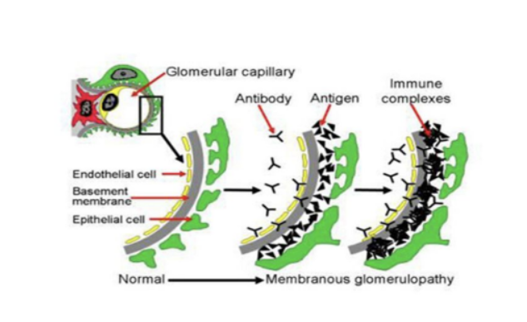
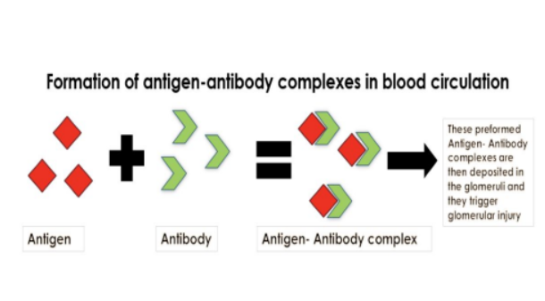
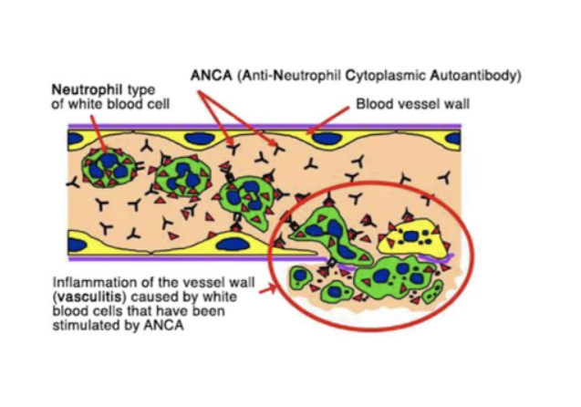
Pathogenesis of glomerular injury
Glomerulonephritis (GN) is frequently caused by immunologic mechanisms. Both antibody-mediated (mainly) and cell-mediated types of immunity play roles in the production of glomerular inflammation.
1. Antibody-mediated immune GN
There are 3 major mechanisms of antibody-mediated inflammation in most forms of GN, all 3 initiate glomerular inflammatory injury by the attraction and activation of leukocytes. These are:
In situ (formed at site) immune complex formation | Certain circulating antibodies react with certain antigens that are already present in glomeruli leading to the formation of immune complexes in the glomeruli. These deposits then attract leukocytes and activate complement leading to a glomerular injury
Deposition of pre-formed circulating immune complexes in the glomeruli | Antigen-antibody reaction take place in circulation and these preformed circulating immune complexes are deposited in the glomeruli, these deposits trigger glomerular injury (by attracting inflammatory cells and activate complements). (the antigen can be a bacteria, virus etc.)
Antineutrophil cytoplasmic autoantibodies (ANCAs) | They cause a severe type of GN in which the patients have circulating autoantibodies against antigens present in neutrophil cytoplasm. This interaction leads to activation and adhesion of the neutrophils to endothelial cells lining the capillaries especially the glomerular capillaries. The neutrophils release injurious products that promote endothelial injury, vascular inflammation (vasculitis) and GN.
2. Cell mediated immune GN:
Sensitized T cells can also cause glomerular injury. (Less common)

Slide 6
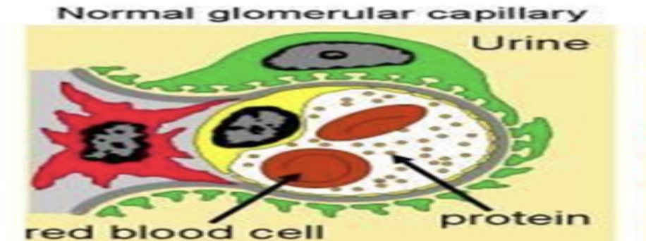
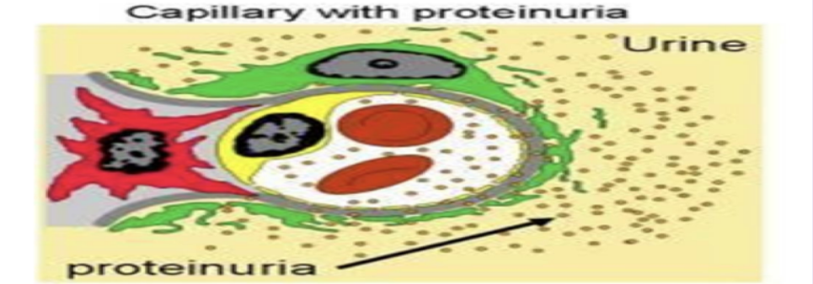
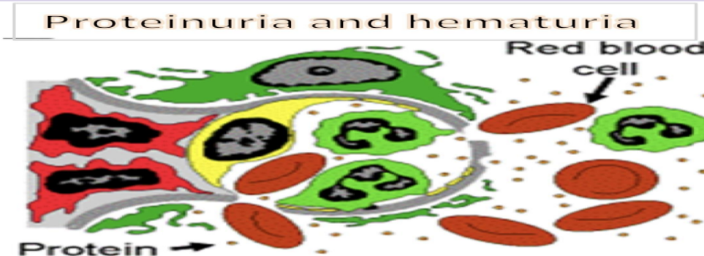
Common markers of renal diseases
In blood | BUN | blood-urea- nitrogen amount of nitrogen in your blood that comes from the urea.
 | Serum creatine
In urine | Hematuria | rbcs in urine (smoky brown urine) as a result of glomerular injury (not specific) and rupture of the glomerular capillaries with resultant bleeding into the Bowman’s/ urinary space. It could be microscopic.
 | Proteinuria | presence of abnormal quantities of protein in the urine
 | Casts | rbcs mix with proteinaceous material in the tubules and form rbc casts (which are found in the urine). microscopic clusters of urinary particles or cells wrapped in a protein matrix and found in the urine, Casts are formed in the distal convoluted tubule and collecting ducts of nephrons, then dislodge and pass into the urine, where they can be detected by microscopy. The presence of casts indicates kidney disease.
Capillary loop in a normal glomerulus retains the RBCs , wbcs and most of the protein in the blood that is passing through and the ultrafiltrate is mainly watery fluid going into the urinary space
In certain types of glomerular injury the injured capillary loop has abnormal permeability and ruptured GBM which allows rbcs (hematuria) and proteins (proteinuria) to leak into the urinary space. These RBCs in the tubule might mix with other materials to form casts
Protein molecules spill out into the
urinary space due to filtration abnormality in the glomerular
capillary wall

Slide 7
Clinical manifestations of kidney disease
Nephritic syndrome | Results from glomerular injury leading to acute onset of hematuria (rbcs in urine), mild to moderate proteinuria, azotemia, edema & hypertension.
Nephrotic syndrome | heavy proteinuria (excretion of more than 3.5 g of protein/day in urine) hypoalbuminemia, severe edema, hyperlipidemia, and lipiduria.
Asymptomatic hematuria &/or non-nephrotic proteinuria | A sign of mild glomerular abnormalities e.g. IgA nephropathy.
Rapidly progressive glomerulonephritis | Results from severe glomerular injury leading to loss of renal function within days or weeks → hematuria, dysmorphic rbcs, rbc casts in urine, mild to moderate proteinuria.
Acute kidney injury | oliguria or anuria with recent onset of azotemia; can result from glomerular injury (e.g. crescentic glomerulonephritis), interstitial injury, vascular injury (e.g. TMA) or acute tubular injury/necrosis.
Chronic kidney disease | Any chronic renal diseases that progresses to end stage kidney requiring dialysis and transplantation
Urinary tract infection | Affect the kidney (pyelonephritis) or the bladder (cystitis) bacteriuria and pyuria (bacteria and leukocytes in urine).
Nephrolithiasis (renal stones) | Renal colic, hematuria (without rbc casts).
Terminology
DIFFUSE:
SEGMENTAL:
Majority of the glomeruli are involved.
Only part of a glomerular tuft is involved
FOCAL:
GLOBAL:
Some of the glomeruli
are involved
Involving the total glomerular tuft

Slide 8
Nephrotic syndrome
A group of clinical features that include the following:
Massive proteinuria:
Is the loss in the urine of >3.5 g of protein/day.
This is due abnormal permeability of the glomerular capillary wall.
Hypoproteinemia or hypoalbuminemia:
plasma albumin levels <3g/dL (this is due to the loss of protein in the urine)
Odema:
hypoproteinemia causes reduced plasma colloid osmotic pressure, salt water retention & odema.
Hyperlipidemia and lipiduria:
hypoalbuminemia causes compensatory increase in lipoprotein secretion by the liver leading to hyperlipidemia. At the same time there is increased loss of lipid in the urine, lipiduria (due to abnormal permeability of the GBM).
Note: in the beginning there is little or no azotemia, hematuria, or hypertension
(not part of definition of nephrotic syndrome).
Causes of nephrotic syndrome
Primary causes | Secondary causes
● Minimal change disease (well explained in the next slide) ● Membranous GN ● Focal segmental glomerulosclerosis (FSGS) ● Membranoproliferative GN (can also present as nephritic syndrome) ● Others | ● Diabetes mellitus (most common systemic causes) ● Amyloidosis ● Systemic lupus erythematosus (it can also present as nephritic syndrome) ● Drugs (gold, penicillamine, "street heroin") ● Others
NOTE: In children the most common cause of nephrotic syndrome is minimal-change disease. In adults the most common primary glomerular diseases that causes nephrotic syndrome are membranous glomerulopathy in aucasians and Asians, and FSGS is the most common etiology in african americans.

Slide 9
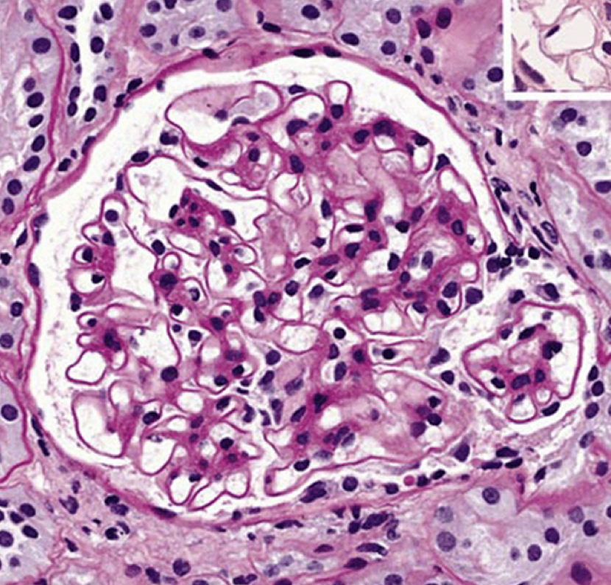
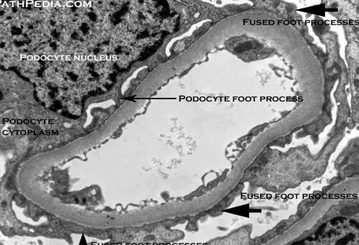
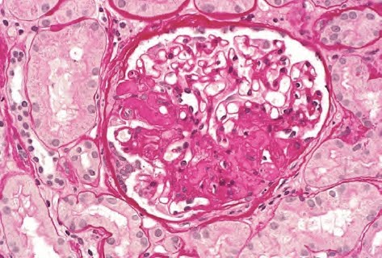
Minimal change disease/glomerulonephropathy (MCD)
Overview | Also known as lipoid nephrosis Causes nephrotic syndrome Characterized by effacement of the foot processes of the visceral epithelial cells (podocytes) Pathogenesis: unknown (usually idiopathic)
LM | Glomeruli look normal. The proximal convoluted tubular cells are heavily laden with protein droplets and lipids. There is no tubular atrophy or interstitial fibrosis.
IF | Negative for immunoglobulins and complements
EM | MCD is characterized by diffuse fusion or effacement of the epithelial cell (podocyte) foot processes. This effacement is due to the retraction of the foot processes as a result of extensive cell swelling. NOTE: effacement occurs in virtually all cases of nephrotic proteinuria; it is not specific for minimal-change glomerulopathy.
Clinical features/ Diagnosis/ Prognosis | CF: Nephrotic syndrome Over 90% of children and few adults have complete remission with corticosteroid therapy. Prognosis: good, especially in children. Some patients become steroid dependent i.e. they relapse each time corticosteroid treatment is stopped. Less than 5% develop chronic renal failure
Focal & Segmental Glomerulosclerosis (FSGS)
LM | Occurs in older children and adults. Glomeruli at the corticomedullary junction are commonly affected. Only some of the glomeruli are involved (i.e. focal). There is focal and segmental sclerosis of the glomeruli (i.e. some glomeruli show sclerosis in a segment of the glomerular tuft). Adhesions and hyalinosis +/-
IF | Usually negative. Sometimes IgM is positive
EM | There is patchy/focal effacement of podocyte foot processes.

Slide 10
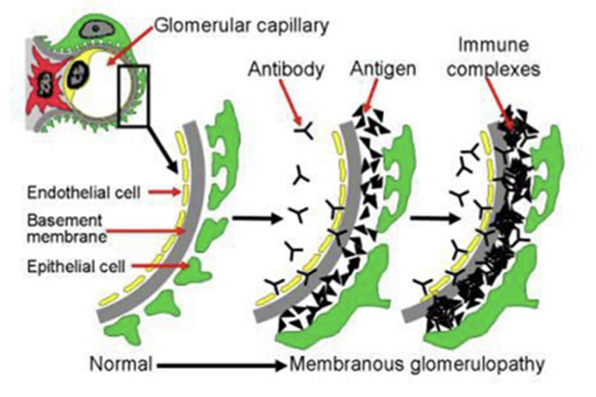
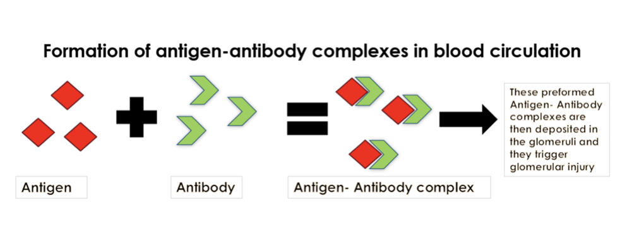
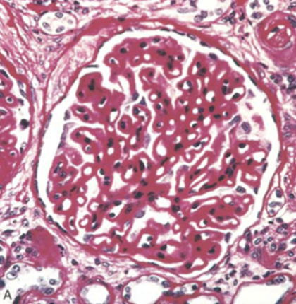
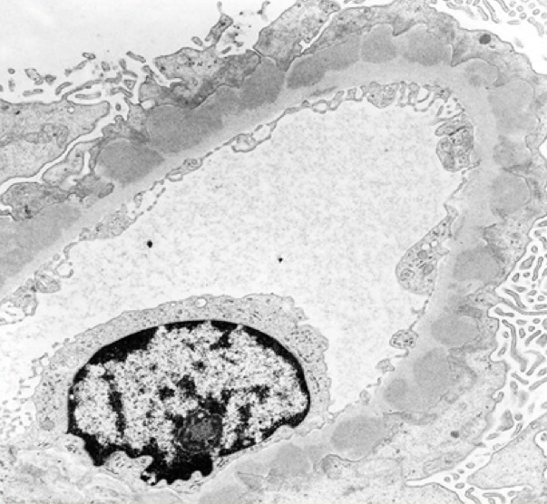
Membranous glomerulonephropathy/membranous glomerulonephritis/membranous nephropathy (GN)
Overview | A frequent cause of the nephrotic syndrome in adults (commonly 30-50 years). The proteinuria does not usually respond to corticosteroid therapy Is an immune complex disease. The antigen-antibody immune complexes are formed either in-situ in the glomeruli or are pre-formed in circulation and then deposited in the glomeruli. It is characterized by deposition of electron dense immune complexes in the subepithelial area in the glomeruli (between the podocytes and the GBM).
Classification | Primary/idiopathic membranous GN (80% of cases): in primary MN there are autoantibodies against phospholipase A2 receptor 1 (PLA2R1) antigen. Secondary membranous GN: causes include autoimmune disease (SLE), infectious disease (hepatitis B virus infection), therapeutic agents (penicillamine), neoplasms (lung cancer). Patient should be investigated for secondary causes.
LM | The capillary walls of the glomeruli are diffusely thickened (due to the subepithelial deposits seen on EM). The deposits are separated from each other by protrusions of GBM matrix called spikes (arrow : the black protruding lines. As the disease progresses there is glomerular sclerosis and interstitial fibrosis.
IF | Granular positivity for immunoglobulin IgG and complement C3 along the GBM.
EM | The immune complex appear in capillary walls as electron-dense deposits in the subepithelial space. There is diffuse effacement of epithelial cell foot processes also
Clinical features/ Diagnosis/ Prognosis | It is a slowly progressive disease. If not treated some cases progress to fibrosis of the kidneys (glomerular sclerosis, atrophy of tubules and interstitial fibrosis) and end stage disease/ renal failure. 10% to 30% have a more benign course with good prognosis.

Slide 11
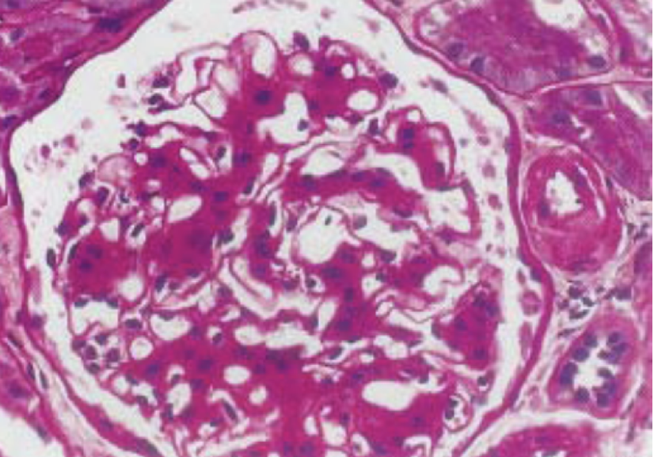
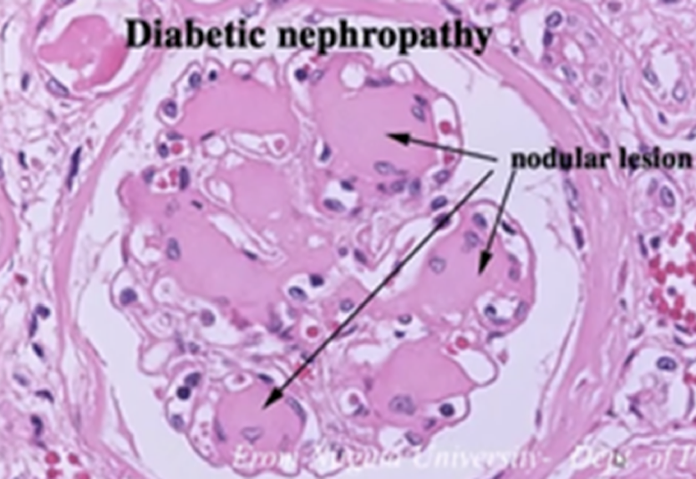
Diabetic Nephropathy
Overview | Long standing poorly controlled DM → leads to kidney disease. It’s a common cause of secondary nephrotic syndrome.
LM | Diffuse glomerulosclerosis: all the glomeruli show increase in mesangial matrix ending in sclerosis. Nodular glomerulosclerosis (Kimmelstiel Wilson nodules): there are nodules in the mesangium. These nodules are spherical and eosinophilic, with central acellular area. It’s pathogonomic of diabetic nephropathy.
IF | Negative
EM | There is diffuse increase in the thickness of the glomerular basement membrane

Slide 12
Nephritic syndrome
A clinical complex characterized by acute onset of:
Hematuria:
(smoky brown urine). The hematuria is a result of glomerular injury and inflammatory rupture of the glomerular capillaries with resultant bleeding into the Bowman’s space. The rbcs pass into the tubules and mix with proteinaceous material in the tubules and forms rbc casts (which are passed in the urine). The hemodynamic changes caused by the rupture lead to a reduction in the glomerular filtration rate (GFR).
Oliguria
A result of the reduced GFR
Azotemia
Increased blood urea nitrogen and creatinine. It is also a result of reduced GRF
Hypertension
it is a result of the fluid retention and renin release from the ischemic kidneys.
NOTE: There may be mild proteinuria and edema.
Examples of nephritic syndrome: | Post infectious glomerulonephritis (most classical example) Lupus nephritis (can also present as nephrotic syndrome)

Slide 13
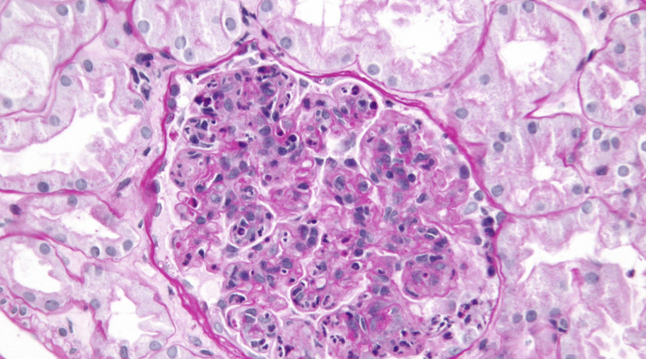
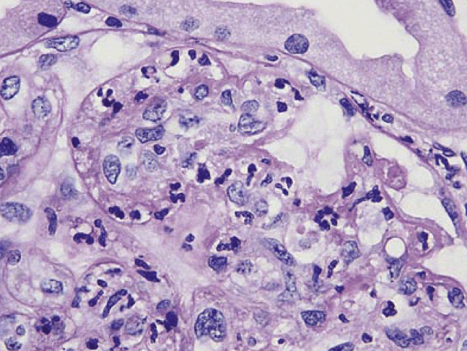
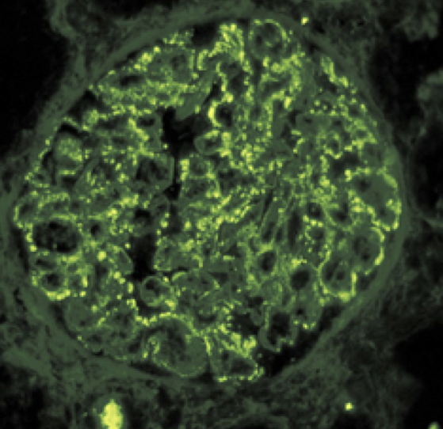
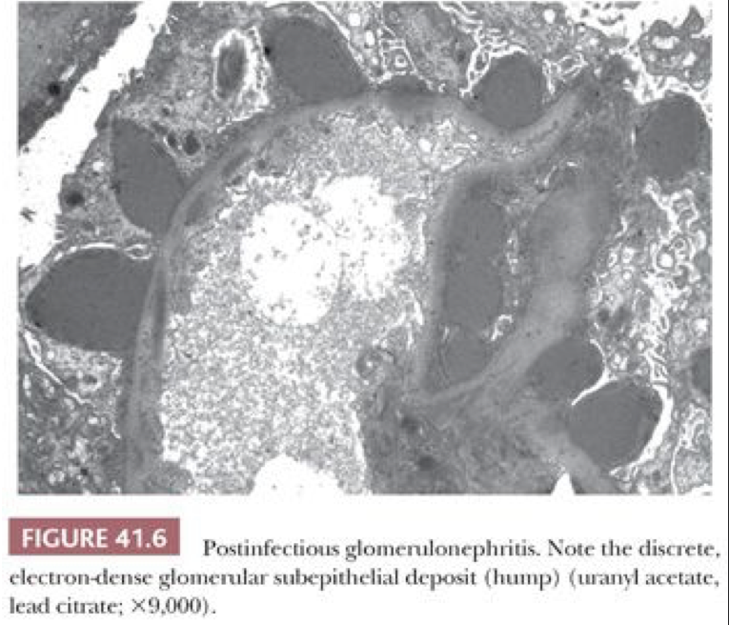
Post-infectious glomerulonephritis (PIGN)
Overview | It is a type of acute diffuse proliferative GN. It is caused by deposition of immune complexes in glomeruli. The most common cause of post-infectious glomerulonephritis is infection with group A, beta-hemolytic streptococci and is therefore also called post- streptococcal glomerulonephritis . Other infections include pneumococcal and staphylococcal infections and viral diseases (mumps, measles, chickenpox etc.). Usually there is a latent period between the exposure and the occurrence of glomerulonephritis Classically PIGN develops in children 1 to 4 weeks after streptococcal infection of the pharynx (pharyngitis) or tonsils (tonsillitis) or the skin (impetigo or infected insect bite). This disease was more common in the past (because now we have antibiotics), but it is still one of the common childhood renal diseases.
LM | There is diffuse enlargement and hypercellularity of glomeruli due to proliferation of endothelial cells and mesangial cells and infiltration of neutrophils and monocytes. Crescents maybe present. Glomerular necrosis maybe present. All histologic changes resolve completely in most patients after several months
IF | Coarse granular (lumpy bumpy) IgG and C3 are positive along the capillary walls.
EM | Characteristic subepithelial electron dense immune deposits. They look like dome shaped humps (called subepithelial humps). The deposits clear up and disappear in a few months.

Slide 14
Post-infectious glomerulonephritis (PIGN) cont.
Pathogenesis | The immune complexes are deposited in the glomeruli in the subepithelial area and are composed of IgG and C3. The deposits initiate inflammation by activating complements: this way the complements get used up leading to development of hypocomplementemia (serum C3 levels are low during the acute phase of disease). And activating various other inflammatory mediators All these inflammatory mediators: attracts and activate neutrophils and monocytes stimulates proliferation of mesangial and endothelial cell proliferation. These effects result in marked glomerular hypercellularity resulting in diffuse proliferative glomerulonephritis.
Clinical features/ Diagnosis/ Prognosis | The onset of kidney disease is sudden. Present as nephritic syndrome (oliguria, hematuria, hypertension and azotemia). Serum C3 levels are low during the acute phase. Diagnosis depends on serologic evidence of a rise in antibody titers to streptococcal products e.g. ASO titre is positive. This disease resolves in over 90% of patients. Rarely patients (usually adults) develop progressive renal failure. Grossly there is multiple punctate hemorrhagic spots on the kidney surface.
Lupus nephropathy/nephritis (LN)
LN is seen in patients with the autoimmune disease called systemic lupus erythematosus (SLE). When SLE patients have associated renal disease its is called as lupus nephritis (LN). These patients classically have high levels of Antinuclear antibodies (ANA) and double stranded DNA (dsDNA) It can present as nephrotic or nephritic syndrome. LN is an immune complex mediated disease in which there is the deposition of antigen antibody complexes in the glomeruli. The deposits trigger an inflammatory response which in turn triggers the proliferation of the epithelial, endothelial and mesangial cells of the glomeruli. It can even lead to glomerular necrosis. LN can be active or chronic or a combination of both. The LN lesions have been classified into 6 classes or groups by the International Society of Nephrology/Renal Pathology Society (ISN/RPS). This classification helps give information regarding the activity, chronicity and the prognosis of the disease.

Slide 15
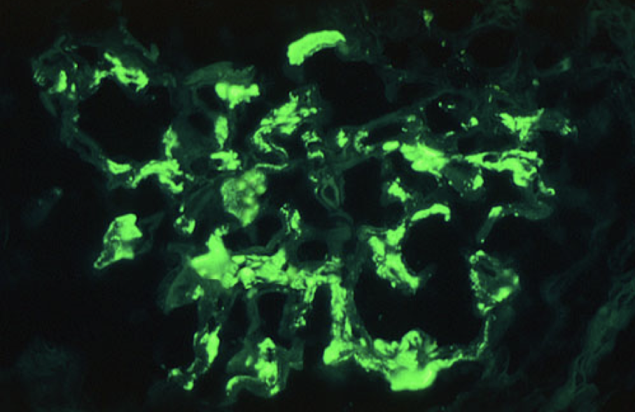
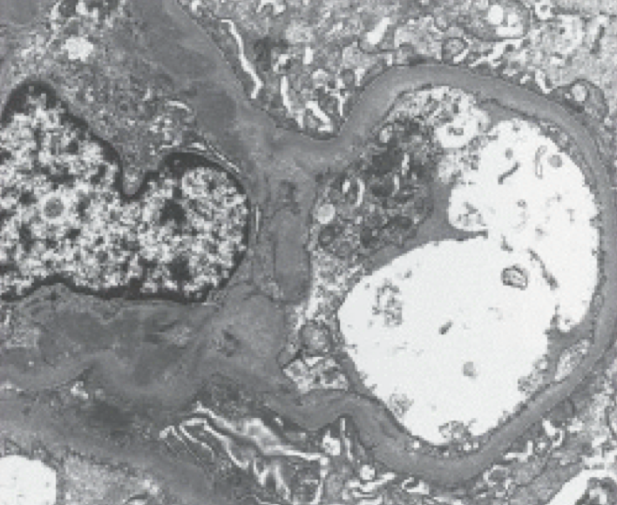
Hematuria
Overview | IgA nephropathy (IgAN) is one of the most common type of primary glomerulonephritis that presents as hematuria IgAN is characterized by the deposition of IgA immunoglobulin in the mesangium/ paramesangium of glomeruli. It usually present as hematuria only and sometimes as nephritic syndrome. When it occurs in combination with vasculitis (leukocytoclastic vasculitis) and multiorgan involvement then is referred to as Henoch-Schonlein purpura.
LM | Very variable (may or may not show mesangial hypercellularity, endocapillary hypercellularity, glomerular sclerosis, tubulo-interstitial scarring).
IF | Dominant IgA stain positivity in the mesangium and paramesangium
EM | Immune complex deposits positive in the mesangium and paramesangial area.

Slide 16
Summary
Nephrotic syndrome
Definition: A group of clinical features that include:
1-Massive Proteinuria, 2-hypoproteinemia, 3-oedema, 4-hyperlipidemia.
Disease | Overview | LM | IF | EM
Minimal change disease MCD | -Also called lipoid nephrosis -Affect children mostly -corticosteroid sensitive | -Glomeruli & interstitial normal -Tubular cells are heavily laden with protein droplets and lipids. | Negative | diffuse fusion or effacement of the epithelial cell (podocyte) foot processes.
Focal & Segmental Glomerulosclerosis (FSGS) | Some Glomeruli at the corticomedullary junction are commonly affected | focal and segmental sclerosis of the glomeruli | negative, Sometimes IgM is positive | focal effacement of podocyte foot processes
Membranous GN glomerulonephritis | -Primary cause idiopathic, But most cause is autoantibodies against PLA2R1 -corticosteroid resistant | deposits are separated from each other by protrusions of GBM matrix called spikes | IgG and complement C3 along the GBM | -electron-dense deposits in capillary walls seen in the subepithelial space -effacement of podocyte
Diabetic Nephropathy | Cause Long standing poorly controlled DM | 1-Diffuse glomerulosclerosis 2-Nodular glomerulosclerosis (Kimmelstiel Wilson nodules) | Negative | increase in the thickness of the GBM
PhosphoLipase A2 Receptor 1

Slide 17
Summary
Nephritic syndrome
A clinical complex characterized by acute onset of:
1-Hematuria, 2-Oliguria, 3-Azotemia, 4-Hypertension,
5-And may have Nephritic edema
Disease | Overview | LM | IF | EM
Post infectious GN | Common cause is group A, beta-hemolytic streptococci (GAS) after an pharyngitis, tonsillitis or impetigo | Hypercellularity of glomeruli Crescents & Necrosis may present | Coarse granular (lumpy bumpy) -IgG and C3 | dome shaped subepithelial humps
Lupus Nephropathy | -Commonly associated among patients with SLE -might be nephrotic or nephritic syndrome -Usually patients are associated with Antinuclear antibodies (ANA) and double stranded DNA (dsDNA)
Hematuria | When it occurs in combination with vasculitis and multiorgan involvement then is referred to as Henoch-Schonlein purpura | variable but mainly hypercellularity | IgA deposit in the mesangium and paramesangium

Slide 18
Quiz
Q1
Glomerulonephritis (nephritic syndrome) is a kidney disorder. This disorder affects the glomeruli (clusters of microscopic blood vessels with small pores through which blood is filtered). Glomerulonephritis is characterized by swelling (edema), high blood pressure, and which of the following?
Red blood cells in the urine.
Extreme thirst.
An inability to urinate.
An increased desire for salt.
Q2
Acute glomerulonephritis most often occurs as a complication of which of the following?
A back injury.
Poor nutrition.
A streptococcal infection.
A viral infection.
Q3
What might be a consequence of glomerular inflammation that results in hematuria, proteinuria and hypertension?
Nephrotic Syndrome.
Nephritic Syndrome.
Cystitis.
Pyelonephritis.
Q4
Which of these is not a common marker for kidney disease ?
BUN
Alkaline CSF
Serum creatine
Casts

Slide 19
Quiz
Q5
Which of these is a clinical manifestation of nephrotic syndrome?
Moderate proteinuria
Hyperproteinemia
Odema
Hypolipidemia
Q6
Which of these is a primary cause of nephrotic syndrome?
Amyloidosis
Diabetes Mellitus
Systemic Lupus Erythromatus
Membranous GN
Answers:
1- A, 2- C, 3- B, 4-B , 5-C , 6-D ,

Slide 20
Members
Members
Team Leaders
Maha Alkoryshy
Manar Alzahrani
Hassan Alabullatif
Team Members
Hoor Aloraini
Farah alhalafi
Shahad Alsalahi
Nouf Aldhalaan
Jana alhazmi
Mayssar Alshobaki
Rahaf Almutairi
layan Aldoukhi
Atheer Alahmari
Walaa AlMutawa
Fatima Halawi
Omar Alkadhi
Emad Almutairi
Rakan Alromayan
Ali Alzahrani
Saad Alahmari
Malik halees
Khalid Alrasheed
Nawaf Alturki
Pathology442@gmail.com
Theme was done by Shatha Almutib

